Slide 1
Introduction to Aether 15.3
Panda Endpoint Security
Aether 15.3: 21 March 2024

Slide 2
Introduction
This presentation describes updates to these products:
Adaptive Defense / Adaptive Defense 360
Endpoint Protection / Endpoint Protection Plus
This presentation does not describe:
Changes before Aether 15.3
Panda Partner Center or Aether for Partners
Cytomic products
WatchGuard Endpoint Security products (go to What’s New in WatchGuard Endpoint Security presentation)
Some minor bug fixes
For a complete list of enhancements and resolved issues, go to the Adaptive Defense 360 Release Notes

Slide 3
Aether 15.3 Update
This update includes improvements for Patch Management settings and installation history:
You can now designate computers as test computers for patch installation
You can specify computers and groups where you do not want to apply patches
Installation status in the Installation History list updates from Requires Restart to Installed when the endpoint restarts and installs the patch
You can filter the Installation History list to show the last patch installation attempt or all attempts in the results
There are new AI categories available in Web Access Control settings

Slide 4
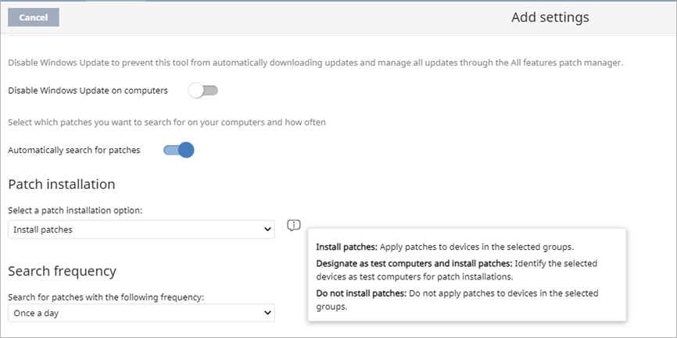
Patch Installation Option
In the Patch Management settings profile, you can specify whether patches install on a device
Install patches — Automatically apply patches to the devices in the assigned groups
Do not install patches — Do not apply patches to devices in the assigned groups
You can also designate computers as test computers for patch installation

Slide 5
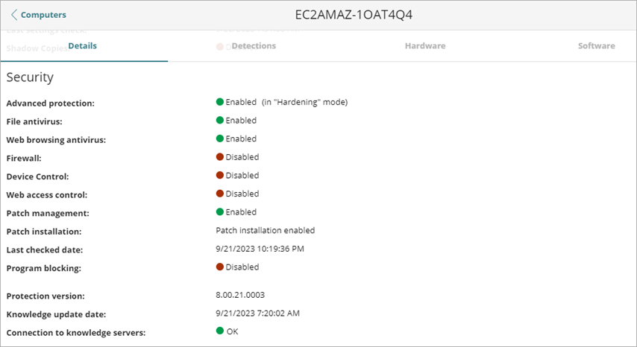
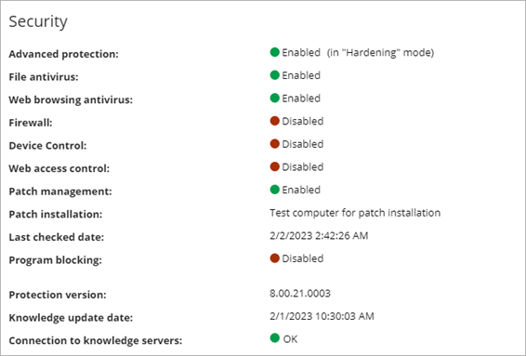
Computer Details – Patch Installation Option
The computer details page for a device shows the patch installation option — Patch installation enabled, Patch installation disabled, or Test computer for patch installation

Slide 6
Available Patches List – Installation Options
In the Available Patches list, you can filter the list by the patch installation option — Patch installation enabled, Patch installation disabled, or Test computer for patch installation

Slide 7
Patch Management Status – New Icon for Installation Option
In the Patch Management Status list, a new icon shows next to a computer that is designated as a test computer for patch installation

Slide 8
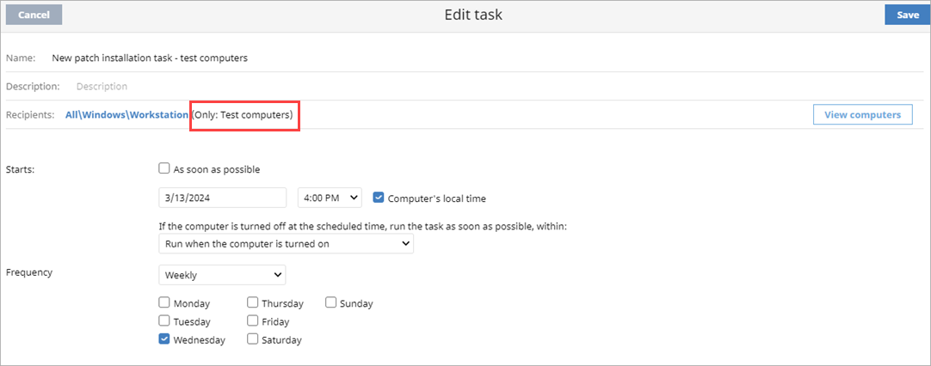
Patch Installation Task – Test Computers
In a patch installation task, you can specify to run the task only on computers that are designated as test computers

Slide 9
Patch Installation Status
In the Installation History list for Patch Management, you can filter the list for additional installation statuses — Error, Download Error, and Installation Error
In the list, if the status was Requires Restart and the patch successfully installs on the computer after it restarts, the status updates to Installed

Slide 10
Patch Installation History – Installation Attempts
In the Installation History list for Patch Management, you can now filter the list to show all attempts or the latest installation attempt for a patch

Slide 11
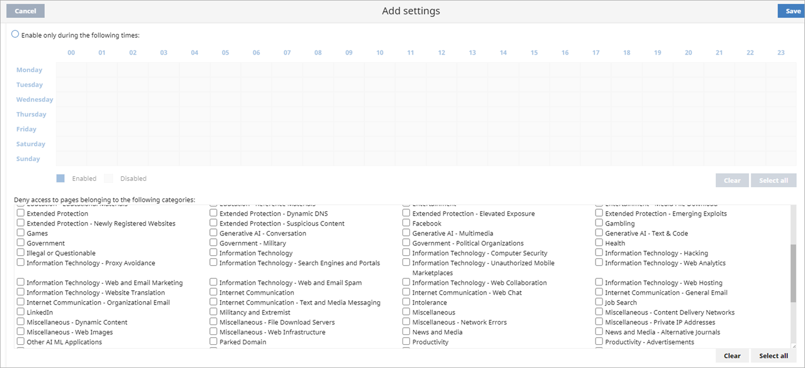
Web Access Control Content Categories for AI
In Web Access Control settings, you can block these new content categories for artificial intelligence:
Generative AI - Conversation Generative AI - Multimedia | Generative AI - Text & Code Other AI ML Applications

