Slide 1
Introduction to Aether 15
Panda Endpoint Security
Aether 15.3 Update: 21 March 2024

Slide 2
Introduction
This presentation describes updates to these products:
  Adaptive Defense / Adaptive Defense 360
  Endpoint Protection / Endpoint Protection Plus
This presentation does not describe:
  Changes before Aether 15 (June 2023)
  Panda Partner Center or Aether for Partners
  Cytomic products
  WatchGuard Endpoint Security products (go to What’s New in WatchGuard Endpoint Security presentation)
  Some minor bug fixes
For a complete list of enhancements and resolved issues, go to the Adaptive Defense 360 Release Notes

Slide 3
Aether 15.3 Update
This update includes improvements for Patch Management settings and installation history:
  You can now designate computers as test computers for patch installation
  You can specify computers and groups where you do not want to apply patches
  Installation status in the Installation History list updates from Requires Restart to Installed when the endpoint restarts and installs the patch
  You can filter the Installation History list to show the last patch installation attempt or all attempts in the results
There are new AI categories available in Web Access Control
Release date: 21 March 2024

Slide 4
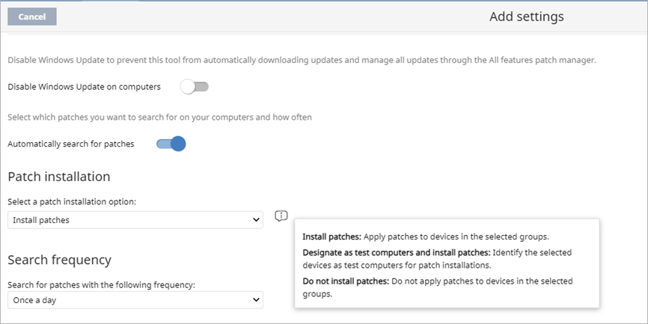
Patch Installation Option
In the Patch Management settings profile, you can specify whether patches install on a device or not
  Install patches — Automatically apply patches to the devices in the assigned groups
  Do not install patches — Do not apply patches to devices in the assigned groups
You can also designate computers as test computers for patch installation

Slide 5
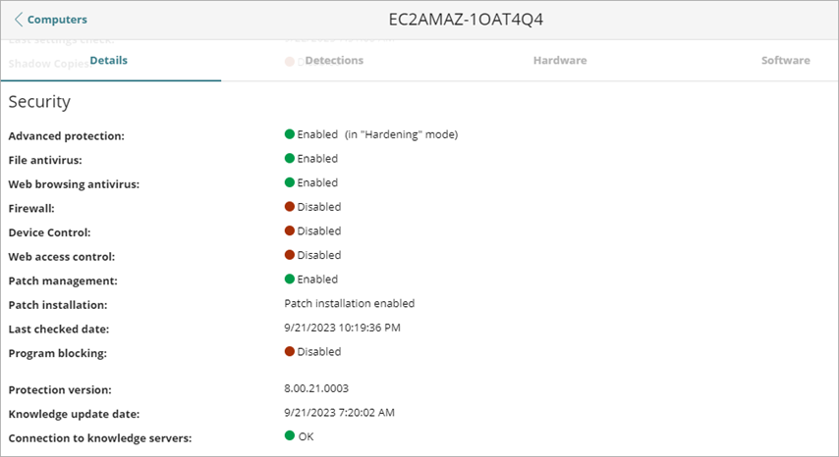
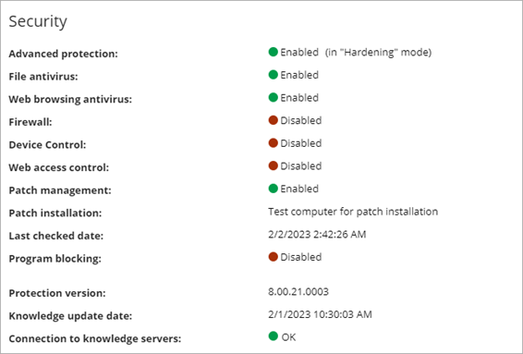
Computer Details – Patch Installation Option
The computer details page for a device shows the patch installation option — Patch installation enabled, Patch installation disabled, or Test computer for patch installation

Slide 6
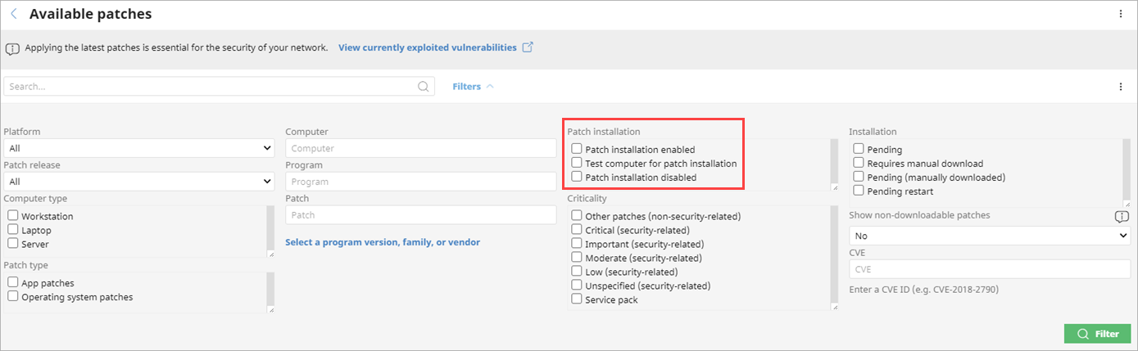
Available Patches List – Installation Options
In the Available Patches list, you can filter the list by the patch installation option — Patch installation enabled, Patch installation disabled, or Test computer for patch installation

Slide 7
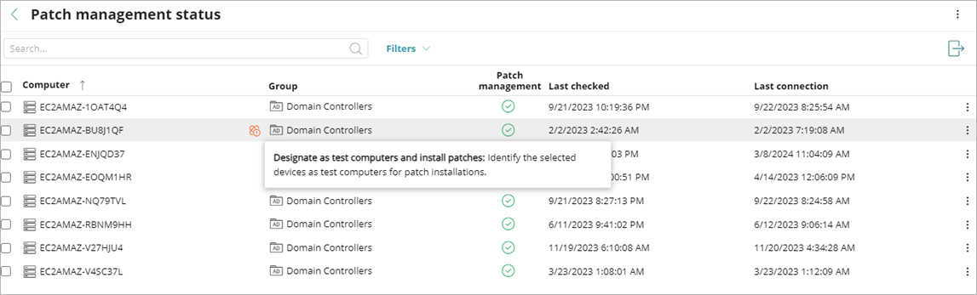
Patch Management Status – New Icon for Installation Option
In the Patch Management Status list, a new icon shows next to a computer that is designated as a test computer for patch installation

Slide 8
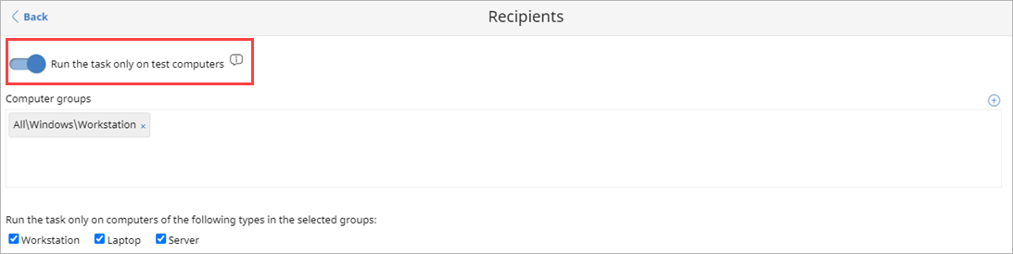
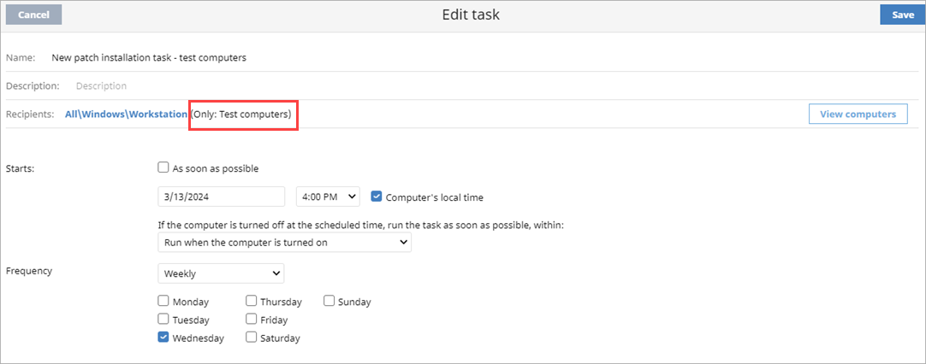
Patch Installation Task – Test Computers
In a patch installation task, you can specify that the task runs only on computers that are designated as test computers

Slide 9
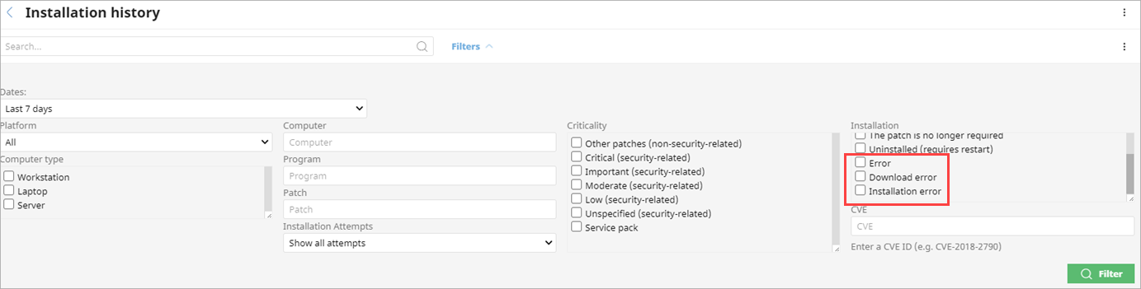
Patch Installation Status
In the Installation History list for Patch Management, you can filter the list for additional installation statuses — Error, Download Error, and Installation Error
In the list, if the status was Requires Restart and the patch successfully installs on the computer after it restarts, the status updates to Installed

Slide 10
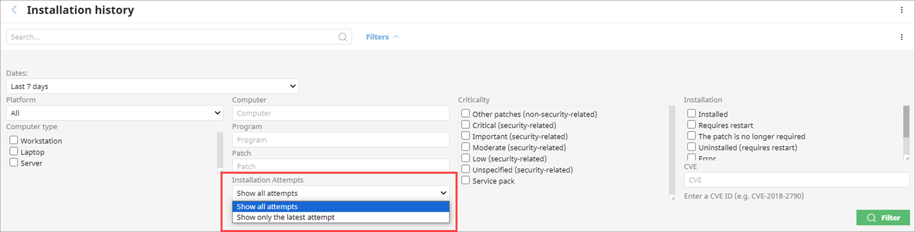
Patch Installation History – Installation Attempts
In the Installation History list for Patch Management, you can now filter the list to show all patch installation attempts or the latest installation attempt for a patch

Slide 11
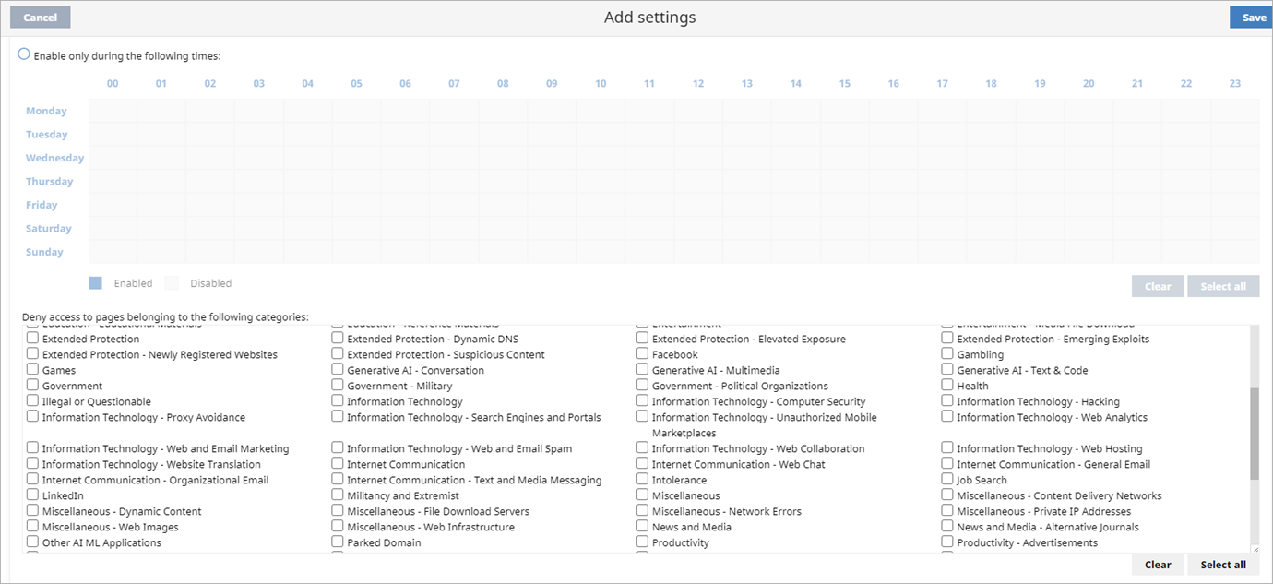
Web Access Control Content Categories for AI
In Web Access Control settings, you can block these new content categories for artificial intelligence:
Generative AI - Conversation Generative AI - Multimedia | Generative AI - Text & Code Other AI ML Applications

Slide 12
Aether 15.2 update
This update is available to all customers with the latest version of these Panda endpoint security products:
  Adaptive Defense, Adaptive Defense 360 v4.30
  Endpoint Protection, Endpoint Protection Plus v9.30
If you do not have this version, a notification to upgrade is available from the console
You can upgrade at any time to the latest version
  We recommend that you plan a controlled upgrade process to reduce the risk of potential issues
For more information, go to this Knowledge Base article: Best Practices to Upgrade Your Network Environment
Release date: 12 December 2023

Slide 13
Full Encryption for Mac Devices
Full Encryption is now available for Mac devices
  Supported on macOS Catalina and higher
  No specific hardware requirements
Full Encryption for macOS uses FileVault technology to encrypt hard disks
  External removable drives can be encrypted from a Windows device only
When an encryption policy is applied to a non-encrypted Mac device, the user is prompted for administrator credentials to start encryption
  If the user does not enter the credentials, they receive a prompt every hour to enter the credentials
  On the Computer Details page, the computer status is Encryption Pending User Action
  When the encryption process is complete, a recovery key associated with the computer is generated

Slide 14
Full Encryption for Mac Devices – Recovery Keys
Recovery keys are centrally managed in the console
  All volumes on the Mac device are encrypted with the same recovery key
  You can search for the recovery key from the console
When a Full Encryption trial or license expires, endpoint devices are not decrypted by default
If a Mac device was previously encrypted by another product, Full Encryption re-establishes the recovery key and prompts the user for administrator credentials

Slide 15
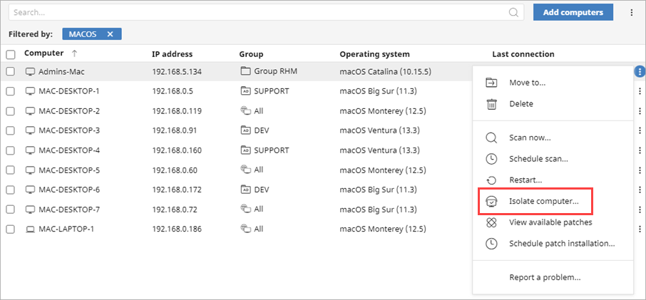
Isolation for Mac Devices
The Isolate Computer action is now available for Mac devices from the console

Slide 16
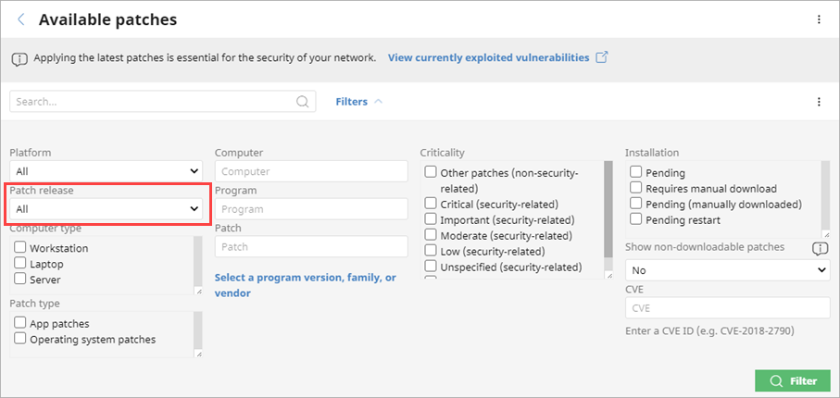
New Filter in Available Patches List
You can now filter the Available Patches list by the patch release date
Use this filter to identify older patches

Slide 17
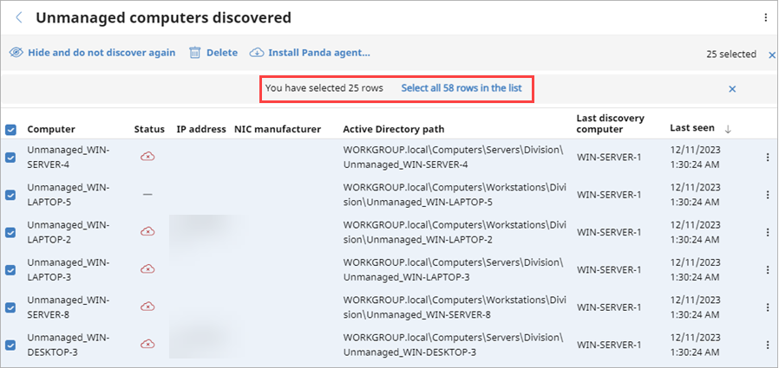
Select All on Unmanaged Computers List
In the Unmanaged Computers list, you can now select all computers across multiple pages

Slide 18
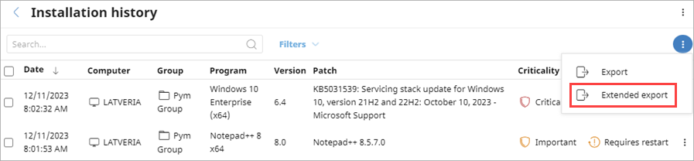
Patch Management Installation History Report
A new Extended Export option is available from the Patch Management Installation History list
The extended CSV file includes these columns in the exported CSV file:
  Task name
  Task launch date
  Task start date
  Task end date

Slide 19
Zero-Trust Application Service Enhancement
The Zero-Trust Application Service can now compress and scan Windows files larger than 50 MB
Unknown Windows executable files larger than 50 MB can now be sent to the Collective Intelligence Service
  We can gather more information about these larger files, and the Zero-Trust Application Service can more accurately classify them as trusted or malware

Slide 20
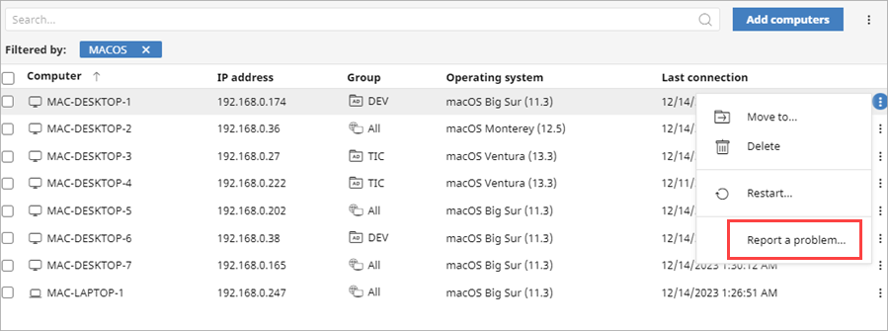
Report a Problem – Mac and Linux
You can now report a problem for Mac and Linux computers from the context menu on the Computers page
When you report a problem, an email message is sent to Panda support with all the information required for diagnosis

Slide 21
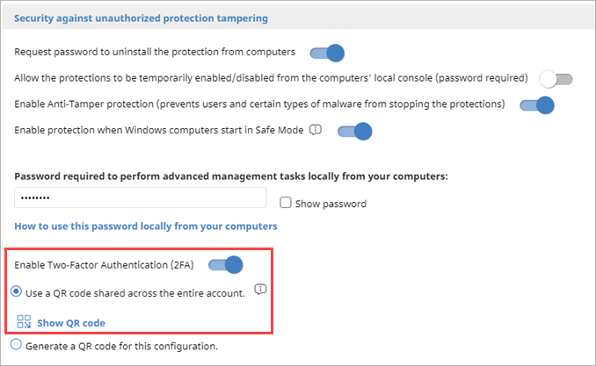
Anti-Tampering Improvements – 2FA*
In the Per-Computer Settings > Security Against Unauthorized Protection Tempering section, you can now enable two-factor authentication (2FA) to help prevent tampering
When you enable 2FA, you generate a QR code that you can scan with any authenticator app, such as AuthPoint, to create a token
When enabled, 2FA is required to authenticate and log in to the local console or to uninstall the protection software from a device
*Requires Windows protection version 8.00.22.0023 or higher. Available January 2024.

Slide 22
Enable 2FA
When you enable two-factor authentication, you can choose to:
  Enable it for all settings profiles in the account
  Enable it in the current per-computer settings profile only
Make sure that all administrators with the existing QR code use the new QR code to activate a new token
If you select to enable two-factor authentication in the current configuration only, you can share a QR code key with other administrators to enable them to generate the same QR code

Slide 23
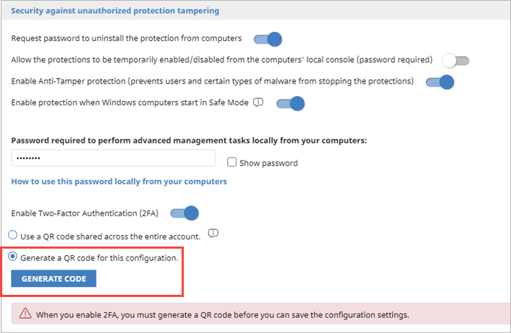
Enable 2FA – Current Configuration
To generate a QR code for the per-computer settings profile only:
  In the Security Against Unauthorized Protection Tampering section, enter a password to perform advanced management tasks locally from your computers
  Select Enable Two-Factor Authentication (2FA)
  Select Generate a QR Code for this Configuration
  Click Generate Code

Slide 24
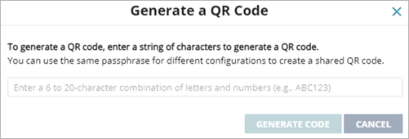
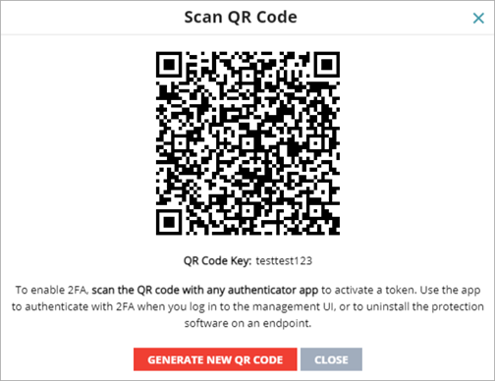
Enable 2FA – Current Configuration
  Enter a 6- to 20-character combination of letters and numbers for the QR code key
  Click Generate Code
  Scan the QR code in the app
  Click Close
  Save the updated configuration settings profile
  Administrators can use the QR code key to generate the same QR code
The QR code key (or passphrase) is used to enable all administrators in the account to generate a shared QR code for different per-computer settings profiles

Slide 25
Enable 2FA – Entire Account
To generate a QR code for the entire account:
  In the Security Against Unauthorized Protection Tampering section, enter a password to perform advanced management tasks locally from your computers
  Select Enable Two-Factor Authentication (2FA)
  Select Use a QR Code Shared Across the Entire Account
  All per-computer settings profiles will share the same QR code

Slide 26
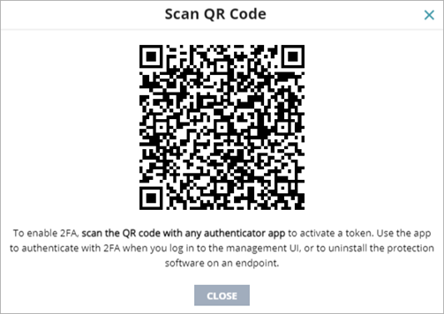
Enable 2FA – Entire Account
  Click Show QR Code
  Scan the QR code in the app
  Click Close
  Save the updated configuration settings profile
The QR code is saved in this settings profile and applies to all configurations assigned to your computers

Slide 27
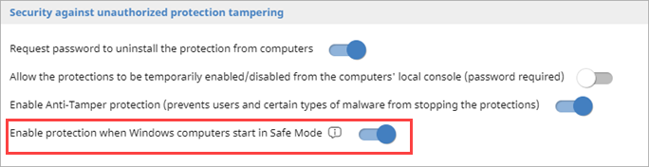
Windows Safe Mode Protection*
In the Security Against Unauthorized Protection Tempering section of the Per-Computer Settings profile, you can enable protection when Windows computers in your network start in Safe Mode
  The toggle is enabled by default in new settings profiles
If you disable the toggle and a computer starts in Safe Mode in the network, the computer and protection could be at risk from tampering
*Requires Windows protection version 8.00.22.0023 or higher. Available January 2024.

Slide 28
Aether 15 Release Summary
The Aether 15 Release includes these new features and enhancements:
  Vulnerability Assessment
  Network Attack Protection
  Audit Mode
  Network Access Enforcement
  Patch Management improvements
  Other enhancements
Aether 15 GA: 10 June 2023

Slide 29
Vulnerability Assessment

Slide 30
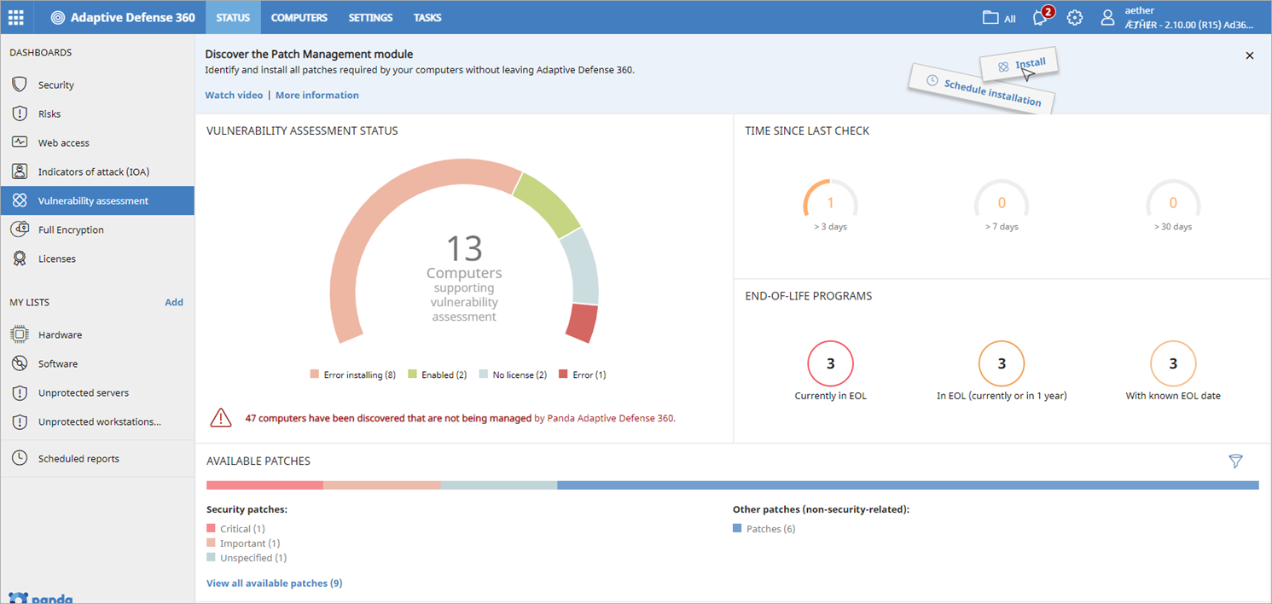
Vulnerability Assessment
Vulnerability Assessment enables you to monitor available patches, software updates, and end-of-life programs on your Windows, Linux, and Mac endpoints
  It is only available in accounts without the Patch Management module
  With Vulnerability Assessment, you cannot see the endpoints affected by a vulnerability or schedule patch updates

Slide 31

Vulnerability Assessment Dashboard
On the Vulnerability Assessment dashboard, you can review:
Click the Vulnerability Assessment Status tile to show a list of computers and when each was last checked for patch vulnerabilities
You can use these lists to monitor vulnerabilities:
  Vulnerability Assessment Status
  Available Patches by Computers
  End-of-Life Programs
Vulnerability Assessment Status Time Since Last Check End-of-Life Programs Available Patches | Available Patches Trend Most Available Patches for Computers Programs with Most Available Patches

Slide 32
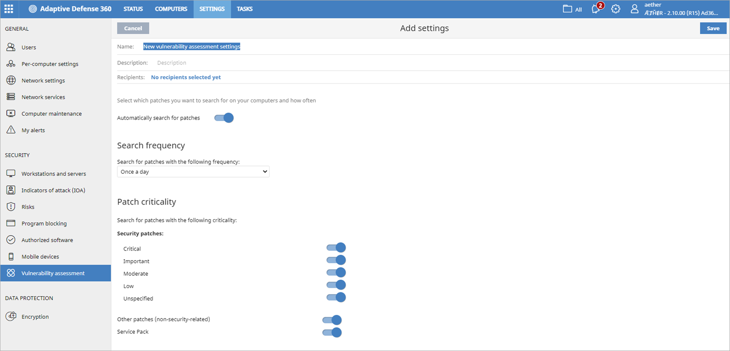
Vulnerability Assessment Settings
In a Vulnerability Assessment settings profile, you specify when to search for new patches and software updates, and the types of patches to search for

Slide 33
Network Attack Protection

Slide 34
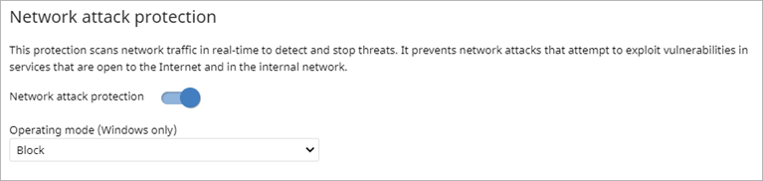
Network Attack Protection (Windows Computers)
In a Workstations and Servers settings profile, you can enable Network Attack Protection to scan network traffic in real-time to detect and stop threats (Adaptive Defense and Adaptive Defense 360 only)
  It prevents network attacks that attempt to exploit vulnerabilities in services that are open to the Internet and in the internal network
You can also select the operating mode:
  Audit – Allows the network attack
  Block – Blocks the network attack before it can perform actions

Slide 35
Network Attack Protection — Types of Attacks Detected
Network Attack Protection enables Endpoint Security to detect and prevent these network attacks in the early stages:
  DCSync
  DCShadow
  EternalBlue (Microsoft CVE-2017-0144 vulnerability)
  BlueKeep (Microsoft CVE-2019-0708 vulnerability)
  ZeroLogon (Microsoft CVE-2020-1472 vulnerability)

Slide 36
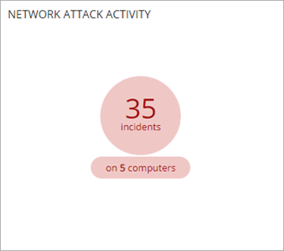
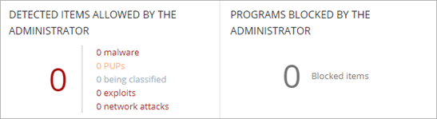
Security Dashboard – Network Attack Activity
On the Security dashboard, the Network Attack
Activity tile shows the number of incidents and
computers with network attack activity
  The Detected Items Allowed by Administrator tile
  (previously Programs Allowed by Administrator) now
  includes network attacks

Slide 37
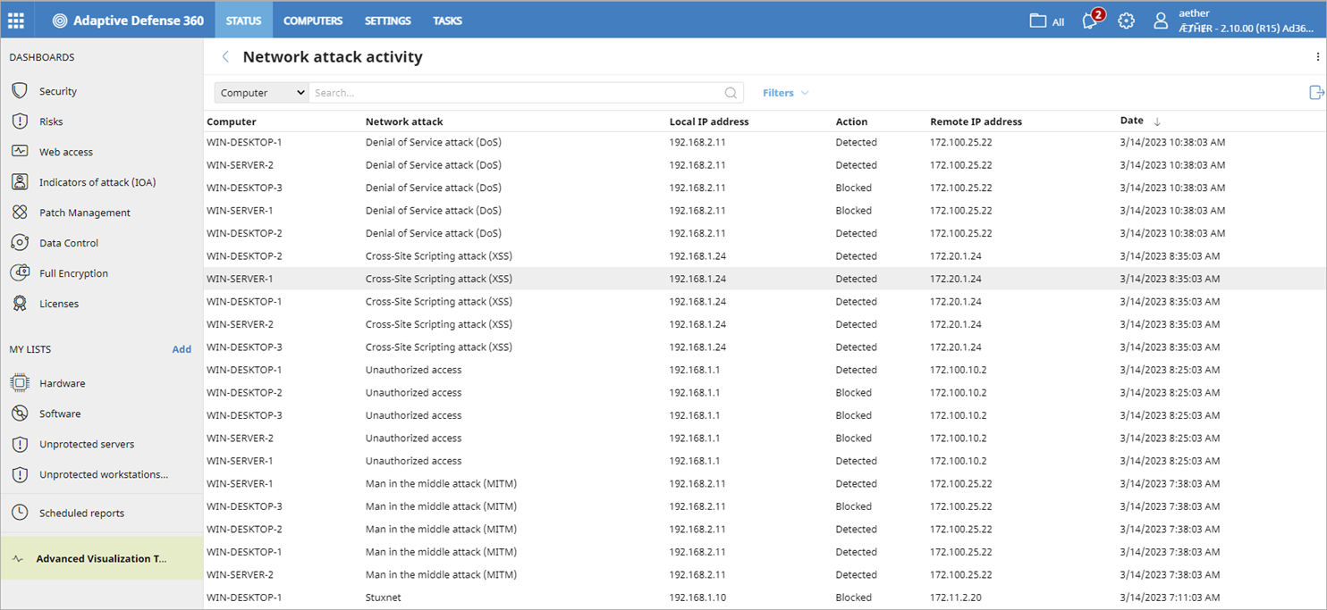
Network Attack Activity List
To open the Network Attack Activity list for all computers affected by a network attack, click the Network Attack Activity tile
Select a computer to review the computer details, including the attack details and actions (events) taken

Slide 38
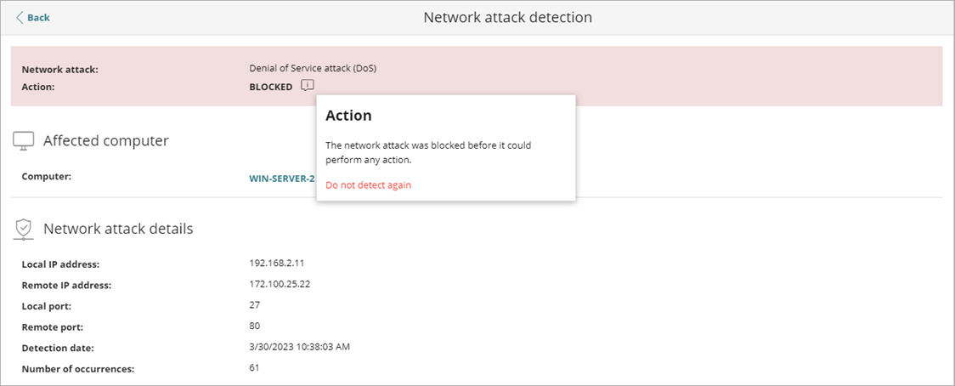
Network Attack Protection – Exclusions
If needed, you can exclude the detection of a specific network attack on all computers in the account
  When you exclude a network attack, your computers are still protected from the remaining types of network attacks in the list
Click Do Not Detect Again and enter the specific IP addresses of the devices you want to exclude from detection

Slide 39
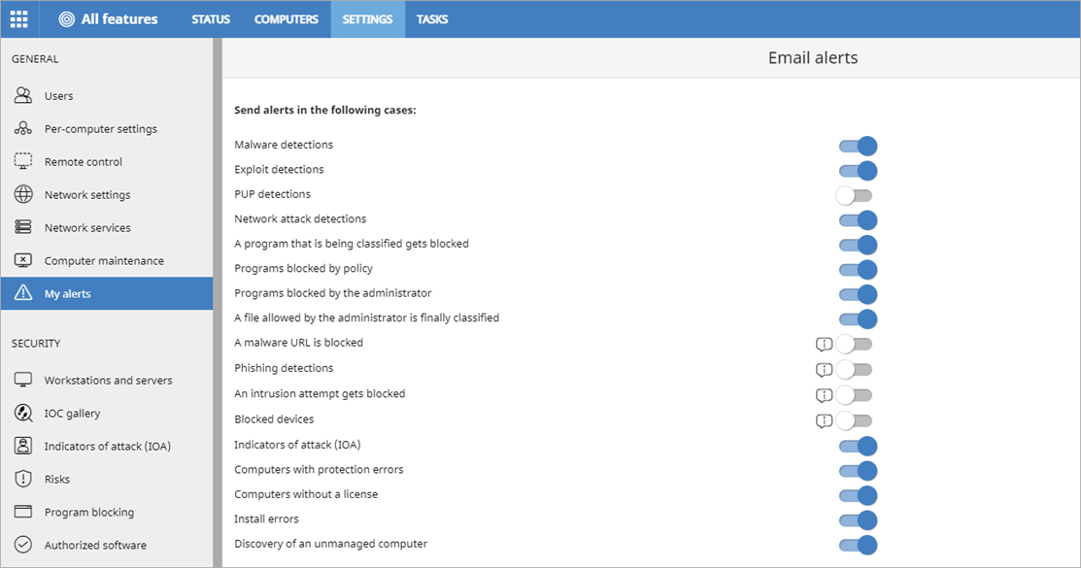
Alerts for Network Attack Detections
You can send email alerts when Network Attack Protection detects a network attack

Slide 40
Audit Mode

Slide 41
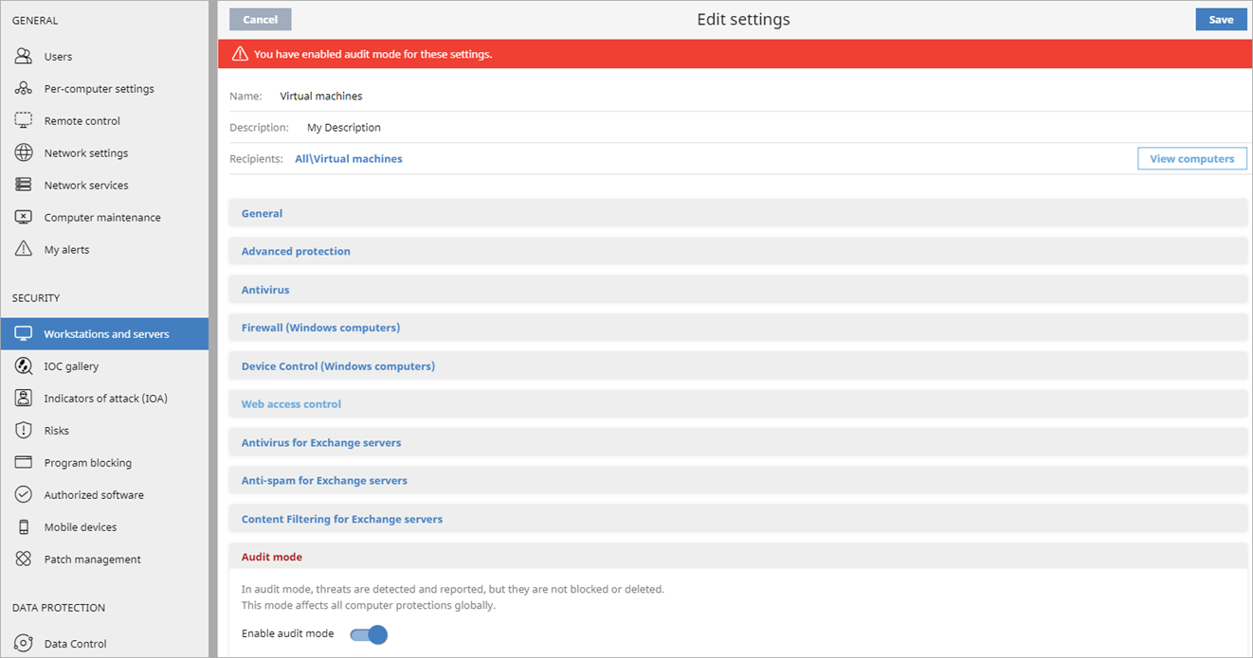
Audit Mode
In a Workstations and Servers settings profile, you can enable Audit mode to detect and report threats on all computers
When enabled, Adaptive Defense 360 notifies the endpoint user when a threat is detected

Slide 42
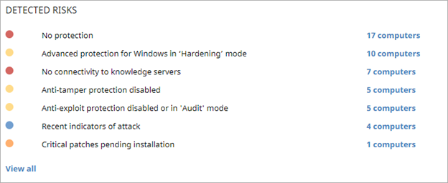

Audit Mode Risk
When a device is in Audit mode, threats are not blocked or deleted
This appears as a risk in the Detected Risks tile of the Risks dashboard (Audit mode enabled) and on the computer details page

Slide 43
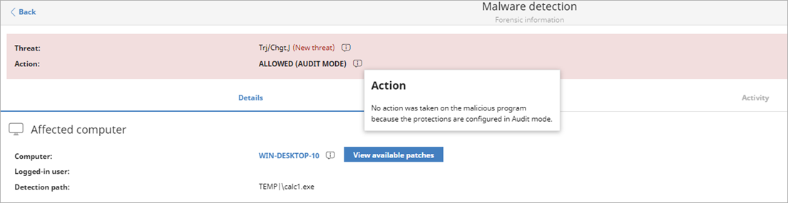
Detection Details — Allowed (Audit Mode)
When Adaptive Defense 360 is set to Audit mode, detected threats show Allowed (Audit Mode) on the detection details page for Malware/PUPs, Exploits, and Network Attacks

Slide 44
Network Access Enforcement

Slide 45
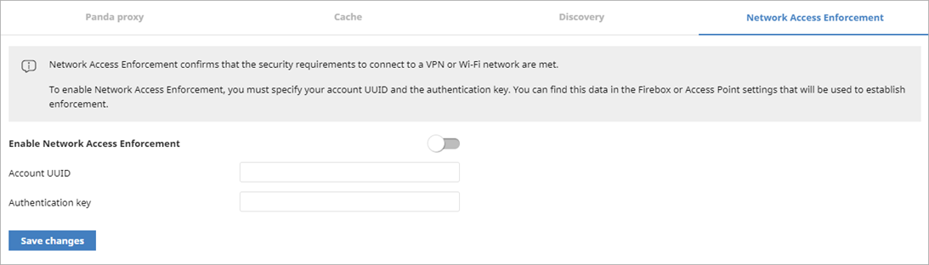
Network Access Enforcement
The Network Services > Secure VPN tab is now called Network Access Enforcement
This change reflects support for VPN and Wi-Fi connections
  In a future release of the access point software, access points will be able to check that connecting devices (client devices) have the Panda Endpoint Agent

Slide 46
Patch Management Improvements

Slide 47
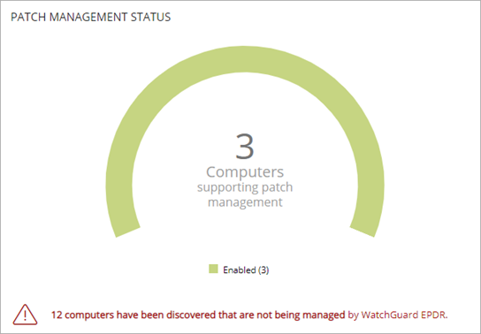
Patch Management Support (macOS and Linux)
Vulnerability Assessment and Patch Management now support Mac and Linux computers
  Operating system patches for macOS with ARM (M1 and M2) require a password and force a restart
  Patch Management cannot uninstall Linux and macOS patches
Mac and Linux computers can install patches from a cache server

Slide 48
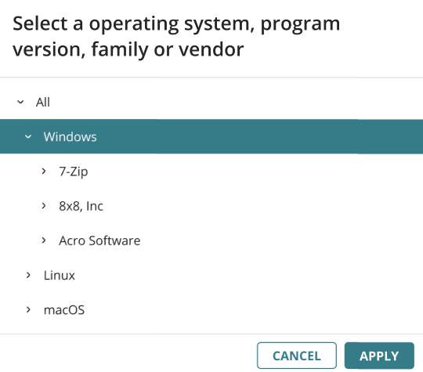
Patch Management Support (macOS and Linux)
In the Available Patches list, you can now filter the list by operating system
(Patch Management only) In tasks, you can install patches based on the operating system
macOS and Linux patches are not included in existing recurring or new recurring Patch Management tasks

Slide 49
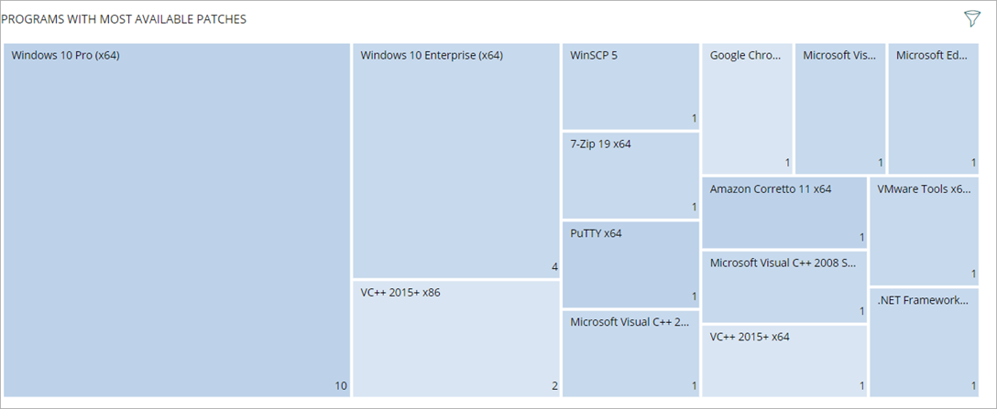
Patch Management Improvements
A new Programs with Most Available Patches tile lists software programs with available patches, as well as the number of available patches for each program, in descending order from left to right
  Click a square to open the Available Patches list filtered to the program
  Filter the tile to show patches by Criticality, Computer Type, and Patch Type
A new Available Patches by Computer list is also available

Slide 50
Other enhancements

Slide 51
IOA – MITRE ID in Filter
In the filter settings, IOAs are now listed with the MITRE ID first and then the technique (for example, T1012 - Query Registry)

