Slide 1
Introduction to Aether 14
Release date: 2 November 2022

Slide 2
Overview
This presentation describes updates to these products:
Adaptive Defense / Adaptive Defense 360
Endpoint Protection / Endpoint Protection Plus
This presentation does not describe:
Changes before Aether 14 (October 2022)
Panda Partner Center or Aether for Partners
Cytomic products
WatchGuard Endpoint Security products and Service Provider Endpoint Manager (see WatchGuard Endpoint Security presentation for 5 October 2022)
Some minor bug fixes
For a complete list of enhancements and resolved issues, see the Adaptive Defense 360 Release Notes

Slide 3
Release Summary
The Aether 14 release includes enhancements in these areas:
Risks
Computer Maintenance
Patch Management
Tasks
Integration with Active Directory
Other Enhancements

Slide 4
Risks

Slide 5
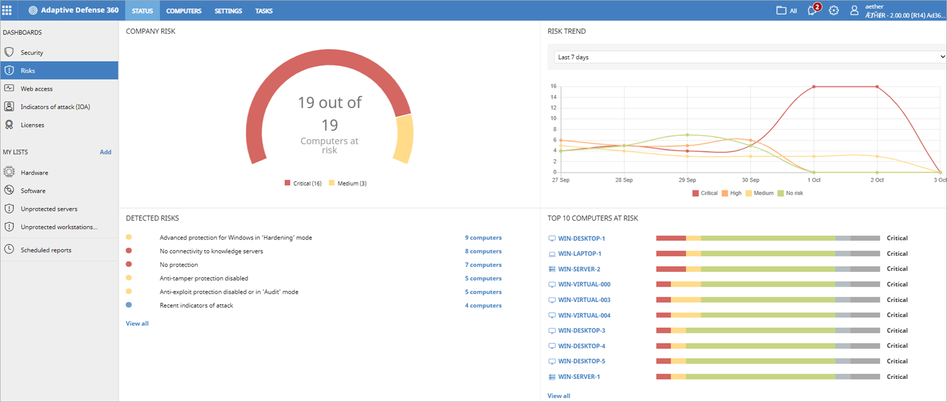
Risks Dashboard
A new Risks dashboard shows information about the security risk level assigned to computers on your network

Slide 6
Risk Assessment
The overall risk level for a computer is calculated by the risk level of one or more risks identified on the computer
Types of risks include:
Status reported by the endpoint
Settings assigned by the administrator
IOAs reported for each computer
Critical patches reported by each computer
When you configure risks, you specify the risks you want to detect on computers, and assign a risk level to each risk (for example, critical, high, or medium)
By default, Panda Security recommends a risk level for each risk

Slide 7
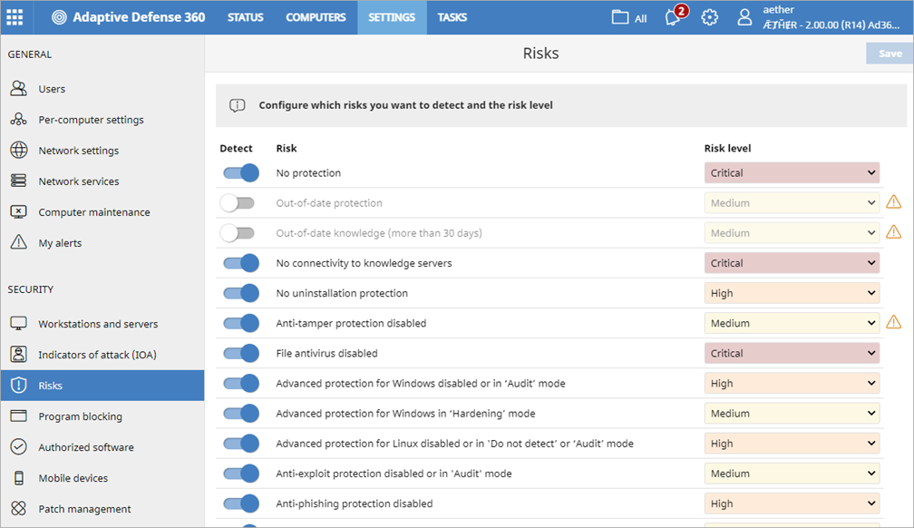
Configure Risk Settings
On the Risks page, you specify which risks you want to detect on the devices in your account and set the risk level for each risk
The risks available depend on the Panda product you have
To configure risk settings for an account:
Select Settings > Risks
Enable the toggles for the risks you want to detect
Select a risk level for each risk If the recommended risk level is different, a warning icon shows the recommended risk level
Click Save
More risks will be available in future releases

Slide 8
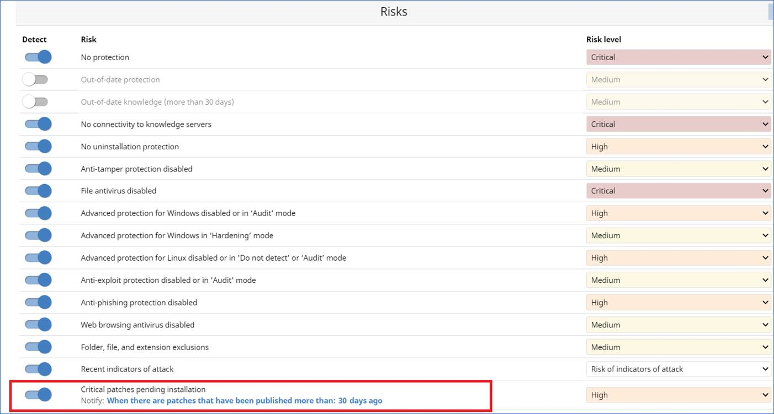
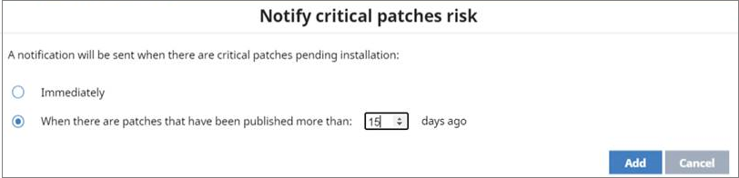
Critical Patches Pending Installation Risk
When there are patches available for installation, you can enable the toggle to detect this risk, specify the risk level, and specify the number of days after which the risk is triggered

Slide 9
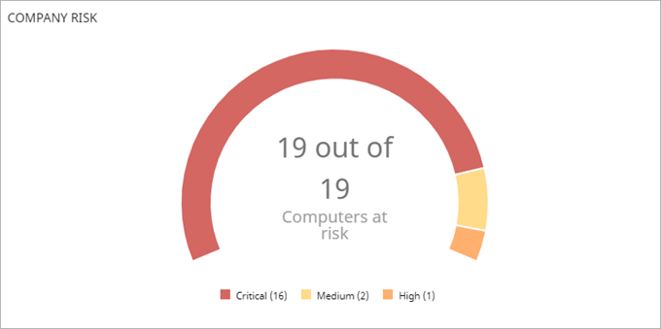
Company Risk
The Company Risk tile on the dashboard shows the number of computers in the network with an assigned risk level
The graph shows computers with no risk and computers with different levels of risks

Slide 10
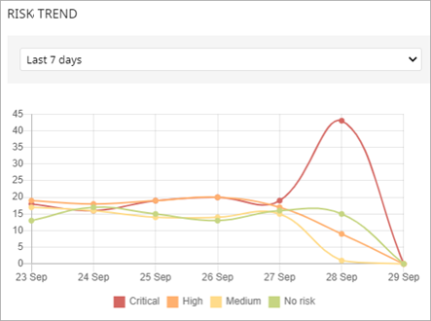
Risk Trend
In the Risk Trend tile, you can see the number of computers with a specific level of risk over a time period
Select a time period from the drop-down list

Slide 11
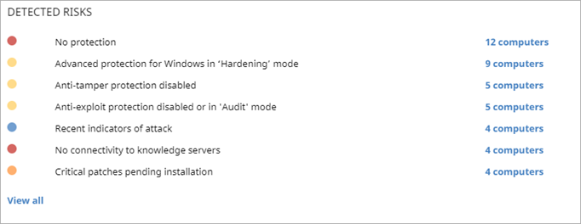
Detected Risks
The Detected Risks tile shows the top risks found and the number of computers where the risk was found
Click the number of computers to see a list of the affected computers
To show all the risks detected, click View All

Slide 12
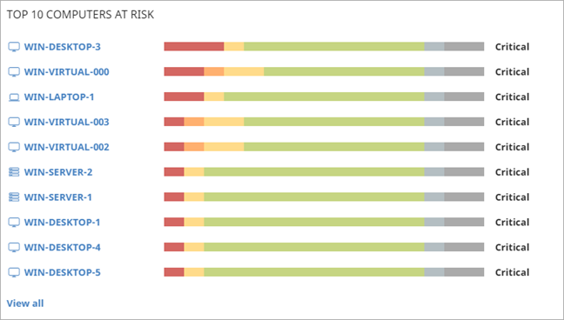
Computers at Risk
The Top 10 Computers at Risk tile shows the computers with the highest risk levels
The list shows in descending order
For each computer, the bar graph indicates the type of risks found and the overall risk status for the computer
Point to a risk type to see the number of risks
Click the computer name to open the Risks list for the computer

Slide 13
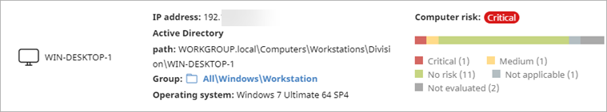
Computer Risk on the Computer Details Page
The computer details page now includes risk information for the computer, including the overall risk status
Click the bar graph or type of risk to open the Risks list filtered for the computer

Slide 14
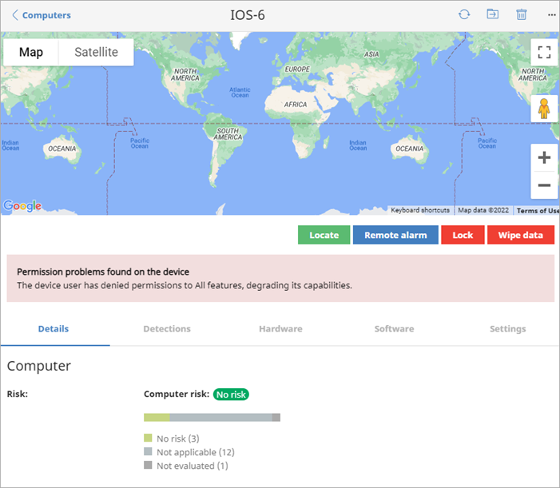
Mobile Device Details Tab
For Android and iOS devices, the Details tab includes risk information for the device, including the overall risk status
Click the bar graph or type of risk to open the Risks list filtered for the device

Slide 15
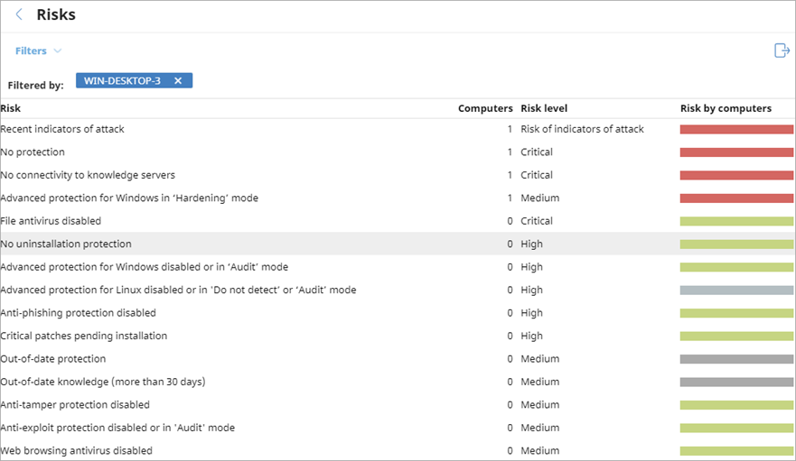
Risks List
To open the Risks list, click the Computers at Risk tile on the Risks dashboard
The list shows all the risks detected on the endpoint, as well as the severity

Slide 16
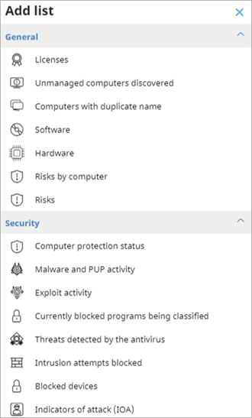
Add Lists
On the Status page, you can add shortcuts to new lists for risks
In My Lists, click Add and select one of the available lists:
Risks by Computer
Risks

Slide 17
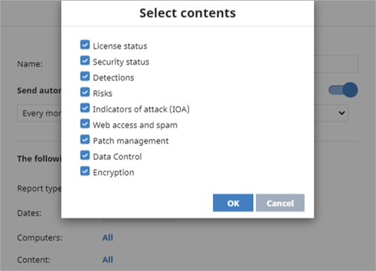
Risks in the Executive Report
You can schedule reports to send daily, weekly, or monthly on specific days and at specific times
You can now include a Risks section in the Executive Report

Slide 18
Computer Maintenance

Slide 19
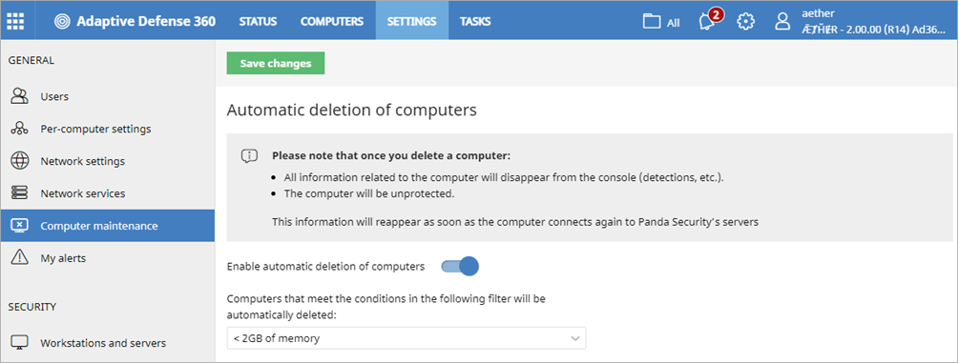
Automatic Deletion of Computers
On the Computer Maintenance page, you can automatically delete endpoints from the console based on a filter
To open the Computer Maintenance page, select Settings > Computer Maintenance

Slide 20
Identify Computers with a Filter
To delete computers from the console, you must be able to see the account and have the computer maintenance permission assigned
Create a filter to identify the computers you want to delete and then select the Enable Automatic Deletion of Computers toggle
When you define a filter, any endpoint devices that match the criteria appear in the filter group
All endpoint devices that meet the criteria in the filter are automatically deleted daily between 01:00 AM and 03:00 AM UTC
Deletions are tracked in system events

Slide 21
Delete Computers from the Console
When you delete computers:
Computers and their information are deleted from the console and are no longer protected
The endpoint security software and endpoint agent are not removed
Encrypted computers remain encrypted, but you cannot get the recovery keys
We recommend that you turn off a computer when it is deleted
If you do not turn off the computer, it will appear in the console when it reconnects to the Panda Cloud servers
Information generated by the device is not permanently deleted from the cloud servers
If you reassign a license to the device, the information shows in the console when the device reconnects

Slide 22
Patch Management Updates

Slide 23
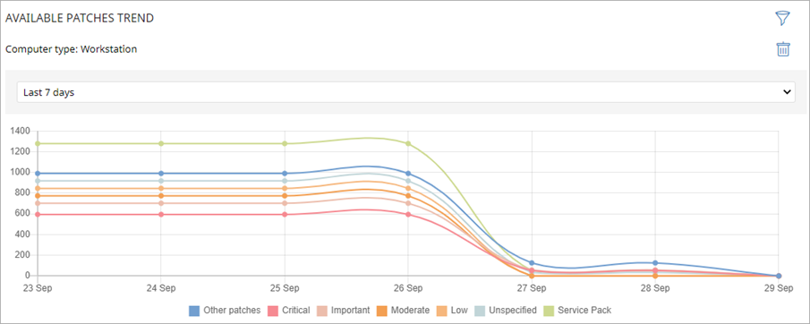
Available Patches Trend
On the Patch Management dashboard, an Available Patches Trend tile shows the number of patches that are available for installation on the computers on the network, grouped by severity, over time
Point to a node on the graph to see a tooltip with the Date, Type, and Number of Patches

Slide 24
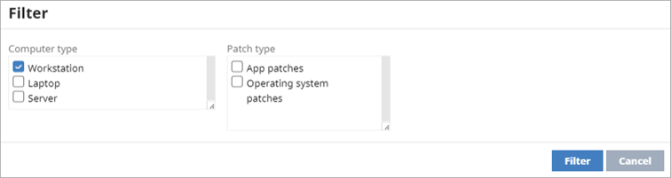
Available Patches Trend
You can filter the tile by Computer Type, Operating System Patches, and App Patches
For information on the patches supported by Panda Patch Management, see this Knowledge Base article:
Vendors and Apps Supported by Patch Management

Slide 25
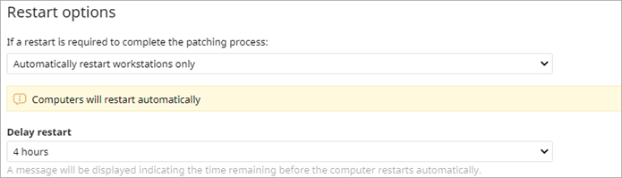
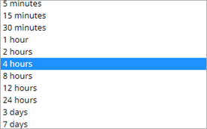
Delay Restart for Patch Management Tasks
In the Restart Options section of an install patches task, you can now specify the maximum time that the system waits before it forces a restart on the endpoint to complete the installation of the patch
You can restart immediately when the task is scheduled, or delay the restart up to seven days
This can be useful to force a restart outside of work hours

Slide 26
Tasks

Slide 27
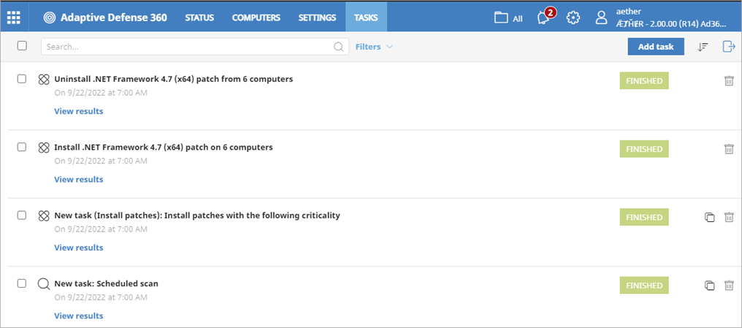
Filter and Export Tasks List
You can filter the list by task status (In Progress, Finished, Cancelled, etc.)
You can now export the tasks list to a CSV file

Slide 28
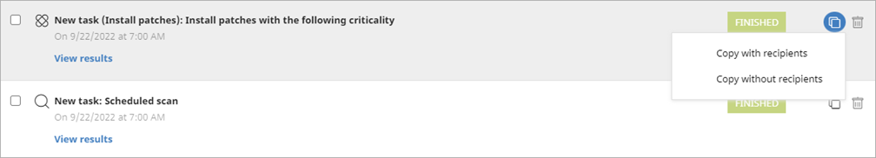
Copy Task Recipients
When you copy a task, you can copy its settings with or without the recipients
To copy a task with the recipients:
On the Tasks page, find the task you want to copy
Select next to the task
Select Copy with Recipients The Copy Task page opens
Edit the copied task
Click Save

Slide 29
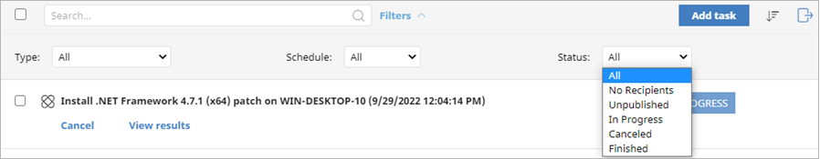
Tasks Filter by Status
You can now filter the task list by status

Slide 30
Integration with Active Directory

Slide 31
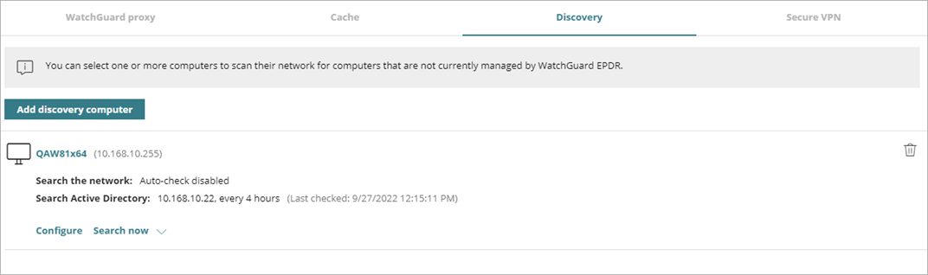
Integration with Active Directory
When Adaptive Defense 360 is integrated with Active Directory, you can now search Active Directory with a Discovery computer to find unmanaged computers

Slide 32
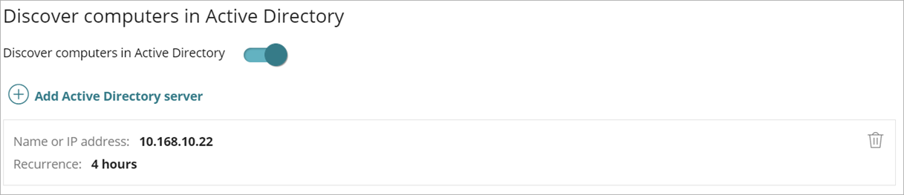
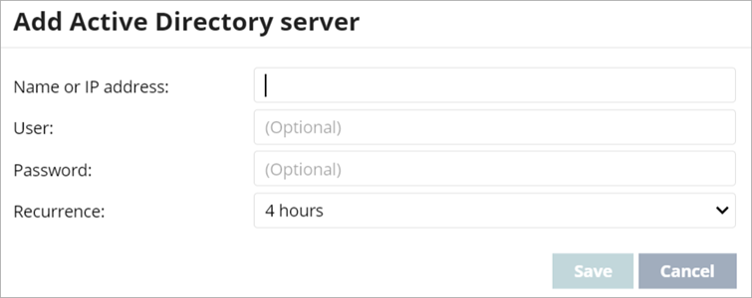
Integration with Active Directory
To discover computers in Active Directory:
Select Network Services > Discovery
Click Configure
Enable the Discover Computers in Active Directory toggle
Click Add Active Directory Server and specify the server details in the dialog box

Slide 33
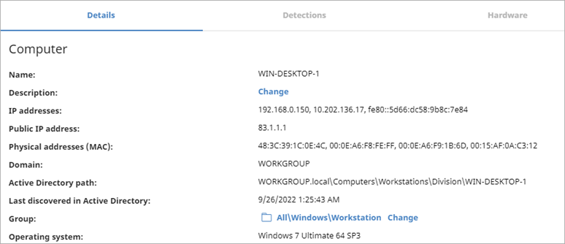
Last Seen in Active Directory
On the computer details page, the time and date when the computer was last discovered in Active Directory now shows on the Details tab
For macOS and Linux endpoints, the Active Directory path now shows on the Details tab

Slide 34
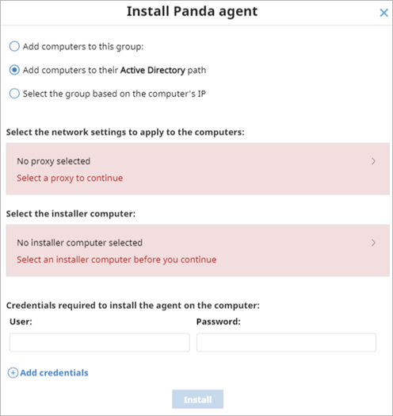
Remote Installation with Active Directory
When a Discovery computer finds a computer through Active Directory, it is not necessarily connected to the computer
To remotely install the security software on the discovered computer, you must select the Discovery computer that found it
In the case of multiple computers, if the selected computers include computers that were discovered with and without Active Directory, then you must select the Discovery computer for each computer discovered through Active Directory

Slide 35
Other Enhancements

Slide 36
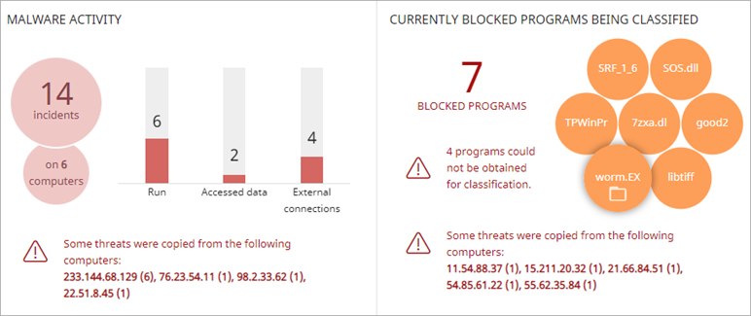
Visualize Infected Devices – Source IP Address
The Malware, Blocked Programs, and PUPs Activity tiles on the Security dashboard now show when a computer visible to you is infected after a file was copied from another computer on the network
The information includes the IP address of the computer where the infection originated, as well as the number of times that IP address was the source of a detection (in parentheses)
Click the IP address link to open the corresponding list

Slide 37
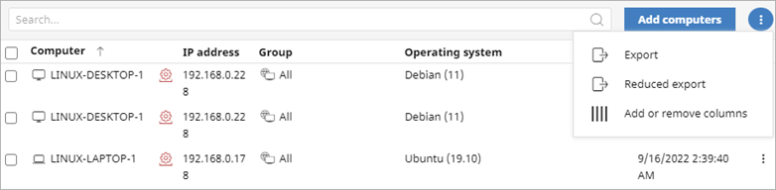
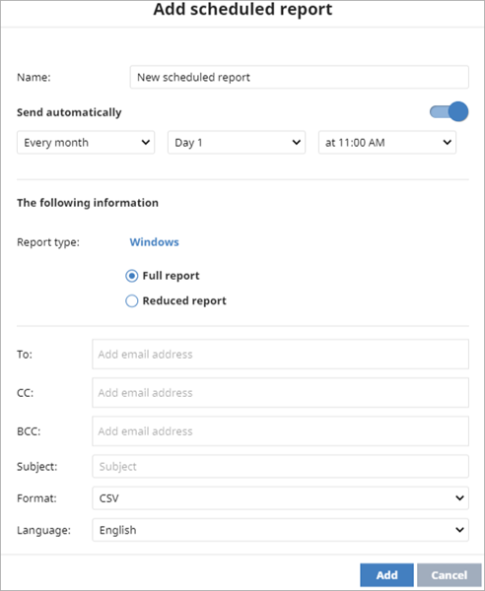
Reduced Export and Reports
You can now export a simplified device list that does not include configuration details
To export a simplified device list, from the Computers page:
From the options menu, select Reduced Export
You can also schedule a reduced report

Slide 38
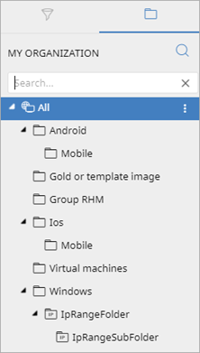
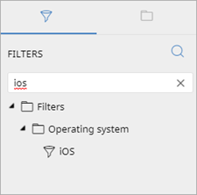
Filters Search
On the Computers page, you can now search Groups and Filters

Slide 39
Updated Linux Support
Protection version 3.02.00.000 now supports these operating system releases:
AlmaLinux 8.3 - 9.0
CentOS Stream 8 - 9
Linux Mint 21
Oracle Linux 8.6
RHEL 9.0
Rocky Linux 8.3 - 9.0
Suse 15SP4
Improved performance on servers with overload

Slide 40
Updated macOS Support
Protection version 3.02.00.000 now supports this operating system:
macOS 13 (Ventura)

Slide 41
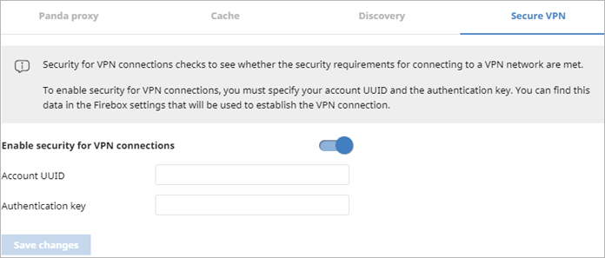
Secure VPN for Endpoint Enforcement (macOS)
With Secure VPN, all VPN connections must meet specified security requirements before they connect to VPN networks
Secure VPN is now available for endpoints with macOS
Secure VPN supports Mac computers that run macOS High Sierra 10.13 or higher

Slide 42
Improvements to Anti-Tampering
Changes were made to strengthen the anti-tampering protection:
Users cannot remove the protection or make changes to the registry during restart
Users cannot change permissions on the protection processes

Slide 43
Windows Filtering Platform
In the Windows protection, there is a new firewall, Windows Filtering Platform
WFP is part of Microsoft Virus Initiative
Not enabled by default
Enabled in some specific accounts
WFP includes performance improvements in high-speed network connections (firewall interceptors)

Slide 44
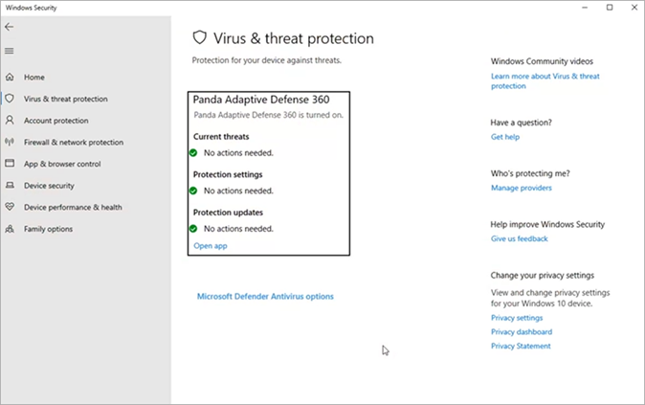
Windows Security Center — Windows 11
New integration with Windows Security Center
New process is always protected with ELAM regardless of the anti-tampering configuration
Anti-tampering is not required in Windows 11 22H2

