Slide 1
Introduction to Aether 13
General Availability: 10 May 2022

Slide 2
Aether 13 Updates
This presentation describes updates to these products:
Adaptive Defense / Adaptive Defense 360
Endpoint Protection / Endpoint Protection Plus
This presentation does not describe:
Changes before Aether 13 (May 2022)
Panda Partner Center or Aether for Partners
Cytomic products
WatchGuard Endpoint Security products and Service Provider Endpoint Manager (see WatchGuard Endpoint Security presentation for May 10, 2022)
Some minor bug fixes
For a complete list of enhancements and resolved issues, see the Adaptive Defense 360 Release Notes

Slide 3
Release Summary
The Aether 13 release includes these enhancements:
Support for iOS Devices
Shadow Copies
Decoy Files
Full Encryption - Recovery Key Search
Patch Management Enhancements
Secure VPN
Additional Changes

Slide 4
Support for iOS Devices

Slide 5
Support for iOS Devices
With Aether 13, you can now install the client app for Adaptive Defense 360, EPP, and EP on iOS devices
We recommend that you install the app integrated with the WatchGuard mobile device management (MDM) solution
MDM solutions use software as a component to provision mobile devices and can also protect device applications, data, and content

Slide 6
Mobile Device Management Features for iOS Devices
More features are available for iOS devices when the client app is integrated with the Aether MDM:
* The iOS device must be in supervised mode. When you place a device in supervised mode, you must reset the device to factory-default settings. For more information, see the Panda Adaptive Defense 360 Administration Guide.
Feature | No MDM | 3rd Party MDM | Aether MDM
Location | ✓ | ✓ | ✓
Remote alarm | ✓ | ✓ | ✓
Hardware inventory | ✓ | ✓ | ✓
Web protection* |  | ✓ | ✓
Phishing* |  | ✓ | ✓
Web access control* |  | ✓ | ✓
Wipe |  |  | ✓
Lock |  |  | ✓
Software inventory |  |  | ✓

Slide 7
iOS Installation Requirements
Supported OS Versions
iOS 13 / iPadOS 13
iOS 14 / iPadOS 14
iOS 15 / iPadOS 15
Hardware Requirements
A minimum of 12 MB of internal memory on the target device
For some models, more space can be required

Slide 8
Network Requirements
The application installed on the mobile device uses the Apple Push Notification service to communicate with the software
If the device is connected to the network by 2G, 3G, or 4G, there are no specific network requirements
If the device is connected to the network by Wi-Fi, Access Point (AP), or other method, it connects to specific servers
Make sure these ports are available:
TCP 5223 to communicate with the Apple Push Notification service
TCP 443 or 2197 to send notifications

Slide 9
Available IP Ranges
Servers that make up the Apple Push Notification service use load balancing
This means that the device will not always connect to the same IP address
We recommend that you configure your firewall to allow connections to the entire 17.0.0.0/8 range assigned to Apple
If this is not possible, allow connections to these IP ranges:
IPv4 | IPv6
17.249.0.0/16 17.252.0.0/16 17.57.144.0/22 17.188.128.0/18 17.188.20.0/23 | 2620:149:a44::/48 2403:300:a42::/48 2403:300:a51::/48 2a01:b740:a42::/48

Slide 10
Apple Push Certificates
Integration with the Aether MDM solution enables additional features such as wipe and lock, as well as access to the software inventory on the device
Before you add an iOS device, you must configure the software to use Apple’s Push Notification service
The certificate establishes a trusted connection between the iOS devices and the organization domain
You need an Apple push certificate for each Panda account
Apple push certificates expire annually

Slide 11
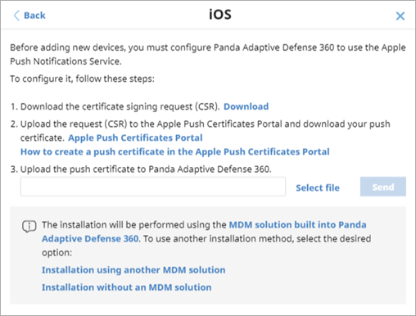
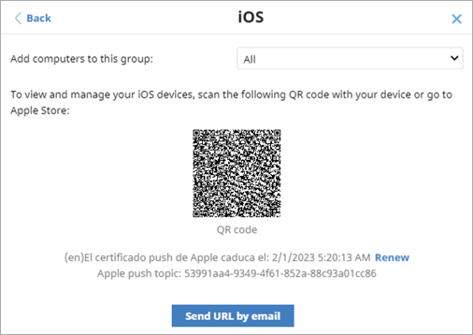
Install Client App – Aether MDM Integration (Recommended)
To install the client app integrated with the Aether MDM solution:
On the Computers page, click Add Computer
Click iOS
Download the certificate signing request (CSR)
Upload the CSR file to the Apple Push Certificates Portal You must have an Apple account to upload the CSR
Download your push certificate from the portal
Click Select File and select the certificate you downloaded
Click Send to upload it to the account
Click Back
Scan the QR code or click Apple Store to install the app

Slide 12
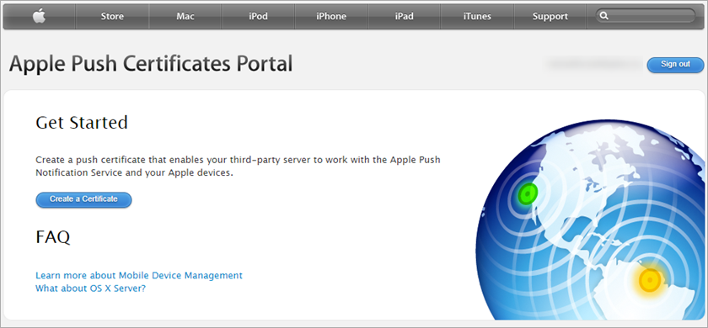
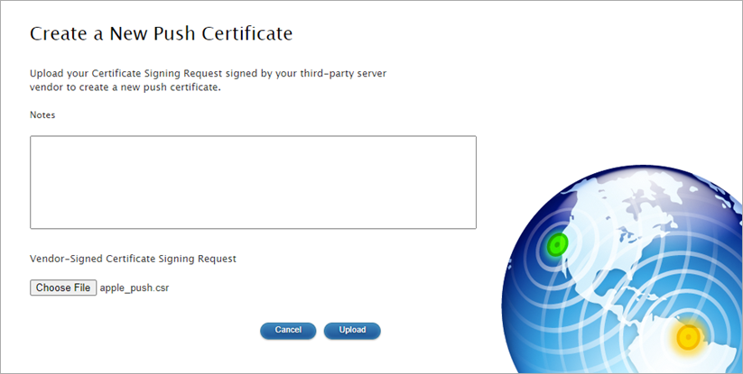
Create an Apple Push Certificate
To create an Apple push certificate:
Log in to the Apple Push Certificates Portal
Click Create a Certificate
Click Choose File and select the client app CSR file
Click Upload

Slide 13
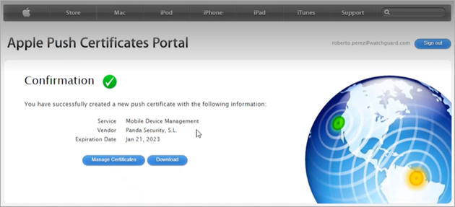
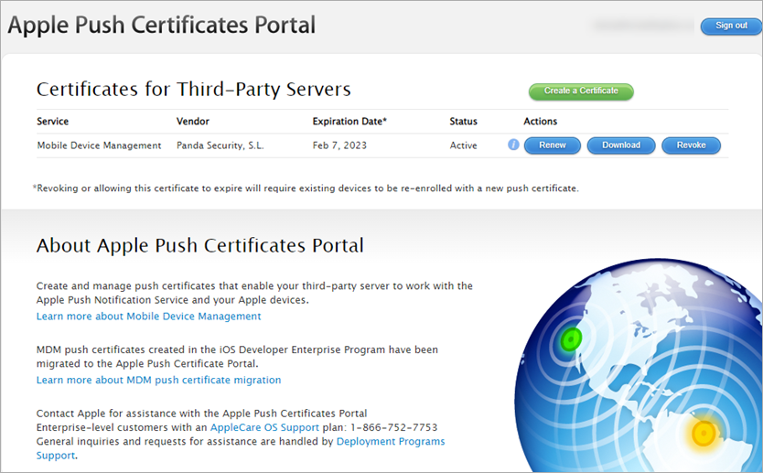
Download the Push Certificate
To download a copy of the certificate to your computer, on the Confirmation page, or on the portal page, click Download

Slide 14
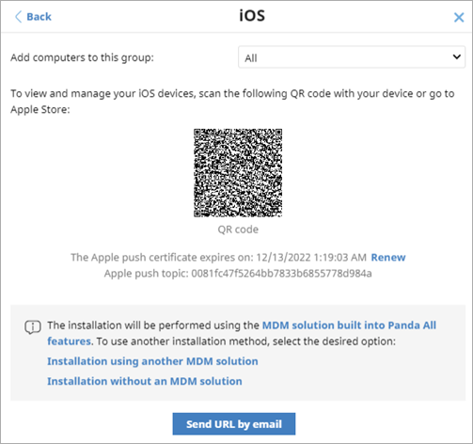
Renew Apple Push Certificate
You must renew the Apple push certificate annually
If your certificate expires before you renew it, you must set up a new certificate and re-integrate all iOS devices in your company

Slide 15
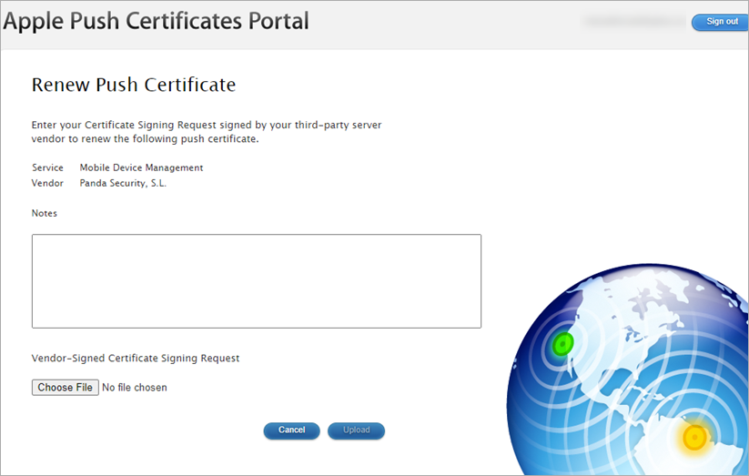
Renew Apple Push Certificate
To renew the certificate:
Log in to the Apple Push Certificates Portal (https://identity.apple.com/pushcert/)
Click Renew
Click Choose File and select the client app CSR file (apple_push.csr)
Click Upload

Slide 16
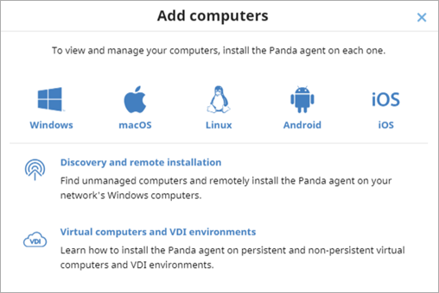
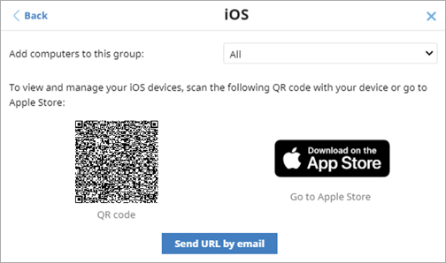
Install Client App – No MDM Integration
To install the client app locally, without an MDM solution:
On the Computers page, click Add Computer
Click iOS
Click Install without an MDM solution
Select the group you want to add the devices to
Scan the QR code or click Apple Store to open the Apple Store, then click Install
To send the Apple Store installation link in an email message, click Send URL by Email

Slide 17
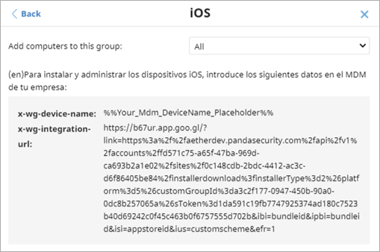
Install Client App – Third-Party MDM Integration
To install the client app integrated with a third-party MDM solution:
On the Computers page, click Add Computer
Click iOS
Click Installation using another MDM solution
Select the group you want to add the devices to
Copy and paste this information in your MDM solution:
x-wg-device name
x-wg-integration-url
Click Back and scan the QR code or click Apple Store to install the app

Slide 18
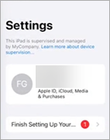
About Supervised Mode
Supervised mode gives an administrator more control of an iOS device owned by their organization, and provides greater flexibility to configure apps and manage devices
To use the URL filtering and anti-phishing capabilities provided by AD360, you must configure iOS devices in supervised mode
If an existing iPhone or iPad is not supervised, when you configure the device in supervised mode, it resets to factory-default settings
All data, programs, and settings are deleted
To determine whether a device is supervised, open Settings
A supervision message shows at the top of the Settings page

Slide 19
Enable Supervised Mode
If a device is already in supervised mode, you do not need to reset the device and you can proceed to install the WatchGuard Mobile Security app from the Panda MDM solution or a third-party MDM solution
For information on how to enable supervised mode and install the WatchGuard Mobile Security app, see the Panda Adaptive Defense 360 Administration Guide

Slide 20
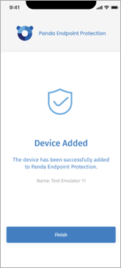
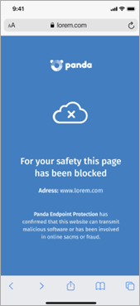
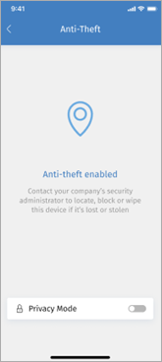
iOS Client App
When users start the app for the first time, they must Allow notifications
Protection can include detection of malware and phishing URLs, anti-theft protection, and web access control

Slide 21
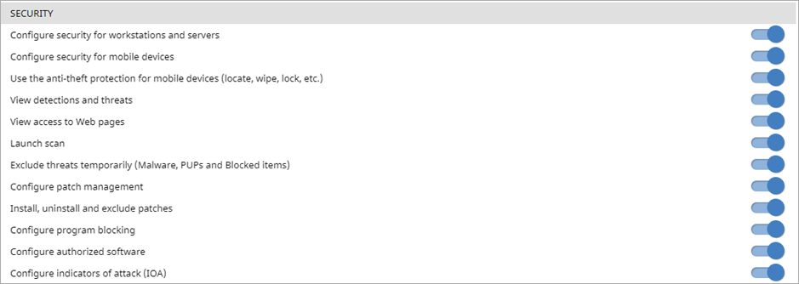
Mobile Permissions
Security permissions now include Android and iOS devices
To update mobile permissions:
From the top navigation bar, select Settings
Select Users
Select the Roles tab and add a new role or edit an existing role
In the Security section, enable the mobile security permissions, as required

Slide 22
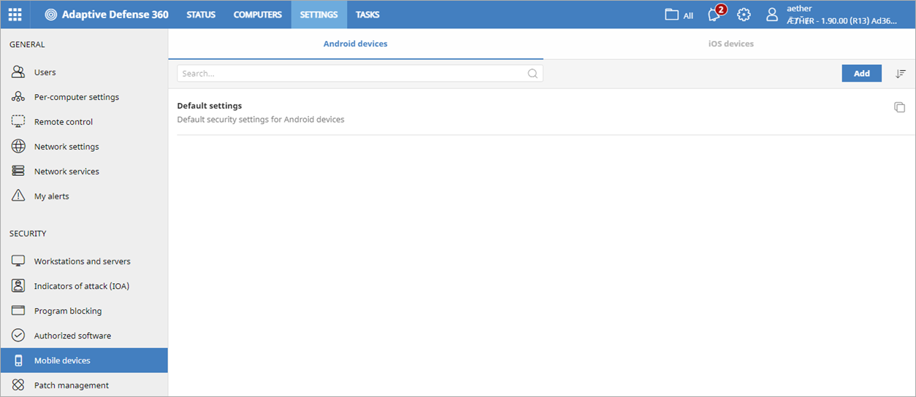
Mobile Devices Settings
On the new Mobile Devices page in the console, you can configure security settings to protect Android and iOS tablets and mobile phones against threats, malware, and theft

Slide 23
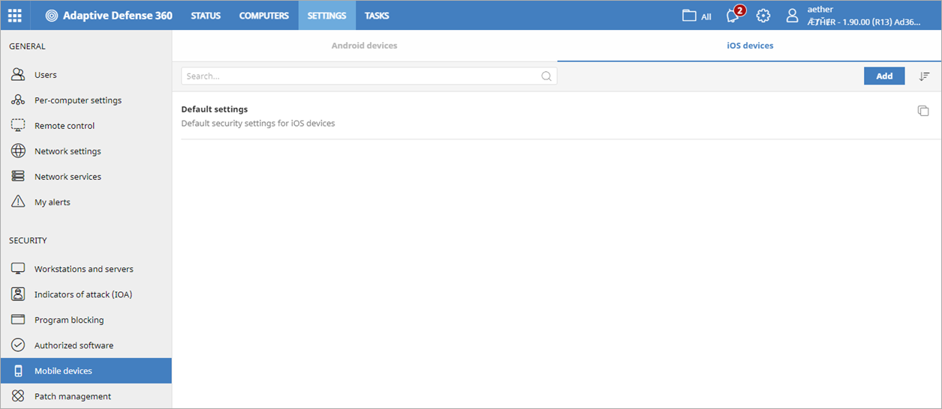
Configure iOS Device Settings
In an iOS device settings profile, you configure settings to enable antivirus protection for web browsers (detection of malware and phishing URLs), anti-theft protection, and web access control
To configure iOS device settings:
From the top navigation bar, select Settings
From the left pane, select Mobile Devices
Click iOS Devices
To create a new profile, click Add You can also copy or edit an existing profile

Slide 24
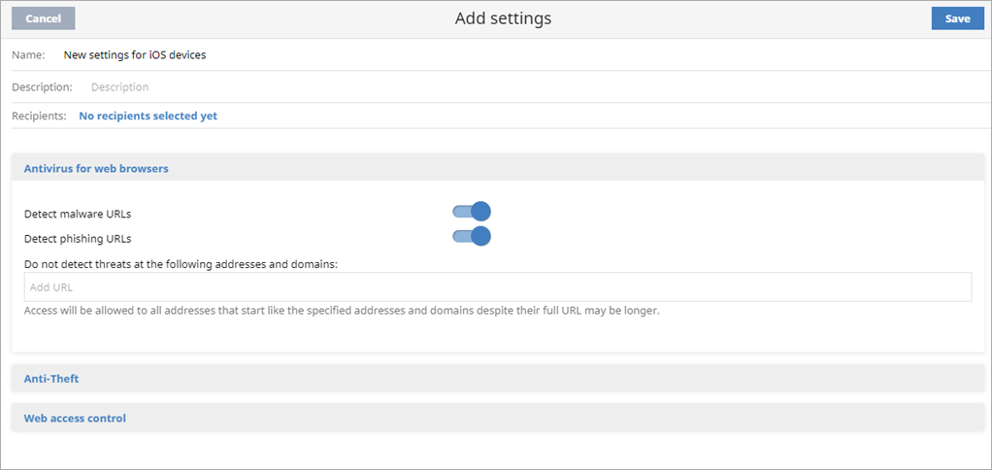
Configure Web Protection for Web Browsers on iOS Devices
In the Antivirus for Web Browsers section, you enable detection of malware and phishing URLs
Web protection is only available for supervised iOS devices integrated with the Aether MDM solution

Slide 25
Configure Web Protection for Web Browsers on iOS Devices
To configure web protection for web browsers:
Click Antivirus for Web Browsers
To Detect malware URLs, enable the toggle
To Detect phishing URLs, enable the toggle
(Optional) In the text box, type addresses and domains you want to exclude from antivirus protection
Click Save

Slide 26
Configure Anti-Theft Settings for iOS Devices
Anti-theft settings are only available for iOS devices integrated with an MDM solution
The anti-theft feature enables you to send actions to iOS devices to prevent data loss or locate the devices in the event of loss or theft
In the Anti-Theft section, you can enable anti-theft protection, including reporting
In the settings, you can also allow users to enable private mode on their devices

Slide 27
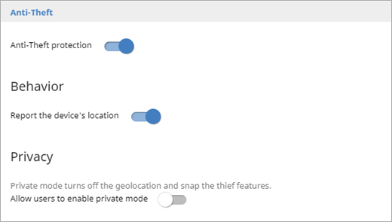
Configure Anti-Theft Settings for iOS Devices
To configure anti-theft settings:
Click Anti-Theft
Enable the Anti-Theft Protection toggle
In the Behavior section, enable the toggle to report the device location
In the Privacy section, enable the toggle to Allow Users to Enable Private Mode
When the user enables private mode, geolocation is no longer available

Slide 28
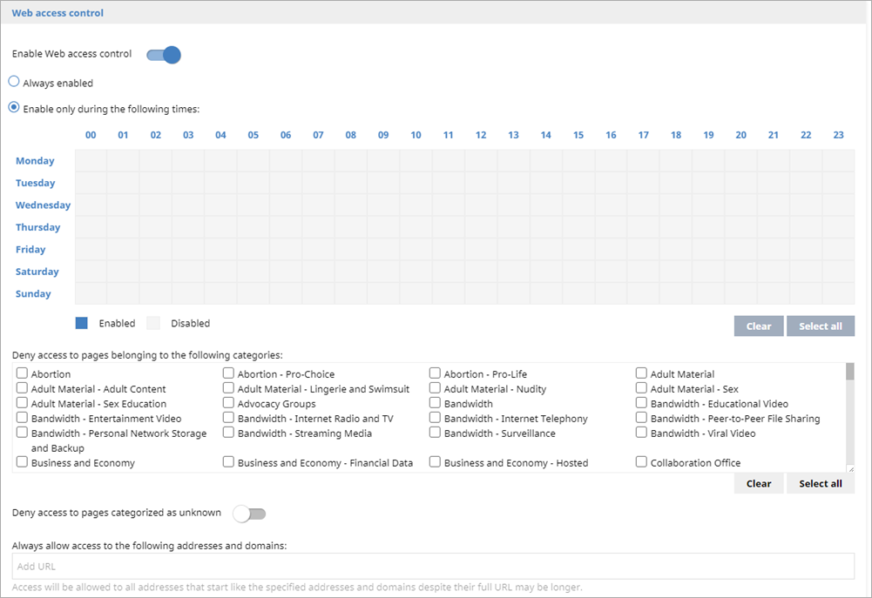
Configure Web Access Control for iOS Devices
Web access control is only available for supervised iOS devices integrated with a mobile device management solution
In the Web Access Control settings, you can limit access to specific web content categories, and configure a list of URLs to allow and deny

Slide 29
Configure Web Access Control for iOS Devices
To configure web access control:
Click Web Access Control
Enable the Enable Web Access Control toggle
To specify when you want to enable web access control, select Enable Only During the Following Times and specify the days and hours when you want web access control to apply
To exclude sites from web access control and always allow access to them, in the Always allow access to the following addresses and domains text box, enter the URLs
To always deny access to an IP address or domain, in the Deny access to the following addresses and domains text box, enter the IP address or domain

Slide 30
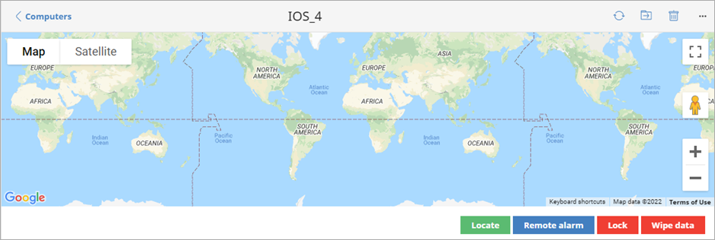
Anti-Theft Dashboard
The anti-theft dashboard for iOS devices includes these features:
Locate – Locates the iOS device on the map (requires a code if the user has privacy mode enabled on the device)
Remote Alarm – Sends an audible alarm and message to the device
Lock – Locks the device and requires the user to enter a 6-digit code to open the device (requires Aether MDM)
Wipe Data – Deletes all content and applications from the device. The device returns to factory settings (requires Aether MDM)

Slide 31
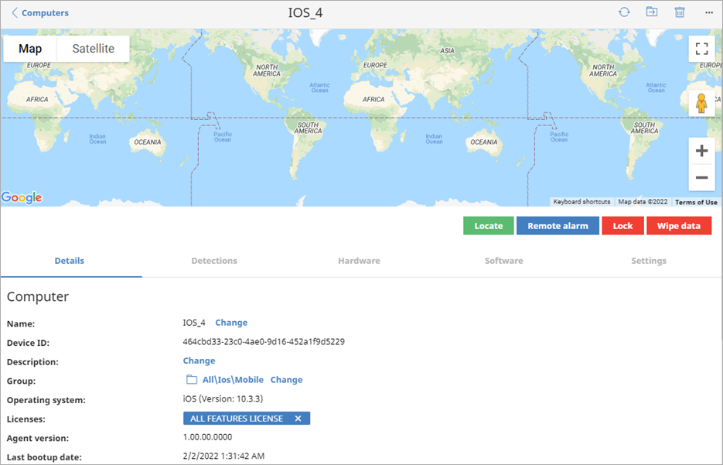
iOS Device Details
To see device details and the anti-theft dashboard, on the Computers page, select an iOS device
The Software tab is only visible for iOS devices integrated in the Aether MDM solution

Slide 32
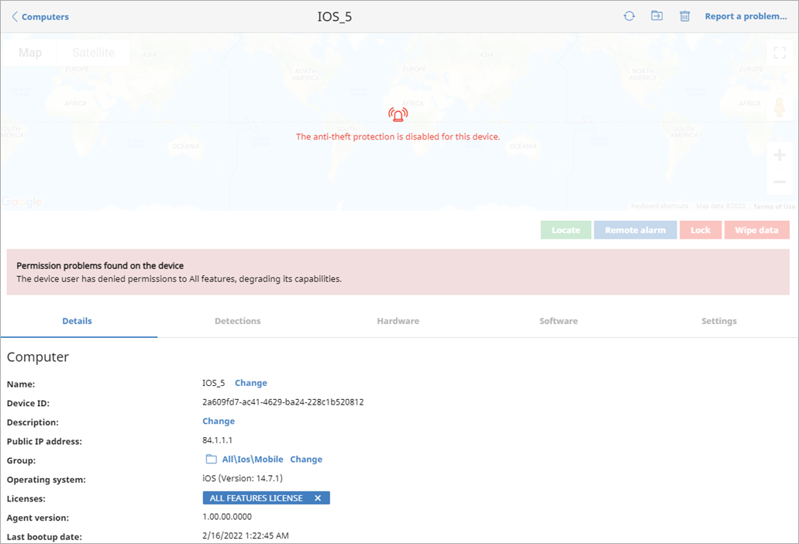
Mobile Device Permissions
When a user does not grant access to the app, the anti-theft dashboard shows that anti-theft protection is disabled

Slide 33
Shadow Copies

Slide 34
Shadow Copies
Shadow Copies is a technology included on Windows computers that can create snapshots of computer files, even when they are in use
When enabled, Windows creates a shadow copy every 24 hours
The Panda software retains up to 7 copies at a given time
You cannot delete a shadow copy created by the Panda software (AD360, AD, EPP, and EP)
To restore a previous version of the file, use the Windows Shadow Copies app on your computer
This feature is available for computers that run these operating systems:
Windows: Windows Vista and higher
Windows Server: Windows Server 2003 and higher

Slide 35
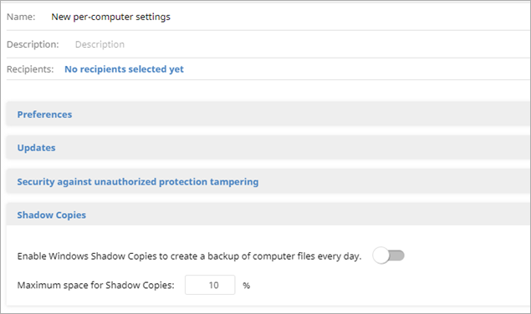
Configure Shadow Copies
To configure shadow copies, in a Per-Computer Settings profile:
Click Shadow Copies
Enable the Enable Windows Shadow Copies to Create a Backup of Computer Files Every Day toggle Windows creates shadow copies of your computer files. The software retains the last 7 copies of a file.
In the Maximum Space for Shadow Copies text box, enter the maximum amount of disk space you want to use for shadow copies By default, the value is 10%. We recommend a value between 5% and 20%.
You can filter the list of computers to see all devices with shadow copies

Slide 36
Decoy Files

Slide 37
Decoy Files
Decoy files are a new layer of protection for AD360, AD, and EPP
Decoy files are used as bait on computers and help detect ransomware
When there is an attempt to modify a decoy file, AD360 identifies the process as ransomware and ends the process

Slide 38
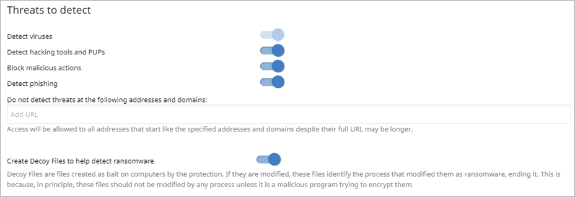
Enable Decoy Files
To enable decoy files, in a Workstations and Servers setting profile:
Click Antivirus
In the Threats to Detect section, enable the Create Decoy Files to Help Detect Ransomware toggle

Slide 39
Secure VPN

Slide 40
Secure VPN
In Settings > Network Services, you can now enable and configure settings for secure VPN on your Firebox
With secure VPN, all VPN connections must meet specified security requirements before they connect to VPN networks
To activate secure VPN, you enter a unique ID for the Firebox and authentication key
Customers without TDR can use a random UUID and authentication key
To generate a random UUID, use one of the free tools available from vendors such as Microsoft
To make sure that the authentication key is secure, we recommend that it includes numbers, letters, and special characters

Slide 41
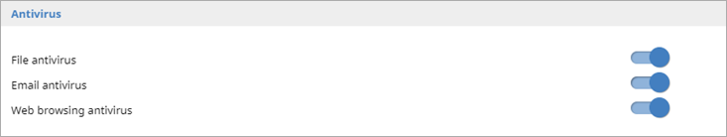
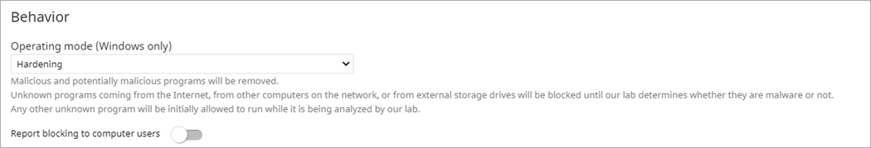
Secure VPN Requirements
Make sure your system meets these requirements before you enable Secure VPN in Network Services:
Host Sensor Enforcement is enabled on the Firebox
Record the Host Sensor Enforcement unique identifier (UUID) and authentication key from the Firebox configuration
Computers you want to enable Secure VPN for must:
Run a Windows operating system
Be able to communicate with the Firebox over port 33000
Have AD360, AD, or EPP installed and running with a Workstation and Servers settings profile with Advanced Protection in hardening or lock mode or Antivirus enabled

Slide 42
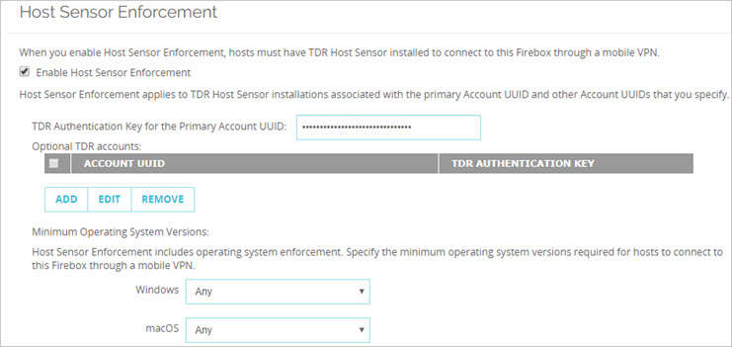
Configure Secure VPN on the Firebox
Until the release of Fireware v12.9, you configure secure VPN for the Firebox with the Host Sensor enforcement settings in Fireware Web UI or Policy Manager
For information on how to configure Host Sensor Enforcement on the Firebox, see Configure TDR Host Sensor Enforcement in Help Center

Slide 43
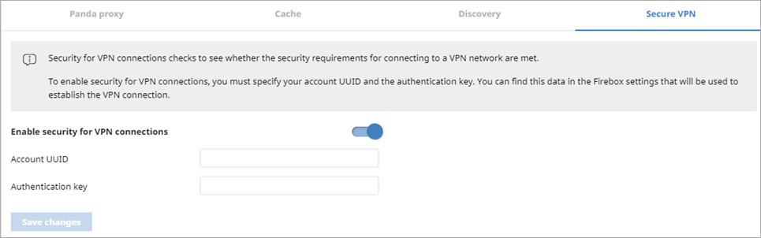
Configure Secure VPN Settings
To configure secure VPN settings:
From the top navigation bar, select Settings
From the left pane, select Network Services
Click Secure VPN
Enable the Enable security for VPN connections toggle
In the Account UUID text box, type the TDR UUID for the Firebox This information is available in the Firebox configuration
In the Authentication Key text box, type the authentication key This information is available in the Firebox configuration
Click Save Changes

Slide 44
Full Encryption

Slide 45
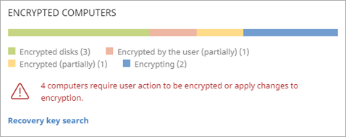
Recovery Key Search
Full Encryption stores a unique recovery key for each encrypted drive or disk it manages
If you have the encrypted drive recovery key ID, but do not know which machine or USB has the recovery key, you can search for it
To find a recovery key from the Full Encryption dashboard:
From the top navigation bar, select Status
From the left pane, select Full Encryption
In the Encrypted Computers tile, click Recovery Key Search The Recovery Key Search dialog box opens

Slide 46
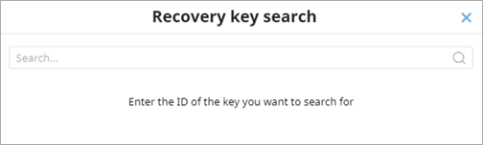
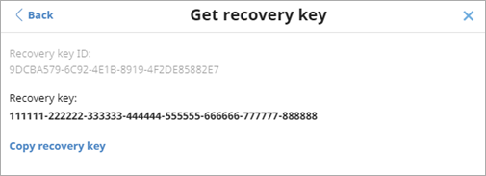
Recovery Key Search
In the Encrypted Computers tile, click Recovery Key Search The Recovery Key Search dialog box opens
In the text box, enter the ID of the recovery key you want to find
Press Enter The Get Recovery Key dialog box shows the ID and corresponding recovery key

Slide 47
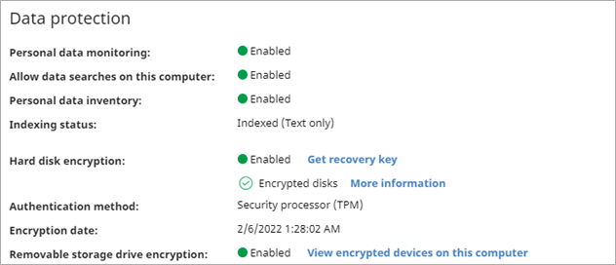
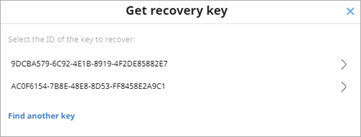
Find Another Recovery Key (Computer Details)
You can now find another key from the Get Recovery Key dialog box
To find another recovery key:
On the Computers > Details tab, click Get Recovery Key in the Data Protection section
In the Get Recovery Key dialog box, click Find Another Key

Slide 48
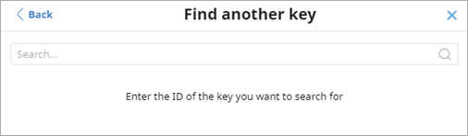
Find Another Recovery Key (Computer Details)
In the Find Another Key dialog box, enter the recovery key ID you want to find the key for
Press Enter You see the recovery keys for computers you have permission to see. Users with full visibility can also see deleted computers that the software no longer manages

Slide 49
Patch Management Enhancements

Slide 50
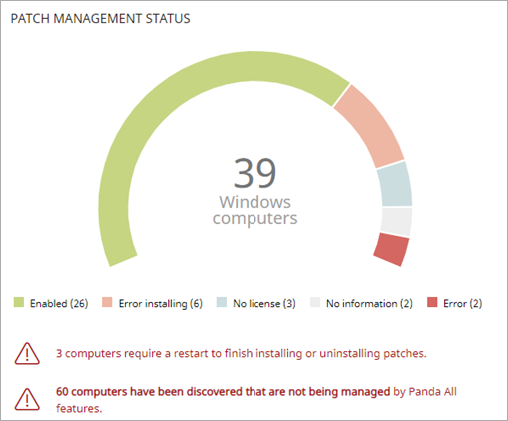
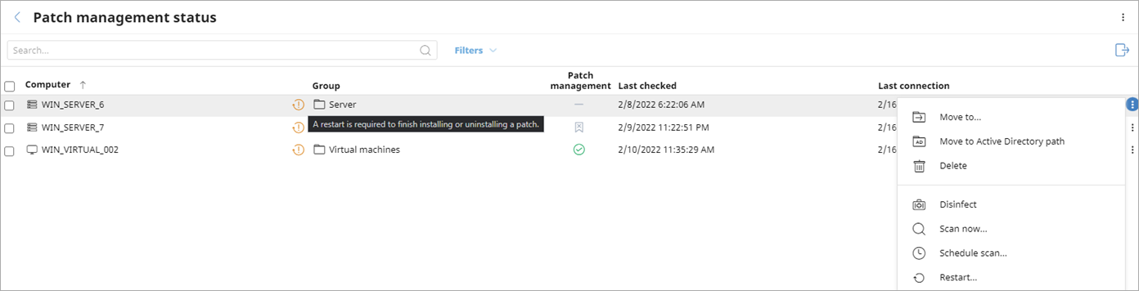
Patch Management
On the Patch Management dashboard, you can now see the number of devices that require a restart to complete installation of a patch
Click the link to open the Patch Management Status list filtered to show computers that need to restart
You can force a computer restart from the more options menu

Slide 51
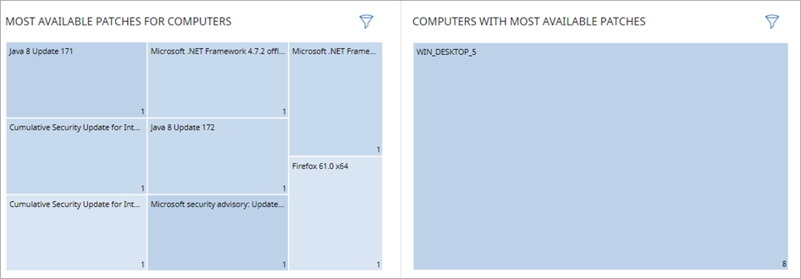
Patch Management – New Dashboard Tiles
On the Patch Management dashboard, two new tiles provide information on:
Most Available Patches for Computers
Computers with Most Available Patches
In these tiles, the patches or devices show in squares in descending order
Click a square in the tile to open a filtered Available Patches list
To filter the patches in a tile by Criticality, Computer Type, or Patch Type, click above the tile

Slide 52
Additional Patch Management Changes
In the Available Patches list, you can view installed patches or computers from the more options menu:
View installed patches of the computer
View computers with patch installed
In the Installation History list, users with the read-only role can now see the task for a specific patch
Patch Management is now end-of-life for Windows XP, Windows Vista, and Windows 2003 computers

Slide 53
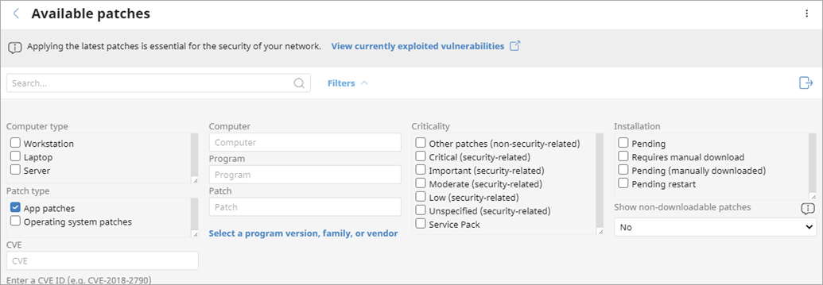
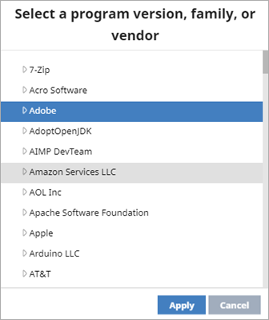
Available Patches List – Patch Filters
In the Available Patches list, you can now filter the list by Patch Type (app patches or operating system patches)
You can also filter the list by Program Version, Family, or Vendor

Slide 54
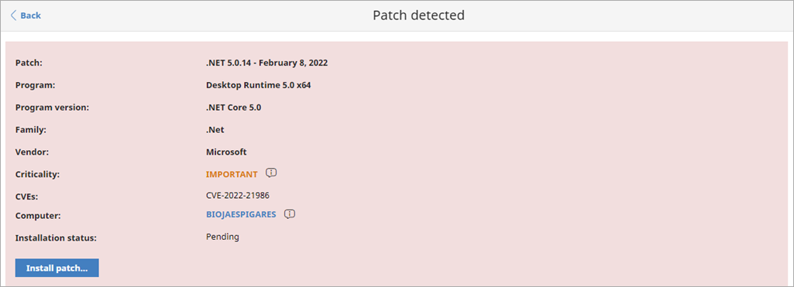
Program Version, Family, or Vendor Information
When you select an available patch, the program version, family, and vendor information shows in the Patch Detected details page

Slide 55
Additional Changes

Slide 56
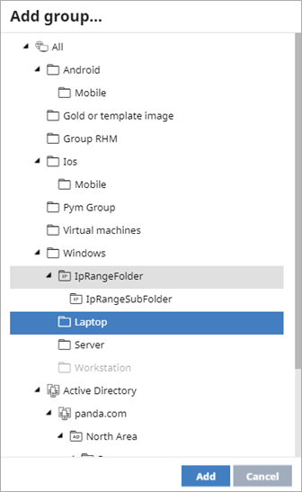
Filter Tasks Scheduled by Device Type
When you add a task, you can now filter the task to apply to specific device types
To create a task and filter by device type:
In the Recipients text box, to add computers and devices to scan, click the recipients or click No recipients selected yet The Recipients page opens
To see a list of the computers to scan, click View Computers
To add computer groups, above the box, click + The Add Group dialog box opens

Slide 57
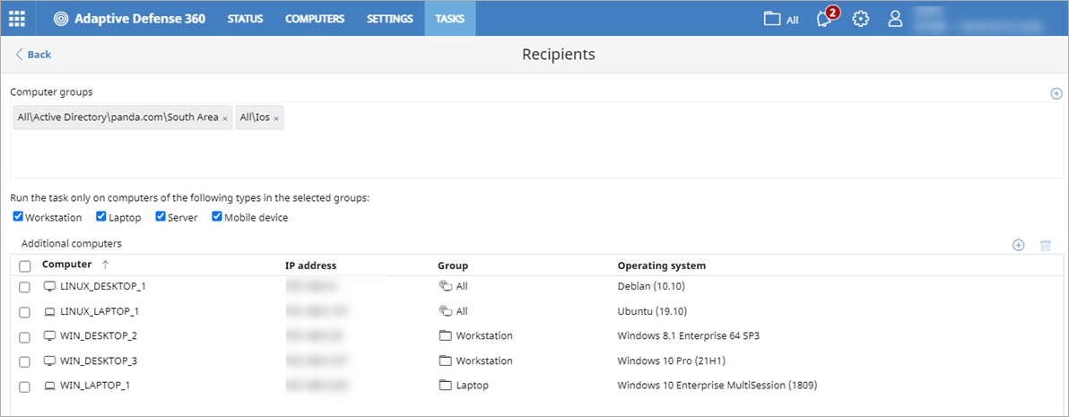
Filter Tasks Scheduled by Device Type
Select the computer groups you want to scan
Click Add The selected groups show in the Computer Groups box
To run the task only on a specific type of computer or device, select the check boxes for the device type you want to include (for example, Workstation, Laptop, Server, Mobile Device)

Slide 58
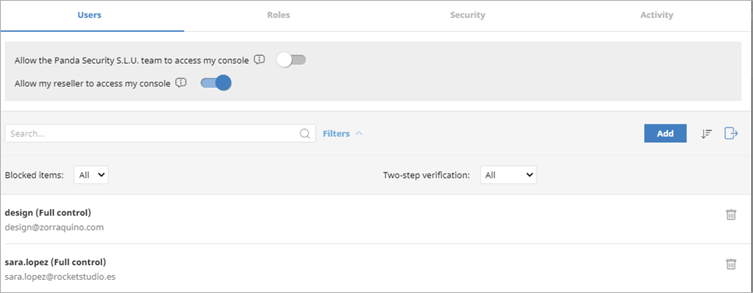
Changes to the Users List
You can now export, sort, and filter the Users list
You can use filters to show or hide Blocked Items and users with Two-step Verification enabled or disabled

Slide 59
Protection Installation Errors for Linux and macOS
You can now see installation errors when they occur for Linux and macOS devices
You can see error details in the Security Status list, on the computer details page, in alerts, and in tooltips in the UI
For more information, see this Knowledge Base article

Slide 60
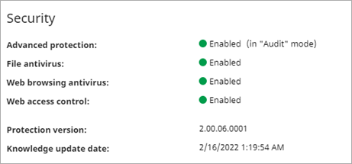
Linux Devices – Advanced Protection Mode Display
In the Advanced Protection settings for Linux computers, the operating mode when the device detects malicious activity now shows on the device details page and in the Security Status list
Possible modes include:
Audit – Reports detected threats, but does not block malware
Block – Reports and blocks detected threats (default option)
Do Not Detect – Does not detect or report malware

Slide 61
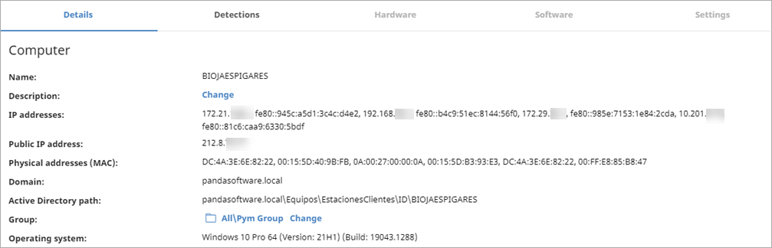
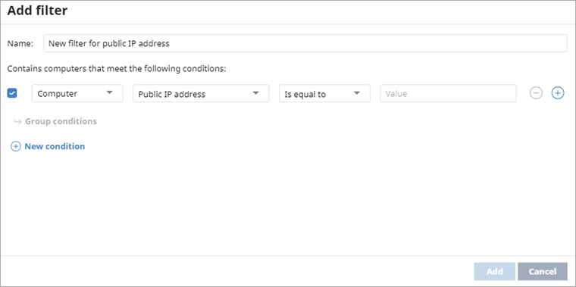
Public IP Address
The Public IP Address for computers (Windows, macOS, Linux) and mobile devices now shows in the computer details page
You can filter the list on the Public IP Address, and it is available in the exported file

Slide 62
New Protection for macOS Computers
There is new protection for macOS computers that run the Catalina operating system or higher
Includes a new local console and uses network extension technology to intercept network traffic
Can intercept traffic when connected by VPN, so web protection and URL filtering is available when using any VPN
Replaces SQUID, which was removed in macOS protection
Eliminates problems when you log into online services such as OneDrive or Google Drive

Slide 63
Network Extension Technology for macOS Computers
The macOS protection now includes network extension technology that must be allowed on all macOS computers
You must approve the use of this feature when you install or update to macOS protection to v3.00.00.0000 or higher
The network extension technology optimizes browsing speed and enables you to open URLs that use TLS 1.3 which can no longer be opened with SQUID technology

Slide 64
Deep Learning and ELAM
Deep learning is now included in Aether:
Deep learning is a machine learning technique that teaches computers to learn by example
Deep learning reduces the mean time to detect or discover (MTTD)
Deep learning reduces the false positives ratio
To strengthen anti-tampering, ELAM is now included in Aether 13:
Early launch anti-malware (ELAM) provides protection for computers in your network when they start up and before third-party drivers initialize
Supported in Windows 10 RS5 and higher
Supported in Windows Server 2019 and higher

