Slide 1
What’s new
Aether 12.1
16 November 2021

Slide 2
Aether 12.1 Updates
This presentation describes updates to these products:
Adaptive Defense / Adaptive Defense 360
Endpoint Protection / Endpoint Protection Plus
Partner Center
Cytomic products
This presentation does not describe:
Changes before Aether 12.1 (November 2021)
WatchGuard Endpoint Security products and Service Provider Endpoint Manager (see WatchGuard Endpoint Security What’s New presentation)
Some small bug fixes
For a complete list of enhancements and resolved issues, see Adaptive Defense 360 Release Notes

Slide 3
Release Summary – Enhancements
The Aether 12.1 release includes these enhancements:
Firewall exclusions in the IDS
Windows installer with an expiration date
Multi-segment repositories for Patch Management patches
Filter the Patch Management Installation History list for Last 7 days and Last month
Partners can send this report to their customers as part of the managed service they offer

Slide 4
Release Summary – Resolved Issues
The Aether 12.1 release includes these resolved issues:
In the web console (for example, Computer Details), Windows 11 devices now show correctly as Windows 11
Windows protection v8.00.19.0010 is required for new installations on ARM processors with Windows 11 (used in Surface devices and some specific laptops)

Slide 5
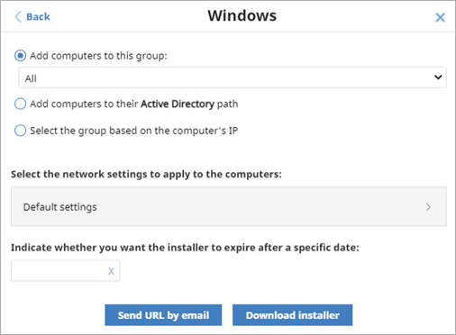
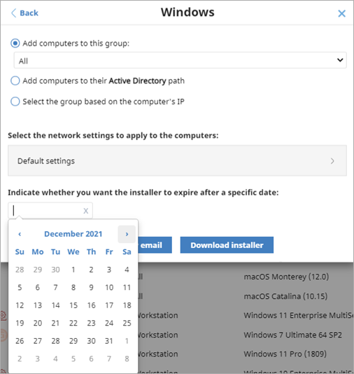
Installer with an Expiration Date
When you select Computers > Add Computers, you can now specify when the Windows installer file expires
After the expiration date, if users try to start the installer, a message informs them that the installer is expired, and they should download a new one or contact their administrator

Slide 6
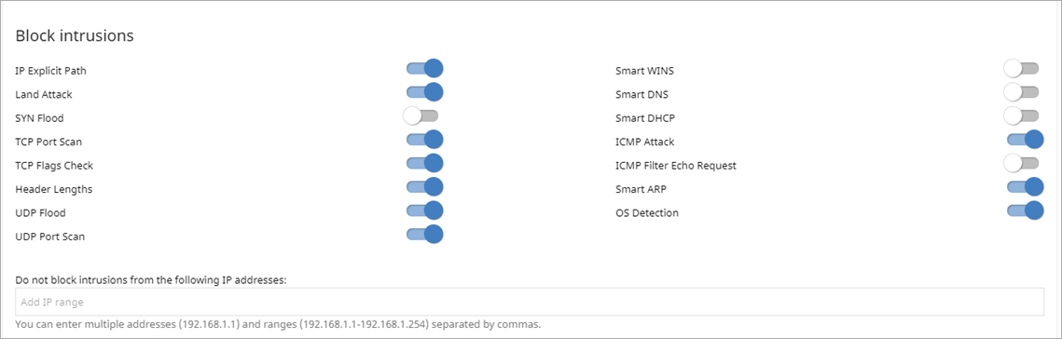
Firewall Exclusions in the IDS
The intrusion detection system (IDS) enables administrators to detect and reject malformed traffic that is specifically crafted to impact the security and performance of protected computers
In the Firewall settings of a Workstations and Servers settings profile, you can now add exclusions to the blocked intrusions list
Add IP addresses in the text box, or an IP range, separated by commas
This feature requires Windows protection v8.00.19.0010 or higher

Slide 7
Multi-Segment Repositories for Patch Management
A computer with the cache role can now send patches to every computer in the customer network, regardless of the subnet it belongs to

Slide 8
Partner Center

Slide 9
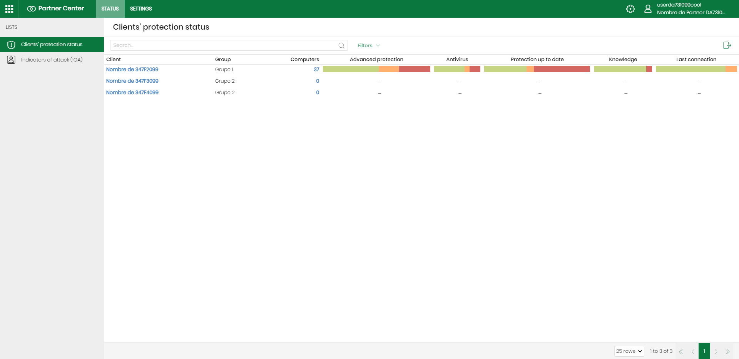
Client Protection Status
On the Status page, you can filter and review protection information for your clients
In the Client column, select the client name to open the client web console
In the Computers column, select the number of computers to see a list of the computers in the client account

Slide 10
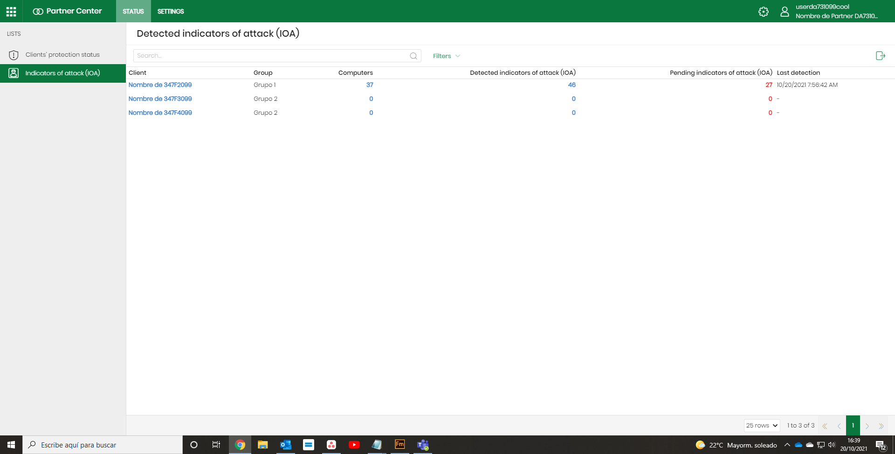
Indicators of Attack Status
On the Status page, you can see a list of the detected Indicators of Attack (IOA) for each client account, including the number of affected computers
In the Client column, select the client name to open the web console
In the Computers column, select the number of computers to see a list of the affected computers in the web console

Slide 11
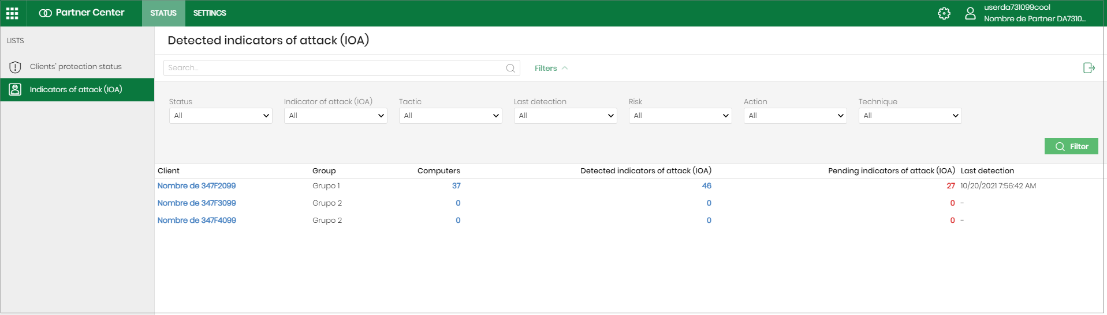
Filter the Detected Indicators of Attack List
To filter the list:
From the top navigation bar, select Status
From the left pane, select Indicators of Attack
Click Filters
Select options to filter the list
Click Filter

Slide 12
Detected Indicators of Attack — Filter Options
Select options from these drop-down lists:
Status — Select the status you want to filter the list for (All, Pending, Archived)
Risk — Select an option to filter the list for the risk level of the IOA (Critical, High, Medium, Low, Unknown)
Indicator of Attack — Select an option to filter the list for a specific IOA (or select All)
Action — Select an option to filter the list for the action taken by WatchGuard Endpoint Security (Reported, Attack Blocked, All)
Tactic — Select an option to filter the list for the MITRE tactic (the goal of a technique)
Technique — Select an option to filter the list for the MITRE technique (the method that an adversary uses to achieve a tactical objective)
Last Detection — Select an option to filter the list for accounts that last detected an IOA (last 24 hours, last 7 days, or last month)

