Slide 1
What’s new in aether 11
Updated: 22 December 2020

Slide 2
Aether Updates
This presentation describes updates to Aether products, including:
Adaptive Defense / Adaptive Defense 360
Endpoint Protection / Endpoint Protection Plus
Full Encryption
Data Control
This presentation does not describe:
Changes before Aether 11 (December 2020)
Changes to Partner Center
Some small bug fixes
For a complete list of enhancements and resolved issues, see the Adaptive Defense 360 Release Notes

Slide 3
Configure Authorized Software
In advanced protection hardening and lock modes, Adaptive Defense 360 prevents the execution of unknown programs until classification is complete
Use the new Authorized Software permission to proactively prevent Adaptive Defense 360 from blocking unknown files such as:
Organization-specific software, software that generates new executables or libraries with different content and names, or software that downloads new libraries when using a specific feature
We recommend that you use the Authorized Software feature instead of file exclusions
Exclusions are not monitored and could potentially allow malware entry
Use exclusions to resolve performance or compatibility issues only
Supported in Adaptive Defense 360, Adaptive Defense

Slide 4
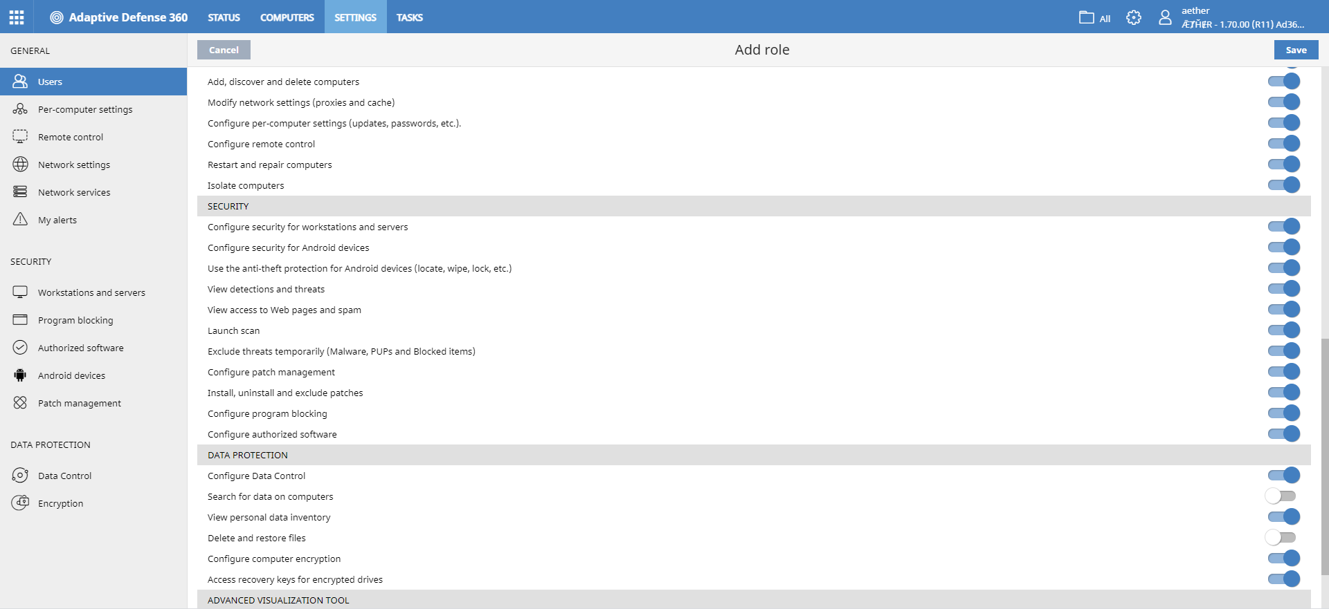
Configure Authorized Software Permission
Select the Configure Authorized Software permission to create, edit, delete, and assign authorized software configurations for Windows computers and servers
Supported in Adaptive Defense 360, Adaptive Defense

Slide 5
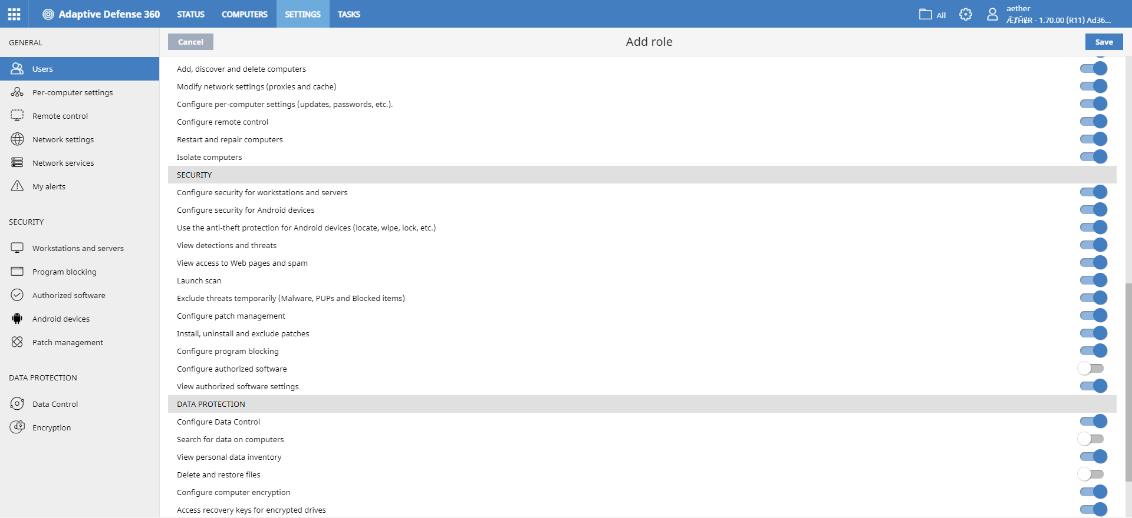
View Authorized Software Settings
Select the View Authorized Software Settings permission to view authorized software configurations for Windows computers and servers
Supported in Adaptive Defense 360, Adaptive Defense

Slide 6
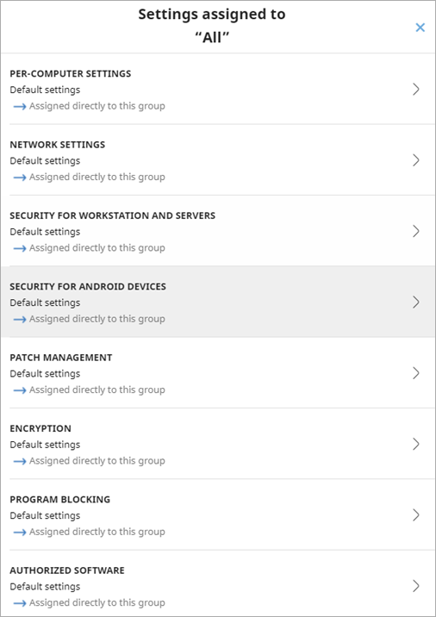
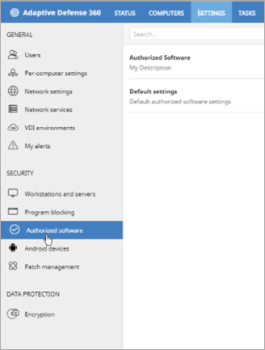
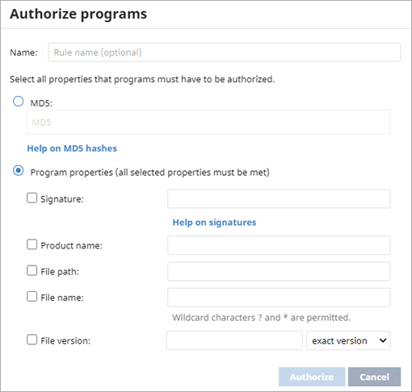
Configure Authorized Software
You can create and assign authorized software configurations for Windows computers and servers
Select which computers are affected and the files you do not want to block, based on these file properties:
MD5
Digital signature
Name
Route
Version
Supported in Adaptive Defense 360, Adaptive Defense

Slide 7
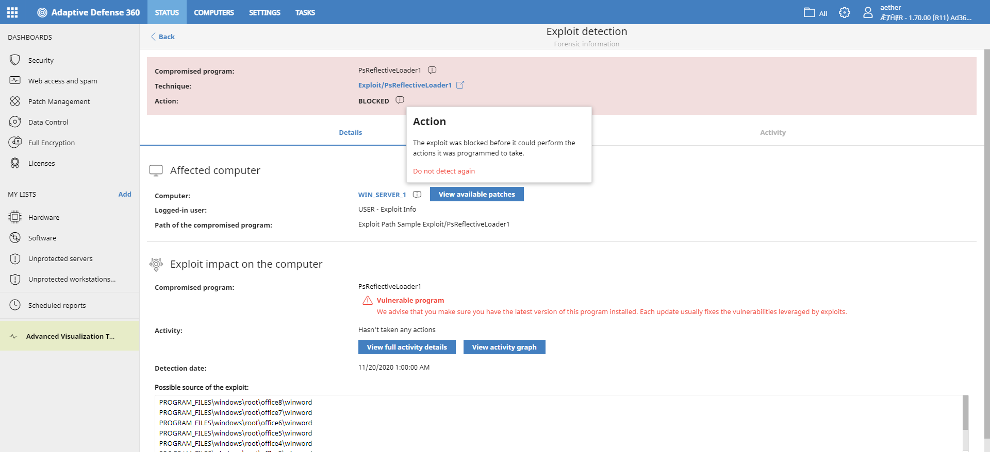
Exclude Exploit Detection Techniques
You can now exclude detections for an exploitation technique in a specific program
You can include an exploitation technique at any time
Supported in Adaptive Defense 360, Adaptive Defense

Slide 8
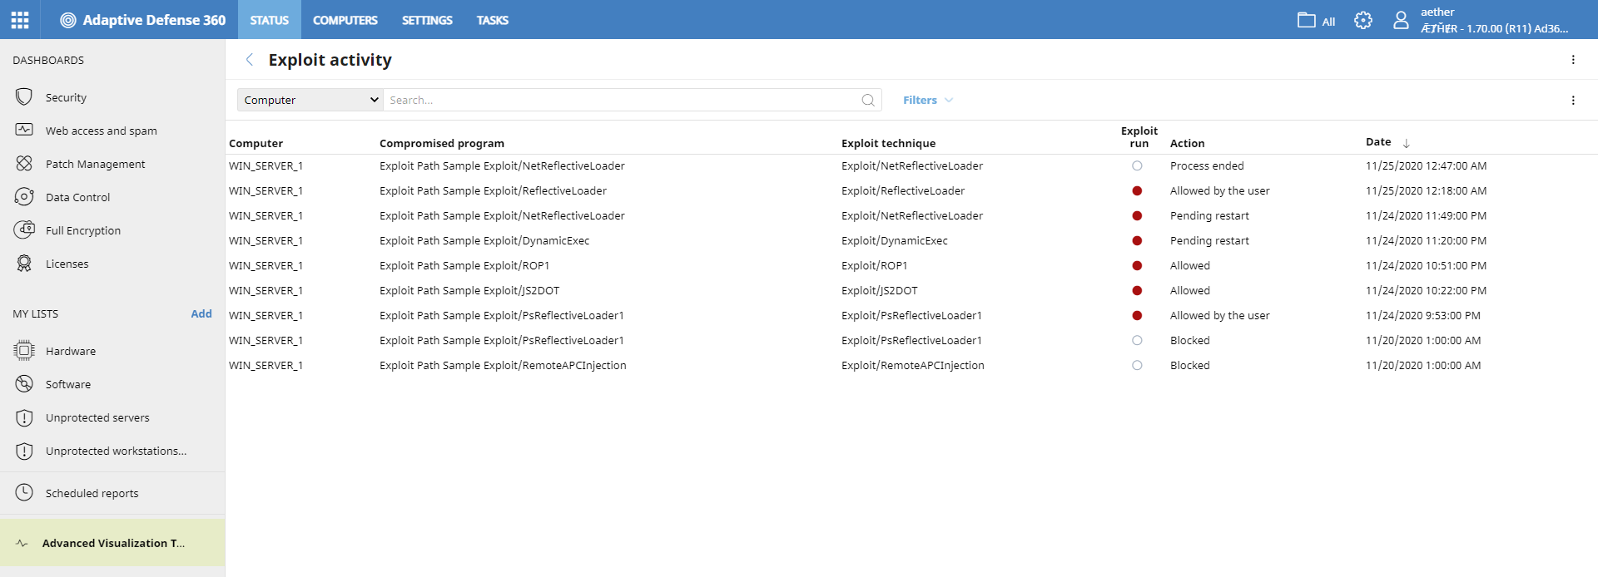
View Exploit Detection Techniques
On the Status page, the Programs allowed by administrator tile and table list exploitation techniques
The Exploit activity table and details of individual exploits now include the exploitation technique
Supported in Adaptive Defense 360, Adaptive Defense

Slide 9
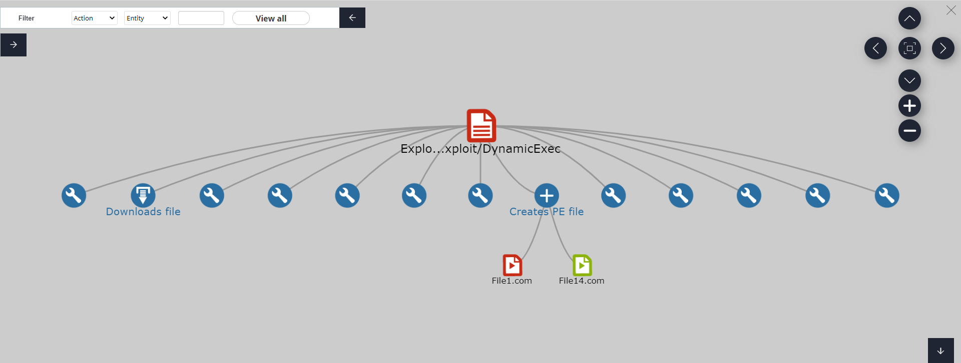
Graph of Exploit Actions Executed
Select an exploit to view forensic information
Select View Activity Graph to see the actions executed by the exploit in hierarchical format
Supported in Adaptive Defense 360, Adaptive Defense

Slide 10
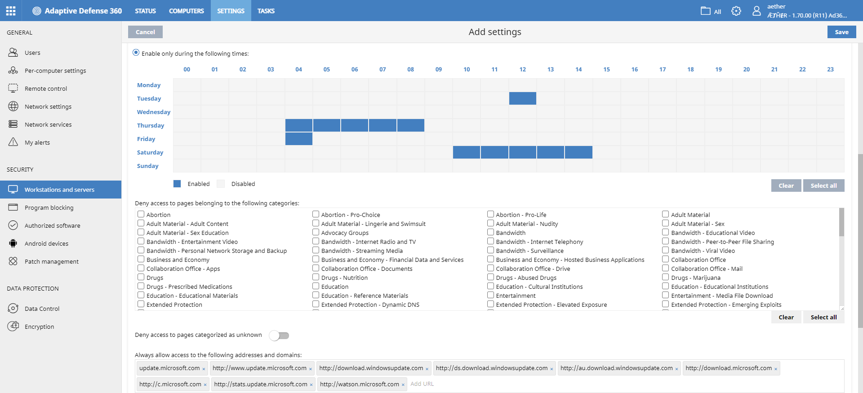
New URL Filtering from Forcepoint
Forcepoint URL Filtering replaces the Cyren web filter engine
Forcepoint URL Filtering limits access to websites based on more than 160 categories and reputation rankings
Customers who do not upgrade can continue to use the Cyren web filter engine
Supported in Adaptive Defense 360, Endpoint Protection Plus

Slide 11
Map Forcepoint Categories to Cyren Categories
When you upgrade to Forcepoint, categories that were selected in Cyren are mapped to the appropriate Forcepoint category
There are new Forcepoint categories which only work if the endpoint is updated to the latest software
Some Forcepoint categories were removed as we do not intercept URLs in HTTPS (only domains)
On the Workstations and Servers > Antivirus page, some Forcepoint categories are associated with Web browsing antivirus and Phishing checks
Supported in Adaptive Defense 360, Endpoint Protection Plus

Slide 12
Report False Positives or Negatives
False positives and false negatives can be reported for specific URLs through a Technical Support Forcepoint account
We do not send URLs automatically to Forcepoint when malware or phishing emails are detected
Supported in Adaptive Defense 360, Endpoint Protection Plus

Slide 13
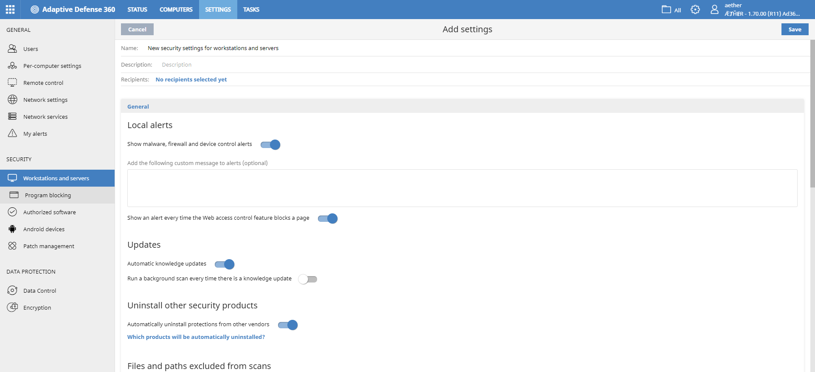
Web Page Access Control
With both Forcepoint and Cyren engines, you can add a custom message or turn off local alerts when Web Access Control blocks a page
This disables local alerts that appear when a user tries to go to a blocked HTTPs page
Supported in Adaptive Defense 360, Endpoint Protection Plus

Slide 14
Support for Windows on ARM Computers
Aether products are now compatible with ARM-based versions of Windows 10 (Pro and Home)
In the web console, you can filter the new Architecture column for these values: X86, X64, ARM
A broad set of Linux distributions as well as the latest macOS (Big Sur) are already supported
Support for the macOS on ARM will be available in a future release
Supported on all Aether-based products

Slide 15
Windows on ARM – Limitations
Only Microsoft and WatchGuard offer protection for Windows on ARM computers
With this release, all features work, with the exception of some Patch Management functionality and anti-exploit
Partial support for Patch Management
Operating system patches are not detected
Only 32-bit patches can be installed
For third-party applications, 32-bit and 64-bit patches are detected
Supported on all Aether-based products

Slide 16
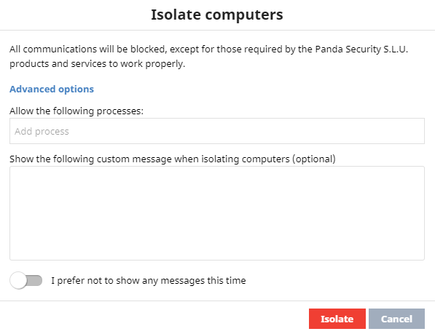
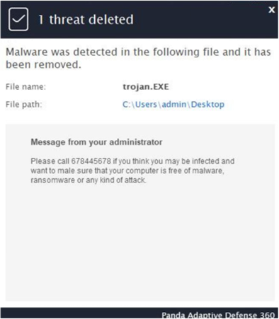
Customized Warning Messages
You can now specify warning text to display to the user when you isolate the user computer, and when Adaptive Defense 360 detects:
A threat with the antivirus engine on the user computer
A threat with the Advanced Protection Engine (Behavior Analysis, Anti-exploit, and Advanced Security Policies) on the user computer
An attack with the firewall on the user computer
A connected device on the user computer with Device Control
Execution of a locked program on the user computer
Supported on all Aether-based products

Slide 17
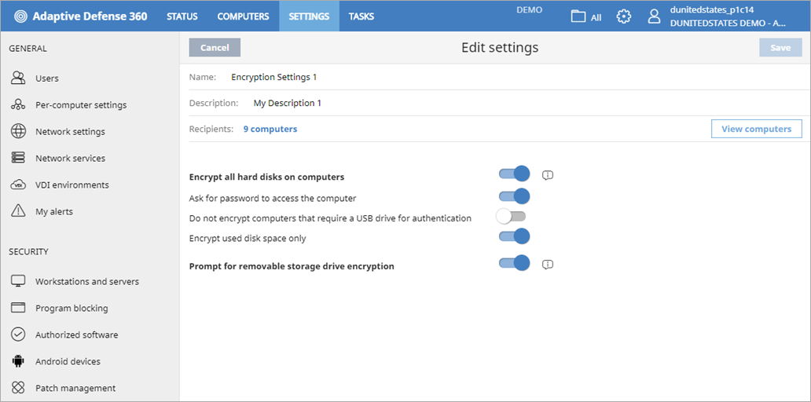
Encryption of Removable Storage (USB) Devices
In the Full Encryption module, you can now enable encryption of USB devices with BitLocker, independent of the current computer encryption setting
The number of Full Encryption licenses required corresponds to the number of machines where disk encryption or USB encryption is enabled
If you want to use USB encryption for a computer or server, it must have BitLocker installed
BitLocker comes preinstalled on many operating systems, such as Windows 7 Ultimate and Enterprise, Windows 8.1 Pro and Enterprise, and Windows 10 Pro
Supported on all Aether-based products

Slide 18
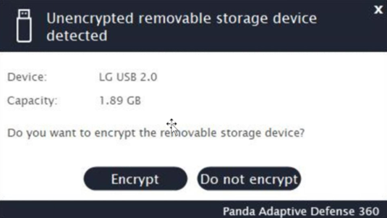
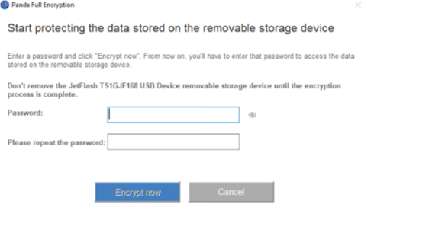
Password Protected Encryption
After you enable encryption of USB devices, when the user inserts a USB device, the user is prompted to encrypt the device and enter a password
Do not remove the USB device during the encryption process
All used space in all partitions in the USB device are encrypted
All partitions are protected with the same password
Supported on all Aether-based products

Slide 19
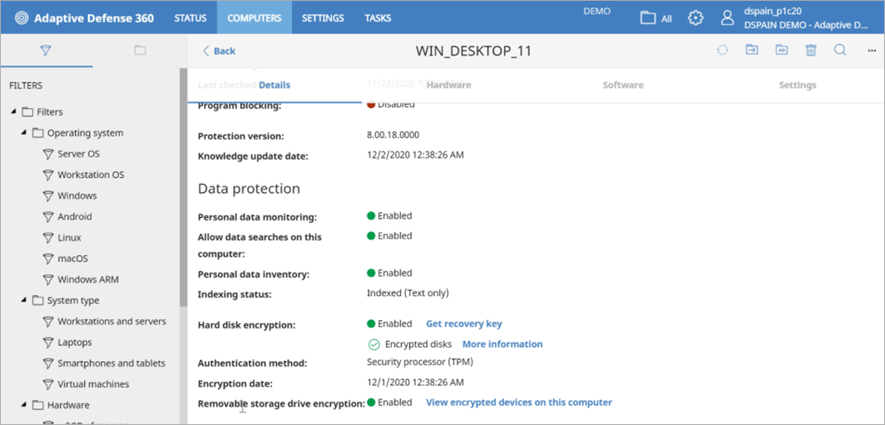
Recovery Key
If the user forgets the password, a unique recovery key is available for all partitions of the encrypted USB device
The recovery key is available from the Computer Details page for the device where the USB was encrypted
Recovery keys are never deleted
Supported on all Aether-based products

Slide 20
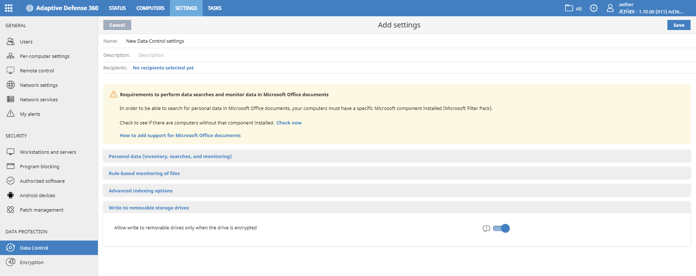
Enforce Encryption on USB Devices with Data Control
In the Data Control module, you can prevent writing to a USB device if it is not previously encrypted with Full Encryption or BitLocker
Supported on all Aether-based products

Slide 21
Decryption of Removable Storage Devices
USB devices are not automatically decrypted when USB decryption or Full Encryption is disabled, or the Adaptive Defense 360 license expires
Decrypt the USB device with the password in BitLocker
Supported on all Aether-based products

Slide 22
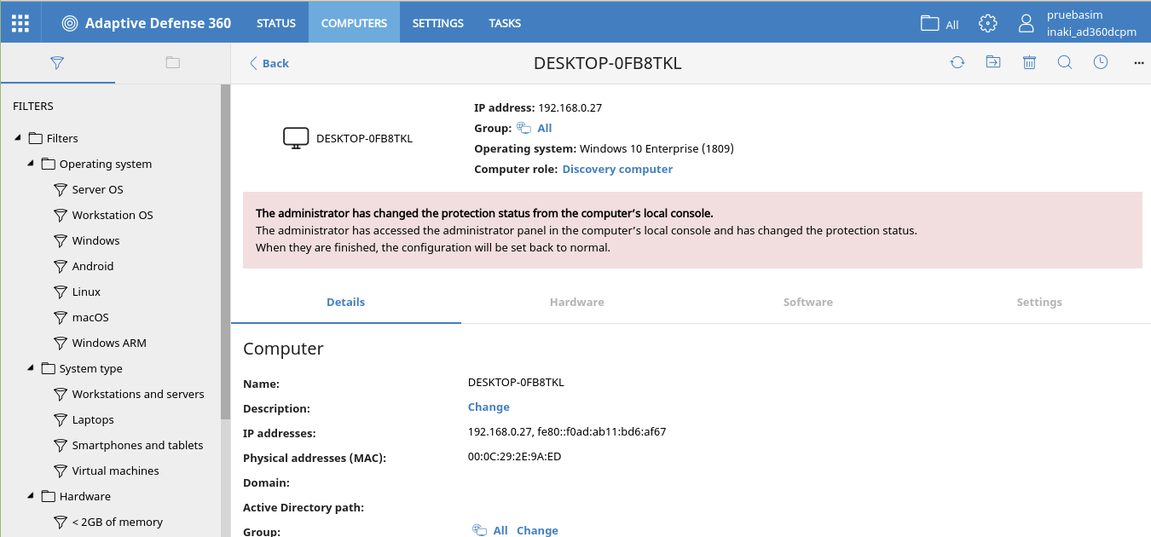
Improved Computer Protection
On Windows computers, you can inform the web console of configuration changes made from the management computer
When a protected computer does not have access to the network, it now uses a local cache of approved software to not block known files
Supported on all Aether-based products

Slide 23
Copy Comma Separate Values
In the web consoles, you can now copy multiple, comma-separated values from a text box to the clipboard
Supported on all Aether-based products

Slide 24
Separate Help for Endpoint Protection & Endpoint Protection Plus
To improve readability, the online help for Endpoint Protection and Endpoint Protection Plus are now separate help systems
https://www.pandasecurity.com/enterprise/downloads/docs/product/help/endpointprotection/v11/EN/index.htm
https://www.pandasecurity.com/enterprise/downloads/docs/product/help/endpointprotectionplus/v11/EN/index.htm
Supported on all Aether-based products

Slide 25
Programs Allowed by the Administrator
In the Programs allowed by the administrator table and History of programs allowed by the administrator table, the Current classification column was renamed to Classification
The column shows the last classification that was calculated
Supported on all Aether-based products

Slide 26
Thank you

