Slide 1
What’s new in fireware 12.9

Slide 2
What’s new in Fireware v12.9
Multi-Factor Authentication for Management Server
DNS Forwarding Policy
Mobile VPN with IKEv2 Split Tunneling
Mobile VPN with IKEv2 DNS Suffix
Routing Engine Update
Routing Link Detection
IP Spoofing Check
Endpoint Enforcement UI Updates
Enable Intra-interface Inspection on Interfaces
LDAP Server Client Certificate Support
spamBlocker Spam ID in Log Messages
Blocked Sites List Enhancement

Slide 3
What’s new in Fireware v12.9
Cloud Connect in the Feature Key

Slide 4
What’s new in Fireware v12.9
Fireware v12.9 is available for these Firebox models:
Firebox M Series: M270, M290, M370, M390, M400, M440, M470, M500, M570, M590, M670, M690, M4600, M4800, M5600, M5800
Firebox T Series: T20, T40, T55, T70, T80
Firebox NV5
FireboxV and Firebox Cloud
Fireware v12.9 does not support these models:
Firebox T10, T15, T30, T35, T50, M200, M300
We continue to support these models with Fireware v12.5.x firmware. For more information, see this KB article

Slide 5
Multi-Factor Authentication for Management Server

Slide 6
Multi-Factor Authentication Support for Management Server
To enhance login security, you can now configure RADIUS servers and use multi-factor and RADIUS challenge/response authentication with the WatchGuard Management Server
RADIUS authentication support on the Management Server enables you to:
Support multi-factor authentication services such as AuthPoint
Supports password only (non-MFA), One-Time Password (OTP) when combined with a password, and push notifications
Support RADIUS authentication servers for traditional password challenge/response authentication
Use shared authentication sessions for the Management Server, WatchGuard System Manager (WSM), Policy Manager, Firebox System Manager (FSM), and other applications (except for WebCenter)
Requires WatchGuard System Manager 12.9 or higher

Slide 7
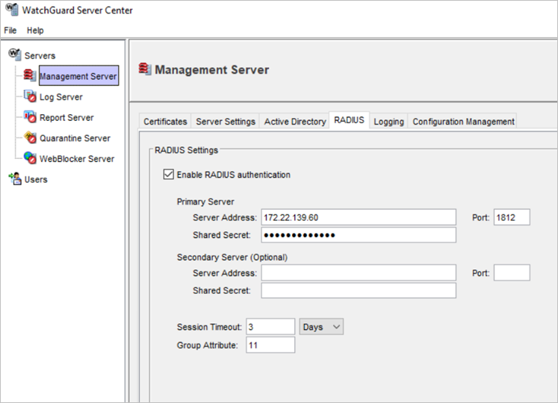
Multi-Factor Authentication Support for Management Server
In the Management Server configuration in WatchGuard Server Center, you can configure RADIUS authentication servers on a new RADIUS tab
Session Timeout specifies the amount of time the authentication session is valid before re-authentication is required
If you authenticate by group instead of user name, the Group Attribute is the RADIUS attribute used to match the group name (default is 11)

Slide 8
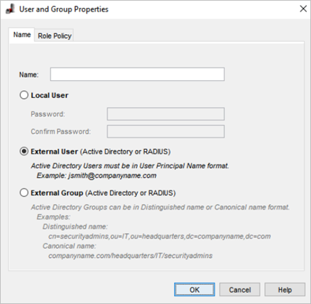
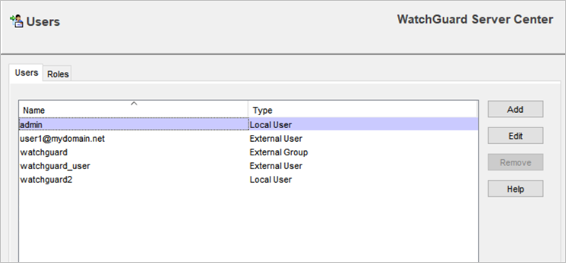
Multi-Factor Authentication Support for Management Server
You can configure external RADIUS users and groups on the Management Server, in addition to the existing support for Active Directory

Slide 9
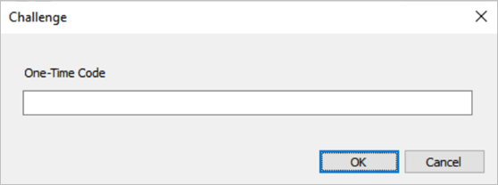
Multi-Factor Authentication Support for Management Server
RADIUS Challenge/Response
The challenge from the RADIUS server appears to the user
The RADIUS server sends the one-time code to the user in an email or other delivery method
The user enters their code, which is sent back to the RADIUS server
Supports multiple rounds of challenges and responses

Slide 10
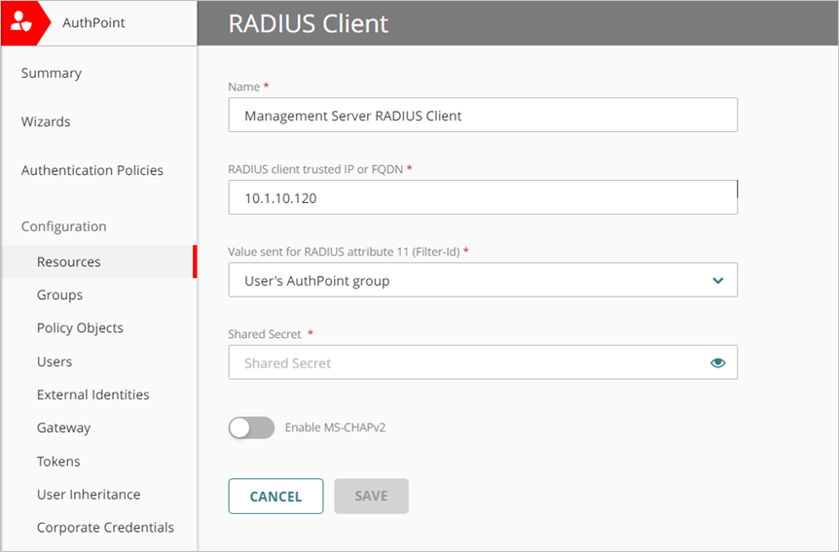
Multi-Factor Authentication Support for Management Server
AuthPoint Integration
To integrate AuthPoint MFA with the Management Server:
In AuthPoint, add a RADIUS Client resource:
Specify the WatchGuard Management Server IP address as the RADIUS Client Trusted IP or FQDN
Select User’s AuthPoint Group as the value to send for RADIUS group attribute 11
Specify a shared secret that the RADIUS server (AuthPoint Gateway) and the RADIUS client (WatchGuard Management Server) will use to communicate

Slide 11
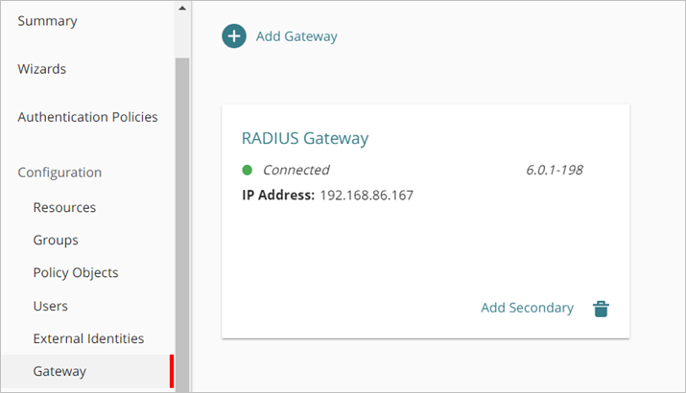
Multi-Factor Authentication Support for Management Server
AuthPoint Integration
Download and install the AuthPoint Gateway
Make sure to add your RADIUS client resource to the AuthPoint Gateway

Slide 12
Multi-Factor Authentication Support for Management Server
AuthPoint Integration
Add the RADIUS resource to your existing AuthPoint authentication policies, or add new authentication policies for the RADIUS resource
Authentication policies in AuthPoint specify which resources users can authenticate to and which authentication methods they can use
If you enable the push and OTP authentication methods for an AuthPoint authentication policy, your RADIUS resource uses push notifications to authenticate users

Slide 13
Multi-Factor Authentication Support for Management Server
AuthPoint Integration
Configure the Management Server RADIUS settings with the AuthPoint Gateway IP address and the shared secret you specified in your RADIUS client resource

Slide 14
Multi-Factor Authentication Support for Management Server
WatchGuard System Manager will try to log in with this authentication priority:
A local user
An Active Directory user (if Active Directory is enabled)
A RADIUS user (if RADIUS is enabled)
If you enable both Active Directory and RADIUS authentication, and both methods can authenticate with the same user name and password, then RADIUS authentication takes priority for multi-factor authentication

Slide 15
Multi-Factor Authentication Support for Management Server
After you start an authenticated session with WatchGuard System Manager (WSM):
Any new sessions you start from Firebox System Manager (FSM), Policy Manager, or other applications, share the same authentication session
A new authentication session is not started
Sessions are only shared from WatchGuard System Manager (WSM) as the parent application to the other applications
For example, if you authenticate a session in Policy Manager, it does not share the session with WSM or FSM
WebCenter is the exception and uses a separate authentication session

Slide 16
DNS FORWARDING POLICY

Slide 17
DNS Forwarding Policy
When you enable DNS Forwarding, a policy named Allow DNS-Forwarding now appears in the policy list
In previous Fireware releases, the DNS Forwarding policy was hidden
Because you can now see and configure this policy, you have more granular control of sources for forwarding
You can now apply this policy to DNS traffic when DNS forwarding is enabled
For example, you might want to exclude IoT devices from DNS forwarding

Slide 18
DNS Forwarding Policy
If you enable DNS Forwarding before you upgrade to Fireware v12.9, the Allow DNS-Forwarding policy appears after you upgrade
If you disable DNS Forwarding, the policy does not appear in the policy list

Slide 19
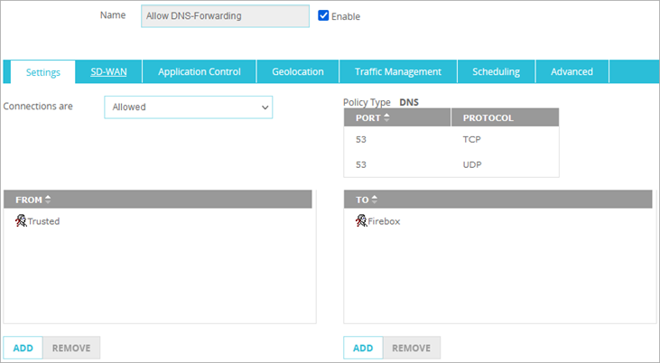
DNS Forwarding Policy
The policy allows DNS traffic (TCP and UDP traffic on port 53) to the Firebox from interfaces that you specify in the DNS Forwarding configuration

Slide 20
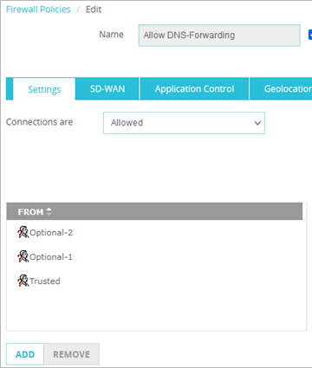
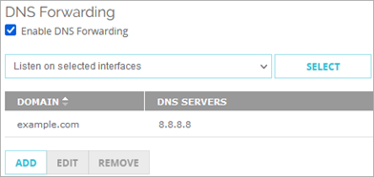
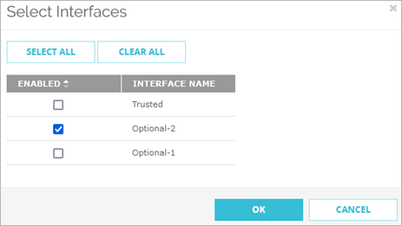
DNS Forwarding Policy
If you edit the policy to add interfaces to the From list, those interfaces do not appear in the DNS Forwarding configuration
Edit the policy to add interfaces
DNS Forwarding configuration does not show the added interfaces

Slide 21
DNS Forwarding Policy
Log messages for this policy are now generated by the Allow DNS-Forwarding policy
In previous Fireware versions, log messages were generated by the hidden DNS forwarding policy

Slide 22
Mobile VPN with Ikev2 Split Tunneling

Slide 23
Mobile VPN with IKEv2 Split Tunneling
In the Mobile VPN with IKEv2 configuration on the Firebox, you can now configure split tunneling
When you configure a split tunnel, traffic destined for internal resources that you specify goes through the tunnel
The Firebox inspects this traffic
Other traffic, which includes Internet traffic, does not go through the VPN tunnel
The Firebox does not inspect this traffic

Slide 24
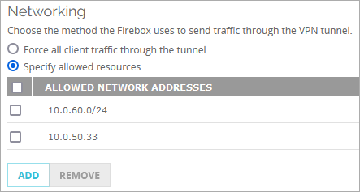
Mobile VPN with IKEv2 Split Tunneling
To configure a split tunnel:
Open the Mobile VPN with IKEv2 configuration
Select Specify allowed resources
Click Add
Enter a host or network IP address
Repeat these steps to add more IP addresses

Slide 25
Mobile VPN with IKEv2 Split Tunneling
After you specify allowed resources in the Firebox configuration:
The allowed resources are added to new Firebox security policies
The IPSec SA still shows the 0.0.0.0/0 traffic selector, but traffic is controlled by the security policy
The Firebox drops traffic that does not match the policies

Slide 26
Mobile VPN with IKEv2 Split Tunneling
Next, update the VPN clients:
Download the VPN client configuration files from the Mobile VPN with IKEv2 configuration on the Firebox
Install the VPN client configuration files on user computers on your network
After you install the client configuration files:
The allowed resources are added to the Windows routing table on the client only when the connection is established
These routes are bound to the specified VPN connection on the client
If the user computer has multiple VPN connections configured, these routes are not bound to the other VPN connections
Routes are deleted from the Windows routing table when the connection disconnects

Slide 27
Mobile VPN with IKEv2 Split Tunneling
If you edit the Allowed Resources list on the Firebox after you download and install the client configuration files on user computers:
Download updated client configuration files from the Firebox and reinstall those on user computers
If you remove a host or network from the Allowed Resources list, but you do not install updated client configuration files on user computers, VPN clients can initiate traffic to that host or network, but the Firebox denies the traffic

Slide 28
Mobile VPN with IKEv2 Split Tunneling
The client configuration files that you can download from the Firebox now have components that support split tunneling:
Microsoft — The .bat configuration script now includes commands and a parameter that enable split tunneling and add the VPN routes
macOS and iOS — The .mobileconfig profile now includes a key that indicates clients should use the routes sent by the Firebox
Android — The strongSwan .sswan profile now includes a section that adds the VPN routes
Only the strongSwan client app for mobile devices supports this option
The strongSwan client for Linux does not support this option

Slide 29
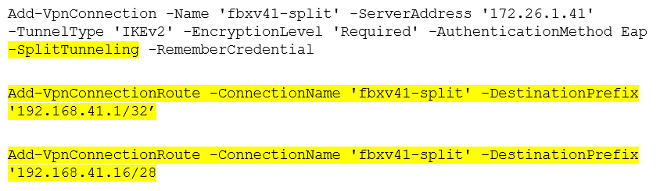
Mobile VPN with IKEv2 Split Tunneling
To support split tunneling, the client configuration file for Microsoft clients now includes the highlighted commands and parameters
For more information about these commands and parameters, see the Microsoft documentation:
Add-VpnConnection
Add-VpnConnectionRoute
Add-VpnConnectionRoute

Slide 30

Mobile VPN with IKEv2 Split Tunneling
To support split tunneling, the client configuration profile for macOS and iOS clients now includes this key
The client profile for Android clients now includes a split tunneling section

Slide 31
Mobile VPN with Ikev2 DNS Suffix

Slide 32
Mobile VPN with IKEv2 DNS Suffix
The Mobile VPN with IKEv2 client configuration files for Windows, iOS, and macOS can now include a domain name suffix
You must first specify a domain name in the network (global) DNS settings on the Firebox
The client configuration files that you download from the Firebox use this setting to define the suffix for VPN clients
The strongSwan client for Android does not have an option to set the domain name suffix

Slide 33
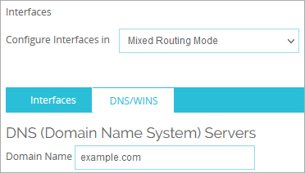
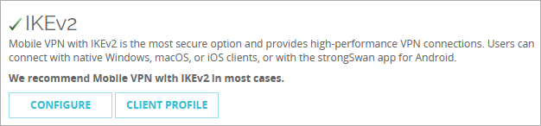
Mobile VPN with IKEv2 DNS Suffix
To include a domain name suffix in the client configuration files:
Specify a domain name suffix in the global DNS settings on the Firebox
On the Mobile VPN selection page, select Client Profile to download the Mobile VPN with IKEv2 client configuration files

Slide 34
Mobile VPN with IKEv2 DNS Suffix
Install the VPN client profile on the user computer:
For Windows, run the .bat script
For macOS or iOS, install the .mobileconfig profile

Slide 35
Mobile VPN with IKEv2 DNS Suffix
In the client configuration files, these settings define the suffix that VPN clients use:
Microsoft
In the automatic configuration script (.bat file) for Microsoft VPN clients, the -DnsSuffix attribute in the Add-VpnConnection PowerShell command sets the domain name suffix
macOS and iOS
In the configuration profile (.mobileconfig file) for macOS and iOS VPN clients:
The DomainName key in the IKEv2 dictionary value sets domain name suffix. The DomainName key is available in iOS 10.0 or higher and macOS 10.12 or higher
A new DNS dictionary is added. The DomainName, SearchDomains, and ServerAddress keys are set in DNS dictionary
The ServerAddresses key is mandatory, which means you must configure the DNS address in the DNS settings on the Firebox or in the IKEv2 mobile VPN configuration file for macOS and iOS devices to use the configured DNS suffix

Slide 36
Mobile VPN with IKEv2 DNS Suffix
macOS and iOS
Example
<key>DNS</key>
<dict>
<key>ServerAddresses</key>
<array>
<string>8.8.8.8</string>
</array>
<key>SearchDomains</key>
<array>
<string>fbxv1.example.net</string>
</array>
<key>DomainName</key>
<string>fbxv1. example.net</string>
</dict>

Slide 37
ROUTING ENGINE Update

Slide 38
Routing Engine Update
Fireware now uses the Free Range Routing (FRR) routing engine, which replaces Quagga
FRR has several benefits:
More frequent security updates and patches
A common routing engine for static and dynamic routing
Richer features, such as Bidirectional Forwarding (BFD)

Slide 39
Routing Engine Update – Dynamic Routing
If your configuration includes Quagga commands for dynamic routing, those commands work after you upgrade to Fireware v12.9
In some cases, FRR converts Quagga commands
For example, in FRR, the network and redistribute commands are under the address-family section
FRR converts your existing Quagga commands in this case, but if you add new network and redistribute commands after you upgrade to Fireware v12.9, make sure to add those under the address-family section
router bgp 26 bgp router-id 169.254.1.26 neighbor 169.254.1.53 remote-as 53 ! address-family ipv4 unicast network 10.4.0.0/24 redistribute static redistribute ospf exit-address-family exit

Slide 40
Routing Engine Update – Dynamic Routing
With FRR, the Firebox cannot learn or announce routes unless you add inbound or outbound BGP filtering policies for the eBGP session
If you prefer not to add BGP policies, you can add this command, which removes the policy requirement: no bgp ebgp-requires-policy
When you upgrade to Fireware v12.9, if you have an existing BGP configuration, the Firebox adds the no bgp ebgp-requires-policy command automatically
If you add a new BGP configuration after you upgrade to Fireware v12.9, you must manually add this command to remove the policy requirement
router bgp 26 no bgp ebgp-requires-policy bgp router-id 169.254.1.26 neighbor 169.254.1.53 remote-as 53 ! address-family ipv4 unicast redistribute static exit-address-family exit

Slide 41
Routing Engine Update – Dynamic Routing
In FRR, the command bgp network import-check is enabled by default
When this setting is enabled, routes created by the network command must be validated before those routes can be advertised to neighbors
If your Firebox includes an existing BGP configuration, and you upgrade from Fireware v12.8.2 or lower to Fireware v12.9 or higher, the configuration conversion automatically disables bgp network import-check
If you add a new BGP configuration in Fireware v12.9 or higher, we recommend that you manually disable this setting so that BGP peers can learn Firebox routes
To disable this setting, use the command no bgp network import-check

Slide 42
Routing Engine Update – OSPF Cost
With FRR, the OSPF cost is the reference bandwidth divided by the interface bandwidth
The reference bandwidth is 100 Gbps
Example:
Interface Type | Bandwidth | OSPF Cost
Physical Interface | 100 Gbps | 1
 | 10 Gbps | 10
 | 1 Gbps | 100
VPN Virtual Interface | n/a | 10

Slide 43
Routing Engine Update – Bidirectional Forwarding (BFD)
Bidirectional Forwarding (BFD) is a network protocol used to detect faults between two routers or switches connected by a link
With this release, you can use a simplified version of BFD:
Add a new firewall policy
In the policy, specify the BFD protocols (UDP 3784 and 4784)
In the From list, specify the interface that receives OSPF or BGP messages from neighbors
In the To list, specify the Firebox

Slide 44
Routing Engine Update – Bidirectional Forwarding (BFD)
Next, enable BFD in either OSPF or BGP
For OSPF, enable BFD in the interface context:
interface vlan20
ip ospf bfd
Exit
For BGP, append the BFD keyword in the neighbor command line:
router bgp 26
bgp router-id 169.254.1.26
neighbor 169.254.1.53 remote-as 53
neighbor 169.254.1.53 bfd
!
address-family ipv4 unicast
redistribute static
exit-address-family
exit

Slide 45
Routing Engine Update – Bidirectional Forwarding (BFD)
This release does not include UI changes for BFD
You cannot configure any additional parameters for BFD, such as the peer address or timer and interval parameters for BFD

Slide 46
Routing Engine Update – ROA/RPKI Support
The BGP configuration on the Firebox now supports Resource Public Key Infrastructure (RPKI)
RPKI is a component of Route Origin Authorization (ROA)
ROA verifies whether the origin autonomous system number (AS) of an IP prefix can legitimately announce that IP prefix
BGP routers connect to RPKI cache servers to receive validated prefix-to-origin AS mappings
In the BGP configuration on your Firebox, you can enable RPKI configuration mode and specify connection settings for RPKI cache servers
For a configuration example, see http://docs.frrouting.org/en/latest/bgp.html?highlight=ROA%2FRPKI#rpki-configuration-example

Slide 47
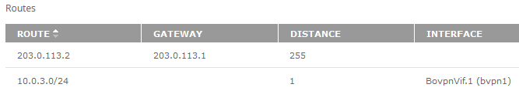
Routing Engine Update – Static Routes
With the change to FRR, Fireware now uses the term distance for the priority of static routes
In previous releases, Fireware used the term metric
Several pages in the UI have this terminology change:
Network > Routes
BOVPN Virtual Interfaces > VPN Routes
BOVPN over TLS > Client / Server Routes
Various Status and Diagnostic pages

Slide 48
Routing Engine Update – Static Routes
When you upgrade to Fireware v12.9, a configuration conversion occurs for the terminology change from metric to distance
Metric values automatically convert to distance values
The range for distance is 1 to 255
If you configured a static route in previous Fireware versions, and the route has a metric outside of this range:
A metric value less than 1 converts to a distance value of 1
A metric value greater than 255 converts to a distance value of 255

Slide 49
Routing link detection

Slide 50
Routing Link Detection
In the Fireware CLI, you can now run a command to automatically update static and dynamic routes if the interface link status changes:
WG(config)#global-setting routing-link-detect enable
To disable this command, run:
WG(config)#[no] global-setting routing-link-detect enable
To show whether this option is enabled, run:
WG(config)#show global-setting routing-link-detect
This option is disabled by default

Slide 51
Routing Link Detection
If you enable link detection:
New static routes are added to the kernel only if the output interface for the next hop is up
If you disable or re-enable this option, static routes are flushed and re-added
Physical and link aggregation (LAG) interfaces — Static routes are removed if the next hop is a physical or LAG interface that is down. If the interface comes back up, the route is added back
Bridge interfaces — Static routes are removed if the next hop is a bridge interface, and all bridge member interfaces are down. If any bridge members come back up, the route is added back
VLAN interfaces — Static routes are removed if the next hop is a VLAN interface, and all VLAN member interfaces are down. If any VLAN members come back up, the route is added back

Slide 52
IP SPOOFING CHECK

Slide 53
IP Spoofing Check
This release simplifies how the Firebox handles IP spoofing checks
When a Firebox interface receives an incoming connection initiated by a remote Firebox, the Firebox runs an IP spoofing check on that interface
To determine whether an incoming connection is spoofed or not, the Firebox initiates a reverse route lookup
For internal and VPN virtual interfaces, the Firebox looks up the route with the source IP address
For external interfaces, the Firebox looks up the route without the source IP address

Slide 54
IP Spoofing Check
This table compares the IP spoofing check behavior for each interface type
Interface Types | Reverse Route Lookup with Source IP Address | Same as Incoming Interface | Default Route Found | Different than Incoming Interface
External Interface | No | Pass | Pass | Fail
Internal Interface | Yes | Pass | n/a | Fail
VPN Virtual Interface | Yes | Pass | n/a | Fail

Slide 55
IP Spoofing Check
Reverse lookup with a source IP address (internal and VPN virtual interfaces)
If a route exists for that interface, the route lookup succeeds, which means the IP spoofing check passes and the Firebox allows the connection
If no route is associated with the interface, the route lookup fails. This means the IP spoofing check fails, and the Firebox denies the incoming connection
Source address lookup is applied to internal interfaces and VPN virtual interfaces

Slide 56
IP Spoofing Check
Reverse lookup without a source IP address (external interfaces)
If the route lookup determines the route is on the same interface, the IP spoofing check passes, and the Firebox allows the traffic
If the route lookup determines that the output interface is different than the incoming interface, but the route is a default route, the IP spoofing check passes, and the Firebox allows the traffic. In this case, the source IP of the traffic can be reached through multiple paths, but the traffic still travels back through the same interface
Use case examples: Multi-WAN failover or a VPN zero route
If the route lookup determines the route is on a different interface, and the route is not a default route, the IP spoofing check fails, and the Firebox denies the incoming connection

Slide 57
Endpoint Enforcement UI Updates

Slide 58
Endpoint Enforcement Updates
The TDR Endpoint Enforcement user interface is updated because you no longer have to manually enable TDR on the Firebox for endpoint enforcement
When you enable local management with cloud reporting for your Firebox, TDR is automatically enabled
WatchGuard Cloud automatically syncs data with the Firebox
The WatchGuard Endpoint Agent also syncs data for endpoints with WatchGuard EDR and WatchGuard EPDR installed

Slide 59
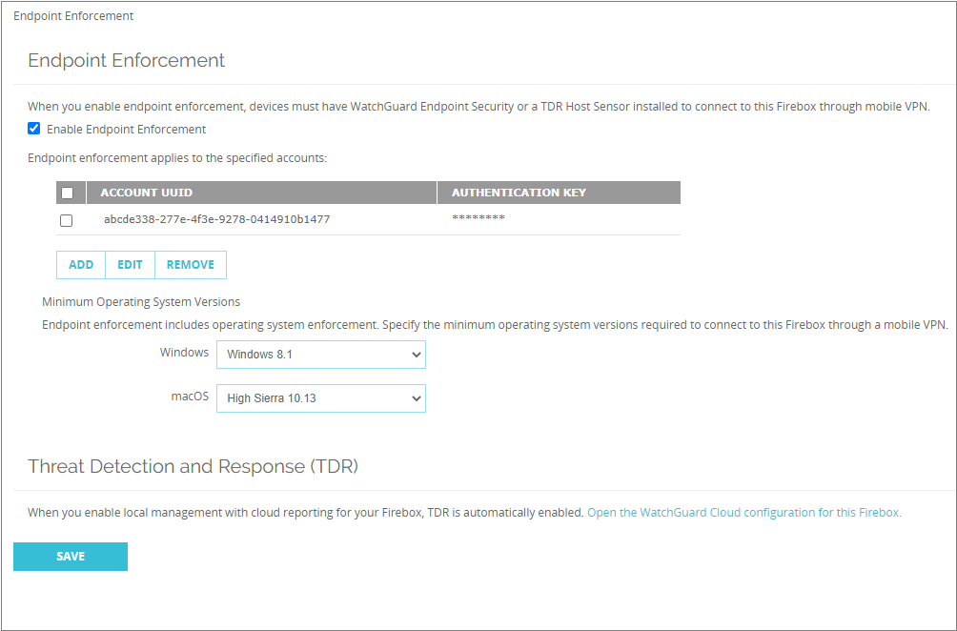
Endpoint Enforcement in Fireware Web UI
Endpoint enforcement is disabled by default
If you had TDR Host Sensor Enforcement previously enabled, Endpoint Enforcement is enabled when you upgrade to Fireware v12.9
To specify the accounts you want to apply endpoint enforcement to, select the Enable Endpoint Enforcement check box

Slide 60
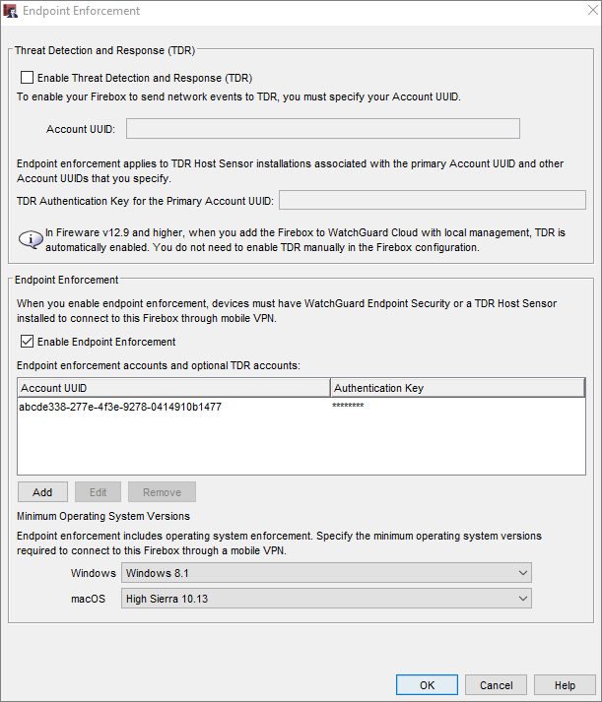
Endpoint Enforcement in Policy Manager
Select Subscription Services > Endpoint Enforcement
For devices that run Fireware v12.8.x and lower, you must enable TDR and configure the primary account UUID before you can enable endpoint enforcement
For devices that run Fireware v12.9 and higher, you do not have to enable TDR to enable endpoint enforcement

Slide 61
Save the Configuration in Policy Manager
When you save the configuration with endpoint enforcement to a Fireware version lower than v12.9, you are prompted to enable TDR
When you save the configuration with TDR enabled to Fireware v12.9 and higher, a message appears to inform you that you do not enable TDR in Policy Manager
TDR is automatically enabled in locally-managed Fireboxes with cloud reporting
You can also apply endpoint enforcement to your Firebox through templates
If you create a template with endpoint enforcement and do not enable TDR in the template, if the template is applied to accounts that include Fireboxes with Fireware v12.8x and lower, a message appears to inform you that the template can only be applied to Fireboxes that run Fireware v12.9 and higher

Slide 62
Enable Intra-interface Inspection on Interfaces

Slide 63
Enable Intra-interface Inspection on Interfaces
The Firebox inspects traffic that goes in and out of the same external interfaces and applies firewall policies to that traffic
The Firebox does not inspect traffic that goes in and out of internal interfaces by default
You can now enable or disable intra-interface inspection on physical and link aggregation interfaces
The user interface in Fireware Web UI and Policy Manager have been updated to reflect these changes

Slide 64
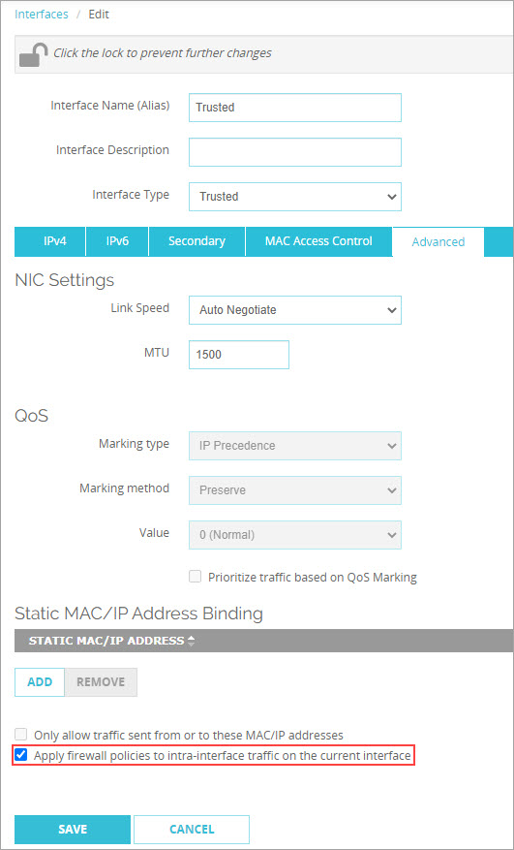
Enable Intra-interface Inspection (Fireware Web UI)
To enable intra-interface inspection, from Fireware Web UI:
Select Network > Interfaces
Select the interface you want to configure and click Edit
Select the Advanced tab
Select the Apply Firewall Policies to Intra-interface Traffic on the Current Interface check box

Slide 65
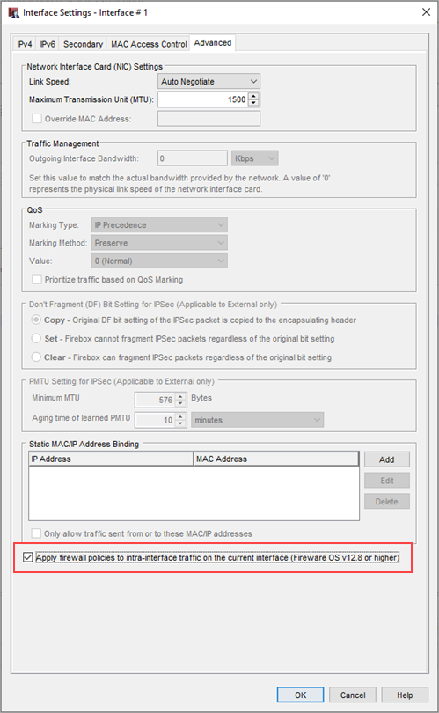
Enable Intra-interface Inspection (Policy Manager)
To enable intra-interface inspection, from Policy Manager:
Select Network > Configuration
Select the interface you want to configure and click Configure
Select the Advanced tab
Select the Apply Firewall Policies to Intra-interface Traffic on the Current Interface check box

Slide 66
LDAP Server Client Certificate Support

Slide 67
LDAP Server Client Certificate Support
When you configure LDAP authentication and enable LDAPS, you can now specify a client certificate
A client certificate provides support for two-way certificate authentication for an SSL handshake
The user interface in Fireware Web UI and Policy Manager have been updated to reflect these changes

Slide 68
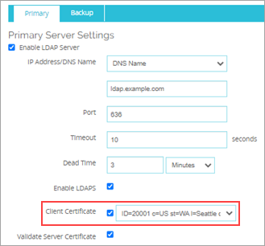
LDAP Server Client Certificate Support (Fireware Web UI)
To enable client certificate support, from Fireware Web UI:
Select Authentication > Servers
From the Server list, select LDAP
Select the LDAP Server check box
Select the Enable LDAPS check box
Select the Client Certificate check box
Select a client certificate from the drop-down list

Slide 69
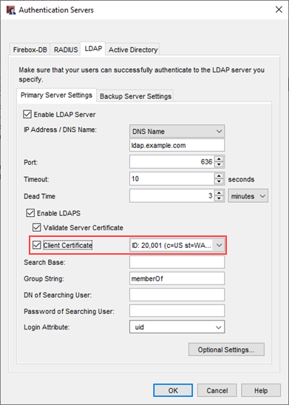
LDAP Server Client Certificate Support (Policy Manager)
To enable client certificate support, from Policy Manager:
Select Setup > Authentication > Authentication Servers
Select the LDAP tab
Select the Enable LDAP Server check box
Select the Enable LDAPS check box
Select the Client Certificate check box
Select a client certificate from the drop-down list

Slide 70
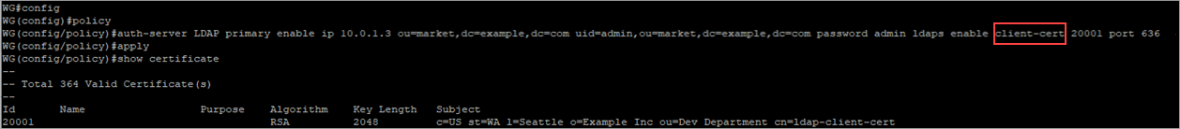
LDAP Server Client Certificate Support (CLI)
To enable client certificate authentication, from the CLI:
Use the CLI to connect to your Firebox
At the command prompt, type: WG(config/policy)#auth-server LDAP primary enable ip 10.0.1.3 ou=market,dc=example,dc=com uid=admin,ou=market,dc=example,dc=com password admin ldaps enable client-cert 20001 port 636 In this example, the LDAP Server information is: ou=market,dc=example,dc=com uid=admin,ou=market,dc=example,dc=com
At the command prompt, type: WG(config/policy)#apply

Slide 71

LDAP Server Client Certificate Support (CLI)
To disable client certificate authentication, from the CLI:
Use the CLI to connect to your Firebox
At the command prompt, type: WG(config/policy)#no auth-server LDAP primary ldaps client-cert 20001
At the command prompt, type: WG(config/policy)#apply

Slide 72
SpamBlocker Spam ID in Log Messages

Slide 73
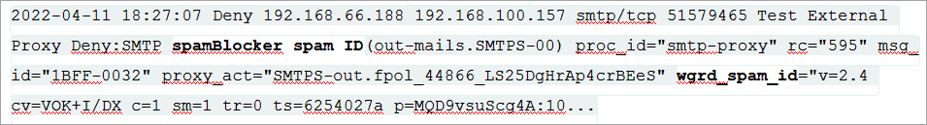
spamBlocker Spam ID in Log Messages
You can now include a spamBlocker spam ID when you send a false positive or false negative spam report to WatchGuard
spamBlocker generates a spamBlocker spam ID in log messages for the SMTP, POP3, and IMAP proxies
To find the spamBlocker spam ID, search traffic log messages for wgrd_spam_id
When you report spam to WatchGuard, send the complete spamBlocker log message that includes the spam ID

Slide 74
Blocked Sites List Enhancement

Slide 75
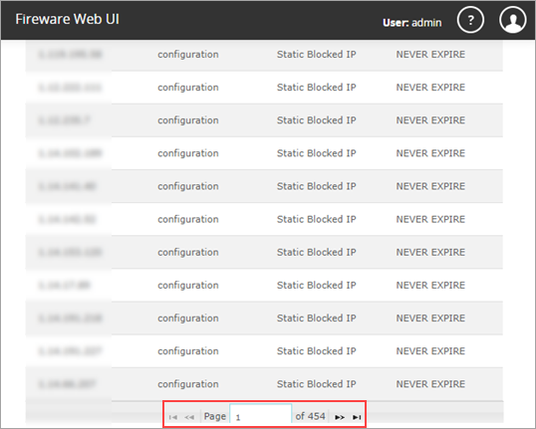
Blocked Sites List Enhancement
In Fireware Web UI, the Blocked Sites page now uses pagination when there are more than 50 blocked sites
This improves performance when you import a large number of blocked sites

Slide 76
Cloud Connect in The Feature Key

Slide 77
Cloud Connect – WatchGuard Cloud in the Feature Key
The Firebox feature key determines whether you can enable WatchGuard Cloud on the Firebox
With the release of Fireware v12.9, to enable WatchGuard Cloud, the feature key on the Firebox for these models must include the Cloud Connect feature:
T20/T20-W, T40/T40-W, T80
M270, M290, M370, M390, M470, M570, M590, M670, M690, M4600, M4800, M5600, M5800
FireboxV, Firebox Cloud (BYOL only)
Older feature keys could include Live Security or Support, and Cloud Visibility or Dimension Basic
For information on how to see the feature key on your Firebox, see About Feature Keys in Help Center

