Slide 1
What’s new in fireware 12.9.4

Slide 2
What’s new in Fireware v12.9.4
WatchGuard IPSec Mobile VPN Client for macOS v4.7
Access Portal Authentication Servers
Resolved Issues

Slide 3
What’s new in Fireware v12.9.4
Fireware v12.9.4 is available for these Firebox models:
Firebox M Series: M270, M290, M370, M390, M400, M440, M470, M500, M570, M590, M670, M690, M4600, M4800, M5600, M5800
Firebox T Series: T20, T25, T40, T45, T55, T70, T80, T85
Firebox NV5
FireboxV and Firebox Cloud
Fireware v12.9.4 does not support these models:
Firebox T10, T15, T30, T35, T50, M200, M300
We continue to support these models with Fireware v12.5.x firmware. For more information, see this KB article

Slide 4
WatchGuard IPSec Mobile VPN Client for macOS v4.7

Slide 5
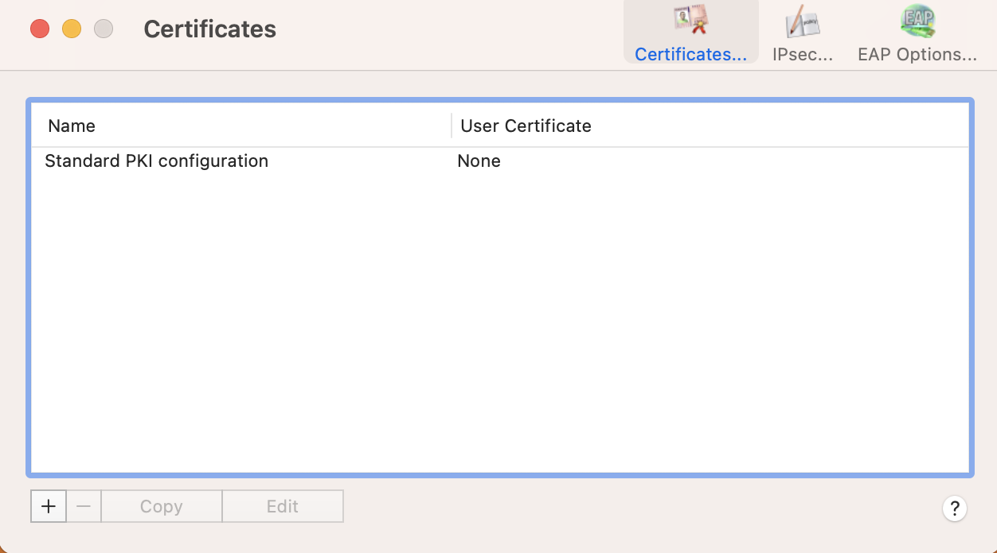
WatchGuard IPSec Mobile VPN Client for macOS v4.7
Fireware v12.9.4 includes an updated WatchGuard IPSec Mobile VPN client for macOS
WatchGuard IPSec Mobile VPN client for macOS v4.7 includes several resolved issues
This version of the client does not include firewall functionality

Slide 6
Access Portal Authentication Servers

Slide 7
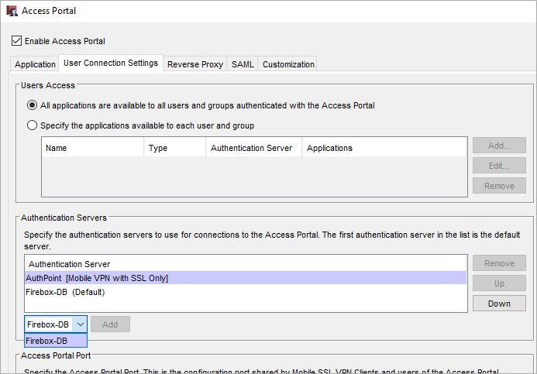
Access Portal Authentication Servers
If you have enabled the AuthPoint authentication server on your Firebox, it appears in the list of Access Portal authentication servers with the label Mobile VPN with SSL Only
If AuthPoint is your default authentication server, the Access Portal uses the next server in the list
When you enable the Access Portal, the Firebox no longer removes AuthPoint from the list of authentication servers
The Access Portal does not use the AuthPoint authentication server

Slide 8
Resolved Issues

Slide 9
Resolved Issues
Fireware v12.9.4 is a maintenance release that includes important resolved issues
For detailed information about the issues resolved in this release, see the Release Notes:
Fireware v12.9.4 Release Notes

