Slide 1
What’s new in fireware 12.9.3

Slide 2
What’s new in Fireware v12.9.3
Firebox T45-CW
Updated Software
Resolved Issues

Slide 3
What’s new in Fireware v12.9.3
Fireware v12.9.3 is available for these Firebox models:
Firebox M Series: M270, M290, M370, M390, M400, M440, M470, M500, M570, M590, M670, M690, M4600, M4800, M5600, M5800
Firebox T Series: T20, T25, T40, T45, T55, T70, T80, T85
Firebox NV5
FireboxV and Firebox Cloud
Fireware v12.9.3 does not support these models:
Firebox T10, T15, T30, T35, T50, M200, M300
We continue to support these models with Fireware v12.5.x firmware. For more information, see this KB article

Slide 4
Firebox T45-CW

Slide 5
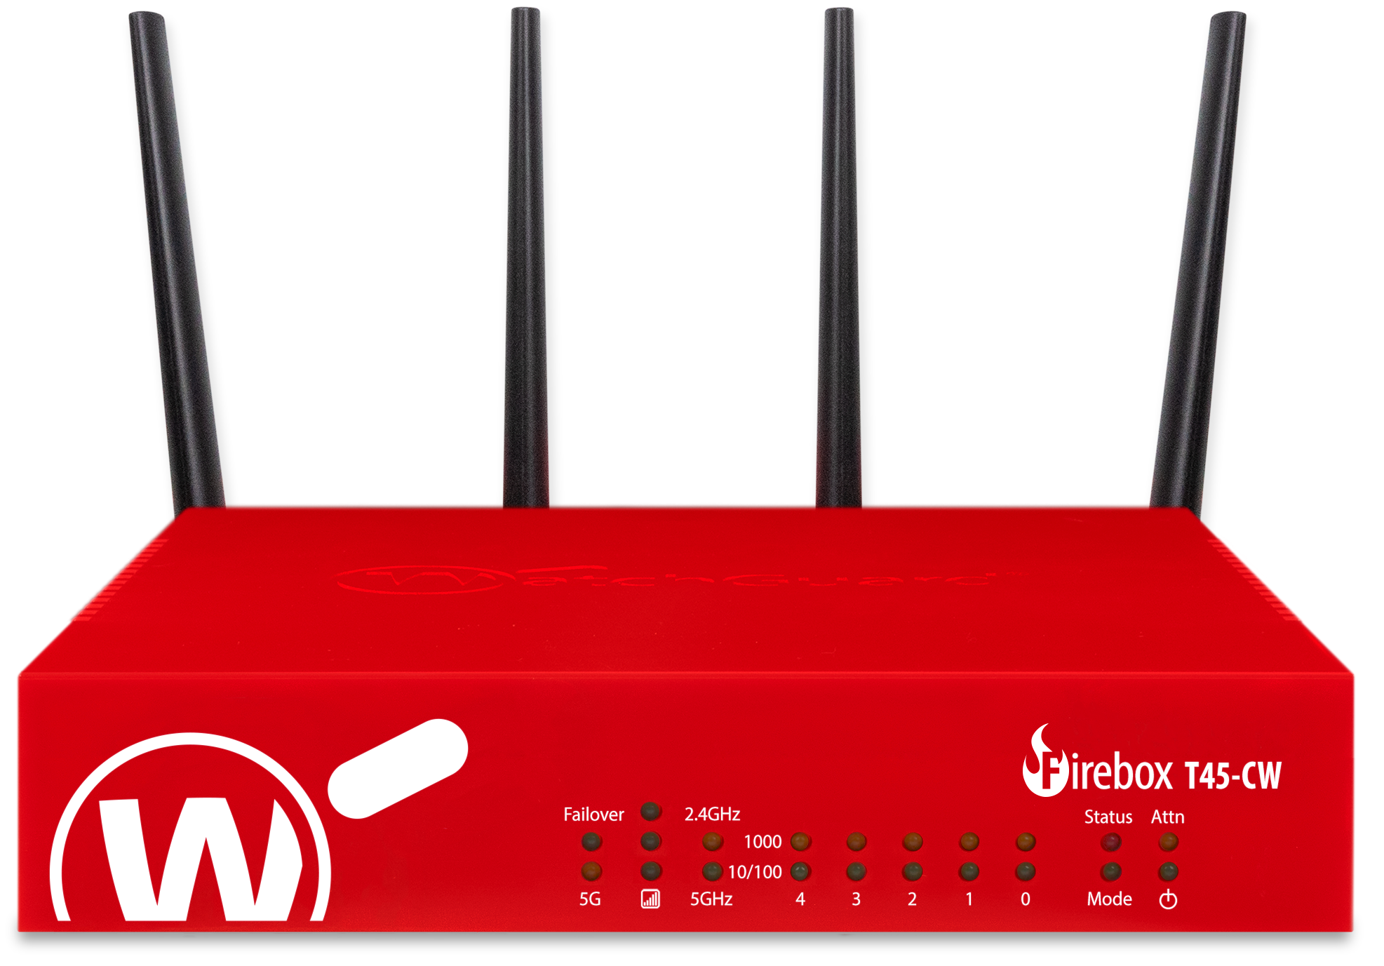
Firebox T45-CW
Fireware v12.9.3 adds support for the new Firebox T45-CW
Designed for users looking for intelligent network security appliances to secure small environments such as a temporary site, branch office, or retail POS
4G/5G cellular and dual-band Wi-Fi 6 options built into the Firebox
SD-WAN can be applied to ensure failover to the cellular network to minimize disruptions to network connectivity and provide both security and reliability

Slide 6
Updated Software

Slide 7
Updated Software
Fireware v12.9.3 includes updated Firebox software:
Mobile VPN with IPSec Client for Windows
Terminal Services Agent software
For more information, go to the Release Notes:
Fireware v12.9.3 Release Notes

Slide 8
Resolved Issues

Slide 9
Resolved Issues
Fireware v12.9.3 is a maintenance release that includes important resolved issues
For detailed information about the issues resolved in this release, see the Release Notes:
Fireware v12.9.3 Release Notes

