Slide 1
What’s new in fireware 12.9.2

Slide 2
What’s new in Fireware v12.9.2
Support for New Firebox T25/T45/T85 Models
Mobile VPN with IKEv2 DNS Suffix
IPv6 Address and Link-local Default Gateway

Slide 3
What’s new in Fireware v12.9.2
Fireware v12.9.2 is available for these Firebox models:
  Firebox M Series: M270, M290, M370, M390, M400, M440, M470, M500, M570, M590, M670, M690, M4600, M4800, M5600, M5800
  Firebox T Series: T20, T25, T40, T45, T55, T70, T80, T85
  Firebox NV5
  FireboxV and Firebox Cloud
Fireware v12.9.2 does not support these models:
  Firebox T10, T15, T30, T35, T50, M200, M300
  We continue to support these models with Fireware v12.5.x firmware. For more information, see this KB article

Slide 4
Firebox T25/T45/T85

Slide 5
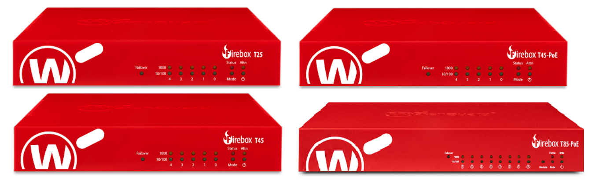
Support for New Firebox T25/T45/T85 Models
WatchGuard tabletop Fireboxes protect branch offices, office equipment, remote devices, retail POS, and remote users from threats
Our newest Firebox tabletop models feature faster processors and more memory, and wireless models feature dual Wi-Fi 6 802.11ax radios

Slide 6
Support for New Firebox T25/T45/T85 Models
Firebox T25 / T25-W — The WatchGuard Firebox T25 is a perfect solution to secure small offices, branch offices, or remote workers. Designed for up to 5 users, the Firebox T25 could be a stand-alone appliance or a VPN gateway for central traffic inspection
Firebox T45 / T45-PoE / T45-W-PoE — The Firebox T45 and T45-PoE support up to 20 users and deliver improved performance plus relentless security to provide both the speed and protection needed for any small business or retail location to stay connected and run their operations
Firebox T85-PoE — The Firebox T85 is the highest performing tabletop WatchGuard Firebox appliance, which supports up to 50 users in mid-size offices and includes two PoE+ (802.3at) ports and a module bay with
1 x SFP+ module or 4G LTE module options available
For more information, see the Firebox T25/T45/T85 Hardware Guides

Slide 7
Mobile VPN with Ikev2 DNS Suffix

Slide 8
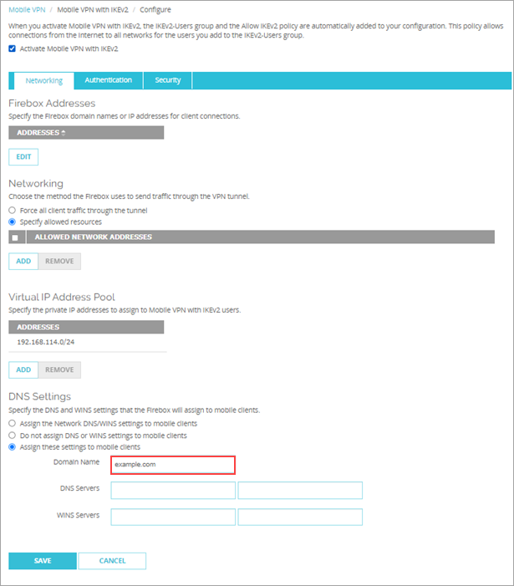
Mobile VPN with IKEv2 DNS Suffix (Fireware Web UI)
In the Mobile VPN with IKEv2 configuration, you can now specify a domain suffix to assign to mobile clients in the DNS settings
From Fireware Web UI:
  Select VPN > Mobile VPN
  In the IKEv2 section, select Configure
  In the DNS Settings section, select Assign these settings to mobile clients
  In the Domain Name text box, type a domain name

Slide 9
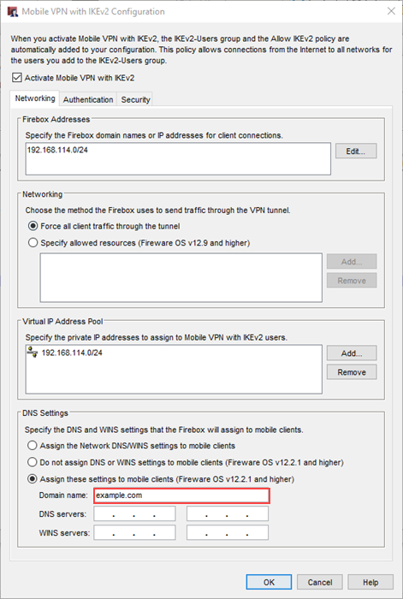
Mobile VPN with IKEv2 DNS Suffix (Policy Manager)
From Policy Manager:
  Select VPN > Mobile VPN > IKEv2
  In the DNS Settings section, select Assign these settings to mobile clients
  In the Domain Name text box, type a domain name

Slide 10
IPv6 Address And Link-local Default Gateway

Slide 11
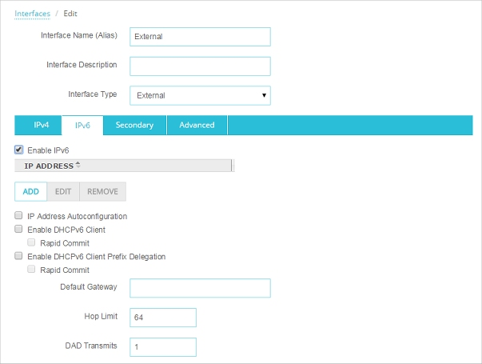
IPv6 Address and Link-local Default Gateway
You can now use an IPv6 static address to configure an interface when you have a link-local address as the default gateway

