Slide 1
What’s new in fireware 12.8

Slide 2
What’s new in Fireware v12.8
SD-WAN Round Robin
SD-WAN Actions in Centralized Management
External VLAN Enhancements
Set External Interface and VLAN ID in Quick Setup Wizard
MOBIKE Support for Mobile VPN with IKEv2
Intra-Interface Inspection
IPv6 in Bridge Mode
Disable GARP
Disable the Geolocation Deny Page
Specify Logging and Notification Settings for Default Packet Handling

Slide 3
What’s new in Fireware v12.8
APT Blocker Automatically Submits PDF Files for Analysis
DF Bit for Mobile VPN with IKEv2
System Integrity Checks
Firebox Management Policy Warnings
OS checksum

Slide 4
What’s new in Fireware v12.8
Fireware v12.8 is available for these Firebox models:
Firebox M Series: M270, M290, M370, M390, M400, M440, M470, M500, M570, M590, M670, M690, M4600, M4800, M5600, M5800
Firebox T Series: T20, T40, T55, T70, T80
FireboxV and Firebox Cloud
Fireware v12.8 does not support these models:
Firebox T10, T15, T30, T35, T50, M200, M300
We continue to support these models with Fireware v12.5.x firmware. For more information, see this KB article

Slide 5
SD-WAN ROUND ROBIN

Slide 6
SD-WAN Round Robin
You can now configure an SD-WAN action to use the Round Robin method
Round Robin is a load-balancing method that distributes outgoing traffic between multiple interfaces based on weight and other factors
You can use SD-WAN Round Robin to:
Share traffic load across multiple ISPs or lines
Get the full benefit from all ISP connections to which your company subscribes. For example, you can use a secondary connection for more than just redundancy

Slide 7
SD-WAN Round Robin
For traffic that matches the SD-WAN action, the Firebox considers these factors to determine the outgoing interface:
Weight — A number that you assign to each interface in an SD-WAN action. Weight corresponds to the proportion of traffic load that the Firebox sends through an interface. A higher number indicates a greater load.
3-tuple — Source IP address, destination IP address, and protocol for packets handled by an SD-WAN action. Connections are sticky, which means traffic from the same source to the same destination using the same protocol is always routed through the same interface.
Measures (Optional) —Loss rate, latency, and jitter for each interface in an SD-WAN action

Slide 8
SD-WAN Round Robin
Example
You have two WAN links of unequal capacity for redundancy. To take advantage of the redundant link, you want to distribute outbound Internet traffic over both links.
Configure an SD-WAN action that includes the two WAN interfaces, External-1 and External-2. The External-1 link has more capacity.
In the SD-WAN action, assign a weight of 6 to the External-1 interface and a weight of 4 to the External-2 interface
If 10 connections match the SD-WAN action, the External-1 interface handles 6 of those connections. The External-2 interface handles 4 connections

Slide 9
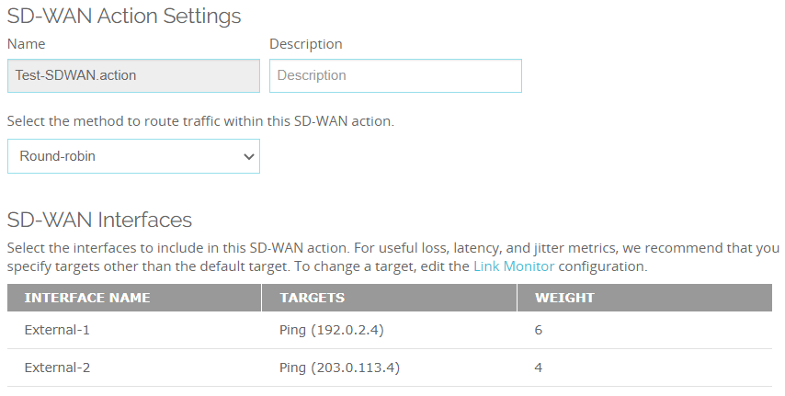
SD-WAN Round Robin
Example (Fireware Web UI)

Slide 10
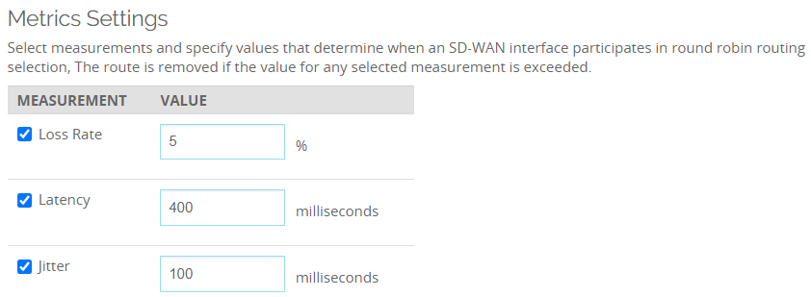
SD-WAN Round Robin
Optionally, you can configure loss rate, latency, and jitter measures that apply to all interfaces in the SD-WAN action
These measures determine whether an interface qualifies to be part of the path selection
To qualify, an interface must have loss rate, latency, and jitter values equal to or less than those you specified

Slide 11
SD-WAN Round Robin
Add one or more policies that use the SD-WAN action
Example HTTP and HTTPS policies

Slide 12
SD-WAN Round Robin
The Firebox removes an interface from Round Robin path selection in these cases:
Inactive (down) — Interface is physically disconnected, or Link Monitor probes fail
Unqualified — Interface exceeds the loss rate, latency, or jitter values
The Firebox distributes traffic among the qualified interfaces that remain
If no interfaces are qualified, the Firebox routes traffic to the first active (up) interface, which is the first active interface in the SD-WAN action configuration
If no interfaces are active, the Firebox drops packets that match the SD-WAN action
If an interface becomes active or qualified again, it automatically becomes available for Round Robin selection

Slide 13
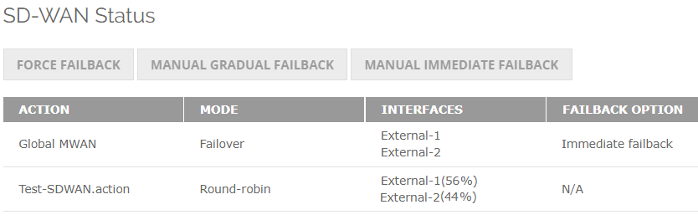
SD-WAN Round Robin
On the SD-WAN Status page, you can see the percent of connections handled by each interface in the SD-WAN action
When an SD-WAN action handles many connections (hundreds or thousands), the load balancing percentage more closely matches the weight ratio
The percentage resets after any interface status change
For an SD-WAN action with no usage, the percentage is 0%

Slide 14
SD-WAN Actions iN Centralized Management

Slide 15
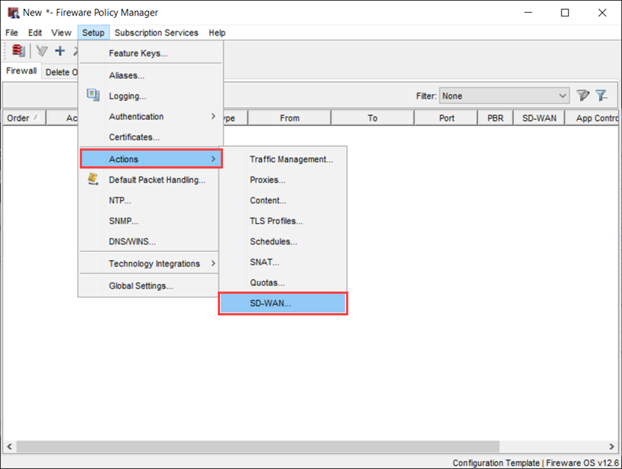
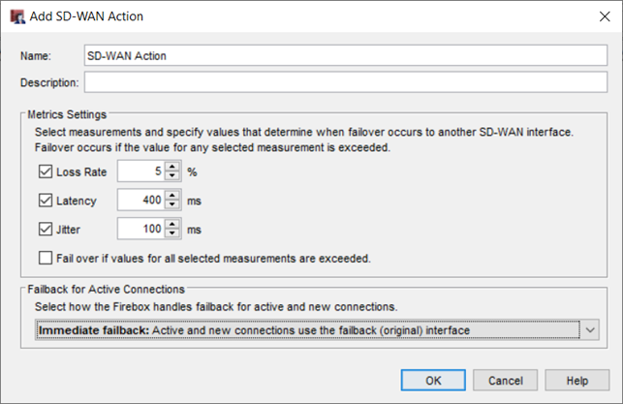
SD-WAN Action in Centralized Management
You can now create and apply SD-WAN actions in a Centralized Management policy template
Enables you to apply SD-WAN metrics and failback settings to multiple Fireboxes at the same time (requires the same SD-WAN action name on the Firebox)

Slide 16
EXTERNAL VLAN Enhancements

Slide 17
External VLAN Enhancements
To increase network design flexibility, external VLAN configurations now have fewer restrictions:
An external VLAN can now have more than one physical interface member
External VLAN members that are physical interfaces can now be untagged
An interface can now simultaneously belong to both an External and Internal VLAN

Slide 18
Set External Interface and VLAN ID in Quick Setup Wizard

Slide 19
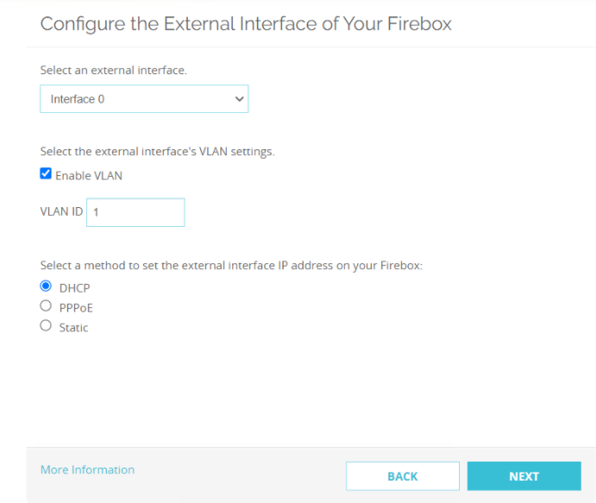
Set External Interface and VLAN ID in Quick Setup Wizard
You can now select which interface you want to use as the external interface in the Fireware Web UI Quick Setup Wizard
You can also enable and specify a VLAN ID for the external interface if required by your provider

Slide 20
MOBIKE for Mobile VPN with IKEv2

Slide 21
MOBIKE for Mobile VPN with IKEv2
Mobile VPN with IKEv2 now automatically supports the MOBIKE protocol
The Firebox can keep or reuse a VPN connection because MOBIKE allows changes to the IP address associated with IKEv2 and the tunnel mode IPSec security association (SA)
This means your remote workers can remain connected to the VPN even if they move to a different network
For example, a remote worker is connected to Mobile VPN with IKEv2. The worker changes physical locations, which causes the laptop to connect to a different wi-fi network and obtain a different IP address. Traffic continues to flow through the tunnel, and the user does not have to re-authenticate to remain connected to the VPN.

Slide 22
MOBIKE for Mobile VPN with IKEv2
MOBIKE applies to IKEv2 VPN clients only
MOBIKE does not apply to the gateway
For example, if you change the Mobile VPN with IKEv2 IP address in the Firebox configuration, users experience an interrupted VPN connection
For detailed information about the MOBIKE protocol, see RFC 4555
In the RFC, the terms “initiator” and “responder” correspond to the IKEv2 VPN client and the Firebox, respectively

Slide 23
INTRA-INTERFACE INSPECTION

Slide 24
Intra-Interface Inspection
In Fireware CLI, you can now specify a command to apply firewall policies to intra-interface traffic on physical and link aggregation interfaces
In the Configuration Command Mode, enter the Interface Command Mode and specify an interface
To enable intra-interface inspection, run this command: intra-if-inspection enable
To disable intra-interface inspection, run this command: no intra-if-inspection enable
Examples WG(config/if-fe01)#intra-if-inspection enable WG(config/if-fe01)#no intra-if-inspection enable

Slide 25
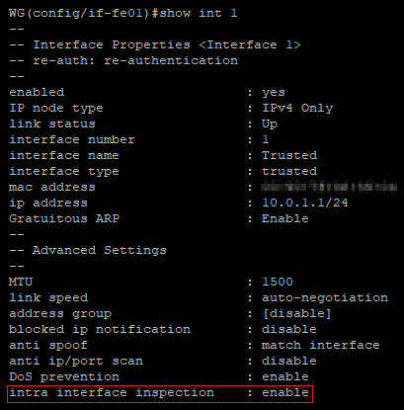
Intra-Interface Inspection
To verify that intra-interface inspection is enabled or disabled, run the show interface command and specify the interface number

Slide 26
Intra-Interface Inspection
The default intra-interface inspection behavior from previous Fireware versions remains unchanged:
External interfaces — Enabled by default
Non-external interfaces — Disabled by default

Slide 27
IPv6 in Bridge Mode

Slide 28
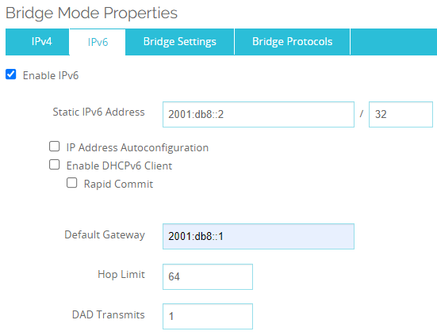
IPv6 in Bridge Mode
In Bridge mode, you can now specify a static IPv6 address and other IPv6 settings
On the Bridge Mode Properties page, select the IPv6 tab

Slide 29
IPv6 in Bridge Mode
IPv6 Bridge Mode settings
Static IPv6 Address — Specify a system IP address and netmask for redundant management access
(Optional) IP Address Autoconfiguration — Automatically assign an IPv6 link-local address to the interface
(Optional) Enable DHCPv6 Client — Enable DHCPv6 clients on the interface to request an IP address from a DHCPv6 server
(Optional) Rapid Commit — Use a two-message exchange instead of a four-message exchange for DHCPv6 requests from clients to a DHCPv6 server
Default Gateway — Specify the gateway for the static IPv6 address (required unless you select IP Address Autoconfiguration)
Hop Limit — Specify the number of segments a packet can traverse before a router discards it
DAD Transmits — Specify the number of Duplication Address Detection transmits

Slide 30
IPv6 in Bridge Mode
On the Bridge Settings tab, you can manually add IPv6 related hosts
The IPv6 gateway is added automatically to related hosts
If you change the IPv6 gateway, the related hosts are updated automatically
Related hosts are removed if you enable IP Address Autoconfiguration or Enable DHCPv6 Client on the IPv6 tab
Related hosts must be on the same subnet as the static IPv6 address that you configured

Slide 31
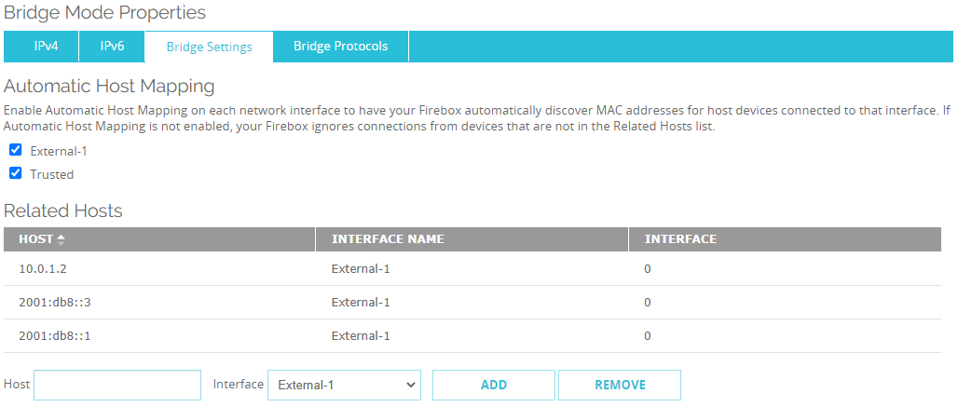
IPv6 in Bridge Mode
Related Hosts example (Fireware Web UI)

Slide 32
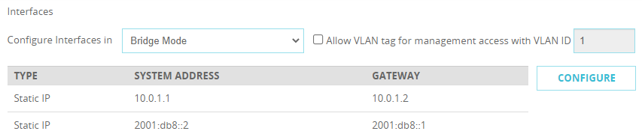
IPv6 in Bridge Mode
IPv4 is always required for Bridge Mode, even if you specify IPv6 settings

Slide 33
IPv6 in Bridge Mode
IPv6 policies
In Bridge mode, the Firebox now supports policy matching for policies that include IPv6 hosts, IPv6 networks, and IPv6 ranges
IPv6 traffic
If you configure a Firebox to use Bridge mode, and you do not enable IPv6, the Firebox drops IPv6 traffic that does not match a policy rather than allow the traffic to pass through the bridge
In previous Fireware versions, which did not support IPv6 in Bridge mode, the Firebox allowed IPv6 traffic to pass through the bridge

Slide 34
IPv6 in Bridge Mode
Bridge mode supports these Firebox features that support IPv6:
Blocked Sites and Ports
Quotas
IPS and Application Control
QoS
Geolocation
Traffic Management
Schedule
Default Packet Handling
Proxy policies

Slide 35
DISABLE GARP

Slide 36
DISABLE GARP
In Mixed Routing mode only, you can now run a Fireware CLI command to disable gratuitous ARP (GARP) on Ethernet-like interfaces:
Physical interfaces
Link aggregation interfaces
Bridge interfaces
VLAN interfaces
Wireless interfaces

Slide 37
DISABLE GARP
By default, GARP is enabled for these interface types
If you disable GARP, the Firebox no longer sends GARP broadcasts
You cannot disable GARP for 1-to-1 NAT or for FireCluster failover
Even if you disable GARP for interfaces included in 1-to-1 NAT or FireCluster failover configurations, GARP broadcasts required for these features are not suppressed

Slide 38
DISABLE GARP
To disable GARP, from Fireware CLI:
In the Configuration Command Mode, enter the Interface Command Mode and specify an interface
To disable GARP for the interface, run this command: no garp enable
To enable GARP for the interface, run this command: garp enable
Examples: WG(config/if-fe01)#garp enable WG(config/if-fe01)#no garp enable

Slide 39
DISABLE GARP
The GARP setting is added to the Firebox XML configuration and remains after a reboot

Slide 40
Disable Geolocation Deny Page

Slide 41
Disable the Geolocation Deny Page
In Fireware Web UI, WSM, and the Command Line Interface (CLI), you can now enable or disable the Geolocation deny page for policies
Disable the Geolocation deny page if you do not want inbound traffic to receive a deny page that attackers could use to confirm the presence of a Firebox in your network
The deny page applies to HTTP and HTTPS traffic on ports 80 and 443
In Fireware v12.8, the new Enable Deny Page check box is selected by default
To disable the deny page, clear the Enable Deny Page check box

Slide 42
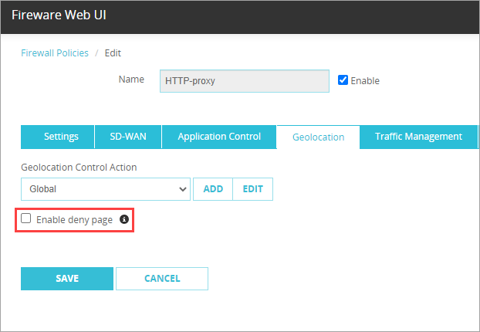
Disable Geolocation Deny Page – Web UI
To disable the deny page, from Fireware Web UI:
Select Firewall > Firewall Policies
Select a policy
Select the Geolocation tab
Clear the Enable Deny Page check box

Slide 43
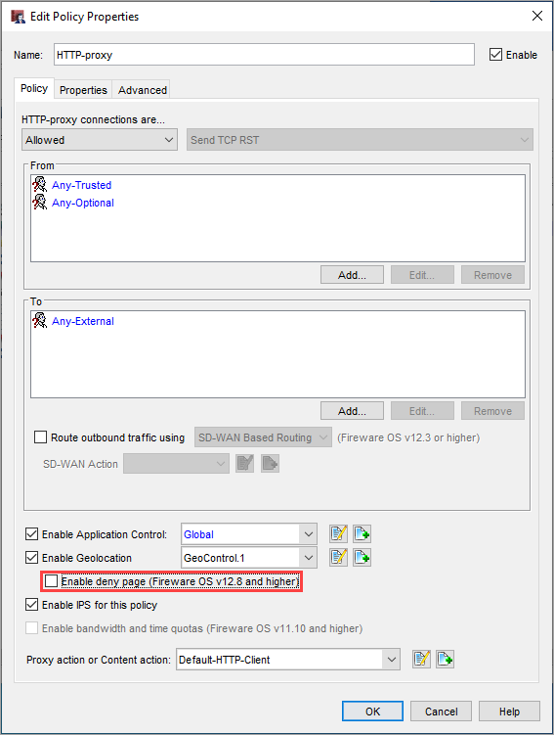
Disable Geolocation Deny Page – Policy Manager
To disable the deny page, from Policy Manager:
Double-click a policy
In the Edit Policy Properties dialog box, clear the Enable Deny Page check box

Slide 44
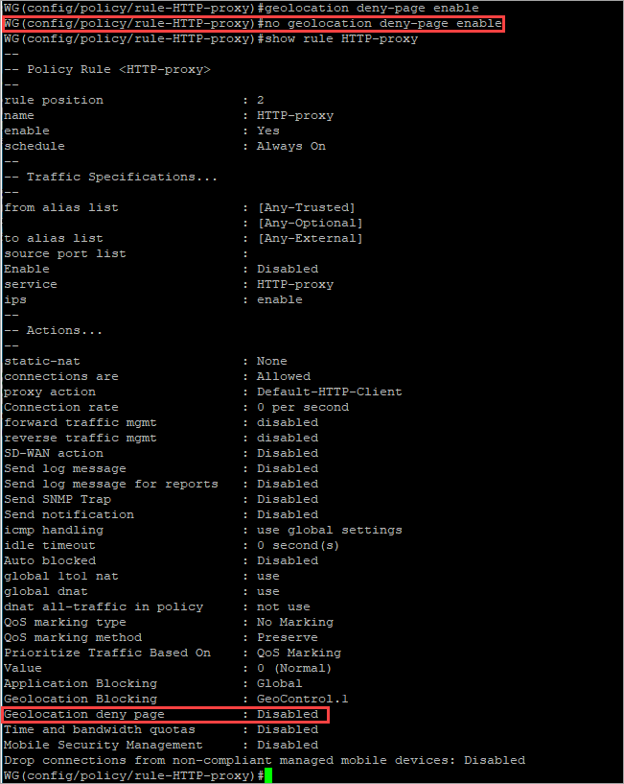
Disable Geolocation Deny Page – CLI
To disable the deny page, from the CLI:
Use the CLI to connect to your Firebox
At the command prompt, type: WG(config/policy/rule-HTTP-proxy)# no geolocation deny-page enable Note: In this example, HTTP-proxy is the name of the policy

Slide 45
Specify Logging and Notification Settings for Default Packet Handling

Slide 46
Default Packet Handling Logging Settings
In Fireware Web UI, you can now specify logging and notification settings for different Default Packet Handling dangerous activities:
SYN flood attack
UDP flood attack
ICMP flood attack
IPsec flood attack
IKE flood attack
IP source route
DDOS source attack
DDOS destination attack
Port scan
IP scan
IP spoofing attack
Select the dangerous activity and specify the log rate and notifications you want to receive when that activity is detected

Slide 47
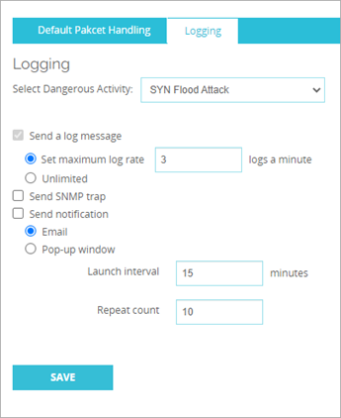
Default Packet Handling Logging Settings
To specify logging and notification settings by dangerous activity type, from Fireware Web UI:
Select Firewall > Default Packet Handling
Select the Logging tab
Select an activity from the Select Dangerous Activity drop-down list
Set your log and notification options for the activity

Slide 48
APT Blocker automatically submits PDF files for Analysis

Slide 49
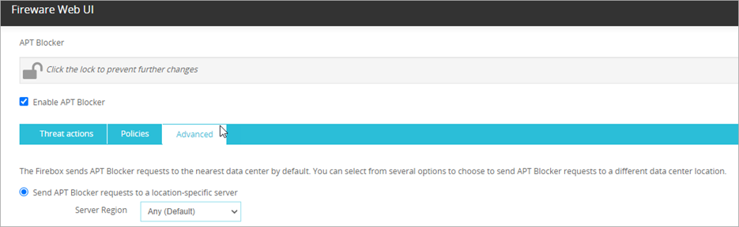
APT Blocker Automatically Submits PDF Files for Analysis
APT Blocker now automatically submits unrecognized PDF files to the data center for analysis
In Fireware Web UI, on the APT Blocker page, Advanced tab, the optional check box for PDF submission is removed
In Policy Manager, for Fireboxes that run a Fireware version lower than v12.8, you can still specify whether to submit unrecognized PDF files

Slide 50
DF Bit for Mobile VPN with IKEv2

Slide 51
DF Bit for Mobile VPN with IKEv2
You can now specify a custom DF bit option for Mobile VPN with IKEv2 client connections
You must use this CLI command:
diagnose vpn “/ike/param/set mobile_ikev2_dfbit=(option-number)”
option-number is a number between 0 and 2 that corresponds to an option:
0 — Copy (default). Applies the DF bit setting of the original frame to the IPSec encrypted packet
1 — Set. Instructs the Firebox to not fragment the frame regardless of the original bit setting
2 — Clear. Breaks the frame into pieces that can fit in an IPSec packet with the ESP or AH header, regardless of the original bit setting

Slide 52
DF Bit for Mobile VPN with IKEv2
If you specify action=now, you do not have to restart the Firebox for this setting to take effect and the tunnel will not be rekeyed. The new timeout value that you specify will apply to new IKEv2 connections
For example, to clear the DF bit, specify this command: WG#diagnose vpn "/ike/param/set mobile_ikev2_dfbit=2 action=now"

Slide 53
SYSTEM Integrity Checks

Slide 54
System Integrity Checks
The Firebox now uses a cryptographic signature to verify the integrity of the appliance
System integrity checks make sure that system files are valid and have not been corrupted
Integrity checks now run automatically:
Each time the Firebox boots
Before each software upgrade
You can also run an on-demand integrity check from Fireware Web UI

Slide 55
System Integrity Checks
After you upgrade to a Fireware version that includes system integrity checks, you cannot downgrade to a Fireware version that is not signed by WatchGuard

Slide 56
Boot Time Integrity Check
When the Firebox boots, it uses the public key installed with the appliance image to verify the integrity of the files and directories on the appliance
If the boot time integrity check fails:
The boot process halts but power stays on
All interfaces are disabled
You cannot connect to the Firebox to see status
The error Error: integrity check failed appears in the serial console

Slide 57
Upgrade Integrity Check
The Firebox now runs an integrity check before every firmware upgrade
When you select a Fireware upgrade file to install, the Firebox makes sure the file contains a cryptographic signature
If the cryptographic signature is present, the Firebox uses the public key from the previously installed image to verify the relevant portion of the upgrade file
If the Firebox cannot verify the signature, or if the signature is not present, the Firebox refuses the upgrade

Slide 58
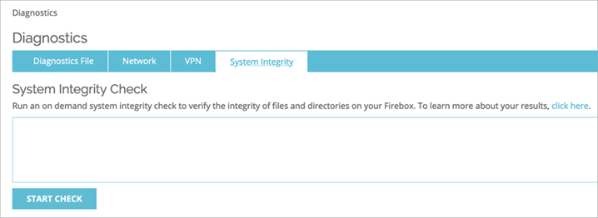
On-Demand Integrity Check
You can run a Boot Time integrity check at any time from the Web UI
Select System Status > Diagnostics (locally-managed Fireboxes) or select Diagnostics (cloud-managed Fireboxes)
On the System Integrity tab, click Start Check
If the on-demand integrity check fails, the Firebox generates a fault report
To see the fault report, click the Diagnostics File tab

Slide 59
Firebox Management Policy Warnings

Slide 60
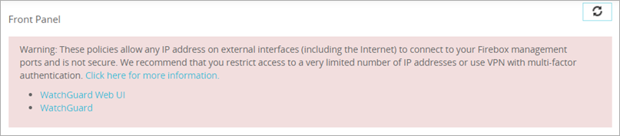
Firebox Management Policy Warnings
You now see a warning in the Front Panel and Policies pages (Fireware Web UI) and above the firewall policy list (Policy Manager) when your configuration includes a Firebox management policy (such as WatchGuard or WatchGuard Web UI) that allows unrestricted Internet access to your Firebox
The warning message lists any affected policies
Click the name of a policy to open and edit it

Slide 61
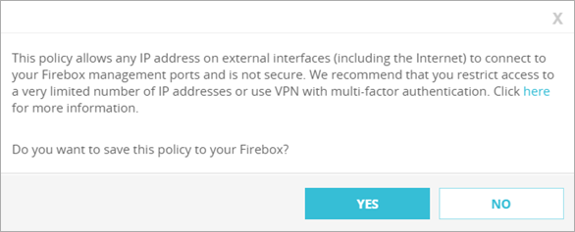
Firebox Management Policy Warnings
You also see a warning message in Policy Manager and Fireware Web UI when you try to save a Firebox management policy that allows unrestricted Internet access to your Firebox
We recommend that you configure Firebox management policies to restrict management access to the Firebox
For more information, see the Firebox Remote Management Best Practices Knowledge Base article and the Secure Firebox Management Access Video Tutorial

Slide 62
OS Checksum

Slide 63
OS Checksum
The OS checksum feature has been deprecated and removed from Fireware Web UI and Firebox System Manager.

