Slide 1
What’s new in fireware 12.8.2

Slide 2
What’s new in Fireware v12.8.2
Support for 8x1Gb Network Module
Resolved Issues

Slide 3
What’s new in Fireware v12.8.2
Fireware v12.8.2 is available for these Firebox models:
  Firebox M Series: M270, M290, M370, M390, M400, M440, M470, M500, M570, M590, M670, M690, M4600, M4800, M5600, M5800
  Firebox T Series: T20, T40, T55, T70, T80
  FireboxV and Firebox Cloud
Fireware v12.8.2 does not support these models:
  Firebox T10, T15, T30, T35, T50, M200, M300
  We continue to support these models with Fireware v12.5.x firmware. For more information, see this KB article

Slide 4
8x1Gb Network Module

Slide 5
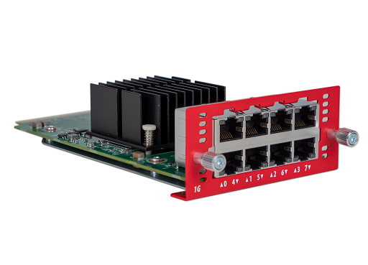
8x1Gb Copper Network Module
Fireware v12.8.2 adds support for a new 8x1Gb Copper network module (WG9022) for Firebox M290, M390, M590, and M690 devices
This module expands your Firebox with an additional 8 Gigabit Ethernet network ports

Slide 6
Resolved Issues

Slide 7
Resolved Issues
Fireware v12.8.2 is a maintenance release that includes important resolved issues
For detailed information about the issues resolved in this release, see the Release Notes:
  Fireware v12.8.2 Release Notes

