Slide 1
What’s new in fireware 12.8.1

Slide 2
What’s new in Fireware v12.8.1
Tor Exit Node Blocking
Mobile VPN with IPSec Client Updates
VPN Failover to Azure
WatchMode

Slide 3
What’s new in Fireware v12.8.1
Fireware v12.8.1 is available for these Firebox models:
  Firebox M Series: M270, M290, M370, M390, M400, M440, M470, M500, M570, M590, M670, M690, M4600, M4800, M5600, M5800
  Firebox T Series: T20, T40, T55, T70, T80
  FireboxV and Firebox Cloud
Fireware v12.8.1 does not support these models:
  Firebox T10, T15, T30, T35, T50, M200, M300
  We continue to support these models with Fireware v12.5.x firmware. For more information, see this KB article

Slide 4
Tor Exit Node Blocking

Slide 5
Tor Exit Node Blocking
You can now enable the Tor Exit Node Blocking service to block inbound traffic from Tor exit nodes to the Firebox
  Tor provides anonymity that can be used to hide malicious activity
  A Tor exit node is the final node that routes Tor traffic to a destination
When you enable Tor Exit Node Blocking globally, it is enabled in all policies
You can also enable or disable the service for specific policies
If your configuration has Botnet Detection enabled, after you upgrade to Fireware v12.8.1, Tor Exit Node Blocking is enabled in all policies by default
To use Tor Exit Node Blocking, you must have a feature key that enables the RED subscription service

Slide 6
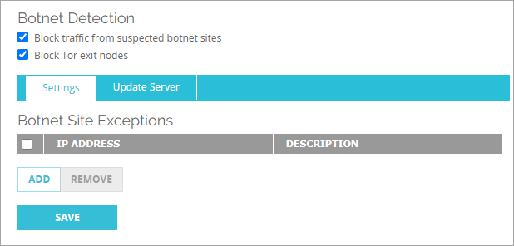
Enable Tor Exit Node Blocking – Web UI
To globally enable Tor Exit Node Blocking, from Fireware Web UI:
  Select Subscription Services > Botnet Detection
  Select the Block Tor Exit Nodes check box
  The service is enabled in all policies

Slide 7
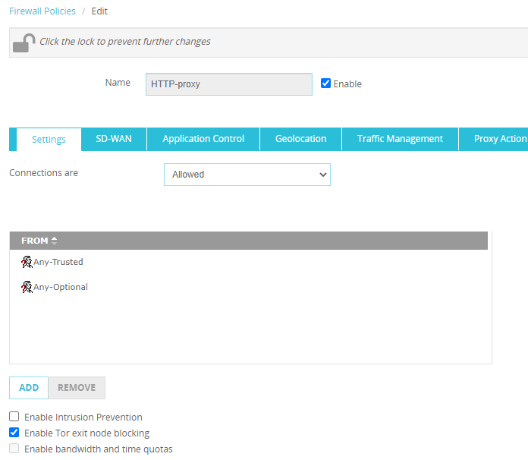
Enable Tor Exit Node Blocking in a Policy – Web UI
To enable or disable Tor Exit Node Blocking in a policy, from Fireware Web UI:
  Select Firewall > Firewall Policies
  Click a policy
  Select the Settings tab
  Select the Enable Tor Exit Node Blocking check box

Slide 8
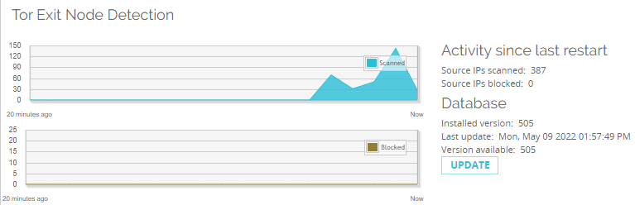
View Tor Exit Node Blocking Statistics – Web UI
To view Tor Exit Node Blocking statistics, from Fireware Web UI:
Select Dashboard > Subscription Services

Slide 9
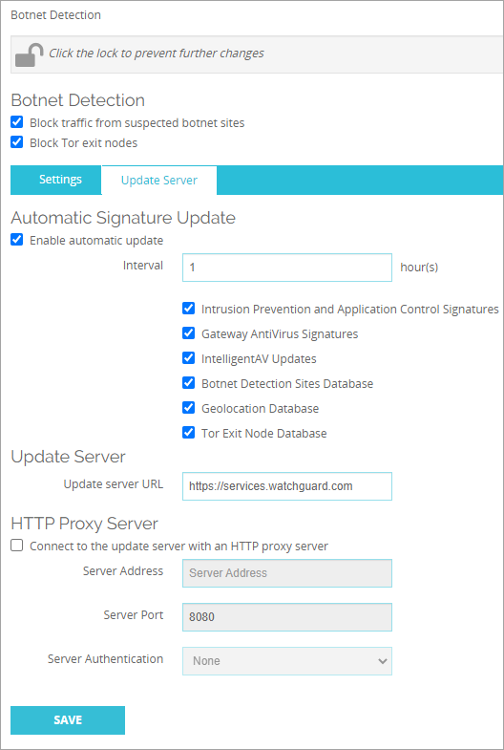
Update the Tor Exit Node Blocking Database – Web UI
To configure updates for the Tor Exit Node Blocking database, from Fireware Web UI:
    Select the Update Server tab
    Select the Enable Automatic Update check box
    In the Interval text box, select the number of hours between automatic updates
    Select the Tor Exit Node Database check box
    Click Save

Slide 10
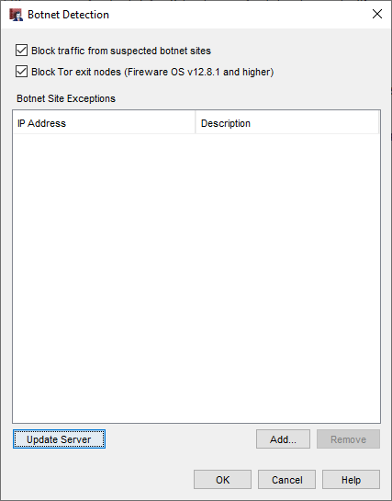
Enable Tor Exit Node Blocking – Policy Manager
To globally enable Tor Exit Node Blocking, from Policy Manager:
  Select Subscription Services > Botnet Detection
  Select the Block Tor Exit Nodes check box
  Click OK
  Save the configuration to the Firebox
  The service is enabled in all policies

Slide 11
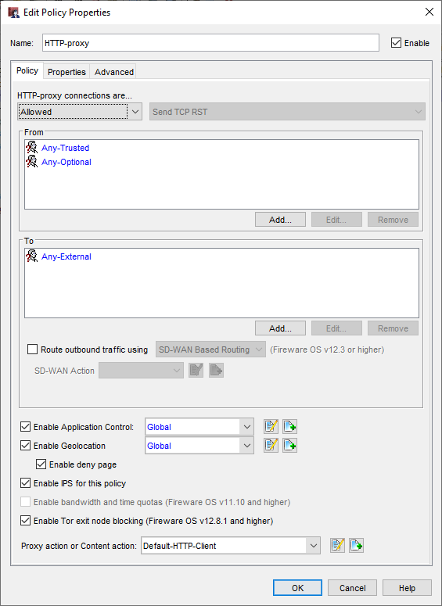
Enable Tor Exit Node Blocking in a Policy – Policy Manager
To enable or disable Tor Exit Node Blocking in a policy, from Policy Manager:
  Double-click a policy
  In the Edit Policy Properties dialog box, select the Enable Tor Exit Node Blocking check box

Slide 12
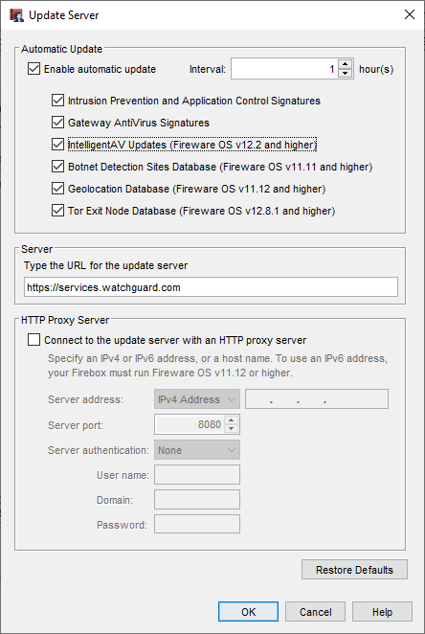
Update the Tor Exit Node Blocking Database – Policy Manager
To configure updates for the Tor Exit Node Blocking database, from Policy Manager:
  Click Update Server
  Select the Enable Automatic Update check box
  In the Interval text box, select the number of hours between automatic updates
  Select the Tor Exit Node Database check box
  Save the configuration to the Firebox

Slide 13
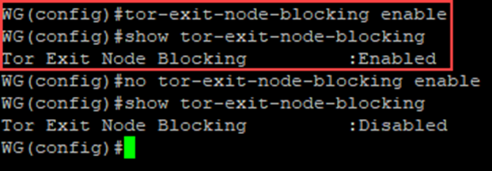
Enable Tor Exit Node Blocking – CLI
To globally enable Tor Exit Node Blocking, from the CLI:
  Use the CLI to connect to your Firebox
  At the command prompt, type:
  WG(config)#
  tor-exit-node-blocking enable

Slide 14
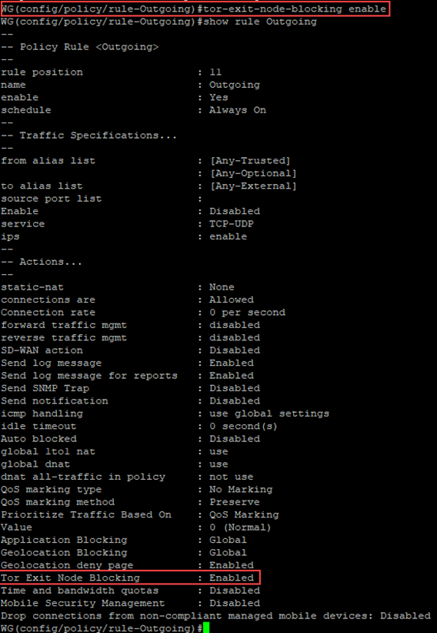
Enable Tor Exit Node Blocking in a Policy – CLI
To enable Tor Exit Node Blocking in a policy, from the CLI:
  Use the CLI to connect to your Firebox
  At the command prompt, type:
  WG(config/policy/rule-Outgoing)#
  tor-exit-node-blocking enable
  Note: In this example, Outgoing is the name of the policy

Slide 15
Update the Tor Exit Node Blocking Database – CLI
To enable Tor Exit Node Blocking automatic signature updates, from the CLI:
  Use the CLI to connect to your Firebox
  At the command prompt, type:
  WG(config)#
  signature-update signature-type tor enable

Slide 16
Mobile VPN with IPSec Client Updates

Slide 17
Mobile VPN with IPSec Client Updates
Fireware v12.8.1 includes updated WatchGuard Mobile VPN with IPSec NCP client software for both Microsoft Windows and macOS
These releases include minor enhancements and resolved issues

Slide 18
VPN failover to azure

Slide 19
BOVPN Virtual Interface Failover to Azure
The Firebox supports Microsoft Azure VPN failover for these configurations:
  BOVPN virtual interface to a Microsoft Azure VPN gateway in active-standby mode
    Azure configuration includes one gateway and one public Azure IP address
    Firebox configuration includes one BOVPN virtual interface with one gateway endpoint that connects to the public Azure IP address
    Azure VPN gateway fails over automatically from the active tunnel to the standby tunnel

Slide 20
BOVPN Virtual Interface Failover to Azure
  BOVPN virtual interface to Microsoft Azure VPN gateway in active-active mode
    Azure configuration includes one gateway and two public Azure IP addresses
    Firebox configuration includes two BOVPN virtual interfaces with one gateway endpoint
    Each BOVPN virtual interface gateway connects to one of the Azure IP addresses
    BGP ECMP routing provides load balancing and redundancy
    Return traffic from Azure might use a different tunnel
    Microsoft recommends active-active mode for higher throughput

Slide 21
BOVPN Virtual Interface Failover to Azure
For information about high availability (HA) Azure VPN configurations, see the Microsoft documentation:
  https://docs.microsoft.com/en-us/azure/vpn-gateway/design
  https://docs.microsoft.com/en-us/azure/vpn-gateway/vpn-gateway-highlyavailable

Slide 22
WatchMode

Slide 23
WatchMode
For WatchGuard partners, WatchMode is an audit-only mode you can enable on a “not for resale” (NFR) Firebox to demonstrate the value a WatchGuard Firebox can add to your network security solution for a customer
The Firebox collects information about network activity in log messages and sends the log messages to an external Dimension server
On the Dimension server, you can generate reports that demonstrate how the Firebox provides superior security, as well as detailed reports about network activity
WatchMode is supported on rack-mountable Fireboxes (M Series) and T70/T80 Fireboxes that run Fireware v12.8.1 or higher
For information about how to use WatchMode, see the WatchMode Configuration Guide

