Slide 1
What’s new in fireware 12.7.2

Slide 2
What’s new in Fireware v12.7.2
Support for new M290, M390, M590, and M690 Firebox models
Support for Huawei E3372 USB LTE modem
You can now enable or disable Active Directory Mode for SSO
Number of supported Terminal Services Agents increased to 512
WSM Cyclops Blink Detector (v12.7.2 Update 2)
System Integrity Checks (v12.7.2 Update 2)
Downgrade Prevention (v12.7.2 Update 2)
Firebox Management Policy Warnings (v12.7.2 Update 2)

Slide 3
What’s new in Fireware v12.7.2
Fireware v12.7.2 is available for these Firebox models:
M Series: M270, M290, M370, M390, M400, M440, M470, M500, M570, M590, M670, M690, M4600, M4800, M5600, M5800
T Series: T20, T40, T55, T70, T80
FireboxV and Firebox Cloud
Fireware v12.7.2 does not support these models:
T10, T15, T30, T35, T50, M200, M300
We continue to support these models with Fireware v12.5.x firmware. For more information, see this KB article

Slide 4
Firebox M290, M390, M590, and M690

Slide 5
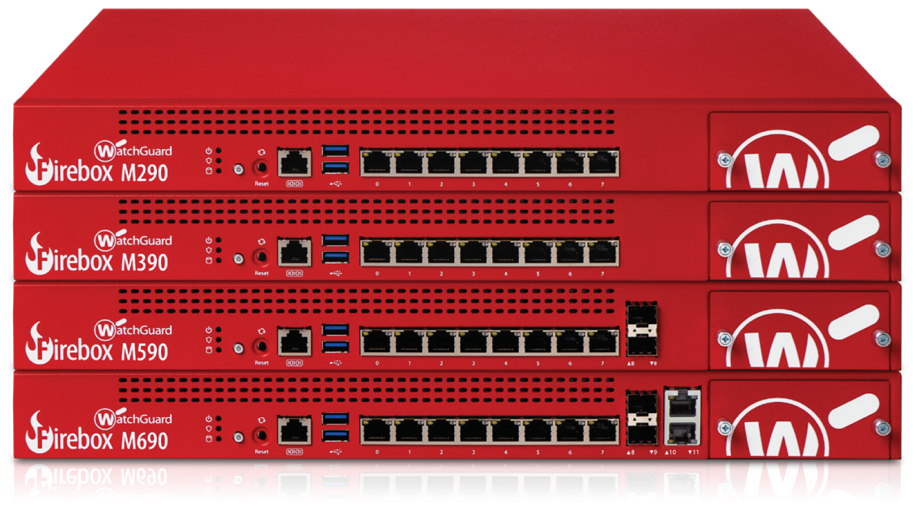
Firebox M290, M390, M590, and M690
Fireware v12.7.2 provides support for WatchGuard’s newest appliances, the Firebox M290, M390, M590, and M690
Best-in-class unified threat management appliances deliver the flexibility that small and mid-size organizations need as their networking demands expand

Slide 6
Firebox M290, M390, M590, and M690
WatchGuard's new Firebox appliances offer faster performance in all aspects of firewall and security service throughput
Faster and more powerful – Each appliance benefits from improved performance (especially for HTTPS throughput) and more on-board memory for more efficient scanning
Flexible and future-proof – Module expansion bays and available expansion modules enable you to customize your port configuration to meet current needs and give you the flexibility to adapt as your network evolves
Easy to deploy and manage – WatchGuard Cloud enables deployment, monitoring, reporting, and device management from the cloud
Reliable – Redundant power supplies on the Firebox M590 and M690 provide maximum availability

Slide 7
Huawei E3372 USB LTE Modem Support

Slide 8
Huawei E3372 USB LTE Modem Support
Fireware v12.7.2 adds support for the Huawei E3372 USB LTE Modem

Slide 9
Active Directory Mode For SSO

Slide 10
Active Directory Mode
You can now choose to enable or disable Active Directory (AD) Mode in the SSO Agent Configuration Tool
In Fireware v12.7.2, AD Mode is now disabled by default
If SSO is already configured, AD Mode will be disabled when you upgrade the SSO Agent to v12.7.2

Slide 11
Active Directory Mode
To enable or disable Active Directory mode for SSO:
Open the WatchGuard SSO Agent Configuration Tool
To log in, type your User Name and Password
Select Edit > SSO Agent Contact Settings
In the SSO Agent Contacts section, select or clear the Enable Active Directory Mode check box
Click OK

Slide 12
Supported Terminal Services Agents

Slide 13
Terminal Services Agents
The number of supported Terminal Services Agents is increased to 512
The previous limit was 128
If you specify more than 512 agents, Fireware only recognizes the first 512 agents

Slide 14
WSM Cyclops Blink Detector (v12.7.2 Update 2)

Slide 15
WSM Cyclops Blink Detector
You can use the WSM Cyclops Blink Detector to determine if your Fireboxes are affected by Cyclops Blink
The WSM Cyclops Blink Detector can scan:
Single locally-managed Fireboxes
Single cloud-managed Fireboxes
Single or multiple Fireboxes managed by Management Server
Other detection tools are available online and from WatchGuard Cloud. For more information, see the 4-Step Cyclops Blink Diagnosis and Remediation Plan
To scan devices in a FireCluster, we recommend that you upload support.tgz files to the Cyclops Blink Web Detector at detection.watchguard.com

Slide 16
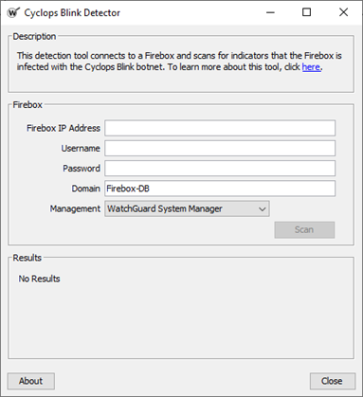
Scan a Single Firebox
Select Tools > Cyclops Blink Detector
You can also right-click the device, and select Cyclops Blink Detector
Enter details of the Firebox to scan:
Firebox IP Address – IP address or FQDN of the Firebox to scan
Username/Password – Credentials for a Device Administrator (read-write) user account
Domain – Authentication server for the user account you specified
Firebox-DB is selected by default. If you use Active Directory or RADIUS, type the server domain name specified in the Firebox configuration

Slide 17
Scan a Single Firebox
Management - Select the method to connect to the Firebox:
Fireware Web UI/WatchGuard Cloud - Select for cloud-managed or locally-managed Fireboxes
WatchGuard System Manager - Select for locally-managed Fireboxes only
If you select Fireware Web UI/WatchGuard Cloud, and you changed the port used to connect to Fireware Web UI on the Firebox, type the port number
Click Scan
The tool connects to the Firebox and runs

Slide 18
Scan a Single Managed Device
To scan a single device managed by WSM Management Server:
In WSM, select File > Connect to Server
Connect to your Management Server
On the Device Management tab, select the device to scan, then select Tools > Cyclops Blink Detector
You can also right-click the device and select Cyclops Blink Detector
The tool automatically connects to the managed device and runs

Slide 19
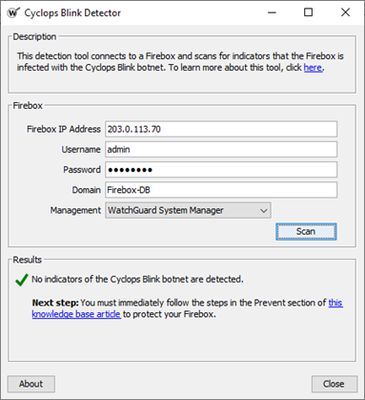
See Results for a Single Device
When the scan is complete for a single device, one of these results appears in the Results section:
This Firebox is infected with Cyclops Blink botnet
You must immediately follow the steps in the Remediate section of the 4-Step Cyclops Blink Diagnosis and Remediation Plan
If you cannot remediate immediately, we recommend you take the Firebox offline
No indicators of the Cyclops Blink botnet are detected
You must immediately follow the steps in the Prevent section of the 4-Step Cyclops Blink Diagnosis and Remediation Plan

Slide 20
Scan Multiple Managed Devices
To scan multiple devices managed by WSM Management Server:
In WSM, select File > Connect to Server
Connect to your Management Server
Do one of the following:
To scan all managed devices, right-click the top-level Devices folder, and select Cyclops Blink Detector. All folders and subfolders are scanned
To scan devices in a specific folder, right-click the folder, and select Cyclops Blink Detector. Only the selected folder is scanned; no subfolders are scanned
If you selected a large number of devices, it might take some time for all results to appear

Slide 21
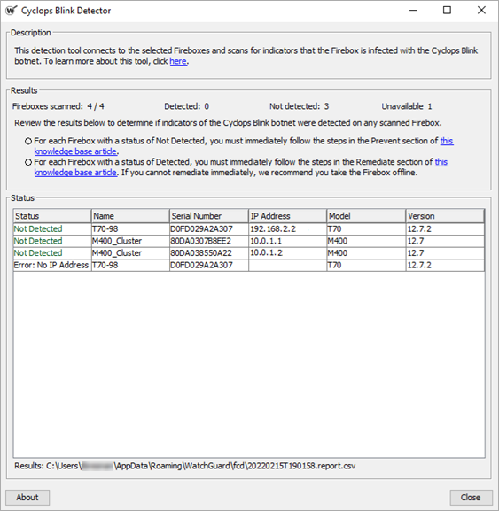
See Results for Multiple Managed Devices
In the Results section, the Status column shows results for each device
Detected – You must immediately follow the steps in the Remediate section of the 4-Step Cyclops Blink Diagnosis and Remediation Plan
If you cannot remediate immediately, we recommend you take the Firebox offline
Not Detected – You must immediately follow the steps in the Prevent section of the 4-Step Cyclops Blink Diagnosis and Remediation Plan
You can copy the text from the Results section
Results are also saved to a CSV file: C:\Users\<username>\AppData\ Roaming\WatchGuard\fcd\results.csv

Slide 22
SYSTEM Integrity Checks (v12.7.2 Update 2)

Slide 23
System Integrity Checks
The Firebox now uses a cryptographic signature to verify the integrity of the appliance
System integrity checks make sure that system files are valid and have not been corrupted
Integrity checks now run automatically:
Each time the Firebox boots
Before each software upgrade
You can also run an on-demand integrity check from Fireware Web UI for locally-managed or cloud-managed devices

Slide 24
System Integrity Checks
After you upgrade to a Fireware version that includes system integrity checks, you cannot downgrade to a Fireware version that is not signed by WatchGuard

Slide 25
Boot Time Integrity Check
When the Firebox boots, it uses the public key installed with the appliance image to verify the integrity of the files and directories on the appliance
If the boot time integrity check fails:
The boot process halts but power stays on
All interfaces are disabled
You cannot connect to the Firebox to see status
The error Error: integrity check failed appears in the serial console

Slide 26
Upgrade Integrity Check
The Firebox now runs an integrity check before every firmware upgrade
When you select a Fireware upgrade file to install, the Firebox makes sure the file contains a cryptographic signature
If the cryptographic signature is present, the Firebox uses the public key from the previously installed image to verify the relevant portion of the upgrade file
If the Firebox cannot verify the signature, or if the signature is not present, the Firebox refuses the upgrade

Slide 27
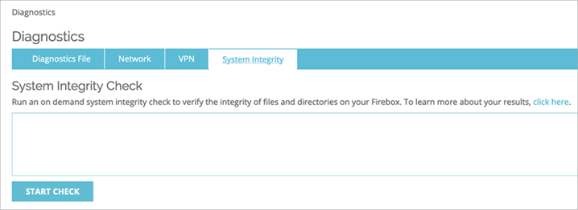
On-Demand Integrity Check
You can run a boot time integrity check at any time from Web UI
Select System Status > Diagnostics (locally-managed Fireboxes) or select Diagnostics (cloud-managed Fireboxes)
On the System Integrity tab, click Start Check
If the on-demand integrity check fails, the Firebox does not halt or shut down but does generate a fault report
To see the fault report, click the Diagnostics File tab

Slide 28
Downgrade Prevention (v12.7.2 Update 2)

Slide 29
Fireware Downgrade Prevention
In addition to the new upgrade integrity check, to prevent downgrades to unprotected versions of Fireware, this release changes the public key used to sign firmware images
After you upgrade to this Fireware release, you cannot downgrade a Firebox to a version of Fireware lower v12.7.2 Update 2
When WatchGuard releases future Fireware versions, you will be able to downgrade to v12.7.2 Update 2 or higher

Slide 30
Firebox Management Policy Warnings (v12.7.2 Update 2)

Slide 31
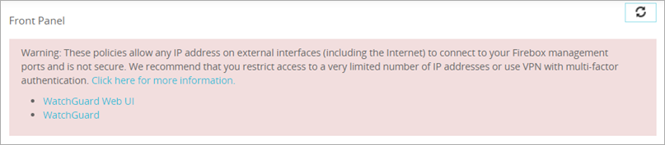
Secure Firebox Management Policies
You now see a warning in the Front Panel and Policies pages (Fireware Web UI) and above the firewall policy list (Policy Manager) when your configuration includes a Firebox management policy (such as WatchGuard or WatchGuard Web UI) that allows unrestricted Internet access to your Firebox
The warning message includes the names of any affected policies
Click the name of a policy to open and edit it

Slide 32
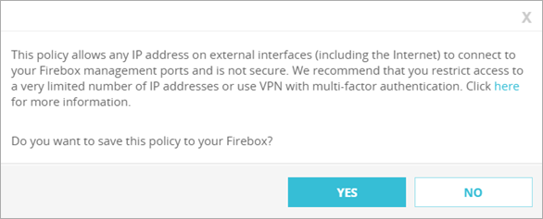
Secure Firebox Management Policies
You also see a warning message in Policy Manager and Fireware Web UI when you try to save a Firebox management policy that allows unrestricted Internet access to your Firebox
We recommend that you configure Firebox management policies to restrict management access to the Firebox
For more information, see the Firebox Remote Management Best Practices Knowledge Base article and the Secure Firebox Management Access Video Tutorial

