Slide 1
What’s new in fireware 12.7.1

Slide 2
What’s new in Fireware v12.7.1
AuthPoint Firebox Integration Support for Azure AD Users
Post-NAT IP Addresses in NetFlow
WatchGuard Cloud Connection Status for Cloud-managed Fireboxes
RADIUS Enhancements
Support for the Firebox T80 LTE Interface Module

Slide 3
What’s new in Fireware v12.7.1
Fireware v12.7.1 is available for these Firebox models:
M Series: M270, M370, M400, M440, M470, M500, M570, M670, M4600, M4800, M5600, M5800
T Series: T20, T40, T55, T70, T80
FireboxV and Firebox Cloud
Fireware v12.7.1 does not support these models:
T10, T15, T30, T35, T50, M200, M300
We continue to support these models with Fireware v12.5.x firmware. For more information, see this KB article

Slide 4
AuthPoint Firebox Integration Support for Azure AD Users

Slide 5
AuthPoint Firebox Integration
The AuthPoint authentication server on the Firebox now supports Azure Active Directory users for:
Mobile VPN with SSL
Mobile VPN with IKEv2
Firebox Authentication Portal

Slide 6
Requirements
You must register and connect your Firebox to WatchGuard Cloud as a locally-managed Firebox (this integration does not support cloud-managed Fireboxes)
Microsoft Network Policy Server (NPS) is required to authenticate Azure Active Directory users that use Mobile VPN with IKEv2
In AuthPoint, you must configure at least one group before you can add users or authentication policies
To sync Azure Active Directory users to AuthPoint, in AuthPoint you must configure an Azure AD external identity

Slide 7
Mobile VPN with SSL Authentication Workflow
User initiates a VPN connection from a Mobile VPN with SSL client to the Firebox
Firebox forwards the request to AuthPoint
AuthPoint determines if the user is an Azure Active Directory user and verifies the user has a valid MFA policy
AuthPoint contacts Azure Active Directory to validate the first factor (password)
Azure Active Directory validates the user credentials and responds to AuthPoint Continued on the next slide

Slide 8
Mobile VPN with SSL Authentication Workflow
AuthPoint authenticates the user with MFA
For Push:
AuthPoint sends a push notification to the user's mobile phone
User receives and approves the push notification
AuthPoint receives the push approval and contacts the Firebox
Firebox receives the approval and allows the user to connect to the VPN
For OTP:
AuthPoint validates the OTP
Firebox receives the approval and allows the user to connect to the VPN

Slide 9
Mobile VPN with IKEv2 Authentication Workflow
User initiates a Mobile VPN with IKEv2 VPN connection to the Firebox
Firebox forwards the request to AuthPoint
AuthPoint determines if the user is an Azure Active Directory user and verifies the user has a valid MFA policy
AuthPoint communicates to the Firebox that the NPS server must validate the user
Firebox sends the user’s credentials to NPS for validation (RADIUS protocol). NPS is required for Azure Active Directory users who log in from an IKEv2 client
NPS responds to the Firebox Continued on the next slide

Slide 10
Mobile VPN with IKEv2 Authentication Workflow
Firebox sends an MFA request to AuthPoint
AuthPoint sends a push notification to the user's mobile phone
User receives and approves the push notification
AuthPoint receives the push approval and contacts the Firebox
Firebox receives the approval and allows the user to connect to the VPN

Slide 11
Firebox Authentication Portal Authentication Workflow
User connects to the Firebox Authentication Portal on port 4100
User provides credentials and selects the AuthPoint authentication domain
Firebox forwards the request to AuthPoint
AuthPoint determines if the user is an Azure Active Directory user and verifies the user has a valid MFA policy
AuthPoint contacts Azure Active Directory to validate the first factor (password)
Azure Active Directory validates the user credentials and responds to AuthPoint Continued on the next slide

Slide 12
Firebox Authentication Portal Authentication Workflow
User is presented with an authentication page that shows the available authentication methods
User selects an authentication method
Firebox sends an MFA request to AuthPoint Continued on the next slide

Slide 13
Firebox Authentication Portal Authentication Workflow
AuthPoint authenticates the user with MFA:
For Push:
AuthPoint sends a push notification to the user's mobile phone
User receives and approves the push notification
AuthPoint receives the push approval and contacts the Firebox
Firebox receives the approval and allows the user to log in
For OTP:
AuthPoint validates the OTP
Firebox receives the approval and allows the user to log in

Slide 14
Post-NAT IP addresses in Netflow

Slide 15
Post-NAT IP Addresses in NetFlow
IP addresses for NAT and NAT-T (NAT traversal) events now appear in NetFlow records if you select V9 in the Firebox NetFlow configuration
In the flow record, X-Src and X-Dst indicate the post-NAT source and destination IP addresses
You can use NAT events to identify which clients on the local network generated traffic
Date first seen | Event | XEvent | Proto | Src IP Addr:Port | Dst IP Addr:Port | X-Src IP Addr:Port | X-Dst IP Addr:Port | In Byte | Out Byte
6/14/2021 11:43 | CREATE | Ignore | TCP | 10.0.0.100:42170 | 203.0.113.32:80 | 10.148.39.62:42170 | 203.0.113.32:80 | 0 | 0

Slide 16
WatchGuard Cloud Connection Status For Cloud-managed Fireboxes

Slide 17
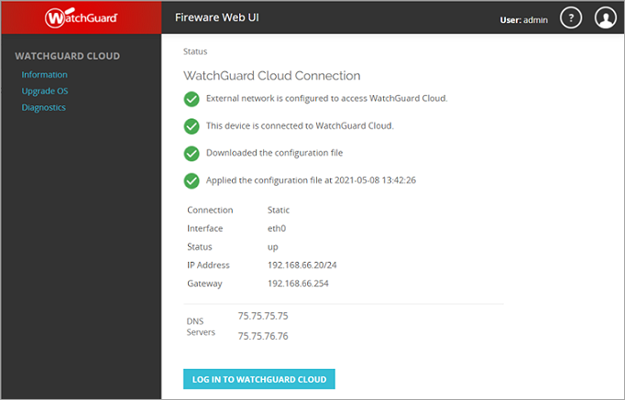
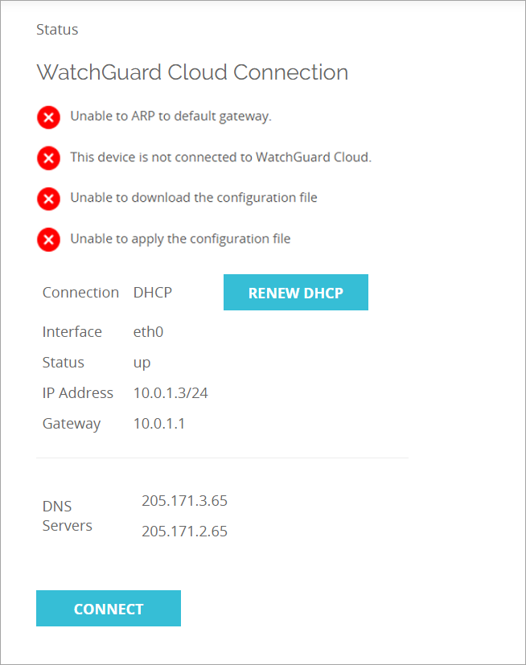
WatchGuard Cloud Connection Status
To help identify the cause of connection issues between a cloud-managed Firebox and WatchGuard Cloud, the Fireware Web UI > Information page now indicates when there is a connection issue and the reason, including:
No external interface is connected
No external network address is configured
No default gateway is configured
Unable to ARP to default gateway
No DNS server is configured
Unable to resolve the IP address of cloud.watchguard.com
Unable to connect to cloud.watchguard.com

Slide 18
RADIUS support for 256-character shared secret

Slide 19
256-Character Shared Secret
In Fireware Web UI and Policy Manager, you can now include up to 256 characters in the shared secret for RADIUS servers

Slide 20
Support For The Firebox T80 LTE Interface Module

Slide 21
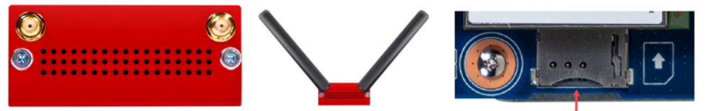
Firebox T80 LTE Interface Module
A new interface module is available for the Firebox T80 that enables you to install a SIM card and use the 4G LTE cellular connection as an external interface on the Firebox
Use the interface as a backup or primary connection for WAN connectivity
Operates the same way as any other modem interface
Note: Verizon is currently not yet supported for 4G LTE access on the T80 LTE interface module

Slide 22
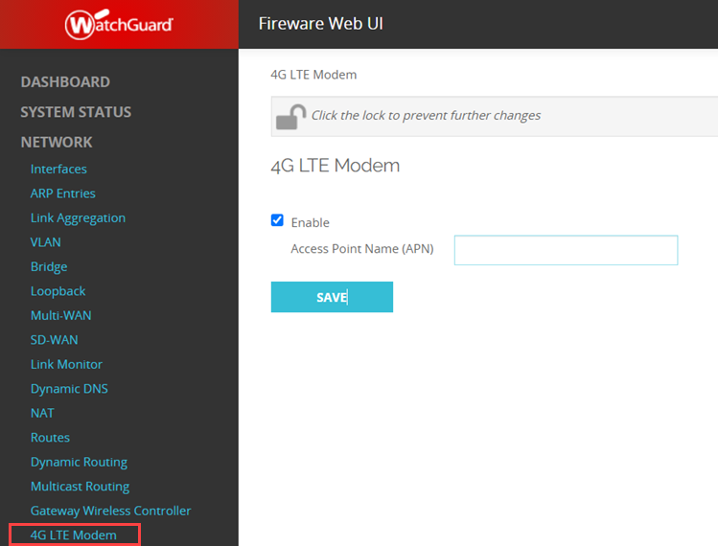
Configure the LTE Interface Module
From Fireware Web UI, select Network > 4G LTE Modem
Access Point Name (APN)
Some wireless service providers require an APN
Contact your provider for an APN, if required
In most cases, your service provider automatically assigns the APN when the connection is established

Slide 23
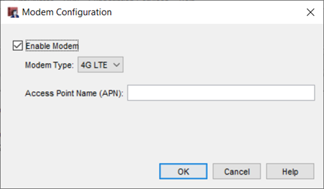
Configure the LTE Interface Module
From WatchGuard System Manager, select Network > Modem
Select 4G LTE as the modem type
Specify an Access Point name, if required

Slide 24
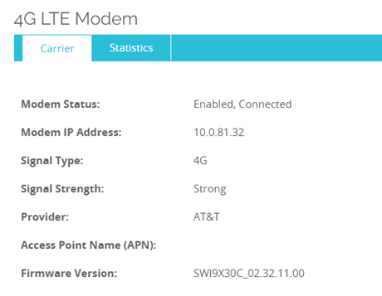
Monitor the LTE Interface Module
To monitor the 4G LTE modem from Fireware Web UI:
Select System Status > 4G LTE Modem

Slide 25
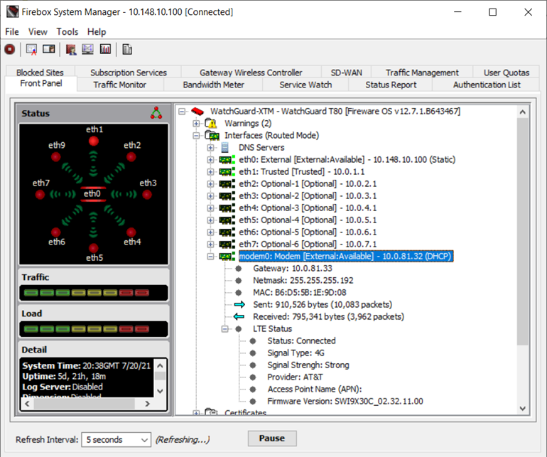
Monitor the LTE Interface Module
To monitor the 4G LTE modem from Firebox System Manager:
Expand the modem0 interface on the Front Panel

Slide 26
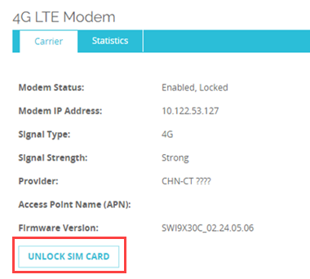
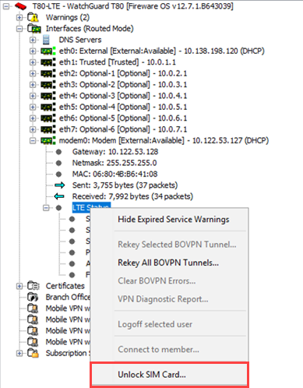
SIM Card Lock PIN
Some cellular providers lock their SIM card with a PIN to prevent unauthorized use
Contact your provider for information on how to disable or unlock the SIM card
To unlock the SIM card, you can specify a SIM card PIN from Fireware Web UI or Firebox System Manager

