Slide 1
What’s New in Fireware v12.5

Slide 2
What’s New in Fireware v12.5
Reverse Proxy for Access Portal
NetFlow Egress
WebBlocker Override Enhancements
WebBlocker Warn Message Customization
ECDSA Certificates for BOVPN and BOVPN Virtual Interfaces
Gateway Wireless Controller Enhancements
Support for Multiple RADIUS Servers

Slide 3
What’s New in Fireware v12.5
MTU Setting for BOVPN Virtual Interfaces
Device Configuration Template Enhancements

Slide 4
Reverse Proxy for Access Portal

Slide 5
Access Portal Enhancements
In the Access Portal configuration, you can now configure reverse proxy actions so remote users can connect to internal web applications and Microsoft Exchange services with an external URL
With reverse proxy actions, you can give remote teams access to internal resources without the need for a VPN
Because multi-factor authentication is supported, you can deploy this solution in compliance environments

Slide 6
Reverse Proxy
The reverse proxy on the Firebox Access Portal forwards traffic from external networks to Exchange servers or other web servers on your internal networks
You can configure reverse proxy actions so remote users can connect to an internal Exchange server with these clients:
  Mobile devices with Microsoft mail clients (through ActiveSync)
  Microsoft Outlook
  Microsoft Outlook Web Access
  Microsoft Outlook Web Access through the Access Portal (with automatic sign-in)
You can also configure reverse proxy actions so users can authenticate through the Access Portal to connect through to other internal web applications

Slide 7
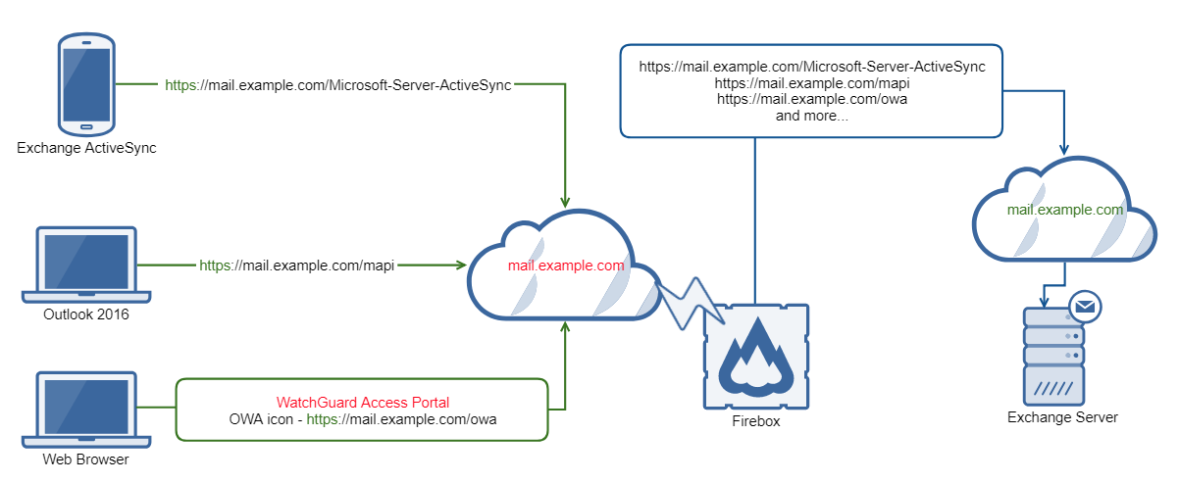
Configuration Example

Slide 8
Authentication and Access to Web Apps
Users can be authenticated by the Firebox to get access to internal web applications
  Users can be authenticated by ActiveSync through the Firebox for mobile email applications
  Users can be authenticated by HTTP over TLS through the Firebox for select email applications
  Users can be authenticated by MFA through the Firebox to access internal web applications
We recommend that custom web applications use the Access Portal for security reasons

Slide 9
Authentication and Access to Web Apps
There is an option to forward Access Portal credentials
  Enable this option to automatically log users in to web applications with their Access Portal credentials.
  When this feature is enabled, the Access Portal caches user credentials. The cached credentials are sent to the web application with the HTTP authorization header over TLS.
To log in to web applications with Access Portal credentials:
  The web application must accept HTTP basic authentication
  The Access Portal and the web application must share the same authentication domain

Slide 10
Authentication and Access to Web Apps
Do not enable the option to forward Access Portal credentials in these cases:
  Users log in to the Access Portal with SAML
  Users log in to the Access Portal with a different authentication domain than the web application (for example, with Firebox-DB)

Slide 11
Certificates
To avoid certificate warnings on client side, Firebox web certificate must include host names of the web applications as subject alternative names or use a wildcard host name (*.example.com) as the common name
To validate the server certificate of the web application, the self-signed certificate option for the reverse proxy action must be disabled and the CA certificates must be present on Firebox
If the self-signed certificate option for an internal web application is disabled, the Firebox validates the server certificate of the web application and denies access if the certificate is not trusted

Slide 12
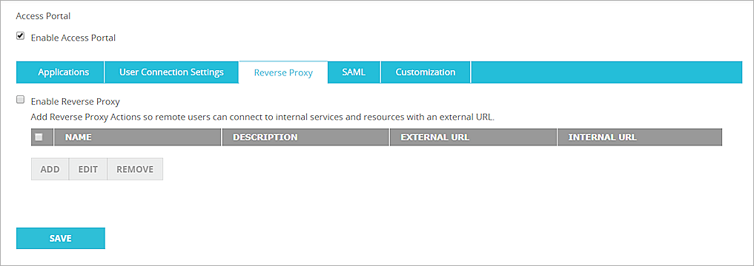
Add an Action
You can add reverse proxy actions in the Access Portal configuration
  Enable Reverse Proxy
  Add, edit, and remove Reverse Proxy Actions
  The Reverse Proxy Actions list shows the external URLs that are redirected to the URLs of the internal web resources

Slide 13
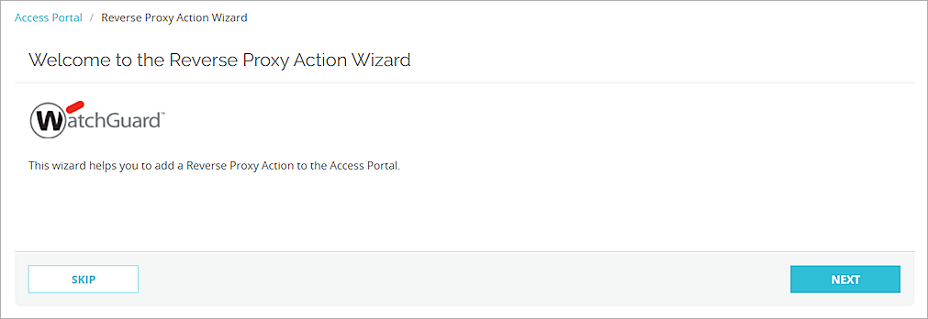
Add an Action
You can add a reverse proxy action with the wizard or you can skip the wizard to manually configure an action
To configure Exchange services, we recommend the wizard because it includes pre-defined mappings

Slide 14
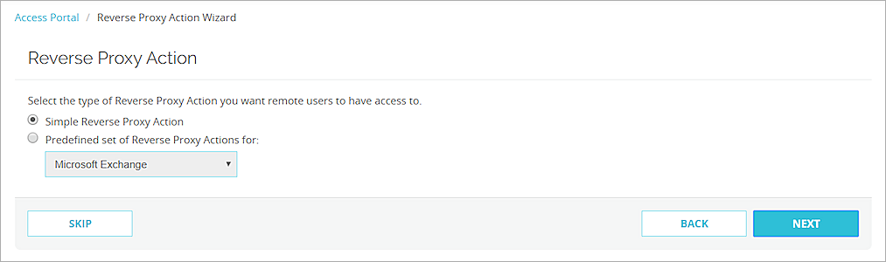
Add an Action (Wizard)
In the wizard, to add an action other than a Microsoft Exchange action:
  Select Simple Reverse Proxy Action

Slide 15
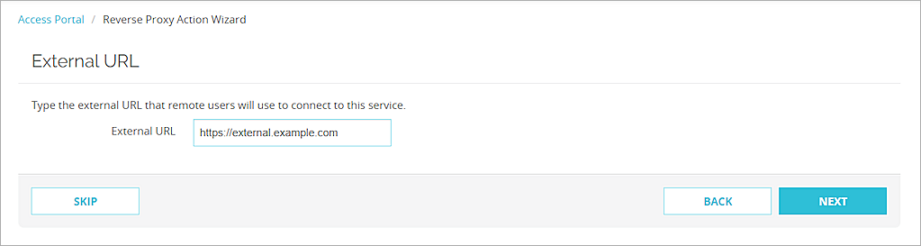
Add an Action (Wizard)
Specify the external URL that users type to connect to the service

Slide 16
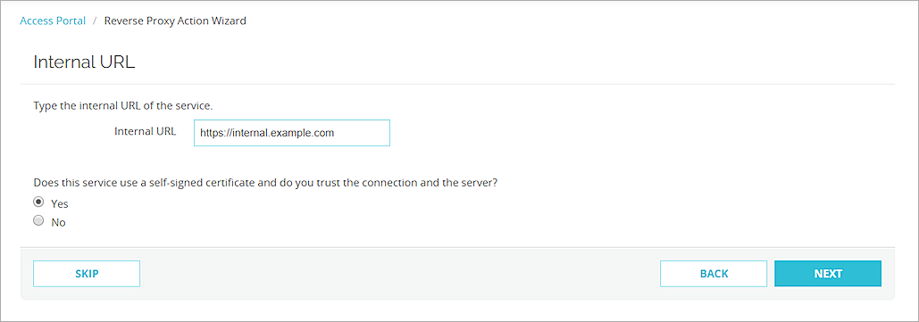
Add an Action (Wizard)
Specify the internal URL of the server and whether the server has a self-signed certificate

Slide 17
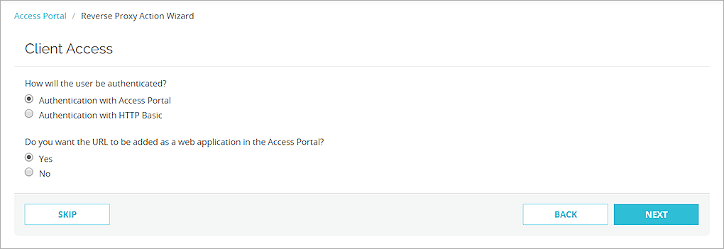
Add an Action (Wizard)
Select how to authenticate users
Select whether to add this URL as a web application in the Access Portal

Slide 18
Add an Action (Wizard)
If you add the app to the Access Portal, you must also specify:
  App name
  App description (optional)
  Custom icon (optional)
  Whether to forward credentials from the Access Portal to the URL
If you chose not to add this URL as a web application in the Access Portal, you must type a name and description for the reverse proxy action

Slide 19
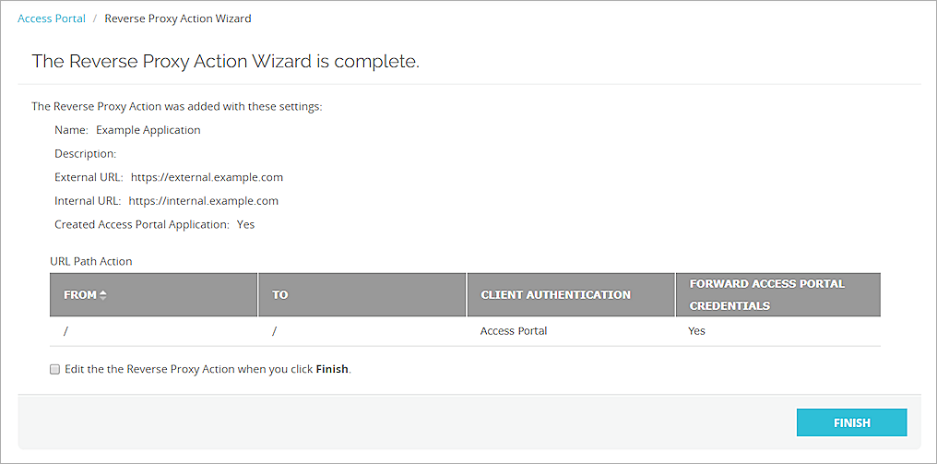
Add an Action (Wizard)
You can edit the action after the wizard closes
  You might do this if you want to specify a URL path action

Slide 20
Add an Action (Manually)
Skip the wizard to manually add a reverse proxy action
When you manually add an action, you must:
  Specify a name and description (optional)
  Specify the URL that remote users will use to access this web service
  Specify the internal URL of the web service
  Specify whether the web service uses a self signed certificate
  Add URL path mappings

Slide 21
Add an Exchange Action
To configure a reverse proxy action for Exchange:
  The Exchange server must accept HTTP basic authentication
  The administrator must configure the internal and external URLs in the Exchange settings

Slide 22
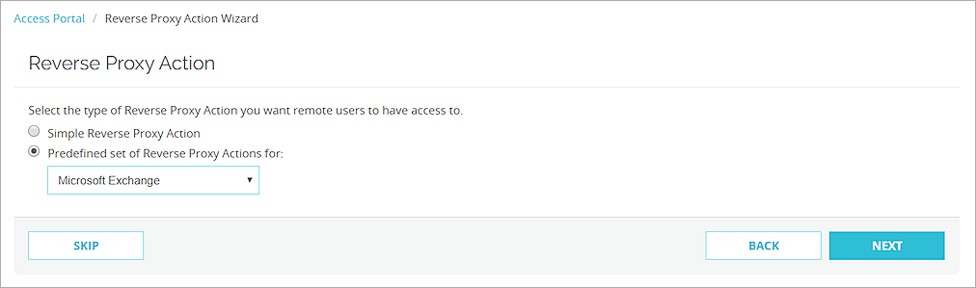
Add an Exchange Action (Wizard)
In the wizard, to add a Microsoft Exchange action:
  Select Predefined set of Reverse Proxy Actions for
  From the drop-down list, select Microsoft Exchange

Slide 23
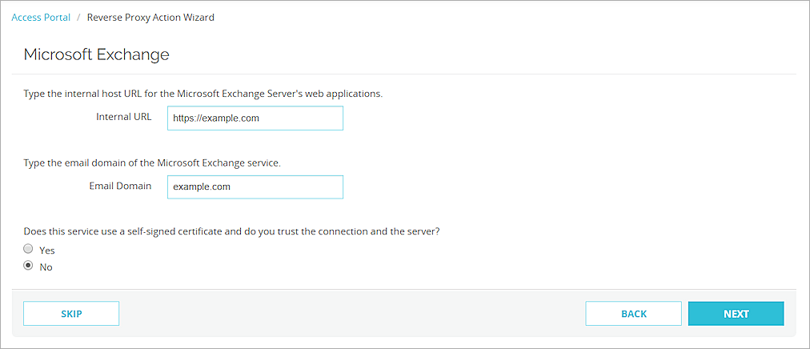
Add an Exchange Action (Wizard)
Specify the internal host URL for web applications on the Microsoft Exchange Server
Specify your Microsoft Exchange email domain
Select whether the web service uses a self signed certificate

Slide 24
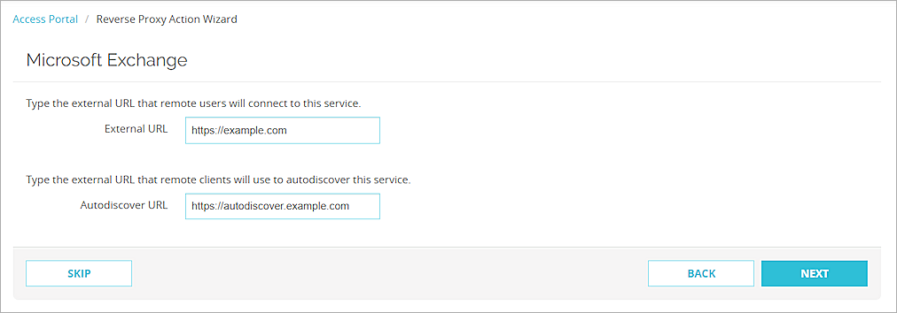
Add an Exchange Action (Wizard)
Specify the URL that remote users use to access this service
Specify the URL that remote clients use to discover this service

Slide 25
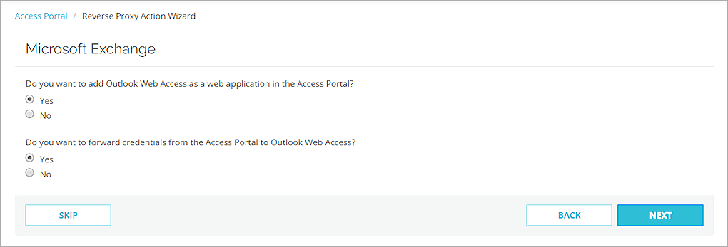
Add an Exchange Action (Wizard)
Select whether to add Exchange as a web application in the Access Portal
Select whether to forward credentials from the Access Portal to Exchange
  This option automatically logs users in to web applications with their Access Portal credentials

Slide 26
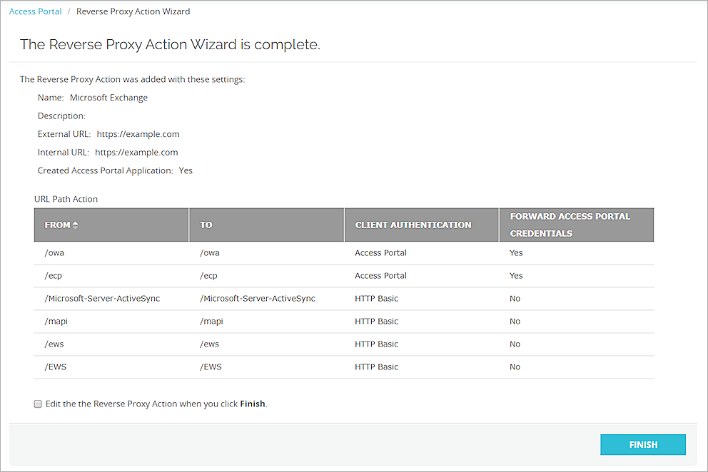
Add an Exchange Action (Wizard)
You can edit the action after the wizard closes
  You might do this if you want to specify a URL path action

Slide 27
Path Mapping
URL Path Actions determine the necessary URL translation that happens when a user navigates to the Access Portal URL and successfully authenticates
The default Path Action (from “/” to “/”) allows anything from the external host to the internal host

Slide 28
Path Mapping
Paths are case sensitive
  /owa is different from /OWA
If the path is a (virtual) directory on the web server, we recommend that the path end with a forward slash (/)
  Example: /app/
Paths followed by a query string should not end with a forward slash (/)
  Correct: /owa?query=foo
  Incorrect: /owa?query=foo/ or /owa/?query=foo
We recommend that the From path and the To path match

Slide 29
NetFlow Egress

Slide 30
NetFlow Egress
The Firebox now supports NetFlow in both directions (ingress and egress) so you can gain more insight into your network traffic

Slide 31
NetFlow Egress
In the NetFlow configuration, you can now select to monitor egress traffic for Firebox interfaces
  Egress traffic is traffic that exits an interface
  You can select to monitor ingress traffic, egress traffic, or both

Slide 32
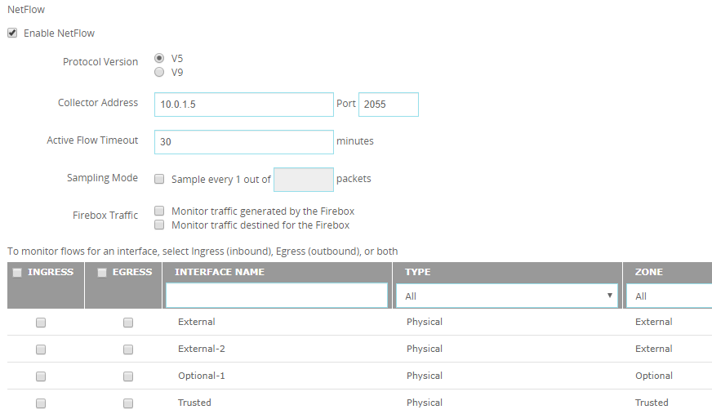
NetFlow Egress
Web UI

Slide 33
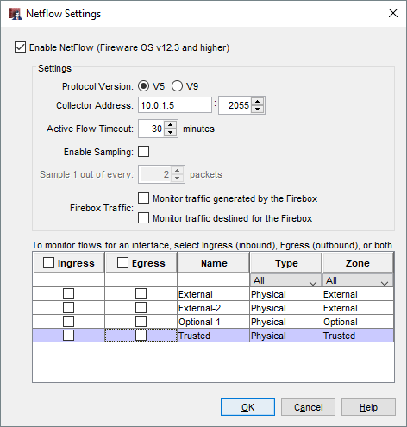
NetFlow Egress
Policy Manager

Slide 34
NetFlow Egress
To monitor traffic generated by the Firebox itself
(self-generated traffic), select one or both of these options:
  Monitor traffic generated by the Firebox
  Monitor traffic destined for the Firebox

Slide 35
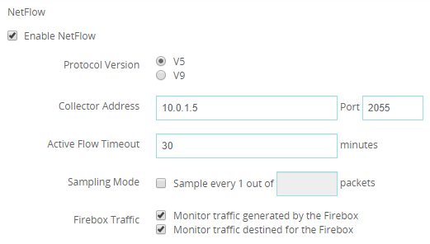
NetFlow Egress
Web UI

Slide 36
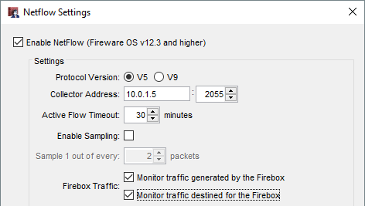
NetFlow Egress
Policy Manager

Slide 37
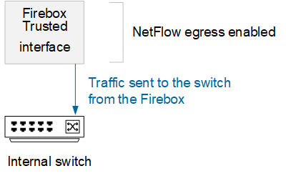
NetFlow Egress
Example —
  If you have an internal switch without NetFlow, enable NetFlow egress on the internal Firebox interface the switch connects to
  This captures traffic that exits the internal Firebox interface, which includes traffic sent to the switch

Slide 38
NetFlow Egress
If you enable both ingress and egress in the Firebox NetFlow configuration on multiple interfaces, be aware that your NetFlow data might include duplicate data
  To avoid duplicate data, enable either ingress or egress rather than both

Slide 39
WebBlocker Override Enhancements

Slide 40
WebBlocker Override
Administrators now have more control over when users can override WebBlocker settings:
  Enable or disable WebBlocker Override for websites in specific denied WebBlocker categories
    Example: Enable override for all websites in the Health category but not the Shopping category
  Allow users who are members of a specific user group to type their own credentials to override denied websites
    Example: Allow only users in the Teachers group to override WebBlocker settings

Slide 41
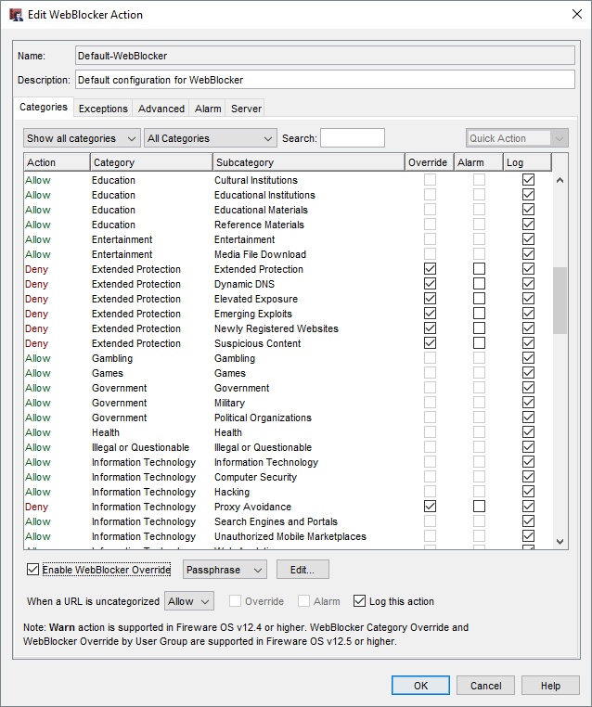
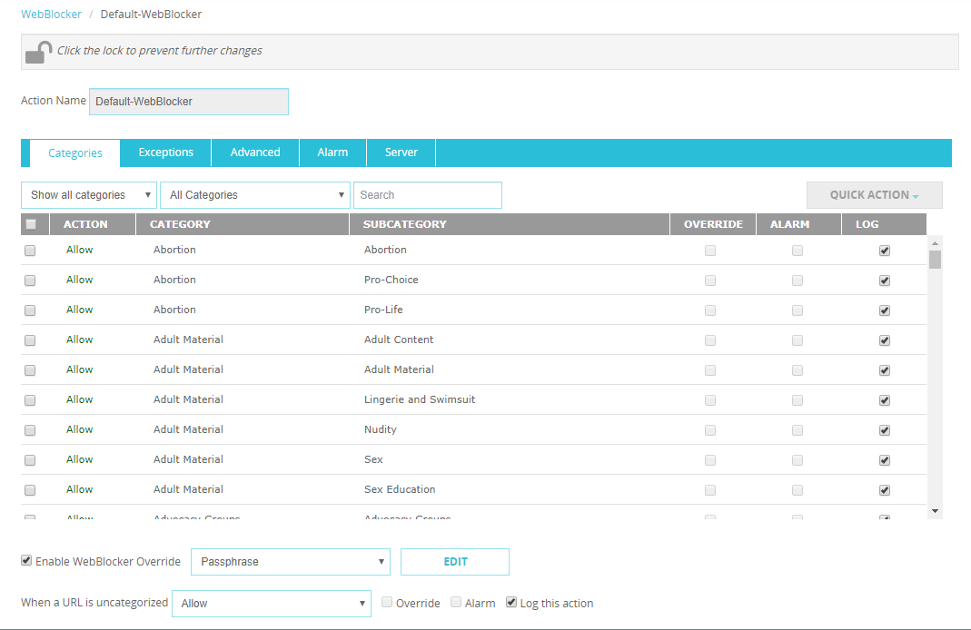
WebBlocker Override Settings
In a WebBlocker action, WebBlocker Override settings have moved from the Advanced tab to the Categories tab

Slide 42

WebBlocker Override Methods
You can now configure a WebBlocker action to use one of two override methods:
  Passphrase – Specify a passphrase that users type to override the WebBlocker settings and get access to denied content. This method was also available in previous Fireware versions
  User Group – Select an existing Firebox-DB or Active Directory user group. Other authentication servers are not supported for User Group override. Users who are members of the selected group can type their credentials to override the WebBlocker settings and get access to denied content
For each WebBlocker action, you can configure only one method

Slide 43
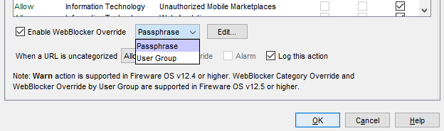
Enable WebBlocker Override
To enable WebBlocker Override:
Edit a WebBlocker action
In the Categories tab, select the Enable WebBlocker Override check box
From the drop-down list, select the override method:
  Passphrase – Users type an override passphrase
  User Group – Users in the selected group type their credentials
To configure Passphrase or User Group settings, click Edit

Slide 44
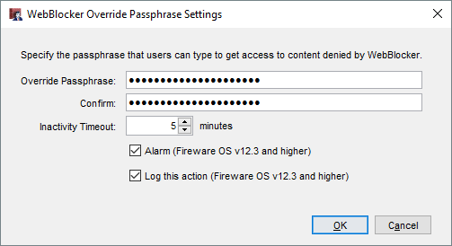
WebBlocker Override Passphrase Settings
Override Passphrase/Confirm – Type an override passphrase between 8 and 32 characters
Inactivity Timeout – Type the number of minutes after which inactive users can no longer access the content
Alarm/Log this action – Specify whether to send an alarm and log message when someone uses the override passphrase

Slide 45
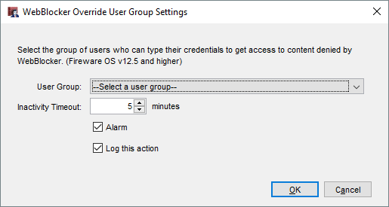
WebBlocker Override User Group Settings
User Group – Select a Firebox-DB or Active Directory user group. Other authentication servers are not supported for User Group override
Inactivity Timeout – Type the number of minutes after which inactive users can no longer access the content
Alarm/Log this action – Specify whether to send an alarm and log message when someone overrides with user group credentials

Slide 46
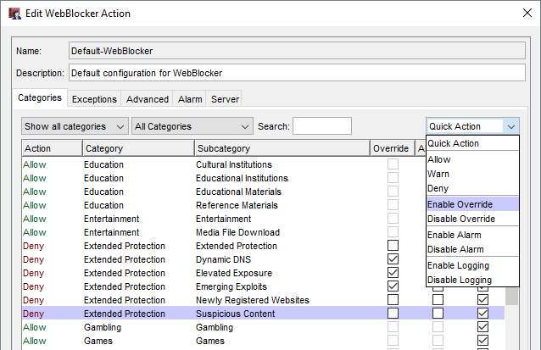
Select WebBlocker Override Categories
When you enable WebBlocker Override in a WebBlocker action, it is enabled for all denied categories automatically
To change which denied categories users can override:
  In the Override column, select or clear the check boxes
  Select a category, then from the Quick Action drop-down list, select Enable Override or Disable Override

Slide 47
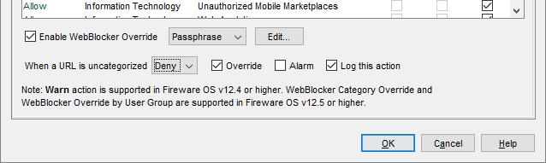
Override Denied Uncategorized URLs
If the WebBlocker action denies uncategorized URLs, you can allow users to override the denied URLs
Next to the When a URL is uncategorized drop-down list, select the Override check box

Slide 48
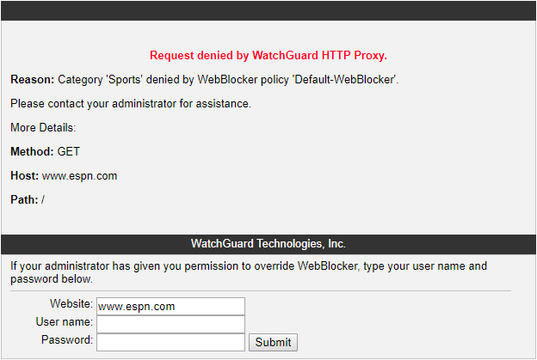
Override with User Group Credentials
If you configure WebBlocker Override for User Groups, all users see this page when they go to a site in a WebBlocker category that has override enabled:
Users in the specified Firebox-DB or Active Directory user group can type their credentials to get access to the website
This does not affect login limits configured in group settings

Slide 49
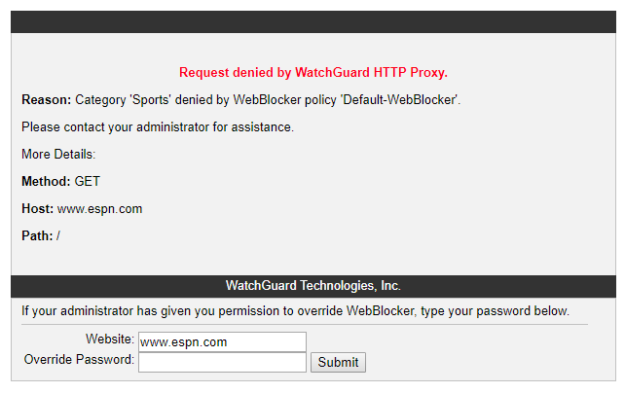
Override with the Override Passphrase
If you configure the WebBlocker Override Passphrase, all users see this page when they go to a site in a WebBlocker category that has override enabled:
Users can type the override passphrase specified in the WebBlocker action to get access to the website

Slide 50
WebBlocker Override and HTTPS
For HTTPS, WebBlocker Override is only supported when content inspection is enabled in the HTTPS proxy for all HTTPS traffic
If content inspection is not enabled in the HTTPS proxy:
  When users go to a site in a denied WebBlocker category that has override enabled, the HTTPS proxy drops the connection
  Users see a browser warning instead of the WebBlocker Deny page, and cannot override WebBlocker to get access to the site

Slide 51
WebBlocker Override Log Messages
If you enable logging, the Firebox sends a log message when a user overrides WebBlocker:
  Log message for a Passphrase override:
    Apr 3 16:57:00 2019 WatchGuard-XTM local1.info http-proxy[2642]: msg_id="1AFF-0021" Allow 1-Trusted 0-External tcp 10.0.1.70 157.140.2.32 49372 80 msg="ProxyAllow: HTTP Request categories" proxy_act="HTTP-Client.Standard.2" cats="" details="Allowed by passphrase overriding category action" op="GET" dstname="iczn.org" arg="/" geo_dst="GBR" (HTTP-proxy-00)
  Log message for a User Group override:
    Apr 4 01:41:59 2019 WatchGuard-XTM local1.info http-proxy[2641]: msg_id="1AFF-0021" Allow 1-Trusted 0-External tcp 10.0.1.70 157.140.2.32 50369 80 msg="ProxyAllow: HTTP Request categories" proxy_act="HTTP-Client.Standard.2" cats="" details="Allowed by user group overriding category action. user=user1@ECObios, group=group1" op="GET" dstname="iczn.org" arg="/" geo_dst="GBR" src_user="test@jacky_radius" (HTTP-proxy-00)

Slide 52
WebBlocker Override – Upgrades
When you upgrade to Fireware v12.5:
  Users can no longer override WebBlocker for websites denied by WebBlocker exceptions and WebBlocker Server timeouts
  WebBlocker actions that were not previously configured with an override passphrase do not have WebBlocker Override enabled
  WebBlocker actions that were previously configured with an override passphrase have WebBlocker Override enabled:
    WebBlocker Override uses the Passphrase override method with the same passphrase
    All denied categories in the WebBlocker action have the Override check box selected automatically
    If the WebBlocker action denied uncategorized URLs, the Override check box next to the When a URL is uncategorized drop-down list is selected automatically

Slide 53
WebBlocker Warn Message Customization

Slide 54
WebBlocker Warn Message
You can now customize the Warn message used for WebBlocker Warn actions in HTTP and Explicit proxies
Administrators can use this feature to:
  Customize the Warn message text and add content to educate and inform their users about acceptable usage policies
  Match the Warn message appearance to the custom styles and branding used in the Deny message
Preview buttons in the proxy action now show you a preview of both the Warn and Deny messages

Slide 55
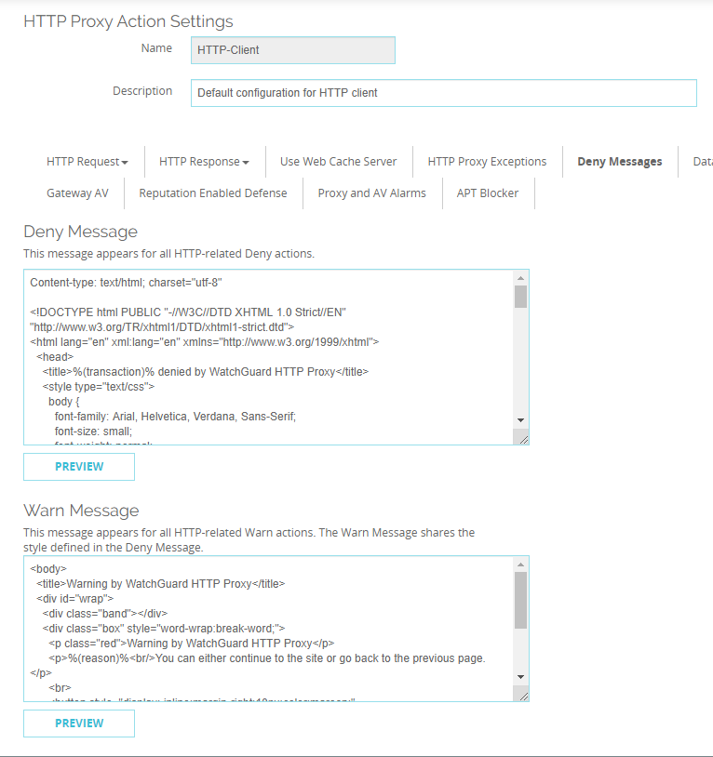
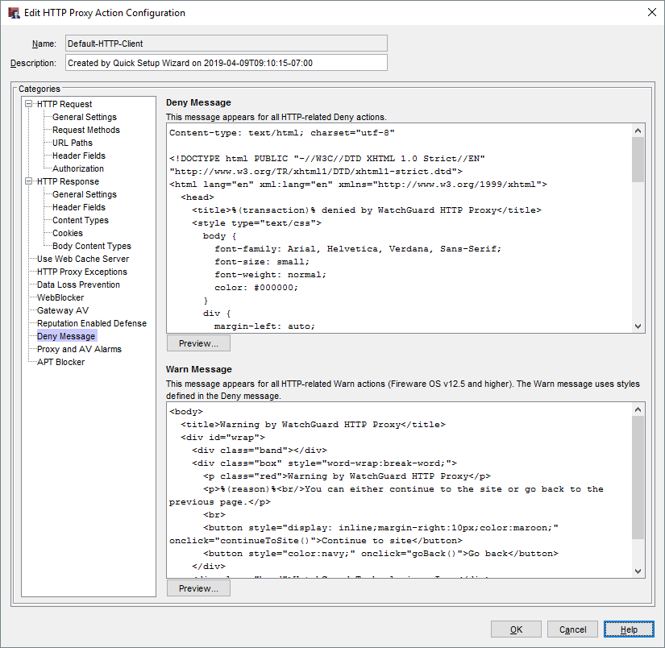
WebBlocker Warn Message
In HTTP and Explicit proxy actions, the Deny Message category now includes a new Warn Message section
  Currently, the Firebox uses the Warn message text for WebBlocker Warn actions only

Slide 56
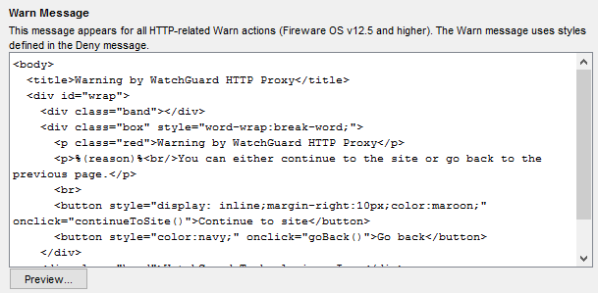
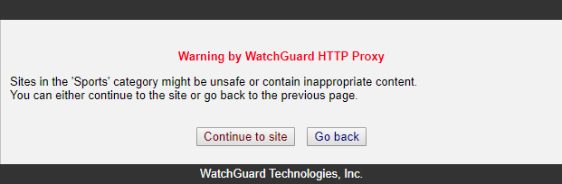
WebBlocker Warn Message – Upgrade
After you upgrade to Fireware v12.5, all HTTP and Explicit proxy actions in your configuration include default Warn message text

Slide 57
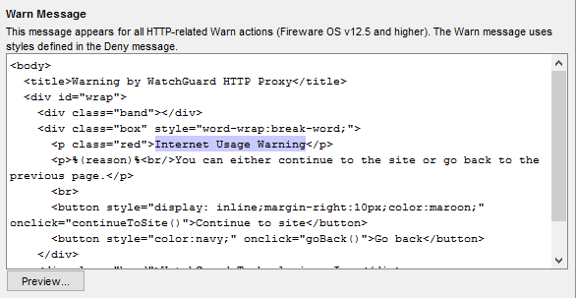
Customize Warn Message Text
To customize the Warn message, in the Warn Message text box, edit the Warn message text and HTML code
If the Warn message text does not include the <body> and </body> tags, your users see the default Warn message text instead of your custom Warn message

Slide 58
Warn Message Variables
You can include these variables in the Warn message text:
  %(transaction)% – Transaction that caused the warning
  %(reason)% – Reason the Firebox showed the warning
  %(method)% – Request method from the request
  %(url-host)% – Server host name (or IP address) from the URL
  %(url-path)% – Path from the URL
  %(user-name)% – Authenticated user name
  %(serial)% – Serial number of the Firebox
  %(firewall)% – Name of the Firebox
When the Warn message appears in the browser, users see the relevant text instead of the variable name

Slide 59
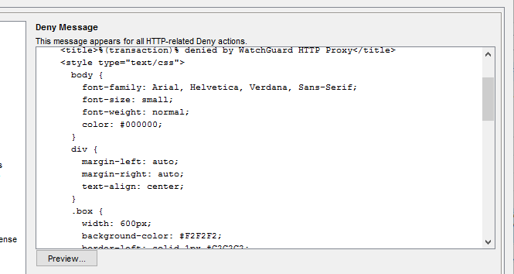
Customize Warn Message Styles
The Warn message uses the styles defined in the <HEAD> section of the proxy action Deny message
To customize the styles, make updates in the Deny message text box
Style changes apply to both the Deny and Warn messages

Slide 60
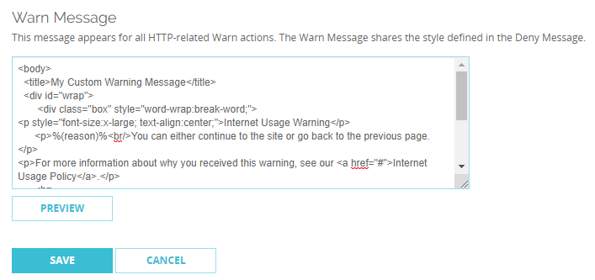
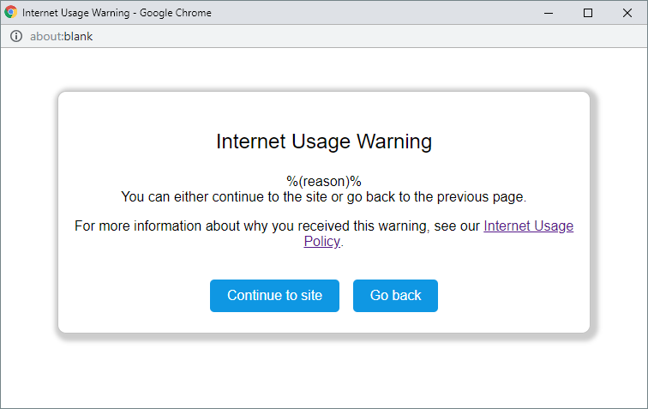
Preview the Warn Message
To see a preview of the Warn message or Deny message in a pop-up dialog box, click Preview
  Previews show variable names, not the text that replaces them
  In Policy Manager, the Preview displays the Continue to Site and Go Back buttons as text, but they appear as buttons in the Warn message your users see

Slide 61
ECDSA Certificates

Slide 62
ECDSA Certificates
The Firebox now supports Elliptic Curve Digital Signature Algorithm
(ECDSA) certificates for BOVPN, BOVPN virtual interfaces, and Mobile VPN with IKEv2
Compared to RSA, ECDSA certificates have equivalent security, smaller keys, and increased efficiency
Governments in some countries require ECDSA certificates for regulation compliance

Slide 63
ECDSA Certificates
ECDSA certificates are also known as EC certificates
You must import EC certificates
  The Firebox does not generate certificate signing requests for EC certificates
The Firebox supports these elliptic curves:
  Prime256v1
  Secp384r1
  Secp521r1

Slide 64
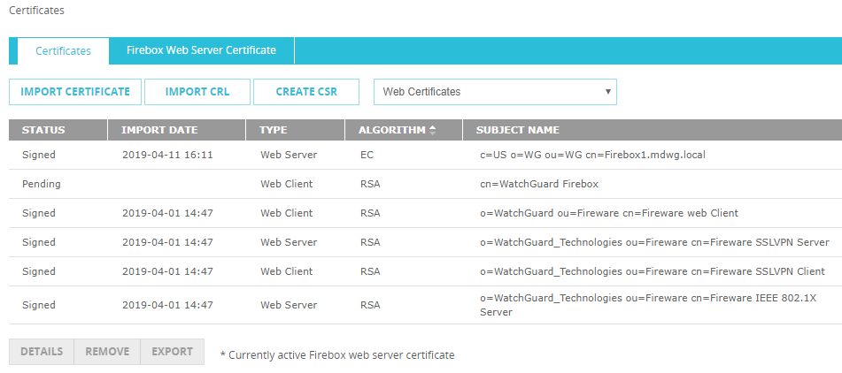
ECDSA Certificates for BOVPN and BOVPN VIF
When you import an EC certificate on your Firebox, the algorithm appears as EC

Slide 65
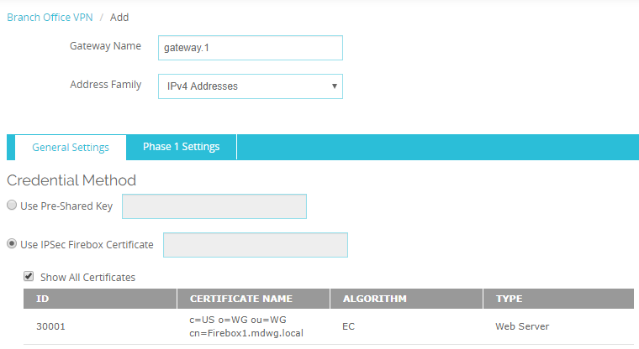
EC Certificates for BOVPN and BOVPN VIF
In the BOVPN gateway and BOVPN virtual interface configurations, you can select an EC certificate
BOVPN gateway

Slide 66
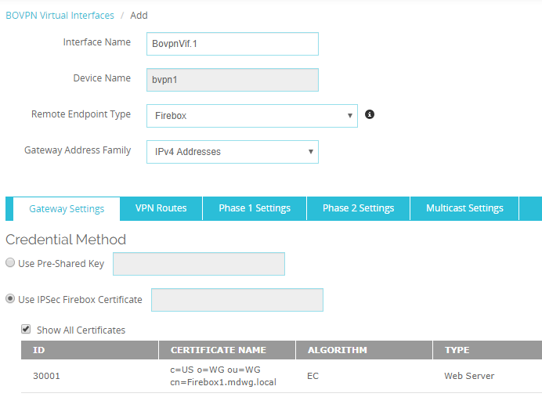
ECDSA Certificates for BOVPN and BOVPN VIF
BOVPN virtual interface

Slide 67
ECDSA Certificates for BOVPN and BOVPN VIF
BOVPNs and BOVPN virtual interfaces support EC certificates for IKEv1 and IKEv2
BOVPN tunnels with IKEv1 —
  If one VPN peer uses an EC certificate, the other peer must use an EC certificate
  VPN peers can use EC certificates with different elliptic curves
    The peer that initiates the VPN connection determines the authentication method
  The EC certificate determines the Hash algorithm
    For example, if you select SHA256-AES256-DH14 as the Phase 1 transform and specify an ECDSA-384 certificate, the Hash algorithm is SHA384 instead of SHA256

Slide 68
ECDSA Certificates for BOVPN and BOVPN VIF
BOVPN tunnels with IKEv2 —
  If one VPN peer uses an EC certificate, the other peer must use an EC certificate
  VPN peers can have EC certificates with different elliptic curves
    Each peer determines its own authentication method based on the EC certificate, which means peers can use different authentication methods

Slide 69
ECDSA Certificates for Mobile VPN with IKEv2
The Firebox supports EC certificates for Mobile VPN with IKEv2
IKEv2 clients must also support EC certificates, but support varies by operating system
  Windows 10 — Partial support (ECDSA-256 and ECDSA-384 only)
  Android — Support with strongSwan, an open-source client
  macOS and iOS — No support

Slide 70
Gateway Wireless Controller
Enhancements

Slide 71
Gateway Wireless Controller Enhancements
Added support for the upcoming AP327X platform
  IP67-rated Outdoor AP
  Dual Radio 802.11ac Wave 2
  External antenna support
Additional suffix support for AP firmware versions
  x.x.x-xxx.x
  Currently only the AP125 has an additional suffix in the firmware version: 8.6.0-644.3
  Suffix does not appear in the UI when the AP is unpaired

Slide 72
Support for Multiple RADIUS Servers

Slide 73
Multiple RADIUS Servers
Support for more than one RADIUS server in Web UI and WSM
All features that supported RADIUS authentication servers now support multiple RADIUS authentication servers
Improved workflow for adding a RADIUS server
SecurID servers are now RADIUS servers with SecurID enabled

Slide 74
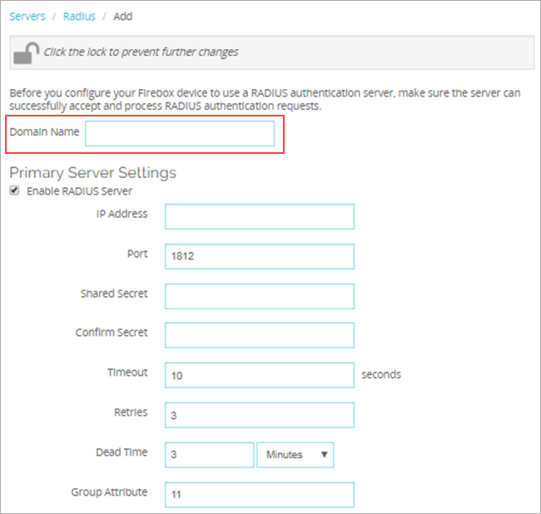
Unique Domain Names
You must specify a unique Domain Name for each RADIUS Server
  Important: You cannot edit the Domain Name after you
  add a server

Slide 75
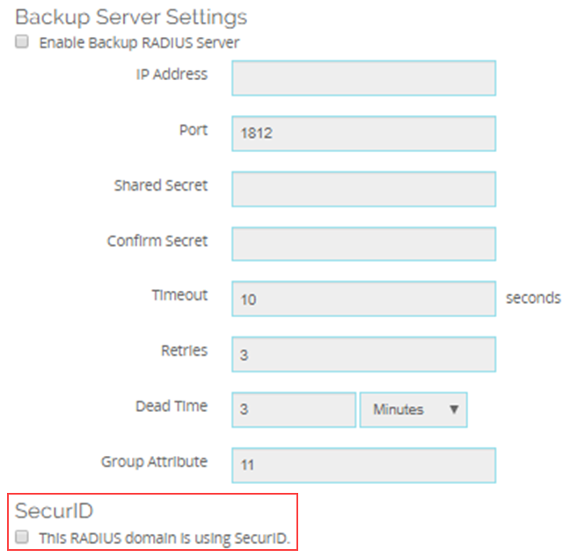
New SecurID option
SecurID cannot be configured as a standalone authentication server in v12.5
We now have RADIUS servers with SecurID enabled
New check box instead of a tab if RADIUS uses SecurID

Slide 76
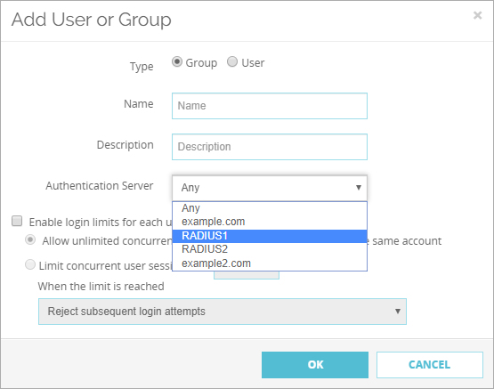
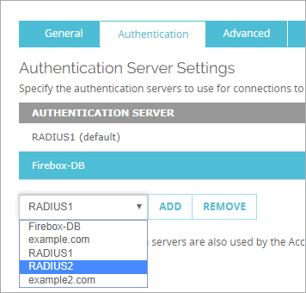
RADIUS Servers Available in All Features
In features that require authentication server configuration, all configured RADIUS servers appear in the drop-down lists
If a server is RADIUS with SecurID enabled, it will not appear in lists for features not supported by SecurID

Slide 77
RADIUS Server Drop-Down Lists
  Users and Groups
  Mobile VPN with IKEv2
  Mobile VPN with L2TP
  Mobile VPNS with SSL
  Mobile VPN with IPSec
  Default Authentication Servers
  System > Users and Roles
  Hotspot > Guest Administrators
  Wireless Access Point – only with WPA, WPA2 or WPA/WPA2
  Access Portal > User Connection Settings
  4100 authentication page – Default server appears first
  Web UI Login page – Must select RADIUS first, then the appropriate RADIUS server

Slide 78
RADIUS + SecurID Servers Not Available
If SecurID is enabled for the RADIUS server, the server does not appear in the Authentication Server
drop-down list for features that do not support SecurID
  Mobile VPN with IKEv2
  Mobile VPN with L2TP
  Hotspot > Guest Administrators
  Wireless Access Point

Slide 79
Upgrade Considerations
After you upgrade to Fireware v12.5, any previously configured SecurID servers become RADIUS servers with SecurID enabled
No changes to:
RADIUS SSO
Gateway Wireless Controller

Slide 80
MTU Setting for BOVPN Virtual Interfaces

Slide 81
MTU Setting for BOVPN Virtual Interfaces
You can now specify a custom maximum transmission unit (MTU) value for BOVPN virtual interfaces
You might need to do this if your Firebox connects to a third-party VPN endpoint that requires a custom MTU value
  For example, a Microsoft Azure VPN gateway requires an MTU of 1400
In most cases, you can use the default MTU values:
  For GRE-based virtual interfaces, the MTU is 1476
  For VTI-based virtual interfaces, the MTU is 1500
The MTU setting is specific to individual BOVPN virtual interfaces and is not a global Firebox setting

Slide 82
MTU Setting for BOVPN Virtual Interfaces
In Fireware v12.5, the MTU setting is available only through the CLI
In the CLI, specify this command:
diagnose vpn "/ipsec/vif/mtu/set \“[name]\" [MTU]"
For example, to change the MTU for the interface BovpnVif.1 to 1400, specify:
diagnose vpn "/ipsec/vif/mtu/set \"BovpnVif.1\" 1400"

Slide 83
Device Configuration Template Enhancements

Slide 84
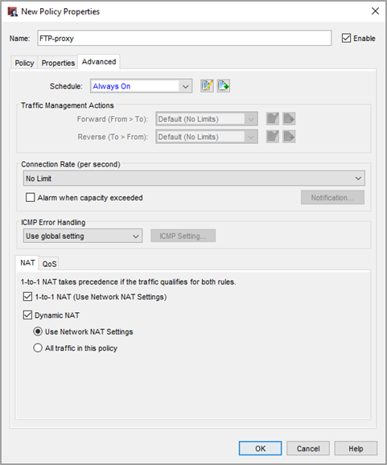
Device Configuration Templates
In Fireware v12.0 Device Configuration Templates
you can now configure
policy settings for:
  1-to-1 NAT
  Dynamic NAT

Slide 85
Thank You!

