Slide 1
What’s New in Fireware v12.5.5/12.6.2

Slide 2
What’s New in Fireware v12.5.5/12.6.2
CSfC Mode (12.6.2 only)
FireboxV on KVM (12.6.2 only)
Source Port in Policies (12.6.2 only)
ICMPv6 in Firewall Policy Templates (12.6.2 only)
Logon Disclaimer Behavior (12.6.2 only)
WebBlocker Server Timeout Default (12.6.2 only)
Certificate Signing Request Encryption Support (12.6.2 only)

Slide 3
What’s New in Fireware v12.5.5/12.6.2
Certificate Verification for VPN Peers
Panda Exceptions
TLS Version Requirements
DHCP Leases in the FSM Status Report
Test WebBlocker Actions in Fireware Web UI (12.6.2 U2 Only)
Default Packet Handling Options (12.6.2 U2 Only)

Slide 4
What’s New in Fireware v12.5.5/12.6.2
Fireware v12.6.2 is available for these Firebox models:
  M Series: M270, M370, M400, M440, M470, M500, M570, M670, M4600, M5600
  T Series: T20, T40, T80
  FireboxV and Firebox Cloud
Fireware v12.5.5 runs on all other Firebox models
Unless noted, the features described in this document are available in both Fireware v12.5.5 and Fireware v12.6.2

Slide 5
What’s New in Fireware v12.5.5/12.6.2
Use WSM v12.6.2 to manage Fireboxes that run Fireware v12.5.5 or Fireware v12.6.2
There is no WSM v12.5.5

Slide 6
CSfC Mode
(12.6.2 only)

Slide 7
CSfC Mode (12.6.2 only)
The U.S. National Security Agency (NSA) Commercial Solutions for Classified (CSfC) program certifies security-enabled products to be used for classified applications
The NIAP (National Information Assurance Partnership) defines Protection Profiles with certification requirements
  Firebox certification is in progress for these Protection Profiles:
    Network Device
    Virtual Private Network
    Firewall
  Firebox models evaluated for certification:
    T Series: T20, T35, T40, T55, T70, T80
    M Series: M270, M370, M470, M570, M670, M4600, M5600

Slide 8
CSfC Mode
CSfC mode is supported only in Fireware v12.6.2
  To request Fireware v12.6.2 for T35, T55, or T70, send an email to CSfC@watchguard.com
CSfC mode enables additional integrity and validity checks:
  At boot time, the Firebox runs integrity checks
    If the check fails, the Firebox shuts down immediately
  At upgrade time, the Firebox checks a signature in the upgrade image against a key already installed on the Firebox
    If the signature check fails, the Firebox refuses the upgrade
In CSfC mode, TLS v1.3 is disabled by default
  TLS v1.3 is not yet federally certified

Slide 9
CSfC Mode — CLI Commands
To enable CSfC mode, you must use the Command Line Interface (CLI)
CLI commands for CSfC:
  Show CSfC status: show csfc
    Shows whether CSfC mode is enabled or disabled
  Enable CSfC mode: csfc enable
    Enables CSfC mode, disables TLS 1.3
    Reboots the Firebox
  Disable CSfC mode: no csfc enable
    Disables CSfC mode, enables TLS 1.3
    Reboots the Firebox

Slide 10
CSfC and TLS 1.3 CLI Commands
You can use CLI commands to enable or disable TLS 1.3
  See TLS 1.3 status: show tlsv13
  Enable TLS 1.3: tlsv13 enable
    Enables TLS 1.3 and reboots the Firebox
  Disable TLS 1.3: no tlsv13 enable
    Disables TLS 1.3 and reboots the Firebox
These CLI commands are available regardless of CSfC mode

Slide 11
FireboxV on KVM
(12.6.2 only)

Slide 12
FireboxV on KVM (12.6.2 only)
Fireware now supports FireboxV on Kernel-based Virtual Machine (KVM)
  KVM is the open source hypervisor included with Linux
  The KVM kernel component is included in Linux as of 2.6.20
  The KVM user space component is included in QEMU as of 1.3
High-level setup steps:
  Install KVM server
  Convert the VMware installation image file to fireware.qcow2
  Install the FireboxV VM, and configure network interfaces
  Use the Web Setup Wizard to create a basic configuration

Slide 13
Source Port in Policies
(12.6.2 only)

Slide 14
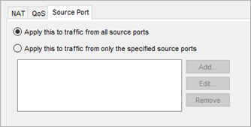
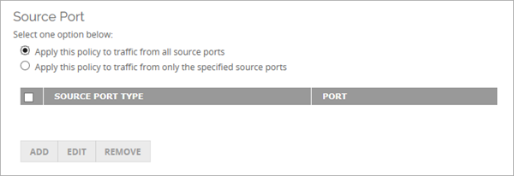
Source Port in Policies (12.6.2 only)
Firewall policy properties now include an option to limit policy scope based on the source port of the connection
Configure Source Port settings in Advanced policy properties
Policy Manager
Fireware Web UI

Slide 15
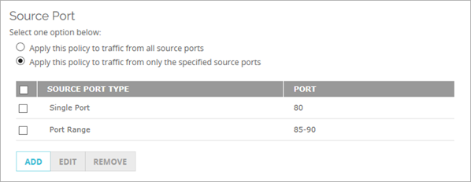
Source Port in Policies
By default, policies apply to traffic from all source ports
To apply a policy to traffic from specific source ports:
  Select Apply this policy to traffic from only the specified source ports
  Add source ports or port ranges to the list

Slide 16
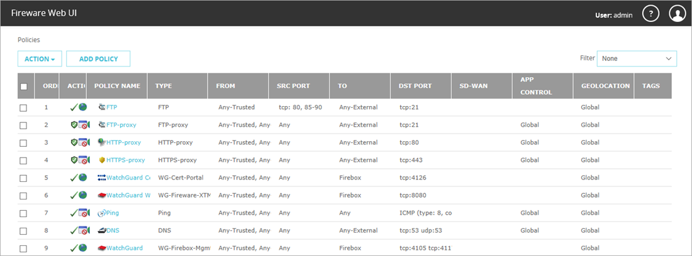
Source Port in Policies
If Source Port is enabled in any policy, the Policies list in Fireware Web UI includes a new SRC PORT column

Slide 17
Source Port in Policies — Restrictions
Source Port is configurable only for policies that handle TCP and/or UDP traffic (and do not apply to other protocols)
  Policies that apply only to TCP, such as HTTPS, FTP, RDP
  Policies that apply only to UDP, such as SNMP, L2TP, IKE
  Policies that apply to both TCP and UDP, such as DNS, NTP
Source Port is not configurable for any policy that includes a protocol other than TCP and UDP
  Examples: Any, Ping, IPSec, GRE, IGMP

Slide 18
ICMPv6 in Custom Policy Templates
(12.6.2 only)

Slide 19
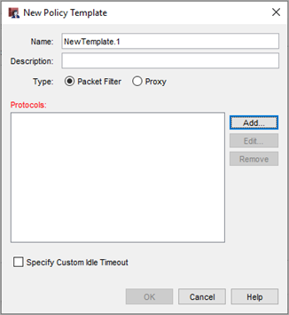
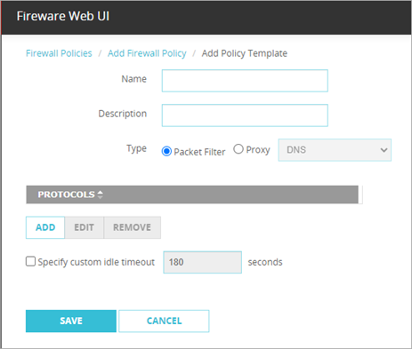
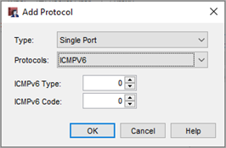
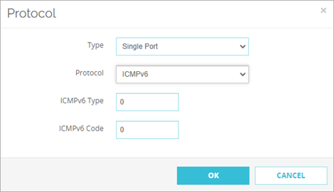
ICMPv6 in Custom Policy Templates
(12.6.2 only)
You can now configure a custom firewall policy template for ICMPv6 (Internet Control Message Protocol v6)
When you add the ICMPv6 protocol, you specify:
  ICMPv6 Type
  ICMPv6 Code

Slide 20
ICMPv6 in Custom Policy Templates
When you manage your Fireboxes with the WatchGuard Management Server, you can create Device Configuration Templates that you can apply to managed Fireboxes
Device Configuration Templates for Fireware v12.6 or higher support custom policy templates with the ICMPv6 protocol
If the Device Configuration Template is configured with a custom policy template for ICMPv6, you can deploy it only to a Firebox that runs Fireware v12.6.2

Slide 21
Logon Disclaimer Behavior
(12.6.2 only)

Slide 22
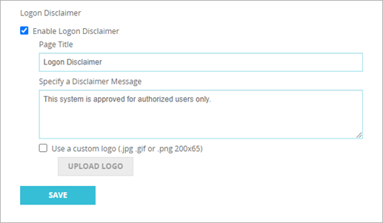
Logon Disclaimer Behavior (12.6.2 only)
When the Logon Disclaimer is enabled, the logon disclaimer text now appears before an administrative user logs in
Login Disclaimer configuration settings did not change

Slide 23
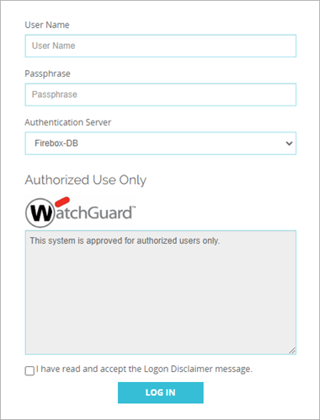
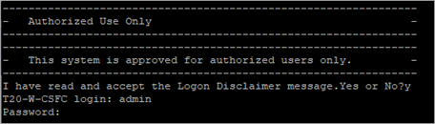
Logon Disclaimer Behavior
In Fireware Web UI and CLI, the user must accept the Login Disclaimer before they can log in
For WatchGuard System Manager, the user must accept the Logon Disclaimer after they log in (no change from previous versions)

Slide 24
WebBlocker Server Timeout Default
(12.6.2 only)

Slide 25
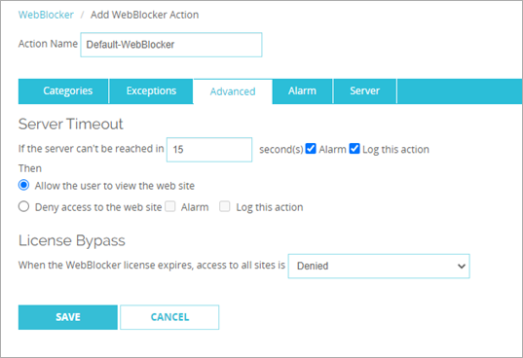
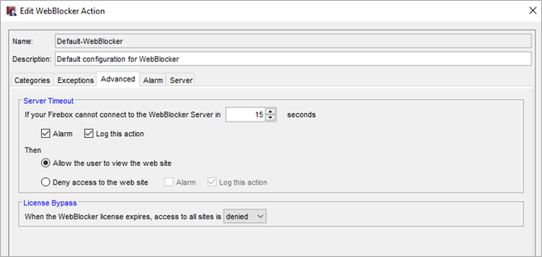
WebBlocker Server Timeout Default
(12.6.2 only)
By default, WebBlocker now allows users to view a website when the WebBlocker Server times out

Slide 26
Certificate Signing Request Encryption Support (12.6.2 only)

Slide 27
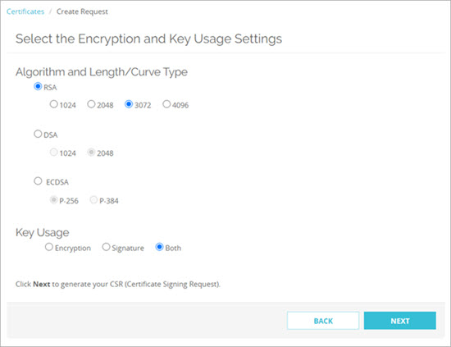
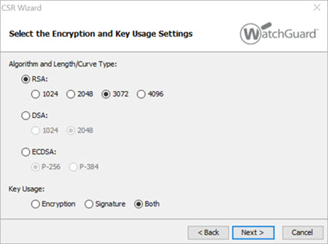
Certificate Signing Request Encryption Support (12.6.2 only)
Certificate Signing Requests (CSRs) in Fireware Web UI and WSM now support these encryption settings:
  RSA 3072
  RSA 4096
  ECDSA P-256
  ECDSA P-384

Slide 28
Certificate Verification for VPN Peers

Slide 29
Certificate Verification for VPN Peers
In the BOVPN and BOVPN virtual interface configurations, you can now specify a root or intermediate CA certificate for VPN peer verification
The Firebox uses the CA certificate to verify the certificate received from the VPN peer
  The certificate from the VPN peer must be part of the certificate chain that includes the specified root or intermediate CA certificate
  If the peer certificate is not part of the chain, the Firebox rejects Phase 1 tunnel negotiations
The CA Certificate setting appears when you select the Use IPSec Firebox Certificate credential method

Slide 30
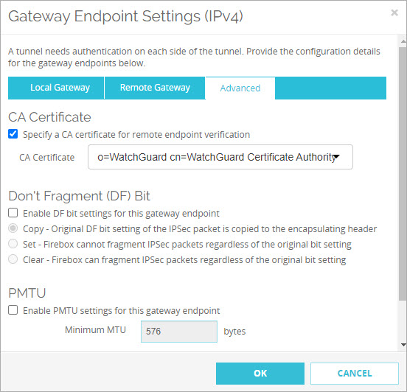
Certificate Verification for VPN Peers
Web UI

Slide 31
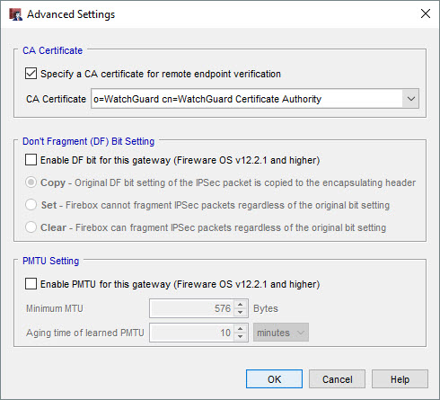
Certificate Verification for VPN Peers
Policy Manager

Slide 32
Panda Exceptions

Slide 33
Panda Exceptions
To allow connections to Panda products and services through the Firebox, these domains were added to the WebBlocker Exceptions list, Blocked Sites Exceptions list, and HTTPS Proxy Pre-defined list of Content Inspection Exceptions:
*.pandasecurity.com aether100proservicebus.servicebus.windows.net aether100pronotification.table.core.windows.net content.ivanti.com | *.globalsign.net *.globalsign.com *.digicert.com *.ctmail.com (for domain filtering and anti-spam protection)

Slide 34
TLS Version Requirements

Slide 35
TLS Version Requirements
TLS 1.2 or higher is now required for TLS connections to the Firebox
  The Firebox no longer accepts TLS handshakes that use TLS 1.1 or lower
This requirement affects all HTML pages served by the Firebox

Slide 36
DHCP Leases in the FSM Status Report

Slide 37
DHCP Leases in the FSM Status Report
In the FSM Status Report, the DHCP section now shows:
  Number of DHCP leases in use
  Total number of DHCP leases available in the configuration

Slide 38
Fireware v12.6.2 U2 Updates

Slide 39
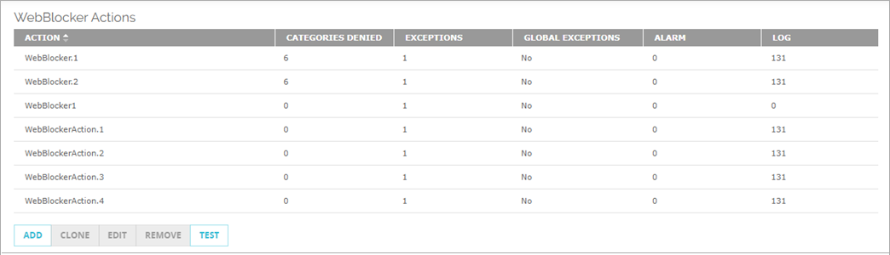
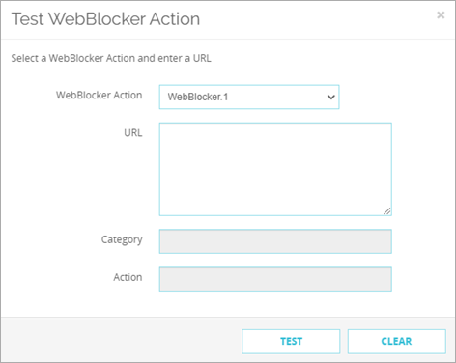
Test WebBlocker Actions in Fireware Web UI
In Fireware Web UI, you can now test WebBlocker actions to confirm whether WebBlocker will allow or block a URL
In the Test WebBlocker Action dialog
box, select the action, enter the HTTP
or HTTPS URL, and click Test
The WebBlocker Category and Action
for the URL show in the dialog box

Slide 40
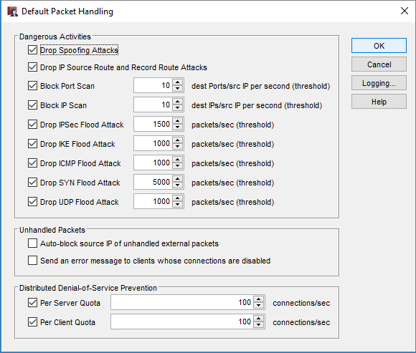
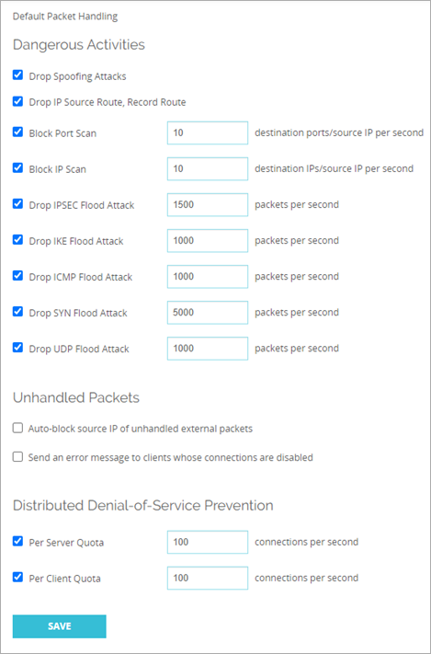
Default Packet Handling Options
In the Default Packet Handling dialog box, the Drop IP Source Route and Record Route Attacks check box was renamed to better describe the action that occurs

Slide 41
Thank You!

