Slide 1
What’s New in Fireware v12.5.3

Slide 2
What’s New in Fireware v12.5.3
Changes to the Web Setup Wizard
Wi-Fi enabled by default
New RapidDeploy configuration option
Online activation removed
AP225W Wall Plate AP support
Firebox registration to WatchGuard Cloud with TPM
Mobile VPN with SSL client upgrade prompt
Office 365 traffic over Mobile VPN with SSL

Slide 3
What’s New in Fireware v12.5.3
Disk statistics in Fireware CLI
Autotask integration updates
Updates to support TDR APAC region

Slide 4
Web Setup Wizard — Wi-Fi Enabled by Default for Wireless Firebox Models

Slide 5
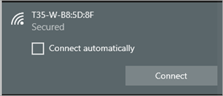
Wi-Fi Enabled by Default
For wireless Firebox models started with factory-default settings, Wi-Fi is now enabled with by default
Default SSID — the Firebox model plus the last part of the wireless MAC address
Default password is the Firebox serial number with the dash included
You can use a Wi-Fi connection to run the Web Setup Wizard

Slide 6
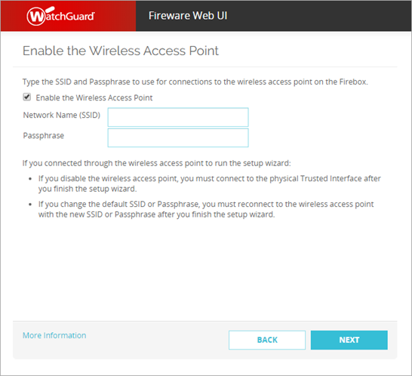
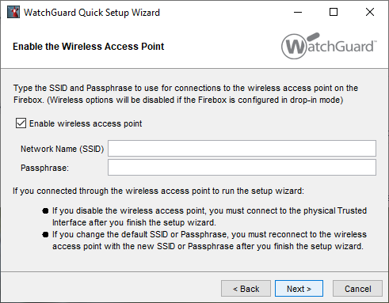
Wi-Fi Enabled by Default
The Web Setup Wizard and WSM Quick Setup Wizard include a step to configure the Firebox Wi-Fi SSID and Passphrase
This enables Wi-Fi access to the trusted network through a network bridge

Slide 7
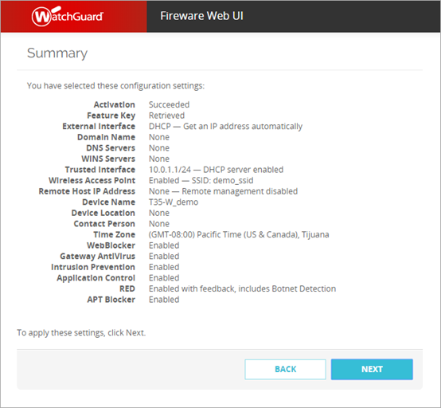
Wi-Fi Enabled by Default
Summary page shows the wireless access point SSID

Slide 8
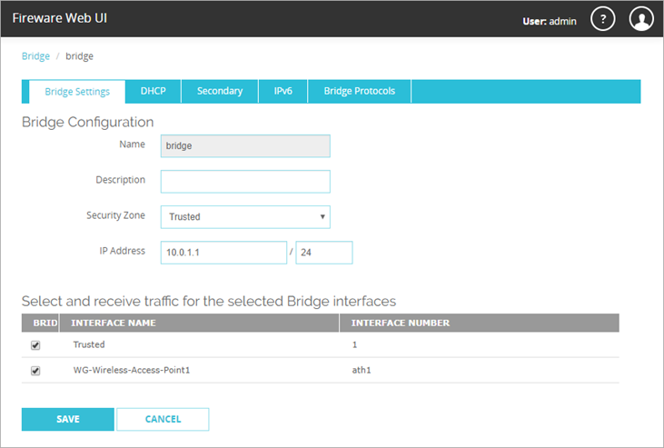
Wi-Fi Enabled by Default
The Web Setup Wizard configures a network bridge:
Network and DHCP settings match the trusted network settings configured in the setup wizard
Bridge Members — Trusted (interface1) and the wireless access point (ath1)

Slide 9
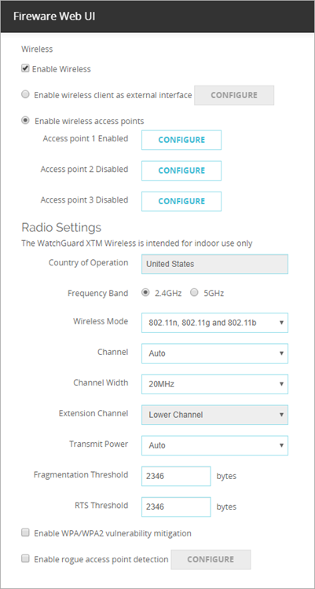
Wi-Fi Enabled by Default
Default radio settings:
Frequency Band
2.4GHz
Wireless Mode
802.11n, 802.11g and 802.11b

Slide 10
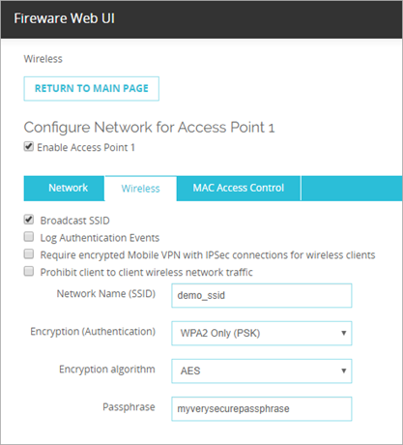
Wi-Fi Enabled by Default
Default wireless encryption settings:
Encryption (Authentication) — WPA2 Only (PSK)
Encryption algorithm — AES

Slide 11
Web Setup Wizard — Configuration Methods

Slide 12
Web Setup Wizard — Configuration Methods
The Web Setup Wizard has two new configuration methods that enable the Firebox to download a configuration file:
RapidDeploy
Configure network settings to enable the Firebox to download a configuration for RapidDeploy
The network settings you configure in the Web Setup Wizard override the settings in the RapidDeploy configuration file
Cloud-Managed
Configure temporary network settings to enable the Firebox to download a configuration created in WatchGuard Cloud
WatchGuard Cloud does not yet support cloud-managed Fireboxes

Slide 13
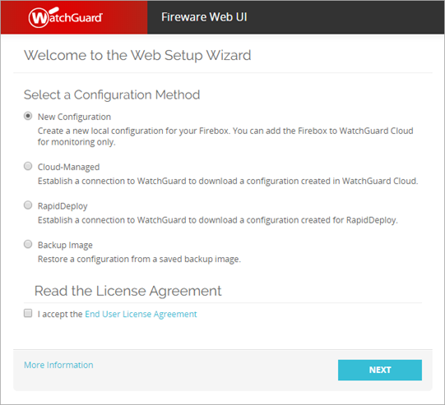
Web Setup Wizard — Configuration Methods
Two new configuration methods appear at the start of the Web Setup Wizard

Slide 14
Web Setup Wizard — RapidDeploy
A Firebox started with factory-default settings automatically tries to connect to WatchGuard to download a RapidDeploy configuration:
The Firebox uses DHCP to request an IP address for interface 0
If the Firebox can connect to WatchGuard and download a configuration, it uses the downloaded configuration and the Web Setup Wizard does not appear
If the Firebox cannot connect to WatchGuard, or if there is no configuration to download, the Web Setup Wizard appears
Previously, it was difficult to use RapidDeploy on a network that did not support DHCP

Slide 15
Web Setup Wizard — RapidDeploy
With the new RapidDeploy Web Setup Wizard option:
You configure external interface network settings so that the Firebox can download the RapidDeploy configuration file
The interface settings in the wizard override the RapidDeploy configuration for interface 0
Benefits:
Makes it easier to use RapidDeploy to set up a Firebox on a network that does not use DHCP to assign IP addresses
Previously, this required you to create a CSV file with the interface settings, copy the file to a USB drive, and connect the USB drive to the Firebox

Slide 16
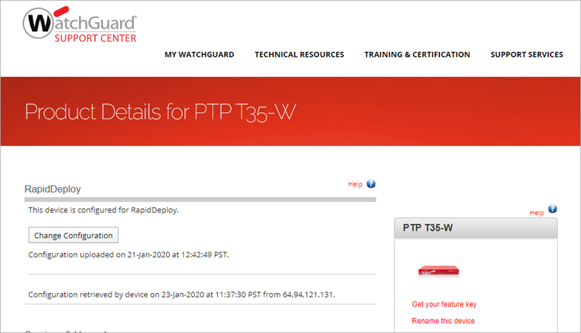
Web Setup Wizard — RapidDeploy
Before you select RapidDeploy, make sure a RapidDeploy configuration is available for the Firebox to download
In Support Center, on the Product Details page for your Firebox, you can see status and configure RapidDeploy

Slide 17
Web Setup Wizard — RapidDeploy
Web Setup Wizard steps for RapidDeploy:
Select the RapidDeploy configuration method
Configure connection settings to enable the Firebox to connect to WatchGuard

Slide 18
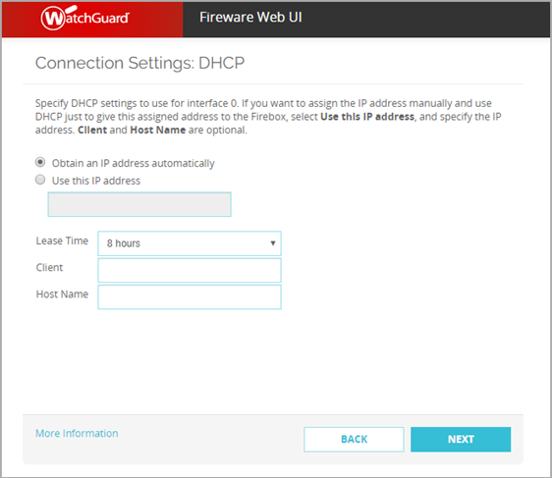
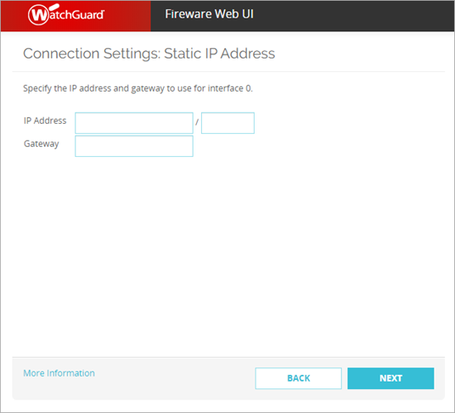
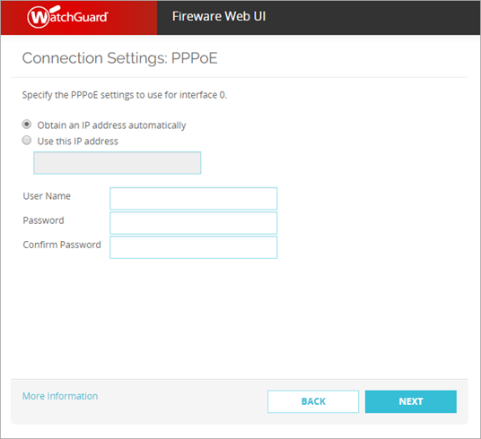
Web Setup Wizard — RapidDeploy
In the Web Setup Wizard, configure connection settings for the Firebox to connect to the Internet (DHCP, PPPoE, or Static IP address)

Slide 19
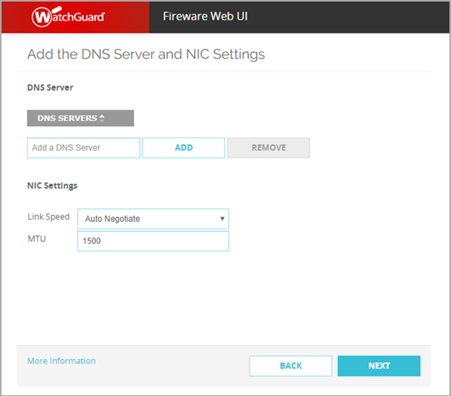
Web Setup Wizard — RapidDeploy
DNS Server and NIC Settings
Add a DNS server
Change NIC settings if required for your network (this is rare)

Slide 20
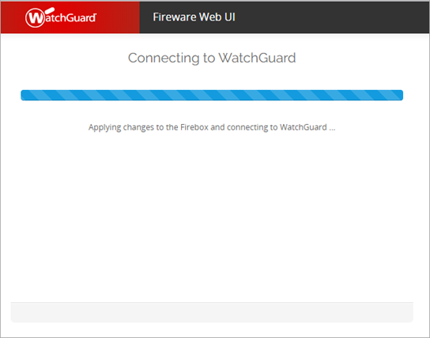
Web Setup Wizard — RapidDeploy
Firebox connects to WatchGuard to download a configuration

Slide 21
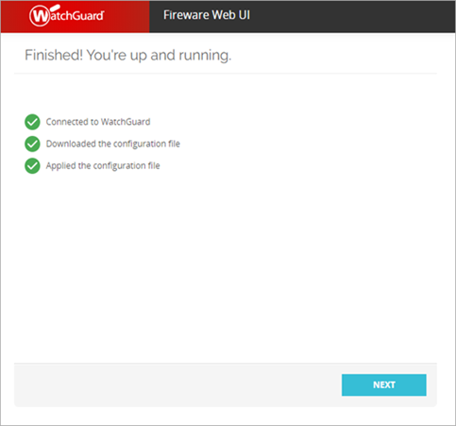
Web Setup Wizard — RapidDeploy
To manage the Firebox, use the credentials you specified when you uploaded the configuration for RapidDeploy

Slide 22
Web Setup Wizard — Cloud-Managed
The other new configuration option is Cloud-Managed:
Before you choose this option, you must add the Firebox to your WatchGuard Cloud account as a cloud-managed device and configure the device settings
WatchGuard Cloud does not yet support cloud-managed Fireboxes

Slide 23
Web Setup Wizard — Online Activation Removed

Slide 24
Setup Wizard — Online Activation Removed
Previously, the New Configuration option in the Web Setup Wizard supported three methods to get a feature key:
Automatic Activation — Automatically retrieve the feature key for an activated Firebox from WatchGuard
Online Activation — Activate the Firebox in your account on the WatchGuard website and then retrieve the feature key
Manual Activation — Paste the feature key for an activated Firebox in the wizard
The Online Activation method has been removed
Before you run the Web Setup Wizard, activate your Firebox at watchguard.com/activate

Slide 25
AP225W Wall Plate Access Point Support

Slide 26
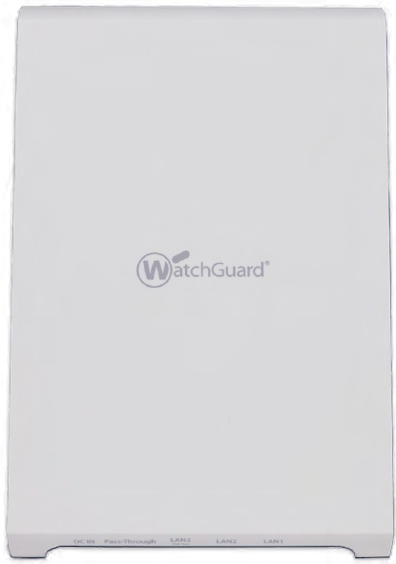
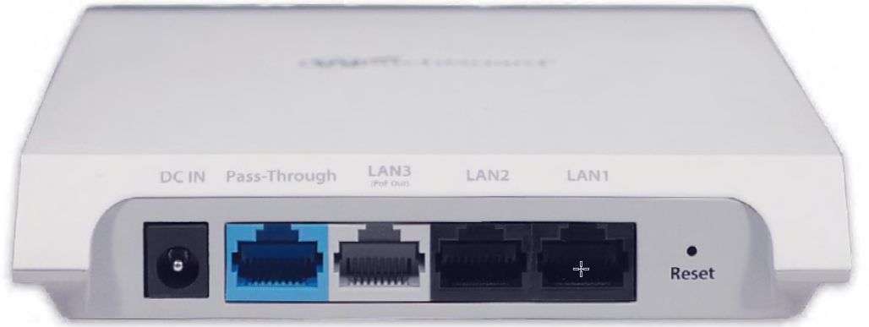
AP225W Wall Plate Access Point Support
Enterprise-grade 2x2 MU-MIMO 802.11ac Wave 2 access point
Dual concurrent 2.4 GHz and 5 GHz radios
You can install the AP225W on an existing wall plate with pre-wired Ethernet connections for efficient installation and a low-profile deployment
Includes additional LAN ports for a bridged wired extension, pass-through port, and a PoE Out port to power other devices

Slide 27
Registration to WatchGuard Cloud with TPM

Slide 28
Registration to WatchGuard Cloud with TPM
Newer Firebox models include a TPM (Trusted Platform Module) chip, a secure crypto-processor
Firebox models with a TPM chip:
T15, T35, T55
M270, M370, M470, M570, M670
When you enable WatchGuard Cloud on a Firebox that supports TPM:
The Firebox uses TPM to register with WatchGuard Cloud
The Verification Code generated by WatchGuard Cloud is not required on the Firebox

Slide 29
Registration to WatchGuard Cloud with TPM
Firebox model and manufactured software version determine what happens when you add a Firebox to WatchGuard Cloud:
For a Firebox manufactured with Fireware v12.5.2 or lower:
When you add the Firebox, WatchGuard Cloud generates a Verification Code to use for registration
If the Firebox has been upgraded to Fireware v12.5.3 or higher and supports TPM, the Verification Code is not needed on the Firebox
For a Firebox manufactured with Fireware v12.5.3 or higher:
When you add the Firebox, WatchGuard Cloud does not generate a Verification Code if the Firebox supports TPM
For a FireCluster, WatchGuard Cloud always generates a Verification Code

Slide 30
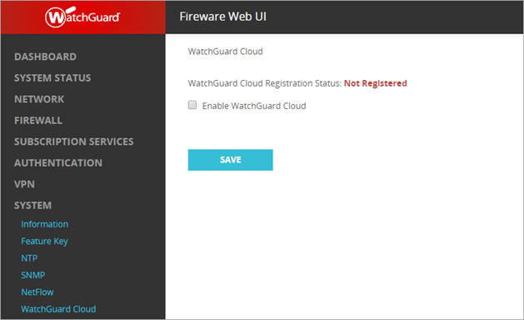
Registration to WatchGuard Cloud with TPM
When you enable WatchGuard Cloud on a Firebox:
If the Firebox supports TPM, the Firebox does not require a Verification Code
If the Firebox does not support TPM, you must paste the Verification Code to register the Firebox with WatchGuard Cloud

Slide 31
Mobile VPN with SSL Client Upgrade Prompt

Slide 32
Mobile VPN with SSL Client Upgrade Prompt
The Mobile VPN with SSL client now prompts a user to upgrade only if the user has administrator privileges on the computer
If the user does not have administrator privileges, a message now appears that tells the user to contact a system administrator for assistance

Slide 33
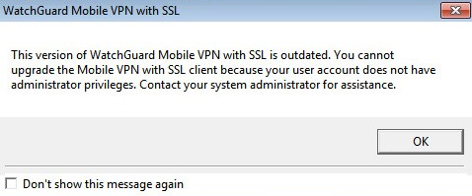
Mobile VPN with SSL Client Upgrade Prompt
For client upgrades to minor versions, this message now appears:
You can select Don’t show this message again
You can still connect to the VPN in this case, which is the same behavior found in previous software versions

Slide 34
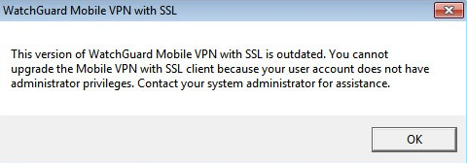
Mobile VPN with SSL Client Upgrade Prompt
For client upgrades to major versions, this message now appears:
The Don't show this message again check box does not appear
You cannot connect to the VPN in this case, which is the same behavior found in previous software versions

Slide 35
Mobile VPN with SSL and Office 365

Slide 36
Mobile VPN with SSL and Office 365
To make sure Office 365 traffic uses a full-tunnel SSL VPN, you can now enable the default-route-client CLI option
This option helps you to work around an issue where Office 365 traffic does not use the tunnel because the Windows TAP adapter does not set a default gateway

Slide 37
Mobile VPN with SSL and Office 365
When you enable the default-route-client option:
The Firebox pushes the general route 0.0.0.0/0.0.0.0 to Windows computers
The default gateway of the TAP interface on each Windows computer is set to the VPN gateway IP address
When you disable the default-route-client option:
The Firebox pushes the routes 0.0.0.0/1 and 128.0.0.0/1 to Windows computers
These routes are added instead of a more general route to avoid replacing existing routes
The TAP interface on Windows computers does not have a default gateway

Slide 38
Mobile VPN with SSL and Office 365
Before you enable the default-route-client CLI option, the Force all client traffic through tunnel setting must be enabled in the Mobile VPN with SSL configuration on the Firebox
To enable the CLI option, specify this command:
WG(config/policy)#sslvpn resource default-route-client
To disable the CLI option, specify this command:
WG(config/policy)#no sslvpn resource default-route-client
By default, the default-route-client option is disabled

Slide 39
Mobile VPN with SSL and Office 365
The default-route-client CLI option affects only Windows computers
Computers with other operating systems do not receive the 0.0.0.0/0.0.0.0 route

Slide 40
Disk Statistics in Fireware CLI

Slide 41
Disk Statistics in Fireware CLI
Disk statistics are now available through the Fireware command line interface (CLI)
Before Fireware v12.5.1, disk statistics were available in the Disk Statistics section of the Firebox Status Report
To see disk statistics in the CLI:
Log in to the Fireware command line interface
Run this command: diagnose hardware disk
These device models support the disk parameter:
Firebox T Series, model T35 and higher
Firebox M Series, model M400 and higher
The support.tgz file also includes disk statistics

Slide 42
Autotask Integration Updates

Slide 43
Autotask Integration Updates
On 15 April 2020, Autotask will move to a new single sign-on authentication platform that requires two-factor authentication for all Autotask users
In addition, to increase security, the Autotask API will no longer allow access from regular non-API Autotask user accounts
This improves security for Autotask accounts because the use of regular non-API user accounts with API access permissions requires users to share their Autotask credentials with third parties
From 15 April 2020, only an API user account can access Autotask API services and the Firebox Autotask integration

Slide 44
Autotask Integration Updates
If you currently use a regular non-API Autotask user account with API permissions for your Firebox integration, this account will no longer have access after 15 April 2020
To continue to use Autotask integration with your Firebox after 15 April 2020, you must:
Create a new API User account in Autotask.
Update your Firebox Autotask integration configuration with the new API User account username and password.

Slide 45
Autotask Integration Updates
If you currently use an Autotask API user account with your Firebox integration, there is no action you need to take
To support the latest Autotask API updates, we strongly recommend that all Autotask Integration users upgrade their Firebox to Fireware version 12.5.3
If you do not currently use an Autotask API user for your Firebox integration, do not update to Fireware 12.5.3 until you create a new API user account in Autotask for the integration
An API user is mandatory for use with the Autotask integration in Fireware 12.5.3 and higher

Slide 46
Updates to Support TDR APAC Region

Slide 47
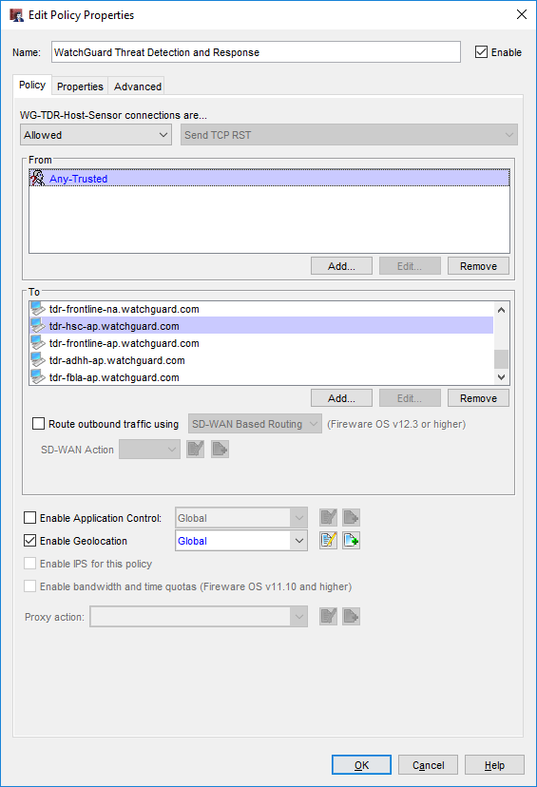
Updates to Support TDR APAC Region
Fireware v12.5.3 includes configuration changes to support the future APAC cloud region for TDR
These policies now include new FQDNs for the APAC region in the To list:
WatchGuard Threat Detection and Response
WG-TDR-Host-Sensor
The FQDNs are also added to existing policies when you upgrade
TDR does not yet support the APAC cloud region

Slide 48
Thank You!

