Slide 1
What’s new in fireware 12.5.12

Slide 2
What’s new in Fireware v12.5.12
IPS and Application Control Engine Update
New OS Compatibility Option
Removal of Web Reputation Authority Service from RED

Slide 3
What’s new in Fireware v12.5.12
Fireware v12.5.12 is available for these Firebox models:
Firebox T Series: T15, T35
For more information about supported Firebox models, see this KB article

Slide 4
IPS and Application control engine update

Slide 5
IPS and Application Control Engine Update
In Fireware v12.5.12, Intrusion Prevention Service and Application Control now use the same engine and signature set used by Fireware v12.6.x and higher
The engine upgrade is transparent to users
The signature set version number has changed from 4.x to 18.x
Signature IDs have changed, and in some cases multiple signatures are consolidated into a single, more efficient signature
The new engine does not support XTM Firebox models

Slide 6
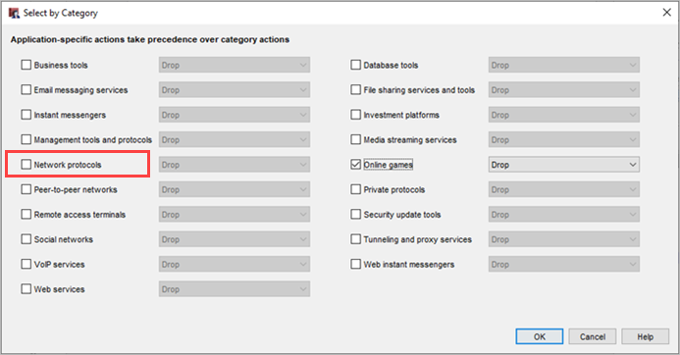
Application Control Categories
Minor reorganization of application categories:
Network Protocols (1), Network Protocols (2), and Network Protocols (3) have been merged into a single category
If you previously configured actions for applications in these categories, review your Application Control settings after upgrade.
Other minor text changes

Slide 7
Security Portal
These Security Portal URLs accommodate the new IPS and Application Control engine:
Applications: https://securityportal.watchguard.com/Applications
Threats: https://securityportal.watchguard.com/Threats
On these pages, select a signature set to see information for:
18.x – Signature set for Fireware v12.5.12 and higher
4.x – Signature set for Fireware versions lower than v12.5.12
The main Security Portal landing page remains the same

Slide 8
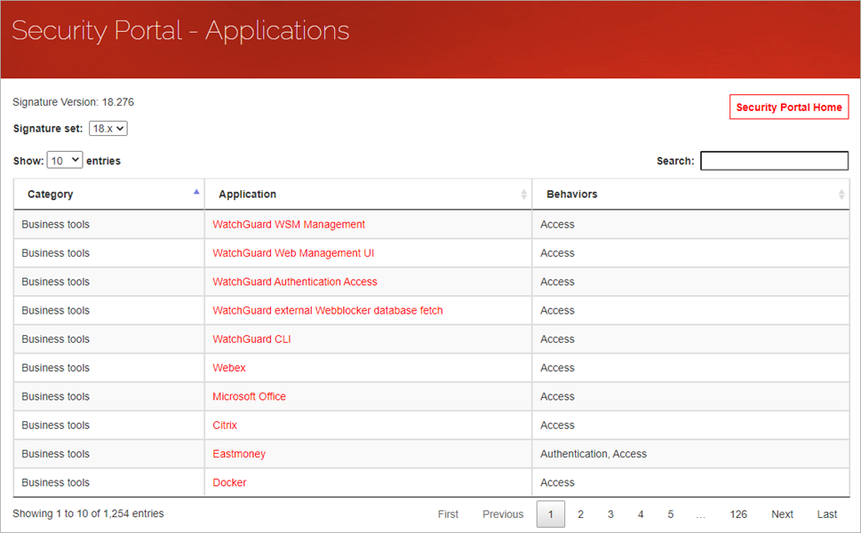
Security Portal – Applications

Slide 9
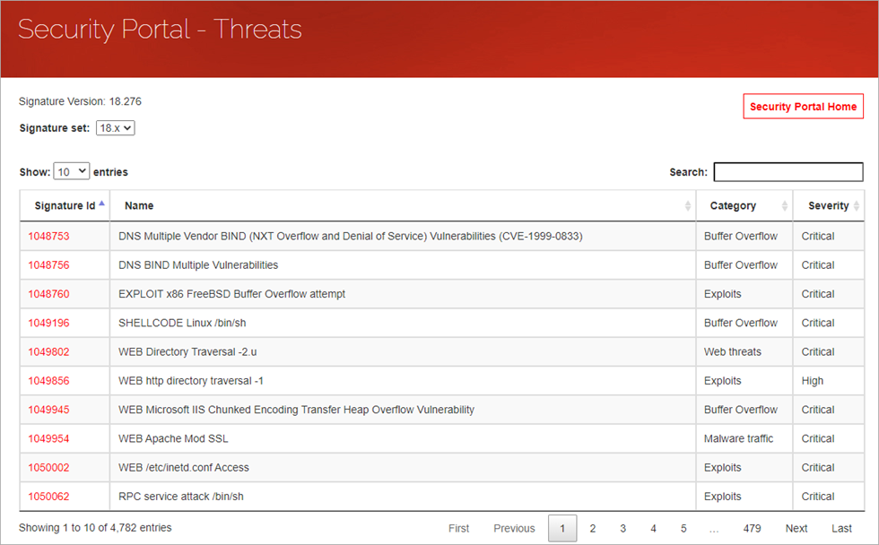
Security Portal – Threats (IPS)

Slide 10
Updated OS Compatibility Option

Slide 11
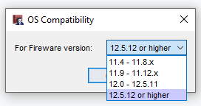
Updated OS Compatibility Option
In Fireware v12.5.12, Intrusion Prevention Service and Application Control use the same engine and signature set used by Fireware v12.6 and higher
To support this change, the OS Compatibility setting in Policy Manager now includes a 12.5.12 or higher option
Previously this option was 12.6 or higher
To manage Fireboxes that run Fireware v12.5.12 with WSM, you must use WSM v12.10 or higher

Slide 12
Removal of WEB Reputation Authority Service from RED

Slide 13
Removal of Web Reputation Authority Service from RED
In Fireware v12.5.12 and higher, Reputation Enabled Defense (RED) no longer includes support for the Web Reputation Authority service
This service assigned a reputation score to a URL when an HTTP proxy processed traffic
The Firebox could allow or deny the connection before Gateway AntiVirus scanned the traffic, based on the reputation score
Helped improve performance on older Firebox models, but caught few threats
We recommend that you enable Gateway AntiVirus scans on newer devices, which perform quicker scans and can use cached results of previous scans
Other services enabled with the RED feature key are still supported in v12.5.12 (Botnet Detection, Geolocation, and Tor Exit Node Blocking)

Slide 14
Removal of Web Reputation Authority Service from RED
In the WSM Quick Setup Wizard, RED is no longer shown in these steps:
Subscription services
Configuration summary
In Fireware Web UI, RED no longer appears in:
Subscription Services Dashboard
Subscription Services navigation menu
Diagnostic logs
HTTP proxy actions
In the Command Line Interface (CLI), the reputation-enabled-defense command is removed

