Slide 1
What’s New in Fireware v12.5.1

Slide 2
What’s New in Fireware v12.5.1
Gateway Wireless Controller AP License Enforcement
WebBlocker Warn and Deny messages now appear less frequently to users

Slide 3
Gateway Wireless Controller AP License Enforcement

Slide 4
AP License Enforcement
WatchGuard is introducing changes that affect how your APs are managed and supported by the Gateway Wireless Controller on a Firebox after Basic Wi-Fi subscriptions expire

Slide 5
About Basic Wi-Fi AP Subscriptions
With a Basic Wi-Fi AP subscription, you can manage an AP with a Gateway Wireless Controller on a Firebox and have access to WatchGuard’s Standard Support package for your AP
This includes 24x7 technical support with unlimited support cases, advanced hardware replacement service, and access to software updates

Slide 6
AP License Enforcement
Beginning with the Fireware v12.5.1 release, WatchGuard will enforce licensing requirements for Basic Wi-Fi APs
Each WatchGuard AP managed by a Gateway Wireless Controller on a Firebox must be activated with a Basic Wi-Fi subscription
APs purchased and activated on or after 1 September 2018:
APs are subject to license enforcement, and the Gateway Wireless Controller will monitor the AP license status and expiry date

Slide 7
AP License Enforcement
APs purchased and activated before 1 September 2018:
APs are exempt from license enforcement unless they were renewed after this date
A future date is displayed for the AP expiry to indicate a perpetual license until the end-of-life of the AP
If you require support for the AP, you must have a current valid Basic Wi-Fi subscription
If the AP was originally activated before September 1, 2018 with a Secure Wi-Fi, Total Wi-Fi, or Wi-Fi Cloud trial license, and is now managed as a Basic Wi-Fi AP by the Gateway Wireless Controller, the AP is still subject to license enforcement

Slide 8
What Happens When an AP Expires?
When a Basic Wi-Fi AP subscription expires:
The expired AP continues to broadcast SSIDs and allow wireless access to the network based on the most recent configuration applied to the AP
The Gateway Wireless Controller does not perform further configuration updates or software updates to an expired AP
The Gateway Wireless Controller does not monitor or collect data for an expired AP, except for basic traffic information
You cannot perform any actions on APs that do not have an active Basic Wi-Fi subscription except for licensing functions and resetting the AP to factory default settings

Slide 9
AP Support and Basic Wi-Fi Subscriptions
You must have a valid Basic Wi-Fi subscription to receive support for a WatchGuard AP managed by a Gateway Wireless Controller on a Firebox
If the Firebox has an active support subscription, you can receive support for issues specific to the Gateway Wireless Controller, but support issues specific to APs managed by the Gateway Wireless Controller require a valid AP subscription
If your AP was purchased and activated before September 1, 2018 with a Basic Wi-Fi subscription, your AP is exempt from license enforcement, however, you must have a current valid Basic Wi-Fi subscription if you require support for the AP

Slide 10
AP License Management
After you successfully activate an AP in your account, an AP feature key is generated and downloaded to your Firebox
The Gateway Wireless Controller continuously monitors the status of your AP’s Basic Wi-Fi subscription and expiry date
You can view the current activation status of your APs in the Gateway Wireless Controller

Slide 11
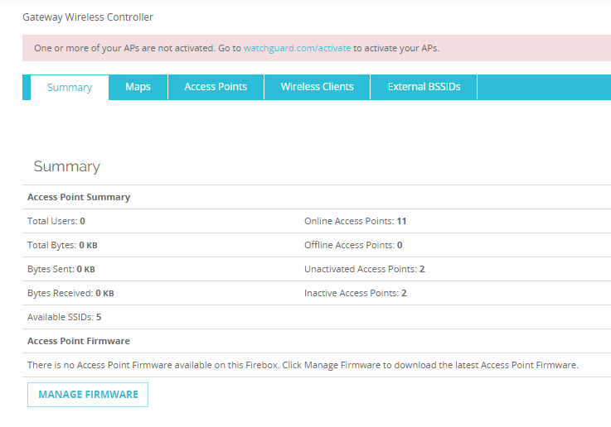
Monitor AP Activation Status
The Gateway Wireless Controller Dashboard indicates any Online, Offline, Unactivated, or Inactive (expired or status unavailable) access points

Slide 12
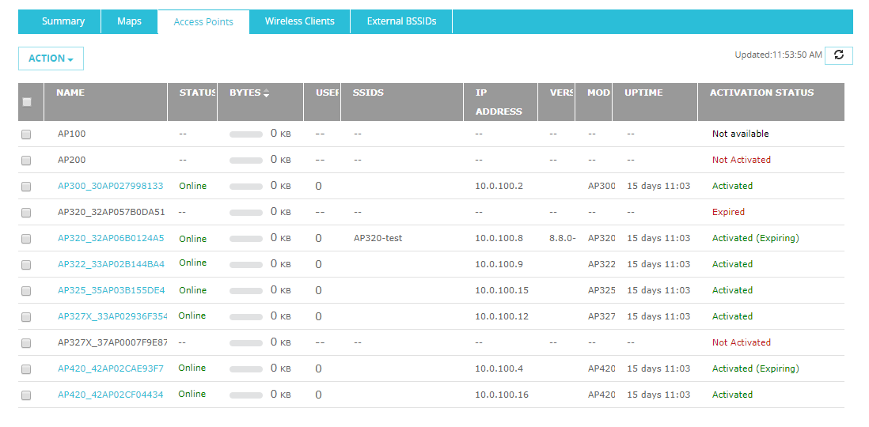
Monitor AP Activation Status
New Activation Status column on the Gateway Wireless Controller Access Points Dashboard
Activated, Not Activated, Expired, or Not available
Activated (Expiring) indicates less than 90 days to expiry

Slide 13
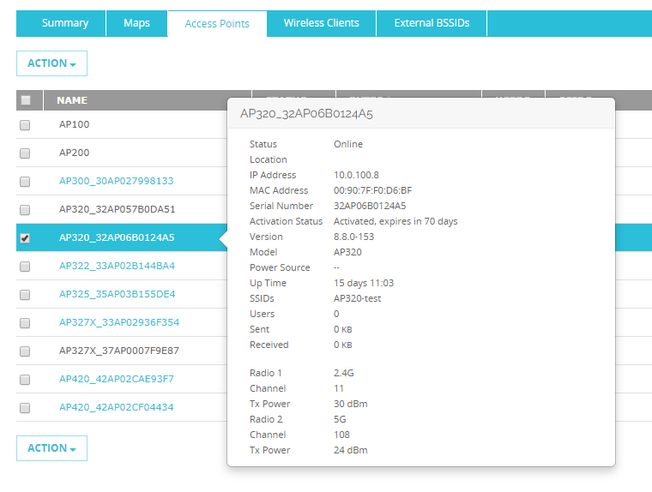
Monitor AP Activation Status
Click on an AP to see full activation status details

Slide 14
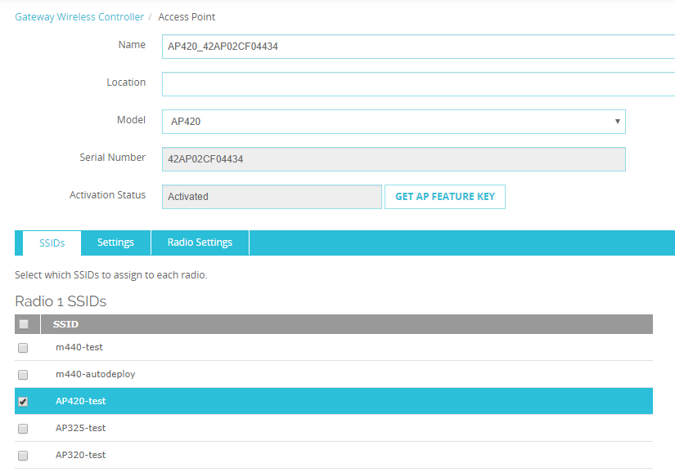
Monitor AP Activation Status
AP configuration settings show activation status and enable you to update the AP feature key

Slide 15
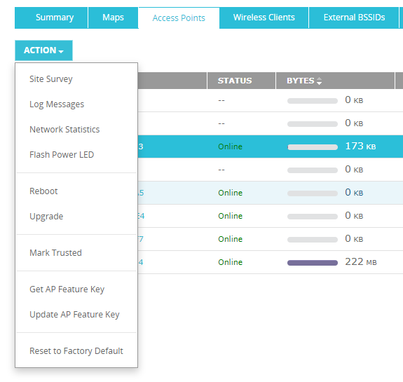
Update AP Activation Status
If you have renewed or updated your AP subscription, you can use AP actions to:
Get AP Feature Key — Update the AP license status and automatically download the AP feature key
Update AP Feature Key — Manually import the AP feature key

Slide 16
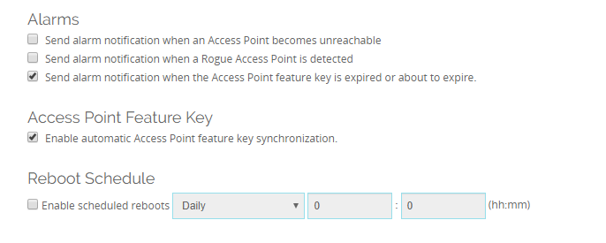
Automatic AP Feature Key Synchronization
In the Gateway Wireless Controller settings, automatic access point feature key synchronization is enabled by default
This synchronization occurs on a periodic basis to make sure the Gateway Wireless Controller has the latest activation status and AP feature key for your AP

Slide 17
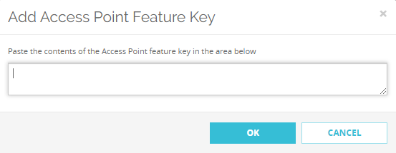
Manual AP Feature Key Update
You can also manually update the AP feature key
You can get a copy of the AP feature key from your WatchGuard Support Center account

Slide 18
AP Feature Key Expiry Alarm Notifications
The Gateway Wireless Controller will show in the Dashboard if your feature key is expired or expiring in 90 days or less
You can also enable an alarm notification about access point feature key expiration events

Slide 19
WebBlocker Enhancements

Slide 20
WebBlocker Enhancements
WebBlocker Warn and Deny messages now appear less frequently to users:
When a user overrides WebBlocker, the Deny message does not appear again for websites in any denied category with WebBlocker Override enabled
When a user clicks Continue to site in a Warn message, the Warn message does not appear again for websites in any category with the Warn action
Previously, Warn or Deny messages appeared each time users went to a website in a WebBlocker category with the Warn or Deny action

Slide 21
WebBlocker Warn Message Enhancements
When users click Continue to Site in a WebBlocker Warn message, they do not see the Warn message again for other websites in WebBlocker categories with the Warn action
For example, the WebBlocker Warn action applies to both the Job Search and Vehicles categories:
User goes to jobs.com and sees the Warn message
User clicks Continue to Site to get access to the site
User goes to cars.com and gets access to the site immediately without another Warn message
After users are inactive for 15 minutes (not configurable), they see the Warn message when they next go to a website with the Warn action

Slide 22
WebBlocker Override Enhancements
When users type a password or user group credentials in a Deny message to override WebBlocker settings, the override now applies automatically to all websites in denied categories that have WebBlocker Override enabled
For example, WebBlocker Override is enabled for the Social Web – YouTube and Social Web – Twitter categories:
User tries to go to twitter.com and sees the Deny message
User types the override password to get access to the site
User goes to youtube.com and gets access to the site immediately without another Deny message
After users are inactive for the period specified in the Inactivity Timeout setting, they see the Deny message again when they next go to a website in a category with Override enabled

Slide 23
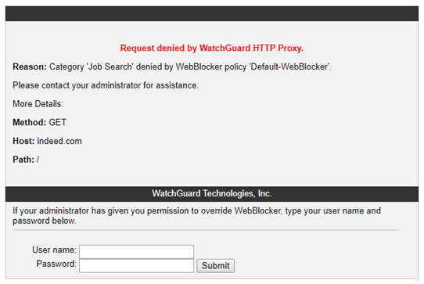
WebBlocker Override Enhancements
When WebBlocker Override is enabled, the WebBlocker Deny message no longer includes a Website text box in the override section
Users cannot specify the domain to which the override applies
The override now applies to all websites in denied WebBlocker categories that have WebBlocker Override enabled

Slide 24
Thank You!

