Slide 1
What’s New in Fireware v12.3

Slide 2
What’s New in Fireware v12.3
Updates to Networking functionality:
  SD-WAN actions
  SD-WAN reporting enhancements
  Link monitor enhancements
  NetFlow support
  Centralized FireCluster diagnostics
Updates to Mobile VPN functionality
  Mobile VPN Selection Assistance
  Mobile VPN with SSL wizard
  2FA support for SSL OpenVPN clients

Slide 3
What’s New in Fireware v12.3
Updates for Policies, Proxies, and Services:
  Geolocation actions
  WebBlocker enhancements
  Services usability enhancements
  STARTTLS in the IMAP proxy
  TCP-UDP proxy action enhancements
  Policy highlighting enhancements
Tigerpaw Integration

Slide 4
What’s New in Fireware v12.3
USB backup enhancements
Active Directory wizard
IPv6 support for Active Directory single sign-on
SSO Agent debug information
Gateway Wireless Controller enhancements
WatchGuard IPSec Mobile VPN Client updates

Slide 5
SD-WAN Actions

Slide 6
SD-WAN Actions
The method used to route outbound traffic that matches a policy has changed: SD-WAN actions replace policy-based routing
SD-WAN actions offer more granular control of external interface failover and failback for traffic that matches a policy
  In an SD-WAN action, you can select to use network performance metrics (loss, latency, and jitter) to determine whether an interface fails over or fails back
  If you select no metrics, the up/down status of the interface is used to determine whether an interface fails over or fails back
Policies that include SD-WAN actions are especially effective for applications that are latency-sensitive, such as VoIP and video conferencing

Slide 7
SD-WAN Actions
Policies that include SD-WAN actions take precedence over multi-WAN settings
To configure SD-WAN actions:
  Web UI ─ Select Network > SD-WAN
  Policy Manager ─ Select Network > Configuration > SD-WAN
You can also edit or create an SD-WAN action from within a policy
In an SD-WAN action, you specify:
  One or more external interfaces
  (Optional) Loss rate, latency, and jitter values
  Failback options

Slide 8
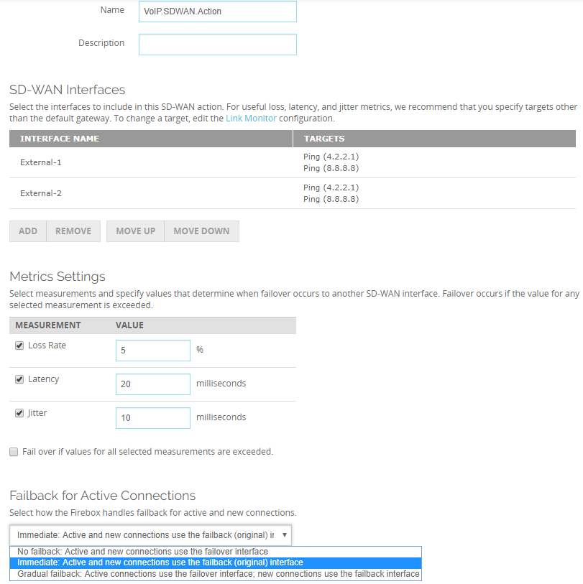
SD-WAN Actions
SD-WAN action
(Web UI)
Interfaces
Metrics
Failback

Slide 9
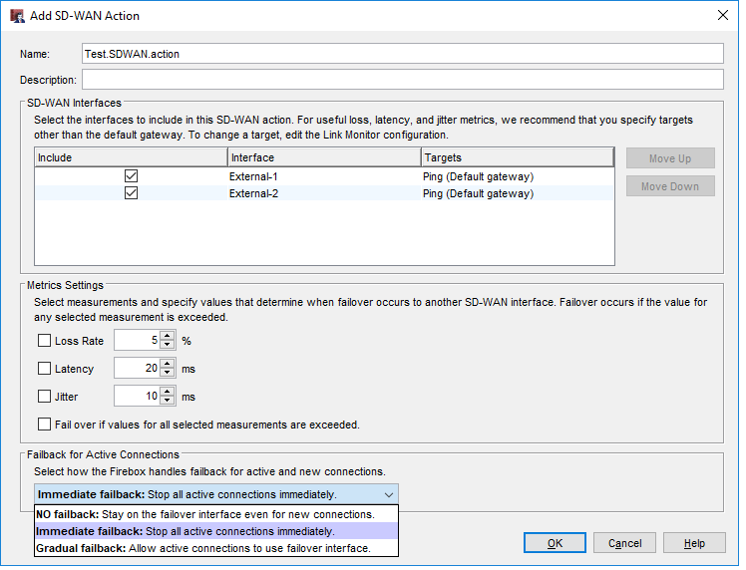
SD-WAN Actions
SD-WAN action (Policy Manager)
Interfaces
Metrics
Failback

Slide 10
SD-WAN Actions
SD-WAN interfaces ─
  You must add at least one external interface or BOVPN virtual interface
  To configure loss, latency, and jitter values for failover and failback:
    You must add two or more external interfaces
    External interfaces must have a link monitor target
  The first interface in the list is the primary interface
  The primary interface is preferred if it is up and has metrics that do not exceed the values you specified
  You can move interfaces up or down in the list to change the primary interface

Slide 11
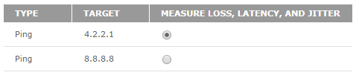
SD-WAN Actions
SD-WAN interfaces ─
  For useful interface performance data, we recommend that you specify link monitor targets other than the default gateway
  The link monitor settings moved in Fireware v12.3. To change a link monitor target:
    From the Web UI, select Network > Link Monitor
    From PM, select Network > Configuration > Link Monitor
  In the Link Monitor configuration, you can select to measure loss, latency, and jitter for only one target

Slide 12
SD-WAN Actions
SD-WAN interfaces ─
  Loss, latency, and jitter metrics apply only to external interfaces
    These metrics do not apply to BOVPN virtual interfaces
  You can specify a BOVPN virtual interface in the SD-WAN action to route matching traffic to the virtual interface. However, if you do so:
    You cannot add other interfaces to the SD-WAN action, which means failover to other interfaces is not available
      SD-WAN actions with both BOVPN virtual interfaces and external interfaces are not supported
    You cannot specify link monitor targets for the virtual interfaces
    You cannot specify loss, latency, or jitter values

Slide 13
SD-WAN Actions
Loss rate, latency, and jitter ─
  Select one or more of these measures to use as the basis for failover and failback
    For example, if you specify a jitter value of 10 ms, and jitter on the interface exceeds 10 ms, connections fail over to another interface
  Because each network is different, and some applications are more sensitive to performance issues, you must select loss, latency, and jitter values based on your knowledge of your network
    To establish baseline values for interface performance, you can use the historical data for SD-WAN loss, latency, and jitter available in the Web UI at Dashboard > Interfaces > SD-WAN

Slide 14
SD-WAN Actions
Failover ─
  Only failover mode is supported (round robin, interface overflow, and routing table modes are not supported)
  If you selected to measure loss, latency, or jitter:
    By default, failover occurs if the primary interface has metrics that exceed any the values you specified
    To initiate failover only if all of the values are exceeded, you must select the Fail over if values for all selected measurements are exceeded option
  If you did not select to measure loss, latency or jitter, failover occurs if the interface is down
    An interface is considered down if the link monitor target fails
    Active and new connections use the failover interface

Slide 15
SD-WAN Actions
Failback ─
  You can select one of three failback options:
    No failback ─ Active and new connections remain on the failover interface and never fail back to the original interface
    Immediate ─ Active and new connections immediately fail back to the original interface
    Gradual ─ Active connections remain on the failover interface. New connections use the original interface.
  The default setting is Immediate failback

Slide 16
SD-WAN Actions
Failback ─
If you select No failback or Gradual failback in the SD-WAN action, you can select to manually fail back connections at a later time
To initiate manual failback:
  In Fireware Web UI, select System Status > SD-WAN Status
  In FSM, select the SD-WAN tab

Slide 17
SD-WAN Actions
Failback ─
  If you select Gradual failback in the SD-WAN action:
    You can select the Force Failback option on the SD-WAN status page
    This option terminates active connections and forces new connections to use the failback (original) interface
  If you select No failback in the SD-WAN action, you can select these options on the SD-WAN status page:
    Manual Gradual ─ Keeps active connections on the failover interface and forces new connections to use the failback (original) interface
    Manual Immediate Failback ─ Terminates active connections and forces new connections to use the failback interface

Slide 18
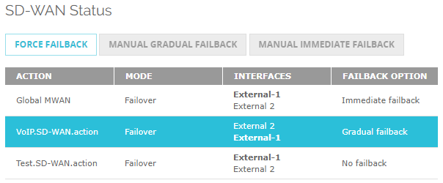
SD-WAN Actions
Failback (Web UI) ─
  If the failback option is Gradual Failback, you can click the action and click Force Failback

Slide 19
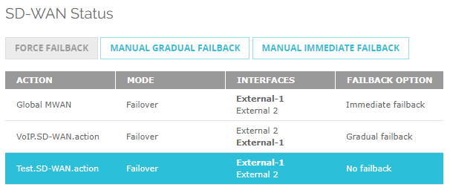
SD-WAN Actions
Failback (Web UI) ─
  If the failback option is No failback, you can click the action and click Manual Gradual Failback or Manual Immediate Failback

Slide 20
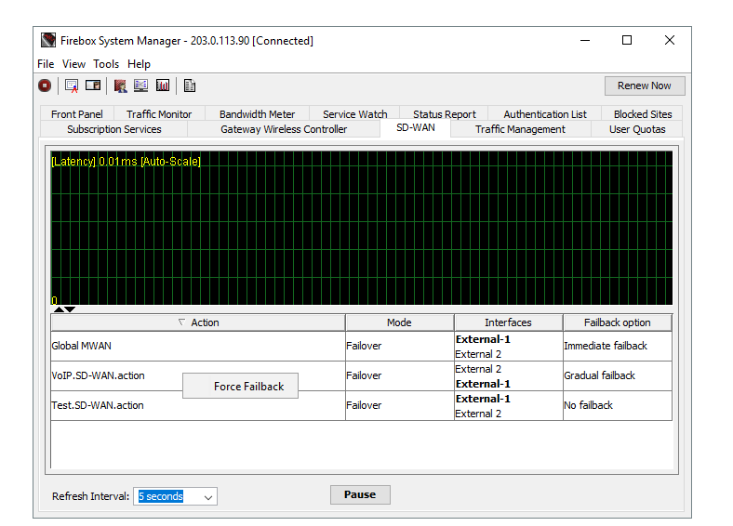
SD-WAN Actions
Failback (FSM) ─
  If the failback option is Gradual Failback, you can right-click the action and select Force Failback

Slide 21
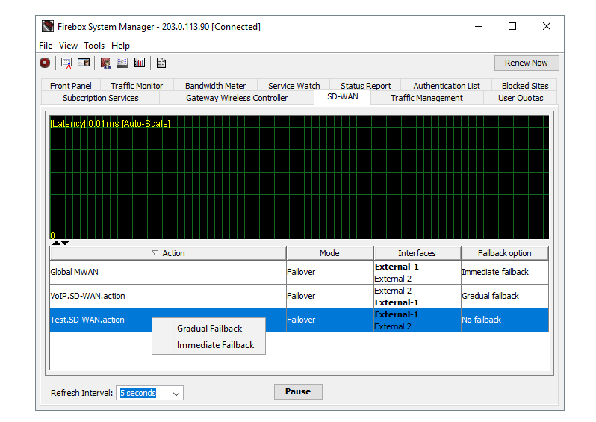
SD-WAN Actions
Failback (FSM) ─
  If the failback option is No Failback, you can right-click the action and select Gradual Failback or Immediate Failback

Slide 22
SD-WAN Actions
After you configure an SD-WAN action, you can enable SD-WAN routing in a policy
In the policy, select the SD-WAN tab and select the SD-WAN action from the list

Slide 23
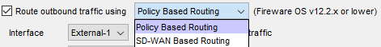
SD-WAN Actions
Configuration conversion
  For policies you created in Fireware v12.2.1 or lower:
    Policy-based routing without failover is converted to an SD-WAN action with a single interface
    Policy-based routing with failover is converted to an SD-WAN action with multiple interfaces
  In Policy Manager, the policy-based routing setting is still available for backwards compatibility with older Fireware OS versions

Slide 24
SD-WAN Reporting Enhancements

Slide 25
SD-WAN Reporting Enhancements
The accuracy of SD-WAN reporting is improved
To calculate loss, latency, and jitter, the Firebox now uses the 100 most recent probe results from link monitor targets
  Probe results are stored in groups of 10
  When 10 groups are each filled with 10 probe results, probe results in the oldest group are cleared, and 10 new results are stored
Jitter calculation
  The standard deviation is now used instead of the corrected standard deviation

Slide 26
Link Monitor Enhancements

Slide 27
Link Monitor Enhancements
Link monitor settings have moved from the Multi-WAN configuration
  Web UI ─ Select Network > Link Monitor
  Policy Manager ─ Select Network > Configuration > Link Monitor
In the Web UI, you can now configure link monitor targets for an external interface regardless of whether multi-WAN is enabled
  For example, if your configuration includes only one external interface, you can configure link monitor targets for that interface in the Web UI
  In Policy Manager, you cannot configure link monitor targets if multi-WAN is disabled

Slide 28
Link Monitor Enhancements
If multi-WAN is enabled, you can configure link monitor targets for an external interface that is not a multi-WAN member
If you configure only one link monitor target for an interface, loss, latency, and jitter are measured for that target by default
If you configure two or more link monitor targets for an interface, you must select one target for which loss, latency, and jitter are measured
  You cannot select to measure loss, latency, and jitter for more than one target for an interface

Slide 29
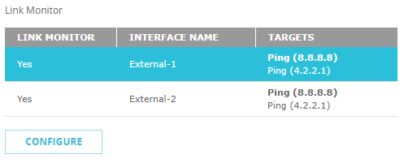
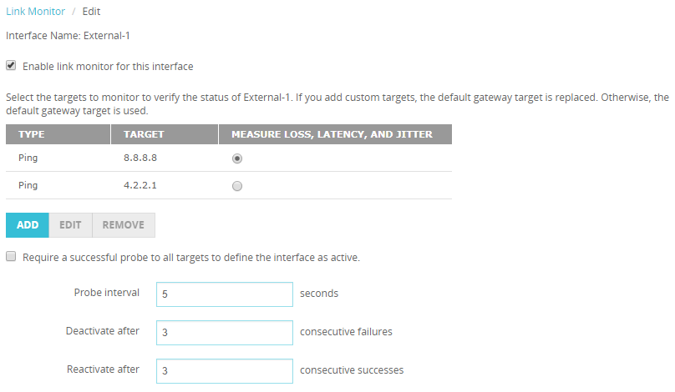
Link Monitor Enhancements
Web UI
Select to measure loss, latency, and jitter for one target

Slide 30
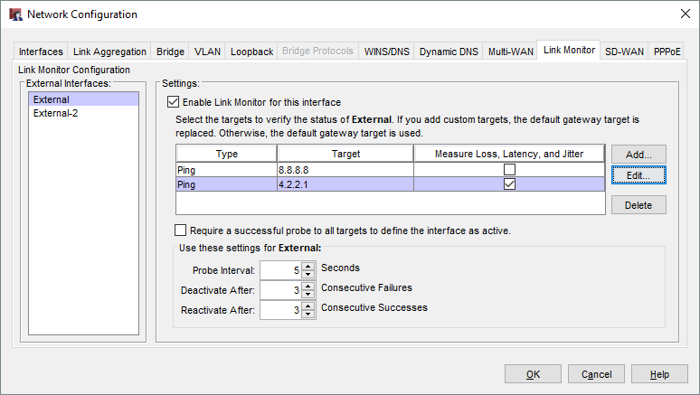
Link Monitor Enhancements
Policy Manager
Select to measure loss, latency, and jitter for one target

Slide 31
Link Monitor Enhancements
When you enable link monitor for an interface, the default gateway is the target
  For meaningful data, we recommend that you specify a target other than the default gateway
  If you add a custom target, the default gateway target is replaced
  If you remove all custom targets that you added, the default gateway target is automatically added back

Slide 32
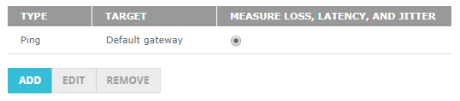
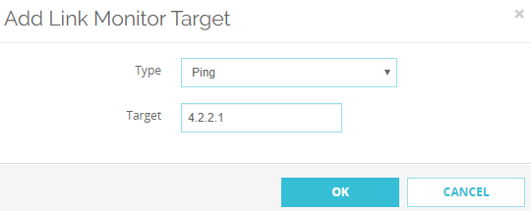
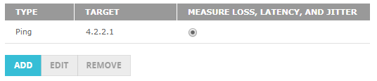
Link Monitor Enhancements

Slide 33
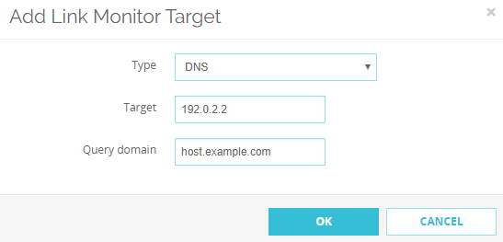
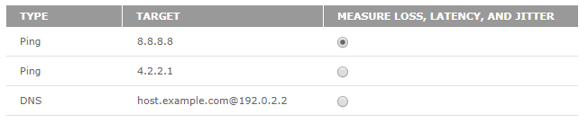
Link Monitor Enhancements
You can now specify DNS targets

Slide 34
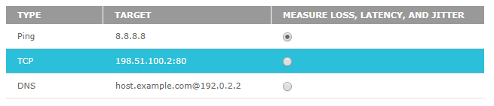
Link Monitor Enhancements
You can now specify up to three link monitor targets for an interface

Slide 35
NetFlow

Slide 36
NetFlow
Configure NetFlow to gain more insight into Firebox traffic
For example, you can troubleshoot network congestion by viewing the source and destination of traffic for an interface, and the class of service

Slide 37
NetFlow
NetFlow is a protocol created by Cisco that is used to collect and analyze IP network traffic
When you configure NetFlow on your Firebox, you specify the IP address of a third-party server known as a collector
The collector runs software that uses the NetFlow protocol to analyze network traffic
  Many third-party software solutions support NetFlow
The Firebox sends streams of data known as net flows to the collector for analysis
The collector can receive data from multiple sources

Slide 38
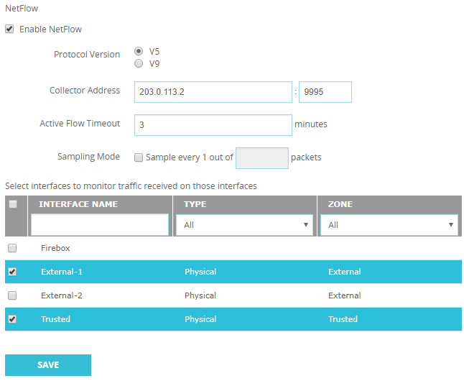
NetFlow
Web UI ─ Select System > NetFlow

Slide 39
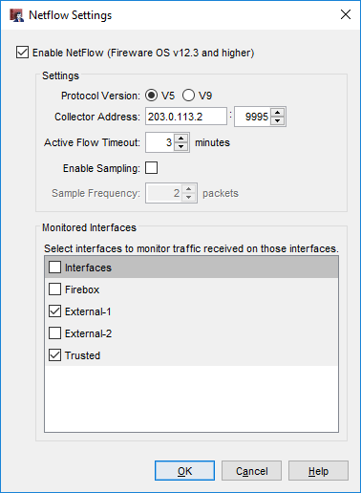
NetFlow
Policy Manager ─ Select Setup > NetFlow

Slide 40
NetFlow
Protocol Version ─
  Fireware supports NetFlow versions 5 and 9
  V9 can monitor IPv6 traffic
Collector Address ─
  You must specify an IPv4 or IPv6 address for the collector
  FQDNs are not supported
Active Flow Timeout ─
  Specify a value that is lower than the Active Flow Timeout value on the collector
    This helps to avoid data loss. If the Active Flow Timeout value is lower on the collector, the collector might stop listening while the Firebox is still sending data

Slide 41
NetFlow
Sampling mode ─
  In this mode, the Firebox randomly selects 1 out of every n packets to sample
  For example, if you specify a Sampling mode of 100, the Firebox samples 1 out of every 100 packets
  Sampling mode can help reduce performance impacts to the Firebox
  We recommend Sampling mode for large-scale environments only

Slide 42
NetFlow
Interfaces ─
  Only traffic received on selected interfaces is monitored unless you select the Firebox option
    If you select Firebox, traffic sent out from the Firebox, also known as self-generated or Firebox-generated traffic, is monitored
  Physical, VLAN, bridge, wireless, and link aggregation interfaces are supported in all zones (Trusted, External, Optional, and Custom)
  BOVPN virtual interfaces are not supported

Slide 43
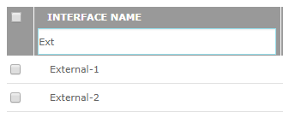
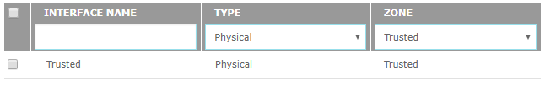
NetFlow
Interfaces ─
  If you have a long list of interfaces, you can use the Interface Name search box to find an interface
  For example, type ext to find all interface names that contain those letters
  You can also filter by type and zone

Slide 44
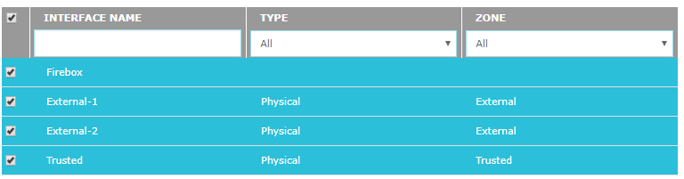
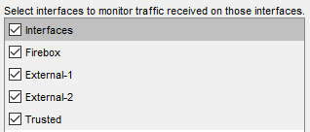
NetFlow
Interfaces ─
  (Web UI) To enable NetFlow on all interfaces, select the check box adjacent to Interface Name
  (Policy Manager) To enable NetFlow on all interfaces, the select Interfaces check box

Slide 45
NetFlow
Flows ─
  The Firebox sends a flow to the collector when the flow terminates either normally or abnormally
  For a long-lasting flow, the flow terminates after the number of minutes elapse that you specified for the Active Flow Timeout value
Data security ─
  Flows are sent as UDP packets in clear text, which means you must make sure the path between the Firebox and collector is secure

Slide 46
NetFlow
Performance impact ─
  NetFlow can impact the performance of the Firebox in some cases
  To mitigate performance impacts, limit the number of interfaces that you monitor. For large-scale enterprise networks, consider enabling Sampling mode.
NetFlow is not available in device configuration templates

Slide 47
FireCluster Diagnostics

Slide 48
FireCluster Diagnostics
A new FireCluster diagnostics page centralizes cluster data, gives you more insight into cluster health, and reduces troubleshooting time

Slide 49
FireCluster Diagnostics
The FireCluster Diagnostics page shows detailed real-time and historical information about your FireCluster
  You can see uptime information, performance and health statistics, and historical data for events
  If an event occurs, you can view or download a detailed Event Status Report
  For example, if a primary cluster member fails over to a backup cluster member, the FireCluster Diagnostics page shows the failover event and reason for the failover, and you can view or download a report for this event to see more details
In Fireware v12.3, the FireCluster Diagnostics page is available only in Fireware Web UI and applies only to Active/Passive clusters

Slide 50
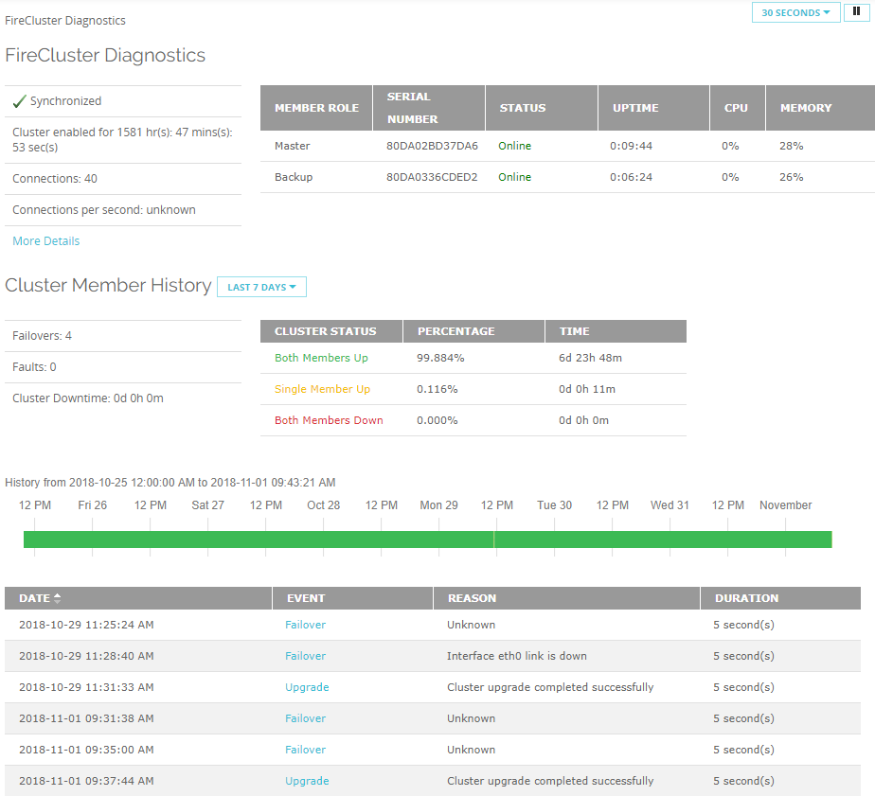
FireCluster Diagnostics
Web UI

Slide 51
FireCluster Diagnostics
This data appears on the FireCluster Diagnostics page:
  Uptime information ─
    How long the cluster members have been synchronized
    How long each member has been online
  Performance statistics ─
    CPU and memory usage
    Network connections
    Connection rate

Slide 52
FireCluster Diagnostics
  Historical data ─
    Total amount of time both members have been up
    Total amount of time only a single member has been up
    Total amount of time both members have been down
    Color-coded graph that shows the cluster status for the last 24 hours
    A list of cluster events that includes date, reason, and duration of each event
    A link to a log file that reveals detailed information about cluster events

Slide 53
FireCluster Diagnostics
When an event occurs, you can click the event to see an Event Status Report that includes:
  Event description (event type, reason, and time)
  Runtime status (how long members have been paired and up)
  Cluster health information (four health indexes)
  Interfaces status (up or down)
  Cluster synchronization status (for the configuration, password, certificate, license, and DHCP)
  VPN synchronization
  Cluster OP events (list of cluster events with time stamps)
You can download this report as a .TGZ file

Slide 54
Mobile VPN Selection Assistance

Slide 55
Mobile VPN Selection Assistance
A new Get Started page helps you select the best mobile VPN product for your network
From the Get Started page, you can:
  See some benefits of each mobile VPN type, along with security information, client compatibility information, and our recommendations
  Select to configure any mobile VPN type
  See which mobile VPN types are configured on the Firebox

Slide 56
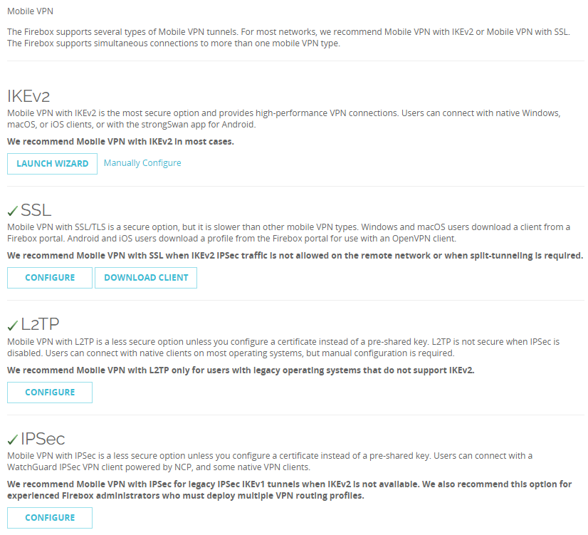
Mobile VPN with SSL Wizard
Web UI

Slide 57
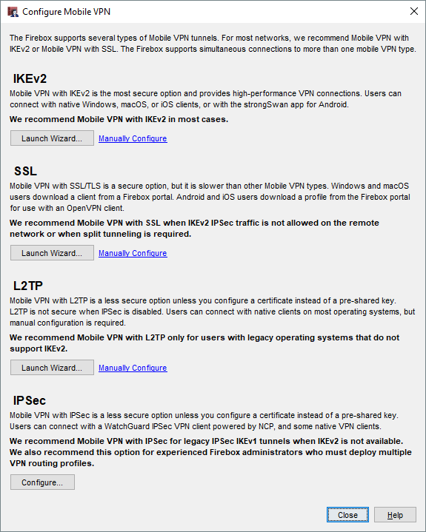
Mobile VPN Selection Assistance
Policy Manager

Slide 58
Mobile VPN with SSL Wizard

Slide 59
Mobile VPN with SSL Wizard
Mobile VPN with SSL configuration is simplified with a new wizard

Slide 60
Mobile VPN with SSL Wizard
You can now use a wizard to configure Mobile VPN with SSL
The wizard prompts you for these settings and automatically creates a Mobile VPN with SSL configuration:
  Primary domain name or IP address for client connections
  (Optional) Backup domain name or IP address for client connections
  Authentication servers
  Users and groups
  Virtual IP address pool for mobile users
After you complete the wizard, you can manually edit the configuration and specify additional settings

Slide 61
Mobile VPN with SSL Wizard
You can select to use the wizard or manually configure Mobile VPN with SSL
  On the new Mobile VPN selection page in the Web UI and Policy Manager, the Launch Wizard option appears if Mobile VPN with SSL is not already configured
  Click Configure Manually to skip the wizard

Slide 62
Mobile VPN with SSL Wizard
Web UI

Slide 63
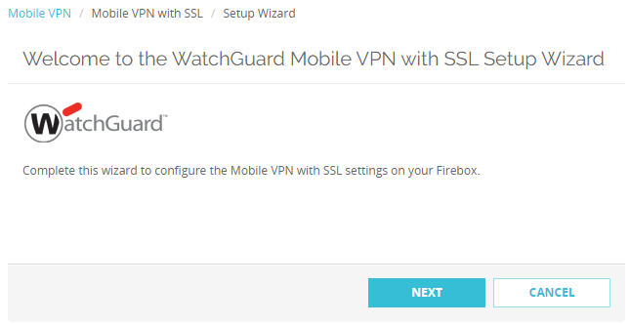
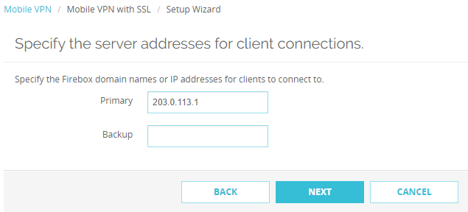
Mobile VPN with SSL Wizard

Slide 64
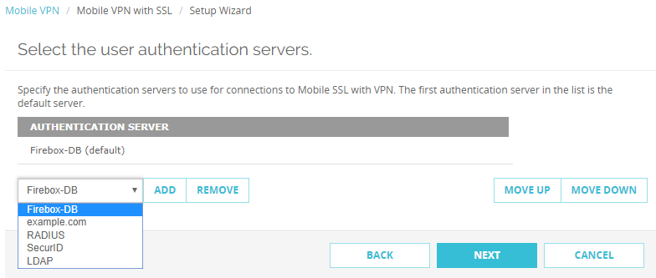
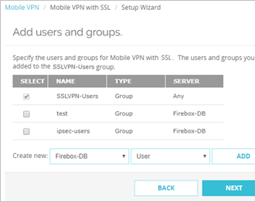
Mobile VPN with SSL Wizard

Slide 65
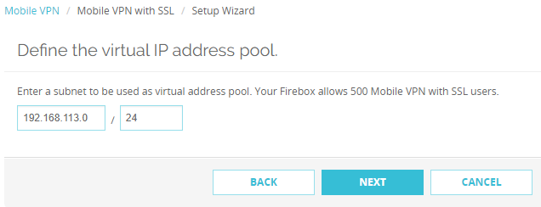
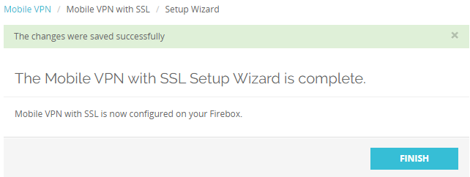
Mobile VPN with SSL Wizard

Slide 66
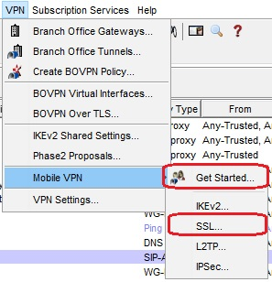
Mobile VPN with SSL Wizard
In Policy Manager, to launch the wizard, select either of these options:
  VPN > Get Started
  VPN > SSL

Slide 67
Mobile VPN with SSL Wizard
If you selected Get Started, the new VPN selection page appears
Click Launch Wizard

Slide 68
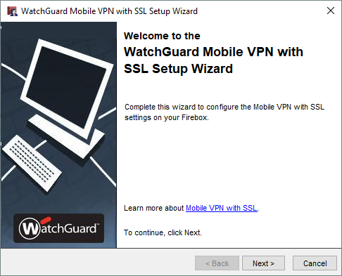
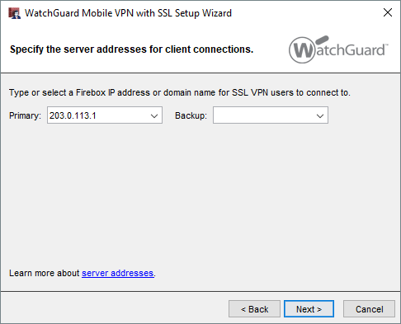
Mobile VPN with SSL Wizard

Slide 69
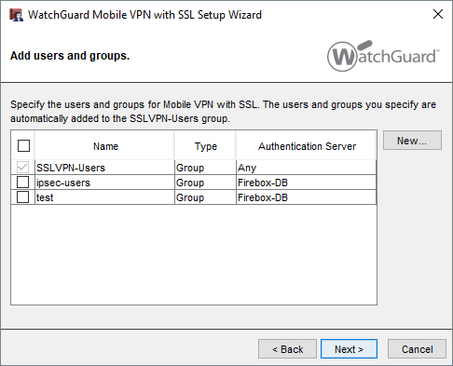
Mobile VPN with SSL Wizard

Slide 70
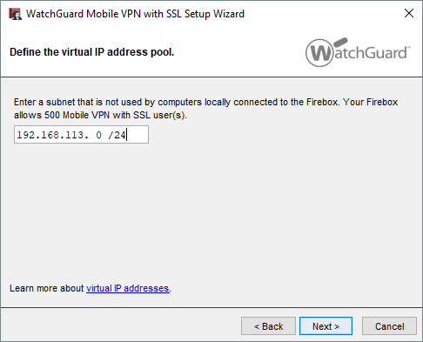
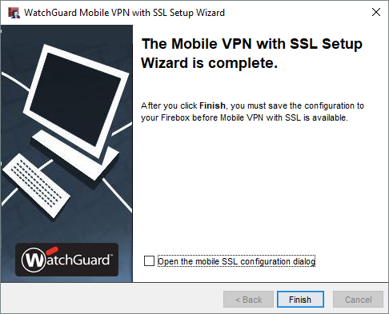
Mobile VPN with SSL Wizard

Slide 71
2FA Support for OpenVPN Clients

Slide 72
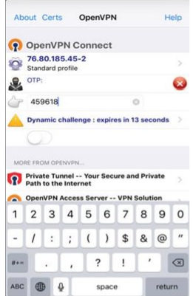
MFA Support for OpenVPN Clients
Mobile VPN with SSL now supports two-factor, challenge-response authentication for native OpenVPN clients
Mobile VPN with SSL users who have OpenVPN clients can type a one-time password to connect to the Firebox

Slide 73
Geolocation Actions

Slide 74
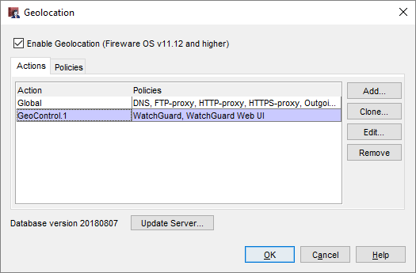
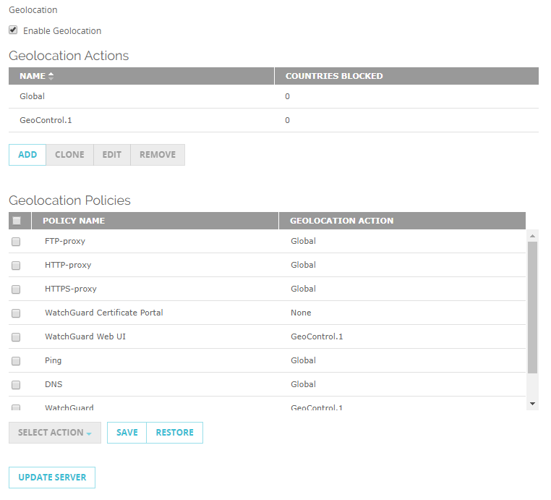
Geolocation Actions
The Geolocation service now supports multiple actions so that you can specify different geographical restrictions by policy
Geolocation settings now include Actions and Policies
  Actions: Add and edit actions
  Policies: Assign actions to policies

Slide 75
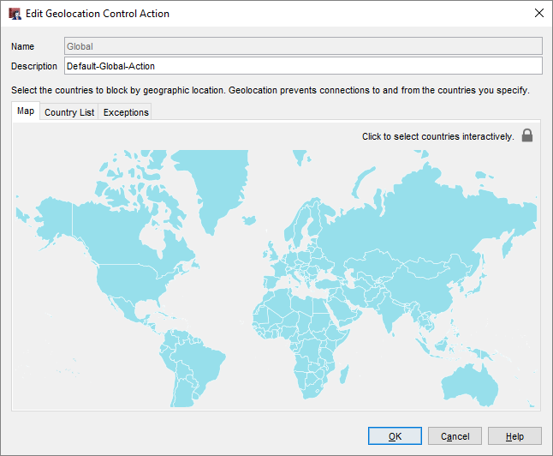
Geolocation Actions
Geolocation actions contain the same settings that were previously configured as global Geolocation settings:
  Countries to block
  Exceptions (shared by all Geolocation actions)
The Global action is
added by default
  You cannot remove it

Slide 76
Geolocation Actions
When you upgrade to Fireware v12.3:
  Previous Geolocation settings are moved to the Global action
  The Global action is assigned to all policies that have Geolocation enabled

Slide 77
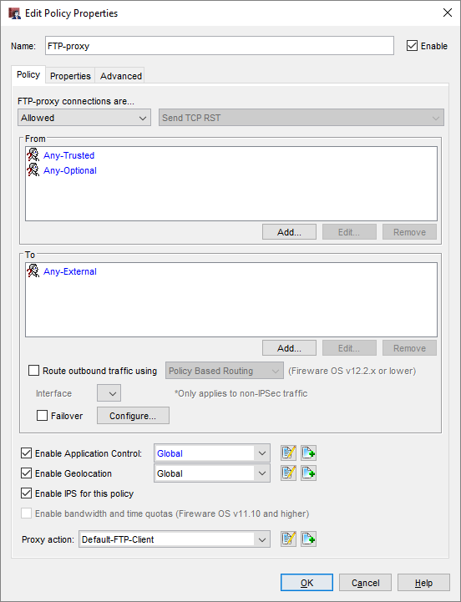
Geolocation Actions
You can also configure Geolocation in a policy
  Enable Geolocation
  Select the Geolocation action to use
  Click the adjacent icons to:
    Edit the selected action
    Add a new action

Slide 78
Geolocation Actions
The Policies list has a new Geolocation column
This column shows the configured Geolocation action for each policy

Slide 79
WebBlocker Enhancements

Slide 80
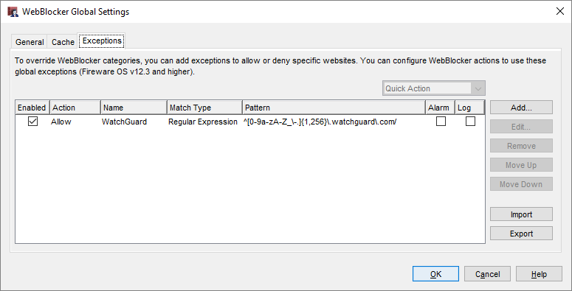
WebBlocker Enhancements
WebBlocker has a new global exceptions list
  This eliminates the need to add the same exceptions to multiple WebBlocker actions
  The global exceptions list includes a predefined exception to allow connections to WatchGuard servers

Slide 81
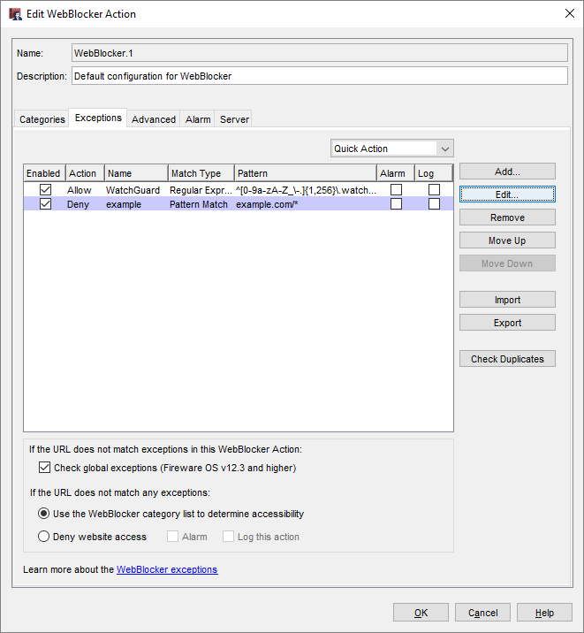
WebBlocker Enhancements
In each WebBlocker action, you control whether the action uses the global exception list for URLs that do not match exceptions in the WebBlocker action
Local exceptions take precedence over global exceptions

Slide 82
WebBlocker Enhancements
To identify any duplication between
the global exceptions and local exceptions in the WebBlocker action,
click Check Duplicates
This check compares
all enabled exceptions that have the same Match Type and Pattern

Slide 83
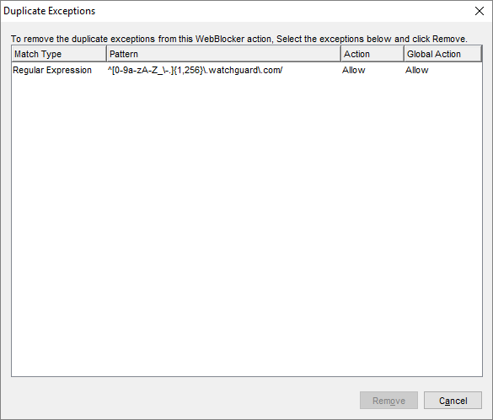
WebBlocker Enhancements
The Duplicate Exceptions list shows both the global action and the local action for
a duplicate exception
To remove a duplicate exception from the local exceptions list, select the exception and click Remove

Slide 84
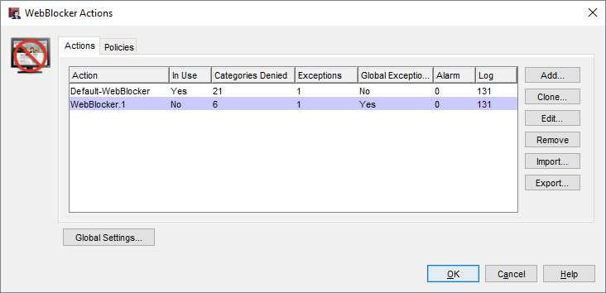
WebBlocker Enhancements
In the WebBlocker Actions list, the Global Exceptions column shows whether each action uses the global exceptions list

Slide 85
WebBlocker Enhancements
To make it easier to use the same WebBlocker settings on different Fireboxes, you can now export and import WebBlocker actions
  Import and export is supported only in Policy Manager
  Exported WebBlocker actions are stored as XML in a text file
  Default path: \users\<username>\Documents\My WatchGuard

Slide 86
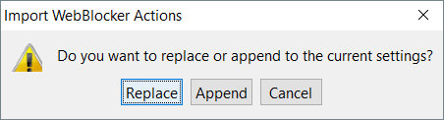
WebBlocker Enhancements
When you import WebBlocker actions to your Firebox, specify whether to replace existing actions:
  Replace — Add new actions and replace any existing actions with imported actions that have the same name
  Append — Add new actions but do not replace existing actions

Slide 87
WebBlocker Enhancements
In the WebBlocker action Advanced tab, you can now enable logs and alarms for WebBlocker local overrides:
  Alarm — Select to send an alarm when a user enters the local override password
  Log this action — Select to send a message to the log file when a user enters the local override password
  The message appears in the log with "Allowed by overriding category action" in the details field

Slide 88
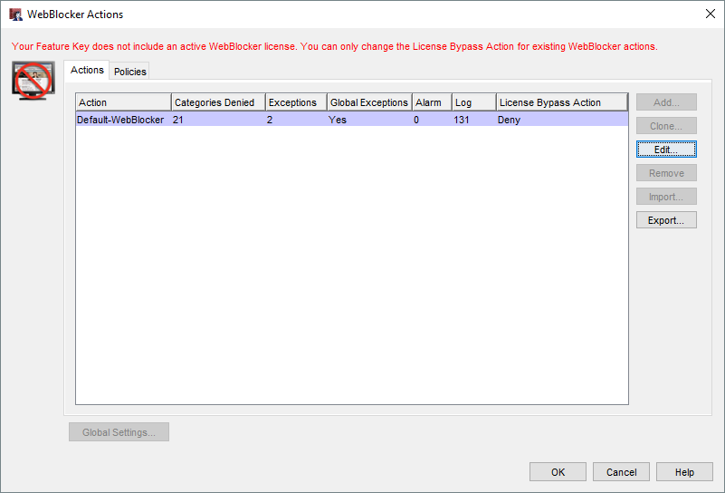
WebBlocker Enhancements
When your WebBlocker license expires, a new License Bypass Action column in the WebBlocker Actions page shows whether an action allows or denies access to all sites
You can now change the license bypass action for WebBlocker actions after your WebBlocker license expires
In the WebBlocker action,
select the Advanced tab,
then select Allowed or
Denied from the License
Bypass drop-down list

Slide 89
WebBlocker Enhancements
In Policy Manager, in the WebBlocker Actions list, a new In Use column shows whether each WebBlocker action is used by a proxy action
You can use this column to identify WebBlocker actions that are no longer used and can be removed

Slide 90
Services Usability Enhancements

Slide 91
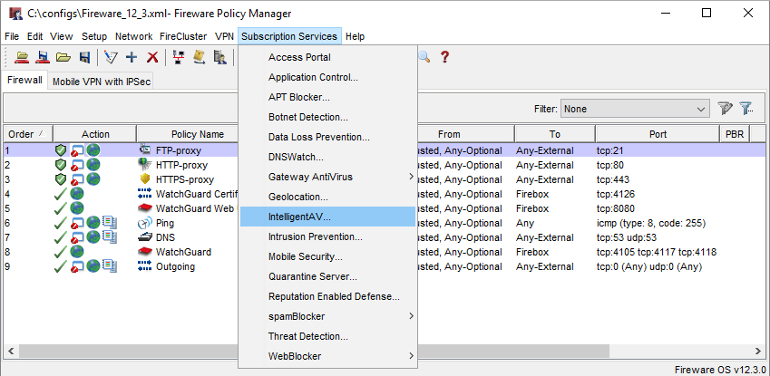
IntelligentAV
IntelligentAV is now a separate menu item in the Subscription Services menu in Policy Manager and Fireware Web UI
Previously, IntelligentAV was available from within the Gateway AV settings

Slide 92

File Exceptions
The File Exceptions option has moved from the Subscription Services menu to a button within each of these services:
  APT Blocker
  Gateway AV
  IntelligentAV
  Data Loss Prevention
This makes it easier to edit
exceptions while you configure
services
The same file exceptions are
still shared between these services

Slide 93

Intrusion Prevention Service
In Fireware Web UI, the IPS menu item in the Subscription Services menu is now renamed to Intrusion Prevention Service

Slide 94
STARTTLS in the IMAP Proxy

Slide 95
STARTTLS in the IMAP Proxy
The IMAP proxy now supports STARTTLS
  This feature enables IMAP clients to use the STARTTLS command to upgrade an IMAP connection to a secure channel and perform content inspection on the encrypted data
STARTTLS functionality for IMAP is simpler than for SMTP
  In the IMAP proxy action there are no separate rules for sender and recipient encryption
  The encryption is end-to-end

Slide 96

STARTTLS in the IMAP Proxy
In the IMAP proxy action, STARTTLS settings are below Capabilities
  To enable STARTTLS, select the Enable STARTTLS for Content Inspection check box
  The Content Inspection Summary appears only when
  STARTTLS is enabled
  When STARTTLS is
  enabled, Inspection is
  always On

Slide 97
STARTTLS in the IMAP Proxy
You can enable both STARTTLS and IMAPS (TLS) in the same proxy action
When both STARTTLS and IMAPS (TLS) are enabled, each connection uses only one encryption method:
  Connections on port 993
  use IMAPS
  Connections on port 143
  use STARTTLS

Slide 98

STARTTLS in the IMAP Proxy
The IMAP proxy action can now use two different TLS profiles, one for TLS and one for STARTTLS
In the TLS Profiles configuration, the Policies list now shows both the TLS and STARTTLS profiles configured in each IMAP proxy action

Slide 99
TCP-UDP Proxy Action Enhancements

Slide 100


TCP-UDP Proxy Action Enhancements
TCP-UDP Proxy Action settings are now reorganized into two categories:
  Redirection: Configure proxy actions to redirect traffic
  General Settings: Configure timeout values and logging settings

Slide 101

TCP-UDP Proxy Action Enhancements
You can now specify when idle TCP and UDP connections will timeout:
  TCP: Specify a number of minutes (default is 5 minutes)
  UDP: Specify a number of seconds (default is 30 seconds)

Slide 102
Policy Highlighting Enhancements

Slide 103

Policy Highlighting Enhancements
In Policy Manager, the Policy Highlighting dialog box now includes three new settings:
  Highlight disabled policies
  Highlight deny policies
  Highlight allow policies
When you upgrade, the new settings
are disabled by default
Policy highlighting settings are now
listed in order of precedence
If a policy matches more than one
setting, it uses colors from the
highest ranked setting it matches

Slide 104
Tigerpaw Integration

Slide 105
Tigerpaw Integration
You can now integrate a Firebox with Tigerpaw, a professional service automation tool
Integration is similar to the existing ConnectWise and Autotask integrations
Tigerpaw integration enables you to:
  Automatically synchronize your Firebox asset and subscription information to Tigerpaw cloud or on-premise servers
  Set event monitoring thresholds for a wide range of Firebox parameters to automatically create service order tickets in Tigerpaw

Slide 106

Tigerpaw Integration
Available as a new tab on the System > Technology Integrations page
Configure Tigerpaw server login credentials, external account ID, details for service orders and assets

Slide 107

Tigerpaw Integration
Set thresholds for event monitoring
Events that exceed the threshold automatically generate a service order in Tigerpaw

Slide 108
USB Backup Enhancements

Slide 109
USB Backup Enhancements
This release adds enhancements to the back up process when you save backup images on a USB drive connected to the Firebox:
  The Backup and Restore Image page in Web UI now enables you to back up and restore images from the connected USB drive
  When you save a backup image to the USB drive, you can now choose whether to include Fireware OS
  Auto-restore of a backup image from the USB drive now works
  The auto-restore backup image is now stored on the USB drive in a folder path that includes the Firebox model
  When you downgrade Fireware OS, you can now restore a compatible backup image from the USB drive

Slide 110
Manage Backup Images on a USB Drive
You can now use the Backup and Restore Image page in Fireware Web UI to see and manage backup images saved on a USB drive connected to the Firebox
  Select System > Backup and Restore
  Select the USB tab

Slide 111
Include Fireware OS in USB Backup Images
You can now choose whether to include the Fireware OS in backup images saved to the USB drive
To save backup images to the USB drive:
  Fireware Web UI: Select System > Backup and Restore Image. Click Create Backup Image.
  Firebox System Manager: Select Tools > USB Drive. Click Create.
Select the Include OS check
box to include the Fireware OS
in the backup image (not
included by default)

Slide 112
Select an Auto-Restore Backup Image
A Firebox in recovery mode can now automatically restore a backup image created in Fireware 12.3 from the USB drive
To use the auto-restore feature, you must upgrade SysB on your Firebox to version 12.3
To select the backup image to auto-restore:
  In Fireware Web UI or FSM,
  select a backup image that
  includes the Fireware OS
  Click Set Auto-Restore
  Type the password that was
  used to encrypt the file
  A duplicate of the selected image is saved on the USB drive at: /pending/usb/auto-restore/<Firebox Model>/auto-restore.fxi

Slide 113
Auto-Restore Backup from the USB Drive
To auto-restore the selected backup image from the connected USB drive, you must start your Firebox in recovery mode
If the USB drive contains a valid auto-restore image for the Firebox, the Firebox automatically restores the backup image and reboots

Slide 114
Downgrade and Restore USB Backup Image
If you use the Fireware Web UI Upgrade feature to downgrade the Fireware OS, you can now choose to restore a backup image that does not include the Fireware OS from a USB drive
To use a backup image from the USB drive that includes the Fireware OS to downgrade, use the Restore feature

Slide 115
Active Directory Wizard

Slide 116
Active Directory Wizard
You can now use a wizard to configure Active Directory server settings on your Firebox
The wizard simplifies the configuration process because it automatically determines these settings based on the domain name you specify:
  Search base settings
  Active Directory server address
After you complete the wizard, you can manually edit the Active Directory server settings
If you prefer not to use the wizard, you can click Skip to manually configure an Active Directory server

Slide 117

Active Directory Wizard
Policy Manager ─
  Select Next to use the wizard
  Select Skip to manually configure settings

Slide 118


Active Directory Wizard

Slide 119

Active Directory Wizard
On the last page of the wizard, you can select to edit the Active Directory server settings after you click Finish

Slide 120

Active Directory Wizard
If you select to edit the settings, or if you select Skip in the wizard, the manual configuration page appears

Slide 121
IPv6 Support for Active Directory SSO

Slide 122

IPv6 Support for Active Directory SSO
Most Active Directory single sign-on (SSO) components now support IPv6
  The Firebox, SSO Agent, SSO Client, and Event Log Monitor support IPv6
  Exchange Monitor does not support IPv6 in Fireware v12.3
On the Firebox, you can configure either an IPv4 or IPv6 address for the SSO agent if the Firebox can connect to either

Slide 123


IPv6 Support for Active Directory SSO
You can also specify an IPv6 address for a network, range, or host in the SSO Exceptions list
To reduce unnecessary network traffic, make sure to add exceptions for IPv6 hosts you want to exclude from SSO queries

Slide 124
IPv6 Support for Active Directory SSO
If user computers on your network have both IPv4 and IPv6 addresses, we recommend that you enable both IPv4 and IPv6 support on servers where Event Log Monitor or the SSO Agent are installed

Slide 125

IPv6 Support for Active Directory SSO
IPv4 and IPv6 traffic is processed separately in environments that use both
  For example, a user named test3 has a computer with both IPv4 and IPv6 addresses. In the Authenticated Users list on the Firebox, two different sessions appear for the user test3:

Slide 126
IPv6 Support for Active Directory SSO
To see the IPv6 address of an authenticated user:
  Web UI – Select System Status > Authentication List
  Firebox System Manager – Select Authentication List

Slide 127
SSO Agent Debug Information

Slide 128
SSO Agent Debug Info
Real-time information about single sign-on components helps you troubleshoot SSO issues on your network

Slide 129
SSO Agent Debug Information
In the SSO Agent on the Status page, you can now see this information:
  SSO client connection information
  Version and build numbers for the SSO Agent, Event Log Manager, Exchange Manager, and SSO clients
This information refreshes every 3 seconds
Click a column to sort the list

Slide 130

SSO Agent Debug Information
In the SSO Agent, select Information > Status

Slide 131
Gateway Wireless Controller
Enhancements

Slide 132

Client Limits Per SSID
You can now apply a limit to the number of clients that can associate to an SSID
Supported by AP120, AP320, AP322, AP325, and AP420
The option is located in the SSID configuration

Slide 133
AP Actions Performed in Background
When you take actions on multiple APs, such as reboot, reset, and firmware update actions, these actions are now performed asynchronously as a background process
This greatly improves the UI response times and returns you to the UI to perform other tasks while the AP operations complete

Slide 134
Deprecated Features
Automatic AP activation no longer occurs when an AP pairs to a Gateway Wireless Controller
  You must go to www.watchguard.com/activate to activate your AP before you pair the AP to the Gateway Wireless Controller
You can no longer configure client limits per radio for the legacy AP300

Slide 135
WatchGuard IPSec Mobile VPN Client

Slide 136
WatchGuard IPSec Mobile VPN Client
The WatchGuard IPSec mobile VPN client has these enhancements:
  Supports Microsoft Windows 10 version 1809
  Appears only in the Windows taskbar when the client is open
Silent installation is improved in this release:
  Additional parameters previously required for compatibility with InstallShield are now built in

Slide 137
Thank You!

