Slide 1
What’s New in Fireware v12.3.1

Slide 2
What’s New in Fireware v12.3.1
Subscription services enhancements
Gateway Wireless Controller enhancements
Localization updates

Slide 3
Subscription Services

Slide 4
Subscription Services Enhancements
APT Blocker
APT Blocker can now submit the MD5 hash values of files larger than 10MB to the cloud-based data center
Because APT Blocker only analyzes files up to 10 MB in size, files larger than 10MB are no longer uploaded to the data center
IntelligentAV
APT Blocker and Data Loss Prevention can now scan files that IntelligentAV identifies as Suspicious

Slide 5
Gateway Wireless Controller Enhancements

Slide 6
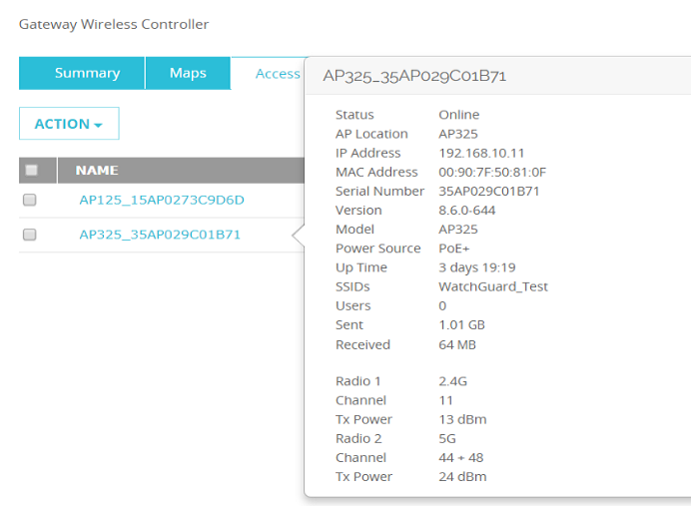
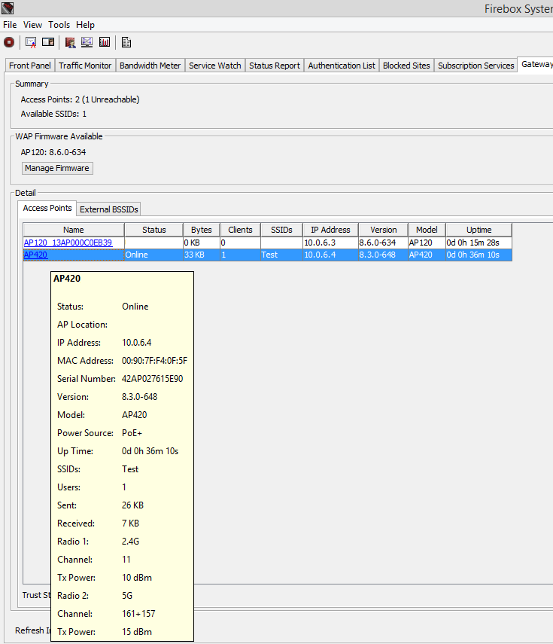
View AP and Client Details
You can now click on APs in the Gateway Wireless Controller status in both Fireware Web UI and Firebox System Manager to see detailed AP information

Slide 7
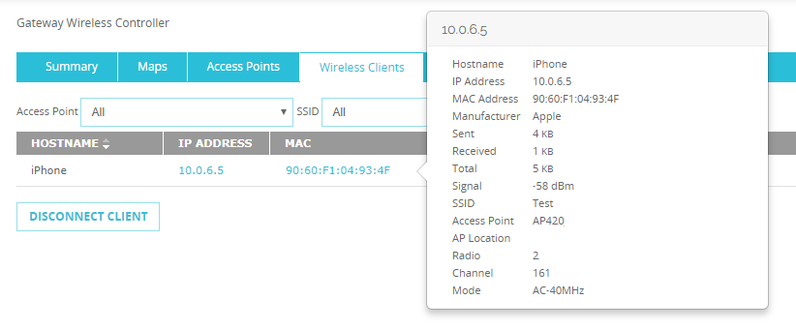
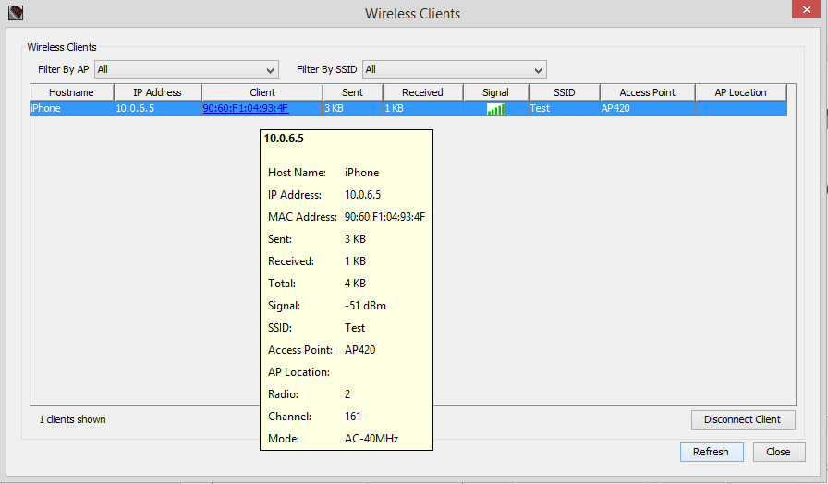
View AP and Client Details
Click a client MAC address to see detailed client information in both Fireware Web UI and Firebox System Manager

Slide 8
View AP and Client Details
These columns from the AP and Client status views have been moved to the pop-up window details:
AP: Radio 1 and Radio 2
Client: Manufacturer, Radio, and Mode

Slide 9
AP Power Source Information
You can now see the type of power source in use by an AP
The sources include:
PoE+ (802.11at)
PoE (802.11af)
DC (Power adapter)
-- (Not supported)
Power source indication is only supported on WatchGuard Wave 2 APs (AP325, AP420)
Wave 1 and legacy APs will display “--” to indicate the ability to see the power source is not supported

Slide 10
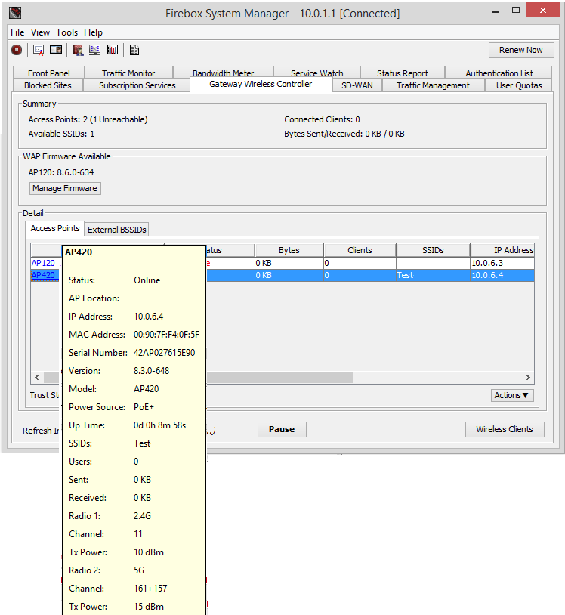
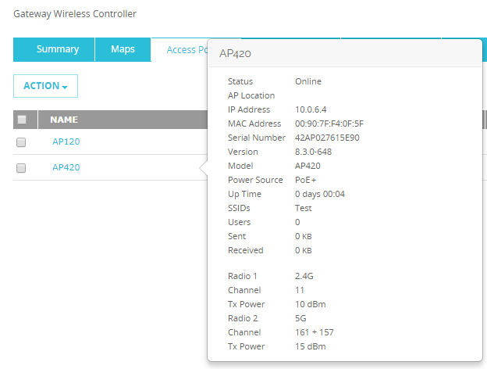
AP Power Source Information

Slide 11
Localization Update

Slide 12
Localization Update
UI localization is updated and includes all UI strings released as of Fireware v12.2.1
User interface text or elements added since the release of Fireware v12.2.1 remain in English when using localized UI
Supported languages include French (France), Japanese, and Spanish (Latin American)
Localized Help is near complete and will be available on WatchGuard website
French is currently available; other languages will be added soon

Slide 13
Thank You!

