Slide 1
What’s New in Fireware v12.2

Slide 2
What’s New in Fireware v12.2
IntelligentAV
File Exceptions
Geolocation by Policy
TLS profile minimum protocol version
TLS profiles for SMTP & POP3 proxies
Restore configuration file from Web UI
Firebox Cloud Enhancements
WebBlocker Usability Enhancements
On-premises WebBlocker Server
FQDN Enhancements

Slide 3
What’s New in Fireware v12.2
Control Firebox-generated traffic
Loopback interface IP address support for global dynamic NAT and per-policy dynamic NAT
AES-GCM support
Secondary IP addresses for BOVPN gateways
Mobile VPN with SSL and Access Portal settings
Redundant single sign-on
SSO Agent connection status tool

Slide 4
What’s New in Fireware v12.2
Certificate Management Enhancements
Gateway Wireless Controller Enhancements
Authentication Setting Enhancements
Other Enhancements

Slide 5
Supported Platforms
Fireware v12.2 is supported on:
Firebox T Series and
Firebox M Series appliances
FireboxV
Firebox Cloud
Fireware v12.2 is not supported on XTM devices.
We will provide updates to Fireware v12.1.x for XTM devices to fix bugs and address security issues

Slide 6
IntelligentAV

Slide 7
IntelligentAV
IntelligentAV is a new subscription service that enhances the ability of Gateway AntiVirus to detect new threats and polymorphic malware
WatchGuard has partnered with Cylance to provide this as a supplemental scanning solution for our higher-end Firebox models
IntelligentAV uses artificial intelligence and mathematical models to examine and characterize millions of file attributes to determine if a file is a threat

Slide 8
IntelligentAV and Gateway AntiVirus
IntelligentAV adds another layer of protection to the Gateway AntiVirus security service
With IntelligentAV enabled, Gateway AntiVirus uses two scan engines
Bitdefender — Gateway AntiVirus scan engine
Cylance — IntelligentAV scan engine
These scan engines work together to increase the ability of the Firebox to detect and block malware before it can enter your network

Slide 9
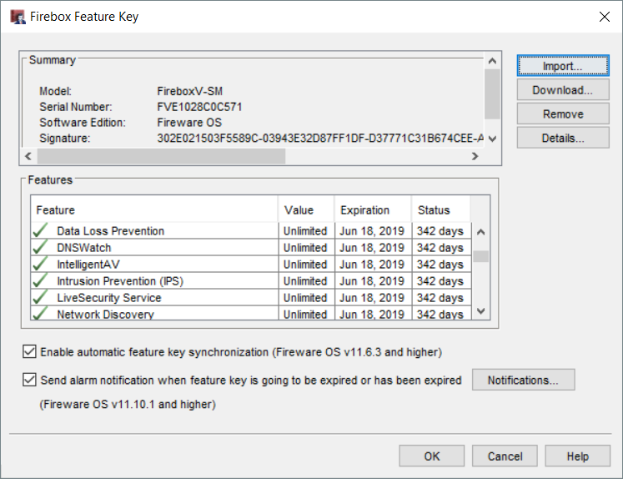
IntelligentAV Models and Licensing
IntelligentAV is supported on these Firebox models:
Firebox M Series (except M200/300)
Firebox Cloud
Firebox V
IntelligentAV is included in Total Security subscription for Firebox models that support it
To enable this feature, the feature key must include the feature IntelligentAV
Notes:
From Networking/Interface page add a custom DHCP Option

Slide 10
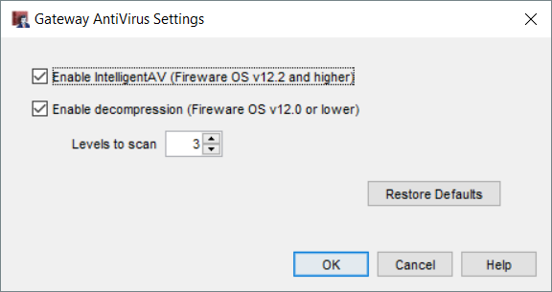
IntelligentAV Configuration
When IntelligentAV is licensed, you can enable it in Gateway AntiVirus global settings
Select Enable IntelligentAV
Notes:
From Networking/Interface page add a custom DHCP Option

Slide 11
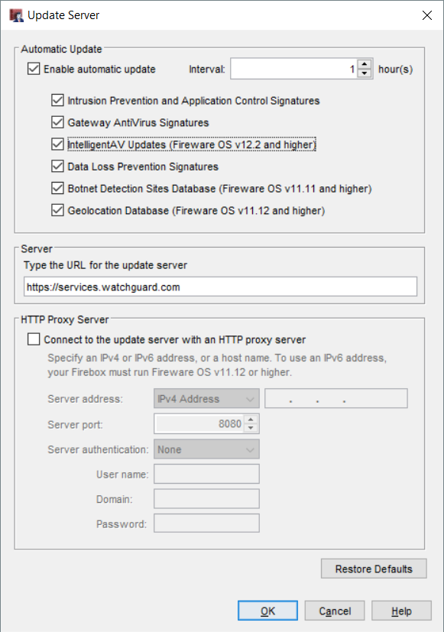
IntelligentAV Configuration
In the Update Server settings for services, enable automatic updates for IntelligentAV Updates

Slide 12
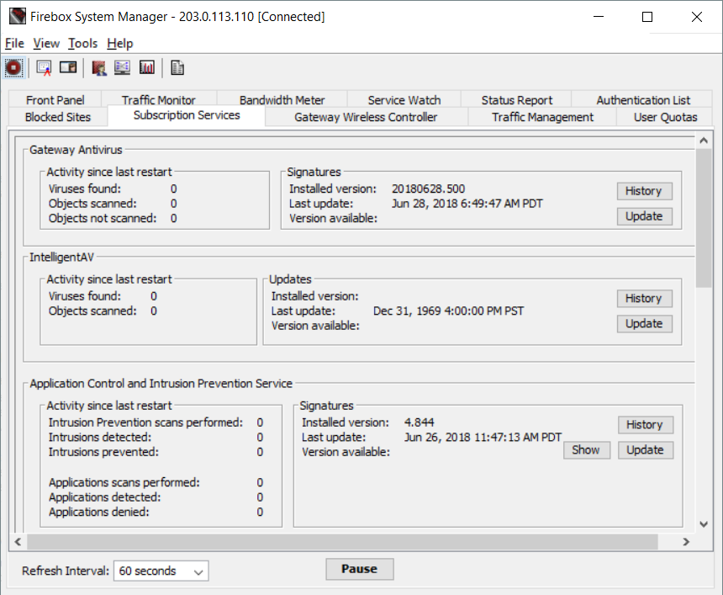
IntelligentAV Status
In Firebox System Manager, IntelligentAV status and statistics are available on the Subscription Services tab

Slide 13
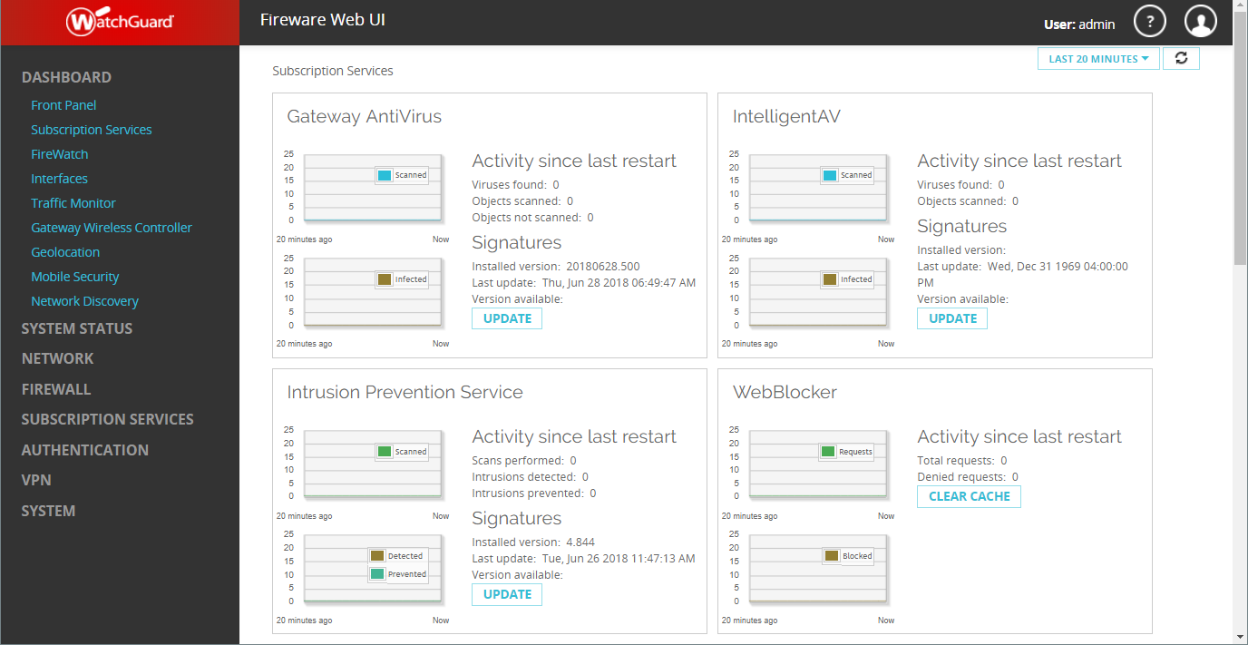
IntelligentAV Status
In Fireware Web UI, IntelligentAV status and statistics are available on the Subscription Services dashboard

Slide 14
File Exceptions

Slide 15
File Exceptions
You can now use the File Exceptions list to bypass some subscription services for specific files
For example, if a PDF document is incorrectly identified as a threat by IntelligentAV, you might want to bypass future scans of the file and allow users to download or open it
Files added to the File Exceptions list are not scanned by the following security services:
APT Blocker
Data Loss Prevention
Gateway AntiVirus
IntelligentAV
You can add up to 1024 files to the File Exceptions list

Slide 16
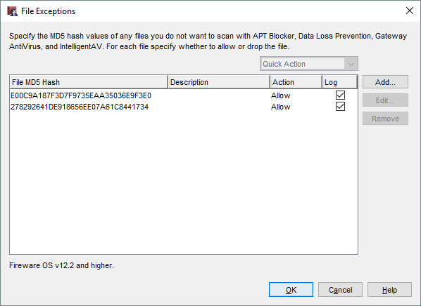
File Exceptions Configuration
To set up file exceptions, select Subscription Services > File Exceptions

Slide 17
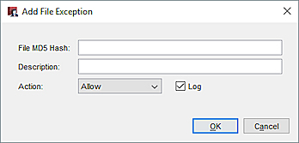
Add File Exceptions
To add a file to the list, click Add, and provide the file information:
File MD5 Hash – 32-character string that uniquely identifies a specific version of a specific file. You can use Windows, Mac OS, and Linux utilities to find the MD5 hash value of a file. See Fireware Help for details.
Description – Description of the file
Action
Allow – Allows the file to be downloaded or the email attachment to be delivered to the recipient
Drop – Denies the transaction (HTTP), drops the connection (FTP), or removes the attachment from the email before it is delivered to the recipient (SMTP/POP3/IMAP)
The Firebox performs the selected action immediately and does not scan the file with the relevant security services

Slide 18
Geolocation by Policy

Slide 19
Geolocation by Policy
You can now enable Geolocation at the policy level
This provides you with more granular control over the types of connections the Firebox denies based on geographic location

Slide 20
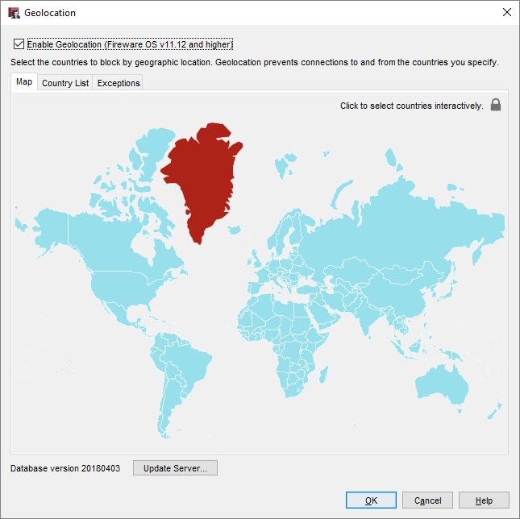
Geolocation by Policy
Geolocation prevents connections to and from the countries you specify
When you enable the Geolocation subscription service, Geolocation is automatically enabled in all policies
Notes:
From Networking/Interface page add a custom DHCP Option

Slide 21
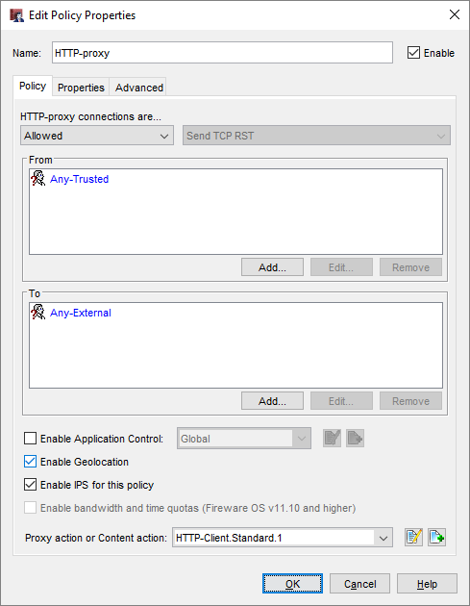
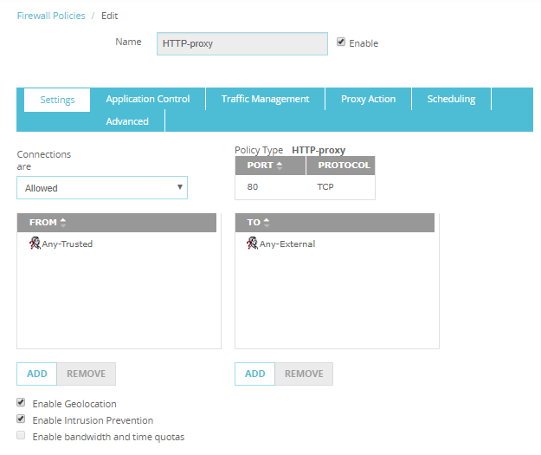
Geolocation by Policy
You can enable or disable Geolocation in policy settings
Notes:
From Networking/Interface page add a custom DHCP Option

Slide 22
TLS Minimum Protocol Version

Slide 23
TLS Minimum Protocol Version
You can now set the minimum protocol version for TLS
This enables you to configure the minimum TLS version for PCI compliance

Slide 24
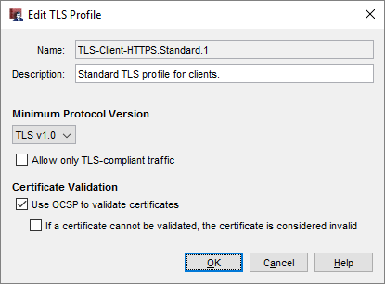
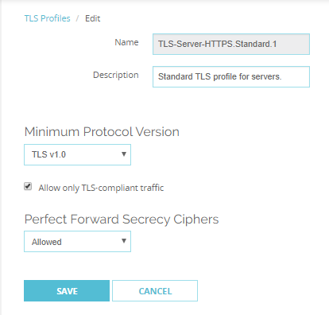
TLS Minimum Protocol Version
In a TLS profile, you can now configure the Minimum Protocol Version:
TLS v1.1
TLS v1.0 (default)
SSL v3
This replaces the previous Allow SSLv3 check box
For PCI compliance, set the Minimum Protocol Version to TLS v1.1

Slide 25
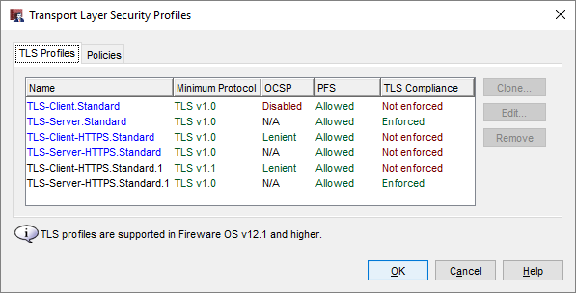
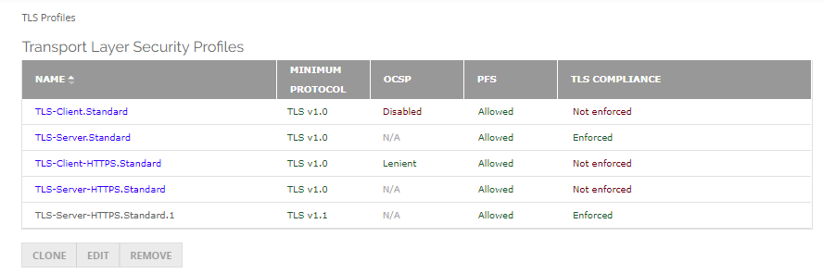
TLS Minimum Protocol Version
The Minimum Protocol Version now appears in the TLS Profiles list

Slide 26
SMTP and POP3 over TLS

Slide 27
SMTP and POP3 over TLS
This release extends TLS profile support to the POP3 and SMTP proxies
TLS profiles were previously supported only for the IMAP and HTTPS proxies
This update enables POP3 and SMTP proxies to inspect mail traffic encrypted with TLS on implicit secure ports:
POP3 over TLS
SMTP over TLS​
​STARTTLS settings for SMTP also now use TLS profiles

Slide 28
Explicit and Implicit TLS
Transport Layer Security (TLS) is a protocol that provides encryption and security for data sent over a network
TLS can be explicit or implicit
Explicit TLS
Server converts a non-TLS connection to a TLS connection when it receives the STARTTLS command
Implicit TLS
Server expects TLS based on the port
IMAPS: port 993 (support added to IMAP proxy in Fireware v12.1)
SMTPS: port 465 (support added to SMTP proxy in Fireware v12.2)
POP3S: port 995 (support added to POP3 proxy in Fireware v12.2)

Slide 29
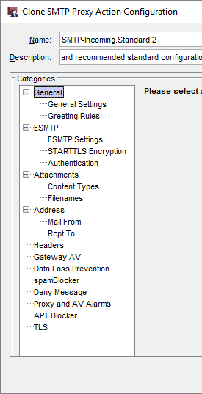
SMTP Proxy — TLS
The SMTP proxy now supports both implicit and explicit TLS
Explicit TLS (STARTTLS Encryption)
Supported in previous releases
STARTTLS now uses a TLS profile
Implicit TLS (SMTPS)
New in Fireware v12.2
Uses a TLS profile
You can select a separate TLS profile for STARTTLS and SMTPS

Slide 30
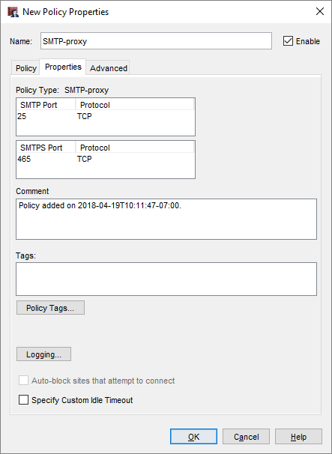
Secure SMTP (SMTPS)
The SMTP proxy now supports Secure SMTP (SMTPS)
The SMTP proxy supports:
SMTP on TCP port 25
SMTPS on TCP port 465 (new)

Slide 31
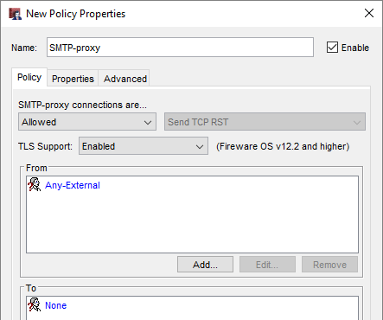
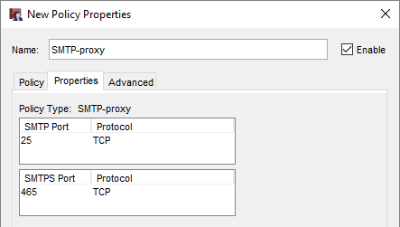
SMTP Proxy — TLS Support
The TLS Support option controls which ports the SMTP proxy listens on:
Disabled — SMTP proxy listens on port 25 only
Enabled (default ) — SMTP proxy listens on ports 25 and 465
Required — SMTP proxy listens on port 465 only
The port list depends on the TLS Support option

Slide 32
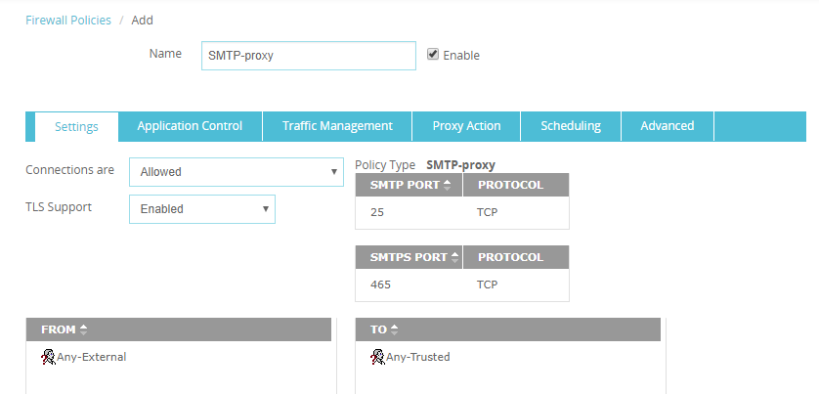
SMTP Proxy — TLS Support
In Fireware Web UI, the TLS Support option and ports appear together on the Settings tab

Slide 33
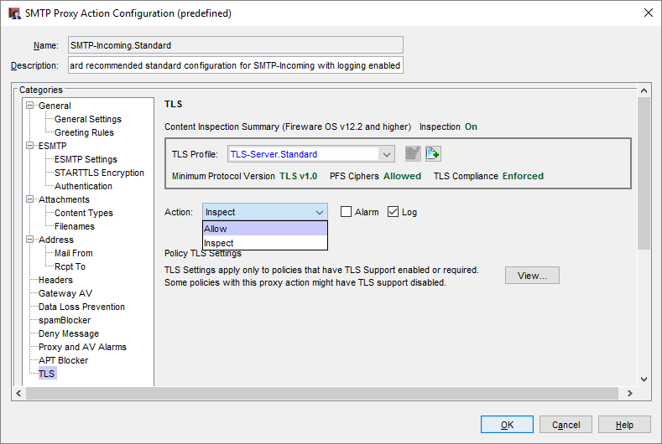
SMTP Proxy Action — TLS Settings
SMTP proxy actions now include TLS settings
TLS settings apply only when TLS Support is set to Enabled or Required in the SMTP policy
The TLS settings in the proxy action include:
TLS Profile
Action
Allow
Inspect

Slide 34
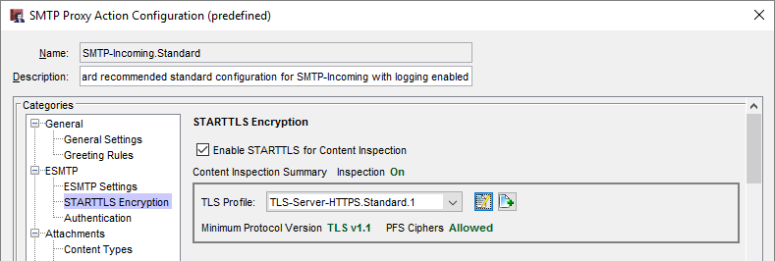
SMTP Proxy Action — STARTTLS Encryption
In the ESMTP settings, the TLS Encryption settings are now called STARTTLS Encryption
These settings also use a TLS profile
The TLS profile you select in the STARTTLS Encryption settings can be different from the TLS profile in the TLS settings

Slide 35
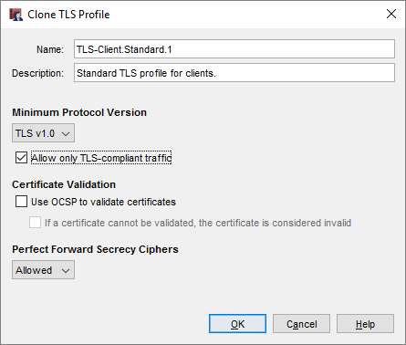
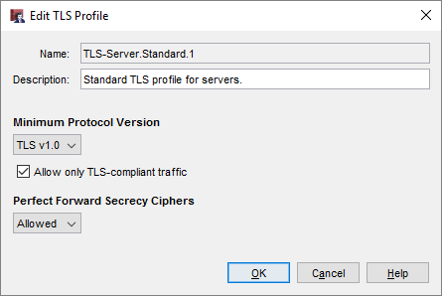
SMTP and POP3 over TLS
A TLS profile is a collection of TLS-related security settings:
Minimum Protocol Version
Allow only TLS compliant traffic
Certificate Validation (OCSP)
Perfect Forward Secrecy Ciphers
The POP3 and SMTP proxies now use the same client and server TLS profiles previously supported for other proxies
Notes:
From Networking/Interface page add a custom DHCP Option

Slide 36
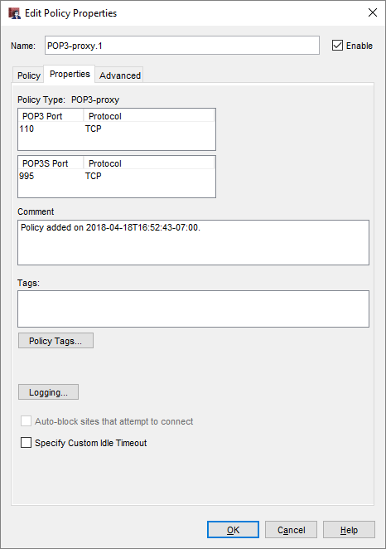
Secure POP3 (POP3S)
The POP3 proxy now supports Secure POP3 (POP3S)
The POP3 proxy supports:
POP3 on TCP port 110
POP3S on TCP port 995 (new)

Slide 37
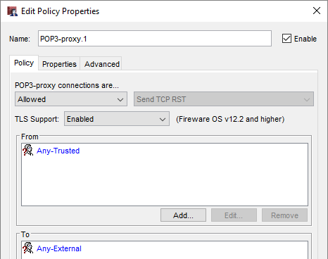
POP3 Proxy — TLS Support
The TLS Support option controls which ports the POP3 proxy listens on:
Disabled — POP3 proxy listens on port 110 only
Enabled (default ) — POP3 proxy listens on ports 110 and 995
Required — POP3 proxy listens on port 995 only
The port list depends on the TLS Support option

Slide 38
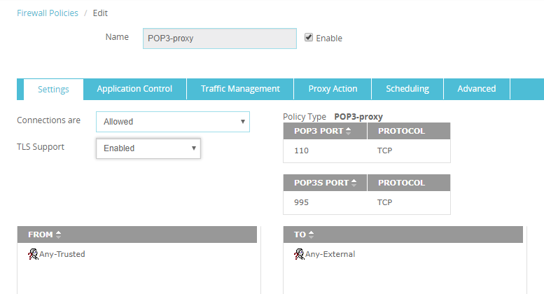
POP3 Proxy — TLS Support
In Fireware Web UI, the TLS Support option and ports appear together on the Settings tab

Slide 39
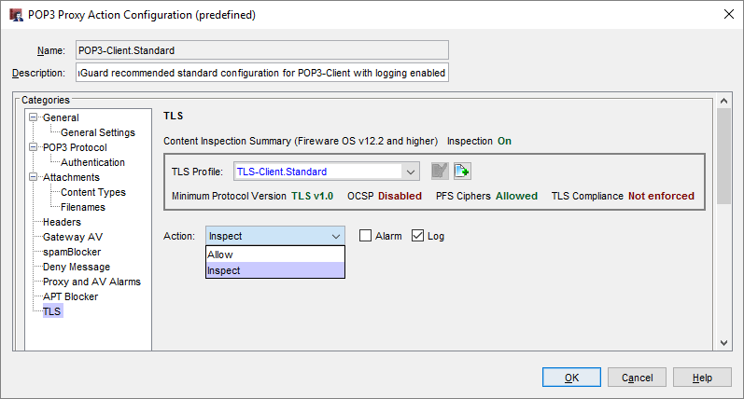
POP3 Proxy Action — TLS Settings
POP3 proxy actions now include TLS settings
TLS settings apply only when TLS Support is set to Enabled or Required in the POP3 policy
The TLS settings in the proxy action include:
TLS Profile
Action
Allow
Inspect

Slide 40
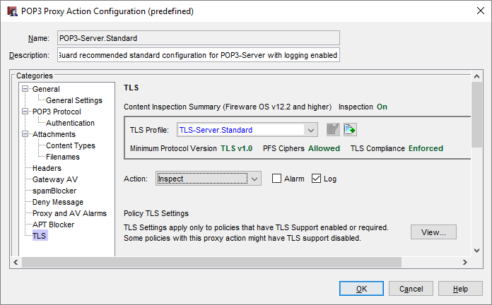
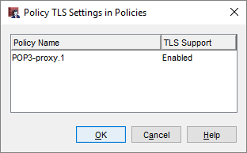
POP3 Proxy Action TLS Settings
TLS settings apply only when TLS Support is enabled or required in a policy
If you edit the proxy action from the Proxy Actions list, click View to see whether TLS is enabled for policies that use the proxy action

Slide 41
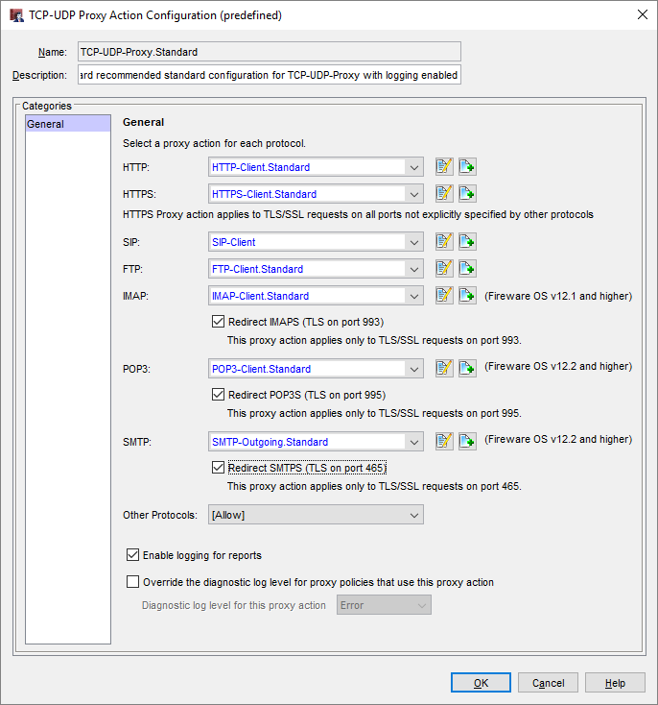
TCP/UDP Proxy Action
The TCP-UDP proxy action now applies to POP3 and SMTP
The POP3 proxy action applies only to TLS/SSL requests on port 995
The SMTP proxy action applies only to TLS/SSL requests on port 465
The HTTPS proxy action applies to TLS/SSL requests on all ports not specified by other protocols

Slide 42
Restore Configuration from Fireware Web UI

Slide 43
Restore Configuration from Fireware Web UI
In previous versions of Fireware, you could save the configuration to a file from Fireware Web UI
You can now restore the saved configuration file from Fireware Web UI

Slide 44
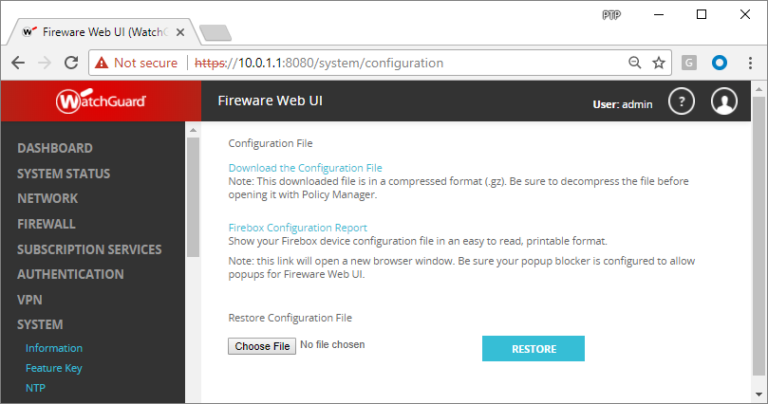
Restore Configuration from Fireware Web UI
In Fireware Web UI, you can restore a saved configuration file from the Configuration File page

Slide 45
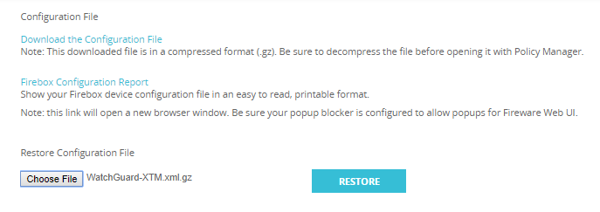
Restore Configuration from Fireware Web UI
To restore a saved configuration file:
In Fireware Web UI, select System > Configuration
Select a saved configuration file for the same Firebox model The configuration file can be one of these types:
Compressed (.gz) configuration file downloaded from the Web UI
Configuration file (.xml) saved from the File > Save > As Version command in Policy Manager or extracted from the .gz file
Click Restore

Slide 46
Restore Configuration from Fireware Web UI
When you restore a configuration file, the Firebox checks the file to verify compatibility
The Firebox does not restore the configuration file if:
Firebox model does not match
OS compatibility setting is newer than the installed OS version
When you restore a configuration file, there is no change to the Firebox feature key
If you restore a configuration that enables subscription services that are missing or expired in the feature key, or if the Firebox does not have a feature key, the behavior for those services is the same as when a feature key expires

Slide 47
Firebox Cloud Enhancements

Slide 48
Firebox Cloud Enhancements
WatchGuard System Manager and WSM Management Server can now manage Firebox Cloud
Firebox Cloud now supports these features:
Single Sign-On (SSO)
spamBlocker
Quarantine Server
Firebox Cloud for Azure will support an hourly license option

Slide 49
Firebox Cloud — WSM Support
WatchGuard System Manager (WSM) now supports management of Firebox Cloud
WatchGuard System Manager
Policy Manager
Firebox System Manager
WSM Management Server now supports management of Firebox Cloud for:
Management of multiple Firebox OS updates
Drag-and-drop VPNs
Templates
WSM Quick Setup Wizard is not supported for Firebox Cloud

Slide 50
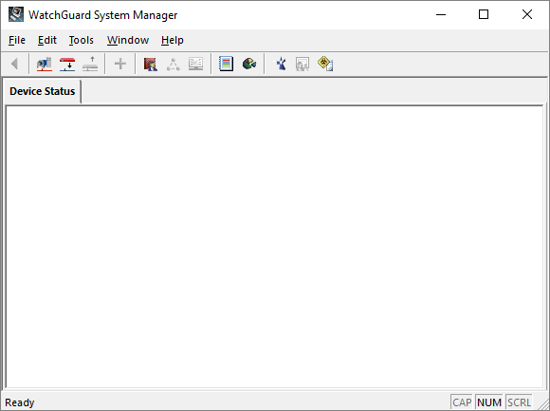
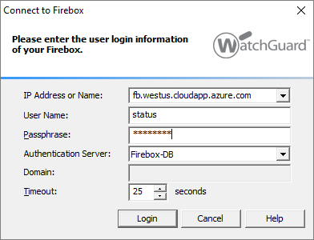
Firebox Cloud — WSM Support
To connect to Firebox Cloud from WatchGuard System Manager, use the Firebox Cloud IP address or DNS name

Slide 51
Firebox Cloud — Policy Manager
Policy Manager does not allow you to configure features and options that are not supported by Firebox Cloud, such as:
Most networking features (manage network settings in the VM configuration)
Gateway Wireless Controller
Quotas
Mobile VPN with SSL Bridge VPN option
Services: Network Discovery, Mobile Security, DNSWatch
Hotspot
Explicit Proxy (not currently hidden, but not supported)

Slide 52
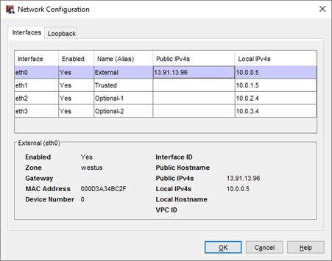
Firebox Cloud — Policy Manager
On the Network > Configuration page:
The Interfaces tab shows read-only interface information
On the Loopback tab you can configure a loopback interface

Slide 53
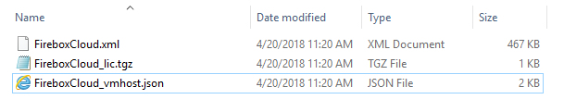
Firebox Cloud — Policy Manager
When you save the Firebox Cloud configuration to a file, Policy Manager saves three files:
The configuration file (.xml)
The feature key file (_lic.tgz)
The VM information file ( _vmhost.json)

Slide 54
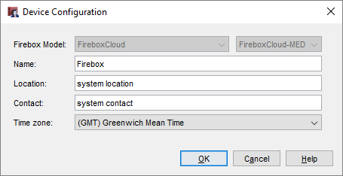
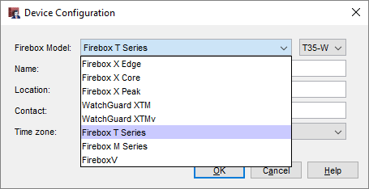
Firebox Cloud — Policy Manager
Firebox Cloud configuration files are not compatible with other Firebox models
On the Setup > System page for Firebox Cloud, you cannot change the Firebox Model
On the Setup > System page for any other Firebox model, you cannot change the model to Firebox Cloud
In Policy Manager, you cannot create a new Firebox Cloud configuration

Slide 55
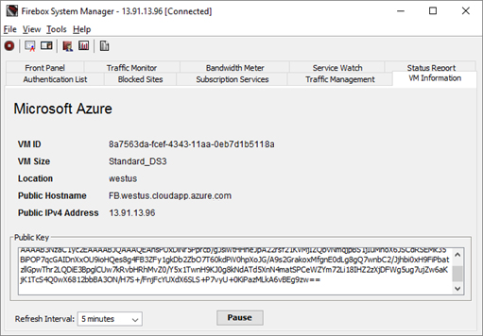
Firebox Cloud — Firebox System Manager
In Firebox System Manager, the VM Information tab shows information about the Firebox Cloud virtual machine
This is the same information available in Fireware Web UI on the System Status > VM Information page

Slide 56
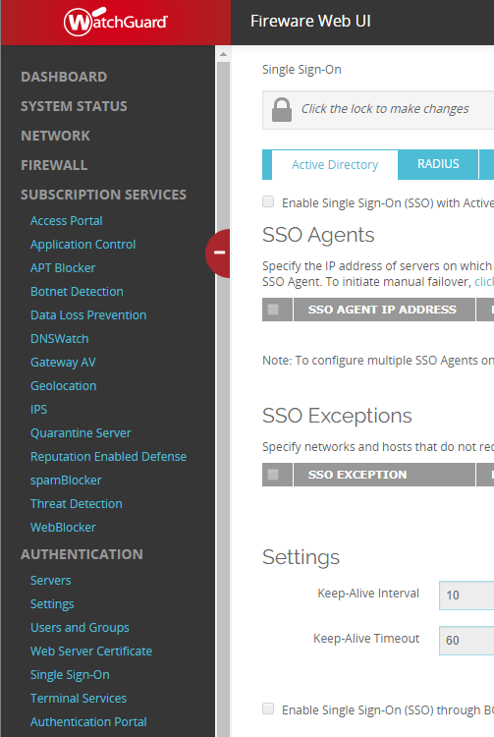
Firebox Cloud — New Supported Features
Fireware v12.2 for Firebox Cloud now supports configuration of these features in both Web UI and Policy Manager:
Single Sign-On
spamBlocker
Quarantine Server

Slide 57
Firebox Cloud — Feature Key Visibility
Firebox Cloud with an hourly license does not require a feature key from WatchGuard
The cost of Firebox Cloud and all security services is included in the hourly price
For Firebox Cloud with an hourly (pay as you go) license, the Feature Keys page is now visible in Fireware Web UI
Select System > Feature Key
The Feature Key page shows only the list of licensed features
There is no expiration date for each feature
The Feature Key page is read-only

Slide 58
Firebox Cloud — Azure Hourly License
Previously, Firebox Cloud was available in the Microsoft Azure Marketplace only with a BYOL license
Firebox Cloud v12.2 will be available for Azure with both BYOL and hourly license options
The hourly license includes a free 30 day trial
No hourly software charges for the instance during the trial
Azure infrastructure charges still apply
The trial converts to a paid hourly subscription upon expiration
Firebox Cloud with both license options will be available in Azure Marketplace shortly after general availability (GA) of Fireware v12.2

Slide 59
WebBlocker Usability Enhancements

Slide 60
WebBlocker Usability
WebBlocker has been updated to make it easier to see and manage denied categories in WebBlocker actions
The UI for category management in WebBlocker is now more consistent with category management in Application Control

Slide 61
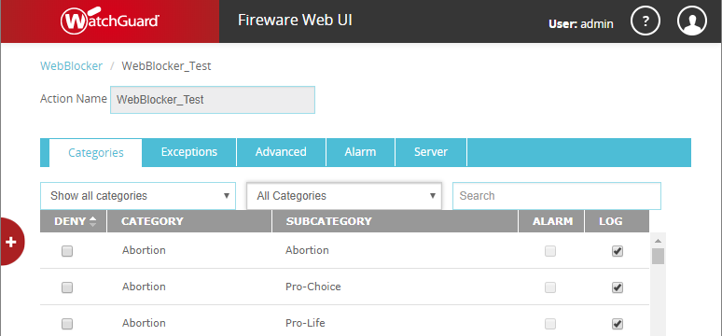
WebBlocker Usability Enhancements
In a WebBlocker action you can now:
Filter categories by deny status or by top-level category
Search for a category by name
Click a column heading to sort the list by that column

Slide 62
WebBlocker Usability Enhancements
You can now configure Alarm and Log options per category
To receive notification when WebBlocker denies content for a category, select Alarm
To generate a log message when WebBlocker denies content for a category, select Log

Slide 63
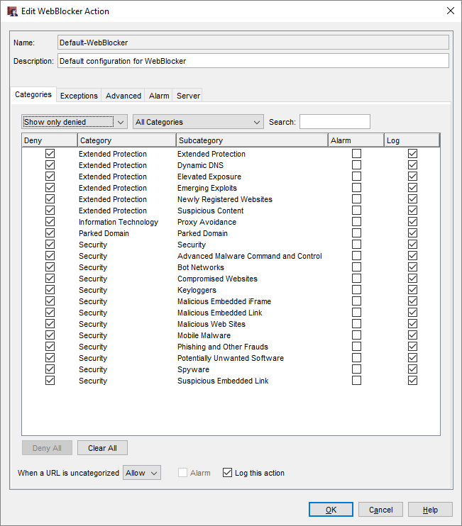
WebBlocker Usability Enhancements
WebBlocker action configuration in Policy Manager
To see a list of denied categories, select the filter Show only denied
To deny all categories in the filtered list, click Deny All
To clear the Deny check box for all categories in the filtered list, click Clear All

Slide 64
On-Premises WebBlocker Server

Slide 65
On-Premises WebBlocker Server
Fireware now supports an on-premises WebBlocker Server with the same set of content categories as Websense cloud (now called WebBlocker cloud)
Supports more content categories than the WebBlocker Server previously available for local installation with WSM

Slide 66
On-Premises WebBlocker Server
The on-premises WebBlocker Server must be installed as a virtual machine
Supported environments:
Microsoft Hyper-V System Center VMM 2012 and higher
VMWare ESXi 5.5 and higher
The WebBlocker Server in WatchGuard Server Center is supported only for Fireboxes that run Fireware v12.1.x or lower
Notes:
From Networking/Interface page add a custom DHCP Option

Slide 67
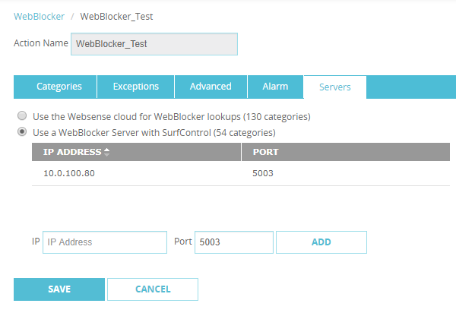
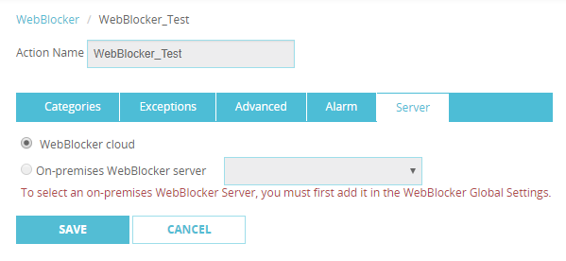
On-Premises WebBlocker Server — Upgrade
When you upgrade to Fireware v12.2:
WebBlocker actions that use a WebBlocker Server with SurfControl are updated to use WebBlocker Cloud
Previously configured content categories are automatically converted to equivalent categories in WebBlocker Cloud
Fireware v12.1.1
Fireware v12.2

Slide 68
On-Premises WebBlocker Server Licensing
The on-premises WebBlocker Server is licensed as part of a WebBlocker subscription
To activate an on-premises WebBlocker Server, you must have a Firebox with an active Total Security or WebBlocker subscription
If the WebBlocker subscription expires, the WebBlocker Server activation also expires

Slide 69
On-Premises WebBlocker Server Setup
WebBlocker Server installation files:
.OVA file for installation on VMWare
.VHD file for installation on Hyper-V
Installation:
Use the .OVA or .VHD file to create a virtual machine
Connect and run the WebBlocker Server Setup Wizard

Slide 70
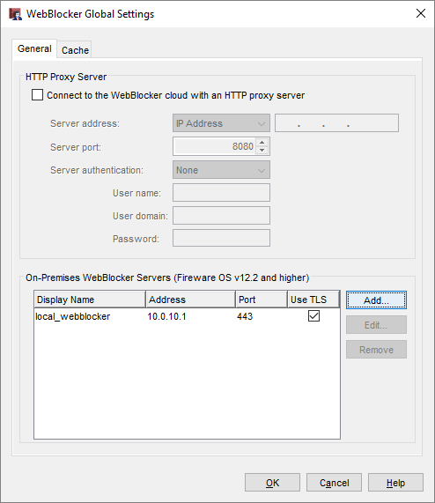
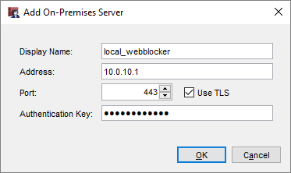
On-Premises WebBlocker Server Setup
To add an on-premises WebBlocker Server to the Firebox configuration, edit WebBlocker Global settings
WebBlocker Server Properties:
Display Name — The server name as it appears in the WebBlocker configuration
Address — WebBlocker Server host name or IP address
Port and TLS options — Default settings match the defaults for the on-premises WebBlocker Server
Authentication Key — the Authentication Key on the WebBlocker Server

Slide 71
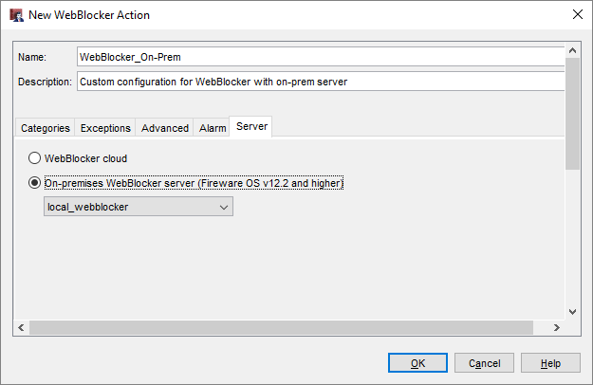
On-Premises WebBlocker Server Setup
By default, all WebBlocker actions use WebBlocker cloud
To use an on-premises WebBlocker Server
Create or edit a WebBlocker action
On the Server tab, select the on-premises WebBlocker Server

Slide 72
FQDN Enhancements

Slide 73
FQDN Improvements
FQDN support has been extended to provide greater granularity and flexibility
You can now use a wildcard FQDN with multi-level subdomains
More than one FQDN can now resolve to the same IP address
You can use the same FQDN in more than one policy
FQDN support for SNAT

Slide 74
FQDN Subdomain Wildcard Support
Multi-level wildcard subdomain support for FQDNs in policies, aliases, and any feature that supports FQDN input
Previously only supported 2 levels (*.example.com)
Now multiple-level support up to a theoretical 126 level maximum for wildcard FQDN, and 127 levels for full name FQDN
For example, you can now specify a wildcard FQDN as:
*.example.com
*.a.example.com
*.a.b.example.com
*.a.b.c.example.com
Supports a maximum of 255 IPs for each FQDN

Slide 75
FQDN Wildcard Support
Overlapping addresses in FQDN wildcards are resolved by policy precedence
For example, a.b.example.com is applicable to all three of these FQDN entries:
*.example.com
*.b.example.com
a.b.example.com
The policy that is applied is based on the policy precedence order
If a policy with the FQDN *.example.com appears first in the policy order, a.b.example.com will be applicable to that policy

Slide 76
Multiple FQDN Resolution to One IP Address
Multiple FQDNs can resolve to the same IP address
For example:
*.blog.example.com
*.example.com
Previously, Fireware mapped the IP address only to the first FQDN that resolved to it
This created limitations because FQDNs can be used in many places in the configuration
This becomes a more common issue with wildcard FQDNs
Now an IP address can be mapped to more than one FQDN
The FQDN that appears in traffic log messages depends on policy precedence

Slide 77
FQDN in Multiple Policies
The same FQDN can be used in more than one policy
Prevents issues with multiple FQDN matches in different packet level features, such as packet filter policies, blocked sites, and blocked sites exceptions
Policy order precedence decides the FQDN resolution

Slide 78
FQDN Support for SNAT
You can now specify an FQDN in a static NAT (SNAT) action to help make policy management easier and to avoid downtime from IP address changes
For example, if your Firebox is configured to process SMTP traffic from an Office 365 mail server, you can specify an FQDN instead of IP addresses for Office 365
If the Office 365 IP addresses change, you no longer need to update the SNAT entry

Slide 79
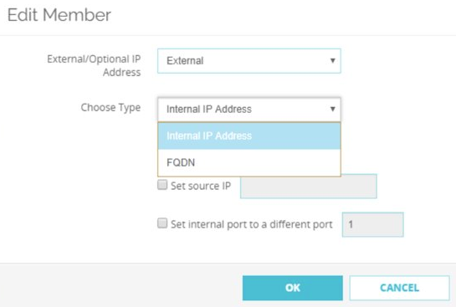
FQDN Support for SNAT
When you add or edit a SNAT member, a new drop-down list appears that includes an FQDN option:

Slide 80
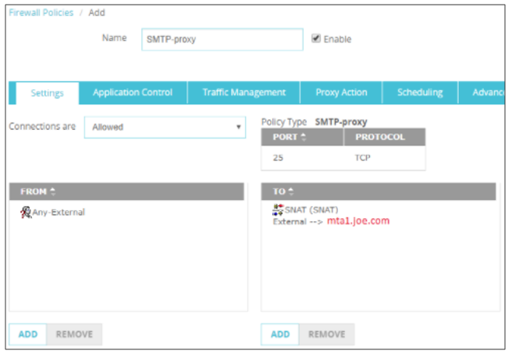
FQDN Support for SNAT
Example – Hybrid mail environment with a local mail server and Office 365 in the cloud
On the Firebox, configure an SMTP-proxy policy for port 25 traffic from the External interface
Add an SNAT entry that specifies an FQDN for the Office 365 mail server

Slide 81
Control Firebox-Generated Traffic

Slide 82
Control Firebox-Generated Traffic
New enhancements give you control over traffic generated by the Firebox:
Enable a global setting to configure policies for Firebox-generated traffic
Configure policy-based routing for Firebox-generated traffic
Set a different source IP address for Firebox-generated traffic
Specify the loopback IP address as the source in dynamic NAT policies

Slide 83
Control Firebox-Generated Traffic
These enhancements have many uses:
You can apply global NAT, per-policy NAT, policy-based routing, traffic management, and QoS to policies for Firebox-generated traffic
Examples of Firebox-generated traffic:
Signature-based cloud services, such as Gateway AntiVirus, Intrusion Prevention Service, Application Control, Data Loss Prevention, Botnet Detection, and Geolocation
Tunnels not tied to an interface (SSL management and BOVPN TLS clients)
Log traffic from the Firebox to a Dimension server

Slide 84
Control Firebox-Generated Traffic
To add new policies for Firebox-generated traffic, you must first select the Enable configuration of policies for traffic generated by the Firebox global setting

Slide 85
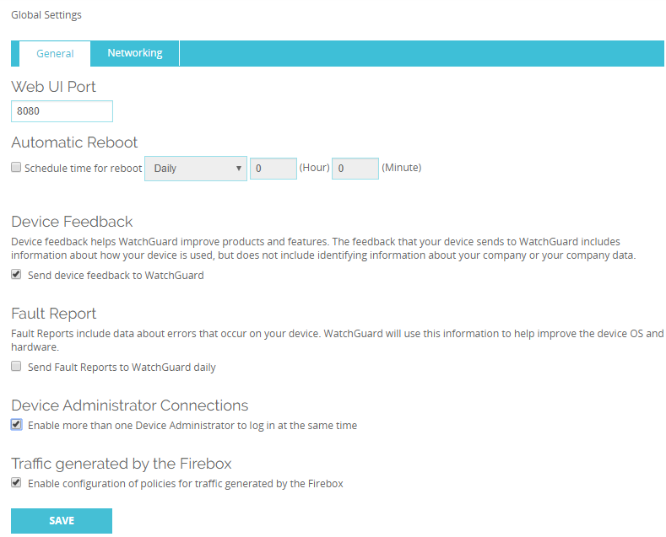
Control Firebox-Generated Traffic
Web UI

Slide 86

Control Firebox-Generated Traffic
Policy Manager

Slide 87
Control Firebox-Generated Traffic
When the Enable configuration of policies for traffic generated by the Firebox check box is selected:
The Any-From-Firebox policy appears in the list of policies. This policy cannot be modified or removed.
You can add new policies that apply to Firebox-generated traffic
When the list of policies is configured for auto-order mode, policies that specify Firebox-generated traffic appear before all other policies
Policies that you add for Firebox-generated traffic appear before the Any-From-Firebox policy because they are more granular

Slide 88
Control Firebox-Generated Traffic
Proxy actions are not supported for Firebox-generated traffic
As a best practice, we recommend that you do not configure Deny policies for Firebox-generated traffic

Slide 89

Control Firebox-Generated Traffic
Web UI

Slide 90

Control Firebox-Generated Traffic
Policy Manager

Slide 91
Control Firebox-Generated Traffic
Logging for the Any-From-Firebox policy is controlled by the Enable logging for traffic sent from this device check box
This check box appears in the global logging settings:
Web UI — System > Logging > Settings
Policy Manager — Setup > Logging > Diagnostic Log Level
Logging for policies that you create is controlled in those policies

Slide 92
Control Firebox-Generated Traffic
Use cases
For multi-WAN, you can control which WAN interface is used for Firebox-generated traffic to cloud-based WatchGuard subscription services
This helps you prevent subscription services traffic to unintended or expensive interfaces
Example: On a connection with limited bandwidth, force WebBlocker traffic to use a specific interface so WebBlocker traffic does not reduce the bandwidth available to VoIP traffic
Example: Force traffic from the Firebox to your Log Server to use a specific interface rather than the VPN tunnel

Slide 93
Control Firebox-Generated Traffic
Use cases
For BOVPN virtual interface tunnels configured as zero route, you can create exceptions
Example: If the local Firebox requests signature updates, the request is sent through the tunnel. If the remote Firebox does not allow DNS requests, the signature updates fail
To avoid this issue, you can force traffic to cloud-based WatchGuard subscription services to use a WAN interface instead of the VPN tunnel
You can force traffic that matches local, static, or policy-based routing routes to take precedence over routes specified in your BOVPN configuration

Slide 94
Control Firebox-Generated Traffic
Use cases
Configure the Firebox to use provider-independent IP addresses
Example: You have a provider-independent block of IP addresses and multiple ISPs. The external Firebox interface has a public IP address that is not part of the provider-independent IP address block.
To use provider-independent addresses for Firebox-generated traffic or traffic that passes through the Firebox, set the source IP address in a DNAT rule to one or more IP addresses from the provider-independent block
A provider-independent IP address you specify as the source IP address is not bound to a specific interface

Slide 95
Control Firebox-Generated Traffic
Use cases
Apply Quality of Service (QoS) and traffic management to traffic generated by the Firebox
Example: Apply QoS and traffic management to Firebox-generated traffic to make sure emergency calls placed over VoIP are not interrupted

Slide 96
Loopback Interface IP Addresses and DNAT

Slide 97
Loopback Interface IP Addresses and DNAT
You can now specify loopback IP addresses for global dynamic NAT (DNAT) and per-policy dynamic NAT

Slide 98
Loopback Interface IP Addresses and DNAT
In the global dynamic NAT configuration or in the per-policy dynamic NAT settings, you can specify the primary or secondary IP address of the loopback interface
If you have a provider-independent block of IP addresses, you can now use these addresses without binding them to a specific external interface
You can use provider-independent IP addresses for Firebox-generated traffic and NAT

Slide 99
AES-GCM Support

Slide 100
AES-GCM Support
Fireware now supports AES-GCM for IPSec and SSL/TLS VPN and mobile VPN tunnels
GCM (Galois/Counter Mode) is an authenticated encryption algorithm known for its security, efficiency, and performance
Encryption and data integrity check occur simultaneously
Performance increases on Intel-based Fireboxes without hardware crypto support (T55 and T70)
Performance increases on FireboxV and Firebox Cloud for any processor models that support AES-NI
GCM is required by NSA Suite B, a standard specified by the United States government and adopted worldwide for data security

Slide 101
AES-GCM Support
AES-GCM is supported for these features:
BOVPN (IPSec and TLS)
BOVPN virtual interfaces
Mobile VPN with IKEv2
Mobile VPN with SSL
These options are supported:
AES-GCM-128
AES-GCM-192
AES-GCM-256

Slide 102

AES-GCM Support
Mobile VPN example — Mobile VPN with SSL
WatchGuard Mobile VPN with SSL client must be v12.2 or higher to support AES-GCM
OpenVPN client must be v2.4.x or higher to support AES-GCM

Slide 103

AES-GCM Support
BOVPN example — Phase 1 settings

Slide 104

AES-GCM Support
BOVPN example — Phase 2 settings

Slide 105
AES-GCM Support
AES-GCM support details
IPSec BOVPN and BOVPN virtual interface configurations:
AES-GCM is supported for IKE proposals only when you select IKEv2
AES-GCM is supported for IPSec proposals in both IKEv1 and IKEv2
Mobile VPN with IKEv2 clients:
Windows supports all AES-GCM options, but only for IPSec proposals
macOS and iOS support AES-GCM-128 and AES-GCM-256 for IKE and IPSec proposals. AES-GCM-192 is not supported.
Android supports all AES-GCM options in for IKE and IPSec proposals

Slide 106
AES-GCM Support
AES-GCM support details
Mobile VPN with SSL
Windows and MacOS clients can support all AES-GCM options
Mobile SSLVPN servers can support all AES-GCM options
BOVPN over TLS
Client and Server mode support all AES-GCM options
Unsupported features
Management tunnels over SSL
Mobile VPN with IPSec
Mobile VPN with L2TP

Slide 107
AES-GCM Support
Fireware supports a 16-byte Integrity Check Value (ICV) to verify data integrity
16-byte ICV is required by GCM
8- and 12-byte ICVs are not supported

Slide 108
Secondary IP Addresses for BOVPN Gateways

Slide 109
Secondary IP Addresses for BOVPN Gateways
To configure BOVPN and BOVPN virtual interface connections in more complex environments, you can now specify a secondary IP address as the local gateway IP address

Slide 110
Secondary IP Addresses for VPN Gateways
A new drop-down list named Interface IP Address now appears in the gateway settings in the BOVPN and BOVPN virtual interface configurations
To specify a secondary IP address for a BOVPN or BOVPN virtual interface gateway, the interface you select as the Interface IP Address must already be configured with a secondary IP address

Slide 111

Secondary IP Addresses for VPN Gateways
Web UI — BOVPN configuration

Slide 112

Secondary IP Addresses for VPN Gateways
Web UI — BOVPN virtual interface configuration

Slide 113

Secondary IP Addresses for VPN Gateways
Policy Manager — BOVPN configuration

Slide 114

Secondary IP Addresses for VPN Gateways
Policy Manager — BOVPN virtual interface configuration

Slide 115
Mobile VPN with SSL and Access Portal Settings

Slide 116
Mobile VPN with SSL & Access Portal
In Fireware v12.1, the VPN Portal was added to consolidate settings shared by Mobile VPN with SSL and the Access Portal
This configuration created challenges and generated customer feedback
For a better user experience, in Fireware v12.2:
The VPN Portal configuration page is removed
Settings that appeared on the VPN Portal page now appear in the Mobile VPN with SSL and Access Portal configurations
VPN Portal Port is now named Access Portal Port
The WG-VPN-Portal alias is removed

Slide 117
Mobile VPN with SSL & Access Portal
Mobile VPN with SSL and the Access Portal continue to share these settings:
Authentication servers
Configuration Channel (known as the Access Portal Port in the Access Portal configuration)
SSL/TLS settings precedence remains unchanged for Firebox features that share the same OpenVPN server
For information about settings precedence for Firebox features that share the same OpenVPN server, see Fireware Help

Slide 118
Mobile VPN with SSL & Access Portal
Mobile VPN with SSL
Firebox settings for Mobile VPN with SSL now appear as they did before Fireware v12.1
On the Authentication tab, the Authentication Server list now appears
On the Advanced tab, the Configuration Channel text box now appears
These items were removed:
On Authentication tab, information about VPN Portal interfaces and authentication servers
A link to the VPN Portal page

Slide 119

Mobile VPN with SSL & Access Portal
Web UI — Authentication Server Settings list

Slide 120

Mobile VPN with SSL & Access Portal
Web UI — Configuration Channel text box

Slide 121

Mobile VPN with SSL & Access Portal
Policy Manager — Authentication Server Settings list

Slide 122

Mobile VPN with SSL & Access Portal
Policy Manager — Configuration Channel text box

Slide 123
Mobile VPN with SSL & Access Portal
Access Portal configuration
SAML and Customization tabs
These settings now appear on the User Connection Settings page:
Authentication Servers
Access Portal Port
Timeouts
VPN Portal Port is now named Access Portal Port
These items were removed from User Connection Settings page:
Information about VPN Portal interfaces and authentication servers
A link to the VPN Portal page

Slide 124


Mobile VPN with SSL & Access Portal
Web UI — SAML and Customization tabs
Policy Manager — SAML and Customization tabs

Slide 125

Mobile VPN with SSL & Access Portal
Web UI — Authentication Servers, Access Portal Port, and Timeouts settings

Slide 126

Mobile VPN with SSL & Access Portal
Policy Manager — Authentication Servers, Access Portal Port, and Timeouts settings

Slide 127
Mobile VPN with SSL & Access Portal
Alias change
If the WG-VPN-Portal alias appears in your configuration, when you upgrade to v12.2, this alias is removed from the WatchGuard SSLVPN policy
Interfaces that appeared in the WG-VPN-Portal alias appear in the WatchGuard SSLVPN policy, which means the policy will match the same traffic
To add or remove interfaces for Mobile VPN with SSL or the Access Portal, edit the WatchGuard SSLVPN policy
The default interface in the From field of the WatchGuard SSLVPN policy is Any-External

Slide 128
Mobile VPN with SSL & Access Portal
Known issue
If you use WSM v12.2 or higher to manage a Firebox with Fireware v12.1, v12.1.1, or v12.1.3, and you enable the Access Portal in WSM:
Inaccurate interface information appears in the Web UI
Changes you make to VPN Portal interfaces are not applied to the WatchGuard SSLVPN policy
To avoid this issue, we recommend that you upgrade your Firebox to Fireware v12.2 if you use Mobile VPN with SSL or the Access Portal
You cannot upgrade XTM devices to Fireware v12.2. These devices are not supported with this release.

Slide 129
Redundant Single Sign-On

Slide 130
Redundant Single Sign-On
To eliminate a single point of failure for Single Sign-On (SSO), you can now configure more than one SSO agent
For example, you can install an SSO agent on a secondary domain controller so users can continue to authenticate if you must reboot the primary domain controller

Slide 131
Redundant Single Sign-On
You can configure up to four SSO agents in your Firebox configuration
If an SSO agent becomes unavailable, failover to the next SSO agent in the list automatically occurs
You can also manually fail over to an agent you specify

Slide 132


Redundant Single Sign-On
Web UI — Add an SSO agent

Slide 133


Redundant Single Sign-On
Policy Manager — Add an SSO agent

Slide 134
Redundant Single Sign-On
You can now configure keep-alive timers for SSO agent connections
The Keep-Alive Interval specifies how often the Firebox tries to contact the SSO agent to determine whether the agent is available
This value must be between 1 and 120 seconds
The Keep-Alive Timeout specifies how long the Firebox waits for a response from the SSO agent before the Firebox tries to connect to the next available SSO agent
This value must be between 10 and 1200 seconds, and it must be at least twice as long as the Keep-Alive Interval

Slide 135


Redundant Single Sign-On
Configure the keep-alive timers in the Web UI and Policy Manager

Slide 136
Redundant Single Sign-On
Failover to a different SSO agent occurs automatically when:
The connection to an SSO agent is lost or closed
The SSO agent does not respond to keep-alive messages in the specified amount of time
You remove the SSO agent from the Firebox configuration
You manually initiate a failover to a different SSO agent
Failover occurs sequentially:
If the first SSO agent in the list that is active and becomes unavailable, failover occurs to the second SSO agent in the list
If the last SSO agent in the list is active and becomes unavailable, failover occurs to the first SSO agent in the list

Slide 137
Redundant Single Sign-On
Failback does not occur
For example, if the first agent in the list becomes unavailable, failover occurs to the second agent in the list
If the first agent becomes available again, the second agent remains the active agent. Failback does not occur to the first agent.

Slide 138
Redundant Single Sign-On
You can move SSO agents up and down in the list

Slide 139

Redundant Single Sign-On
To view the status of SSO agents or to manually fail over to an agent that you specify:
Web UI — select System Status > SSO Agents

Slide 140

Redundant Single Sign-On
To view the status of SSO agents or to manually fail over to an agent that you specify:
Firebox System Manager — select Tools > SSO Agents

Slide 141
Redundant Single Sign-On
SSO agents can have these status indicators:
Connecting — Firebox is trying to connect to the agent
Connected — Agent is currently active
Standby — Agent is available, but it is not the currently active agent
Unreachable — Firebox cannot communicate with the agent
Incompatible — Agent with a Fireware OS version that does not support redundant SSO

Slide 142
SSO Agent Connection Status Tool

Slide 143
SSO Agent Connection Status Tool
You can now view the connection status for SSO components on your network
For example, if you have Event Log Manager installed, you can see whether the SSO Agent and Event Log Monitor are connected
This information refreshes every 3 seconds

Slide 144

SSO Agent Connection Status Tool
To see the connection status of SSO components on your network, in the SSO Agent, select Information > Status

Slide 145
Certificate Management Enhancements

Slide 146
Certificate Management Enhancements
This release includes several enhancements to certificate management on a Firebox:
Improved certificate management
Improvements to the certificate list and certificate detail views
Ability to define a custom certificate display name​ for Proxy Server certificates
Improvements to the certificate import process
Ability to select and use separate certificates for content inspection for an inbound HTTPS proxy

Slide 147

Certificate Management Enhancements
Drop-down list shows certificate types
New column for Import Date​
Indicates the file timestamp for non-proxy server certificates
Not visible for pending CSRs or items that cannot be exported

Slide 148

Improved Certificate Management
A new Display Name column is available when you view a Proxy category
The default display name is comprised of the certificate's Common Name and the internal filename
If another certificate has the same default display name, a number is appended to the name

Slide 149

Improved Certificate Management
Proxy Server certificate import page enables you to define a custom Proxy Server certificate display name

Slide 150

Improved Certificate Management
Proxy certificate details page now includes the Import Date and the Display Name
You can edit the display name for Proxy certificates only

Slide 151
Certificate Import Enhancements
Provides more information on certificate import requirements, correct import order, and troubleshooting import errors
Validation of certificate import success
Improved error messages when the certificate fails to import:
Mismatch between private key and certificate​
Lack of root certificate​
Incorrect certificate format​ or type
Wrong order of certificate import
Certificate has been revoked
Incorrect PFX file password
Certificate already exists

Slide 152

Certificate Import Enhancements
New check box to import a certificate as the default Proxy Server certificate
By default, certificates are imported as a non-default Proxy Server certificate and do not overwrite any existing certificates

Slide 153
Certificate Import Enhancements
Certificate Display Name and Overwrite if certificate already exists check box
Only visible when you import a Proxy Server certificate
Select Overwrite if the certificate to import will overwrite a certificate with the same display name
If Overwrite is not selected, you cannot import a certificate with the same display name as an existing certificate

Slide 154
Multiple Certificate Support for HTTPS Proxy
You can now select and use separate certificates for content inspection for an inbound HTTPS proxy
The ability to use separate certificates for content inspection enables organizations to host several different public-facing web servers and applications behind one Firebox
Different applications can use different certificates for inbound HTTPS traffic

Slide 155

Multiple Certificate Support for HTTPS Proxy
Certificates are assigned to inbound HTTPS proxy domain name rules
When you edit domain name rules, you can use a new Certificate drop-down list when the action is Inspect

Slide 156
Gateway Wireless Controller Enhancements

Slide 157

RSSI Setting for Band Steering
You can now specify an RSSI value for Band Steering in the SSID settings
Previously not configurable and hard coded to -75 dBm
Client RSSI must be equal to or above this threshold to be steered to the 5 GHz band.
Clients with weak signal strength cannot operate effectively in the 5 GHz band and should not be steered even if they are capable of operating in 5 GHz

Slide 158
SSH CLI Access for Legacy APs
Previously released firmware updates for security vulnerabilities for AP100, AP102, AP200, and AP300 devices disabled local UI access to these APs
In Fireware v12.2 and these AP firmware versions:
AP100, AP102, AP200 – 1.2.9.16
AP300 – 2.0.0.11
You can SSH to the IP address of these APs and perform basic troubleshooting commands
Login: config
Password: (this is the AP configuration passphrase configured in the Gateway Wireless Controller for paired APs)

Slide 159
SSH CLI Access for Legacy APs
Use can use these AP CLI commands:
help – Display the help page
reboot – Reboot the AP
sysinfo – Display system information including the serial number, device name, and MAC address
factory_default – Reset the AP to factory default settings
logout – Log out of the AP command line interface

Slide 160
Authentication Setting Enhancements

Slide 161
Authentication Setting Enhancements
The Dead Time default is now 3 minutes for RADIUS, Active Directory, SecurID, and LDAP
The Dead Time text box moved in the RADIUS, SecurID, and LDAP configurations
The Timeout default increased to 10 seconds

Slide 162

Authentication Setting Enhancements
RADIUS configuration

Slide 163

Authentication Setting Enhancements
SecurID configuration

Slide 164

Authentication Setting Enhancements
SecurID configuration

Slide 165
Other Enhancements

Slide 166

DNSWatch Status in FSM Front Panel
In Firebox System Manager, DNSWatch status now appears in the Front Panel tab

Slide 167

DNSWatch Status in Web UI Front Panel
In Fireware Web UI, DNSWatch status now appears in the Front Panel dashboard

Slide 168
Gateway AV Log Message Enhancement
When Gateway AntiVirus cannot scan a file in a compressed archive (such as a .zip or .tgz file), the scan error in the traffic log message now includes the name of the file within the archive
Example log message:
Mar 27 11:07:23 2018 xtmv local1.info http-proxy[1678]: msg_id="1AFF-003D" Allow 1-Trusted 0-External tcp 10.0.1.2 203.0.113.3 51770 80 msg="ProxyAllow: HTTP Gateway AV object encrypted (password-protected)" proxy_act="HTTP-Client.Standard.1" error="Object (password-protected-file.pdf) Encrypted" host="example.net" path="/archive.zip"
Previously, the error in this log message would say:
error=“Object Encrypted”

Slide 169
Modem Support
Support is added for these modems:
NCXX UX302NC and UX302NC-R (NTT DoCoMo ─ Japan)
Fuji Soft FS040U (NTT DoCoMo / au by KDDI / Softbank ─ Japan)
Netgear 341U revision (Sprint ─ USA)

Slide 170
Thank You!

