Slide 1
What’s new in fireware 12.12

Slide 2
What’s new in Fireware v12.12
Firebox Integration with FireCloud
Advanced Device Feedback Management Type Counts
Firebox T45-CW 5G Modem Enabled in Default Configuration
View Firebox Wireless Interface Summary in WatchGuard Cloud
Backup SSL Server Configuration for an SSL Management Tunnel

Slide 3
What’s new in Fireware v12.12
Fireware v12.12 is available for these Firebox models:
  Firebox M270, M290, M370, M390, M470, M570, M590, M670, M690, M4600, M4800, M5600, M5800
  Firebox T20, T25, T40, T45, T80, T85
  Firebox NV5
  FireboxV and Firebox Cloud
Fireware v12.12 does not support these models:
  Firebox T115, T125, T145, T185, M295, M395, M495, M595, M695 (v2026.x firmware)
  Firebox T15 and Firebox T35 (v12.5.x firmware)
For more information on supported Firebox models, see this KB article

Slide 4
Firebox integration with fIRECLOUD

Slide 5
About FireCloud
FireCloud is a managed cloud-based firewall-as-a-service that protects your remote users against Internet-based security threats
With FireCloud, you can give remote users access to local resources on the company network without a VPN
To do this, you set up a FireCloud Gateway on your network (the Gateway establishes a connection between FireCloud and your network)

Slide 6
Firebox Integration with FireCloud
You can now configure a Firebox as a FireCloud Gateway
  The Firebox establishes a connection between FireCloud and your network
  This enables you to give remote FireCloud users access to local resources that are behind a Firebox
This integration makes it easier to set up FireCloud, and enables you to use your existing Firebox hardware

Slide 7
Requirements
These are the requirements to use a Firebox as a FireCloud Gateway:
  Supported Firebox models and Fireware versions:
    Fireware v2026.2 – T115-W, T125, T145, T185, M295, M395, M495, M595, M695
    Fireware v12.12 – T25, T45, T85, M290, M390, M590, M690, M4800, M5800, Mx850, FireboxV, Firebox Cloud
    Your Firebox must have a valid license (Standard, Basic, or Total Security Suite)
  FireCloud license requirements:
    FireCloud Total Access
  WatchGuard Cloud requirements:
    The device must be added to WatchGuard Cloud as a locally-managed or cloud-managed Firebox

Slide 8
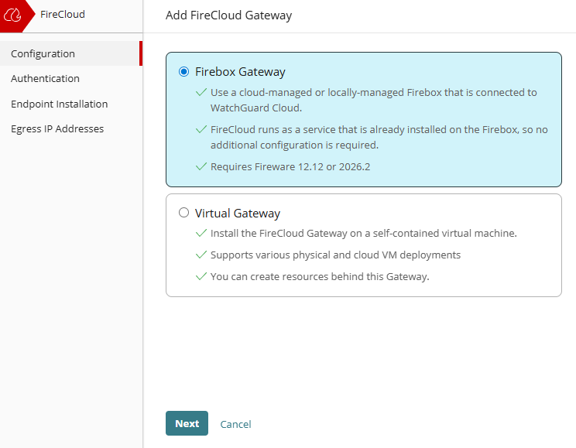
Set Up a Firebox as a FireCloud Gateway
To configure a Firebox as a FireCloud Gateway:
  In WatchGuard Cloud, select Configure > FireCloud
  On the Configuration page, click the Private Resources widget
  Click Add FireCloud Gateway
  Select Firebox Gateway
  Click Next

Slide 9
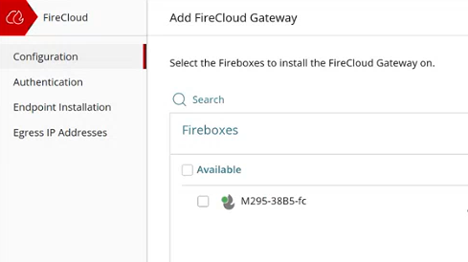
Set Up a Firebox as a FireCloud Gateway
To configure a Firebox as a FireCloud Gateway:
  From the list of Fireboxes, select a Firebox to use as your FireCloud Gateway
  (the list only shows the Fireboxes in your account the meet the requirements)
  Click Next
  Click Finish

Slide 10
Set Up a Firebox as a FireCloud Gateway
After you complete the Gateway setup, the Firebox is connected to FireCloud
  FireCloud builds a WireGuard tunnel to the Firebox so that remote users can connect to private resources behind the Firebox
  A new internal policy called Dynamic Policy: firecloud is created on the Firebox to handle traffic from FireCloud users
  No configuration is necessary on the Firebox
  Your FireCloud access rules apply to traffic from FireCloud users (for example, if you want to configure content filtering you do so in FireCloud)

Slide 11
Set Up a Firebox as a FireCloud Gateway
Next steps:
  Configure a private resource for each local resource that you want to allow remote FireCloud users to have access to on your network
  If you have existing private resources set up in FireCloud, you must create new resources for the Firebox Gateway (you cannot migrate existing resources between FireCloud Gateways)
  To give your users access to your private resources, add the resources to FireCloud access rules
For detailed steps to add private resources, go to Add Private Resources in FireCloud
For detailed steps to add FireCloud access rules, go to FireCloud Access Rules

Slide 12
Troubleshooting
After you set up a Firebox Gateway for FireCloud, there are two places to look at log messages when you want to troubleshoot issues:
  FireCloud Log Search
  Firebox Logs

Slide 13
Troubleshooting
To see traffic that FireCloud denies, use the FireCloud Log Search in WatchGuard Cloud
  In WatchGuard Cloud, go to Monitor > FireCloud > Log Search
  You will see log messages if FireCloud blocks traffic because the protocol is not allowed, or if a FireCloud access rule blocks access to a resource

Slide 14
Troubleshooting
If a route behind the Firebox breaks access to a resource, look at the Firebox log messages
You can see traffic information for the Firebox in several locations:
  In WatchGuard Cloud, go to Monitor > Devices, then select the Firebox and go to Live Status > VPN > WireGuard VPN
  In WatchGuard Cloud, go to Monitor > Devices, then select the Firebox and go to Live Status > Traffic Monitor > Live Logs
  You can also look at Traffic Monitor in WSM and Fireware Web UI to see traffic log messages

Slide 15
Advanced Device Feedback
Management type Counts

Slide 16

Advanced Device Feedback Management Type Counts
With this release, Advanced Device Feedback sent to WatchGuard now includes management counts
Management counts include:
  Number of logins through WatchGuard System Manager (WSM)
  Number of logins through Fireware Web UI
  Number of logins through the CLI
  Number of times a cloud-managed Firebox is removed from WatchGuard Cloud or switched to Visibility Only mode

Slide 17
Firebox T45-CW 5G Modem enabled in Default Configuration

Slide 18
Firebox T45-CW 5G Modem Enabled in Default Configuration
On the Firebox T45‑CW, the 5G modem interface is now enabled in the default configuration
When a compatible SIM card is installed, the device can use cellular as a WAN interface to communicate with WatchGuard Cloud or RapidDeploy for zero‑touch deployments
  If the cellular provider requires an APN or other settings, you must configure these first before the cellular connection is activated
  In many cases, you do not have to specify the APN because the APN is automatically assigned by your service provider when the connection is established
For more information, go to:
  Configure a 4G LTE or 5G Modem for locally-managed Fireboxes
  Configure a Firebox 4G LTE or 5G Modem for cloud-managed Fireboxes

Slide 19
View Firebox Wireless Interface Summary in
WatchGuard Cloud

Slide 20
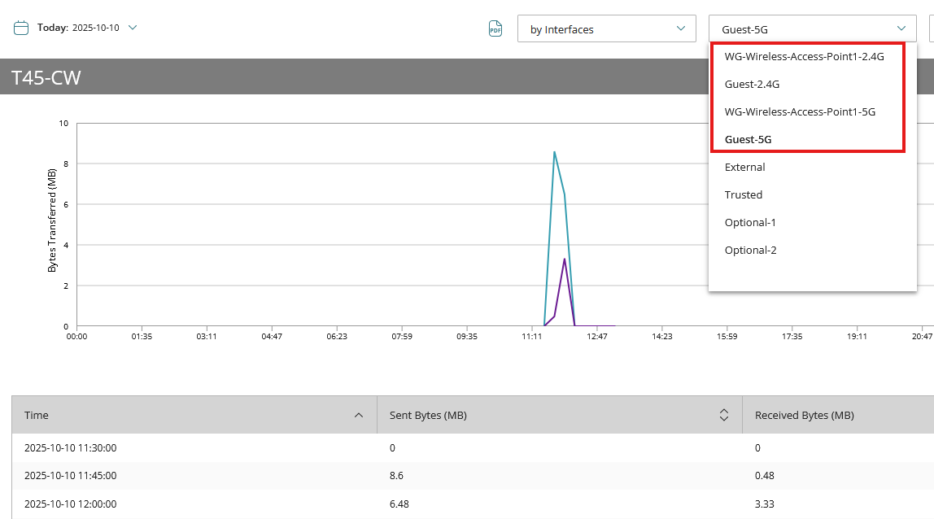
View Firebox Wireless Interface Summary in WatchGuard Cloud
In WatchGuard Cloud, you can now view the wireless interfaces for wireless Firebox models in the Health > Interface Summary report

Slide 21
Backup SSL Server Configuration for an SSL Management Tunnel

Slide 22
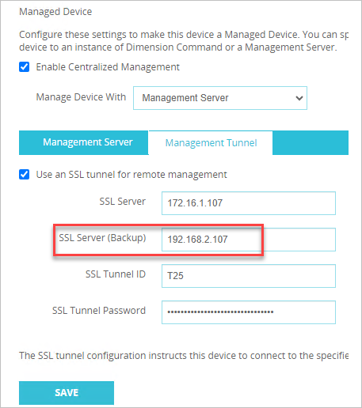
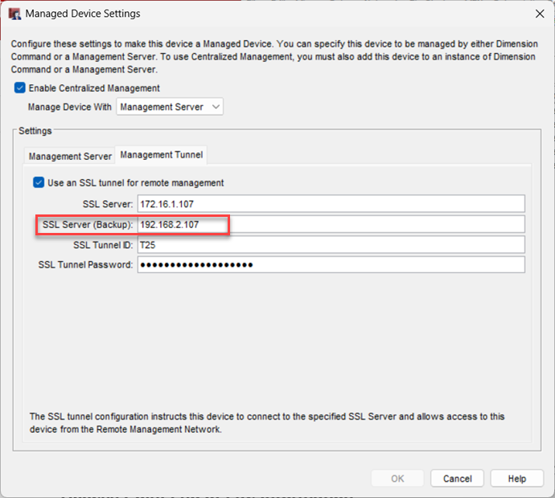
Backup SSL Server Configuration for an SSL Management Tunnel
When you use Centralized Management with a Management Server, you can now configure a backup SSL Server address for an SSL management tunnel in both Fireware Web UI and WSM

Slide 23
Thank you

