Slide 1
What’s new in fireware 12.11.9

Slide 2
What’s new in Fireware v12.11.9
EUCC Certification
FIPS Limitations
Encrypt the Firebox Configuration File
Resolved Issues

Slide 3
What’s new in Fireware v12.11.9
Fireware v12.11.9 is available for these Firebox models:
  Firebox M Series: M290, M390, M590, M690, M4800, M5800
  Firebox T Series: T20, T25, T40, T45, T80, T85
  Firebox NV5
Fireware v12.11.9 does not support these models:
  Firebox T15 and Firebox T35
  We continue to support these models with Fireware v12.5.x firmware. For more information, see this KB article

Slide 4
EUCC Certification

Slide 5
EUCC Certification
Fireware v12.11.9 is the software version submitted for European Union Common Criteria-based Cybersecurity Certification (EUCC) evaluation and approved by the testing laboratory, pending completion of the remaining certification process activities and approval by the certification body

Slide 6
FIPS Limitations

Slide 7
FIPS Limitations
If you enable FIPS 140-3 on your Firebox, the following limitations apply in this release:
  When FIPS 140-3 is enabled, DSA is no longer a supported algorithm for any operation, including certificate generation and Access Portal SSH private key authentication
  TLS proxy policies cannot negotiate TLS 1.2 when PFS is set to None in FIPS mode because no non-PFS cipher suites are available under FIPS 140-3
    To avoid TLS handshake failures, set PFS to Allowed or Required in the TLS profile.
  When a Firebox with FIPS 140-3 enabled acts as a BOVPN over TLS or SSLVPN server, the peer must support Extended Master Secret (EMS, RFC 7627)
    Peers running Fireware v12.1.x–v12.3.x are not supported
    Fireware v12.5.x or later is required

Slide 8
Encrypt the Firebox configuration file

Slide 9

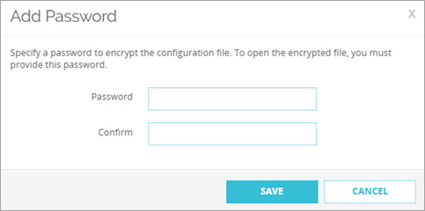
Encrypt the Firebox Configuration File
You can now specify a password that encrypts the Firebox configuration file when you download the configuration from Fireware Web UI
You must use this password to unzip the downloaded .ZIP file that contains the configuration file
For more information, go to Manage the Firebox Configuration File in Help Center

Slide 10
Encrypt the Firebox Configuration File
To download the configuration file, from Fireware Web UI:
  Select System > Configuration File
  Click Download the Configuration File
  Type and confirm a password to use to encrypt the configuration file
  Click Save
  Select the location where you want to save the exported configuration file

Slide 11
Resolved Issues

Slide 12
Resolved Issues
This release includes important security fixes in Fireware and resolves several known issues and bugs
For detailed information, go to the Fireware Release Notes

Slide 13
Thank you

