Slide 1
What’s new in fireware 12.11.3

Slide 2
What’s new in Fireware v12.11.3
DHCPv6 Client Option 3 Identity Association for Non-Temporary Address
Data Loss Prevention (DLP) End-of-Life
Block CBC Weak Ciphers (CLI)

Slide 3
What’s new in Fireware v12.11.3
Fireware v12.11.3 is available for these Firebox models:
Firebox M Series: M270, M290, M370, M390, M470, M570, M590, M670, M690, M4600, M4800, M5600, M5800
Firebox T Series: T20, T25, T40, T45, T55, T70, T80, T85
Firebox NV5
FireboxV and Firebox Cloud
Fireware v12.11.3 does not support these models:
Firebox T15 and Firebox T35
We continue to support these models with Fireware v12.5.x firmware. For more information, see this KB article

Slide 4
DHCPv6 Client Option 3 Identity Association for Non-Temporary Address

Slide 5
DHCPv6 Client Option 3 Identity Association for Non-Temporary Address
Some service providers require the Firebox (the DHCPv6 client) to send specific arguments or options as part of the initial negotiation to obtain an IPv6 address
When you enable DHCPv6 Client Prefix Delegation, this also allows DHCPv6 Client Option 25 (Identity Association for Prefix Delegation) by default
You can also enable the DHCPv6 Client Option 3 IA_NA (Identity Association for Non-Temporary Address) query option and set a custom IAID (Identity Association Identifier), if required by the service provider
The IAID is used for both option 25 and option 3
If you do not set a custom IAID, the default value is based on the MAC address of the external interface of the Firebox

Slide 6
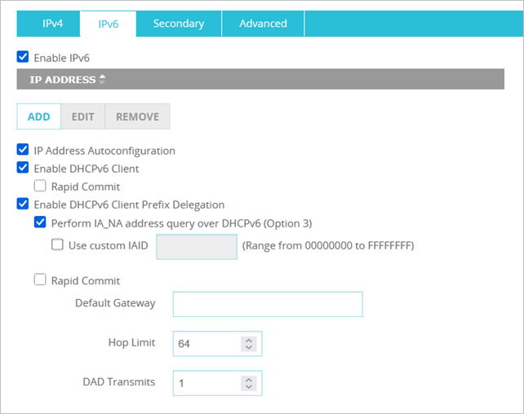
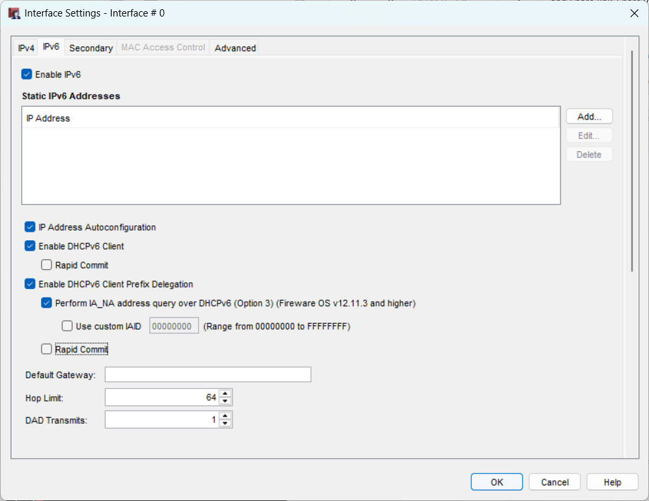
DHCPv6 Client Option 3 Identity Association for Non-Temporary Address
On your External interface, select Enable DHCPv6 Client Prefix Delegation, then enable Perform IA_NA address query over DHCPv6 (Option3) and enter a custom IAID if required

Slide 7
Data Loss Prevention service end-of-life

Slide 8
Data Loss Prevention (DLP) End-of-Life
Data Loss Prevention (DLP) is end-of-life
On 26 February 2025, WatchGuard deprecated and removed DLP from Firebox feature keys, including license renewals for applicable models that previously supported the service (T35, T55, T70, M270, M370, M470, M570, M670, M4600, M5600, FireboxV, and Firebox Cloud)
For Fireboxes that run Fireware v12.11.3, WSM and Fireware Web UI no longer include DLP configuration settings in the user interface
For Fireboxes that run Fireware v12.11.2 or lower, DLP is required by the configuration schema but is no longer functional if your DLP license is expired
For more information, go to this Product and Support News post

Slide 9
Block CBC WEAK Ciphers (CLI)

Slide 10
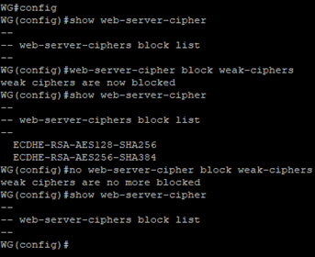
Block CBC Ciphers on the Firebox Web Server (CLI)
To block or unblock weak Cipher Block Chaining (CBC) ciphers, from the CLI, enter:
web-server-cipher block weak-ciphers — Block weak CBC ciphers
no web-server-cipher block weak-ciphers — Unblock weak CBC ciphers
show web-server-cipher — Show the list of blocked CBC ciphers

Slide 11
Thank you

