Slide 1
What’s new in fireware 12.11.2

Slide 2
What’s new in Fireware v12.11.2
Mobile VPN with SSL Client for macOS and SAML Authentication
Upgrade Available Notification in Fireware Web UI

Slide 3
What’s new in Fireware v12.11.2
Fireware v12.11.2 is available for these Firebox models:
  Firebox M Series: M270, M290, M370, M390, M470, M570, M590, M670, M690, M4600, M4800, M5600, M5800
  Firebox T Series: T20, T25, T40, T45, T55, T70, T80, T85
  Firebox NV5
  FireboxV and Firebox Cloud
Fireware v12.11.2 does not support these models:
  Firebox T15 and Firebox T35
  We continue to support these models with Fireware v12.5.x firmware. For more information, see this KB article

Slide 4
Mobile VPN with SSL For macOS Client and SAML Authentication

Slide 5
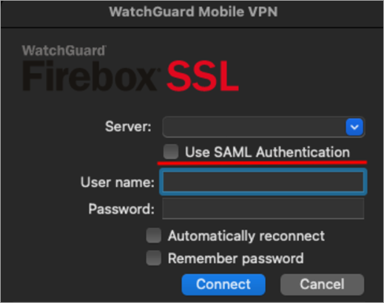
Mobile VPN with SSL Client for macOS and SAML Authentication
You can use Security Assertion Markup Language (SAML) to authenticate users with your Firebox
Fireware v12.11.2 expands support for SAML authentication and macOS
The Mobile VPN with SSL Client for macOS v12.11.2 now supports SAML authentication
Lower versions of the Mobile VPN with SSL for macOS Client do not support SAML authentication

Slide 6
Upgrade Available Notification in Fireware Web UI

Slide 7
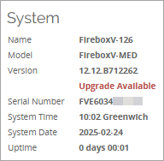
Upgrade Available Notification in Fireware Web UI
On the Fireware Web UI Front Panel page, the System section now shows a notification when a new version of Fireware is available
Click Upgrade Available to go to the Upgrade OS page and view Fireware versions available for upgrade

