Slide 1
What’s new in fireware 12.11.1

Slide 2
What’s new in Fireware v12.11.1
Import IKEv2 VPN Profile to IPSec Mobile VPN Client
IPv6 Connection Support for T45-CW 5G Modem
Message-Authenticator Attribute for RADIUS Servers

Slide 3
What’s new in Fireware v12.11.1
Fireware v12.11.1 is available for these Firebox models:
  Firebox M Series: M270, M290, M370, M390, M470, M570, M590, M670, M690, M4600, M4800, M5600, M5800
  Firebox T Series: T20, T25, T40, T45, T55, T70, T80, T85
  Firebox NV5
  FireboxV and Firebox Cloud
Fireware v12.11.1 does not support these models:
  Firebox T15 and Firebox T35
  We continue to support these models with Fireware v12.5.x firmware. For more information, see this KB article

Slide 4
Import IKEv2 VPN Profile to IPSec Mobile VPN Client

Slide 5
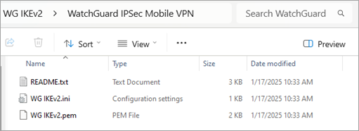
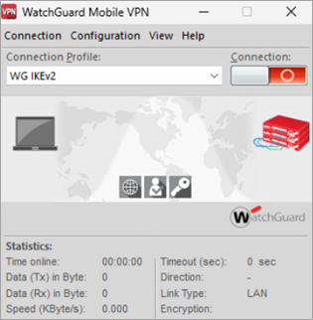
Import IKEv2 VPN Profile to the IPSec Mobile VPN Client
You can now import an IKEv2 VPN profile to the WatchGuard IPSec Mobile VPN client for Windows
To import an IKEv2 profile, you download an IKEv2 .INI profile configuration file and a .PEM certificate file from the Firebox
You use these files with the IPSec Mobile VPN client to create an IKEv2 profile
You can install the IPSec Mobile VPN client and import an IKEv2 VPN profile at the same time
For more information, go to Configure the IPSec Mobile VPN Client for IKEv2 in Help Center

Slide 6
IPv6 Connection Support for T45-CW 5G Modem

Slide 7
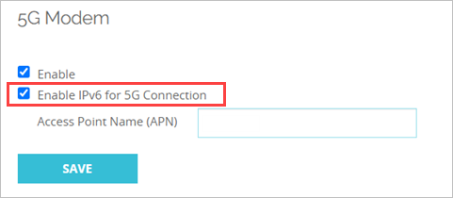
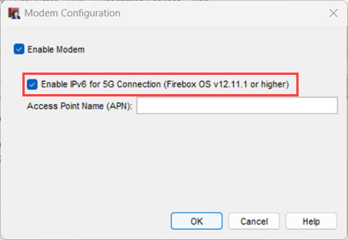
IPv6 Connection Support for T45-CW 5G Modem
You can now enable IPv6 support for 5G modem connections on the T45-CW
This enables IPv4/IPv6 dual-stack capabilities for the connection
Enable this option for specific carriers, such as T-Mobile, that require IPv6 to establish a connection
IPv6 is used only to establish the connection to the provider and is not used for any other purpose
For more information, go to Configure a 4G LTE or 5G Modem in Help Center

Slide 8
Message-Authenticator Attribute for RADIUS Servers

Slide 9
Require Message-Authenticator Attribute for RADIUS
You can now configure RADIUS authentication servers on the Firebox to require the Message-Authenticator attribute
The Message-Authenticator attribute is a field in RADIUS packets that verifies the integrity of the packet and prevents spoofing
The Message-Authenticator attribute protects users from attackers that attempt to exploit CVE-2024-3596

Slide 10
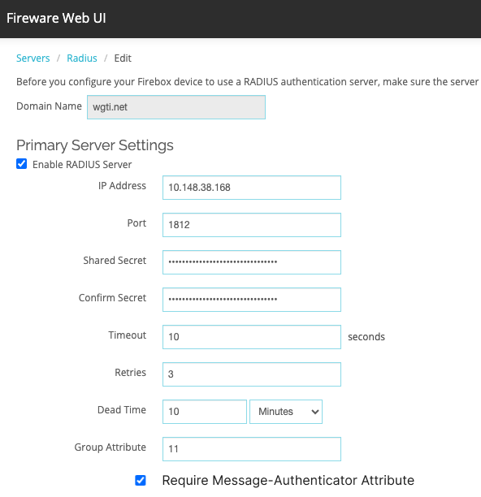
Require Message-Authenticator Attribute for RADIUS
When you add a new RADIUS server in Fireware 12.11.1 or higher, the Require Message-Authenticator Attribute check box is selected by default
When you upgrade to Fireware 12.11.1, the Require Message-Authenticator Attribute check box is not selected for existing RADIUS servers
If you want existing RADIUS servers to require the Message-Authenticator attribute, upgrade to Fireware 12.11.1, edit the RADIUS server settings, and select the check box

