Slide 1
What’s new in fireware 12.10

Slide 2
What’s new in Fireware v12.10
AIA Fetching
WebSocket Connections Support
New Microsoft365 Alias
Network Access Enforcement Updates to Minimum OS Version
Diffie-Hellman Group 21 Support
Security Enhancements
Removal of the wg-support Default User Account
Removal of Firebox Wireless Encryption Algorithm Setting
Removal of TLS v1.0 and Port 4110 for Management Server
Change to the Default Name of a Firebox
Firebox Storage Space Shown as a Percentage

Slide 3
What’s new in Fireware v12.10
Removal of Web Reputation Authority service from Reputation Enabled Defense (RED)
SNMP Query Support for Dynamic Routing
Total Available Memory Support in UCD-SNMP-MIB
WatchGuard Mobile VPN with SSL Client v12.10

Slide 4
What’s new in Fireware v12.10
Fireware v12.10 is available for these Firebox models:
Firebox M Series: M270, M290, M370, M390, M440, M470, M570, M590, M670, M690, M4600, M4800, M5600, M5800
Firebox T Series: T20, T25, T40, T45, T55, T70, T80, T85
Firebox NV5
FireboxV and Firebox Cloud
Fireware v12.10 does not support these models:
Firebox T15 and Firebox T35
We continue to support these models with Fireware v12.5.x firmware. For more information, see this KB article

Slide 5
AIA fetching

Slide 6
AIA Fetching
You can now enable AIA Fetching certificate validation for HTTPS-Client proxy actions from Fireware Web UI and Policy Manager
Authority Information Access (AIA) is an extension in SSL certificates that contains information about the certificate issuer
The extension helps to fetch intermediate certificates from the certificate issuer
This provides a more secure browsing experience and avoids certificate errors

Slide 7
AIA Fetching
In Fireware v12.10 and higher, AIA Fetching is enabled by default in all existing and new TLS client profiles
For locally-managed Fireboxes, you can enable and disable AIA Fetching from Fireware Web UI and Policy Manager
For cloud-managed Fireboxes, you cannot disable AIA Fetching
Only HTTPS-Client proxy actions use AIA fetching
TLS profiles now include an Allow AIA Fetching check box in the Certificate Validation section of the page

Slide 8
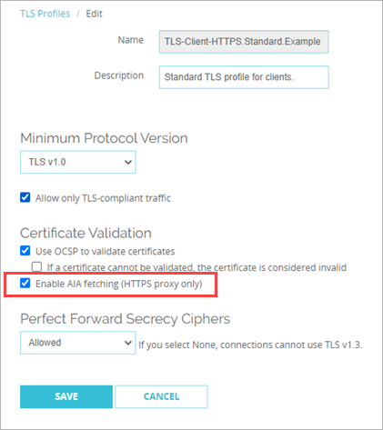
AIA Fetching Support
To enable AIA fetching, from Fireware Web UI:
Select Firewall > TLS Profiles
Select the TLS profile you want to edit and click Edit
Select the Allow AIA Fetching check box and click Save

Slide 9
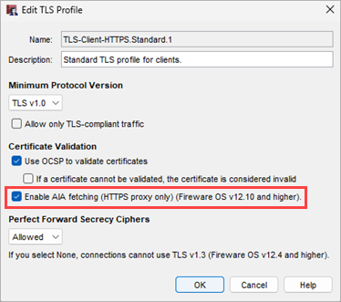
AIA Fetching Support
To enable AIA fetching, from Policy Manager:
Select Setup > Actions > TLS Profiles
Select the TLS profile you want to edit and click Edit
Select Allow AIA Fetching check box and click OK

Slide 10
WebSocket Connections Support

Slide 11
WebSocket Connections Support
WebSocket connections allow bidirectional communication between a client and server over a single TCP connection, which enables faster and more efficient data transfer
You can now specify whether HTTP proxy actions allow connections that use the WebSocket protocol
WebSocket connections are disabled by default for all HTTP proxy actions
In HTTP proxy actions, select the Allow WebSocket Connections check box to allow WebSocket connections

Slide 12
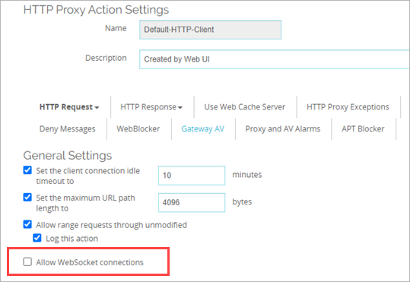
WebSocket Connections Support
To allow WebSocket connections, from Fireware Web UI:
Select Firewall Policies > Proxy Actions
Select the HTTP proxy action you want to edit and click Edit
In the General Settings section, select Allow WebSocket Connections
Click Save

Slide 13
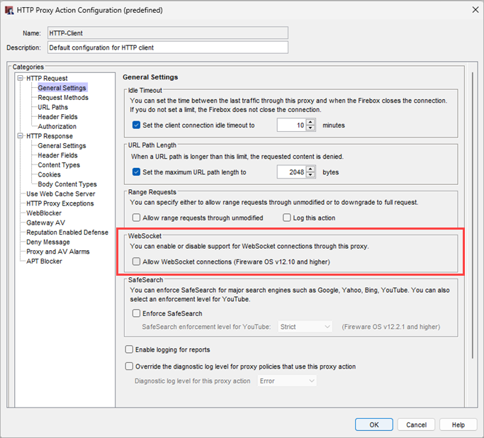
WebSocket Connections
To allow WebSocket connections, from Policy Manager:
Select Setup > Actions > Proxies
Select the HTTP proxy action you want to edit and click Edit
In the General Settings section, select Allow WebSocket Connections
Click OK

Slide 14
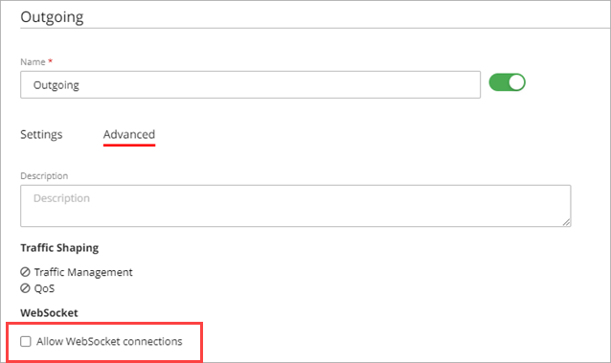
WebSocket Connections
To allow WebSocket connections, from WatchGuard Cloud:
From the Firebox Device Configuration page, click the Firewall Policies tile
Click the outbound policy you want to edit
Select the Advanced tab
In the WebSocket section, select Allow WebSocket Connections
Click Save

Slide 15
New Microsoft365 Alias

Slide 16
Microsoft365 Alias
Fireware v12.10 provides a new default Microsoft365 alias
The Microsoft365 alias includes a list of domain names and IP addresses used by Microsoft 365
Microsoft 365 was previously named Office 365
Add the new alias to your policies to allow network traffic to and from Microsoft 365 products and services

Slide 17
Microsoft365 Alias
WatchGuard updates the alias automatically when Microsoft adds domains and IPs, so you no longer have to manually configure exceptions for a long list of domains and IPs that change frequently
The Firebox can check for updates to the alias signature automatically or you can update manually
If your existing configuration includes an alias named Microsoft365, it is automatically renamed to Microsoft365.1 on upgrade
Any policies that use the existing alias will automatically update to use the renamed Microsoft365.1 alias – you do not have to create a new policy

Slide 18
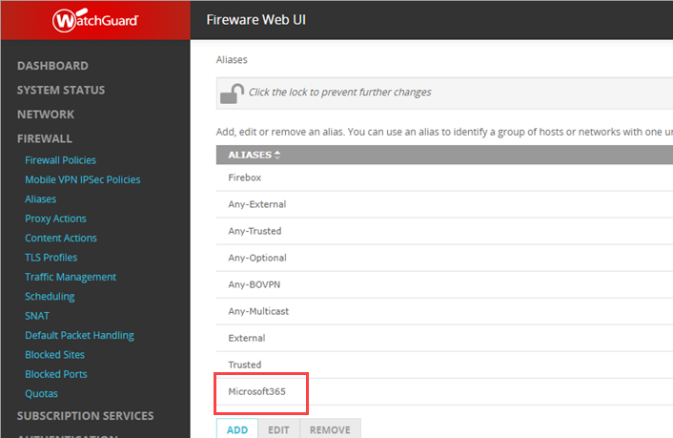
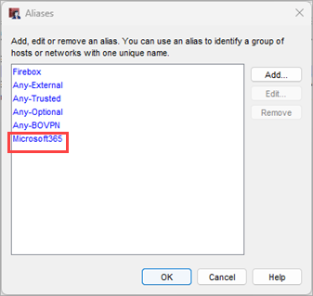
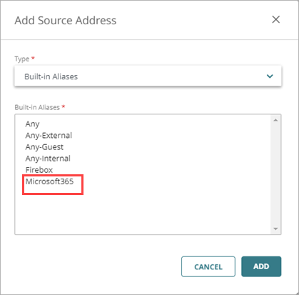
Microsoft365 Alias
The new default Microsoft365 alias appears in the list of aliases in Fireware Web UI, Policy Manager, and WatchGuard Cloud
You cannot edit or remove default aliases

Slide 19
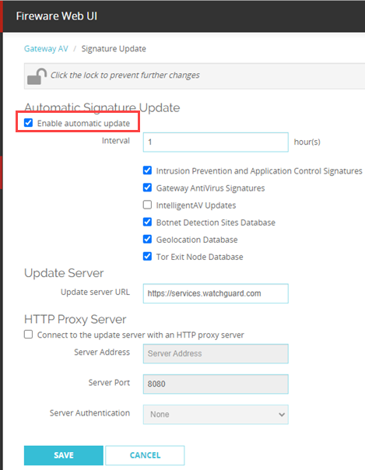
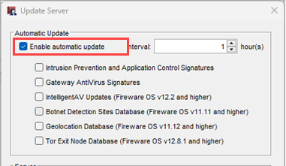
Update Microsoft365 Alias
If you enable automatic updates for any security service, the Firebox also automatically checks for Microsoft365 alias updates
From Subscription Services, select any service that supports automatic updates (IPS, Gateway AntiVirus, etc.)
Click Update Server
Select the Enable Automatic Update check box
Specify an Interval to check for updates
Click OK

Slide 20
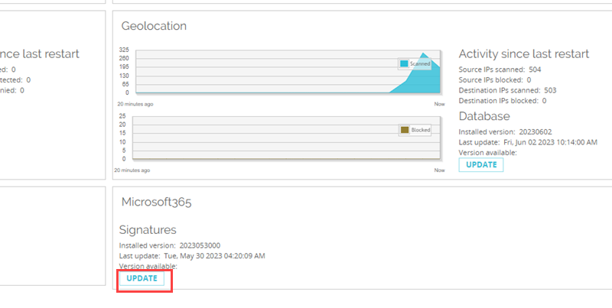
Update Microsoft365 Alias
In Fireware Web UI, the Subscription Services page shows the status of the Microsoft365 alias signature
To manually update to the latest version, from Fireware Web UI:
Select Dashboards > Subscription Services
In the Microsoft 365 tile, click Update

Slide 21
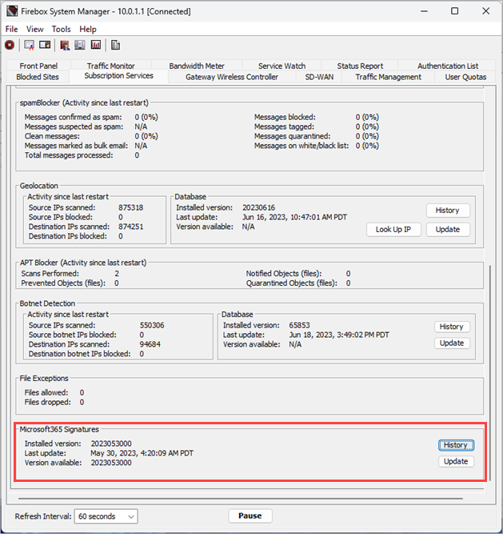
Update Microsoft365 Alias
From Firebox System Manager, you can view the status of the Microsoft365 alias signature
To manually update to the latest version, from Firebox System Manager:
Click the Subscription Services tab
Click Update to download the latest version

Slide 22
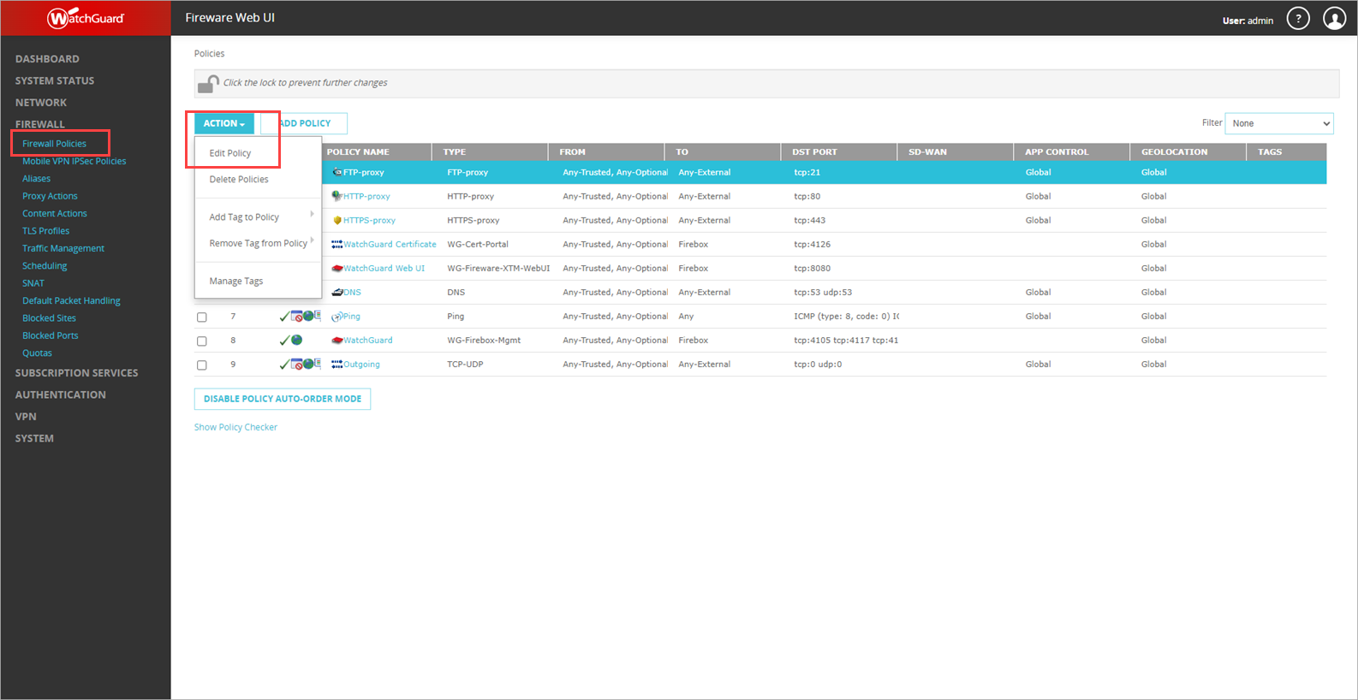
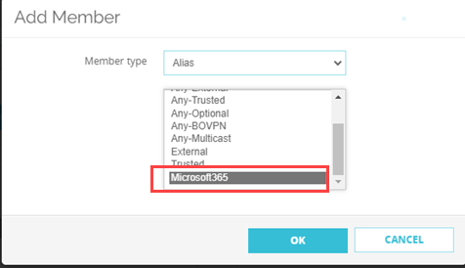
Add the Microsoft365 Alias to a Policy
To add the Microsoft365 alias to a policy, from Fireware Web UI:
Select Firewall > Firewall Policies
Select a policy
From the Action drop-down list, select Edit Policy
From Settings, click Add
In the Add Member dialog box, select Microsoft365
Click OK

Slide 23
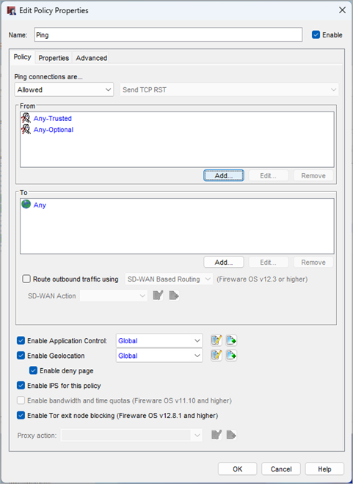
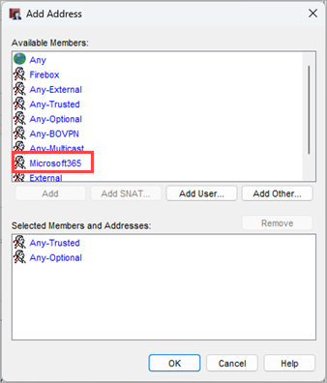
Add the Microsoft365 Alias to a Policy
To add the Microsoft365 alias to a policy, from Policy Manager:
Right-click a policy and select Modify Policy
From the Edit Policy Properties dialog box, click Add
From the Add Address dialog box, Available Members list, select Microsoft365 and click Add
Click OK

Slide 24
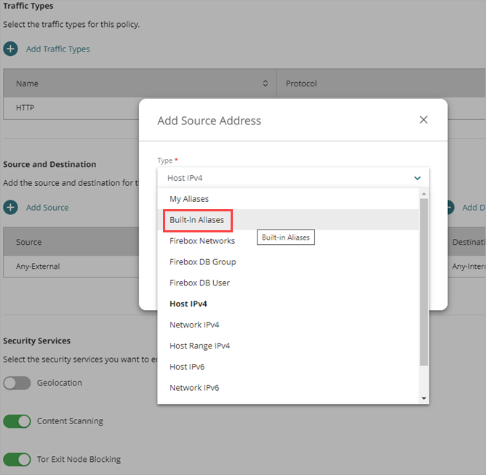
Add the Microsoft365 Alias to a Policy
To add the Microsoft365 alias to a policy, from WatchGuard Cloud:
From the Firebox Device Configuration page, click the Firewall Policies tile
To edit the policy settings, click the policy name
Click Add Source or Add Destination
From the Add Source Address or Add Destination Address dialog box, select Built-In Aliases
From the Built-in Alias list, select Microsoft365. Click Add

Slide 25
Add the Microsoft365 Alias to a Policy
To add the Microsoft365 alias to a policy, from the CLI:
Connect to your Firebox with the CLI
At the command prompt, type one of these commands: WG(config/policy/rule-Ping)# from alias Microsoft365 WG(config/policy/rule-Ping)# to alias Microsoft365 WG(config/policy/rule-Ping)#to alias Any-External

Slide 26
Endpoint Enforcement Updates to Minimum OS Version

Slide 27
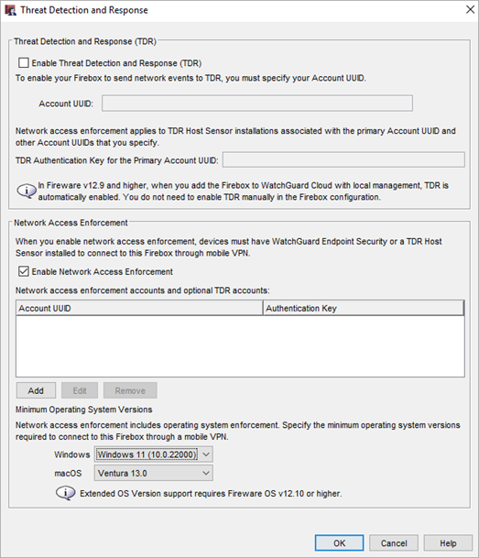
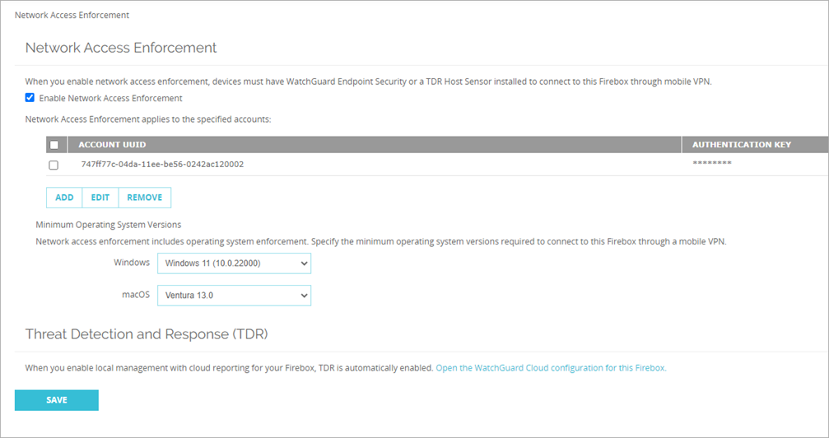
Network Access Enforcement – Minimum OS Version Updates
When Network Access Enforcement is enabled (previously Endpoint Enforcement), to connect to the Firebox through a mobile VPN, devices must meet the specified minimum operating system requirements
Network Access Enforcement now supports these minimum operating system versions:
Windows 11
macOS Ventura 13

Slide 28
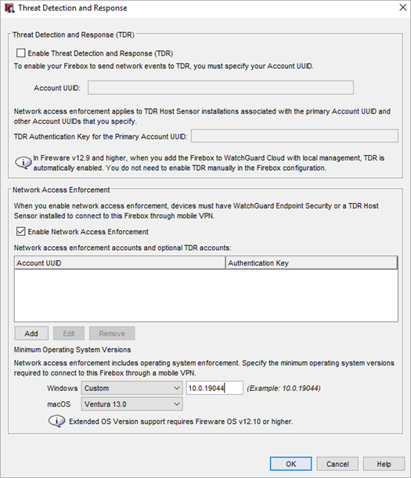
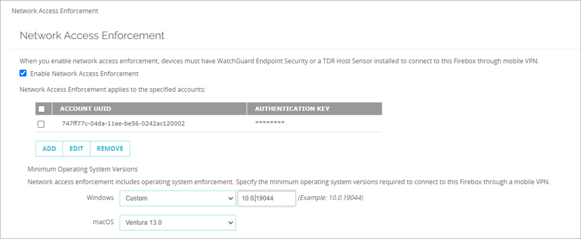
Endpoint Enforcement – Custom OS Version Number
In the Minimum Operating System Versions section, you can now add a custom OS version number for Windows and macOS
Enter up to three segments, separated by periods (for example, 10.0.19044)
Letters are not supported

Slide 29
Diffie-Hellman Group 21 Support

Slide 30
Diffie-Hellman Group 21 Support
Fireware now supports Diffie-Hellman Group 21 (521-bit random)
Diffie-Hellman (DH) groups determine the strength of the key used in the key exchange process
Within a group type (MODP or ECP), higher Diffie-Hellman group numbers are typically more secure
Diffie-Hellman Group 21 is of the ECP group type

Slide 31
Diffie-Hellman Group 21 Support
You can select Diffie-Hellman Group 21 for:
IKEv2 Shared Settings
Mobile VPN with IKEv2
Mobile VPN with IPSec
Mobile VPN with L2TP
BOVPN Gateway
BOVPN Tunnel
BOVPN VIF

Slide 32
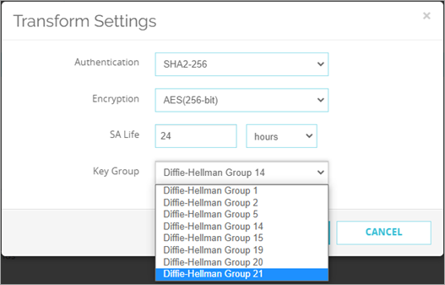
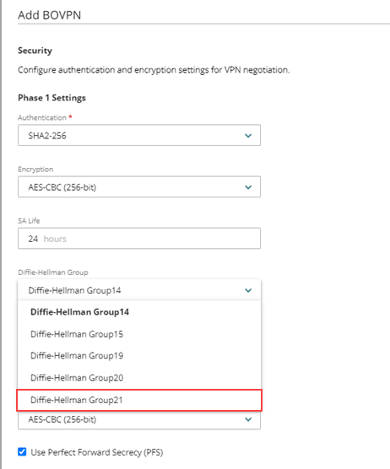
Diffie-Hellman Group 21 Support
Diffie-Hellman Group 21 is available in Fireware Web UI, Policy Manager, WatchGuard Cloud, and the CLI

Slide 33
Removal of the wg-support Default User Account

Slide 34
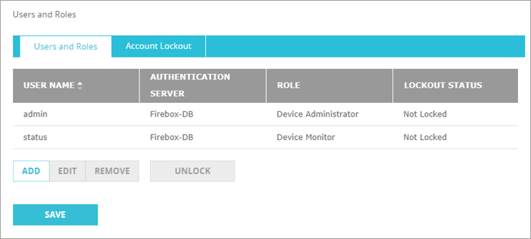
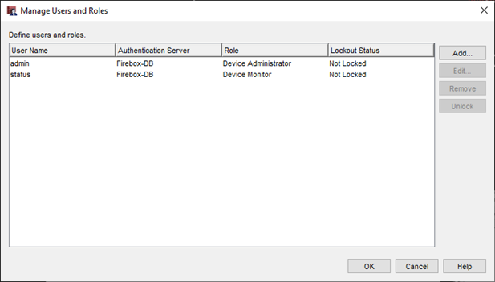
Removal of the wg-support Default User Account
The Firebox includes default, built-in user accounts that you cannot edit or delete
In Fireware v12.10, the user account named wg-support is no longer a default account
You can now add and edit an account named wg-support from Fireware Web UI or Policy Manager

Slide 35
Removal of Firebox Wireless Encryption Algorithm Setting

Slide 36
Removal of Firebox Wireless Encryption Algorithm Setting
You can no longer configure the Encryption Algorithm setting for a wireless network on a Firebox
The encryption algorithm is now automatically set, based on the wireless security mode configured for the SSID (previous configurations are converted to these defaults on upgrade):
Open — No encryption
OWE — SAE
WPA — TKIP
WPA/WPA2 — TKIP/AES
WPA2 — AES CCMP
WPA2/WPA3 — AES CCMP/SAE
WPA3 — SAE

Slide 37
Removal of TLS v1.0 and Port 4110 for Management Server

Slide 38
Removal of TLS v1.0 and Port 4110 for Management Server
The ability to enable or disable TLS v1.0 for the WatchGuard Management Server and Log Server is now removed from WatchGuard Server Center
In Fireware v12.10 and higher, Fireboxes use TLS v1.3 to connect to the server by default
TLS v1.2 is still supported
In addition, as of Fireware v12.10 the Management Server no longer listens for requests on TCP port 4110
This port is deprecated and only TCP ports 4112 and 4113 are required for Management Server connections

Slide 39
Change to the Default Name of a Firebox

Slide 40
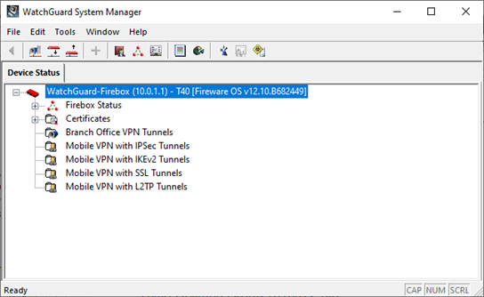
Change to the Default System Name of a Firebox
The default system name of a Firefox has changed from WatchGuard-XTM to WatchGuard-Firebox

Slide 41
Firebox Storage Space ShowN as a Percentage

Slide 42
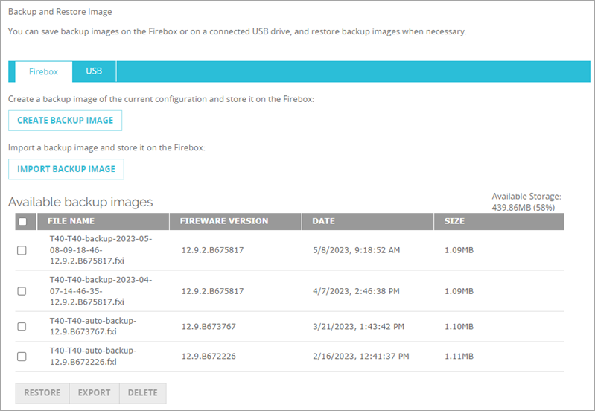
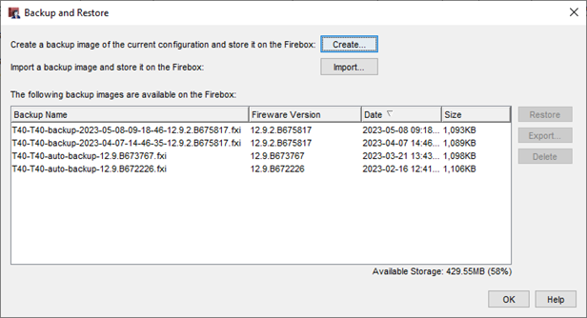
Firebox Storage Space Shown as a Percentage
You cannot save a new backup image to a Firebox if the available storage space is less than 512MB and less than 10% of the total storage capacity
On the Backup and Restore page, Policy Manager and Fireware Web UI now show the available storage space as a percentage

Slide 43
Removal of WEB Reputation Authority Service from RED

Slide 44
Removal of Web Reputation Authority Service from RED
In Fireware v12.10 and higher, Reputation Enabled Defense (RED) no longer includes support for the Web Reputation Authority service
This service assigned a reputation score to a URL when an HTTP proxy processed traffic
The Firebox could allow or deny the connection before Gateway AntiVirus scanned the traffic, based on the reputation score
Helped improve performance on older Firebox models, but caught few threats
We recommend that you enable Gateway AntiVirus scans on newer devices, which perform quicker scans and can use cached results of previous scans
Other services enabled with the RED feature key are still supported in v12.10 (Botnet Detection, Geolocation, and Tor Exit Node Blocking)

Slide 45
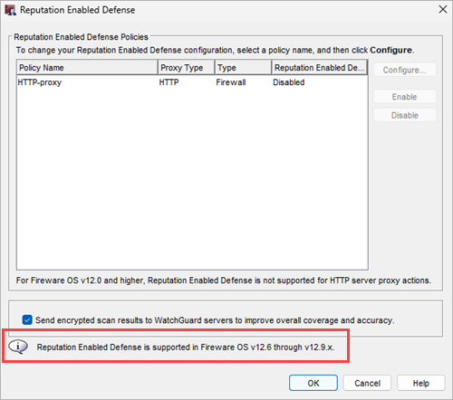
Removal of Web Reputation Authority Service from RED
In Policy Manager, in the Reputation Enabled Defense dialog box, a compatibility message now appears
When you try to save a configuration with RED enabled to a Firebox with Fireware v12.10, a warning appears that indicates RED is not supported and will be disabled if you continue

Slide 46
Removal of Web Reputation Authority Service from RED
In the WSM Quick Setup Wizard, RED is no longer shown in these steps:
Subscription services
Configuration summary
In the Fireware Web UI, RED no longer appears in:
Subscription Services Dashboard
Subscription Services navigation menu
Diagnostic logs
HTTP proxy actions
In the Command Line Interface (CLI), the reputation-enabled-defense command is removed

Slide 47
SNMP Query Support for Dynamic Routing

Slide 48
SNMP Query Support for Dynamic Routing
You can now query the dynamic routing process with SNMP to obtain routing information for RIP, OSPF, and BGP
To enable the ability to query dynamic routing with SNMP, you must add the command “agentx” to your dynamic routing configuration file (FRR). This enables the routing engine to connect to an SNMP agent with the AgentX protocol.
Note that SNMP queries can result in high CPU usage if there is a large number of routes
You can query the Firebox from an SNMP monitoring application with these standard MIB OIDs:
IP routing table — 1.3.6.1.2.1.4.21
RIP — .1.3.6.1.2.1.23 (RIPv2-MIB)
OSPF — .1.3.6.1.2.1.14 (OSPF-MIB, OSPFV3-MIB)
BGP — .1.3.6.1.2.1.15 (BGP4-MIB)

Slide 49
Total Available Memory Support in UCD-SNMP-MIB

Slide 50
Total Available Memory Support in UCD-SNMP-MIB
To accurately track the memory usage of the Firebox, you can now query the Total Available Memory (MemAvailable) statistic with SNMP and the third-party UCD-SNMP-MIB file
Use this OID:
1.3.6.1.4.1.2021.4.27.0
In Fireware v12.10 and higher, this statistic is called MemAvailable in the Firebox Status Report
For more information, go to Which Third-Party SNMP MIBs can you use with the Firebox in the WatchGuard Knowledge Base.

Slide 51
WatchGuard Mobile VPN with SSL Client v12.10

Slide 52
WatchGuard Mobile VPN with SSL Client v12.10
Fireware v12.10 includes updated WatchGuard Mobile VPN for SSL clients for Windows and macOS
The updated WatchGuard Mobile VPN for SSL clients include a number of enhancements:
Updated OpenVPN and OpenSSL versions
Updated TAP driver
Interface metric set to 1 to force DNS traffic through the tunnel
Bug fixes
The updated WatchGuard Mobile VPN for SSL client for Windows supports these operating systems:
Windows 10 and 11
Windows Server 2016, 2019, and 2022

