Slide 1
What’s new in fireware 12.10.4

Slide 2
What’s new in Fireware v12.10.4
Block IP Addresses with Failed Login Attempts
Mobile VPN with SSL Client Updates
Resolved Issues

Slide 3
What’s new in Fireware v12.10.4
Fireware v12.10.4 is available for these Firebox models:
Firebox M Series: M270, M290, M370, M390, M440, M470, M570, M590, M670, M690, M4600, M4800, M5600, M5800
Firebox T Series: T20, T25, T40, T45, T55, T70, T80, T85
Firebox NV5
FireboxV and Firebox Cloud
Fireware v12.10.4 does not support these models:
Firebox T15 and Firebox T35
We continue to support these models with Fireware v12.5.x firmware. For more information, see this KB article

Slide 4
Block IP Addresses with Failed Login Attempts

Slide 5
Block IP Addresses with Consecutive Failed Login Attempts
To prevent brute force attacks against the login pages of the Firebox, you can enable the Block IP Addresses with Consecutive Failed Logins feature
The Firebox temporarily blocks an IP address after a specified number of consecutive, failed authentication attempts to Firebox login pages within a specified period
The number of failed authentication attempts is the total combined number of consecutive failed attempts to all login pages on the Firebox
This feature is disabled by default
This feature does not block failed login attempts for:
The Fireware Web UI login page when the account user name is not admin or status
AuthPoint authentication
You can enable the feature from Policy Manager, Fireware Web UI, WatchGuard Cloud, or the CLI

Slide 6
Block Failed Logins (Locally-Managed Fireboxes)
For a locally-managed Firebox:
The feature blocks IP addresses with failed login attempts to these login pages:
Access Portal
Authentication Portal
Fireware Web UI
Mobile VPN with SSL Client download page
The Firebox automatically adds the blocked IP address to the Blocked Sites list with a Reason of block failed logins
For more information, go to About Blocked Sites

Slide 7
Block Failed Logins (Cloud-Managed Fireboxes)
For a cloud-managed Firebox:
The feature blocks IP addresses with failed login attempts to these login pages:
Authentication Portal
Fireware Web UI
Mobile VPN with SSL Client download page
In WatchGuard Cloud, the Firebox automatically adds the blocked IP address to a temporary blocked sites list
You cannot manage this list in WatchGuard Cloud
If you must allow a blocked IP address, you can add a Blocked Site exception
For information about how to add an exception, go to Add Exceptions in WatchGuard Cloud

Slide 8
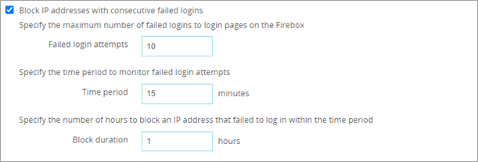
Block Failed Logins (Fireware Web UI)
To block IP addresses with consecutive failed logins, from Fireware Web UI:
Select Authentication > Settings
Select the Block IP addresses with consecutive failed logins check box
In the Failed login attempts text box, enter the maximum failed logins
In the Time period text box, enter the number of minutes
In the Block duration text box, enter the number of hours
Click Save

Slide 9
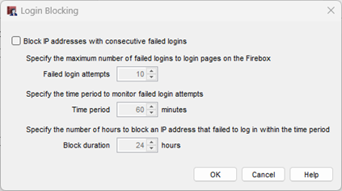
Block Failed Logins (Policy Manager)
To block IP addresses with consecutive failed logins, from Policy Manager:
Select Setup > Authentication > Authentication Settings
Click Block Failed Logins
Select the Block IP addresses with consecutive failed logins check box
In the Failed login attempts text box, enter the maximum failed logins
In the Time period text box, enter the number of minutes
In the Block duration text box, enter the number of hours
Click OK

Slide 10
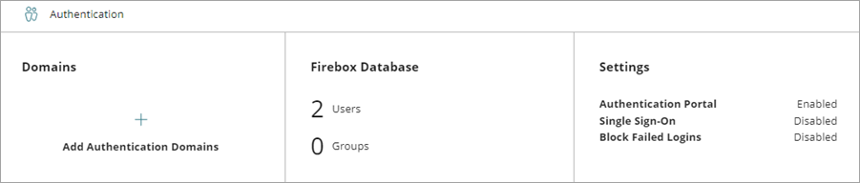
Block Failed Logins (WatchGuard Cloud)
To block IP addresses with consecutive failed logins, from WatchGuard Cloud:
Select Configure > Devices
Select the cloud-managed Firebox
Click Device Configuration
From the Authentication section, click the Settings widget

Slide 11
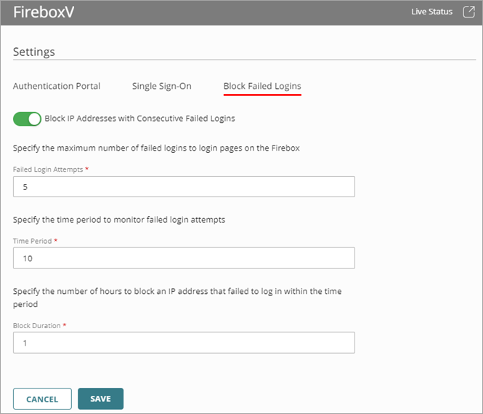
Block Failed Logins (WatchGuard Cloud)
To block IP addresses with consecutive failed logins, from WatchGuard Cloud:
Select the Block Failed Logins tab
Enable Block IP Addresses with Consecutive Failed Logins
In the Failed Login Attempts text box, enter the maximum failed logins
In the Time Period text box, enter the number of minutes
In the Block Duration text box, enter the number of hours
Click Save

Slide 12
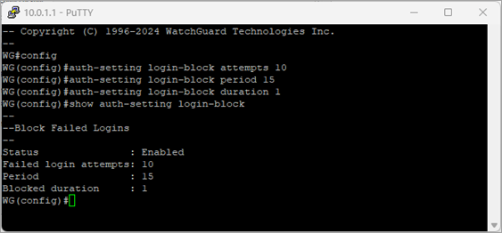
Block Failed Logins (CLI)
To block IP addresses with consecutive failed logins, from the CLI:
From a Command Prompt, enter:
login-block (enable|attempts|period|duration)
enable — Block IP addresses with consecutive failed logins
attempts — Maximum number of consecutive failed logins
period — Number of minutes to monitor failed logins
duration — Number of hours to block an IP address with multiple consecutive failed logins in the specified period

Slide 13
Mobile VPN with SSL Client Updates

Slide 14
Mobile VPN with SSL Client Updates
This release includes updated versions of the Mobile VPN with SSL Client for Windows and macOS
The updated macOS client supports macOS Big Sur 11 and higher and adds support for devices with Apple silicon (M series ARM) processors
The updated Windows client includes security improvements

Slide 15
Resolved Issues

Slide 16
Resolved Issues
Fireware v12.10.4 is a maintenance release that includes important resolved issues
For detailed information about the issues resolved in this release, see the Release Notes:
Fireware v12.10.4 Release Notes

