Slide 1
What’s new in fireware 12.10.2

Slide 2
What’s new in Fireware v12.10.2
VPN Statistics Update
WebBlocker Categories Update
WSM Quick Setup Wizard Defaults Update
Release or Renew a DHCP Lease in Firebox System Manager
Removal of Port 4110 from Management Server Policy

Slide 3
What’s new in Fireware v12.10.2
Fireware v12.10.2 is available for these Firebox models:
Firebox M Series: M270, M290, M370, M390, M440, M470, M570, M590, M670, M690, M4600, M4800, M5600, M5800
Firebox T Series: T20, T25, T40, T45, T55, T70, T80, T85
Firebox NV5
FireboxV and Firebox Cloud
Fireware v12.10.2 does not support these models:
Firebox T15 and Firebox T35
We continue to support these models with Fireware v12.5.x firmware. For more information, see this KB article

Slide 4
VPN Statistics Update

Slide 5
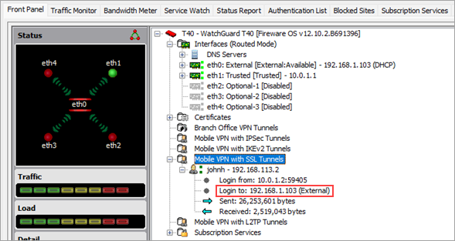
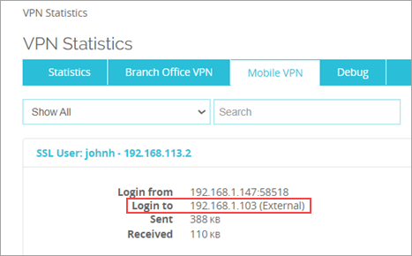
VPN Statistics Update
This release adds a Mobile VPN statistic that shows the IP address of the destination interface on the Firebox
You can view the new Login To statistic from Firebox System Manager, Fireware Web UI, and the CLI

Slide 6
VPN Statistics Update
To view the Login To Mobile VPN statistic, from Firebox System Manager:
Open WatchGuard System Manager (WSM)
Connect to a device
Click Firebox System Manager
To view the Login To Mobile VPN statistic, from Fireware Web UI :
Select System Status > VPN Statistics
Select the Mobile VPN tab
To view the Login to Mobile VPN statistic, from the CLI:
The show vpn-status command includes the Login To VPN statistic for a Mobile VPN with L2TP tunnel

Slide 7
WebBlocker Categories Update

Slide 8
WebBlocker Categories
WebBlocker now supports these new categories and subcategories:
Collaboration – Office
Office – Mail
Office – Drive
Office – Documents
Office – Apps
Information Technology
Generative AI - Text & Code
Generative AI - Conversation
Generative AI - Multimedia
Other AI ML Applications
Social Web – Twitter
Twitter Posting
Twitter Mail
Twitter Follow
Social Web – Facebook
Facebook Posting
Facebook Commenting
Facebook Friends
Facebook Photo Upload
Facebook Mail
Facebook Events
Facebook Apps
Facebook Chat
Facebook Questions
Facebook Video Upload
Facebook Groups
Facebook Games
Social Web – LinkedIn
LinkedIn Updates
LinkedIn Mail
LinkedIn Connections
LinkedIn Jobs
Social Web – Various
Classifieds Posting
Blog Posting
Blog Commenting
Social Web – YouTube
YouTube Commenting
YouTube Video Upload
YouTube Sharing
Internet Watch Foundation

Slide 9
WSM Quick Setup Wizard Defaults Update

Slide 10
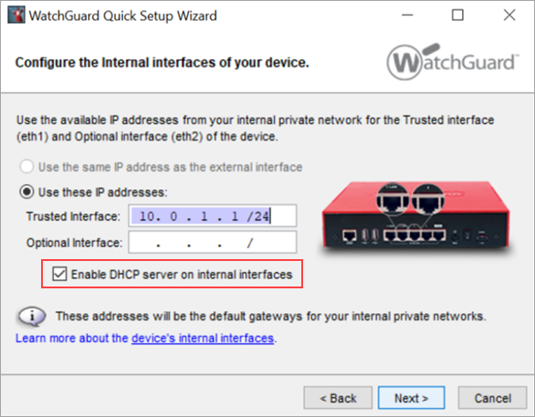
WSM Quick Setup Wizard Defaults Update
The WatchGuard System Manager (WSM) Quick Setup Wizard now enables a DHCP server on the internal interface of a device by default

Slide 11
Release or Renew a DHCP Lease in Firebox System Manager

Slide 12
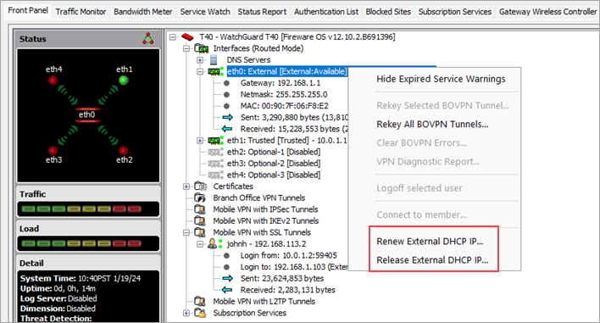
Release or Renew a DHCP Lease in Firebox System Manager
In Firebox System Manager (FSM), you can now right-click an external interface that has DHCP enabled to renew or release the DHCP lease

Slide 13
Removal of Port 4110 from Management Server Policy

Slide 14
Removal of Port 4110 from Management Server Policy
In Fireware v12.10 and higher, the Management Server no longer listens for requests on TCP port 4110
This port is deprecated and only TCP ports 4112 and 4113 are required for Management Server connections
In Fireware v12.10.2, port 4110 is also removed from the WG-Mgmt-Server policy for new configurations

