Slide 1
What’s new in fireware 12.10.1

Slide 2
What’s new in Fireware v12.10.1
WatchGuard Single Sign-On (SSO) Agent v12.10.1
SNMP Support for Feature Key Expiration Date
Network Access Enforcement Updates
Command Line Interface Updates

Slide 3
What’s new in Fireware v12.10.1
Fireware v12.10.1 is available for these Firebox models:
  Firebox M Series: M270, M290, M370, M390, M440, M470, M570, M590, M670, M690, M4600, M4800, M5600, M5800
  Firebox T Series: T20, T25, T40, T45, T55, T70, T80, T85
  Firebox NV5
  FireboxV and Firebox Cloud
Fireware v12.10.1 does not support these models:
  Firebox T15 and Firebox T35
  We continue to support these models with Fireware v12.5.x firmware. For more information, see this KB article

Slide 4
WatchGuard Single Sign-On (SSO) Agent v12.10.1

Slide 5
WatchGuard Single Sign-On (SSO) Agent v12.10.1
Fireware v12.10.1 includes an updated WatchGuard Single Sign-On (SSO) Agent
With this update, WatchGuard Active Directory SSO now supports computers that are joined to your domain with Azure Active Directory
This support is for hybrid environments, where a local Active Directory domain controller is used for authentication by the Firebox, and the computers are added to this domain with Azure AD

Slide 6
SNMP Support for Feature Key Expiration Date

Slide 7
SNMP Support for Feature Key Expiration Date
The WATCHGUARD-INFO-SYSTEM-MIB file now includes an OID that enables you to query the Firebox LiveSecurity feature key expiration date
  For example: LIVESECURITY: Wed, Dec 27 2024 11:59:59 PM
Use this OID to query the Firebox from an SNMP monitoring application with the WATCHGUARD-INFO-SYSTEM-MIB file:
    wgFeatureKeyExpirationInfo: 1.3.6.1.4.1.3097.6.1.5.0
For more information, go to Enterprise MIB File Details in Fireware Help

Slide 8
Network Access Enforcement Updates

Slide 9
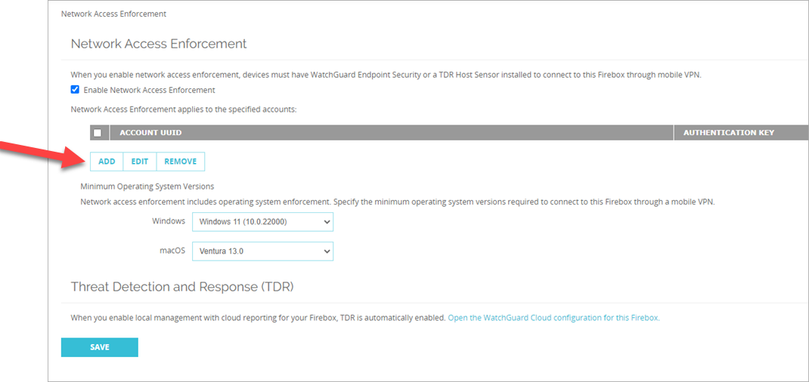
Network Access Enforcement Updates
This release adds validation to the Network Access Enforcement page in Fireware Web UI (Services > Network Access Enforcement)
Now, when you enable Network Access Enforcement, you must enter an Account UUID and Authentication Key

Slide 10
Command Line Interface Updates

Slide 11
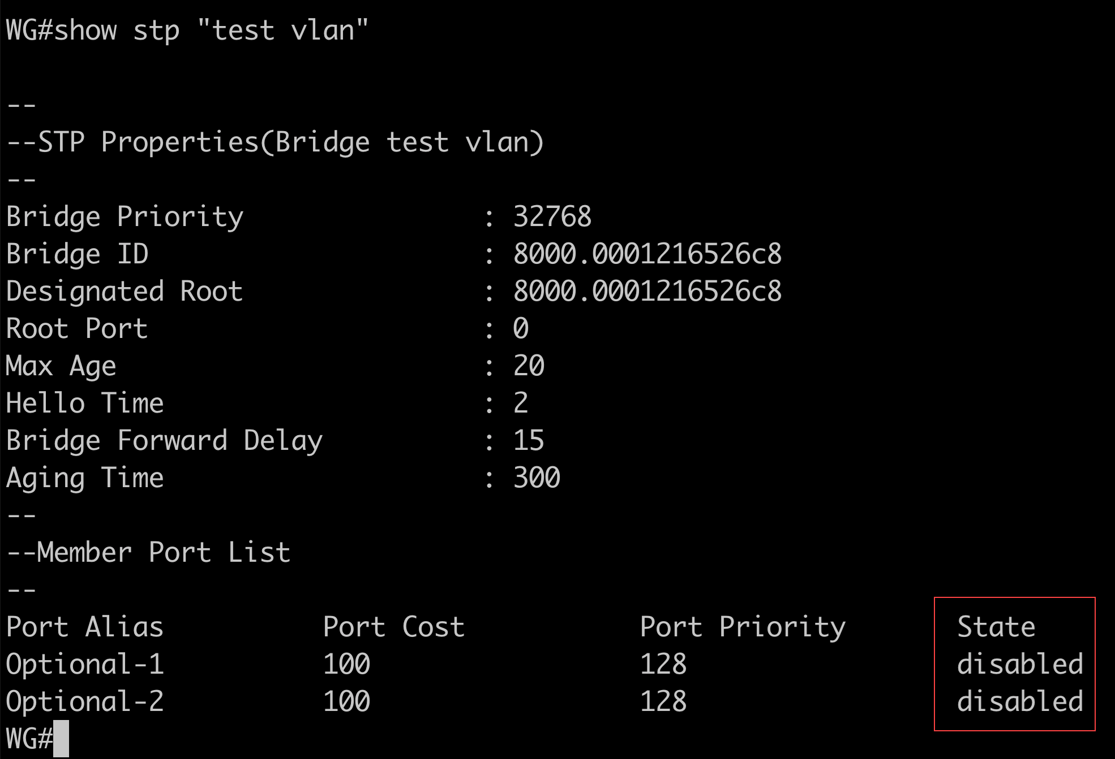
CLI – show stp Command Update
The show stp command now shows the logical status of the ports that participate in the Spanning Tree Protocol of a bridge on the Firebox

