Slide 1
What’s New in Fireware v12.1

Slide 2
What’s New in Fireware v12.1
Access Portal and SAML Single Sign-On
HTTPS Content Inspection Enhancements
Secure IMAP (IMAPS) Proxy
WebBlocker UX/UI Enhancements
Mobile VPN with SSL Portal Updates
Mobile VPN with IKEv2
BOVPN over TLS
SSL/TLS Shared Settings
Modem as an External Interface

Slide 3
What’s New in Fireware v12.1
Multi-WAN Link Monitor Updates
Wildcard Support for IPv4 Addresses
Gateway Wireless Controller Enhancements

Slide 4
Access Portal

Slide 5
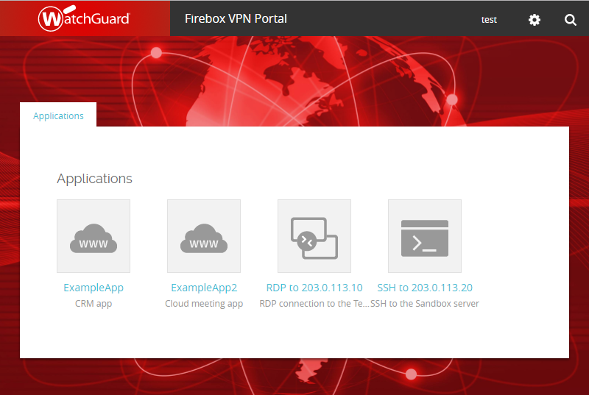
Access Portal
The new Access Portal feature connects users to external third-party web apps, and in-browser RDP and SSH sessions to local resources, without a VPN client

Slide 6
Access Portal
Secure remote access to virtual machines through RDP gives privileged network administrators the flexibility to manage network operations remotely
SSH sessions in HTML5-compliant and SSL-compliant web browsers enables privileged administrators to work in a secure shell to manage critical network assets
TLS 1.2 adds security to RDP and SSH sessions

Slide 7
Access Portal
HTTPS connections to apps are proxied by the Firebox
Users authenticate to the Access Portal and see links to web apps, RDP hosts, and SSH hosts
You can specify the apps/app groups that users and user groups can connect to
Single Sign-On through a third-party identity provider (Okta, OneLogin, Shibboleth, etc.) is supported through the SAML authentication protocol
Access Portal is not supported on XTM, XTMv, T, M200, or M300 devices. The Access Portal is supported on FireboxV, FireboxCloud, and all other Fireboxes.

Slide 8
Access Portal
Access Portal is a subscription service included in the Total Security Suite
Users with a Total Security Suite subscription must update the feature key on the Firebox to get the Access Portal license

Slide 9
Access Portal — Shared Settings
Access Portal and Mobile VPN with SSL share these VPN portal settings:
Interfaces on which the VPN portal is available
Authentication server
VPN Portal port
The VPN Portal port is the TCP configuration channel for Mobile VPN with SSL and the Access Portal
The data channel for Mobile VPN with SSL appears in the Mobile VPN with SSL settings

Slide 10
Access Portal — Shared Settings
Access Portal, Mobile VPN with SSL, and Management Tunnels over SSL share the WatchGuard SSLVPN firewall policy
Any-External is the only available interface for the Access Portal if Mobile VPN with SSL has not been configured on the Firebox
Any-External, Any-Trusted, and Any-Optional interfaces are available if the Access Portal is enabled, and Mobile VPN with SSL is enabled (or was enabled previously) with the default interface settings
Shared SSL/TLS settings affect several Firebox features and are described in more detail in the SSL/TLS Shared Settings section

Slide 11
Access Portal — Configure
Add web apps, RDP hosts, and SSH hosts on the Firebox

Slide 12
Access Portal — Configure
Specify which apps users and groups can connect to

Slide 13
Access Portal — Configure
You can customize these elements of the login and portal pages:
Page title
Login logo
Header logo
Background image
You can also upload a custom .CSS file to customize page elements, such as buttons

Slide 14
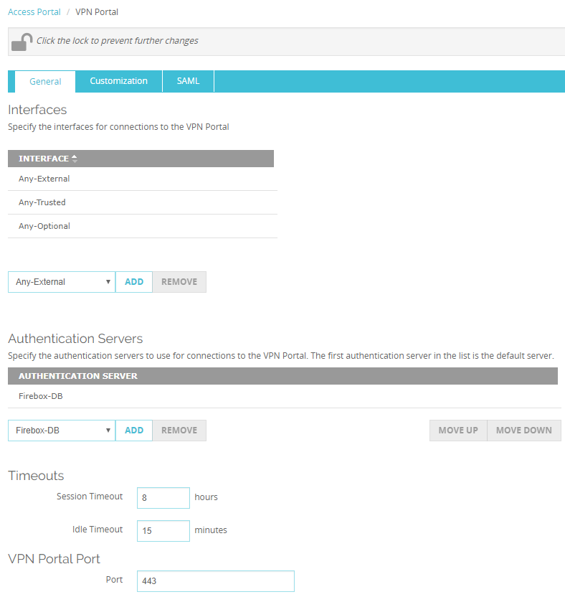
Access Portal — Configure
Configure the interface, authentication server, and port settings
These settings are shared with Mobile VPN with SSL
The Access Portal appears at https://<host name or IP address of the Firebox> unless you change the port number

Slide 15
Access Portal — Configure
You cannot change the VPN Portal Port if the Access Portal and Mobile VPN with SSL are both enabled
If you change the TCP data channel for Mobile VPN with SSL, the VPN Portal port inherits that setting

Slide 16
Access Portal — Configure
If you select UDP for the Mobile VPN with SSL data channel, you can specify a different VPN Portal port

Slide 17
Access Portal — SAML Single Sign-On
SAML 2.0 is the single sign-on (SSO) standard for easy access to web applications through SSO technologies
Access Portal offers a centralized sign-in experience with the convenience of SAML 2.0 for IT administrators who require a convenient and authenticated solution
SAML authentication occurs between a Service Provider (SP) and an Identity Provider (IdP)
The Firebox is the SP
A third-party identity provider that you specify, such as Okta or OneLogin, is the IdP

Slide 18
Access Portal — SAML Single Sign-On
To enable SAML for the Access Portal:
Configure the SAML settings on your Firebox
You can specify the optional IdP metadata URL if your IdP can send metadata to service providers
Give the Firebox SAML information to your IdP administrator
The Firebox automatically generates a webpage at https://<SAML hostname or Firebox IP address>/auth/saml that shows the Firebox SAML URLs and certificate
The IdP administrator must configure your IdP account with the Firebox SAML URLs and certificate

Slide 19
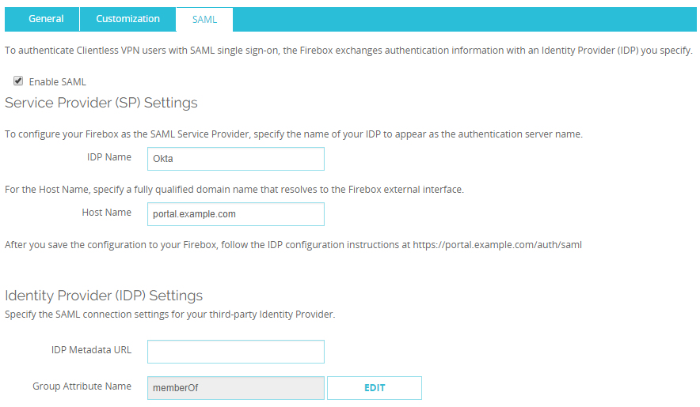
Access Portal — SAML Single Sign-On
SAML settings on the Firebox (Web UI)

Slide 20
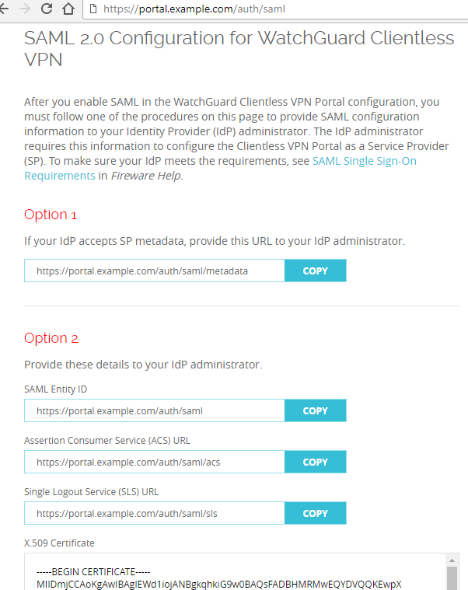
Access Portal — SAML Single Sign-On
SAML IdP instructions appear on a webpage generated from the SAML host name you specify
Automatic IdP configuration
Manual IdP configuration

Slide 21
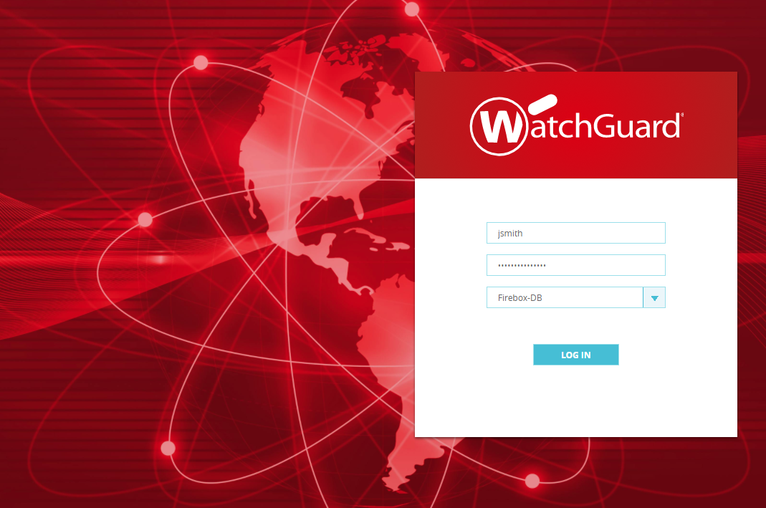
Access Portal
Users connect to the Access Portal at https://<host name or IP address of the Firebox> and authenticate to the authentication server you specified

Slide 22
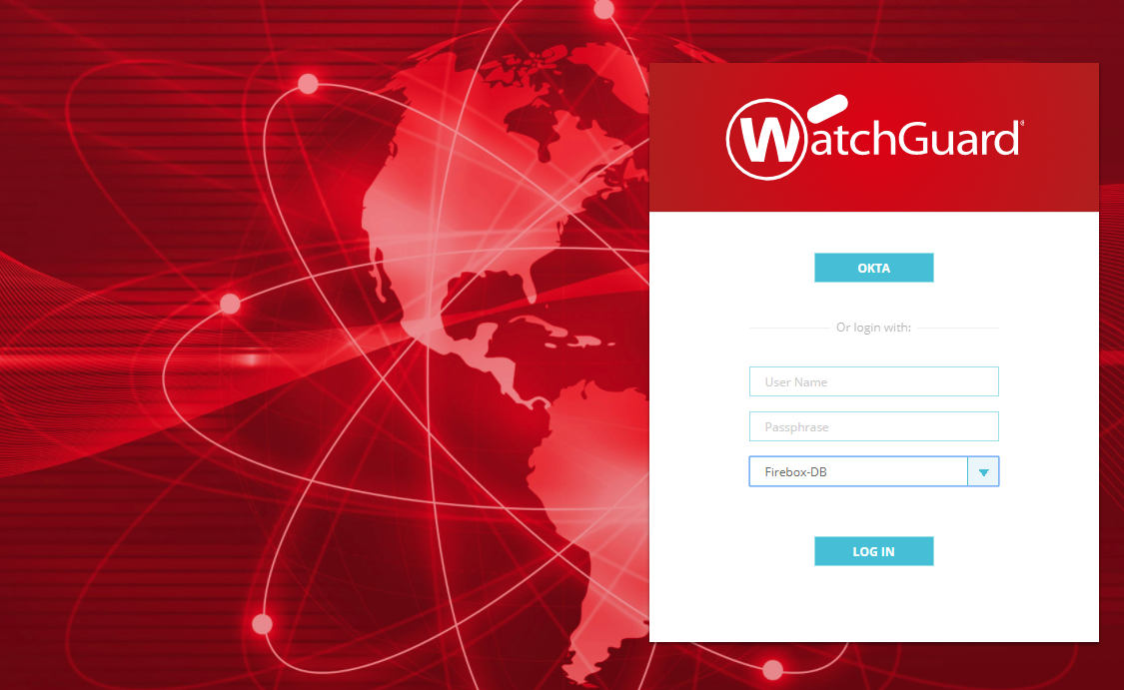
Access Portal
If you enabled SAML, the SAML identity provider you specified appears in the list of authentication servers

Slide 23
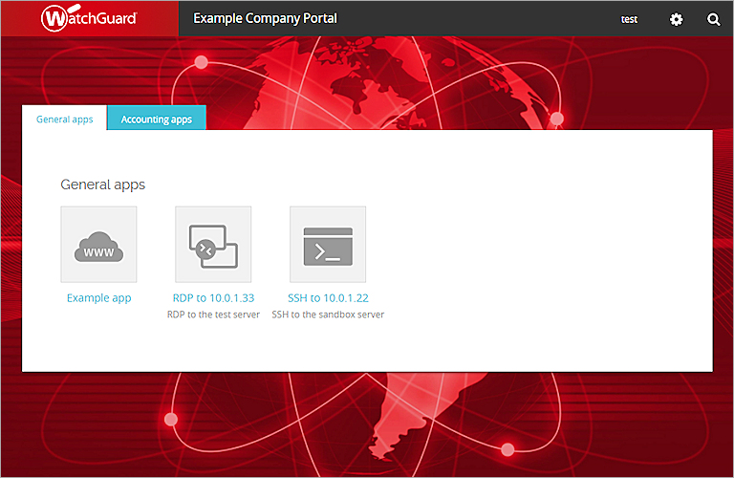
Access Portal
After the user authenticates, apps appear in the portal that the user has permission to connect to
Click an app to connect

Slide 24
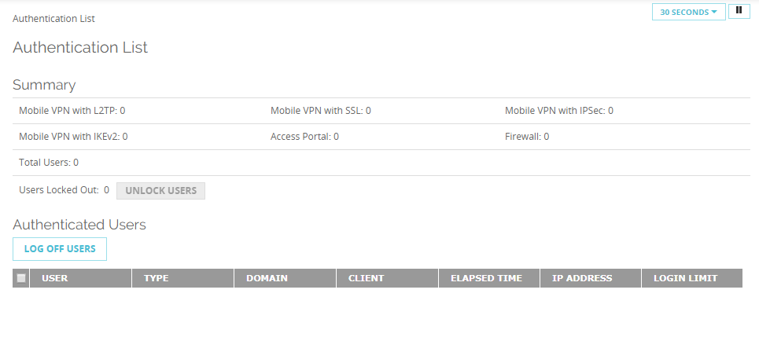
Access Portal — Authenticated Users
You can see the users that are connected to the Access Portal
From Fireware Web UI, on the System Status > Authentication List page

Slide 25
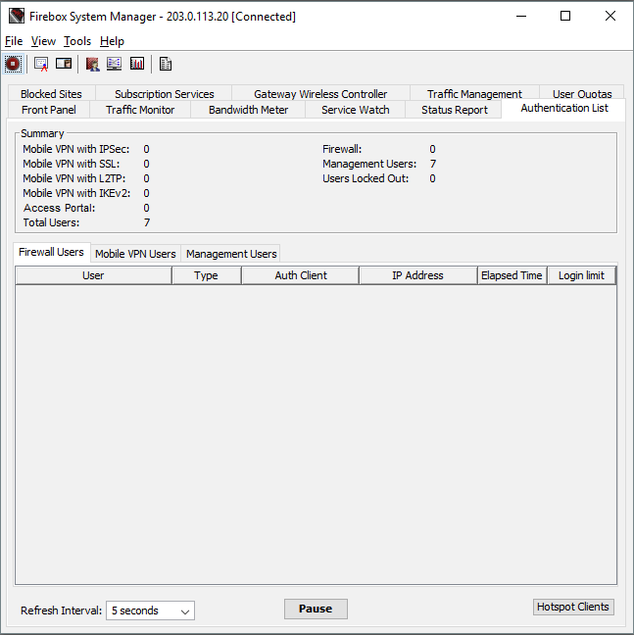
Access Portal — Authenticated Users
From Firebox System Manager, on the Authentication List tab

Slide 26
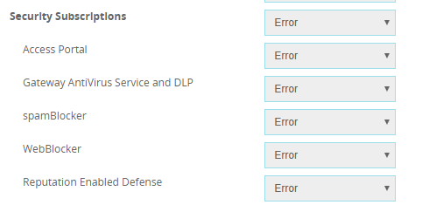
Access Portal — Diagnostic Log Level
You can also set the diagnostic log level for Access Portal connections
Fireware Web UI:
Select System > Diagnostic Log
In the Subscription Services section, select the log level for the Access Portal option

Slide 27
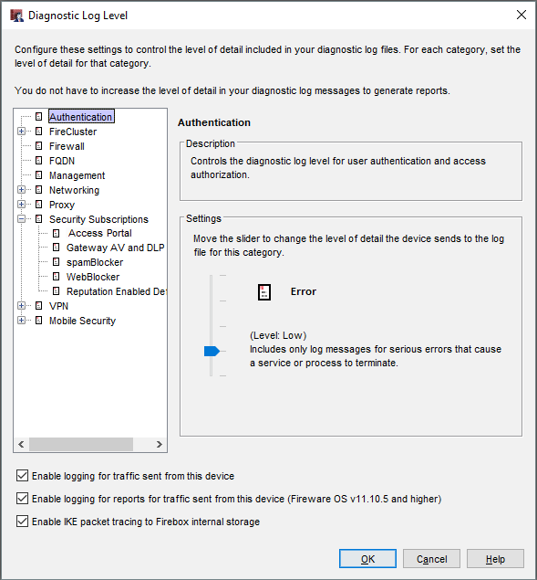
Access Portal — Diagnostic Log Level
Policy Manager:
Select Setup > Logging > Diagnostic Log Level
Expand Security Services and select Access Portal
This option is also available in Device Configuration Templates

Slide 28
HTTPS Content Inspection Enhancements

Slide 29
Content Inspection Exceptions List
Messaging applications and proxying technologies have led the way in non-standard HTTPS traffic
This can lead to problems for SSL inspection, which often burdens the IT administrator with error messages and cumbersome troubleshooting experiences
The Content Inspection Exceptions List is a predefined list of noncompliant, SSL-based, web applications that makes it easy to enable the HTTPS proxy with minimal interference in the end-user browsing experience, or a burden on the IT administrator
Notes:
From Networking/Interface page add a custom DHCP Option

Slide 30
Content Inspection Exceptions List
In the HTTPS-Client proxy action, the HTTPS Content Inspection settings now include a Predefined HTTPS Content Inspection Exceptions List
When Content Inspection is enabled, the HTTPS proxy does not inspect traffic for domains in the Predefined Exception List
The predefined list includes domain names associated with services that do not function correctly when content inspection is enabled
This change improves usability of HTTPS Content Inspection
The Predefined Exception List enables many services to function correctly when content inspection is enabled, without manual configuration of Domain Name rules
Notes:
From Networking/Interface page add a custom DHCP Option

Slide 31
Content Inspection Exceptions List
When you enable Content Inspection in a proxy action, the Predefined Content Inspection Exceptions List is enabled by default
If you do not want to allow connections to the domains in the exception list you can disable the entire exception list, or disable specific exceptions
To disable the predefined exceptions, clear the Enable Predefined Content Inspection Exceptions check box
To disable specific predefined exceptions, click Manage Exceptions, and then disable specific exceptions
Notes:
From Networking/Interface page add a custom DHCP Option

Slide 32
Content Inspection Exceptions List
The Predefined Content Inspection Exceptions List includes domain names used by services such as:
Microsoft services — Office Online, Skype, Teams, Exchange, Sharepoint, Onedrive, Product Activation
Apple services — iTunes, iCloud, App Store
Adobe services — Creative Cloud, Sign
Other services — Facebook, LinkedIn, Dropbox, Okta
In the Content Inspection settings, you can see and manage the list of predefined exceptions

Slide 33
Content Inspection Exceptions List
The Predefined Content Inspection Exceptions list is available with Fireware v12.1 and WatchGuard System Manager v12.1
The predefined exceptions list is created and maintained by WatchGuard
You can enable or disable the predefined exceptions
You cannot add or remove exceptions
You can use Domain Name rules to specify the action for other domains you do not want to inspect
Notes:
From Networking/Interface page add a custom DHCP Option

Slide 34
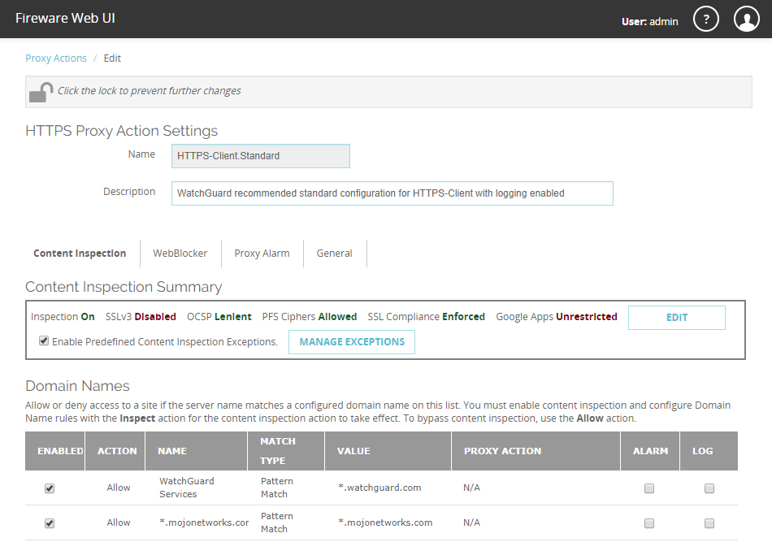
HTTPS Proxy Action UI Updates
Content Inspection — Fireware Web UI
Notes:
From Networking/Interface page add a custom DHCP Option

Slide 35
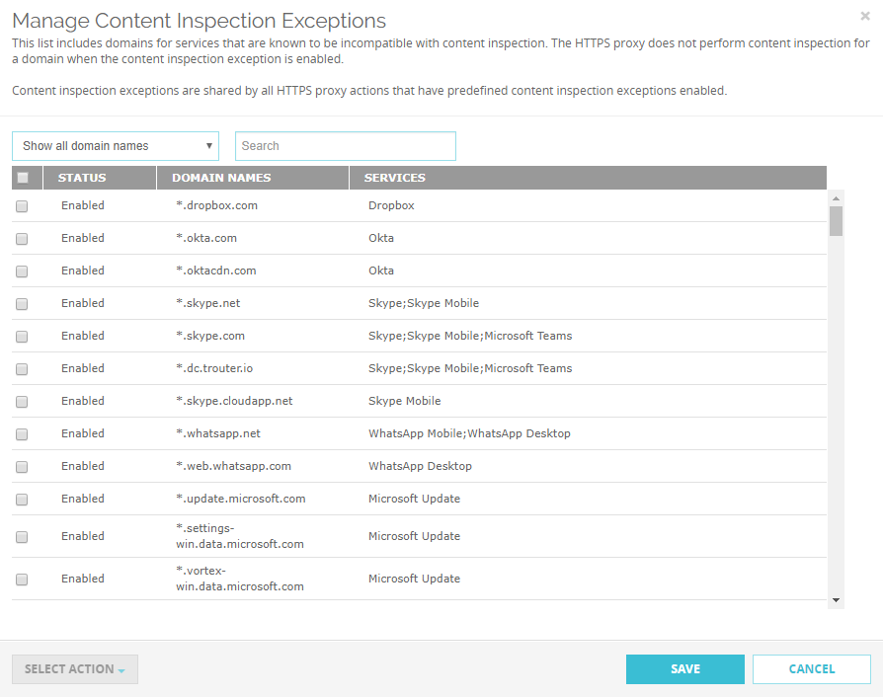
HTTPS Proxy Action UI Updates
Manage Content Inspection Exceptions
Notes:
From Networking/Interface page add a custom DHCP Option

Slide 36
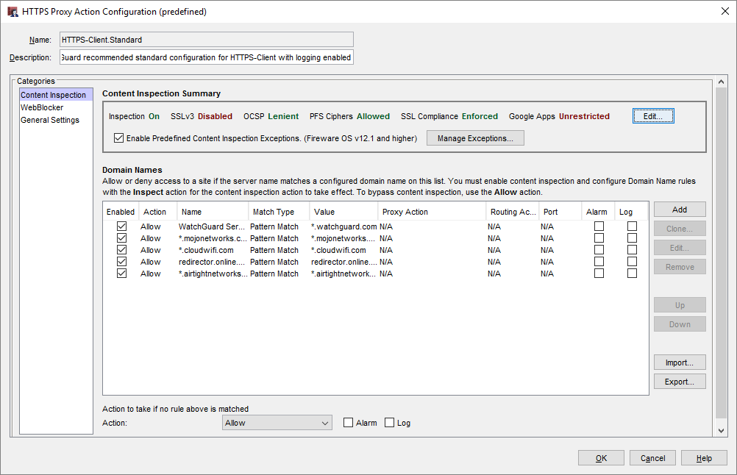
HTTPS Proxy Action UI Updates
Content Inspection — Policy Manager

Slide 37
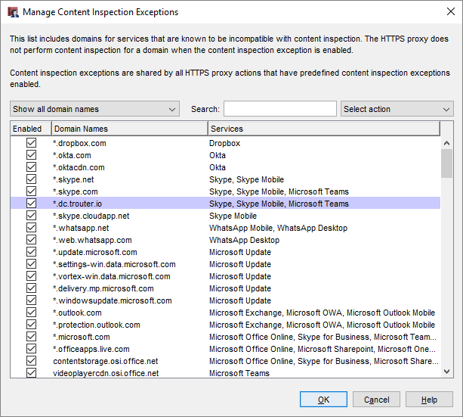
HTTPS Proxy Action UI Updates
To disable an exception, clear the Enabled check box
To enable or disable multiple exceptions:
Select one or more domain names
Select the action Enable or Disable
Notes:
From Networking/Interface page add a custom DHCP Option

Slide 38
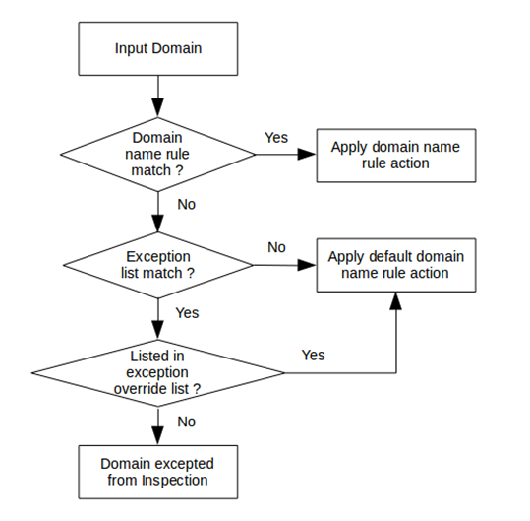
HTTPS Proxy Flow Changes
Domain name rules take higher precedence than any match in the predefined exception list
If a domain name rule is matched, the action from that rule will always be applied
Notes:
From Networking/Interface page add a custom DHCP Option

Slide 39
Log Message Update
A new traffic log message is generated when an exception list match occurs
The log message text:
msg=“ProxyAllow: HTTPS content inspection exception list match”
Notes:
From Networking/Interface page add a custom DHCP Option

Slide 40
Secure IMAP (IMAPS)

Slide 41
Secure IMAP (IMAPS)
IMAP is an alternative to SMTP for mail traffic among popular email vendors (Apple, Google, etc.)
Secure IMAP (IMAPS) is an SSL-compliant proxy solution for the IMAP protocol
The IMAP proxy and TCP-UDP proxy now support Secure IMAP (IMAPS)
The IMAP proxy supports:
IMAP on TCP port 143
IMAP over TLS on TCP port 993 (new)
STARTTLS is not supported

Slide 42
Secure IMAP (IMAPS)
Options for enabling SSL inspection are:
IPS
URL filtering
App Control for IMAP — A protocol regularly used for Apple iOS, Gmail, and other mail service providers

Slide 43
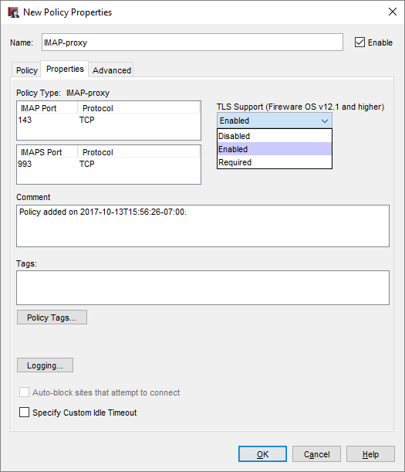
TLS Support in the IMAP Proxy
New TLS Support option on the IMAP policy Properties tab:
Disabled — IMAP proxy listens on port 143 only
Enabled (default ) — IMAP proxy listens on ports 143 and 993
Required — IMAP proxy listens on port 993 only
The Port list is updated based on the configured TLS Support option
Notes:
From Networking/Interface page add a custom DHCP Option

Slide 44
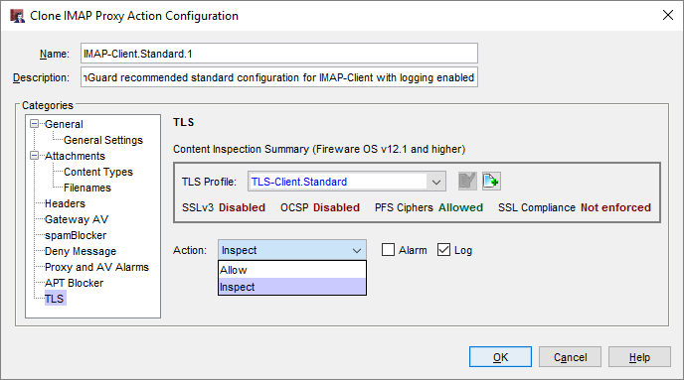
IMAP Proxy Action TLS Settings
IMAP proxy actions now include a TLS category
TLS settings are configurable only when TLS Support is set to Enabled or Required in the IMAP policy Properties tab
The TLS settings in the proxy action include:
TLS Profile
Action

Slide 45
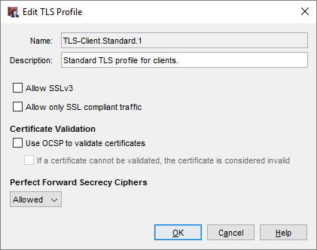
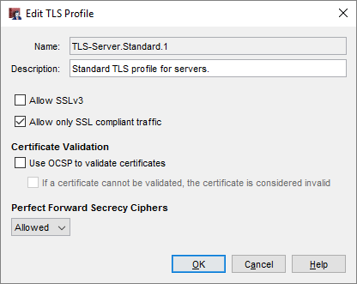
TLS Profiles
A TLS Profile is a collection of TLS-related security settings:
Allow SSLv3
Allow only SSL compliant traffic
Certificate Validation (OCSP)
Perfect Forward Secrecy Ciphers
TLS profiles and default settings are client and server specific
You can select the same TLS profile in more than one IMAP proxy action
Notes:
From Networking/Interface page add a custom DHCP Option

Slide 46
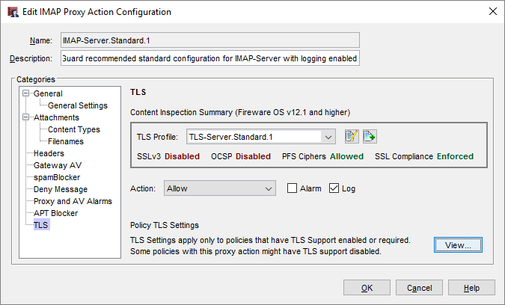
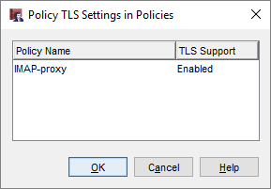
IMAP Proxy Action TLS Settings
An IMAP proxy action can apply to more than one policy
TLS settings apply only when TLS Support is enabled or required in a policy
If you edit the proxy action from the Proxy Actions list, click View to see the TLS settings for all policies that use the proxy action

Slide 47
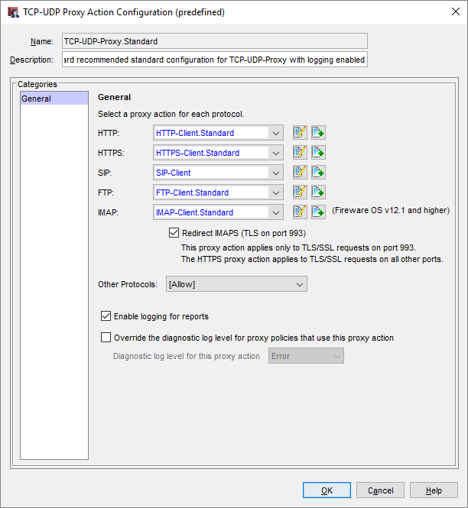
TCP/UDP Proxy
TCP-UDP proxy action now supports IMAP
Select an IMAP-Client proxy action, or select Allow or Deny
The IMAP proxy action applies only to TLS/SSL requests on port 993
The HTTPS proxy action applies to TLS/SSL requests on all other ports

Slide 48
WebBlocker UX/UI Enhancements

Slide 49
WebBlocker UX/UI Enhancements
WebBlocker has been updated to have more consistent terminology — WebBlocker Action
WebBlocker Profile changed to WebBlocker Action
WebBlocker Configurations changed to WebBlocker Actions
New/Edit/Clone WebBlocker Configuration changed to New/Edit/Clone WebBlocker Action
Notes:
From Networking/Interface page add a custom DHCP Option

Slide 50
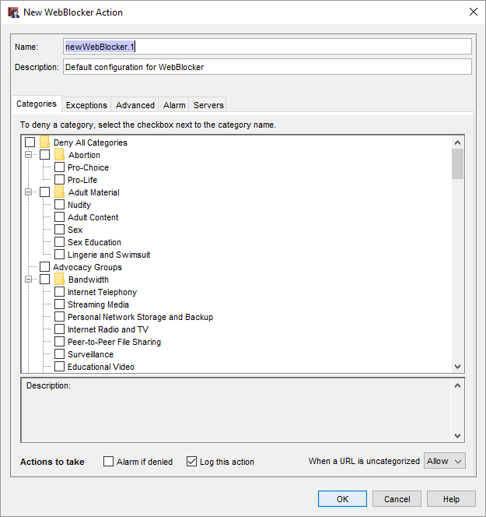
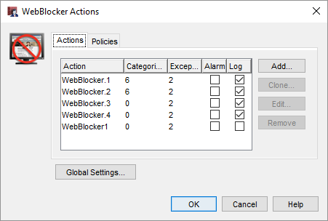
WebBlocker UX/UI Enhancements
Consistent terminology — WebBlocker Action
Notes:
From Networking/Interface page add a custom DHCP Option

Slide 51
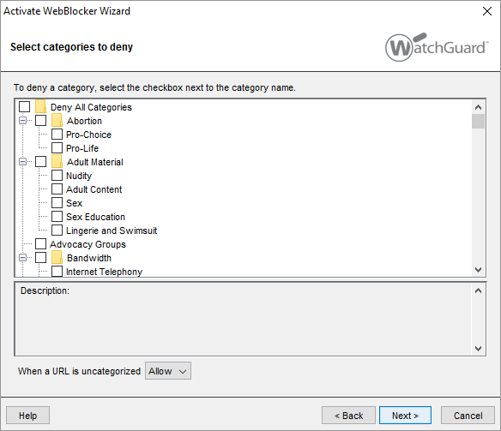
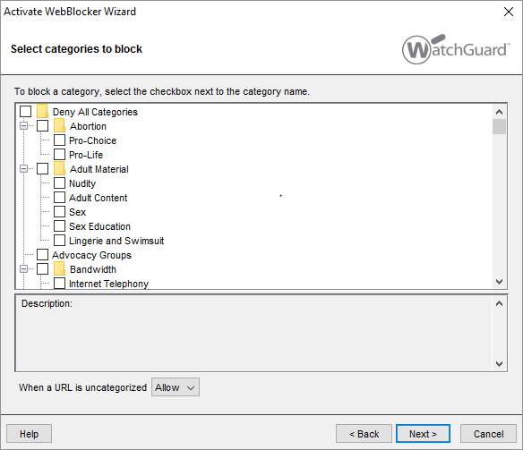
WebBlocker UX/UI Enhancements
Action changed from Block to Deny
Notes:
From Networking/Interface page add a custom DHCP Option

Slide 52
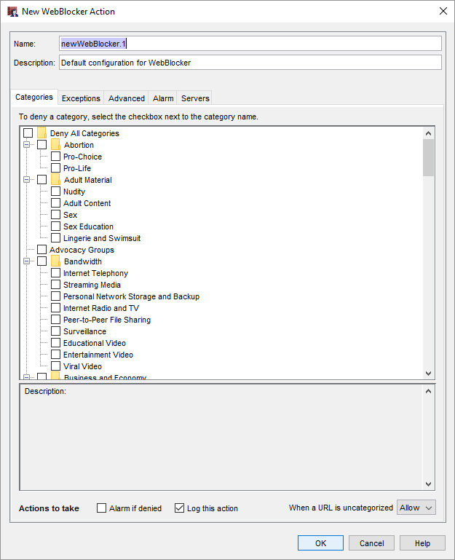
WebBlocker UX/UI Enhancements
The Servers tab has moved to the far right
Notes:
From Networking/Interface page add a custom DHCP Option

Slide 53
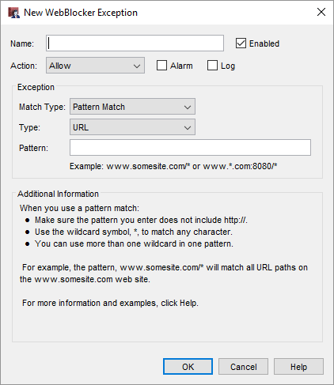
WebBlocker UX/UI Enhancements
Improvements to the New/Edit WebBlocker Exception dialog box include additional descriptive information on pattern match and wildcards
Notes:
From Networking/Interface page add a custom DHCP Option

Slide 54
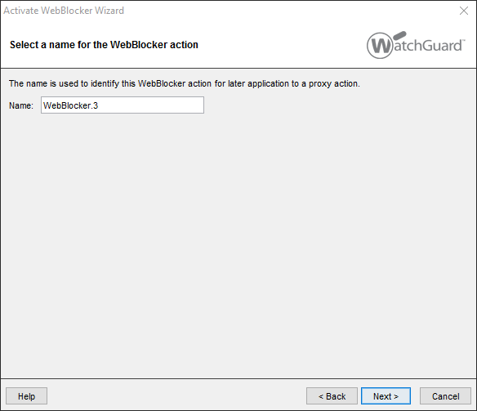
WebBlocker UX/UI Enhancements
Improved WebBlocker wizard
Notes:
From Networking/Interface page add a custom DHCP Option

Slide 55
WebBlocker UX/UI Enhancements
Completely revised WebBlocker dialog box
Old Configure WebBlocker dialog box renamed to WebBlocker Actions
From the Policy tab, multiple policies can be selected to apply the actions
Notes:
From Networking/Interface page add a custom DHCP Option

Slide 56
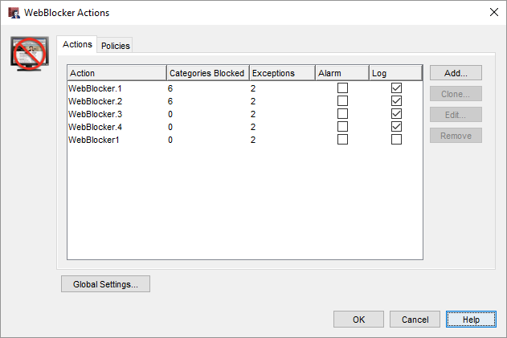
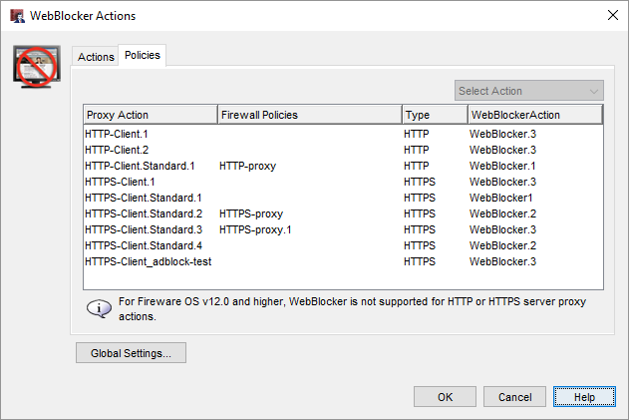
WebBlocker UX/UI Enhancements
Notes:
From Networking/Interface page add a custom DHCP Option

Slide 57
Mobile VPN with SSL

Slide 58
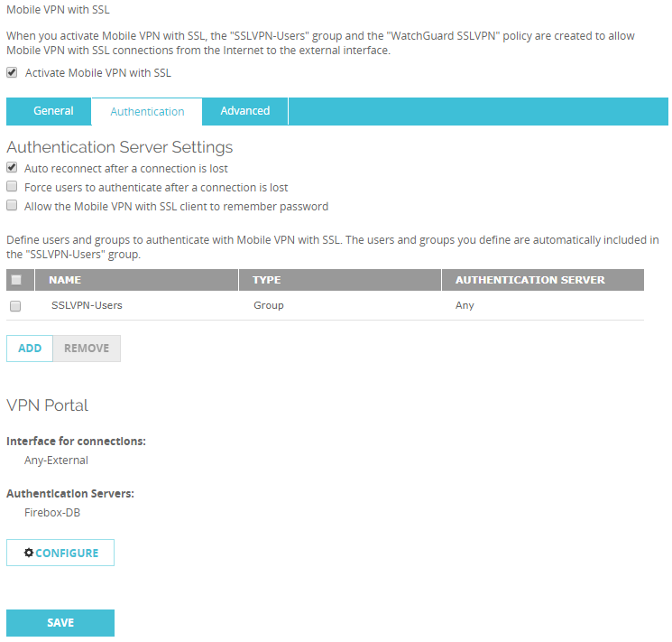
Mobile VPN with SSL Portal Updates
Mobile VPN with SSL and the Access Portal share the new VPN Portal settings
To configure these settings for Mobile VPN with SSL, on the Authentication tab, click Configure

Slide 59
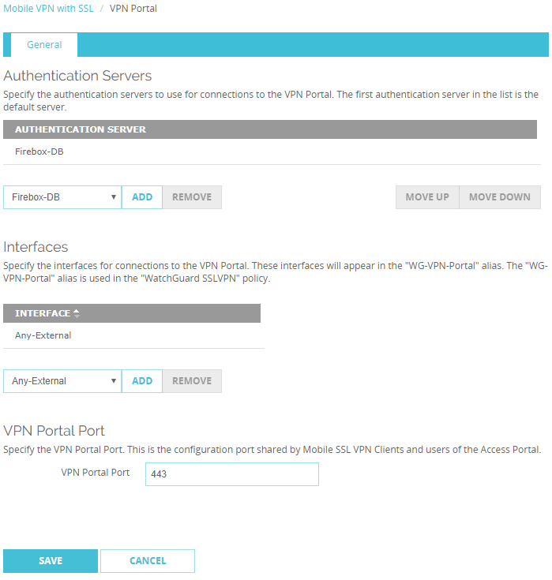
Mobile VPN with SSL Portal Updates
The Configuration Channel setting for Mobile VPN with SSL moved to the VPN Portal settings and is now named VPN Portal port

Slide 60
Mobile VPN with SSL Portal Updates
The Data Channel setting for Mobile VPN with SSL remains in the Mobile VPN with SSL settings

Slide 61
Mobile VPN with SSL Portal Updates
The TCP Data Channel for Mobile VPN with SSL takes precedence over the VPN Portal port
If you change the TCP Data Channel for Mobile VPN with SSL, the VPN Portal Port changes to the same port

Slide 62
Mobile VPN with SSL Portal Updates
If you change the UDP Data Channel for Mobile VPN with SSL, the VPN Portal Port is not affected

Slide 63
Mobile VPN with SSL Portal Updates
Interface and authentication server settings apply to both Mobile VPN with SSL and the Access Portal

Slide 64
Mobile VPN with SSL Portal Updates
To download the client software for Mobile VPN with SSL, you must now go to: https://<host name or IP address>/sslvpn.html
The software downloads page for Mobile VPN with SSL is no longer available at: https://<host name or IP address>
The Access Portal now appears at: https://<host name or IP address>

Slide 65
Mobile VPN with IKEv2

Slide 66
Mobile VPN with IKEv2
IKEv2 is a tunneling protocol for IKEv2/IPSec VPNs
You can now configure the native IKEv2 VPN clients on Windows, macOS, and iOS mobile devices rather than third-party clients
Mobile users can connect to corporate resources through an IKEv2/IPSec tunnel to the Firebox
You can preconfigure corporate mobile devices for rollout or support BYOD scenarios
Android users can connect with the free, third-party strongSwan app

Slide 67
Mobile VPN with IKEv2
You can configure Mobile VPN with IKEv2 on the Firebox manually or with a wizard
Mobile VPN with IKEv2 sends all traffic over the VPN tunnel (full tunnel)
Client devices control routing, not the Firebox
The IPSec VPN Users value in the feature key is a combined limit for Mobile VPN with IKEv2 and Mobile VPN with IPSec
Example — If a feature key allows 250 IPSec VPN user connections, and 200 Mobile VPN with IPSec users are connected, 50 Mobile VPN with IKEv2 users can connect

Slide 68
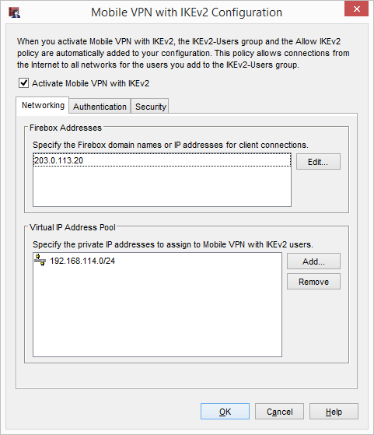
Mobile VPN with IKEv2
When you enable Mobile VPN with IKEv2, the Firebox automatically assigns a default virtual IP address pool for IKEv2 users

Slide 69
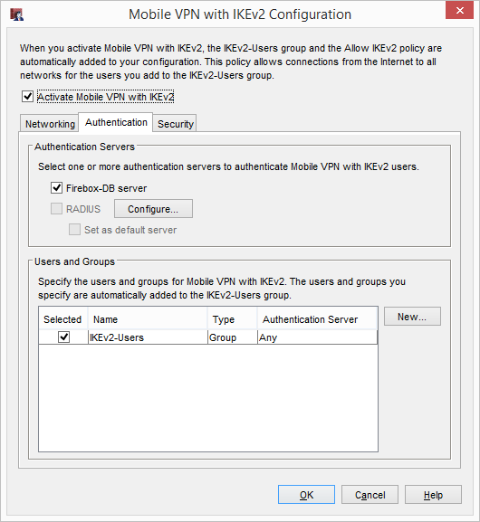
Mobile VPN with IKEv2
The Authentication tab

Slide 70
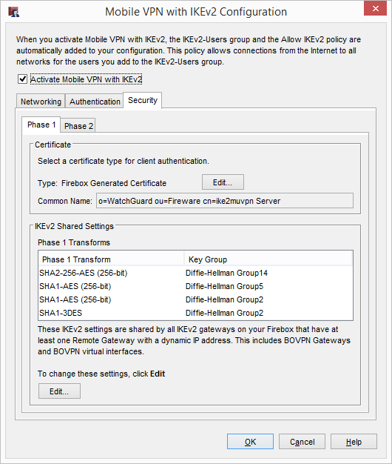
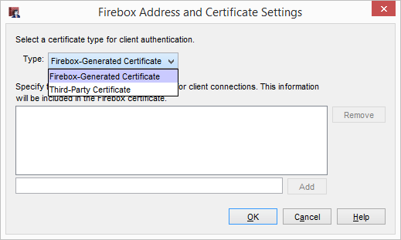
Mobile VPN with IKEv2
70
You can select a Firebox certificate or a third-party certificate

Slide 71
Mobile VPN with IKEv2
Firebox and third-party certificates have these requirements:
Extended Key Usage (EKU) flags serverAuth and IP Security IKE Intermediate (OID 1.3.6.1.5.5.8.2.2)
IP address or DNS name as a Subject Alternative Name value

Slide 72
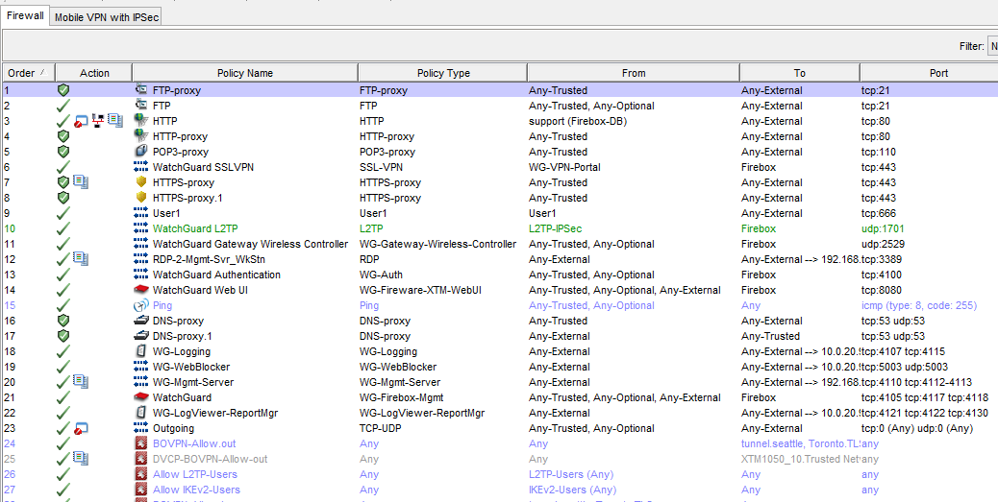
Mobile VPN with IKEv2
The policy for Mobile VPN with IKEv2 appears on the Firewall tab in the policy list

Slide 73
Mobile VPN with IKEv2 — Client Instructions
You can download a Client Instructions file from the Firebox that contains automatic configuration scripts and instructions for IKEv2 VPN clients in Windows, macOS, iOS, and Android
The client settings and the certificate are installed automatically by the script
You must save the Firebox configuration before the file is available to download

Slide 74
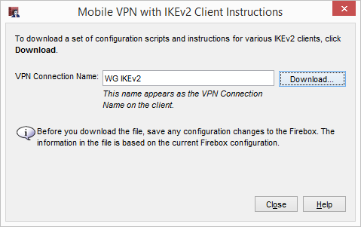
Mobile VPN with IKEv2 — Client Instructions
Download the Client Instructions from the Firebox

Slide 75
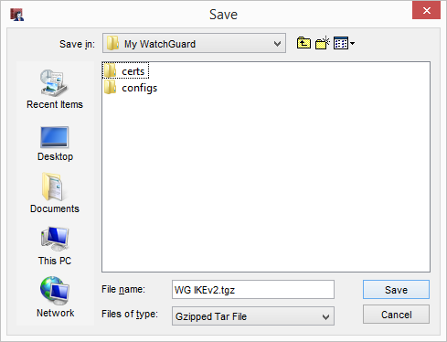
Mobile VPN with IKEv2 — Client Instructions
Save the .TGZ archive
Extract the files from the .TGZ archive

Slide 76
Mobile VPN with IKEv2 — Client Instructions
Each folder contains instructions and an automatic configuration script that are specific to your operating system

Slide 77
Mobile VPN with IKEv2 — Client Instructions
You can manually configure an IKEv2 VPN connection on your device rather than run the script
On your device, you must install the rootca.pem or rootca.crt files provided in the .TGZ download file to establish an IKEv2 VPN connection
Instructions for manual configuration are included in each folder in the .TGZ download file

Slide 78
BOVPN Over TLS

Slide 79
BOVPN Over TLS
You can now enable a BOVPN over TLS tunnel between Fireboxes
BOVPN over TLS uses port 443, which is typically open on networks
This is recommended as an alternative BOVPN solution when:
Your business operates in a location where you do not have full network control, such as a shared office space or a shopping mall, and you cannot open ports required by our IPSec-based BOVPN
IPSec traffic is not correctly handled by your ISP, modem, or router, or is not allowed on your network

Slide 80
BOVPN Over TLS
BOVPN over TLS uses a client/server model
On a Firebox configured in Server mode, you can configure tunnels to one or more Fireboxes configured in Client mode
On a Firebox configured in Client mode, you can configure tunnels to one or more Fireboxes configured in Server mode
A Firebox cannot be configured as both a server and client
Supports only hub-and-spoke topologies
BOVPN over TLS is supported only for Firebox endpoints
In Fireware v12.1, BOVPN over TLS is available only in Fireware Web UI

Slide 81
BOVPN Over TLS
Enable Client Mode

Slide 82
BOVPN Over TLS
Configure Client mode

Slide 83
BOVPN Over TLS
The Advanced Settings dialog box contains the authentication and encryption settings
The TCP data channel is permanently set to port 443
To specify a port other than 443, you must select UDP
The Import configuration file option is for testing purposes and will be removed in a future release

Slide 84
BOVPN Over TLS
You can add tunnels to multiple TLS servers

Slide 85
BOVPN Over TLS
You must also configure at least one Firebox in Server mode
Enable Server mode

Slide 86
BOVPN Over TLS
Configure Server mode

Slide 87
BOVPN Over TLS
Configure Server mode

Slide 88
BOVPN Over TLS
Two configuration options are supported:
Option 1 — TLS server connects to multiple TLS clients
Option 2 — TLS client connects to multiple TLS servers
This option consumes more resources on the Firebox than Option 1

Slide 89
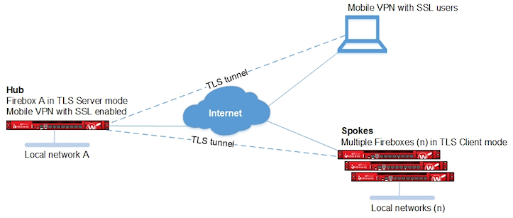
BOVPN Over TLS
Option 1:

Slide 90
BOVPN Over TLS
Option 2:

Slide 91
BOVPN Over TLS
The BOVPN-Allow.in and BOVPN-Allow.out policies are shared with BOVPN, BOVPN virtual interfaces, and TLS BOVPN

Slide 92
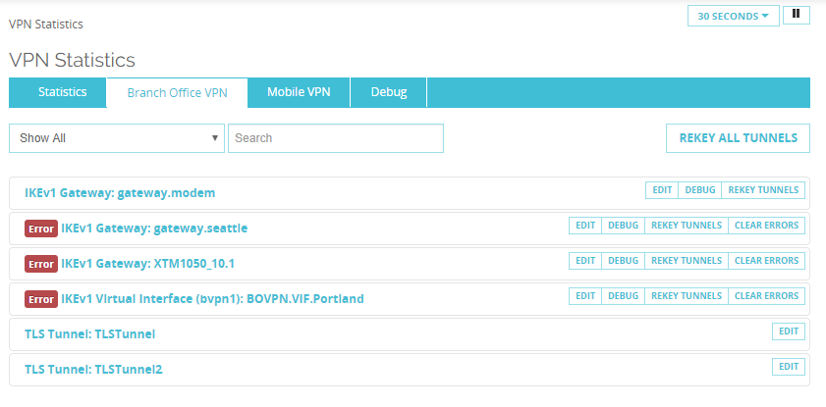
BOVPN Over TLS
From Fireware Web UI, on the System Status > VPN Statistics > Branch Office VPN tab, you can see BOVPN over TLS tunnels
You can filter the page on TLS Tunnels and Edit the tunnel settings

Slide 93
BOVPN Over TLS
Unsupported features:
Active/active FireCluster
IP address ranges
BOVPN NAT
Dynamic routing over the VPN tunnel
Multicast traffic over the VPN tunnel
Policy-based routing
Third-party certificates are not supported

Slide 94
SSL/TLS Shared Settings

Slide 95
SSL/TLS Shared Settings
Several Firebox features use SSL/TLS for secure communication and share the same OpenVPN server
The features that share the OpenVPN server, in order of precedence from highest to lowest, are:
Management Tunnel over SSL on hub devices
BOVPN over TLS in Server mode
Mobile VPN with SSL
Access Portal

Slide 96
SSL/TLS Shared Settings
Features with lower precedence inherit some SSL/TLS settings from enabled features with higher precedence
The shared settings are not configurable for the features with lower precedence

Slide 97
SSL/TLS Shared Settings
When you enable more than one of these features, informational messages appear when settings are inherited from another feature
Example messages:

Slide 98
SSL/TLS Shared Settings
When you enable Management Tunnel over SSL, BOVPN over TLS, Mobile VPN with SSL, or the Access Portal, the WatchGuard SSLVPN policy is created automatically
In Fireware v12.1 and higher:
The WatchGuard SSLVPN policy includes the alias WG-VPN-Portal
By default, the alias WG-VPN-Portal includes only the Any-External interface
The WatchGuard SSLVPN policy is shared by Management Tunnel over SSL, BOVPN over TLS, Mobile VPN with SSL, and the Access Portal

Slide 99
SSL/TLS Shared Settings
If the WatchGuard SSLVPN policy is part of your configuration and you upgrade to Fireware v12.1, the WatchGuard SSLVPN policy does not immediately change
However, if you save the settings for BOVPN over TLS or Mobile VPN with SSL, even if you make no changes, the WatchGuard SSLVPN policy changes:
The alias WG-VPN-Portal appears in the From field of the WatchGuard SSLVPN policy
Interfaces in the WatchGuard SSLVPN policy are moved to the WG-VPN-Portal alias
Aliases that are not interfaces, such as IP addresses or users, are not moved to the WG-VPN-Portal alias, but are included in the From field

Slide 100
SSL/TLS Shared Settings
To edit the interfaces in the WG-VPN-Portal alias, you must edit the Interfaces setting in the VPN Portal settings

Slide 101
SSL/TLS Shared Settings
Example 1 — Management Tunnel over SSL on a hub device, BOVPN over TLS in Server mode, Mobile VPN with SSL, and Access Portal are enabled
These settings are not configurable:
BOVPN over TLS in Server mode — Firebox IP addresses, virtual IP address pool, data channel protocol and port, and renegotiate data channel
Mobile VPN with SSL — Firebox IP addresses, networking method, virtual IP address pool, VPN resources, data channel, authentication, encryption, and timers
Access Portal — VPN Portal port

Slide 102
SSL/TLS Shared Settings
BOVPN over TLS in Server mode

Slide 103
SSL/TLS Shared Settings
Mobile VPN with SSL

Slide 104
SSL/TLS Shared Settings
VPN Portal Port

Slide 105
SSL/TLS Shared Settings
Example 2 — BOVPN over TLS in Server mode, Mobile VPN with SSL, and Access Portal are enabled
These settings are not configurable:
Mobile VPN with SSL — Firebox IP addresses, networking method, virtual IP address pool, VPN resources, data channel, authentication, encryption, and timers
Access Portal — VPN Portal port
In the BOVPN over TLS settings, you can configure the Data Channel for TCP or UDP
The Data Channel setting affects the Data Channel setting for Mobile VPN with SSL

Slide 106
SSL/TLS Shared Settings
If the BOVPN over TLS Data Channel is configured for TCP:
Data Channel port for BOVPN over TLS is 443 and cannot be configured
Data Channel for Mobile VPN with SSL is TCP 443 and cannot be configured
VPN Portal port is 443 and cannot be configured

Slide 107
SSL/TLS Shared Settings
BOVPN over TLS Data Channel

Slide 108
SSL/TLS Shared Settings
Mobile VPN with SSL Data Channel

Slide 109
SSL/TLS Shared Settings
VPN Portal Port

Slide 110
SSL/TLS Shared Settings
If the BOVPN over TLS Data Channel is UDP:
Data Channel for BOVPN over TLS can be a port other than 443
Data Channel for Mobile VPN with SSL changes to UDP, and the port changes to the port you specified for the BOVPN over TLS Data Channel
VPN Portal port is 443 and cannot be configured
The WatchGuard SSLVPN policy includes the UDP and TCP ports

Slide 111
SSL/TLS Shared Settings
BOVPN over TLS Data Channel

Slide 112
SSL/TLS Shared Settings
Mobile VPN with SSL Data Channel

Slide 113
SSL/TLS Shared Settings
VPN Portal Port

Slide 114
SSL/TLS Shared Settings
WatchGuard SSLVPN policy

Slide 115
Modem as an External Interface

Slide 116
Modem as an External Interface
You can now enable a modem as an external interface
If your business operates in areas with weak ISP coverage, or you have non-traditional methods for internet access, a dedicated modem interface can increase your network flexibility
The modem interface can perform as a dedicated interface and support multi-WAN scenarios
3G/4G cellular modems currently supported for failover are supported as external interfaces

Slide 117
Modem as an External Interface
When you enable a modem, it appears in the list of interfaces as modem0

Slide 118
Modem as an External Interface
When you select to edit the modem interface, the Modem configuration page appears

Slide 119
Modem as an External Interface
When you enable a modem, it appears in the list of aliases
You can add the modem to a policy
The modem appears as an interface option in these configurations:
BOVPN and BOVPN virtual interfaces
Dynamic DNS
1-to-1 NAT
SNAT
Dynamic NAT
Traffic management
Applies to modem interfaces for outgoing traffic only

Slide 120
Modem as an External Interface
Modem failover is supported for BOVPN and BOVPN virtual interfaces
If you configure a modem interface as a BOVPN gateway, the Use Modem for failover option is not available

Slide 121
Modem as an External Interface
If you select Use Modem for failover for a BOVPN gateway, the modem does not appear in the External Interface list in the local gateway settings

Slide 122
Modem as an External Interface
Multi-WAN and Link Monitor features are updated
You can now add a modem interface to Multi-WAN
By default, modems do not participate in Multi-WAN
You can enable Link Monitor for a modem that participates in Multi-WAN
By default, Link Monitor is disabled for modem interfaces to prevent bandwidth consumption
The Link Monitor tab was removed from the Network > Modem configuration page
Link Monitor updates affect all interface types and are described in more detail in the next section

Slide 123
Modem as an External Interface
Unsupported features:
FireCluster
RapidDeploy
VLANs
Bridge mode
Multiple modem interfaces

Slide 124
Multi-WAN Link Monitor

Slide 125
Multi-WAN Link Monitor Updates
You can now disable Link Monitor for any interface
Fireware Web UI:

Slide 126
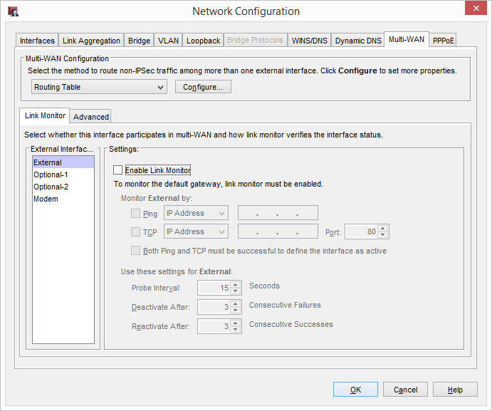
Multi-WAN Link Monitor Updates
Policy Manager:

Slide 127
Multi-WAN Link Monitor Updates
When you add a new interface, Link Monitor is enabled by default for all interfaces except modems

Slide 128
Wildcard IPv4 Addresses

Slide 129
Wildcard IPv4 Addresses
You can now specify wildcard IPv4 address in aliases and in policies
If you create templates for repetitive IPv4 address patterns in your distributed enterprise, wildcard IPv4 addresses add convenience
On the Firebox, you can specify the wildcard IPv4 address in a policy rather than type each individual IPv4 address
A built-in IP address calculator helps you determine IPv4 address ranges
Wildcard IPv4 addresses in aliases and polices are also supported in Device Configuration Templates

Slide 130
Wildcard IPv4 Addresses
Example — The 10.0.0.5/255.255.0.255 wildcard IPv4 address generates a list of 256 IPv4 addresses in this sequence:
10.0.1.5
10.0.2.5
10.0.3.5
10.0.4.5
In a distributed enterprise, you can assign these addresses to hosts at remote sites
In our example, you can use the third octet to identify each site
To create a Firebox policy with these IP addresses, you type the wildcard IPv4 address in the policy

Slide 131
Wildcard IPv4 Addresses
Example — HTTPS policy with a wildcard IPv4 address

Slide 132
Gateway Wireless Controller Enhancements

Slide 133
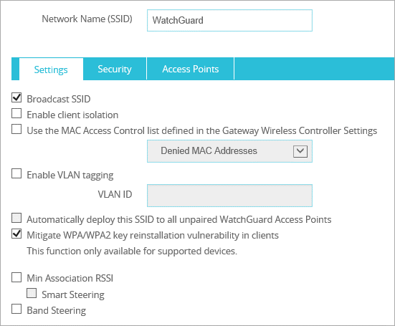
Min. Association RSSI and Smart Steering
AP120, AP300, AP320, AP322, and AP420 now support minimum association RSSI and smart steering on the Gateway Wireless Controller
Formerly known as Fast Handover, these options are now configured for each SSID

Slide 134
Min. Association RSSI and Smart Steering
Min. Association RSSI
Minimum signal strength required to associate with an AP
Will not actively disconnect a client if signal strength falls below the minimum association RSSI
For the AP300, this is a global option. If one or more SSIDs with Min. Association RSSI enabled are assigned to an AP300, the option becomes global on all SSIDs for that AP, including those that do not have Min. Association RSSI enabled.
Smart Steering
Can enable only if Min. Association RSSI is enabled
Prevents clients from staying connected to the current AP even though there is an AP with better signal strength in the vicinity
Proactively steers the client to a better AP for a better connection

Slide 135
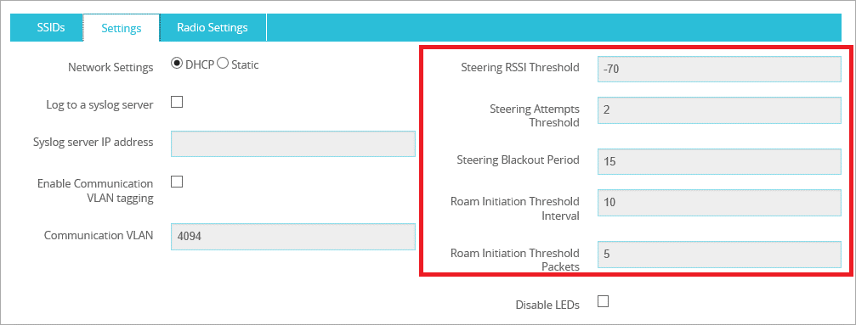
Min. Association RSSI and Smart Steering
Parameters and thresholds for Min. Association RSSI and Smart Steering options are configured in the AP settings

Slide 136
Band Steering
When an SSID is configured in both the 2.4 GHz and 5 GHz bands, clients can be steered towards the less congested 5 GHz band
Helps to evenly distribute the wireless clients between the two bands on an AP
Band Steering has been moved from the AP settings to the SSID settings with the new Min. Association RSSI and Smart Steering options

Slide 137
Improved AP Passphrase Security
Improved Gateway Wireless Controller and AP passphrase security
Must always enter a passphrase when you enable the Gateway Wireless Controller for AP management
The Gateway Wireless Controller automatically generates a unique passphrase for each AP

Slide 138
Deprecated Wireless Options
These wireless options are deprecated in Fireware v12.1:
Telecommuter mode for remote VPN deployment
Band Steering for the AP300
Deployment over wireless (AP300 only feature)

Slide 139
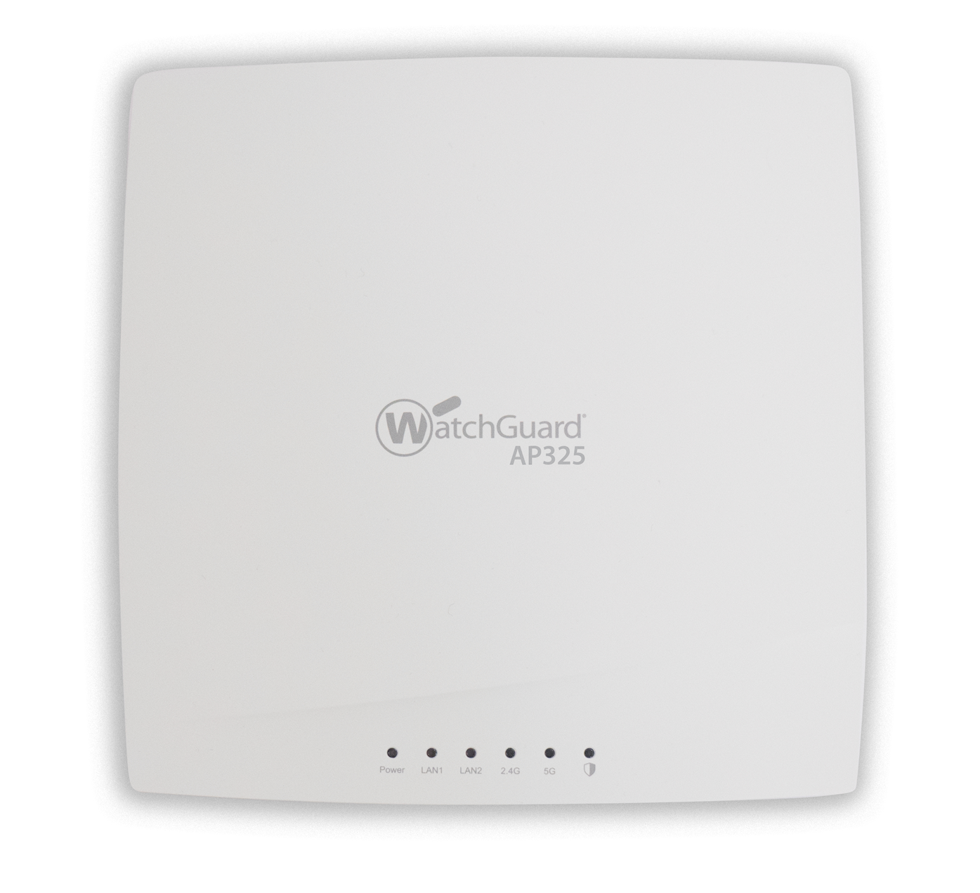
AP325 Support
Support added for the upcoming AP325
802.11ac 2x2 MU-MIMO Wave 2 access point
Ideal for low to medium density deployments

Slide 140
Thank You!

