Slide 1
What’s New in Fireware v12.1.1

Slide 2
What’s New in Fireware v12.1.1
DNSWatch
New Dynamic DNS Providers
Firebox Wireless Enhancements
Networking Enhancements
USB Modem Support
Hot Plug Modem Support
DHCP Server Gateway Enhancements
VLAN Traffic Setting Enhancements

Slide 3
What’s New in Fireware v12.1.1
BOVPN over TLS Support for WatchGuard System Manager and Policy Manager
Content inspection settings moved from HTTPS proxy actions to TLS profiles

Slide 4
New DNSWatch Service

Slide 5
DNSWatch Threat Intelligence
WatchGuard uses a complex set of heuristics to identify malicious certificates and websites
DNSWatch polls threat intelligence sources daily to identify new malicious domains and update the Domain Feeds
DNSWatch users can also share domains they manually add to the DNSWatch Blacklist with WatchGuard to help improve DNSWatch for all users

Slide 6
DNSWatch and the Firebox
When the Firebox receives a DNS query from a host on a protected network, it forwards the request to DNSWatch
DNSWatch evaluates whether the domain is a known threat
If the domain is not a known threat:
DNSWatch resolves the DNS query to the destination
If the domain is a known threat:
DNSWatch resolves the domain to the IP address of the DNSWatch Blackhole Server
The DNSWatch Blackhole Server attempts to gather more information about the threat from the host endpoint
For HTTP and HTTPS requests, the DNSWatch Blackhole Server displays a customizable deny page to the user

Slide 7
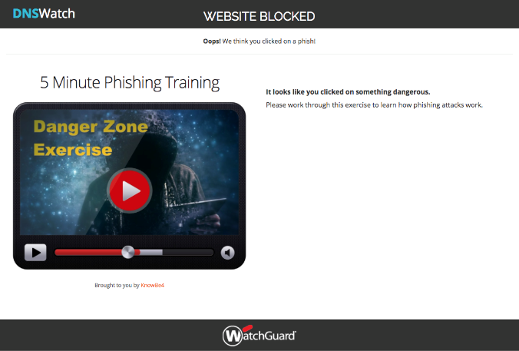
DNSWatch Deny Page
When an HTTP connection is blocked, a customizable deny page appears to the user
The Deny Page includes a short training exercise about how to recognize phishing attacks

Slide 8
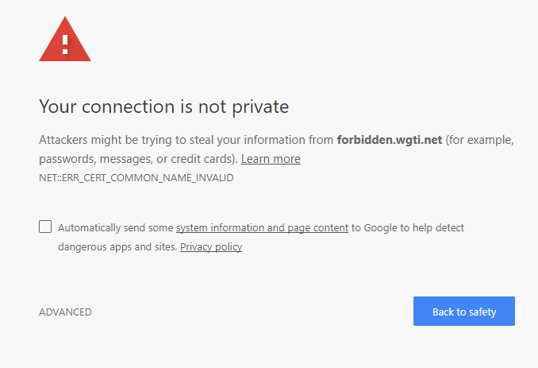
DNSWatch Deny Page
For a denied HTTPS connection, an invalid certificate notice appears first
The Deny Page appears only if the user continues to the site

Slide 9
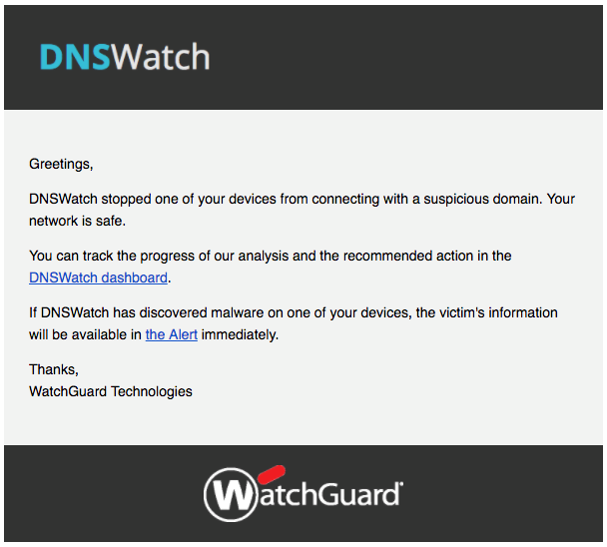
DNSWatch Email Alerts
When DNSWatch denies a connection, DNSWatch sends an email alert to account administrators, with a link to alert details

Slide 10
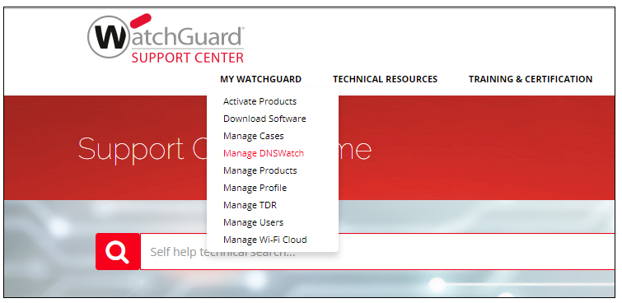
Manage DNSWatch
After you activate DNSWatch for a Firebox in your account, you can connect to DNSWatch in the WatchGuard Portal
In the WatchGuard Support Center, select My WatchGuard > Manage DNSWatch

Slide 11
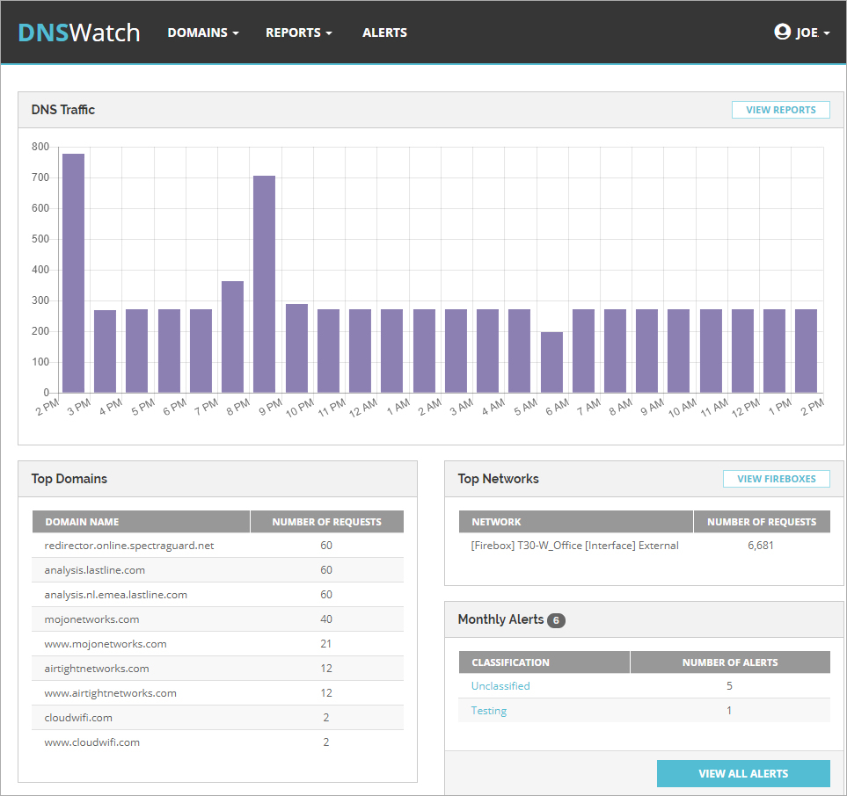
DNSWatch Dashboard
The DNSWatch Dashboard provides:
DNS traffic data
Top domain requests
Top network requests
Monthly alert summary

Slide 12
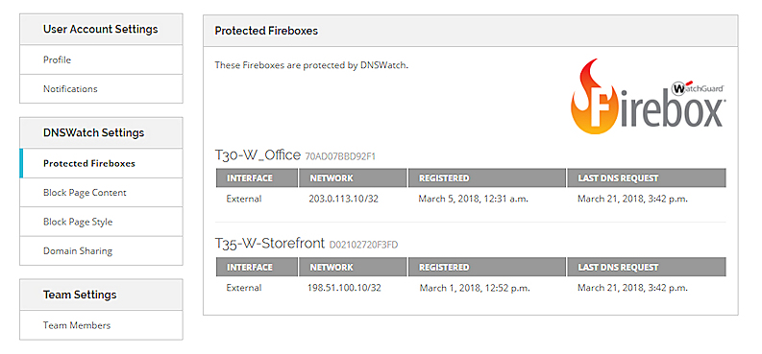
DNSWatch Protected Fireboxes
To see a list of your protected Fireboxes:
Click your user name and select Settings
Select Protected Fireboxes

Slide 13
Learn More
For information about how to get started with DNSWatch and to get more information about the service, see:
Get Started with DNSWatch (download from Centercode)
Introduction to DNSWatch

Slide 14
Dynamic DNS Providers

Slide 15
Dynamic DNS Providers
Fireware now supports multiple dynamic DNS vendors
With more dynamic DNS vendors in the market, WatchGuard can now provide several dynamic DNS options as part of our commitment to consumer choice

Slide 16
Dynamic DNS Providers
Fireware supports these free dynamic DNS providers:
No-IP
Dynu
DNSdynamic
Afraid.org
Duck DNS
Fireware continues to support Dyn, a dynamic DNS provider with tiered pricing
Notes:
From Networking/Interface page add a custom DHCP Option

Slide 17
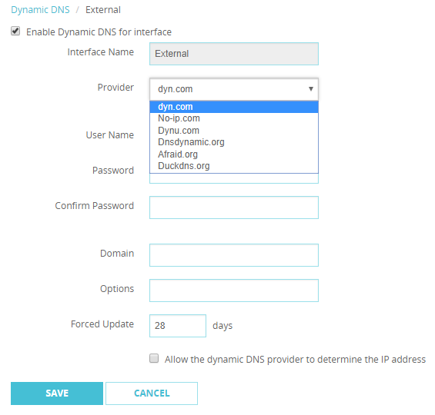
Dynamic DNS Providers
Fireware Web UI

Slide 18
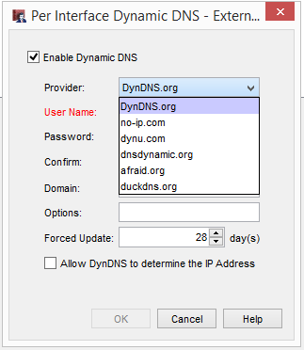
Dynamic DNS Providers
Policy Manager

Slide 19
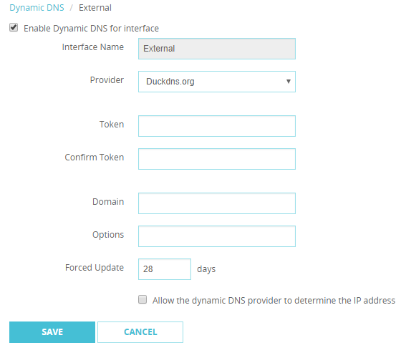
Dynamic DNS Providers
The configuration process for Duck DNS is different from other providers
You must log in to the Duck DNS website with a social network account or Google account
To configure Duck DNS as a provider, you must specify a token for authentication instead of a user name and password

Slide 20
Firebox Wireless Enhancements

Slide 21
Firebox Wireless Enhancements
You can now disconnect wireless clients from a Firebox from the System Status > Wireless Statistics page
When you disable the wireless interfaces on a Firebox, the configuration of your interfaces is now preserved if you enable the wireless interfaces again
You can no longer save a Firebox configuration if the insecure WEP shared key encryption mode is selected for wireless security on an SSID

Slide 22
Networking Enhancements

Slide 23
USB Modem Support
Fireware now supports the Verizon Global Modem USB730L (Vendor ID 0x1410, Product ID 0x9032)

Slide 24
Hot Plug Modem Support
You can now hot plug USB modems into the Firebox
The modem operates and does not require you to reboot the Firebox when:
You plug in a new modem
You unplug a modem and plug it in again
The modem unexpectedly disconnects and reconnects to the Firebox
If you unplug a modem and plug in a new modem that is a different model, you must update the modem configuration settings on the Firebox; you do not have to reboot the Firebox

Slide 25
Hot Plug Modem Support
You can hot plug modems into the Firebox up to 10 times before you must reboot the Firebox
For example, when you hot plug a modem into the Firebox for the eleventh time, you must reboot the Firebox before the modem will operate

Slide 26
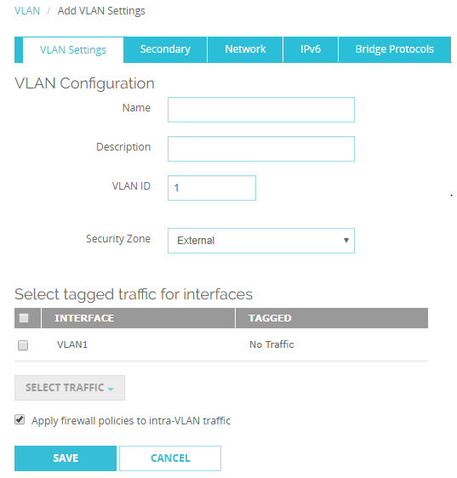
VLAN Traffic Settings
When you create an external VLAN interface, the Apply firewall policies to intra-VLAN traffic option is now enabled by default

Slide 27
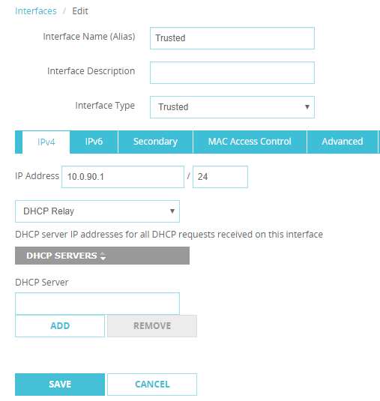
DHCP Relay Server
When you enable DHCP Relay on an interface, the DHCP relay servers you specify now apply only to that interface

Slide 28
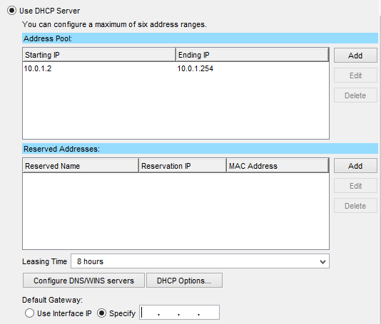
DHCP Server Gateway
For a Firebox interface configured as a DHCP server, you can now specify a default gateway IP address that is not the Firebox interface IP address
This is useful in complex environments with multiple gateways
Typical example — Voice over IP (VoIP) where phones use their own gateway on the network for VoIP service

Slide 29
BOVPN over TLS Support

Slide 30
BOVPN over TLS Benefits
BOVPN over TLS is a recent addition and offers an alternative to IPsec BOVPNs
This feature was first supported in Fireware Web UI in Fireware v12.1
Fireware v12.1.1 adds BOVPN over TLS support to WatchGuard System Manager (WSM) and Policy Manager; this feature is now supported across all WatchGuard user interfaces

Slide 31
BOVPN over TLS Support for WSM and PM
BOVPN over TLS allows you to enable a TLS tunnel between Fireboxes, and is an alternative BOVPN solution when your network does not support IPSec traffic
Server mode and Client mode are supported

Slide 32
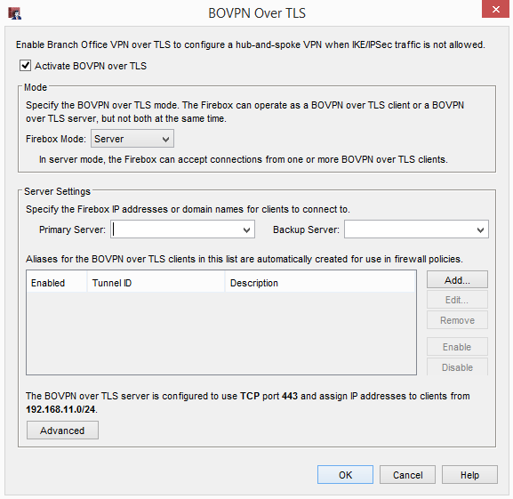
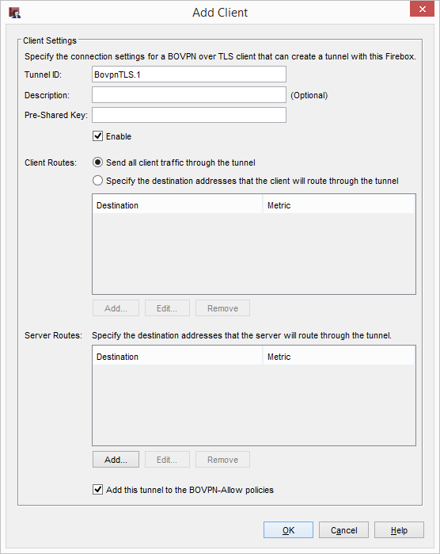
BOVPN over TLS Support for WSM and PM
Server mode in Policy Manager

Slide 33
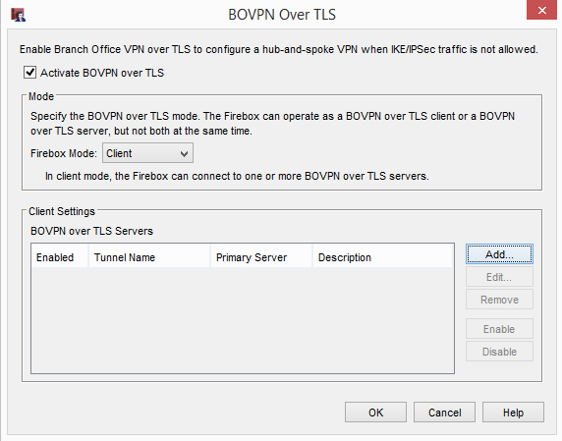
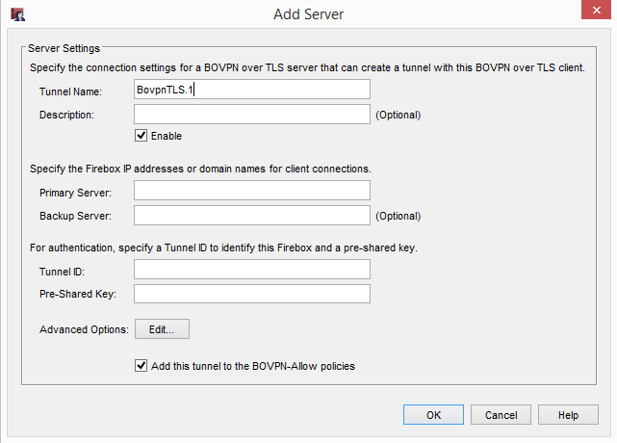
BOVPN over TLS Support for WSM and PM
Client mode in Policy Manager

Slide 34
HTTPS & TLS Profiles

Slide 35
HTTPS & TLS Profiles
WatchGuard continues to innovate our content inspection features to assist users in secure policy configuration
TLS profiles contain the settings used for content inspection by proxy actions
You can use the same TLS profile for multiple policies
TLS profiles make it easier to configure and apply consistent settings for content inspection across multiple proxies

Slide 36
HTTPS & TLS Profiles
Fireware v12.1 supported TLS profiles in the IMAP proxy
Fireware v12.1.1 adds TLS profiles in the HTTPS proxy
The content inspection settings have been moved from the HTTPS proxy actions to two new TLS profiles
TLS-Client-HTTPS.Standard — Settings used by an HTTPS client proxy action
TLS-Server-HTTPS.Standard — Settings used by the HTTPS server proxy action

Slide 37
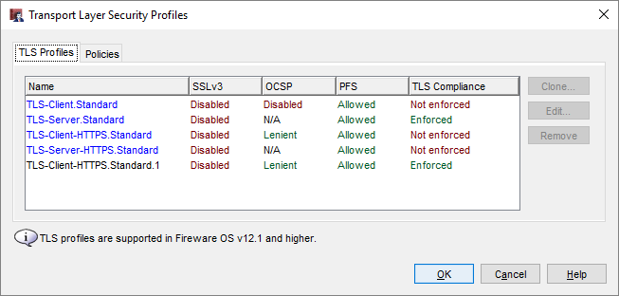
HTTPS & TLS Profiles
You now configure content inspection settings in a TLS profile
In Policy Manager, select Setup > Actions > TLS Profiles
The TLS Profiles tab now has two predefined profiles for HTTPS proxies:
TLS-Client-HTTPS.Standard
TLS-Server-HTTPS.Standard

Slide 38
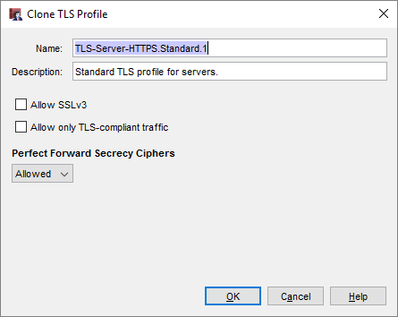
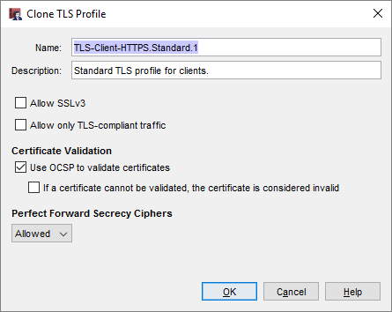
HTTPS & TLS Profiles
The predefined HTTPS TLS profiles have different settings
Only the TLS-Client-HTTPS profile has OCSP settings for certificate validation
To create a custom TLS profile, clone a predefined TLS profile

Slide 39
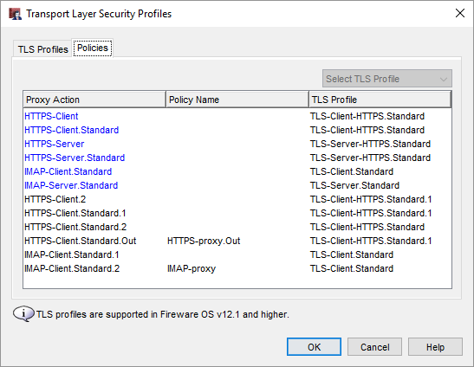
HTTPS & TLS Profiles
On the Policies tab, you can assign a TLS profile to a proxy action

Slide 40
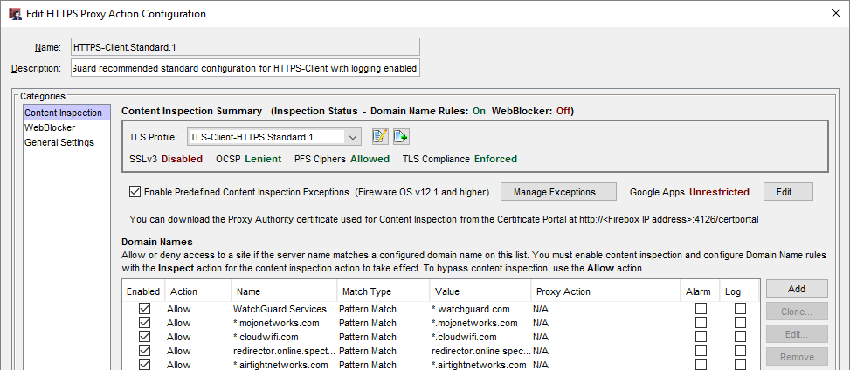
HTTPS & TLS Profiles
In the Content Inspection settings in the HTTPS proxy action, you select the TLS profile
The settings for the selected TLS profile appear below the TLS Profile drop-down list

Slide 41
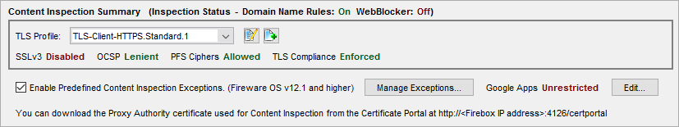
HTTPS & TLS Profiles
The HTTPS proxy action no longer includes the Enable content inspection check box
To enable content inspection, select the Inspect action in the Domain Names or the WebBlocker settings in the proxy action
The Inspection Status shows whether the Inspect action is configured in the Domain Names or WebBlocker proxy action settings

Slide 42
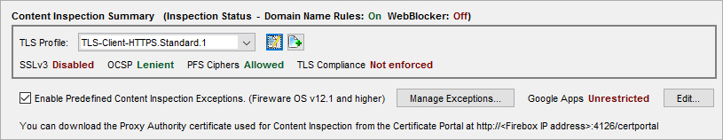
HTTPS & TLS Profiles
With Fireware v12.1.1, you can enable content inspection and not enforce TLS compliance
This can enable some applications (such as Skype) to function when content inspection is enabled
SSL Compliance is now called TLS Compliance
There is no change in functionality, just a more accurate name

Slide 43
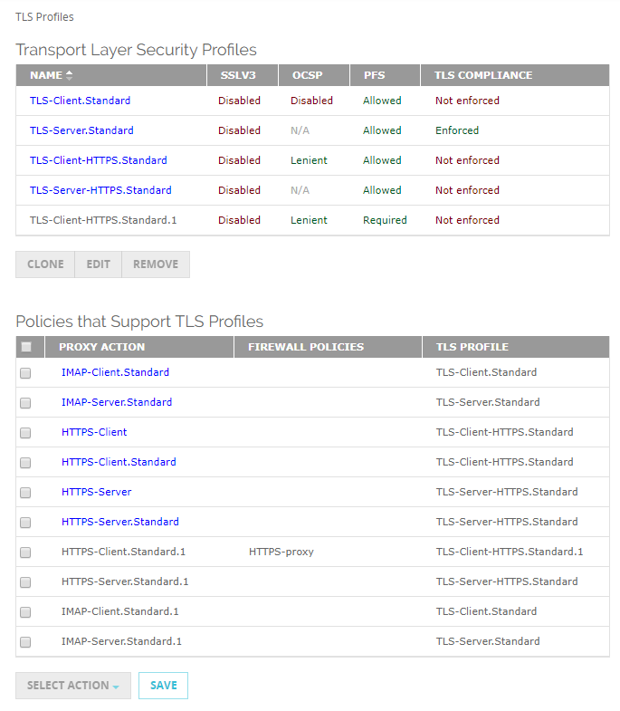
HTTPS & TLS Profiles
To configure TLS profiles from Fireware Web UI, select Firewall > TLS Profiles

Slide 44
HTTPS & TLS Profiles
When you upgrade a Firebox to Fireware v12.1.1, HTTPS proxy actions are automatically updated
For any HTTPS proxy actions with content inspection enabled, the content inspection settings are moved to a new TLS profile
The HTTPS proxy action uses the new TLS profile

Slide 45
HTTPS & TLS Profiles
If you use Policy Manager v12.1.1 to manage a Firebox that runs a lower version of Fireware:
You configure the content inspection settings in a TLS profile
When you save the configuration to the Firebox, the configuration is automatically changed to be compatible with the lower Fireware version
If you open the older configuration in Fireware Web UI, the content inspection settings are still configured in the proxy action
For a v12.1.1 Device Configuration Template, if you apply the template to a Firebox that runs a lower version of Fireware, the default TLS Profile setting for that version of Fireware is applied to the Firebox

Slide 46
Thank You!

