Slide 1
What’s New in Fireware v12.0.2

Slide 2
What’s New in Fireware v12.0.2
Wireless Firebox Enhancements
KRACK WPA/WPA2 client vulnerability mitigation

Slide 3
Fireware Wireless Enhancements

Slide 4
KRACK WPA/WPA2 Vulnerability Mitigation
Access point WPA/WPA2 key reinstallation vulnerabilities were addressed in Fireware v12.0.1 for wireless XTM devices and wireless Fireboxes:
XTM 25-W, 26-W, 33W
Firebox T10-W, T15-W, T30-W, T35-W, T50-W, T55-W
Client vulnerabilities must be addressed on each client
Until all clients are patched, you can mitigate client WPA/WPA2 vulnerabilities with wireless Fireboxes
Client mitigation blocks handshake messages that can potentially exploit clients and forces clients to reauthenticate

Slide 5
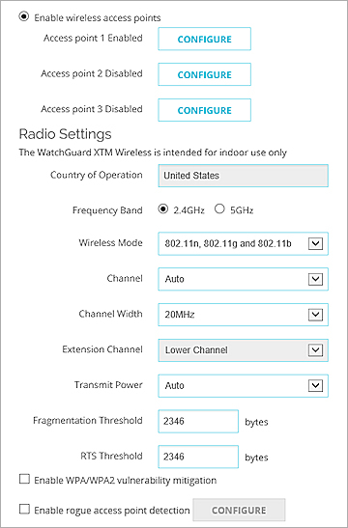
KRACK WPA/WPA2 Vulnerability Mitigation
Configured in Network > Wireless
Disabled by default
The mitigation logic can trigger for similar dropped packet symptoms, for example, natural frame errors during a handshake, or dropped packets when a client roams
Can result in some client connections to fail and be reestablished
We recommend that you enable this option until all clients are patched

Slide 6
Thank You!

