Slide 1
What’s New in Fireware v12.0.1

Slide 2
What’s New in Fireware v12.0.1
Security Services Enhancements
  Gateway AntiVirus checkbox added to Proxy Action settings
  Gateway AntiVirus scan size limit set automatically
  Action for when scan size limit is exceeded
  Action for encrypted files
  Gateway AntiVirus file decompression is enabled by default
  Subscription Service menus in alphabetical order

Slide 3
What’s New in Fireware v12.0.1
Technology Integration Enhancements
  Autotask Integration
  ConnectWise Integration
    Use a new or existing ConnectWise configuration
    Service board selection for Firebox tickets
    Ability to edit configuration questions
Policy Enhancements
  YouTube for Schools removed

Slide 4
What’s New in Fireware v12.0.1
Wireless Enhancements
  KRACK WPA/WPA2 vulnerability mitigation
  TKIP Option Removed for WPA2
Other Enhancements
  Support access for remote login
  Quick Setup Wizard default stance settings updated
  Enable configuration for a specific Fireware version in Policy Manager

Slide 5
Security Services Enhancements

Slide 6
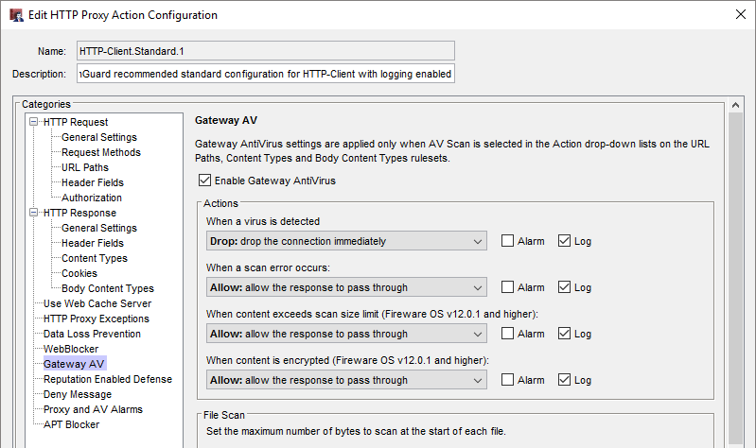
Enable Gateway AV Check Box Added
Enable Gateway AntiVirus check box added to the Gateway AV settings in a proxy action

Slide 7
Added Gateway AV Enable Checkbox
The Enable Gateway AntiVirus check box automatically enables or disables the AV Scan action in the proxy action
  When you select the Enable Gateway AntiVirus check box, actions previously set to Allow are changed to AV Scan
  When you clear the Enable Gateway AntiVirus check box, actions previously set to AV Scan are changed to Allow
This new check box has the same effect as enabling or disabling Gateway AntiVirus for a proxy policy in the Subscription Services > Gateway AntiVirus settings

Slide 8
Gateway AV Scan Size Limits
The Gateway AV default and maximum scan size limits are set based on the hardware capabilities of each Firebox model
Minimum scan size for all models is 1 MB
Default Scan Size Limit | Maximum Scan Size Limit | Model
1 MB | 5 MB | Firebox T10, XTM 25, XTM 26
2 MB | 10 MB | Firebox T30, XTM 33, XTM 330, Firebox Cloud Small, FireboxV Small, XTMv Small
5 MB | 20 MB | Firebox T50, T70, M200, XTM 515, XTM 525, XTM 535, XTM 810, XTM 820, XTM 830, XTM 830-F, Firebox Cloud Medium, FireboxV Medium, XTMv Medium
10 MB | 20 MB | All other models

Slide 9
Gateway AV Action for Scan Limit Exceeded
Configure the action to take when content exceeds the Gateway AntiVirus scan size limit
Actions when content exceeds the scan limit:
  Allow
  Drop
  Block
Notification options:
  Alarm
  Log (default)

Slide 10
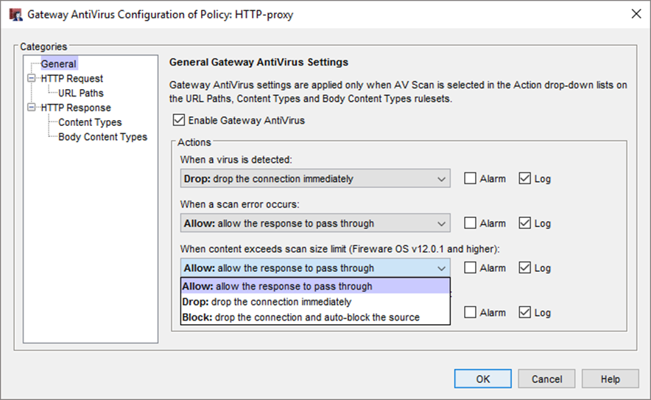
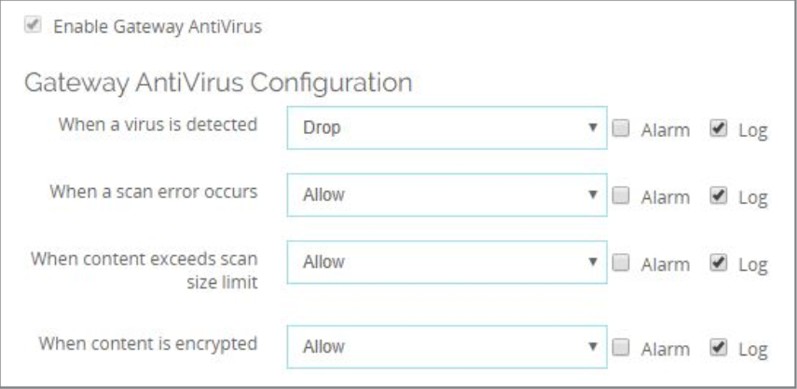
Gateway AV Action for Scan Limit Exceeded

Slide 11
Gateway AV Action for Encrypted Content
Configure the action to take when Gateway AntiVirus cannot scan a file because it is encrypted (password protected)
  Encrypted files were previously handled by the scan error action
  Scan failures for encrypted files can now be differentiated from other scan errors
Actions when content is encrypted:
  Allow
  Drop
  Block
Notification options:
  Alarm
  Log (default)

Slide 12
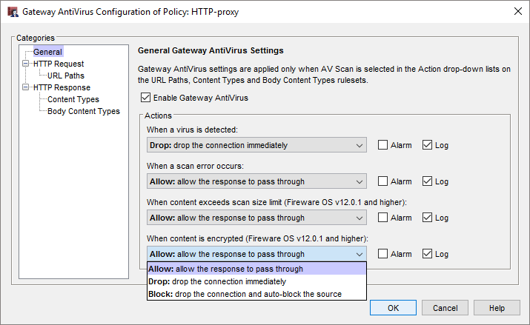
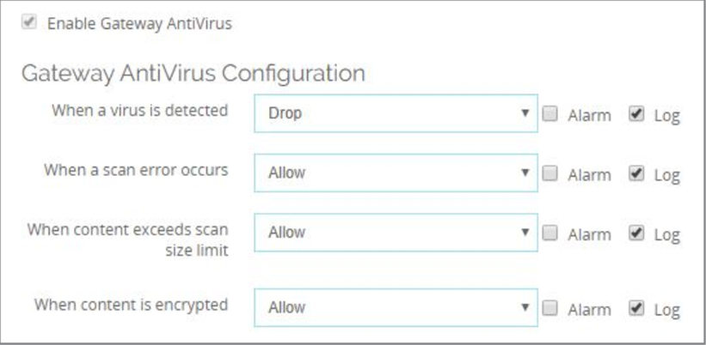

Added Encrypted Content Options

Slide 13
Gateway AV Decompression Enabled
Gateway AntiVirus file decompression is always enabled in Fireware OS v12.0.1 or higher
The scan depth depends on the amount of RAM
  Firebox models with less then 2GB RAM use scan depth 8
  Firebox models with 2GB or greater use scan depth 16
RAM | Decompression
Less than 2GB | Scan depth 8
2GB or greater | Scan depth 16

Slide 14
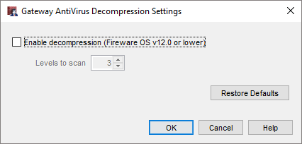
Gateway AV Decompression Enabled
In Policy Manager, the Gateway AntiVirus Decompression Settings are retained for Fireware OS v12.0.0 or lower

Slide 15
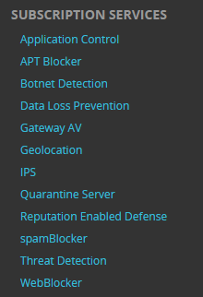
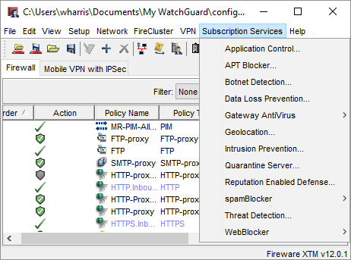
Subscription Service Menu
The Subscription Services menu in the Web UI and WatchGuard System Manager now shows the services in alphabetical order

Slide 16
Technology Integration Enhancements

Slide 17
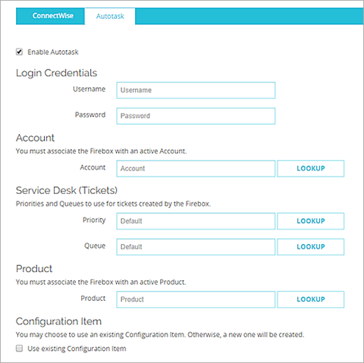
Autotask Integration
Support for Autotask integration
Similar to the current ConnectWise integration
In the Web UI in
System > Technology Integrations
In Policy Manager, in Setup > Technology Integrations

Slide 18
Autotask Integration
To connect the Firebox to Autotask, you must specify:
  An Autotask user name and password
    Autotask does not use API keys
  The name of an active Autotask account
  A Product type
You can select a default Priority and Queue for tickets created by Firebox events

Slide 19
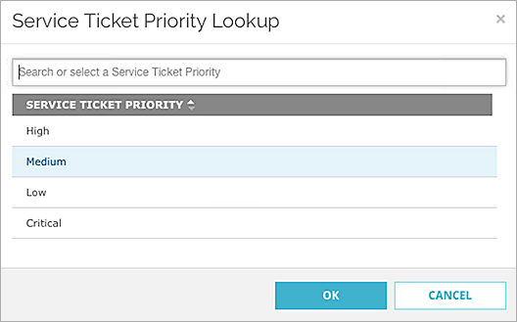
Autotask Integration
When you click Lookup for the Priority, Queue, and Product, default Autotask values appear
On the Autotask website, you can add custom Priority levels, Queues, and Product types that appear on the Firebox when you click Lookup

Slide 20
Autotask Integration
After you save the configuration, Autotask automatically creates an object for the Firebox known as a Configuration Item
Configuration Items are:
  Assets that you manage in Autotask
  Grouped by product type in Autotask

Slide 21
Autotask Integration
In Autotask, if you edit the monitors for configuration items, you must use the same syntax as existing monitors
For example, if you edit the WG: Monitor CPU Usage monitor, the syntax must be > xx% over xx minutes
  > 50% over 30 minutes is valid
  50 percent > 30 mins is invalid
If you create a monitor with invalid syntax, the Autotask UI does not alert you, but error messages appear in the Firebox log messages

Slide 22
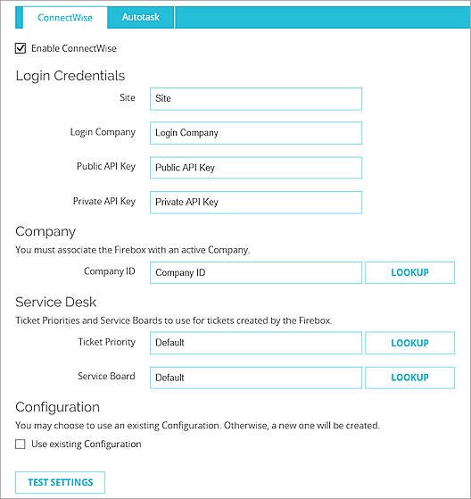
ConnectWise Configuration
When you enable ConnectWise integration on a Firebox, you can now use a ConnectWise configuration that has already been set up for the Firebox (based on Firebox serial number)
If you do not select to use an existing configuration, a new configuration is created in ConnectWise

Slide 23
ConnectWise Service Board
You can now specify the Service Board where new Firebox tickets are created in ConnectWise
Click Lookup to choose from a list of Service Boards in ConnectWise
You can edit the Service Board selections in ConnectWise

Slide 24
Edit ConnectWise Configuration Questions
In ConnectWise, you can now edit Firebox configuration question answers
You must use the same syntax as existing configuration question answers
  For example, for the monitor-based configuration questions such as CPU Usage, the syntax must be > xx% over xx minutes
    > 70% over 30 minutes is valid
    70 percent > 30 mins is invalid

Slide 25
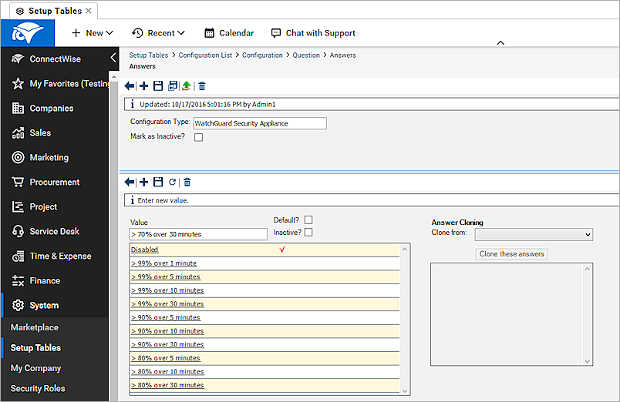
Edit ConnectWise Configuration Questions

Slide 26
Technology Integrations and Config Report
The Firebox Configuration Report now includes information on Technology Integrations (ConnectWise and Autotask)

Slide 27
Policy Enhancements

Slide 28
YouTube for Schools Removed
Google has discontinued the YouTube for Schools service
The YouTube for Schools option is removed from the HTTP proxy action General Settings

Slide 29
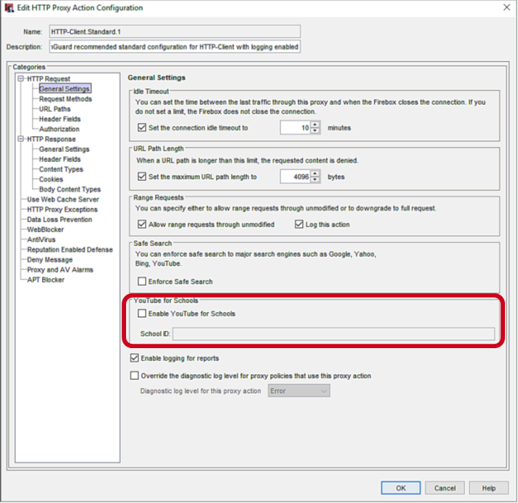
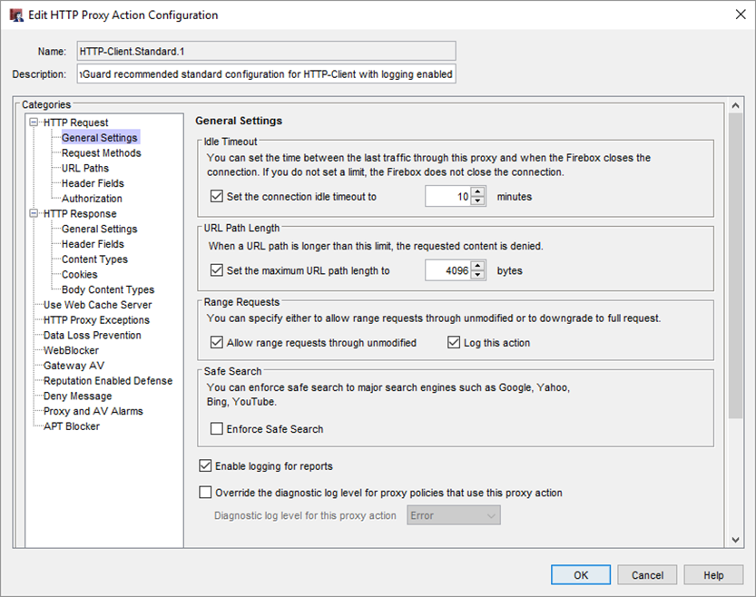
YouTube for Schools Removed
v12.0
v12.0.1

Slide 30
Wireless Enhancements

Slide 31
KRACK WPA/WPA2 Vulnerability Mitigation
WPA/WPA2 key reinstallation vulnerabilities
  Addressed in XTM and Firebox Wireless devices:
    XTM 25-W, 26-W, 33W
    Firebox T10-W, T15-W, T30-W, T35-W, T50-W, T55-W
  Addressed in AP firmware:
    AP120, AP320, AP322, AP420: 8.3.0-657
    AP100, AP102, AP200: 1.2.9.14
    AP300: 2.0.0.9
  Client vulnerabilities must be addressed on each client

Slide 32
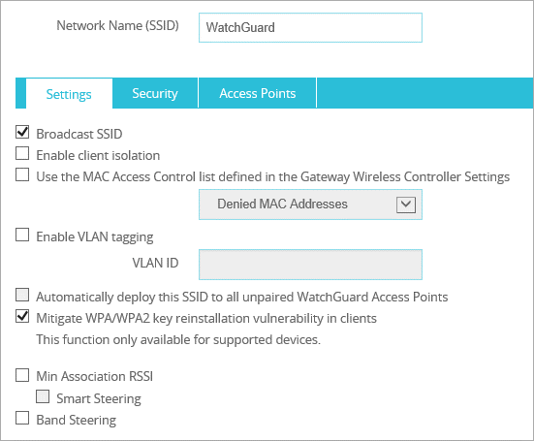
KRACK WPA/WPA2 Vulnerability Mitigation
Mitigate client WPA/WPA2 key reinstallation vulnerabilities with the Gateway Wireless Controller
Blocks handshake messages that can potentially exploit clients and forces clients to reauthenticate
Configured for each SSID
AP120, AP320, AP322, AP420 support only

Slide 33
Gateway Wireless Controller Enhancements
You now cannot select the deprecated and insecure TKIP option for the WPA2 only wireless security mode
  Only AES is supported with WPA2
  You can still select TKIP for WPA/WPA2 mixed mode for legacy support
Fast Roaming is now disabled and not supported on AP300 for WPA/WPA2 vulnerability prevention
The list of available channels in the Preferred Channel list only shows channels available to you in your region for your selected Frequency Band and Channel Mode

Slide 34
Other Enhancements

Slide 35
Support Access for Remote Login
The Enable Support Access checkbox and options to define credentials and expiration have been added
This option enables WatchGuard support to connect to the Firebox with read-only permission
It adds a temporary hidden policy that allows connections to the Firebox from ts.watchguard.com
It adds a temporary user account with read-only permissions
  You can automatically generate credentials, or specify a user name and password
  You can define the expiration for the temporary account
  Options for support access account expiration:
  None, 3 months, 1 month, 1 week, and 1 day

Slide 36
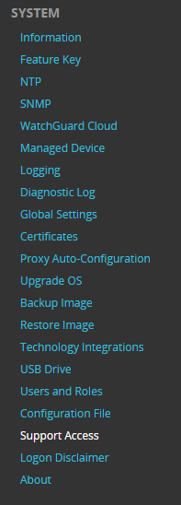
Support Access for Remote Login

Slide 37
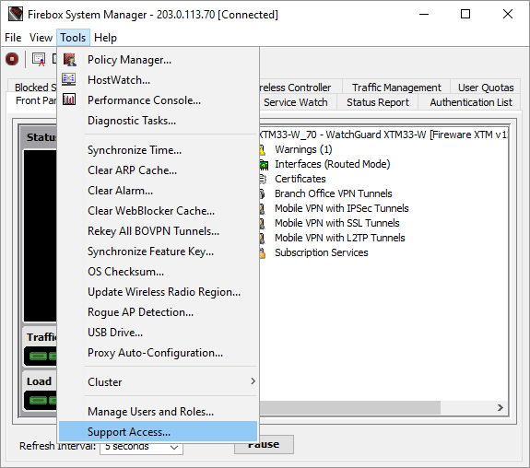
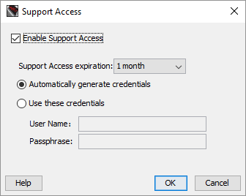
Support Access for Remote Login

Slide 38
Setup Wizard Default Settings
The default settings configured by the Web Setup Wizard and Quick Setup Wizard have been updated for improved security and usability
  If Gateway AntiVirus is licensed, in the Default-HTTP-Client proxy action, the action for the Windows EXE/DLL Body Content Rule is set to AV Scan instead of Deny
  In the APT Blocker configuration, the action for High level threats is set to Drop instead of Block regardless of whether APT Blocker is enabled
  In the Intrusion Prevention configuration, the action for Low level threats is set to Drop instead of Allow, regardless of whether IPS is enabled

Slide 39
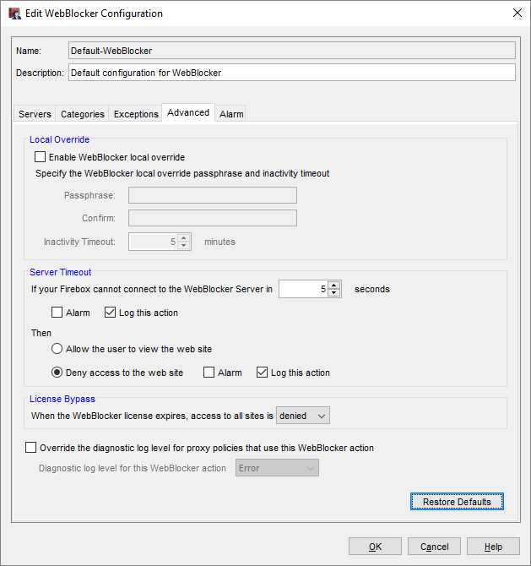
Setup Wizard Default Settings
Changes in the Default-WebBlocker action:
  Server Timeout
  denies access if the Firebox cannot connect to the WebBlocker Server
  License Bypass denies access when the WebBlocker license expires
To restore these default settings, click Restore Defaults

Slide 40
Policy Manager — Save As Version
You can now use Policy Manager to save a configuration file for a specific version of Fireware
  This makes it easier to create configuration files for RapidDeploy
  The version you specify must be in the range of versions in the configured OS Compatibility setting
    This is to make sure that the configuration settings are compatible with the selected Fireware version
To see or change the OS Compatibility setting, from Policy Manager select Setup > OS Compatibility

Slide 41
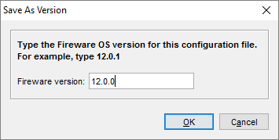
Policy Manager — Save As Version
To save a configuration file for a specific Fireware version, from Policy Manager:
  Select File > Save > As Version
  Type the Fireware Version
  Specify the file name and location
If any feature in the configuration is not compatible with the version you specify, an error message appears with information about what you must change before you can save the configuration as the specified version

Slide 42
Policy Manager — Save As Version
To create a configuration file that you can use for RapidDeploy for a new Firebox, save the configuration file as the version of Fireware the Firebox was manufactured with
You can find the Manufactured with version on the Product Details page in the WatchGuard portal
To upload the saved configuration file, click
Set up RapidDeploy

Slide 43
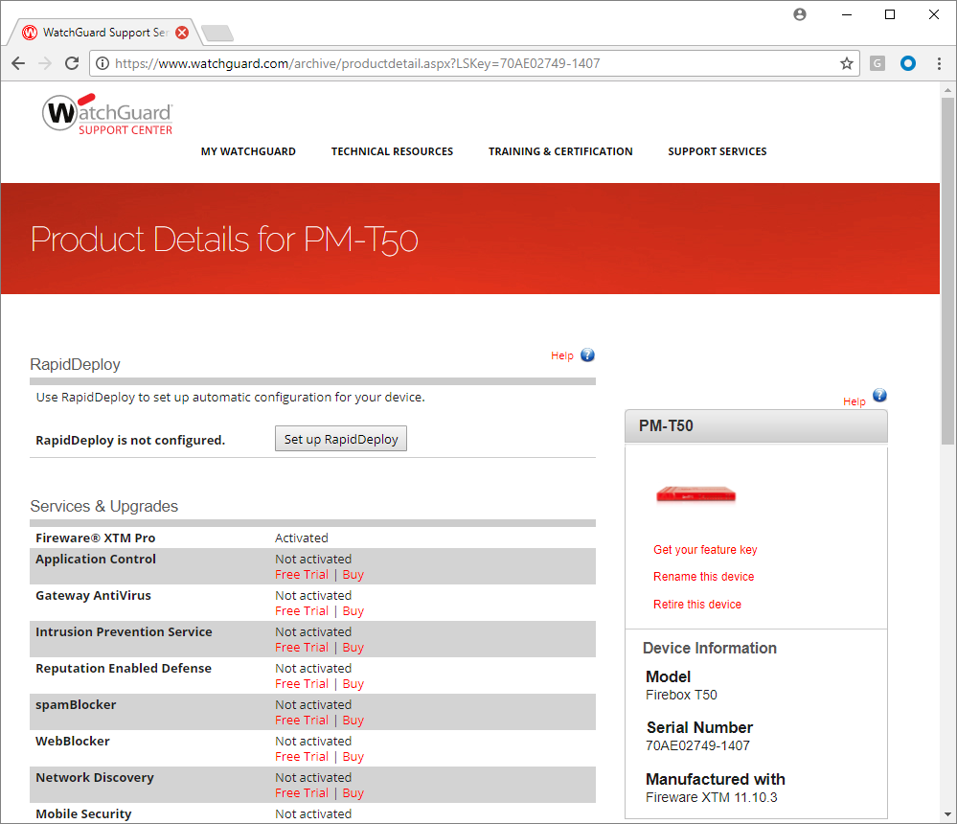
Policy Manager — Save As Version

Slide 44
Import and Export Alias Members

Slide 45
Import and Export Alias Members
In Fireware Web UI, you can now import or export a list that contains these alias member types:
  IPv4
  (hosts, networks, ranges, and wildcard IP addresses)
  IPv6
  (hosts, networks, ranges, and wildcard IP addresses)
  FQDN
  alias
  fw-user
  sslvpn-user
  fw-group
  sslvpn-group
  device
This enhancement will be available in Policy Manager in Fireware v12.1

Slide 46
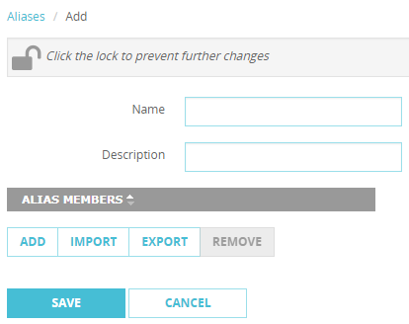
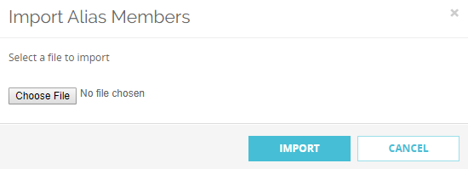
Import and Export Alias Members
To import a list of alias members, from the Add alias page, click Import and select the file with the list of alias members

Slide 47
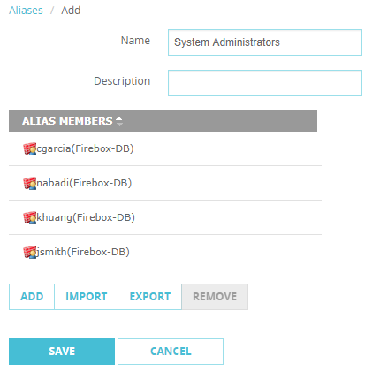
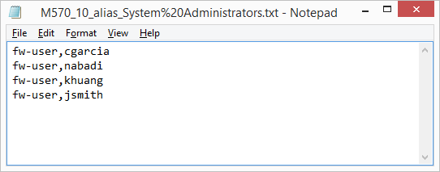
Import and Export Alias Members
To export a list of alias members, from the Add alias page, click Export

Slide 48
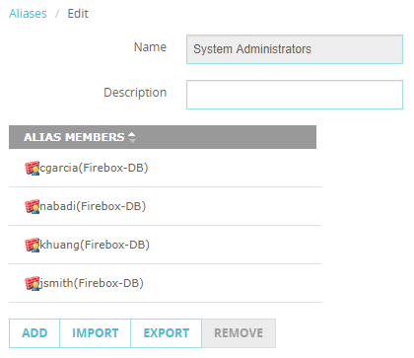
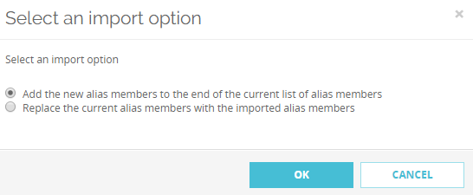
Import and Export Alias Members
If you select to edit an Alias and click Import, you must select whether to add to or replace the list of alias members

Slide 49
Thank You!

