Slide 1
Introduction to WatchGuard EDR Core
Release Date – 23 February 2023

Slide 2
WatchGuard EDR Core
Overview
Get Started
WatchGuard EDR Core in WatchGuard Cloud
Upgrade TDR Host Sensors to Endpoint Security
WatchGuard EDR Core Management UI

Slide 3
Overview

Slide 4
EDR Core in Total Security Suite
EDR Core is a solution included in the Firebox Total Security Suite license and a replacement for the TDR Host Sensor
Includes EDR features and adds XDR capabilities through ThreatSync
Useful for organizations that are protected by next generation antivirus solutions or EDR solutions with minimal advanced capabilities
EDR Core detects and responds to ransomware and many types of unknown malware, as well as fileless and malwareless attacks
Blocks advanced malware that traditional solutions cannot detect
Includes anti-tampering and anti-exploit protection, as well as contextual detections, decoy files, and VPN validation
Supported client operating systems: Windows XP/Server 2003 and higher (Intel and ARM), Linux, macOS Catalina 10.15 and higher (Intel and ARM)

Slide 5
Basic Features
These EDR features are available with EDR Core:
Anti-tampering protection
Visibility into the hardware and software on an endpoint
Remote restart and reinstallation of the endpoint agent and protection software on the endpoint
Isolation of an endpoint
Discovery of unprotected endpoints
Tracking of user actions in the Endpoint Security management UI
You can create security settings profiles in EDR Core that are similar to the profiles you create in WatchGuard EDR

Slide 6
Security Features
These security features are available with EDR Core:
Contextual detections, including HRP detections
Decoy files
Collective intelligence look-up and APT Blocker (programs that run are sent to the cloud and executed in a sandbox to detect unknown threats)
Anti-exploit protection
The Zero-Trust Application Service is not available in EDR Core (Advanced protection mode is not visible)
Blocking (EDR Core does not support disinfection)
VPN enforcement

Slide 7
EDR Core vs Endpoint Security
To take advantage of the Zero-Trust Application Service, endpoint security modules such as Full Encryption and Patch Management and other features listed in this table, we strongly recommend that you upgrade EDR Core to WatchGuard EPDR
 | EDR Core | EDR | EPDR
VPN enforcement | ✓ | ✓ | ✓
Cross-product detections (ThreatSync) | ✓ | ✓ | ✓
Response actions: Quarantine, kill and isolate (ThreatSync) | ✓ | ✓ | ✓
Contextual detections (fileless malware) | ✓ | ✓ | ✓
Anti-exploit | ✓ | ✓ | ✓
Threat Hunting Service and IOA | Partial | ✓ | ✓
Disinfection after blocked attack | X | ✓ | ✓
Detect malware when files are copied or downloaded | X | ✓ | ✓
Zero-Trust Application Service | X | ✓ | ✓
Shadow copies | X | ✓ | ✓
Device control | X | X | ✓
Firewall including IDS, application rules, and systems rules | X | X | ✓
URL filtering | X | X | ✓
Anti-phishing | X | X | ✓
Web protection | X | X | ✓
Mobile protection (Android and iOS) | X | X | ✓
Optional modules (Patch Management, Full Encryption, ART) | X | ✓ | ✓

Slide 8
Get Started

Slide 9
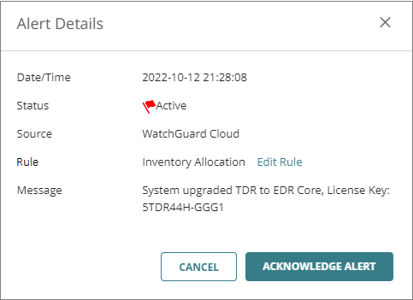
Get Started with EDR Core
To get started with EDR Core, make sure you have an active Total Security Suite license for your Firebox or TDR Host Sensor licenses and a WatchGuard Cloud account
In preparation for the General Availability release of ThreatSync, accounts with TDR Host Sensor licenses in WatchGuard Cloud were duplicated with EDR Core licenses
You might see that the upgrade process automatically generated alerts and audit log entries in WatchGuard Cloud

Slide 10
Get Started with EDR Core
To get started with WatchGuard EDR Core, complete these high-level steps:
Activate a Total Security Suite License
Allocate Endpoints
Configure Pre-Deployment Settings
Deploy the Endpoint Agent
For more information, see Quick Start — Set Up WatchGuard EDR Core in WatchGuard Help Center

Slide 11
EDR Core in WatchGuard Cloud

Slide 12
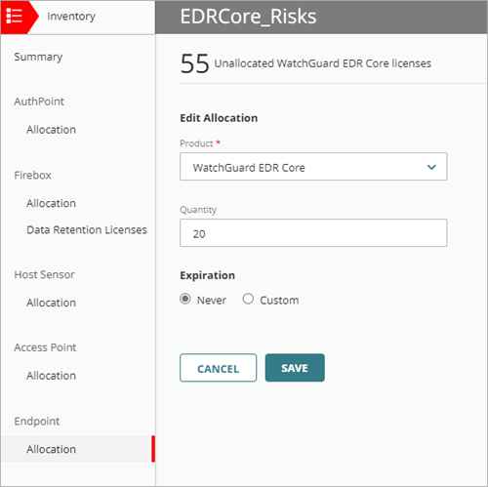
Allocation in WatchGuard Cloud
When Service Providers activate a Total Security Suite license or if they already had TSS or TDR Host Sensor licenses activated, the EDR Core license and the number of available endpoints appear in the Inventory page in WatchGuard Cloud
As a Service Provider, you can allocate endpoints to your own account or any account you manage
Endpoint security modules are not available with WatchGuard EDR Core

Slide 13
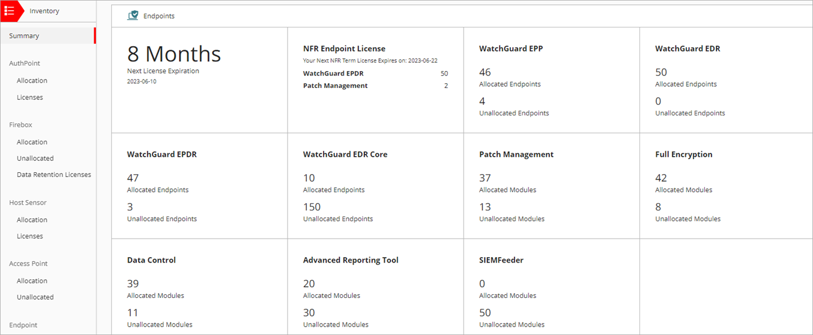
Allocation Summary Page
When you select Overview for a Service Provider account from Account Manager, the Summary page shows an overview of the licenses and endpoints in your inventory, including WatchGuard EDR Core

Slide 14
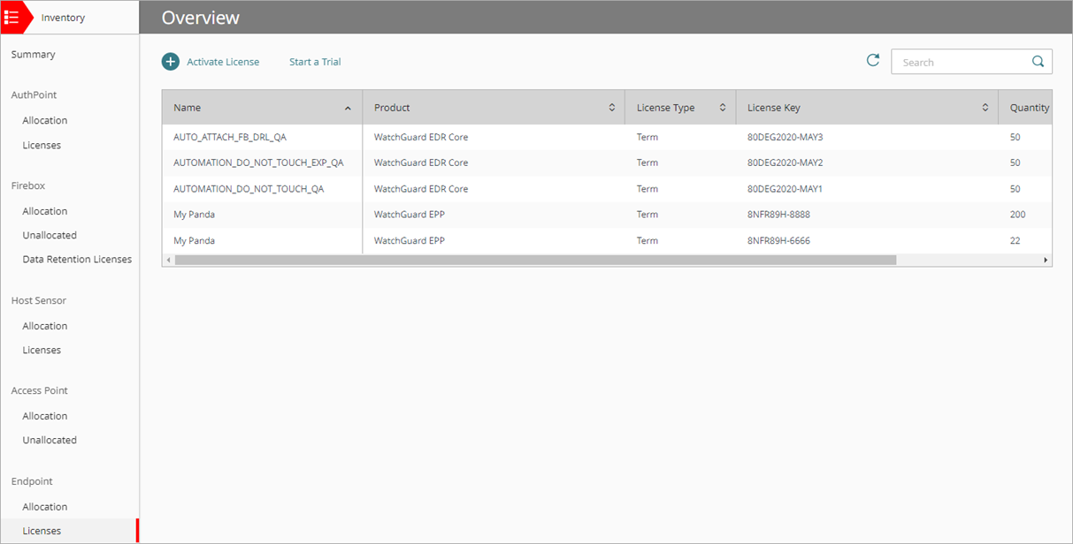
Licenses Page
The Licenses page shows the endpoint security products and modules you have licenses for, the type of license (for example, subscription, term, or trial), license key, quantity, and expiration date

Slide 15
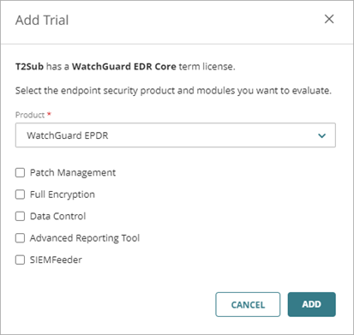
WatchGuard Cloud Trials
With a WatchGuard EDR Core license, you can start a trial for WatchGuard EPDR, EDR, or EPP

Slide 16
Upgrade Path
You can upgrade a WatchGuard EDR Core license to WatchGuard EPDR
If the upgraded license expires, the WatchGuard EDR Core license becomes active
If the Total Security Suite license expires on the Firebox, then EDR Core protection is disabled on the affected devices
There is a seven-day grace period during which devices remain protected
After the grace period, devices with an expired license are unprotected, with no antivirus or advanced protection
For more information, see About Endpoint Security Licenses in WatchGuard Help Center

Slide 17
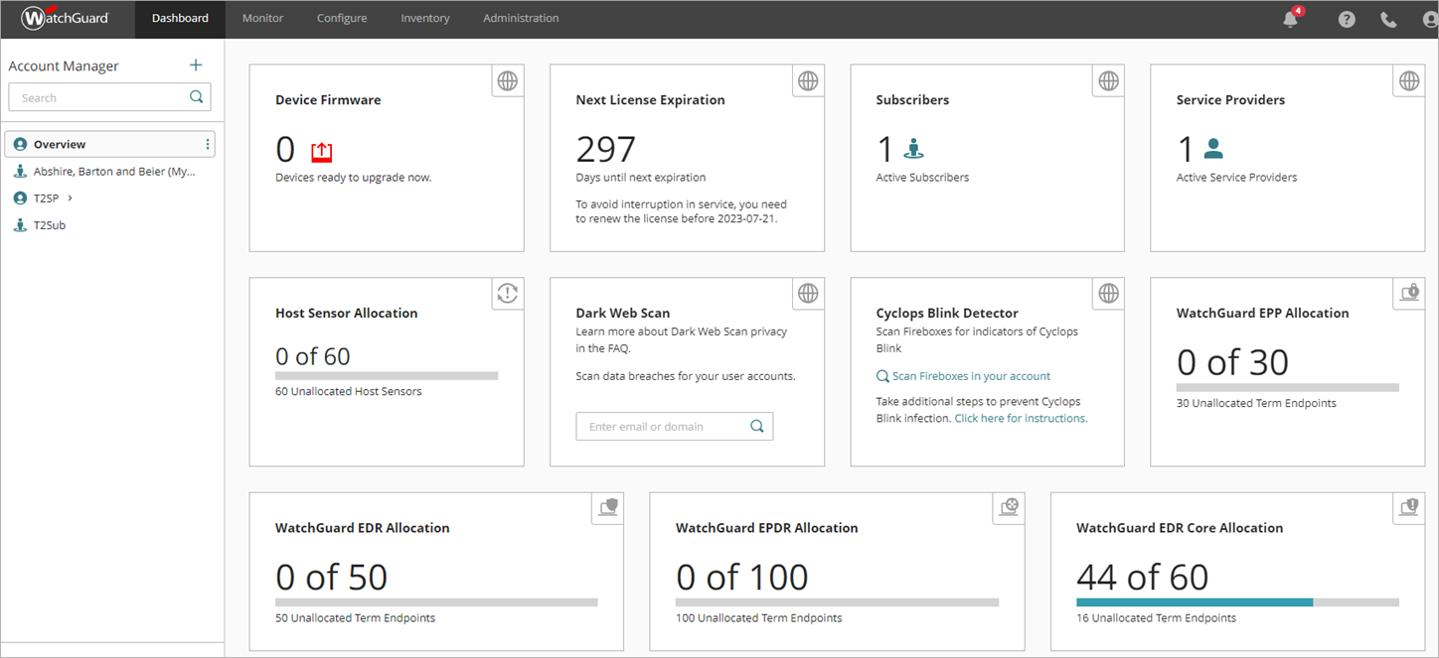
WatchGuard Cloud Dashboards
Dashboards show information on WatchGuard EDR Core license allocation and expiration, and protection status

Slide 18
Upgrade TDR to Endpoint Security

Slide 19
Upgrade TDR to Endpoint Security
TDR users can upgrade their Host Sensors to EDR Core or another endpoint security product from WatchGuard Cloud without the need to reinstall
EDR Core can coexist with third-party endpoint solutions
Endpoints with EDR Core installed send data to ThreatSync to support XDR capabilities
The upgrade process automatically installs the WatchGuard Endpoint Agent
If you have WatchGuard Endpoint Security allocated to the account, but not installed on computers where the Host Sensor is installed, the upgrade process automatically installs the WatchGuard Endpoint Agent and the WatchGuard Endpoint Security protection software on those computers

Slide 20
Upgrade to Endpoint Security — Before You Begin
Before you upgrade, make sure that your WatchGuard Endpoint Security license has enough endpoints to replace the Host Sensors
Make sure that the WatchGuard Endpoint Agent can access the required URLs and ports
For more information, see this Knowledge Base article: URLs used by Panda and WatchGuard Endpoint Security products
This upgrade process is available for Windows endpoints only
For Linux and macOS endpoints, you must manually uninstall the TDR Host Sensor and then install WatchGuard Endpoint Security
For more information, see this Knowledge Base article: Host Sensor upgrade to Endpoint Security

Slide 21
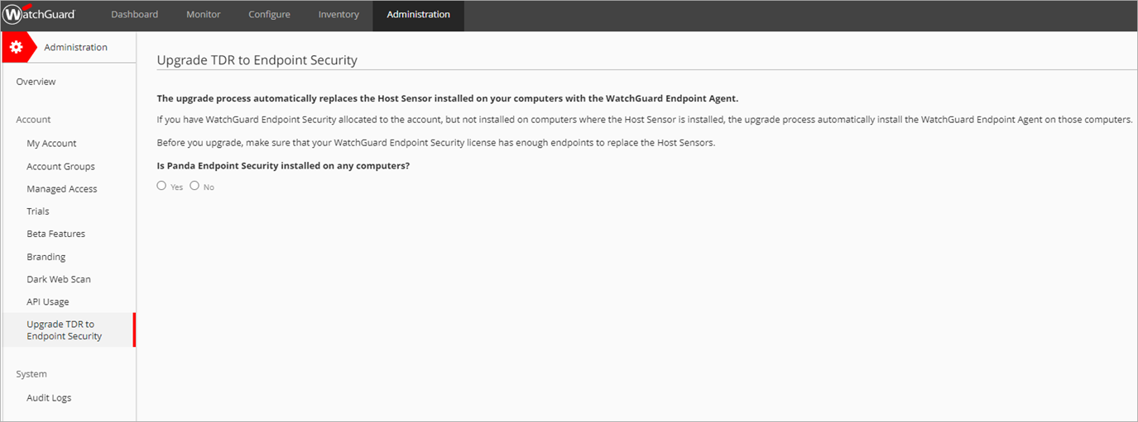
Upgrade to Endpoint Security
To upgrade TDR to Endpoint Security, in WatchGuard Cloud:
From Account Manager, select the account with the Host Sensors you want to upgrade Host Sensors are automatically uninstalled from the endpoints during the upgrade process
Select Administration > Upgrade TDR to Endpoint Security

Slide 22
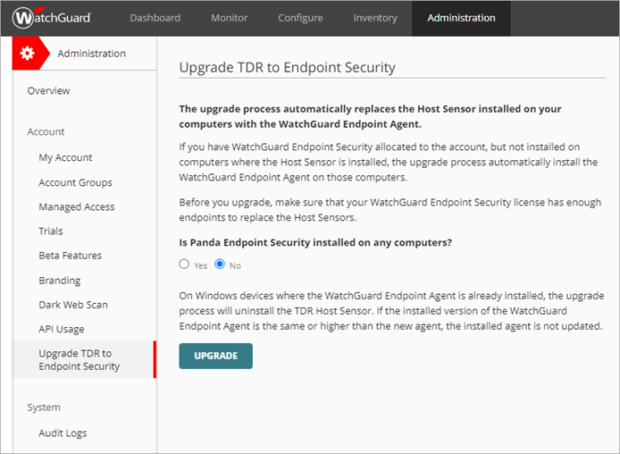
Upgrade to Endpoint Security
Determine whether Panda Endpoint Security is installed on any computers in the account and click Upgrade
If Panda Endpoint Security is installed on any of the computers, we recommend that you do not proceed because you will lose access to Panda Endpoint Protection. This wizard converts your Panda Endpoint Security products to WatchGuard EDR Core. For more information, contact Support.
If Panda Endpoint Security is not installed on any of the computers, click Upgrade. The upgrade process automatically installs the WatchGuard Endpoint Agent on the endpoints of the account. The process can take some time to complete. Make sure that the devices are powered on and connected.

Slide 23
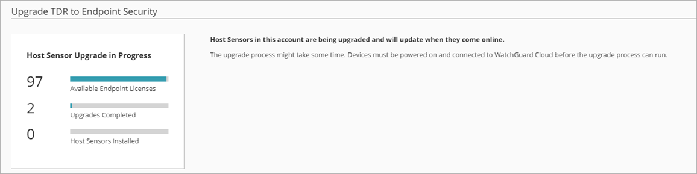
Review Upgrade Progress
The upgrade process can take some time to complete
To review the progress, select Administration > Upgrade TDR to Endpoint Security

Slide 24
EDR Core Management UI

Slide 25
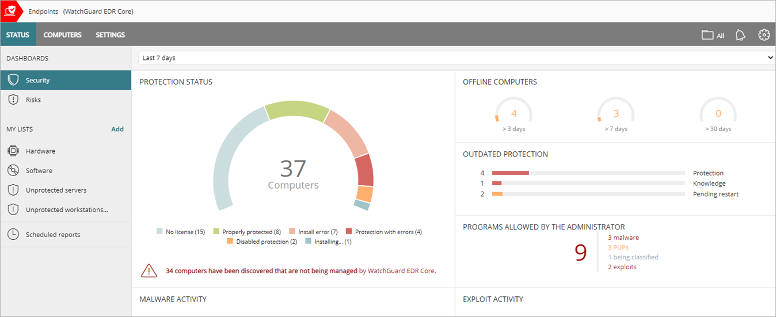
Endpoint Security Management UI
The management UI for EDR Core closely resembles the management UI for WatchGuard EDR

Slide 26
Features Not Available with EDR Core
In addition to modules, these security features are not available in the EDR Core management UI:
Web access control
Firewall
Shadow copies
Device control
Scan tasks
Program blocking
Authorized software
You must upgrade to WatchGuard EPDR to take advantage of these features, the Zero-Trust Application Service, and endpoint security modules such as Full Encryption and Patch Management

Slide 27
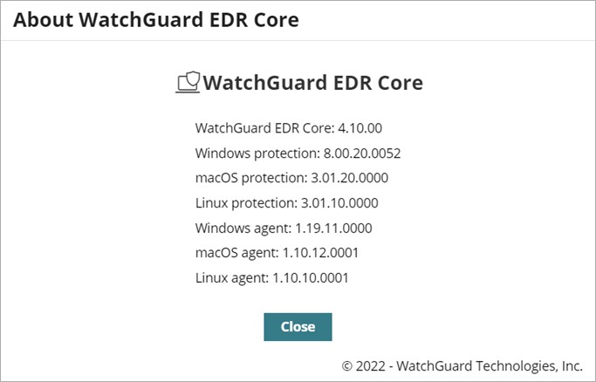
WatchGuard EDR Core Version Information
In the About dialog box, you can see the release version for WatchGuard EDR Core
To open the About dialog box:
In the upper-right corner, click
Select About

