Slide 1
What’s new in WI-Fi Cloud 9.0

Slide 2
What’s new in Wi-Fi Cloud v9.0
Remote Access Point
Enable or Disable an AP Radio
Download Analytics, Audit Logs, and Alerts
Wi-Fi Cloud Enhancements
For a complete list of enhancements and resolved issues for current and previous releases, see the Wi-Fi Cloud Release Notes

Slide 3
Remote Access point

Slide 4
Remote access point Benefits
High-performance, enterprise-grade Wi-Fi AP for employees who work remotely from home or at small branch offices
Secure access to your corporate network resources for remote users
Extend your network SSIDs to remote locations with the same access controls and policies used by your corporate APs
Use existing corporate authentication methods, such as RADIUS / 802.1X servers, pre-shared key, and Captive Portal across all corporate and remote APs
Use the monitoring and troubleshooting tools in Discover to manage and monitor APs deployed both in the corporate network and in remote locations
Integrates easily with industry-standard firewalls, such as the WatchGuard Firebox

Slide 5
How the Remote AP VPN Solution Works
The remote AP uses an IPSec VPN tunnel to securely connect to your corporate network over the public Internet
Remote APs enable you to configure a WatchGuard AP with your corporate network's configuration and security settings, and then send the APs to remote employees
When the remote employee installs the AP at their location, they can connect to the organization's corporate SSID
Remote AP VPN functionality is supported on these access points only:
AP225W
AP327X
AP420

Slide 6
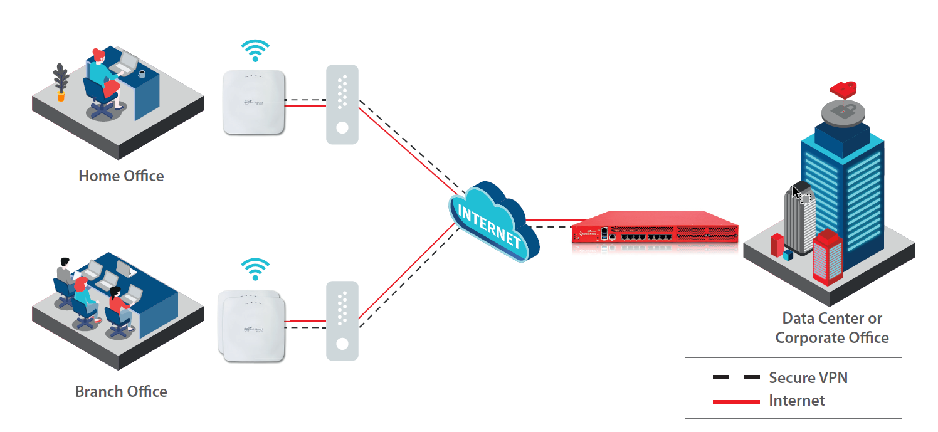
How the Remote AP VPN Solution Works
The Remote AP establishes an IPSec VPN tunnel to the corporate network
The tunnel securely carries network traffic between Wi-Fi clients and the corporate network

Slide 7
How the Remote AP VPN Solution Works
You can configure multiple SSIDs to use a single tunnel, or you can define a separate tunnel for each SSID
To preserve VPN throughput on the remote AP, you can also configure the network to only tunnel corporate network traffic, while Internet-bound traffic is directly forwarded to the Internet from the remote AP through the remote user’s Internet service provider
When a remote employee is no longer employed with your organization, you can delete the VPN tunnel to prevent further connections to the enterprise network from the remote AP

Slide 8
Configure a Remote AP
To configure a remote AP, you must:
Create an IPSec VPN Tunnel Profile
Add the IPSec VPN Tunnel to an SSID Profile
Deploy an SSID to the Remote AP

Slide 9
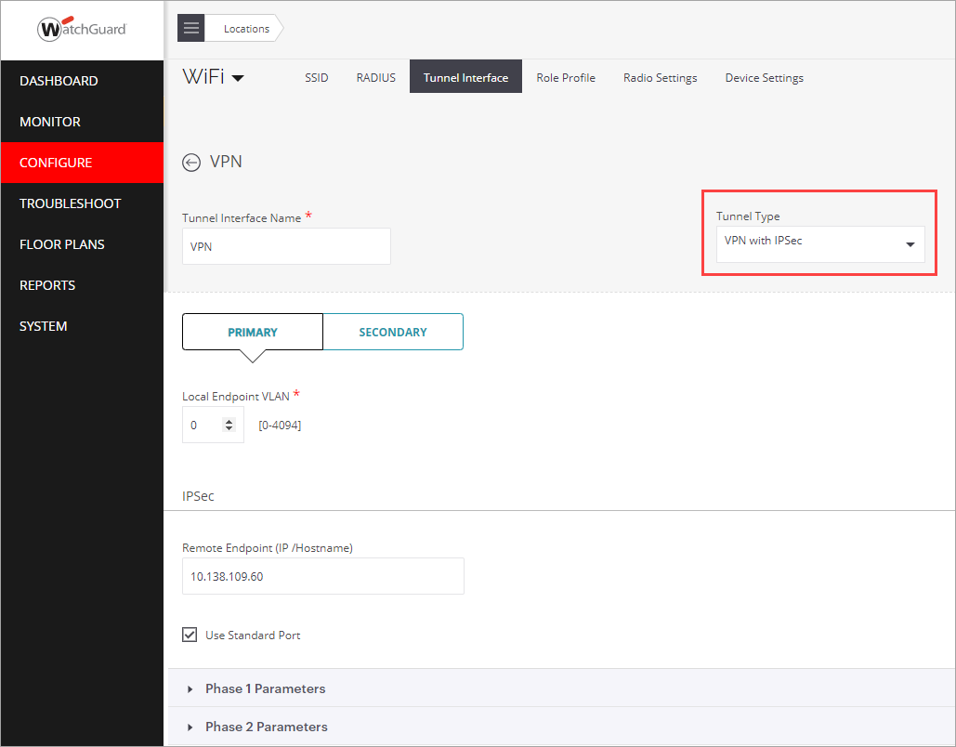
Configure a Remote AP
To create an IPSec VPN Tunnel Interface Profile in Discover:
Select Configure > WiFi, then select the Tunnel Interface tab
Add a VPN with IPSec tunnel interface profile
Specify your remote endpoint addresses and IPSec Phase 1 and Phase 2 information

Slide 10
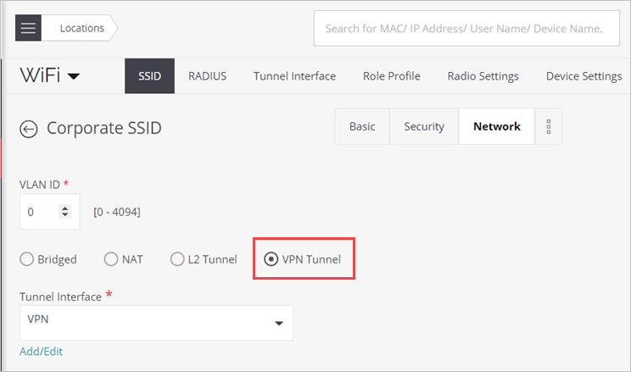
Configure a Remote AP
To add the IPSec VPN Tunnel to an SSID Profile in Discover:
Select Configure > WiFi, then select the SSID tab
Select the Network tab
Select VPN Tunnel, then from the Tunnel Interface drop-down list, select the tunnel that you configured
Specify any NAT settings and whether you want to split the tunnel for client traffic so that Internet-bound traffic goes directly to the Internet and not through the tunnel

Slide 11
Configure a Remote AP
To deploy an SSID to the Remote AP, make sure the SSID with the VPN tunnel you configured is applied to the correct location for the remote AP, such as a remote worker home office AP or a branch office AP

Slide 12
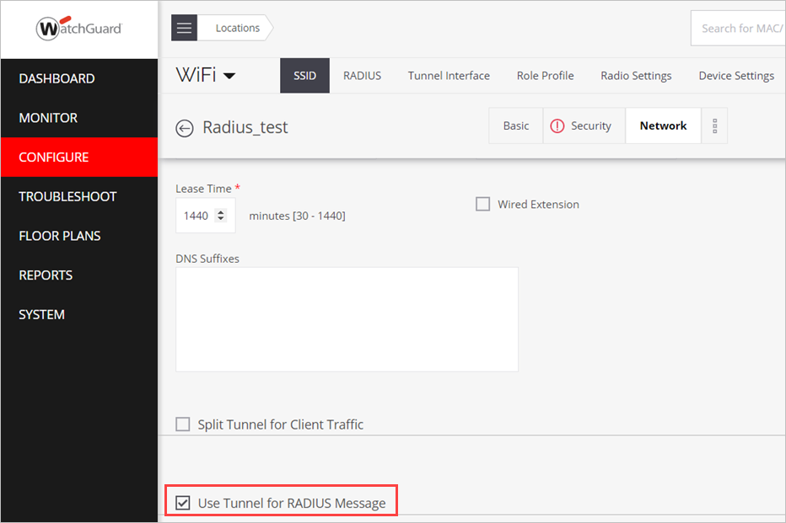
Tunnel Messages to a RADIUS Server
You can now tunnel RADIUS messages to a RADIUS server that is located on a network behind a remote endpoint of a VPN tunnel
This enables you to authenticate Wi-Fi clients with a remote RADIUS server when SSID traffic is tunneled, such as with a Remote AP VPN
This option is available in the Network tab of the SSID settings when you select a VPN Tunnel configuration

Slide 13
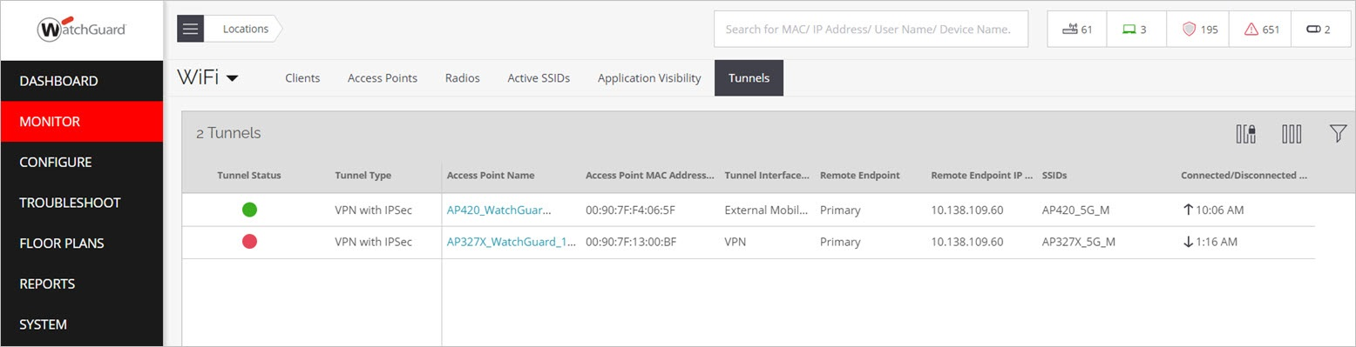
Monitor a Remote AP Tunnel
To monitor the IPSec VPN Tunnel:
From Discover, select Monitor > WiFi, then select the Tunnels tab

Slide 14
Enable or disable AP radio

Slide 15
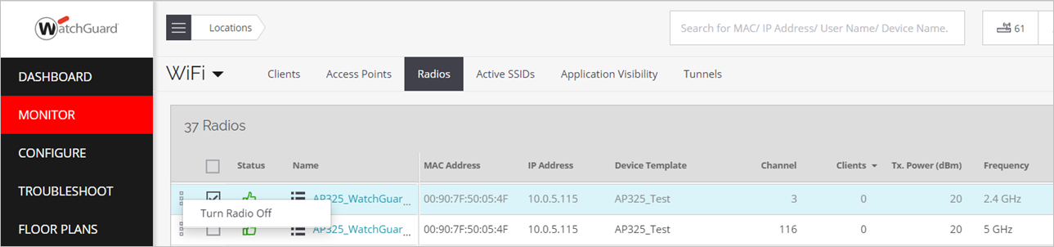
Enable or Disable an AP Radio
You can now individually disable or enable the 2.4 GHz and 5 GHz AP radios
This is useful with deployments where you need to disable the 2.4 GHz radio on specific APs to prevent interference in the 2.4 GHz band in a high-density deployment
To disable or enable radios from Discover, select Monitor > WiFi > Radios, then right-click the AP

Slide 16
Download analytics, audit logs, and alerts

Slide 17
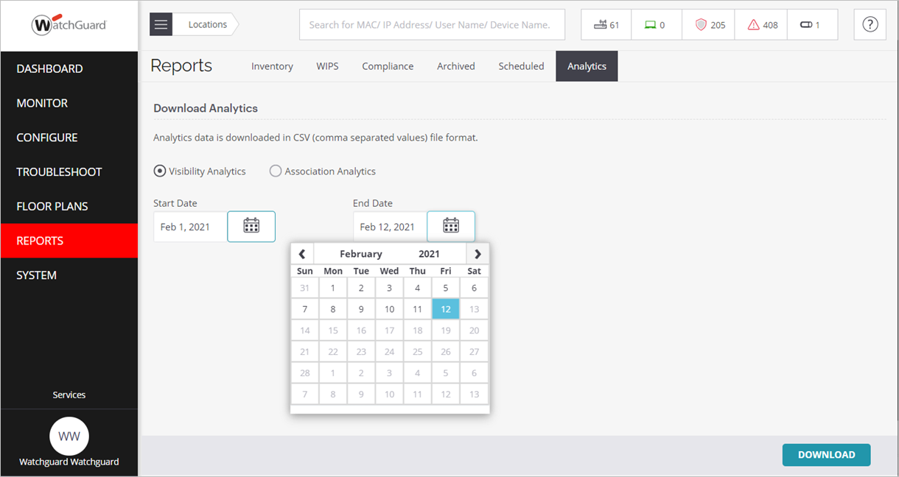
Download Analytics
You can now download Visibility and Association analytics from the Reports menu in Discover

Slide 18
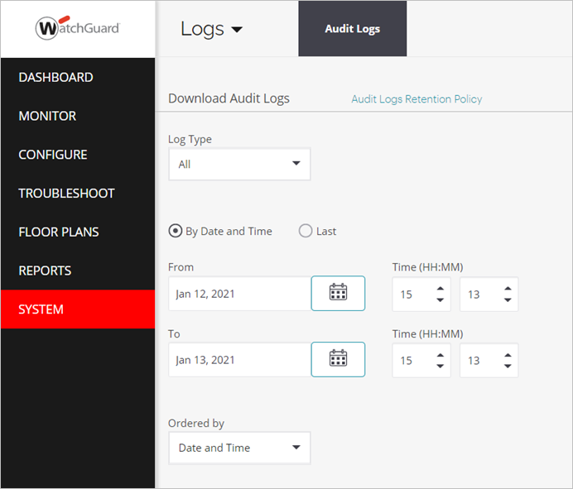
Download Audit Logs
You can now download user management audit logs and set the audit log retention policy in Discover
Select System > Logs

Slide 19
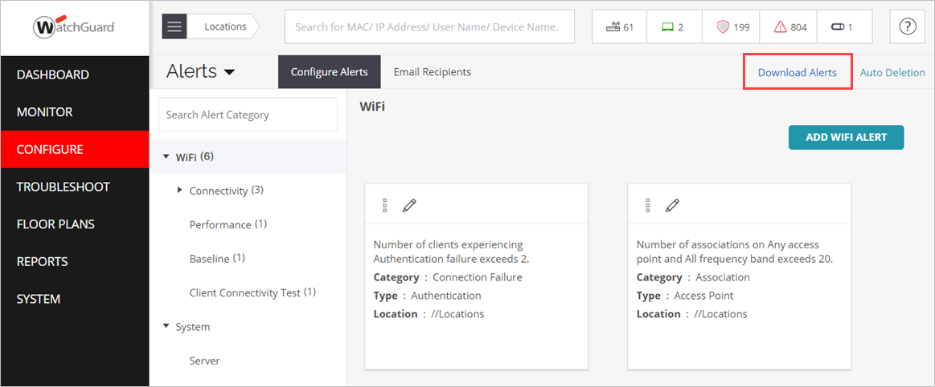
Download Alerts
You can now download a full list of possible alert events in tab-separated value format from the Configure > Alerts page in Discover

Slide 20
Wi-fi Cloud enhancements

Slide 21
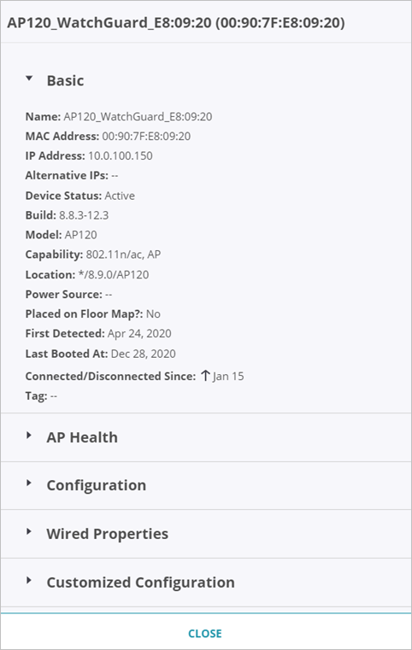
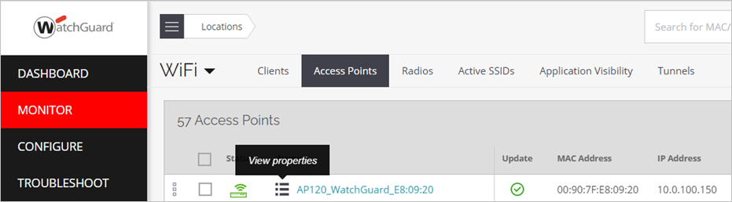
Wi-Fi Cloud Enhancements
From the Monitor pages in Discover, you can now view access point properties directly from the Access Point, Client, and Radio lists

Slide 22
Wi-Fi Cloud Enhancements
The Spectrum Analysis troubleshooting tool is now available again in Discover
Root cause analysis now includes a list of contending clients or BSSIDs in the Recommendations panel if a client experiences high contention issues
For advanced security purposes, you can now configure and manage your own key or passphrase used for authentication and encryption between Wi-Fi Cloud and managed APs
This option is available from the System > Advanced Settings page in Discover

Slide 23
Wi-Fi Cloud Enhancements
You now receive a warning notification message if an AP configuration change might impact end user connectivity For example:
When you modify an SSID configuration, including changes to RADIUS profiles, Role Profiles, and Tunnel Interfaces that require an SSID restart
When you make changes to Device and Radio Settings that require an SSID restart or AP reboot
When you manually reboot an AP
In addition, the system generates an alert event when an AP connected to Wi-Fi Cloud reboots

Slide 24
Thank you

