Slide 1
What’s New in Wi-fi cloud v8.9

Slide 2
What’s New in Wi-fi cloud v8.9
New features added to Discover
  New applications in the Applications Dashboard
  Root cause analysis of client issues
Enhancements to Discover
  Schedule device upgrades
  Configure mesh profiles
  Locate APs and clients
  List filters and sort order preserved
  Enhancements to AP and client details
  CIP high-availability support
  Additional VLAN monitoring and static IP support
  Captive portal support for client connectivity test

Slide 3
What’s New in Wi-fi cloud v8.9
Additional Notes
  WPA3 support for Wi-Fi 6 access points
  AP firmware v8.9 support (Wave 2 APs only)

Slide 4
New dashboard applications

Slide 5
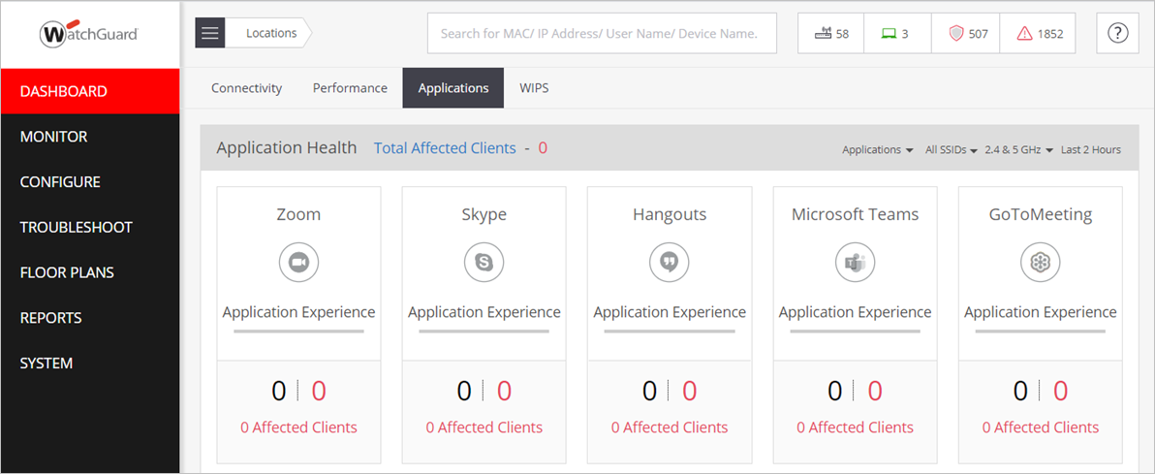
New dashboard applications
The Zoom and Microsoft Teams applications are now available on the Application Dashboard

Slide 6
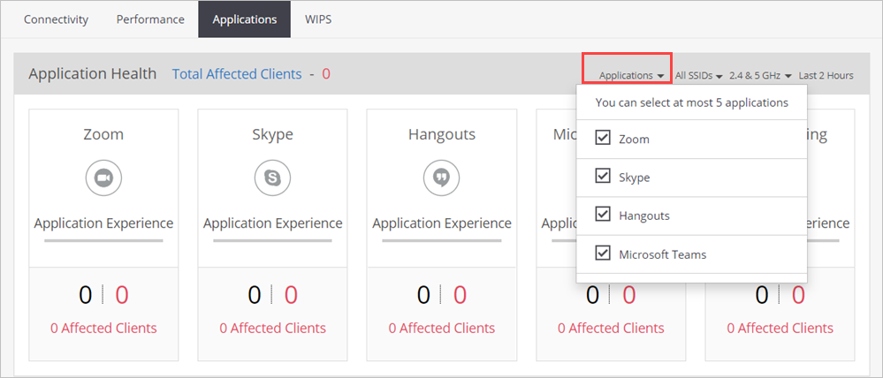
New dashboard applications
You can select up to a maximum of 5 applications to view on the Dashboard

Slide 7
Root cause analysis and recommendations

Slide 8
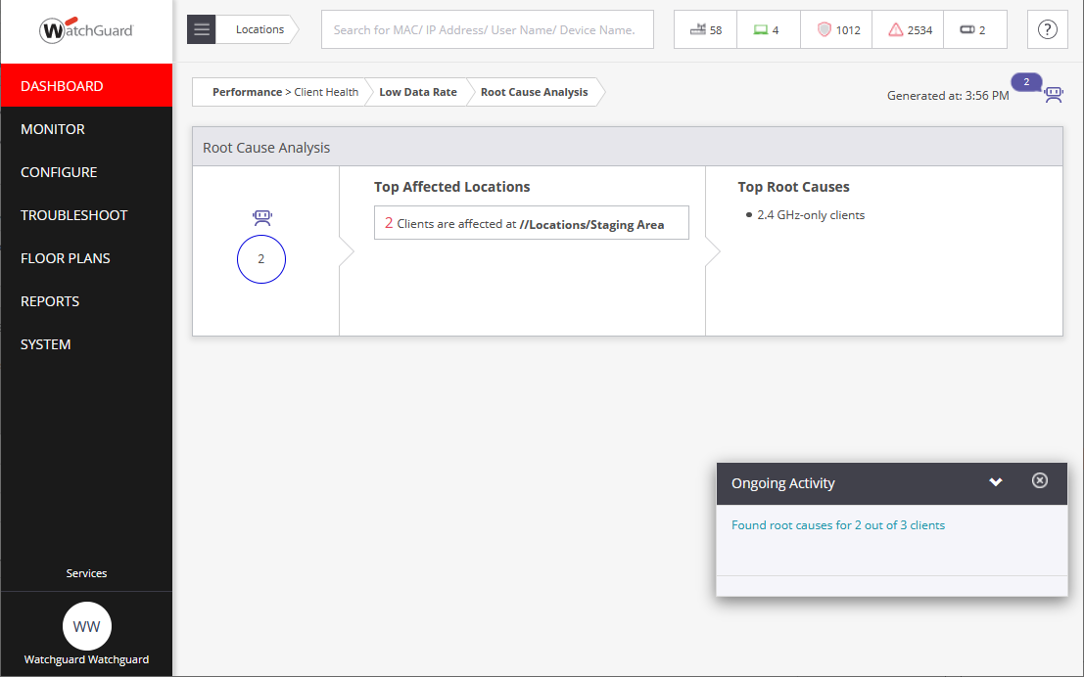
Root cause analysis and recommendations
You can now see the root cause analysis of one or more client devices impacted by Low Data Rates, Low RSSI, and High Retry Rate, including recommendations to resolve these issues

Slide 9
Schedule device upgrades in discover

Slide 10
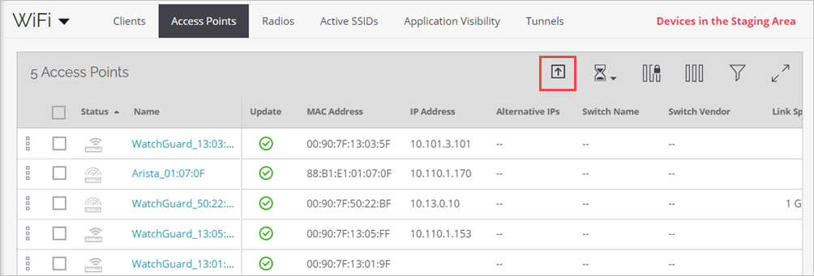
Schedule Device upgrade in discover
You can now configure scheduled firmware upgrades and upgrade options for new devices in Discover

Slide 11
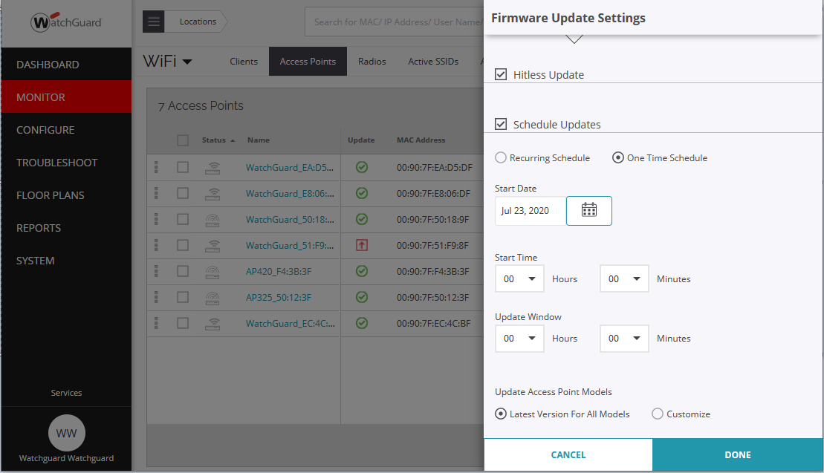
Schedule Device upgrade in discover

Slide 12
Configure mesh profiles in discover

Slide 13
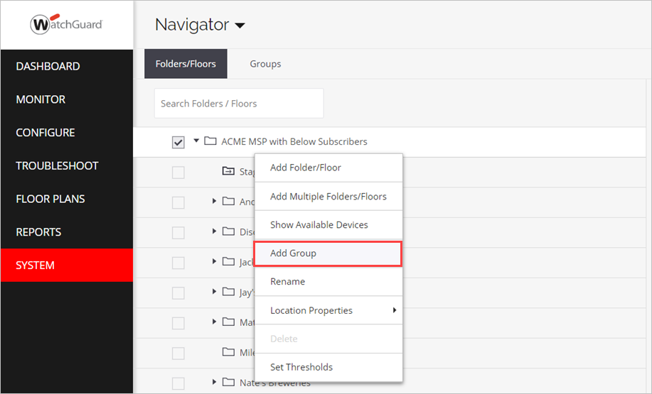
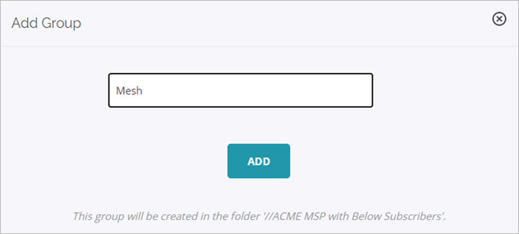
Configure mesh profiles in discover
You can now configure mesh networks in Discover
You must configure mesh capabilities for APs in an AP Group

Slide 14
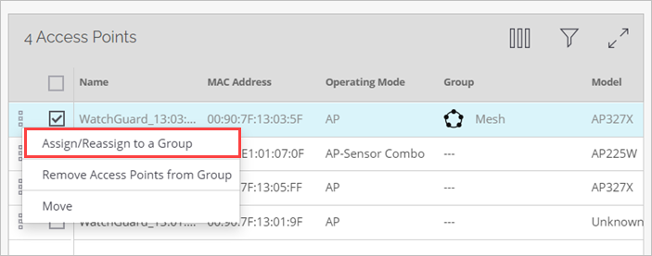
Configure mesh profiles in discover
Add APs to your mesh AP group

Slide 15
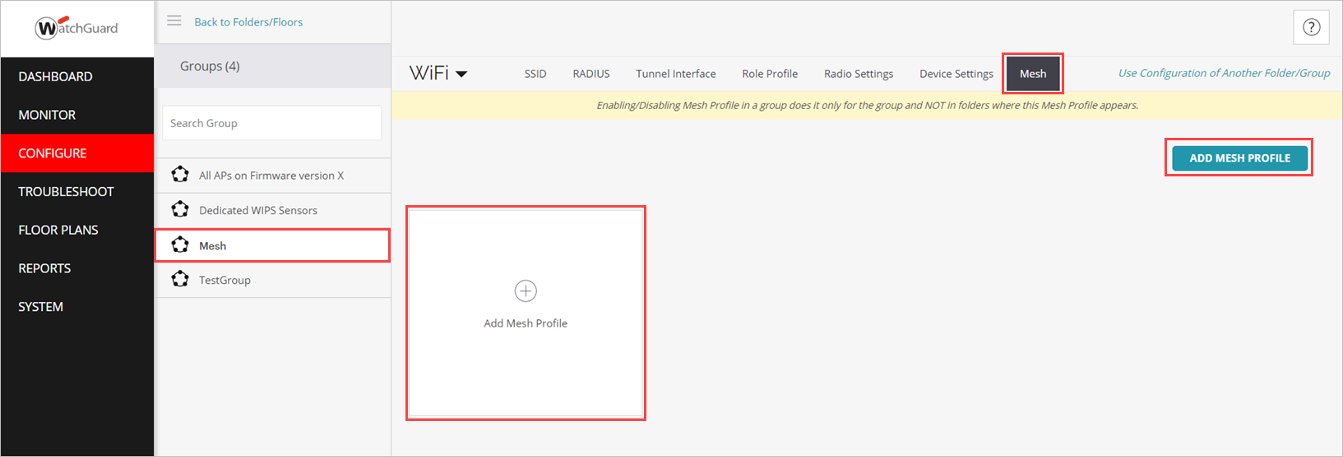
Configure mesh profiles in discover
Create a mesh profile for the AP group

Slide 16
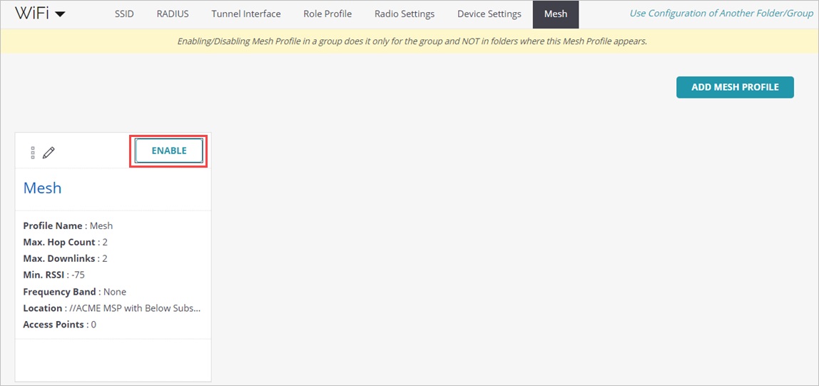
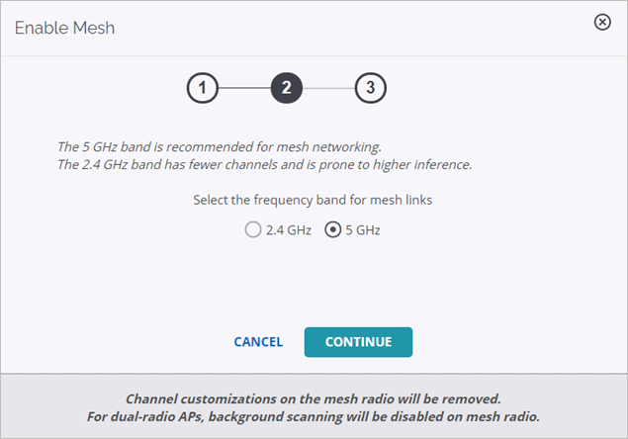
Configure mesh profiles in discover
Enable the mesh profile, then select the mesh radio and channel

Slide 17
Locate Access points and clients in Discover

Slide 18
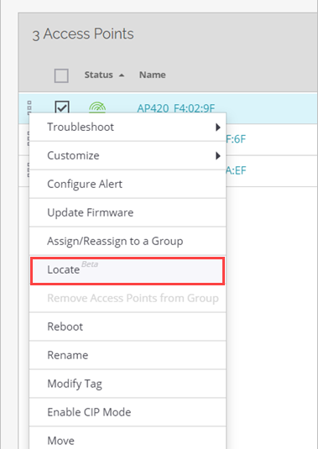
Locate Access points and clients in discover
You can now locate APs and clients on a floor map in Discover
On the Access Points or Clients Monitor page, right-click the device, then click the Locate action

Slide 19
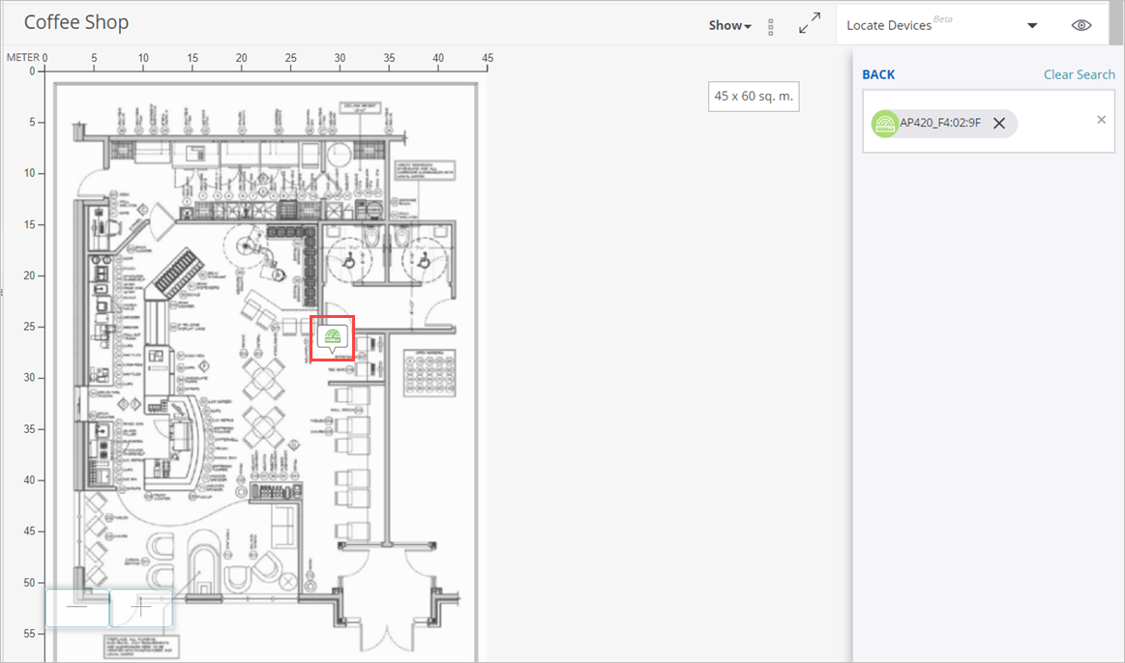
Locate Access points and clients in discover

Slide 20
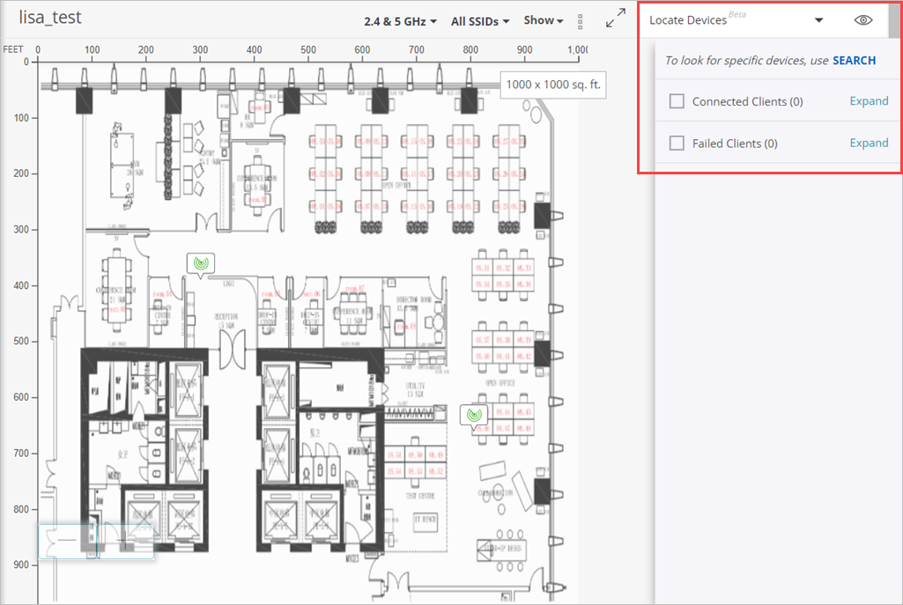
Locate Access points and clients in discover
You can also perform a locate action from the Floor Plans page

Slide 21
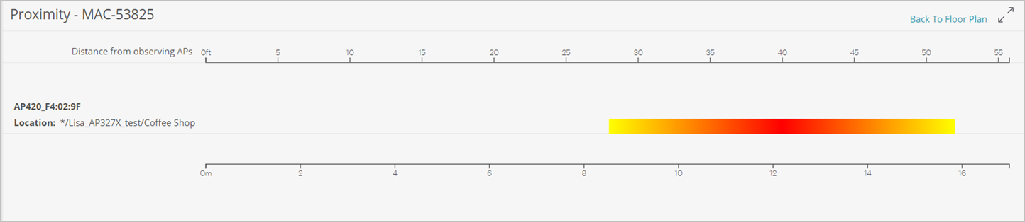
Locate Access points and clients in discover
If you do not have a floor plan image uploaded, or if there is not enough data (minimum of 3 sensing APs required to locate a device) the distance of the device from the nearest sensing AP is indicated

Slide 22
list Filters and Sort order preserved

Slide 23
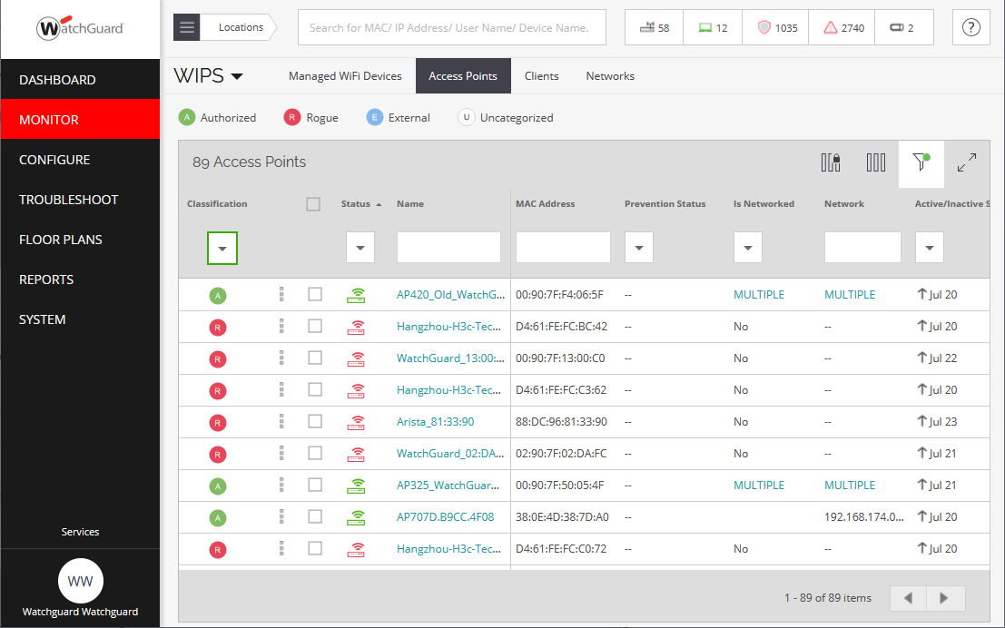
List Filters and sort order preserved
Filters and the sort order of Access Point and Client lists are now preserved when you navigate between pages in Discover

Slide 24
AP and client details enhancements

Slide 25
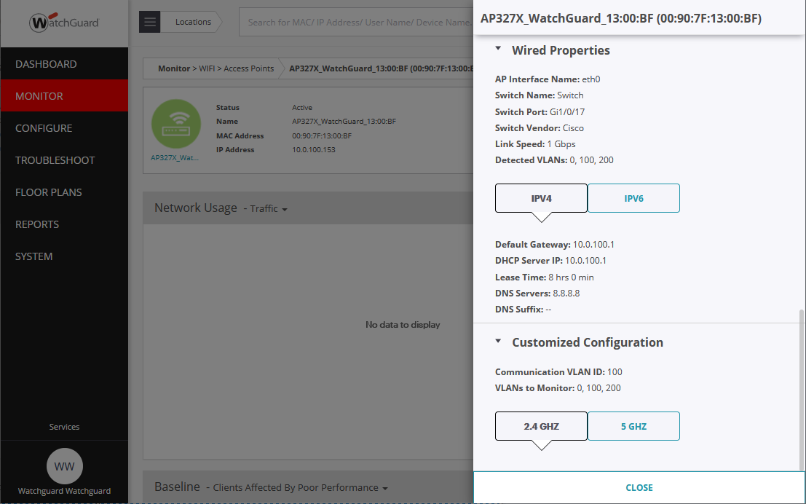
Ap and client details enhancements
New AP health statistics and wired network properties are available in the AP monitoring pages and AP properties

Slide 26
Ap and client details enhancements
AP Health — Shows CPU and memory utilization
Configuration — Indicates the AP location, operating mode, SSID, and channel information
Wired Properties — Indicates the wired side properties of an AP
  Includes the switch details, the link speed, and the VLANs detected by the AP
  The IP address network properties of the AP include the DHCP and DNS servers the AP uses, and the DHCP lease time

Slide 27
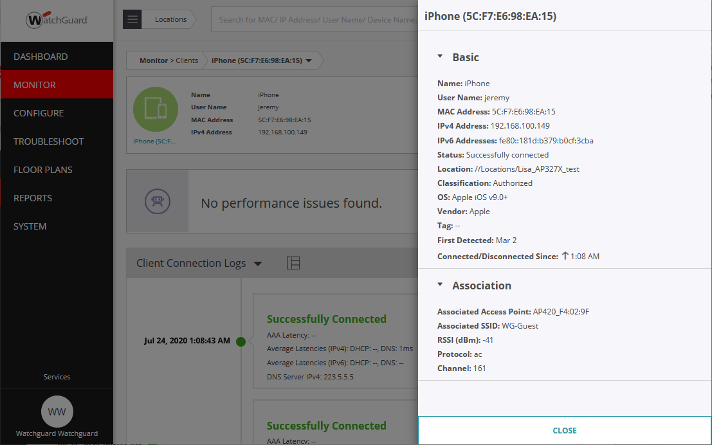
Ap and client details enhancements
Client details include basic client information and association details about the AP to which the client is associated

Slide 28
Cip high-availability support

Slide 29
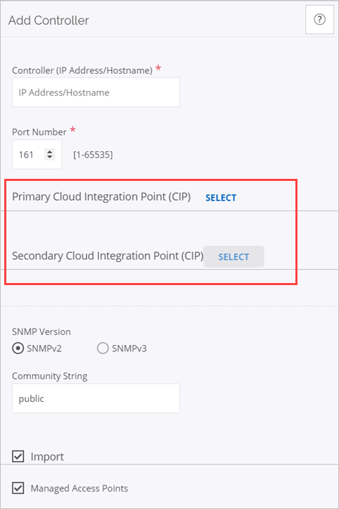
Cip high-availability support
Cloud Integration Point (CIP) now supports a high availability configuration that enables you to select a primary and secondary CIP-enabled AP for syslog and SNMP servers, and WLAN integration

Slide 30
Additional VLAN monitoring and static IP in discover

Slide 31
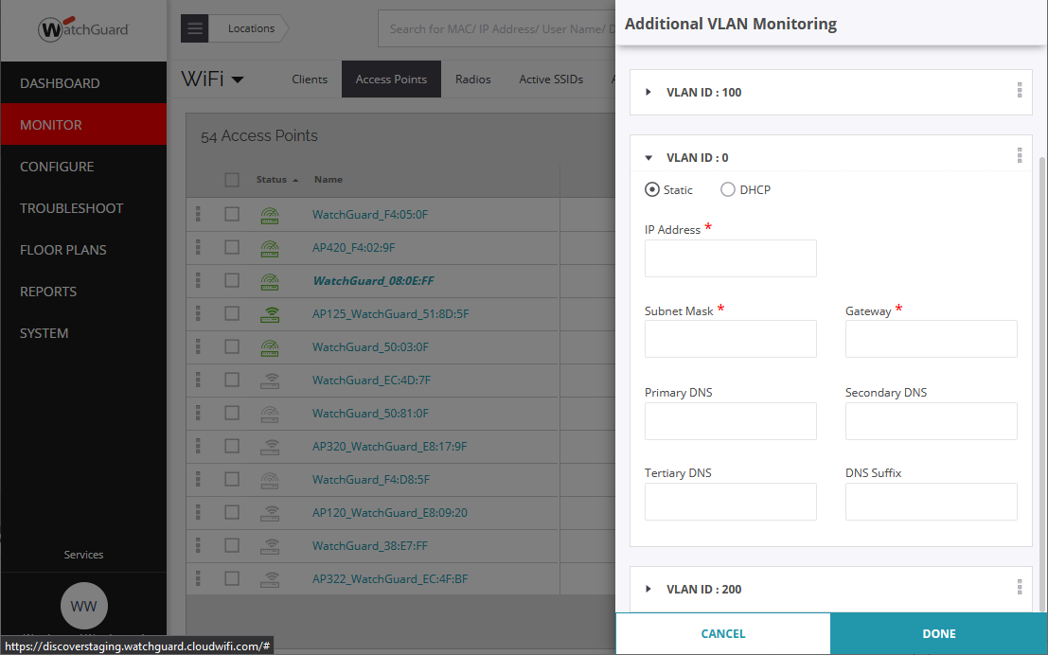
Additional VLAN monitoring and static IP in discover
In the Access Points monitor page in Discover, you can now configure Additional VLAN Monitoring that includes the ability to assign a static IP address to the AP

Slide 32
captive portal support for Client connectivity test

Slide 33
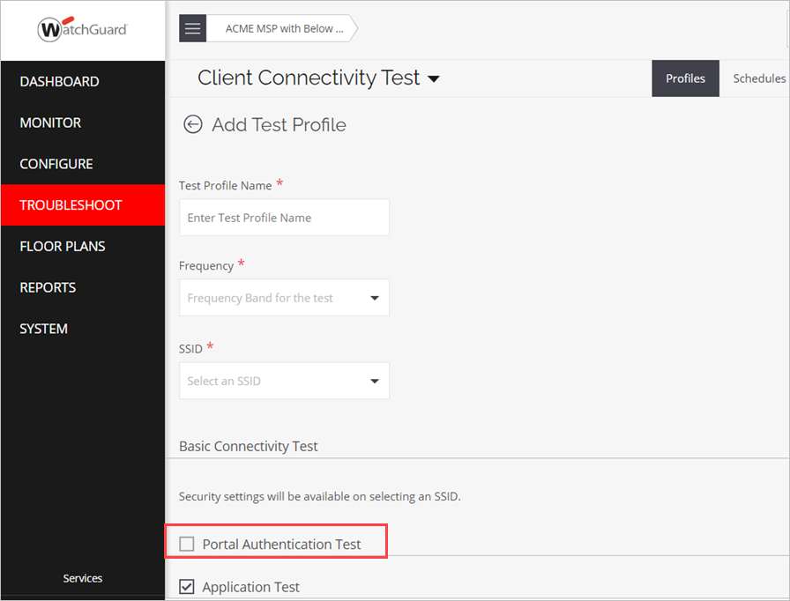
captive portal support for Client connectivity test
You can now perform a Client Connectivity Test on an SSID that uses a Captive Portal
Bypasses authentication so that the test can complete successfully

Slide 34
WPA3 Support for Wi-FI 6 Access points

Slide 35
Wpa3 support for wi-fi 6 Access points
Support for WPA3 personal and enterprise encryption for Wi-Fi 6 APs (802.11ax)
Support for the Enhanced Open Security protocol based on Opportunistic Wireless Encryption (OWE) on Wi-Fi 6 APs
WIPS can detect and prevent threats that use WPA3 encryption (Wi-Fi 6 Access Points on v8.9 firmware or higher)

Slide 36
Ap firmware v8.9 support

Slide 37
AP firmware v8.9 support
AP firmware versions 8.9.0-063 and higher are only available for 802.11ac Wave 2 access points
Wave 1 access points (AP120, AP320, and AP322) will remain on 8.8.x firmware for maintenance releases only

Slide 38
Thank You!

