Slide 1
What’s New in Wi-Fi Cloud v8.8

Slide 2
What’s New in Wi-Fi Cloud
Wi-Fi Cloud 8.8 Enhancements
Wi-Fi and WIPS Configuration in Discover
WIPS Monitoring in Discover
Reports in Discover
Hitless Device Firmware Updates
Use SSID Profiles for Authorized WiFi Policy
Staging Area Location
AP Groups in Discover
Slack Support in Applications Dashboard

Slide 3
What’s New in Wi-Fi Cloud
VXLAN and Tunnel Monitoring Support
SNMP Trap Support
Device Template Migration Tool
Client Connectivity Test and Connectivity Log Enhancements
Monitoring Enhancements

Slide 4
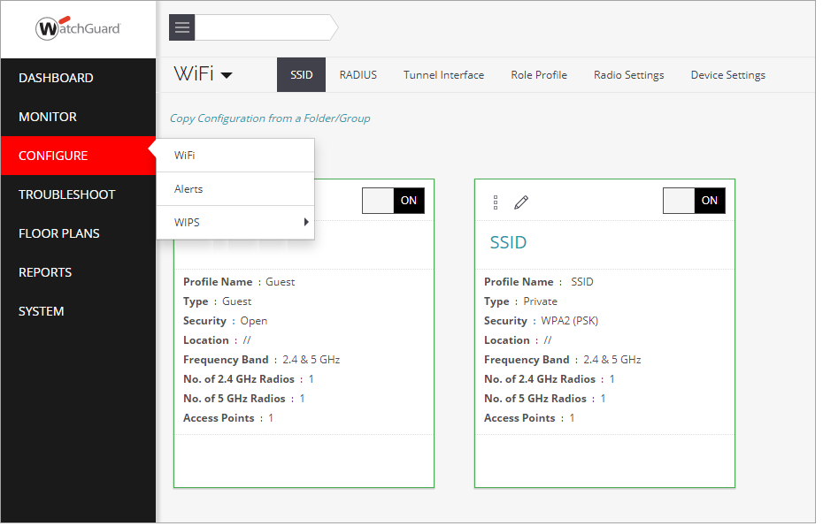
Wi-Fi Configuration in Discover
A new Configure section in Discover enables you to configure your Wi-Fi networks, including SSID settings, and AP device/radio settings

Slide 5
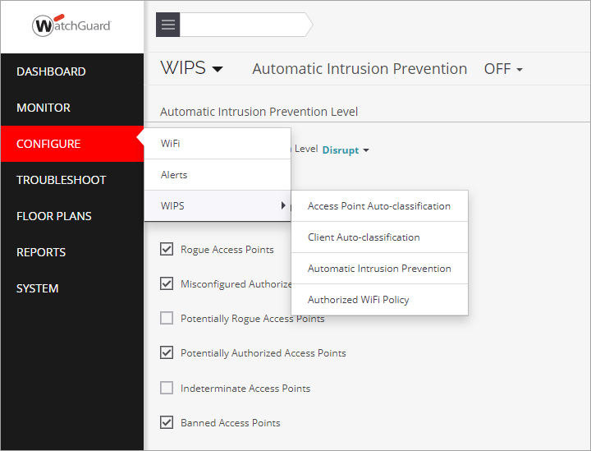
WIPS Configuration in Discover
You can now configure and monitor WIPS settings for your Wi-Fi networks within Discover
You can configure the Authorized Wi-Fi Policy, Intrusion Prevention, and WIPS classification settings

Slide 6
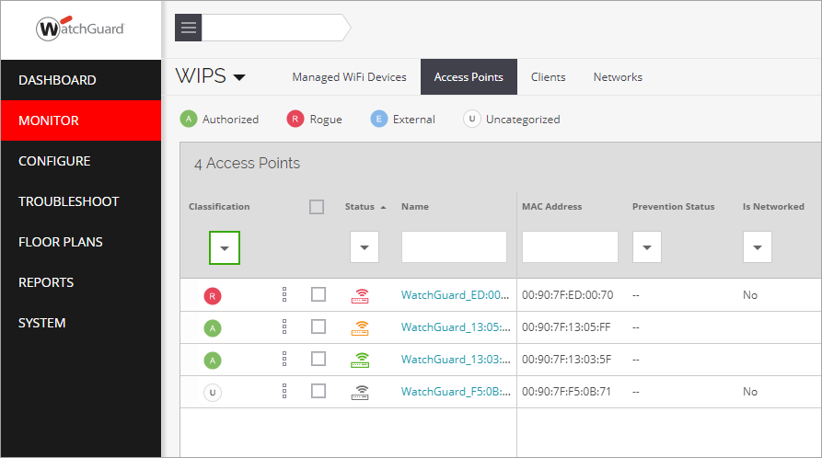
WIPS Monitoring in Discover
The Monitor section in Discover now displays WIPS information, including AP and Client classifications

Slide 7
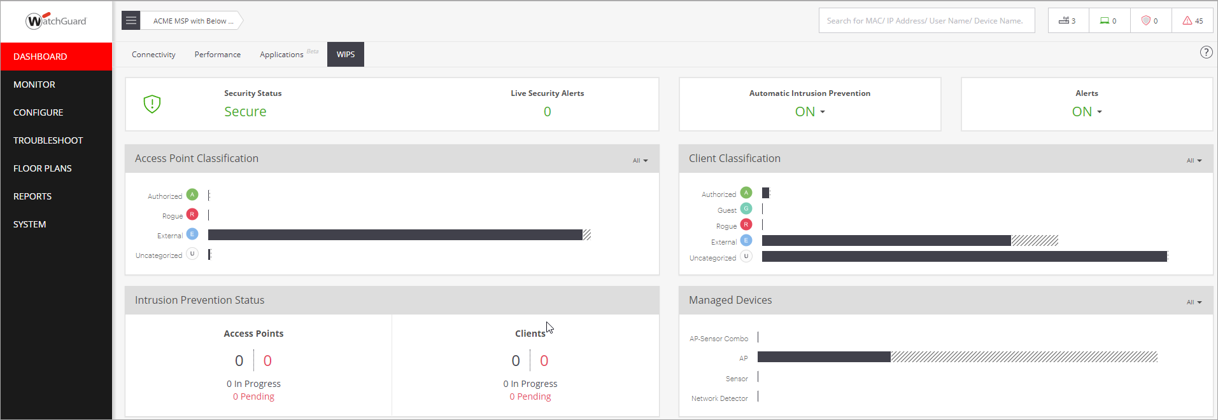
WIPS Dashboard in Discover
The Dashboard section in Discover now displays WIPS information, including an overview of AP and client classifications and security alerts

Slide 8
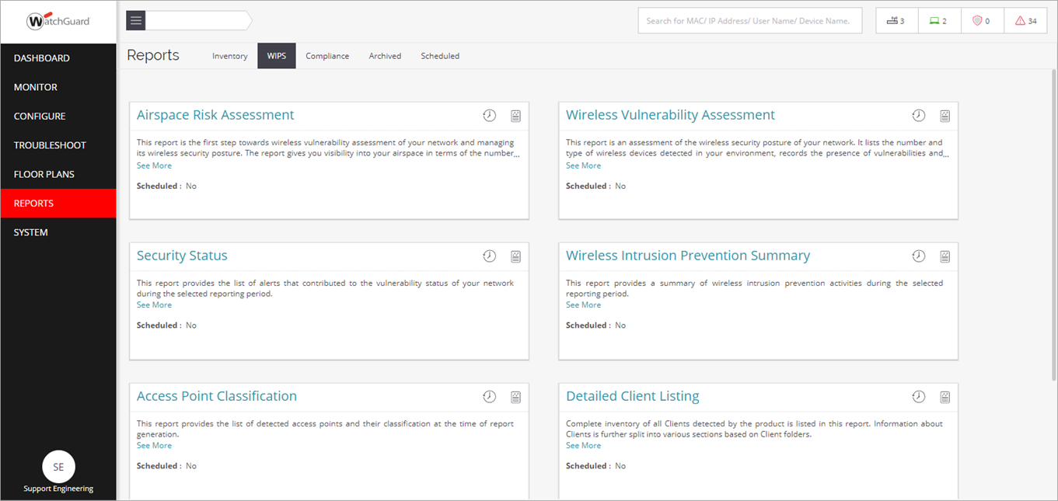
Wi-Fi Cloud Reports in Discover
From Discover, you can now configure, schedule, and view Wi-Fi Cloud reports

Slide 9
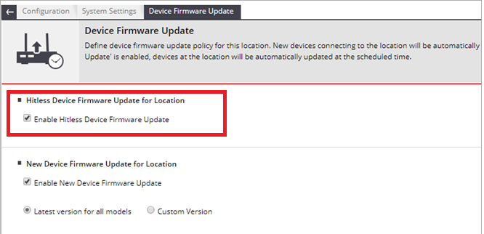
Hitless Device Firmware Update
Minimize downtime for wireless clients during AP upgrades
APs are not upgraded at the same time as nearby APs so that wireless clients in the vicinity can remain connected to the Wi-Fi network
From Manage, select Configuration > System Settings > Device Firmware Updates

Slide 10
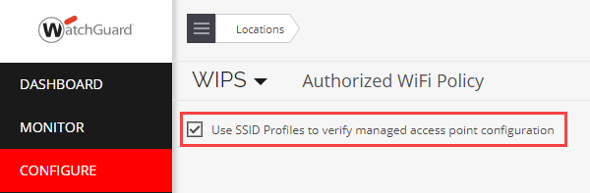
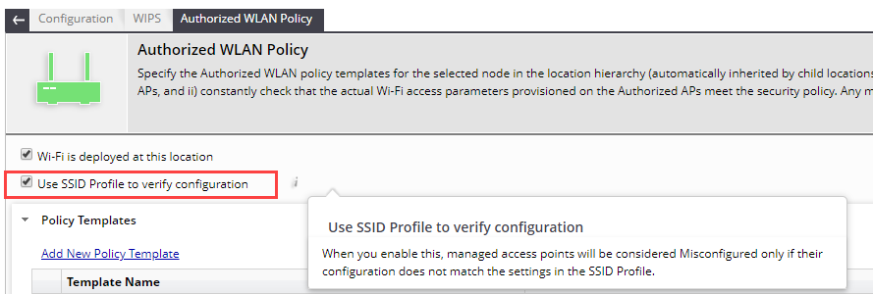
Use SSID Profiles for Authorized WiFi Policy
You can now use the settings of your SSID Profiles to validate the configuration of your APs for the Authorized WiFi Policy
Simplifies the security settings of your deployment when you use only WatchGuard APs
Configure > WIPS > Authorized WiFi Policy settings in Discover
Configuration > WIPS > Authorized WLAN Policy settings in Manage

Slide 11
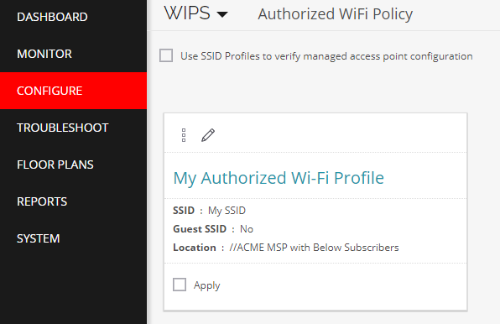
Use SSID Profiles for Authorized WiFi Policy
You do not need to create an Authorized WiFi Policy for each SSID unless you require specific policy settings such as allowed AP vendors for WIPS overlay to protect third-party APs, or any other deployment that requires custom security settings
In this case, disable this option and create an Authorized WiFi Policy for each SSID you use

Slide 12
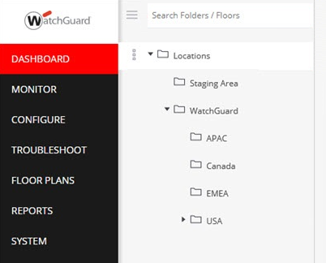
Staging Area Location
The folder for newly deployed APs is now called Staging Area
Previously, this was called the Unknown folder

Slide 13
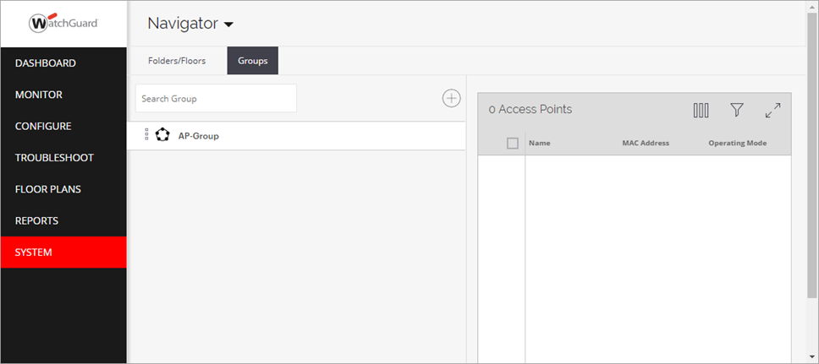
AP Groups In Discover
AP groups in Discover enable you to organize and manage your APs across your location tree
For example, you can apply the same configuration to APs even though the APs are in different location folders and floors
Create your AP groups in System > Navigator

Slide 14
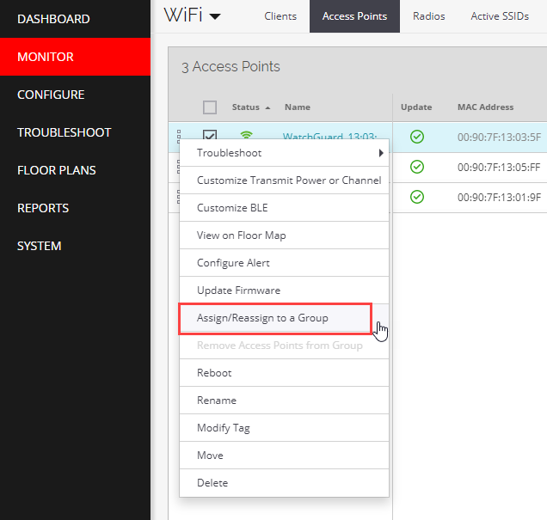
AP Groups In Discover
Go to Monitor > WiFi > Access Points to assign an AP to a group

Slide 15
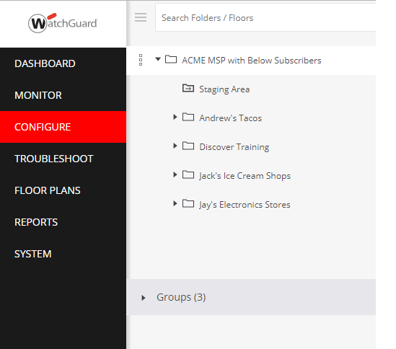
AP Groups In Discover
Apply a configuration to a group in Configure > WiFi
Open the locations tree and select a group instead of a location to apply a configuration to all APs in a group

Slide 16
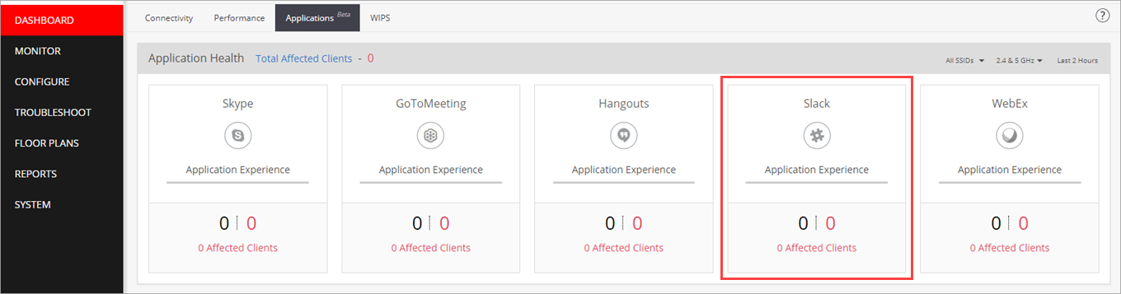
Slack Application Support
The Slack application has been added to the Applications Dashboard in Discover
Skype and Skype for Business are now merged into the same application category

Slide 17
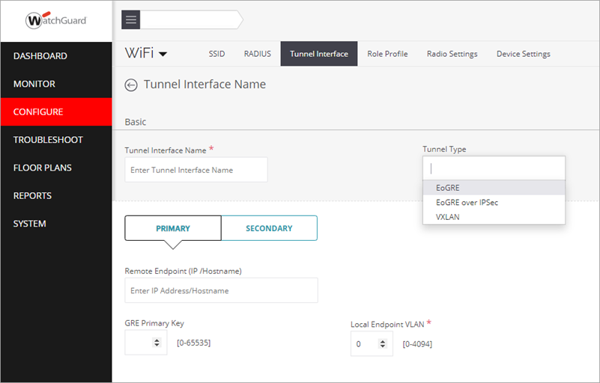
VXLAN Support
You can now configure VXLAN (Virtual Extensible LAN) tunnels in a tunnel interface configuration

Slide 18
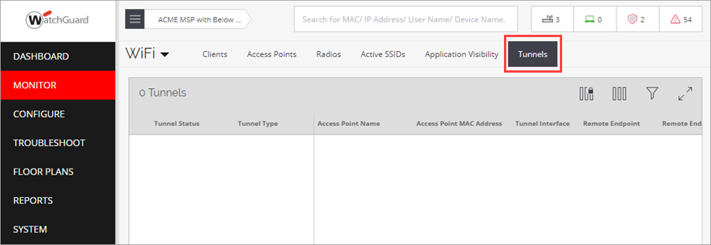
Tunnel Monitoring
You can now monitor the status of EoGRE, EoGRE over IPSec, and VXLAN tunnels

Slide 19
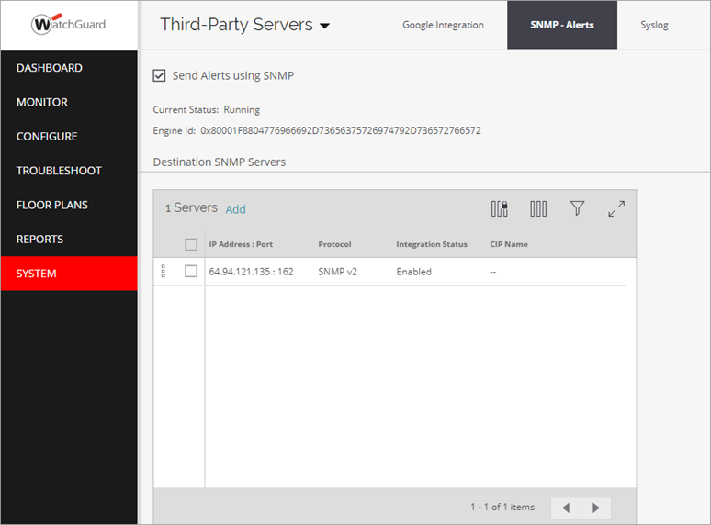
SNMP Trap Support
You can now configure alerts to be sent as SNMP traps to SNMP trap destination servers through an AP420 configured in Cloud Integration Point (CIP) mode

Slide 20
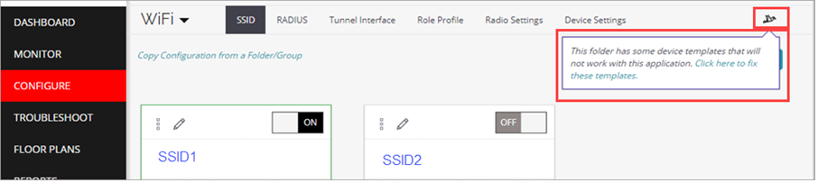
Device Template Migration Tool
Enables you to convert a legacy AP model-specific device template to the universal configuration template used by Discover

Slide 21
Client Connectivity Test Enhancements
HTTP and VoIP connectivity tests in Discover are now supported in cases where the target site blocks ICMP traffic or the web service is stopped
Note that many connectivity tests cannot run successfully on SSIDs that have a Captive Portal enabled
Application tests now use HTTP Get requests instead of ping for better reliability
Client connectivity test results now support a partial success status based on the results of the test categories

Slide 22
Client Connection Logs Enhancements
Additional failure types have been added to the Client Connection Logs in Discover:
Clients with incorrect IP configuration or IP address conflicts
IP address assignment by a rogue DHCP server
Client connection to an SSID that is associated with a non-trunked VLAN on the switch
DHCP and DNS server IP addresses are now included in the connection success and failure logs
AAA (Authentication, Authorization, Accounting) servers IP addresses are now included in the connection success and failure log messages

Slide 23
Monitoring Enhancements
AP transmit power is now displayed as the Equivalent Isotropic Radiated Power (EIRP) power that includes the transmit power with the antenna gain for the AP
All 802.11ac Wave 2 AP firmware has been updated to improve performance and monitoring of APs
Dashboard graphs that display AP data rates and utilization will now include correct data for all Wave 2 APs
Adds support for the upcoming AP327X platform:
IP67-rated outdoor access point
Dual Radio 802.11ac Wave 2
External antenna support

Slide 24
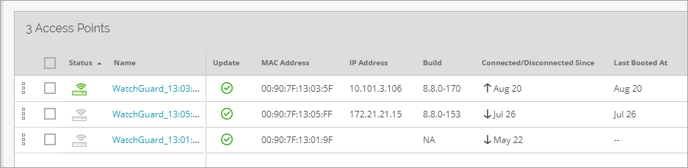
Monitoring Enhancements
The Up/Down Since column is renamed to Connected/Disconnected Since
A new Last Booted At column indicates the time of the last device reboot

Slide 25
Thank You!

