Slide 1
What’s New In
WatchGuard Wi-Fi Cloud v8.6

Slide 2
What’s New in v8.6
Automatic Power Control Enhancements
VoIP-aware Background Scanning
Disable AP LEDs
Third Party Analytics Send Interval
Configuration Support for MU-MIMO
Consolidated Device Template Migration
SSID VLAN Monitoring Configuration
Full Client Isolation
HTTPS Redirection for Captive Portal
Secure EoGRE Tunnels with IPSec

Slide 3
What’s New in v8.6
Analyze and Engage Enhancements
  Reduced Portal Downtime during Upgrades
  Pre-validation for Guest Login
  GDPR Compliance

Slide 4
New Features and Enhancements

Slide 5
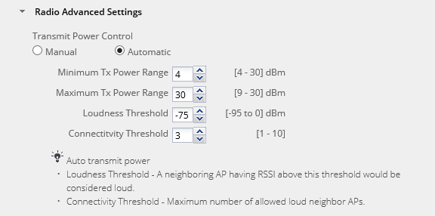
Automatic Power Control Enhancements
You can now configure automatic transmit power control thresholds for APs
You can customize the Minimum and Maximum Tx Power Range, Loudness Threshold (to define a loud neighbor AP), and Connectivity Threshold (the number of allowed loud neighbor APs)
Default values are provided for optimized power control
Notes:
From Networking/Interface page add a custom DHCP Option

Slide 6
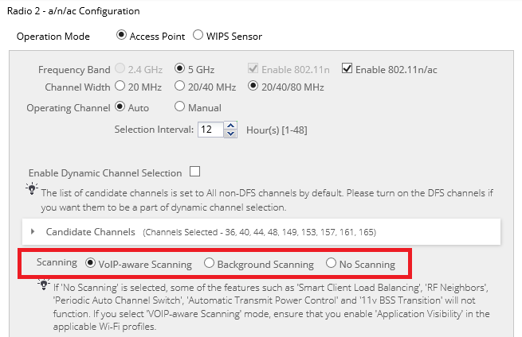
VoIP-aware Background Scanning
You can now enable VoIP-aware Scanning on a radio to perform background scanning functions while minimizing bandwidth impact to high priority traffic
Make sure that SSIDs added to this radio have the Application Visibility option enabled for traffic detection
Supported on Wave 2 APs only (AP325 and AP420)
If you enable on Wave 1 APs (AP120, AP320, or AP322), background scanning is disabled
Notes:
From Networking/Interface page add a custom DHCP Option

Slide 7
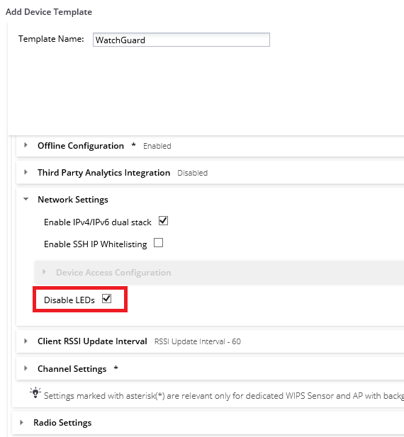
Disable AP LEDs
You can now disable LED activity on 802.11ac Wave 2 APs
(AP325 and AP420)
This option is configured in a device template, and cannot be configured for individual APs
Enables you to hide any visible LED activity on your APs for security reasons
Notes:
From Networking/Interface page add a custom DHCP Option

Slide 8
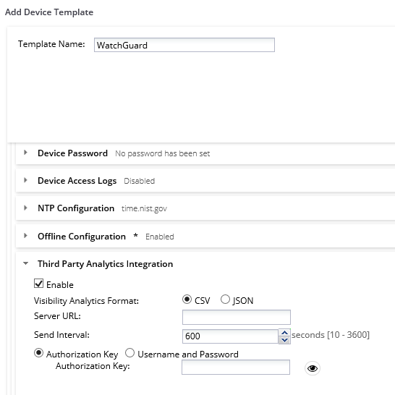
Third-Party Analytics Integration Interval
The minimum send interval for updating a third-party server with visibility analytics is reduced from 1 minute to 10 seconds
Enables you to send more immediate analytics data to the third-party server
Internal can be between 10 and 3600 seconds. The default interval is 600 seconds (10 min)
Notes:
From Networking/Interface page add a custom DHCP Option

Slide 9
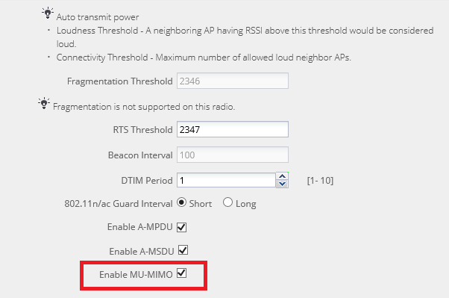
Configuration Support for MU-MIMO
You can now disable the MU-MIMO capability on the 5 GHz radio for 802.11ac Wave 2 APs
(AP325 and AP420)
Useful for cases when clients encounter bandwidth issues when both SU-MIMO and MU-MIMO clients connect simultaneously to Wave 2 capable APs
Located in the Radio Advanced Settings of a Device Template
Notes:
From Networking/Interface page add a custom DHCP Option

Slide 10
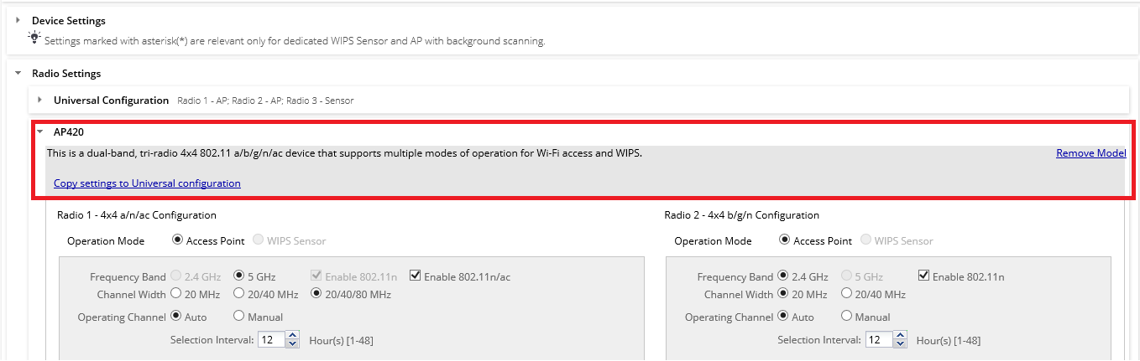
Consolidated Device Template Migration
You can now migrate your existing AP model-specific device templates to the universal consolidated device template
The Device Template page offers tools to help migrate your existing model-specific templates to universal configuration device templates
Notes:
From Networking/Interface page add a custom DHCP Option

Slide 11
SSID VLAN Monitoring Configuration
You now have the option to disable SSID VLAN monitoring if you do not want the AP to monitor VLANs corresponding to the SSIDs defined on the VLAN
This optimizes the use of IP addresses
  No automatic bridge interface is created for every VLAN on an SSID to reduce traffic on wireless networks (for example, the guest network)
Previously all VLANs used in any SSIDs were always monitored
Notes:
From Networking/Interface page add a custom DHCP Option

Slide 12
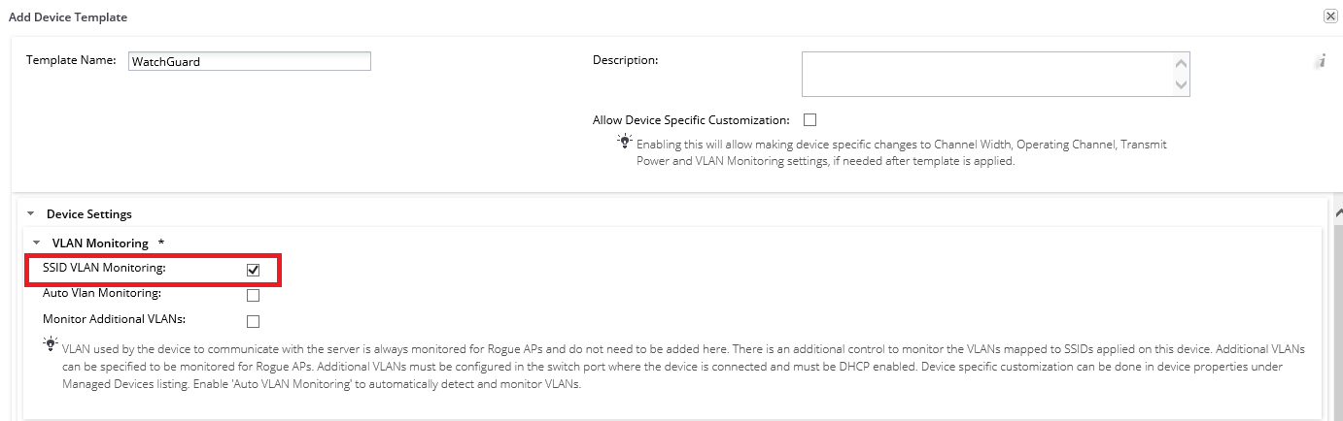
SSID VLAN Monitoring Configuration
Configured in a Device Template in the Device Settings section
SSID VLAN Monitoring is enabled by default
Notes:
From Networking/Interface page add a custom DHCP Option

Slide 13
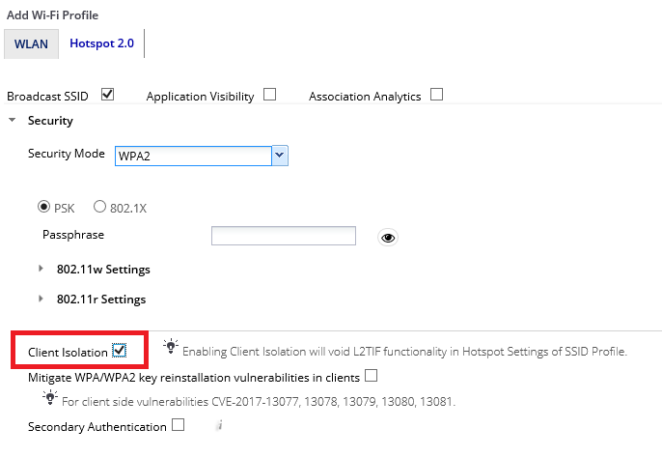
Full Client Isolation
The Client Isolation option now provides complete wireless isolation between clients connected to different APs, the same AP, or different radios of the same AP
Useful for guest Wi-Fi SSIDs
Configured in the Security settings of an SSID Profile and is disabled by default
With full client isolation, wireless clients also cannot communicate with wired-side hosts on the same network
Notes:
From Networking/Interface page add a custom DHCP Option

Slide 14
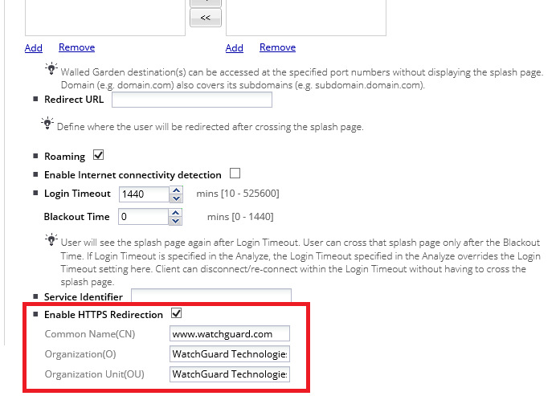
HTTPS Redirection for Captive Portal
A user that is connected to an SSID with a Captive Portal can now be securely redirected to the portal when the user attempts to access an HTTPS site
HTTPS redirection is disabled by default
If HTTPS Redirection not enabled, the client will not be redirected to the captive portal if they first browse to an HTTPS site
Notes:
From Networking/Interface page add a custom DHCP Option

Slide 15
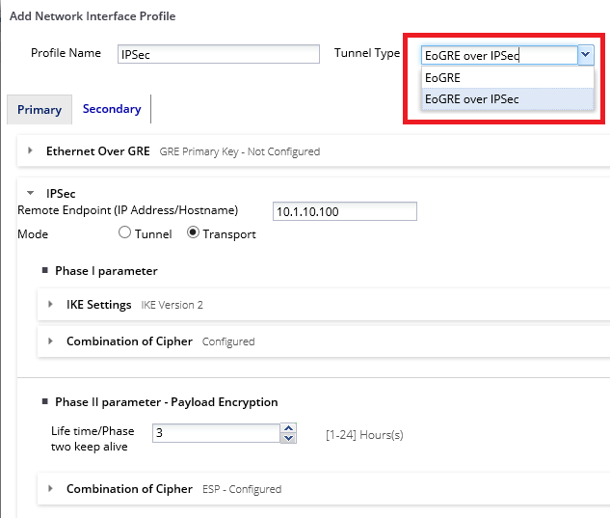
Secure EoGRE Tunnels with IPSec
802.11ac Wave 2 APs (AP325 and AP420) now support tunneling with EoGRE over IPSec
Can use either Tunnel or Transport mode
Use IPSec to provide encryption for encapsulated data to provide a secure and flexible VPN solution for EoGRE
Notes:
From Networking/Interface page add a custom DHCP Option

Slide 16
Analyze and Engage Enhancements
Reduced Portal Downtime during Upgrades
  Captive Portal splash page downtimes are greatly reduced during Wi-Fi Cloud maintenance and upgrades to minimize impact to Wi-Fi users
GDPR Compliance
  The default Captive Portal splash pages designed by the Engage application, including logo and terms and conditions usage, are modified to be compliant for GDPR
Notes:
From Networking/Interface page add a custom DHCP Option

Slide 17
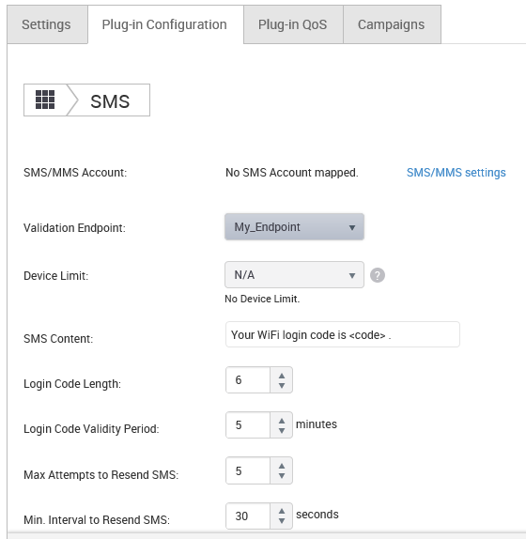
Analyze and Engage Enhancements
Support for third-party endpoint validation for guest Wi-Fi access
In the SMS plug-in, you can configure an external HTTPS endpoint and define custom fields to validate during guest login
Validation occurs before one-time password sent to user via SMS to allow guest Wi-Fi access
Notes:
From Networking/Interface page add a custom DHCP Option

Slide 18
Other Enhancements
AP Software Update Enhancements
  You can now perform manual AP software updates outside of an expired automatic update window
DCS Enhancements
  Dynamic Channel Switching (DCS) has been optimized for high density wireless environments to prevent frequent channel changes
Notes:
From Networking/Interface page add a custom DHCP Option

Slide 19
Other Enhancements
Client Location Tag in Portal Request
  Wi-Fi Cloud now sends the location tag of a client in a portal redirect URL that enables you to determine the location of the client that initiates the portal request
No IP Address Required on VLAN for Captive Portal
  IP addresses are no longer assigned to the AP bridge interface
  Previously the AP would receive a DHCP IP address on all VLANs that are configured in SSID profiles or configured in the Device Template as a VLAN to monitor
Notes:
From Networking/Interface page add a custom DHCP Option

Slide 20
Thank You!

