Slide 1
What’s New in
WatchGuard Wi-Fi Cloud v8.5

Slide 2
What’s New in v8.5
Automatic Transmit Power Control
Consolidated Device Templates
Background Scanning and WIPS Decoupled
RADIUS Profiles
RADIUS MAC Authentication Enhancements
Suspicious AP Monitoring
CIP (Cloud Integration Point)

Slide 3
What’s New in v8.5
Other Enhancements
  AP Upgrades Over Port 443
  AP Firmware Downgrade
  Captive Portal Reauthentication
  Enhanced Bridging Client Detection
  DFS Channel Enhancements
  AP325 Support
  Israel and Egypt Preconfigured Country Code
  Google+ Authentication Deprecated

Slide 4
New Features and Enhancements

Slide 5
Automatic Transmit Power Control
APs can now dynamically adjust and optimize their transmit power in coordination with other APs to provide optimal coverage and minimize interference
Adjustments automatically occur based on the transmit power and RSSI of neighboring APs, AP failures, and newly deployed APs in the vicinity
Ignores third-party access points
Requires background scanning or AP420 devices with a third scanning radio
AP starts at max transmit power and automatically adjusts after approximately 30 minutes or a full background scan
Adjusts in 3 dBm increments

Slide 6
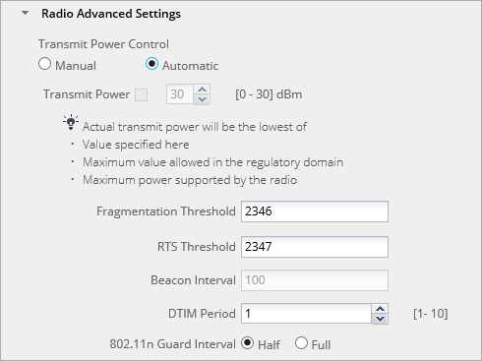
Automatic Transmit Power Control
Configured in the Radio Advanced Settings in a Device Template
Disabled by default

Slide 7
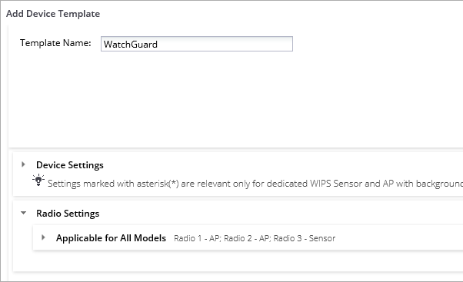
Consolidated Device Templates
Device templates are no longer specific to the AP hardware type
All AP models are now managed through a single configuration in the template; you do not need a separate configuration for each device type
Model-specific settings are only used by the AP to which they apply

Slide 8
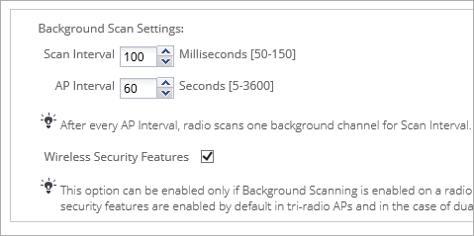
Background Scanning and WIPS Decoupled
Background scanning has been decoupled from WIPS security scanning
You can enable Background Scanning for radio communication optimization without WIPS scanning
When Background Scanning is enabled, to disable WIPS scanning, clear the Wireless Security Features check box

Slide 9
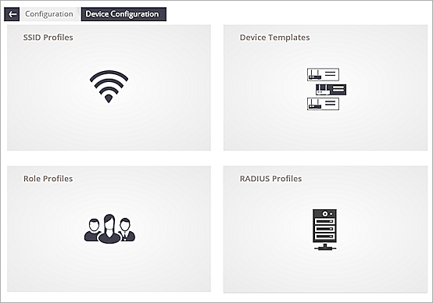
RADIUS Profiles
You can now create RADIUS server profiles for:
  RADIUS MAC authentication
  Captive Portal with RADIUS authentication
  802.1x security
Use a single RADIUS server configuration instead of multiple
SSID Profile RADIUS settings
After you upgrade to v8.5, existing RADIUS configurations are converted to profiles

Slide 10
RADIUS MAC Authentication Enhancements
If a client’s secondary RADIUS MAC authentication fails, you can:
  Disconnect the unauthorized client device
  Assign a Role Profile role to the user
    For example, you can prevent unauthorized devices from getting access to certain VLANs
  Assign the SSID Profile to the client
    For example, you can redirect the client to a portal defined on the SSID that provides information about why access was denied or provide instructions for self-registration
    With subsequent attempts by these clients, the RADIUS server can authenticate their MAC addresses and assign a role for successful clients

Slide 11
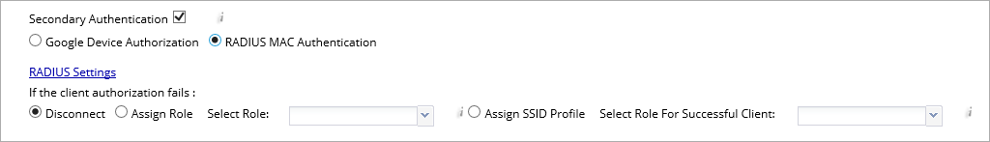
RADIUS MAC Authentication Enhancements

Slide 12
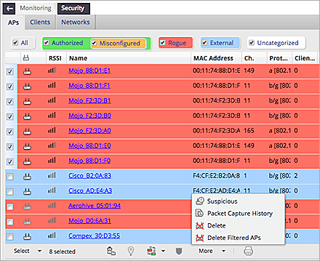
Monitor Suspicious APs
To monitor unmanaged APs, mark them Suspicious
This enables you to track performance data for the AP
No client information is logged
To see performance graphs, click APs that are marked Suspicious

Slide 13
Cloud Integration Point
Cloud Integration Point (CIP) enables the integration of WatchGuard Wi-Fi Cloud with on-premise controllers such as:
  Aruba Mobility Controller
  Cisco Wireless LAN Controller (WLC)
  HP Multi-Service Mobility (MSM) Controller
Enables Wi-Fi Cloud to get information about devices managed by these third-party controllers
Wi-Fi Cloud can use this information for Wireless Intrusion Prevention System (WIPS) classification and location tracking of devices

Slide 14
Cloud Integration Point
Integration with Enterprise Security Management (ESM) servers enables Wi-Fi Cloud to send events and audit logs to these servers:
  ArcSight
  Syslog server
Enables users to manage Wi-Fi Cloud events and logs with their existing infrastructure

Slide 15
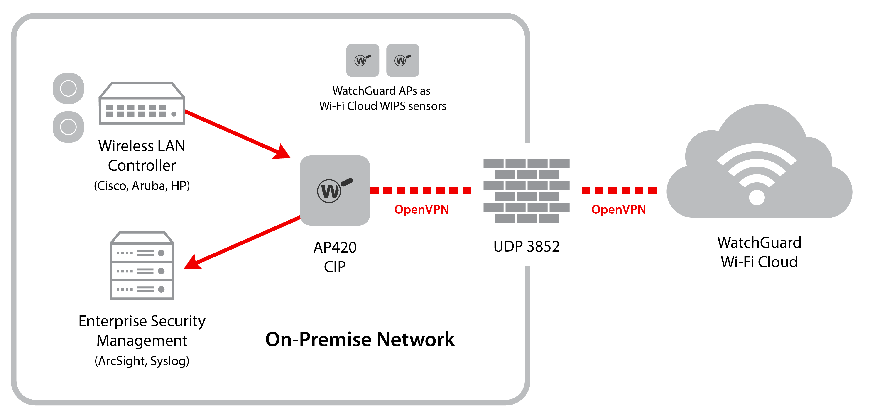
Cloud Integration Point
On-premise third-party controllers typically reside on a private network behind a firewall
Wi-Fi Cloud can use an AP420 installed as a Cloud Integration Point (CIP) in the customer network

Slide 16
Cloud Integration Point
The CIP creates a secure OpenVPN tunnel to Wi-Fi Cloud over UDP port 3852, secured with AES-256-CBC encryption
Wi-Fi Cloud can then get data from the on-premises controller

Slide 17
Configure Cloud Integration Point
In Monitoring > Managed Devices, select an AP420 to run as the CIP
We recommend a static IP address for the AP
In the AP properties, enable the CIP Mode Enabled option, and set the option to Yes

Slide 18
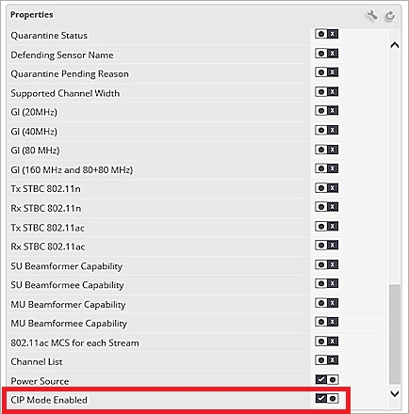
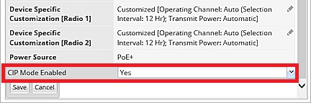
Configure Cloud Integration Point

Slide 19
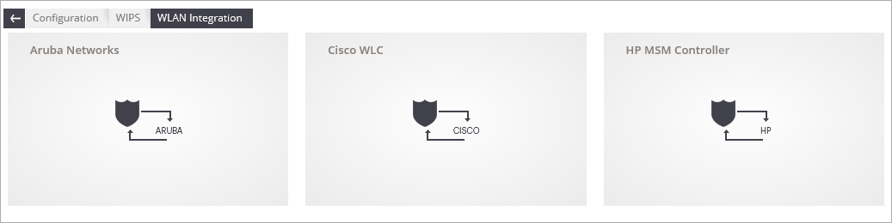
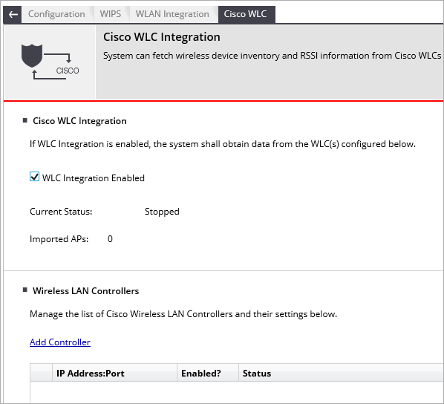
Configure Cloud Integration Point
Select Configuration > WIPS > WLAN Configuration, and select an on-premise controller to configure

Slide 20
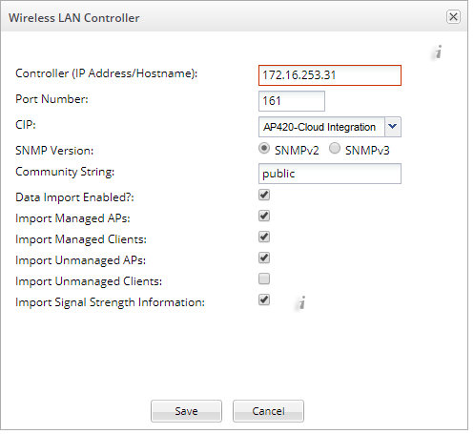
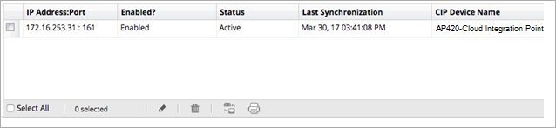
Configure Cloud Integration Point
Add the IP address of the controller and select the CIP name

Slide 21
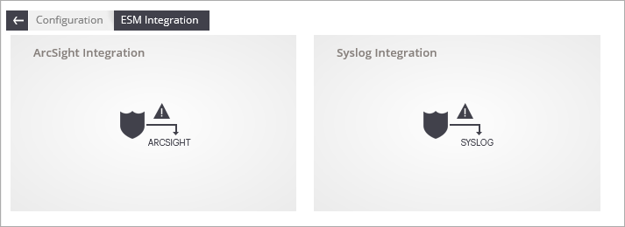
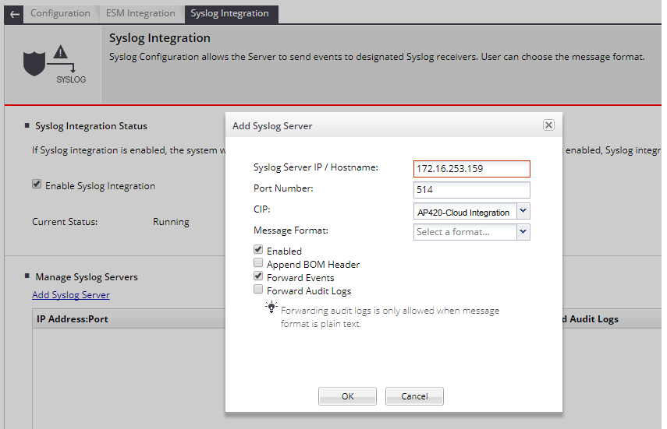
Configure Cloud Integration Point
To add CIP integration for an ArcSight or Syslog server, select Configuration > ESM Integration

Slide 22
Other Enhancements

Slide 23

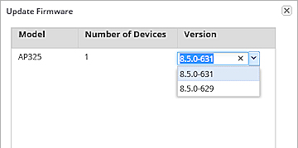
Other Enhancements
AP Upgrades over Port 443
  AP upgrades now occur securely over HTTPS port 443
  If this port is unavailable or blocked, after three attempts, the upgrade process occurs over HTTP port 80
AP Firmware Downgrade
  You can now update the firmware on an AP to a previous firmware version

Slide 24
Other Enhancements
Clients now do not have to reauthenticate to a captive portal splash page when an AP reboots or while the client roams between APs
  Prevents session disruption and having to log in to the portal again
Enhanced Bridging Client Detection
  Advanced techniques have been added to detect if authorized clients are bridging between the authorized network and another network

Slide 25
Other Enhancements
DFS Channel Enhancements
  Added DFS channel support for the AP420
  DFS channels on all AP models are now disabled by default
  You must explicitly enable DFS channels in a Device Template
AP325 Support
  802.11ac 2x2 MU-MIMO Wave 2 access point with third scanning radio is ideal for low-to-medium density deployments

Slide 26
Other Enhancements
Preconfigured Country Code for Israel and Egypt
  AP325 and AP420 devices sold to Israel and Egypt can be configured with their respective country codes when they are manufactured
  The country code is preserved when an AP is factory-reset
Google+ Authentication Support Deprecated
  Google+ has been deprecated by Google
  Google+ authentication for portal splash pages is no longer available

Slide 27
Thank You!

