Slide 1
What’s new in Wi-Fi Cloud 13.0

Slide 2
What’s new in Wi-Fi cloud 13.0
Deprecation of the Manage Application
Device Settings Moved
Monitor Switches
Bluetooth Scanning
VXLAN over IPSec
Spectrum Analysis Enhancements
Channel Map
Access Points and Clients Explorer
DHCP Fingerprinting-based Access Control
Import Device Lists
SAML Authentication Plug-in

Slide 3
New Features and Enhancements

Slide 4
Deprecation of the Manage Application
The legacy Manage application is now deprecated and no longer appears in the Launchpad
You must perform all Wi-Fi network management, configuration, and monitoring in Discover
If you still require access to Manage, click the WatchGuard Logo in the top-left corner of the page in Discover, then select the UI link in the Service Build section

Slide 5
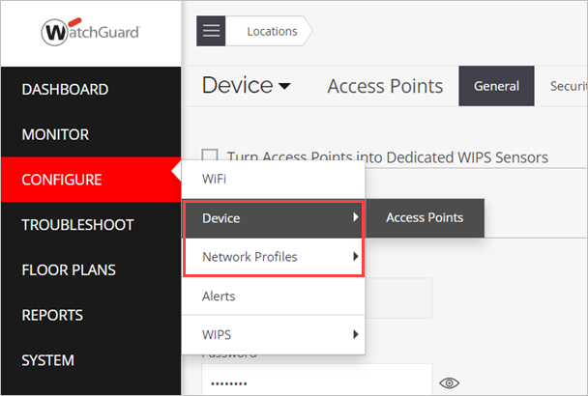
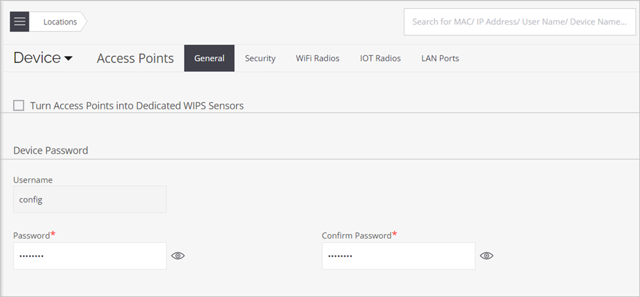
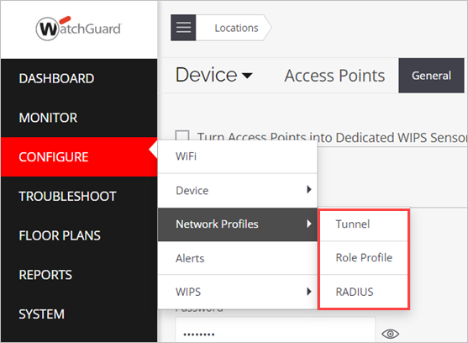
Device Settings Moved
The Device Settings are now located in the Configure > Device menu
The Tunnel/Role Profile/RADIUS configurations are are now located in the Configure > Network Profiles menu
Previously, these settings were in the Configure > WiFi menu

Slide 6
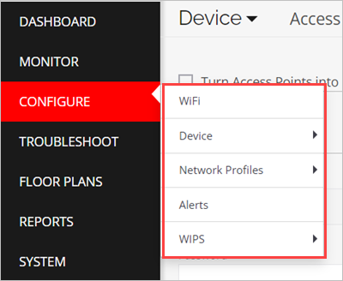
Other Configure Menu Changes
WiFi – Configure, enable, and disable SSIDs (all other settings are moved)
Device > Access Points
Device (General device settings)
Security (VLAN monitoring, WIPS settings)
Wi-Fi Radios (Wireless radio settings)
IoT Radios (Bluetooth settings)
LAN Ports (AP interface settings)
Network Profiles – Includes RADIUS, Tunnel, and Role Profile configurations

Slide 7
Monitor Switches
You can now monitor the network switches that connect your APs to the network from the Monitor > Wired menu
This feature uses LLDP to monitor details such as the switch vendor name, number of APs connected to the switch, and number of clients connected to the switch through a connected AP

Slide 8
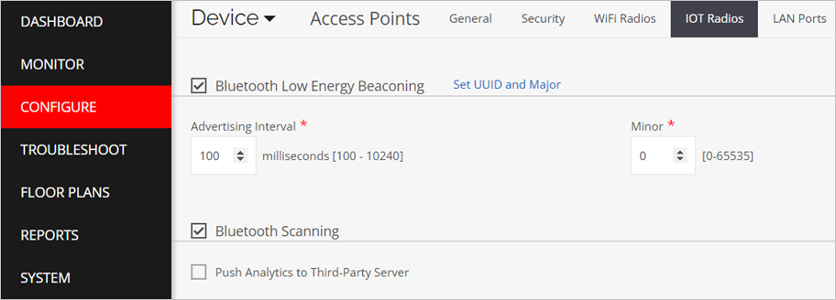
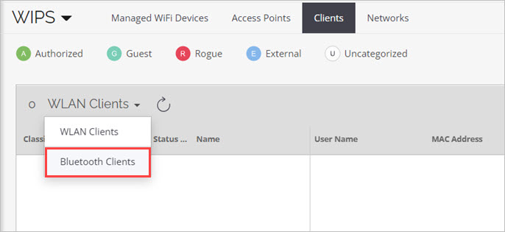
Bluetooth Scanning
You can now scan and detect nearby Bluetooth devices on the AP225W, AP325, and AP327X
To enable Bluetooth Scanning, go to the Configure > Device > Access Points > IoT Radios tab
You can view detected Bluetooth devices on the Monitor > WIPS > Clients page in the Bluetooth Clients drop-down list

Slide 9
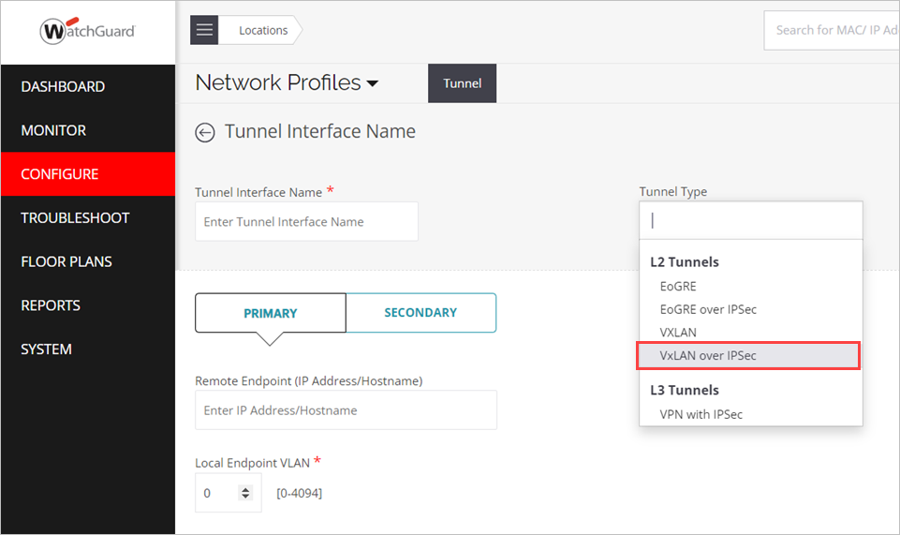
VXLAN over IPSec
You can now configure a VXLAN over IPSec tunnel for an AP on the Configure > Network Profiles > Tunnel page
This adds an extra layer of security to the VXLAN packets to protect client’s data from interception or modification

Slide 10
Spectrum Analysis Enhancements
Spectrum analysis now includes additional charts for Signal Strength, Duty Cycle, and Spectrum Density
You can run Spectrum Analysis from Monitor > WiFi > Access Points in the actions for an AP with a third radio (AP225W, AP325, and AP420)
Spectrum Analysis is no longer available from the Troubleshoot menu

Slide 11
Channel Map
In the Monitor > WiFi > Access Points details page for an AP, you can now view a Channel Map chart that shows the number of APs and clients detected by the AP on each channel
To view the channel map, select Channel Map from the drop-down menu in the Spectrum Occupancy chart

Slide 12
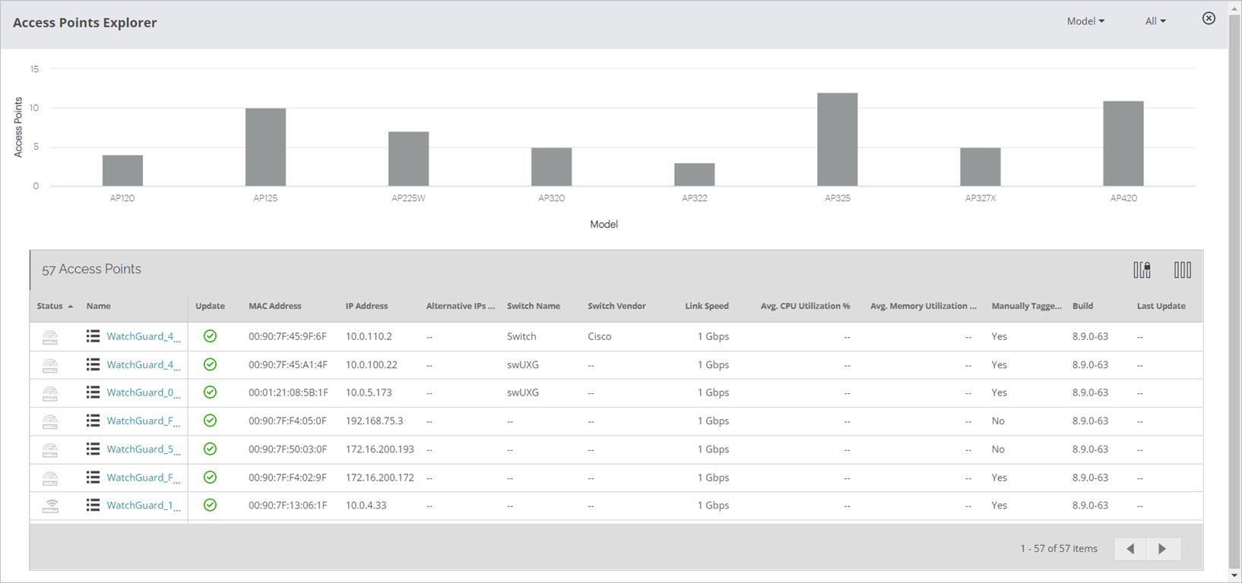
Access Points Explorer
The Monitor > WiFi > Access Points page now includes an Access Point Explorer that helps you view the distribution of APs by attributes such as model, software version, and status

Slide 13
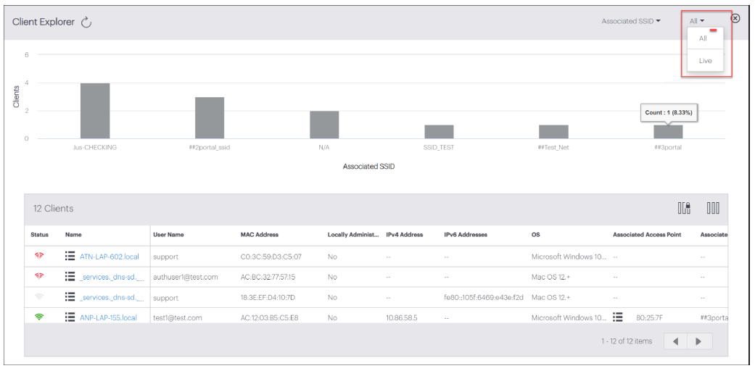
Client Explorer
The Monitor > WiFi > Clients page now includes a Client Explorer that helps you view the distribution of clients by attributes such as associated SSID, OS, and status

Slide 14
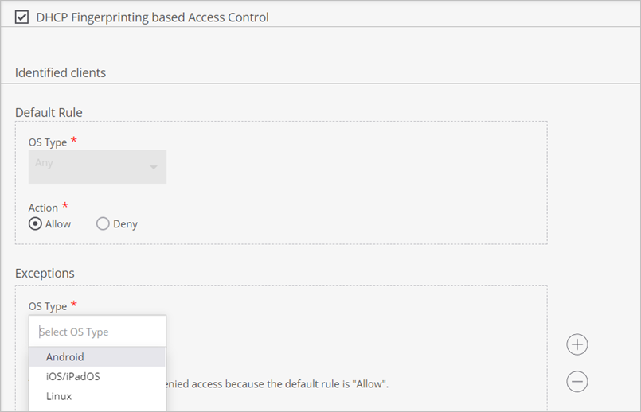
DHCP Fingerprinting-based Access Control
You can now use DHCP Fingerprinting-based access control on the AP420 to allow or deny client connections for an SSID based on the detected OS type of the client
To configure DHCP Fingerprinting, go to Configure > WiFi > SSID, select the Access Control tab, then select DHCP Fingerprinting based Access Control

Slide 15
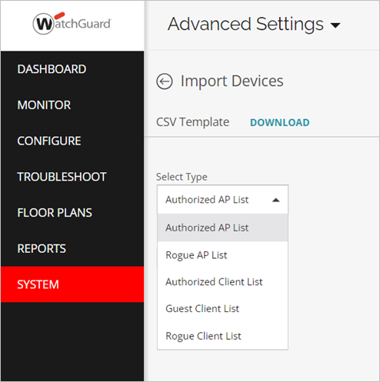
Import Device Lists
In System > Advanced Settings > Import Devices, you can now import a list of devices for:
Authorized APs
Rogue APs
Authorized Clients
Guest Clients
Rogue Clients
Managed Devices

Slide 16
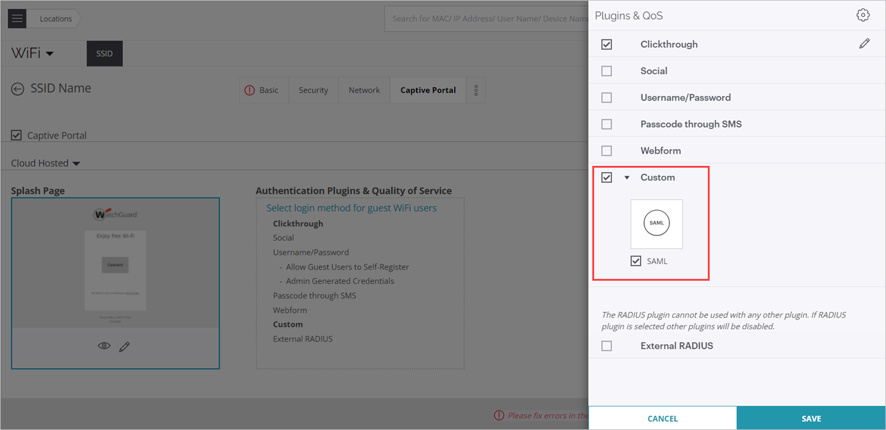
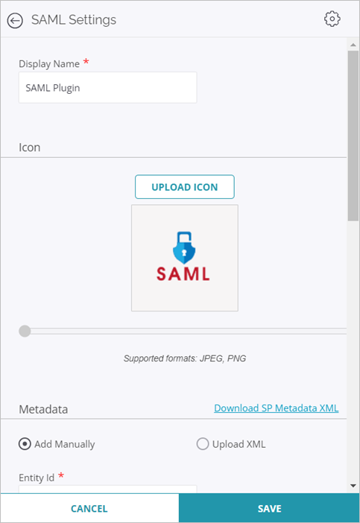
SAML Authentication Plug-in
In the SSID Captive Portal settings, you can now select a new SAML authentication plug-in to authenticate clients with an identity provider (IdP)

Slide 17
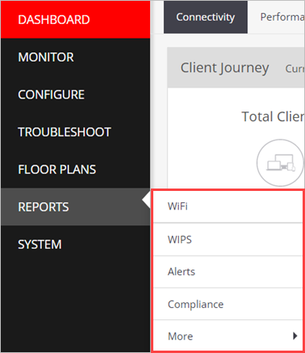
Reports Menu Changes
WiFi – Device inventory and Connectivity reports
WIPS – WIPS device inventory and Policy Enforcement reports
Alerts – System, Wi-Fi, and WIPS alert reports
Compliance – DoD, HIPAA, PCI DSS, and other compliance reports
More – View scheduled, completed, and saved reports

Slide 18
Other Enhancements

Slide 19
Other Enhancements
You can now use Scheduled mode with Automatic Channel Selection (ACS) that enables you to schedule ACS scans up to two times a day
In the 5 GHz radio device settings, you can now select the Use DFS history in channel selection option to optimize automatic channel selection based on the DFS detection history
The baseline charts on the Monitor > WiFi > Clients > Client Details page now include charts for Retry Rate and RSSI
Wi-Fi Cloud now detects high DHCP/AAA/DNS server latency for client root cause analysis
The Access Point logs now show the factors that cause an AP to change its channel due to ACS, DCS, and DFS events
Role Profiles now support redirection of clients to a URL returned from a RADIUS server

Slide 20
Other Enhancements
802.11r settings are moved from the Security tab to the RF Optimization tab in the SSID settings
Enhanced Managed WiFi Device Inventory, WiFi Access Point Details, and Client Connectivity reports are available on the Reports page
You can now add additional CoA server IP addresses and a shared secret when you configure Enterprise RADIUS authentication
This enables organizations with load balancer deployments to add additional CoA server IP addresses to directly send CoA requests from RADIUS servers to APs
APs accept the authentication and authorization messages from a load-balancer server and CoA requests from RADIUS servers

