Slide 1
What’s new in Wi-Fi Cloud 11.0

Slide 2
What’s new in Wi-Fi cloud 11.0
Scheduled AP Firmware Update Enhancements
Offline WIPS Settings
Custom Applications Experience
RADIUS Enhancements
Flash AP LEDs
Other Enhancements

Slide 3
Scheduled AP Firmware Update Enhancements

Slide 4
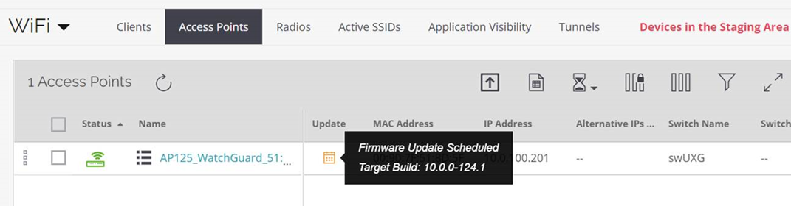
Scheduled AP Firmware Update Enhancements
Wi-Fi Cloud now provides improved visibility for scheduled device updates:
New Scheduled Update icon that shows the version for the next scheduled update

Slide 5
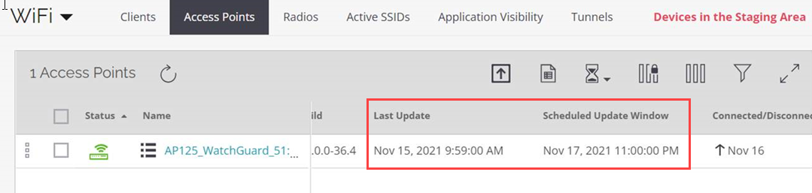
Scheduled AP Firmware Update Enhancements
Additional columns in Monitor > WiFi > Access Points indicate the last successful update and the next scheduled update window

Slide 6
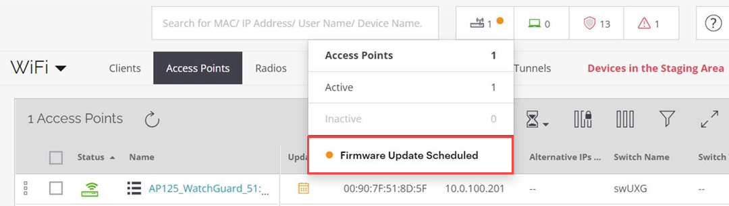
Scheduled AP Firmware Update Enhancements
Scheduled Update Notification in the network counters at the top of the page

Slide 7
Offline WIPS Settings

Slide 8
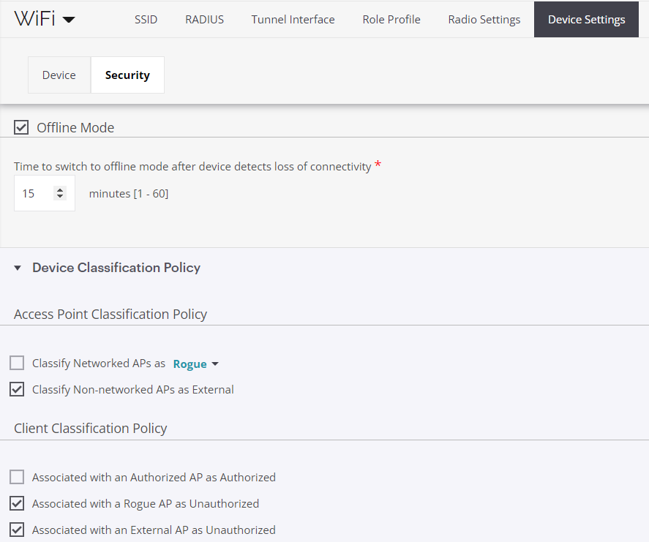
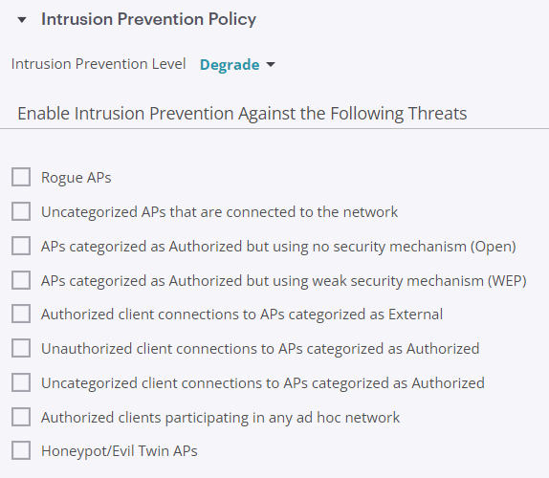
Offline WIPS Settings
You can now apply Offline mode settings for WIPS Device Classification and Intrusion Prevention Policy to access points
The AP can provide some device classification and prevention capabilities when it is disconnected from Cloud services
Select Configure > WiFi > Device Settings > Security

Slide 9
Custom Applications Experience

Slide 10

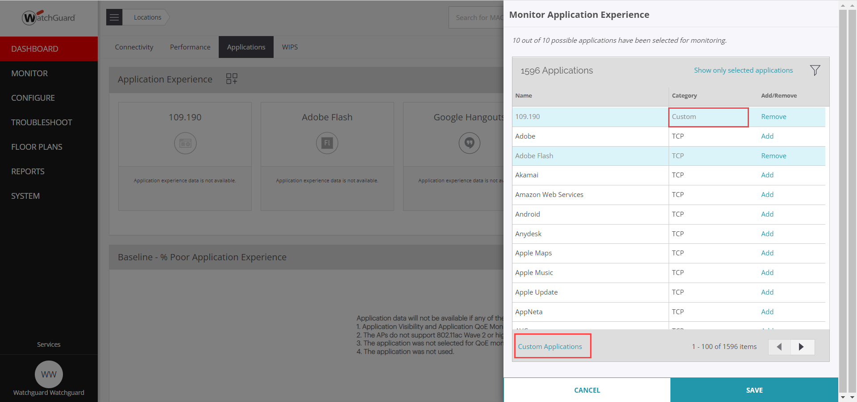
Custom Applications Experience
You can add custom applications to the current Applications Experience Dashboard
Click to open the Monitor Application Experience configuration

Slide 11
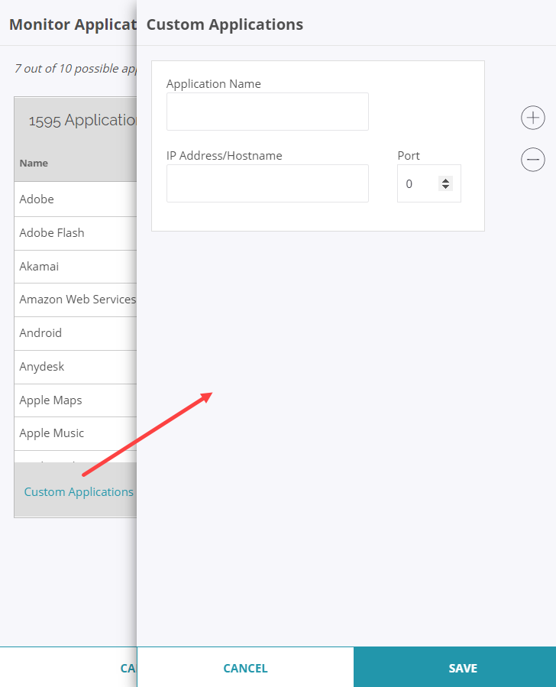
Custom Applications Experience
Click Custom Applications to add the details of a custom application you want to monitor:
Application Name
IP Address/Hostname
Port

Slide 12
RADIUS Enhancements

Slide 13
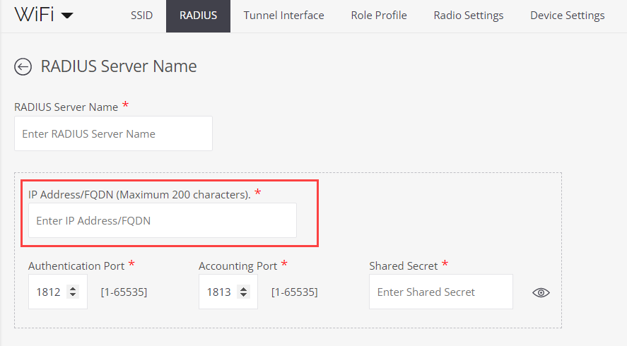
RADIUS Enhancements
You can now define RADIUS servers by a hostname in addition to an IP address

Slide 14
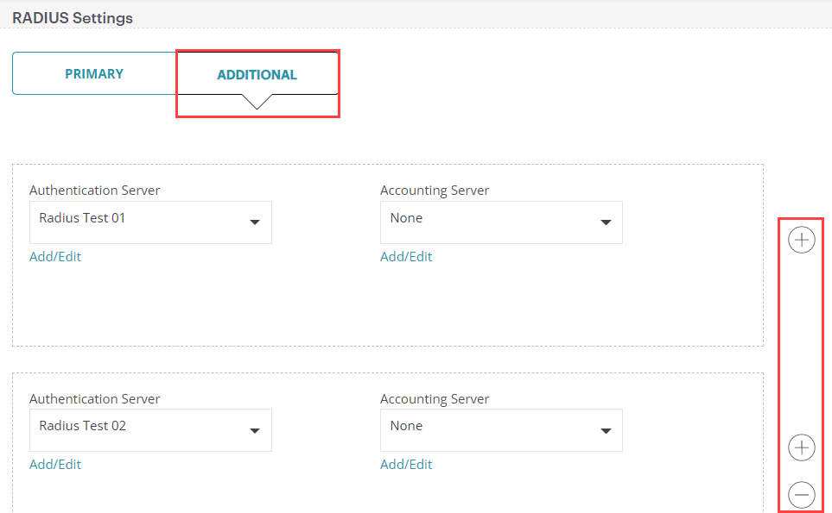
RADIUS Enhancements
You can now define up to 3 backup RADIUS servers in addition to the primary RADIUS server when you configure RADIUS authentication

Slide 15
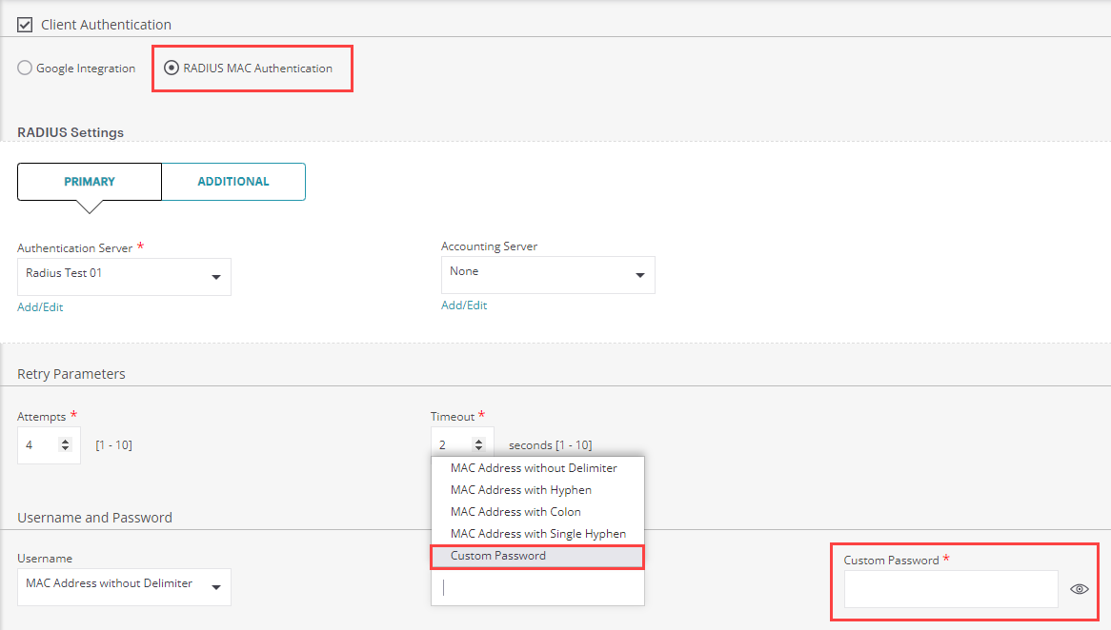
RADIUS Enhancements
You can now use set a custom password in RADIUS MAC authentication for an SSID

Slide 16
Flash AP LEDs

Slide 17
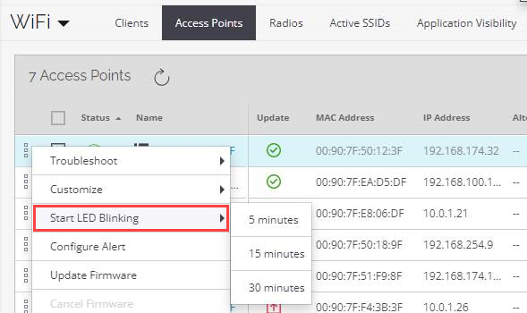
Flash AP LEDs
You can now flash the AP LEDs from the Monitor > WiFi > Access Points page
This is useful if you have disabled LEDs on the AP for security reasons and you want to identify the AP
Right-click an AP, then select Start LED Blinking
Select a duration of 5, 15, or 30 minutes.
Only supported on 802.11ac Wave 2 access points

Slide 18
Other Enhancements

Slide 19
Other Enhancements
Real-time visualization is now available in Discover for AP and client troubleshooting, with enhanced support to identify root causes for wireless client connectivity issues and troubleshoot new clients not yet seen by Wi-Fi Cloud
The Capability column in Monitor > WiFi > Clients now indicates if a client is 802.11ac Wave 1 or Wave 2
You can now place unmanaged authorized devices on a floor plan so you can view the heat map for these devices
The Dynamic VLAN limit on an AP has been raised from 64 to 128

