Slide 1
What’s new in Wi-Fi Cloud 10.0

Slide 2
What’s new in Wi-Fi cloud 10.0
AP Health and Performance Widgets
VLAN Names
Web-Based Applications Experience
Floor Plan Enhancements
System Language Preferences
Auto Deletion Enhancements
Download Inventory List
mDNS Tagging
Other Enhancements

Slide 3
AP Health and Performance Widgets

Slide 4
Feature Benefits
From the Monitor > WiFi > Access Points page in Discover, you can now view additional information widgets when you select a specific AP:
AP health and performance data
Channel/Frequency band utilization
Radio frequency (RF) conditions in the vicinity of the AP

Slide 5
AP Health
A new AP Health widget shows the average CPU and memory utilization of the AP for the selected duration

Slide 6
Average Data Rate
A new Baseline – Average Data Rate widget shows the average data rates for the 2.4 GHz or 5 GHz frequency bands for the selected SSIDs and duration

Slide 7
Channel Utilization
A new Channel Utilization widget shows the utilization of the 2.4 GHz and 5 GHz bands (as a percentage) for the selected duration
This helps you identify congested or under-utilized frequency bands

Slide 8
Spectrum Occupancy
A new Spectrum Occupancy widget shows the number of AP radios and clients that were active in a radio frequency band during the selected duration
Click RF Explorer to show what an AP detects in its RF neighborhood

Slide 9
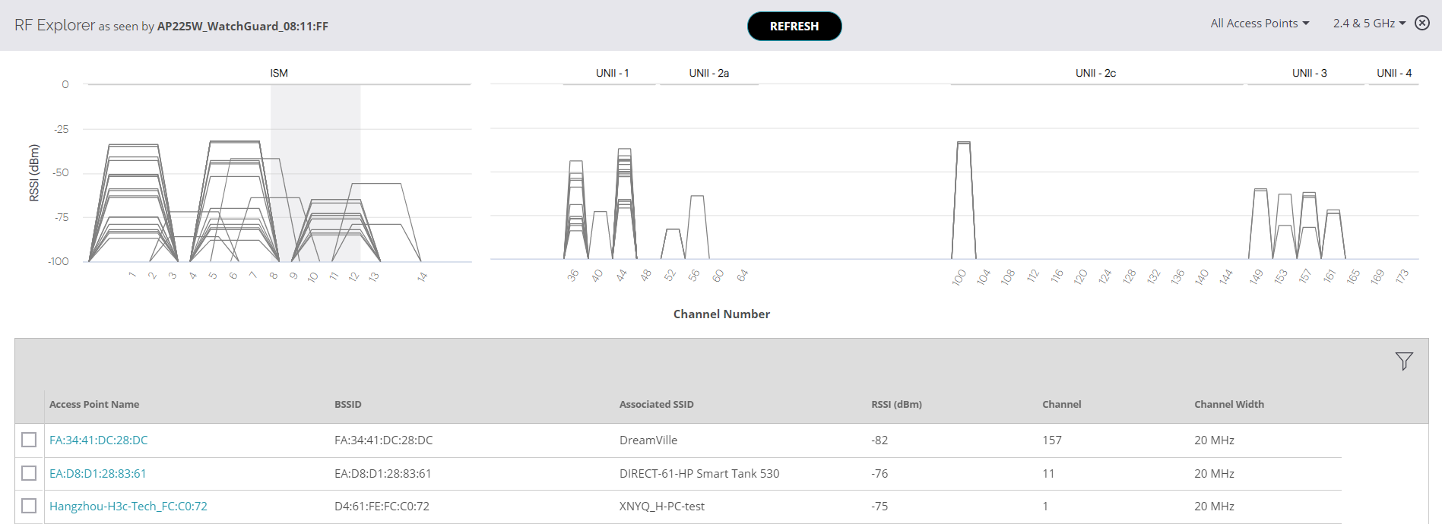
RF Explorer
The RF Explorer enables you to see other APs detected in the vicinity, their signal strength values, and the channels the APs occupy
Helps you identify co-channel and adjacent channel interference, and DFS channels in use by APs

Slide 10
VLAN Names

Slide 11
Feature Benefits
In the SSID configuration for a location, you can specify a VLAN Name instead of a VLAN ID
This enables dynamic resolution of VLAN Names to one or more VLAN IDs so you can map different VLAN IDs at multiple locations to the same SSID
Previously, to use the same SSID with a different VLAN ID in a different location, you had to copy the SSID profile and then change the VLAN ID

Slide 12
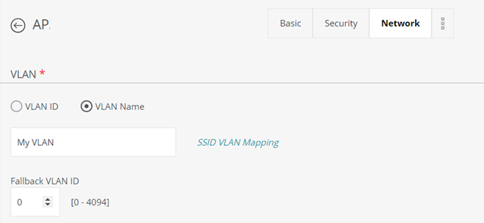
VLAN Names
In the SSID configuration Network tab, specify a VLAN Name instead of a specific VLAN ID
You can also specify a Fallback VLAN ID to use if the mapped VLAN Name and ID are unavailable

Slide 13
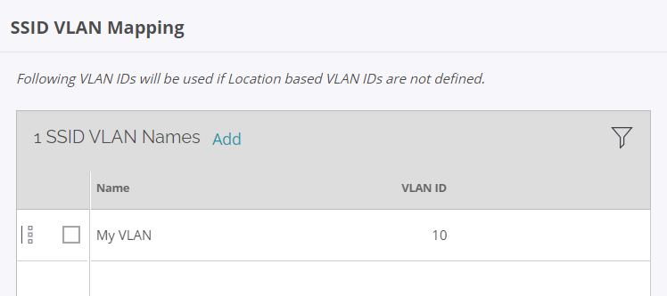
VLAN Names
Click SSID VLAN Mapping to add VLAN Name and ID mappings for the SSID

Slide 14
VLAN Names
You can also configure location-based VLAN mapping where the VLAN ID is mapped to a VLAN name at a specific location
Use location-based VLAN mapping as an exception for some selected locations where the VLAN ID for the required VLAN name does not exist
Location-based VLAN mapping takes preference over the SSID VLAN mapping

Slide 15
VLAN Names
To configure location-based VLAN mapping:
From Discover, select Configure > WiFi
Click then select Location Based VLAN Mapping

Slide 16
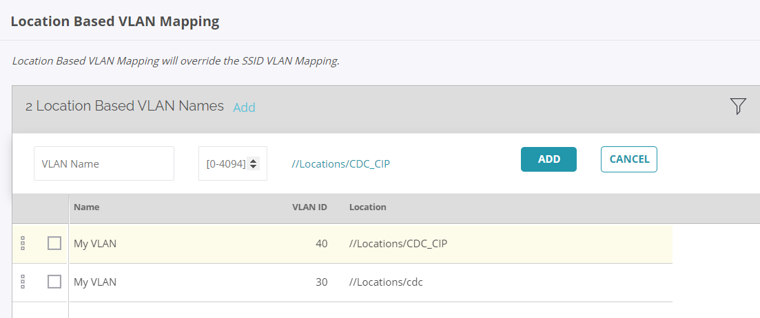
VLAN Names
To add a VLAN name and mapping for the selected location, click Add

Slide 17
Web-Based Applications Experience

Slide 18
Feature Benefits
In addition to the current conferencing application quality and experience measurements, Wi-Fi Cloud v10.0 now enables you to monitor web-based enterprise applications such as:
Cloud services
Web-based Email and office applications
Human resources and project management applications
Online drives
Custom applications that you define

Slide 19
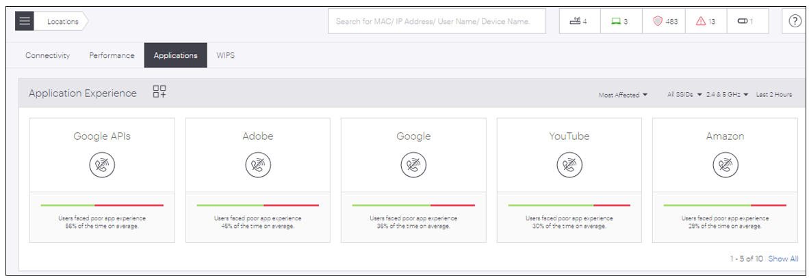
Web-based Applications Experience
From Discover, select Dashboard > Applications

Slide 20
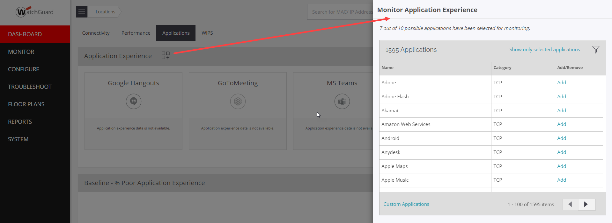
Web-based Applications Experience
Click to open the Monitor Application Experience configuration
Select up to 10 applications to monitor

Slide 21
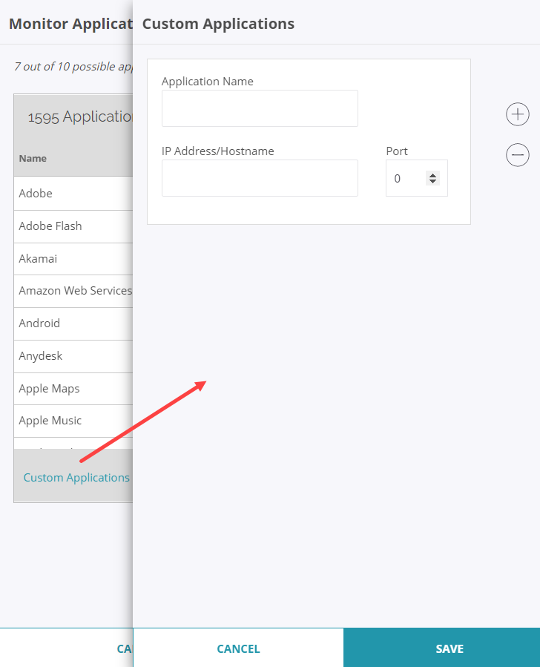
Web-based Applications Experience
Click Custom Applications to add the details of a custom application you want to monitor:
Application Name
IP Address/Hostname
Port

Slide 22
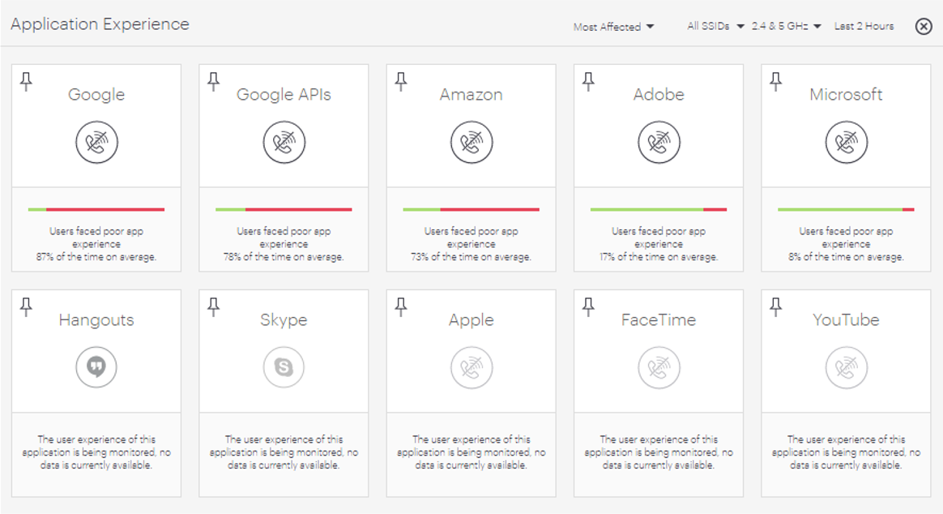
Web-based Applications Experience
You can pin a maximum of 5 out of the 10 applications in the Application Experience widget
To see all 10 applications, click Show All
If you do not pin any applications, you can show the Most Affected or Most Used applications

Slide 23
Web-based Applications Experience
A new Clients by Application Experience widget shows the total number of clients with poor application experience for the selected applications and time period

Slide 24
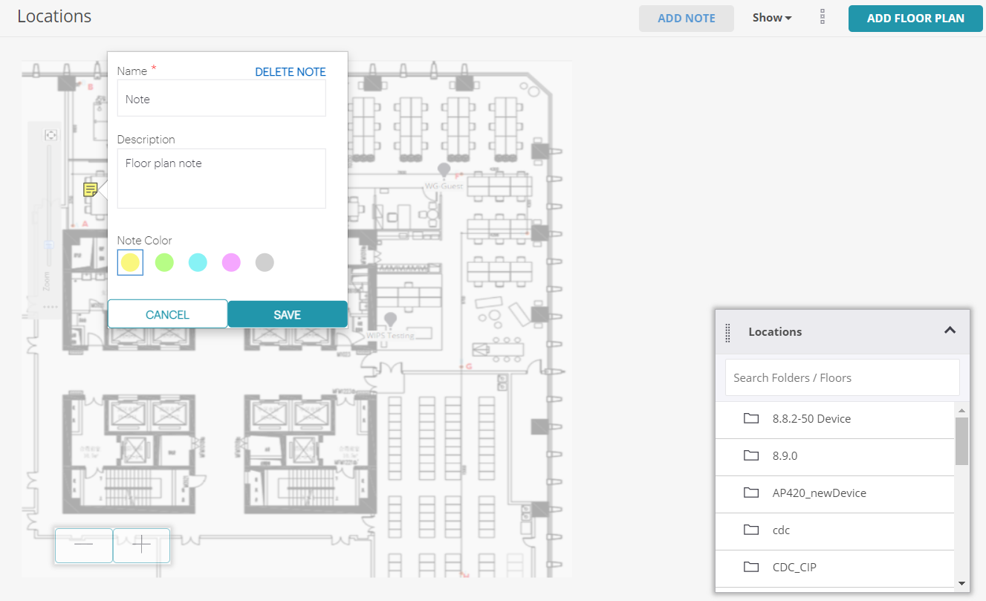
Floor Plan Enhancements
You can now add floor plan images to location folders, add notes to floor plans, and drag and drop subfolder locations on to a floor plan

Slide 25
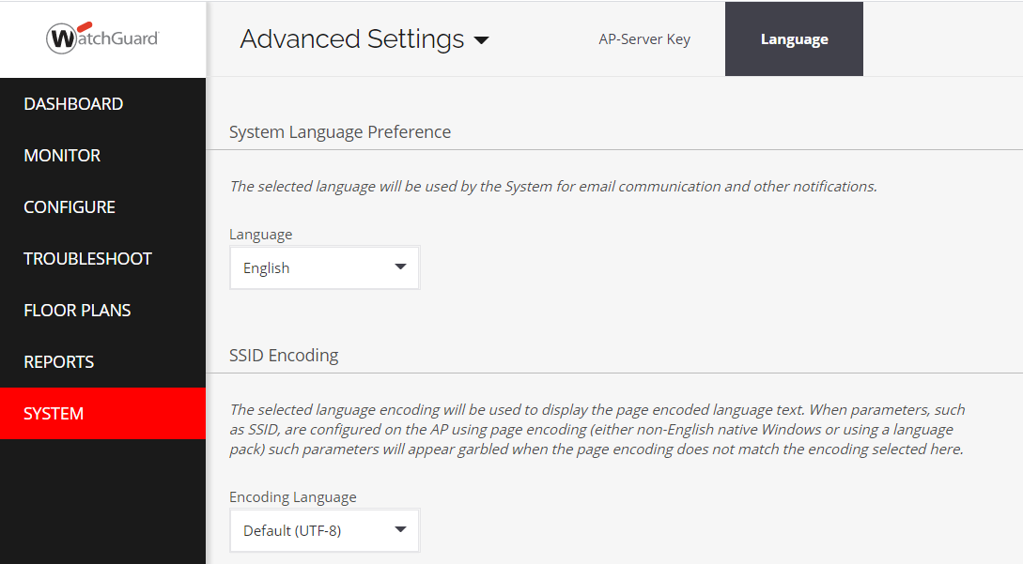
System Language Preferences
You can now set a default language for system notifications and email notifications in the System > Advanced Settings > Language tab

Slide 26
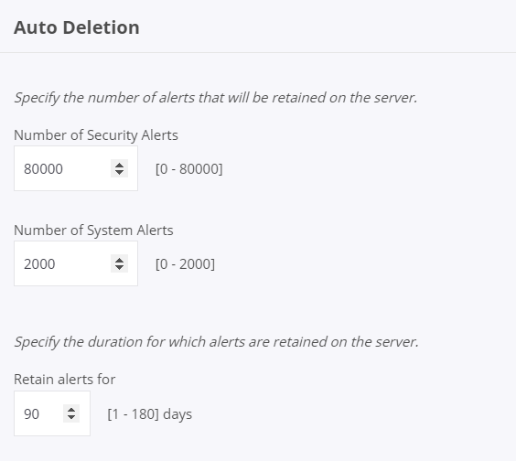
Auto Deletion Enhancements
You can define new auto deletion settings for alerts from Configure > Alerts > Auto Deletion
Configure the number of system and security alerts to retain on the server
Configure the total number of days to retain alerts

Slide 27
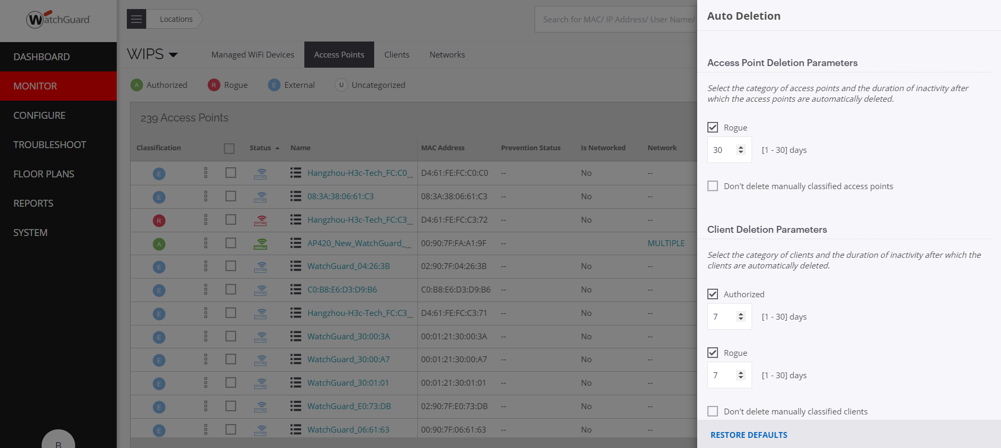
Auto Deletion Enhancements
In Monitor > WIPS, you can now configure auto deletion settings for inactive APs, clients, and networks based on their classification

Slide 28
Download Inventory List
You can now download an inventory list of data from these pages:
Monitor > WiFi > Access Points
Monitor > WiFi > Tunnels
Monitor > WIPS > Managed WiFi Devices
Monitor > WIPS > Networks
Monitor > Alerts

Slide 29
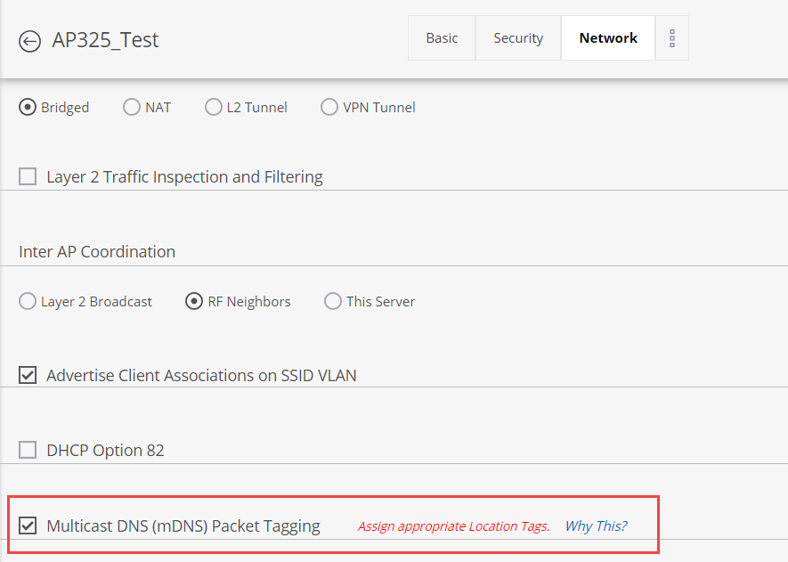
mDNS Tagging
Wi-Fi Cloud APs now support multicast DNS (mDNS) packet tagging
Enables you to resolve host names to IP addresses in networks that do not have a local name server
An mDNS gateway on your network (such as a compatible switch) filters the services returned in the response to an mDNS query from a wireless client
To enable mDNS tagging, select Configure > WiFi > SSID, then select the Network tab

Slide 30
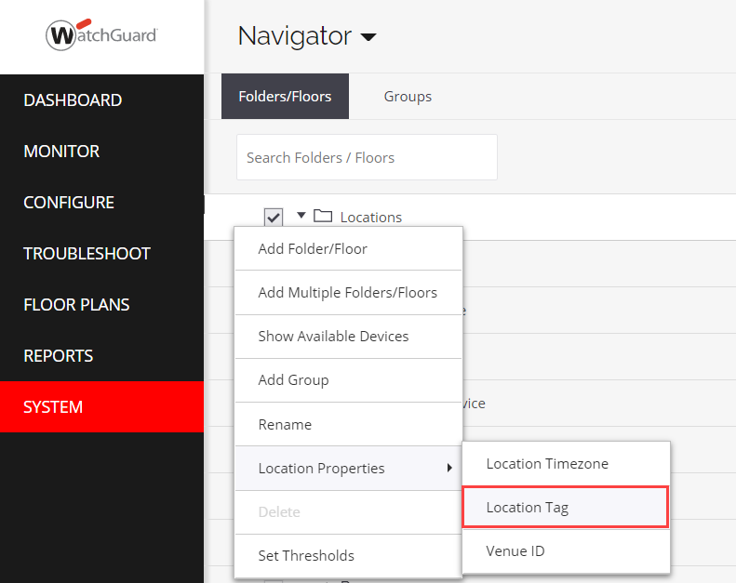
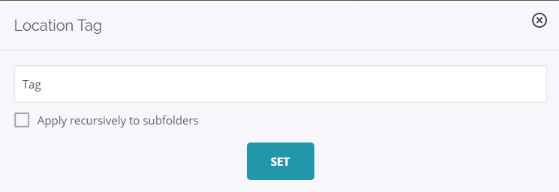
mDNS Tagging
APs can tag wireless client mDNS query packets with a location tag that you define for a specific location folder
From Discover, select System > Navigator
Right-click a location folder, then select Location Properties > Location Tag

Slide 31
Other Enhancements

Slide 32
Other Enhancements
To minimize downtime when an AP reboots, Auto Channel Selection (ACS) now uses the last best channel and does not wait to scan the radio spectrum
The time it takes to update an AP with a configuration change in the device or radio settings has been reduced by 15 seconds, and the radio downtime has been reduced to approximately 1 second (except for operating channel changes)
Configuration changes to SSIDs, WIPS, and radio changes (except for operating channel changes) no longer result in wireless client disconnections
The Root Cause Analysis widget is now more prominently displayed in the Dashboard > Performance page, and includes information on poor application experience for single wireless clients

Slide 33
Other Enhancements
You can now send events to an ArcSight Enterprise Security Management (ESM) server from Discover in System > Third-Party Servers > ArcSight Integration
You can now configure the Dead Time (the time delay before fallback to a primary server) when you enable the Prefer Primary RADIUS Server option in the SSID > Security > RADIUS Settings configuration page
From Discover, you can now open an SSH web shell for command line interface access to a specific AP
Intended for use with WatchGuard Technical Support for troubleshooting
Select Monitor > WiFi > Access Points
Right-click an AP, then click Troubleshoot > Open Web Shell

