Slide 1
Introduction to WatchGuard Advanced EPDR
General Availability – 1 June 2023

Slide 2
WatchGuard Advanced EPDR
Overview
Get Started
WatchGuard Advanced EPDR Licensing and Allocation
WatchGuard Advanced EPDR Management UI
Multi-Tenant Endpoint Security Management

Slide 3
Overview

Slide 4
WatchGuard Advanced EPDR
Advanced EPDR extends WatchGuard EPDR functionality with additional capabilities designed for security operations teams to discover undetected threats on their customer endpoints
Advanced EPDR includes advanced detection and response features such as Advanced Indicators of Attack (IOAs) and events, centralized management of Indicators of Compromise (IOCs) compatible with STIX and Yara rules, Advanced Security Policies, and remote access to detect, contain, and remediate incidents
Advanced EPDR supports these client operating systems:
Windows XP/Server 2003 and higher (Intel and ARM)
Linux
macOS (Intel and ARM)

Slide 5
Get Started

Slide 6
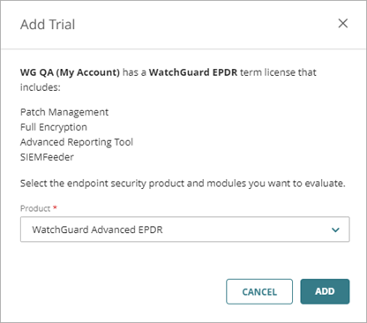
Start a Trial of WatchGuard Advanced EPDR
To start a trial of WatchGuard Advanced EPDR, in WatchGuard Cloud:
Select Overview > Administration > Trials
Select Endpoints
Enable the trial toggle for the account you enabled the beta on
Select WatchGuard Advanced EPDR
Click Add The trial can take up to two minutes to become available
For more information, go to Start a Trial in Help Center

Slide 7
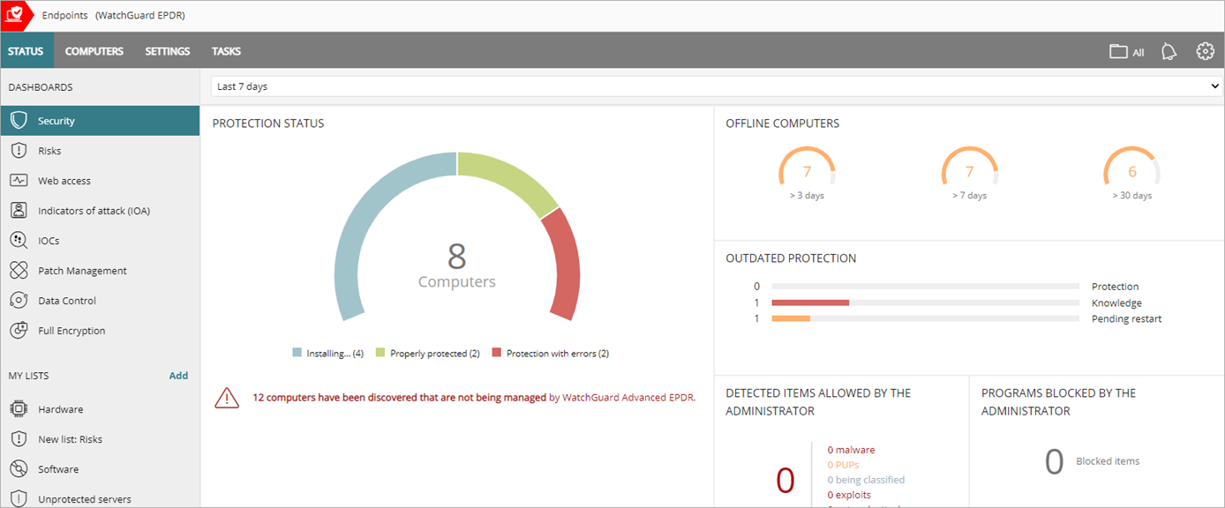
Open Advanced EPDR
To open the Advanced EPDR management UI, select Monitor > Endpoints
The WatchGuard Endpoint Agent automatically updates the endpoints to Advanced EPDR for the duration of the trial period
A restart is required on the endpoints

Slide 8
Advanced EPDR Licensing and allocation

Slide 9
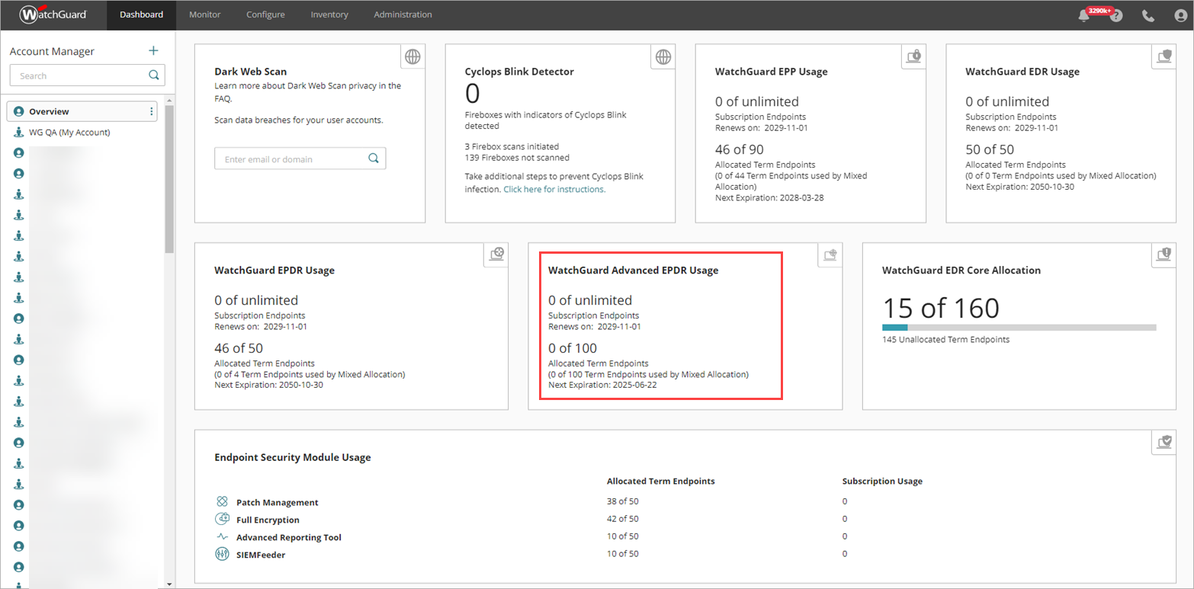
WatchGuard Cloud Dashboards
Dashboards show information on WatchGuard Advanced EPDR license allocation and expiration

Slide 10
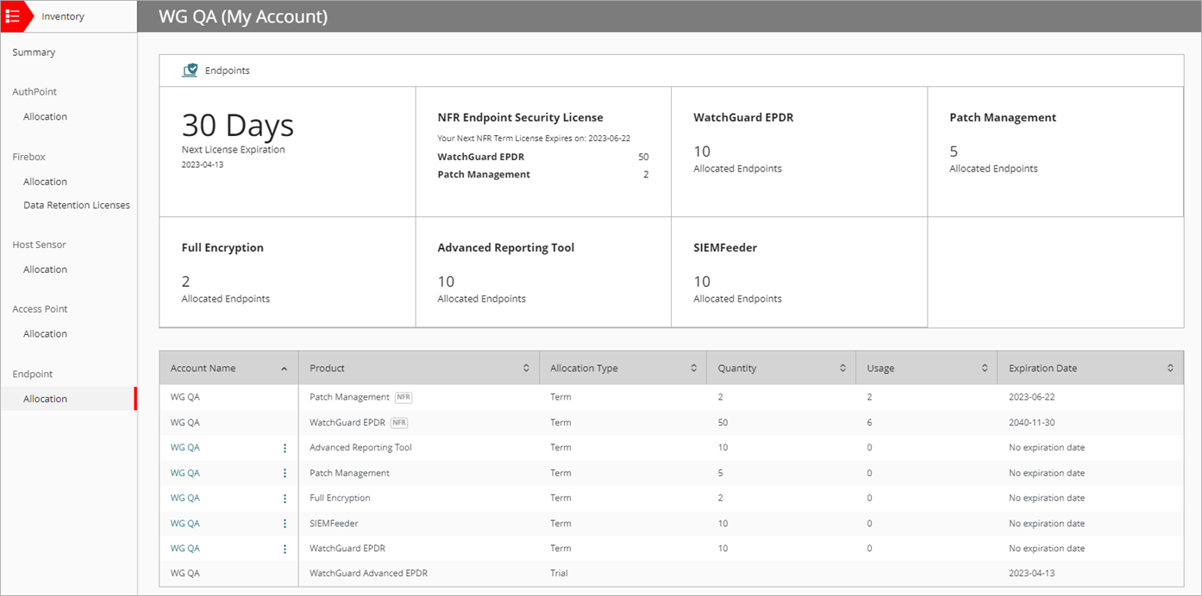
Inventory Pages
When Service Providers select Overview from Account Manager, the Inventory > Summary page shows an overview of the licenses and endpoints in your inventory, including WatchGuard Advanced EPDR
The Inventory > Endpoint > Allocation page shows the trial in progress

Slide 11
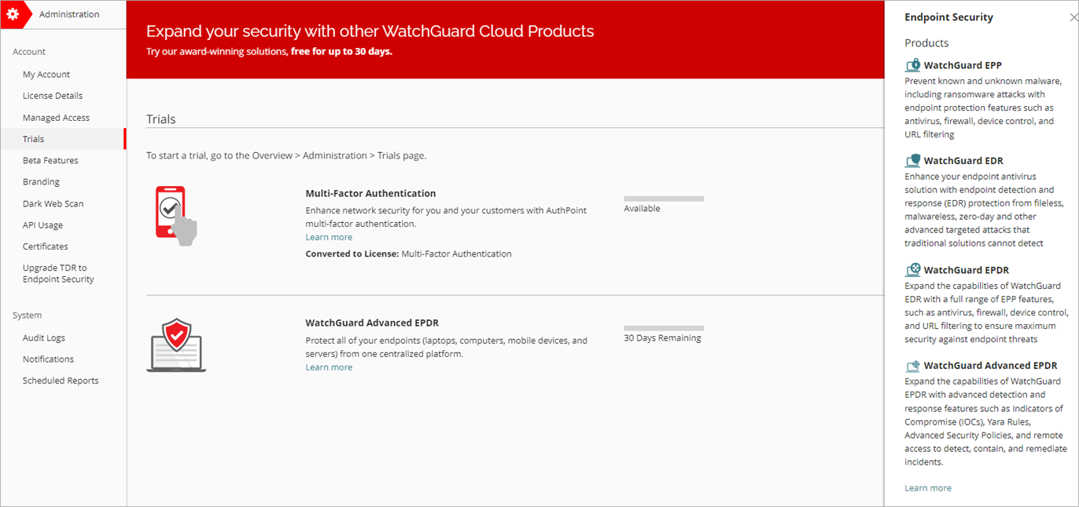
Trials Page
On the Trials page, you can see the WatchGuard Advanced EPDR trial in progress and the days remaining
To see a description of Advanced EPDR, click the Learn more link

Slide 12
Upgrade Path
At the end of the beta period, you can upgrade WatchGuard EPP, EDR Core, EDR, or EPDR to WatchGuard Advanced EPDR
You can convert the Advanced EPDR trial to a term or subscription endpoint security license
All settings in the trial transfer to the term or subscription license when you convert the license
On the Administration > Trials page, in the Account Name column, next to the account you want to convert the trial for, click and select Activate License
For more information, go to Convert a Trial to a Term or Subscription License in Help Center

Slide 13
Advanced EPDR Management UI

Slide 14
Advanced EPDR Management UI
The management UI for Advanced EPDR includes all the functionality in WatchGuard EPDR, as well as these additional features:
Advanced Security Policies
Remote Control
IOCs and YARA Rules
Advanced IOAs and events
To open the Advanced EPDR management UI from WatchGuard Cloud, select Monitor > Endpoints or Configure > Endpoints

Slide 15
Security Dashboard – Advanced EPDR
On the Security dashboard, the Protection Status tile shows the status of computers managed by WatchGuard Advanced EPDR and the number of computers in the network that are not managed by Advanced EPDR

Slide 16
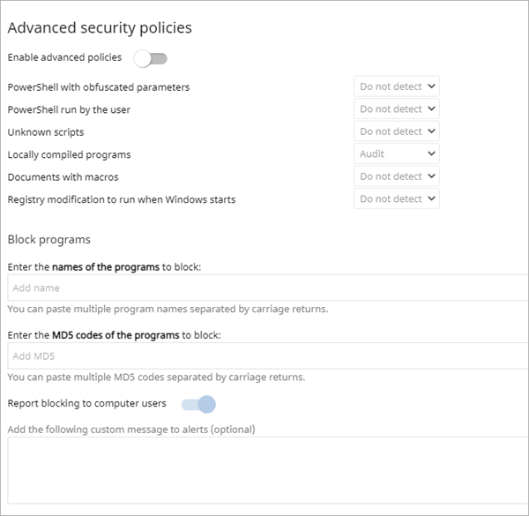
Advanced Security Policies (Windows computers)
In the Advanced Security Policies section of a Workstations and Servers settings profile, you can detect and block suspicious scripts and unknown programs that use advanced infection techniques
For each threat, select to Audit, Block, or Do Not Detect the threat

Slide 17
Advanced Security Policies
PowerShell with obfuscated parameters — The PowerShell interpreter has received suspicious parameters that could result in the execution of dangerous actions on the protected computer. This option requires that you enable the anti-exploit protection.
PowerShell run by the user — The account used to run the monitored PowerShell script is interactive and can potentially perform dangerous operations on the protected computer. This option requires that you enable the anti-exploit protection.
Unknown scripts — Scripts that have not been classified yet by WatchGuard's security intelligence team.

Slide 18
Advanced Security Policies, continued
Locally compiled programs — Programs created on the user’s computer and unknown to WatchGuard's security intelligence team.
Documents with macros — Office-type documents with macros that can perform operations that endanger the security of the protected computer.
Registry modification to run when Windows starts — The monitored program adds registry keys to become persistent on the machine, loading itself along with the operating system on every system restart.

Slide 19
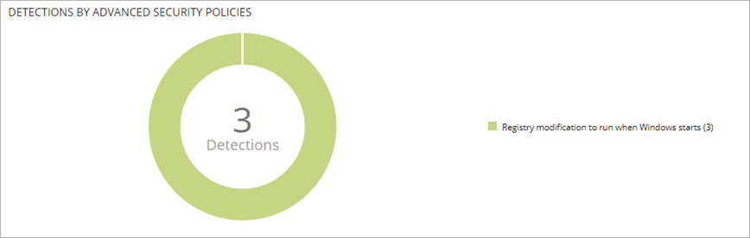
Security Dashboard – Advanced Security Policies
The Security dashboard includes the Detections by Advanced Security Policies tile
To open a list of detections, click the tile

Slide 20
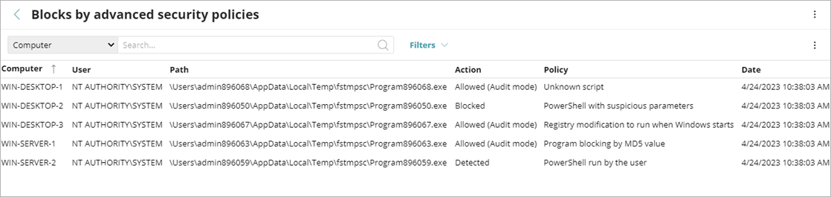
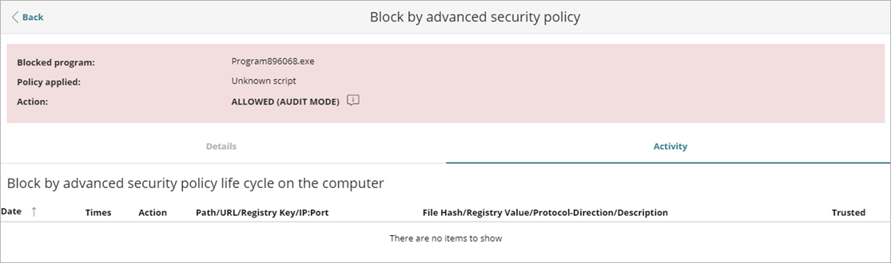
Block by Advanced Security Policy
When you select a detection from the list, you can review the blocked program and its lifecycle on the computer
On the Security dashboard, click the Detections by Advanced Security Policies tile
Select the computer you want to review the block details for
To review program activity, select the Activity tab

Slide 21
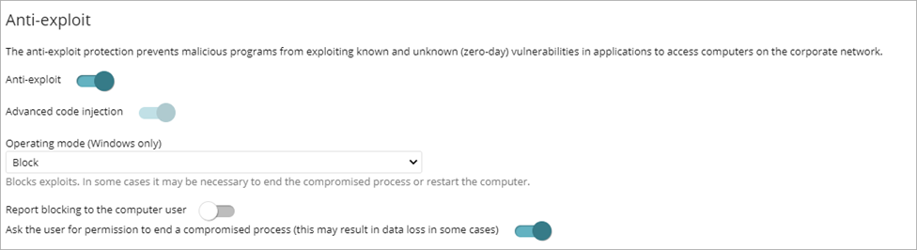
Advanced Security Policies – Advanced Code Injection
In a Workstations and Servers settings profile, the Advanced Protection > Anti-Exploit section includes an Advanced Code Injection toggle, enabled by default
Advanced code injection detects advanced mechanisms that inject code in running processes

Slide 22
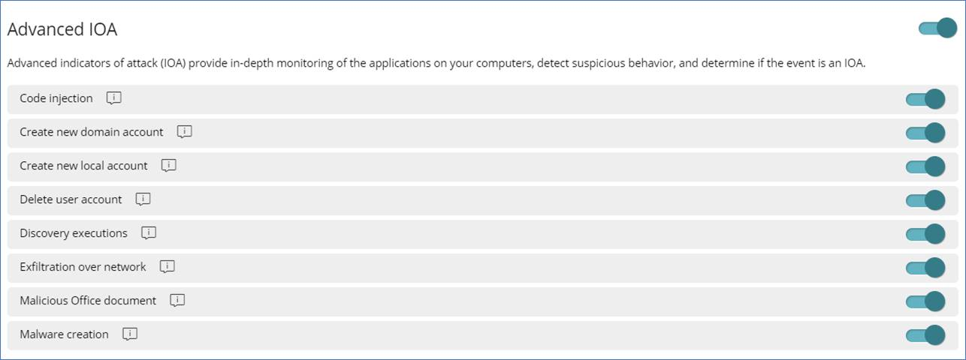
Advanced IOAs (Windows computers)
On the Settings > Indicators of Attack page, IOAs now include Advanced IOAs
Advanced IOAs provide in-depth monitoring of the applications on your computers, to detect and investigate techniques used by hackers
Advanced IOAs are enabled by default in new accounts

Slide 23
Advanced IOA Details Page – Activity Tab
In Advanced EPDR, the IOA details page includes an Activity tab for Advanced IOAs
On the Activity tab, you can see the detected actions for the Advanced IOA, including when activity was detected and the MITRE technique and sub-technique
Click a row in the table to show detailed information (for example, event type, parent, and child information) in an Event Details dialog box
On the MITRE tab, you can review detailed MITRE information (for example, tactic, technique, description)

Slide 24
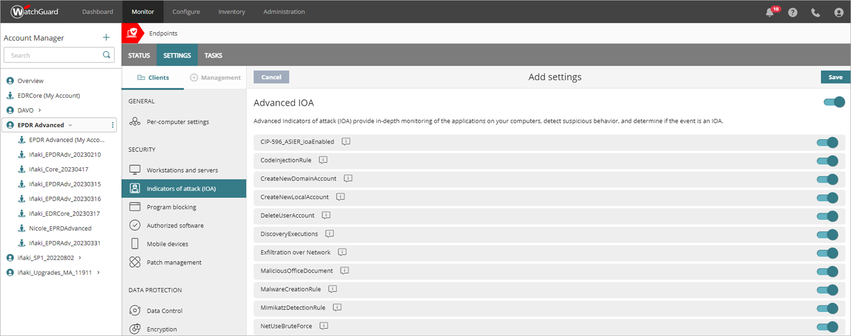
Advanced IOA – Service Provider View
Service Provider accounts can enable advanced Indicators of Attack for tenant accounts with Advanced EPDR

Slide 25
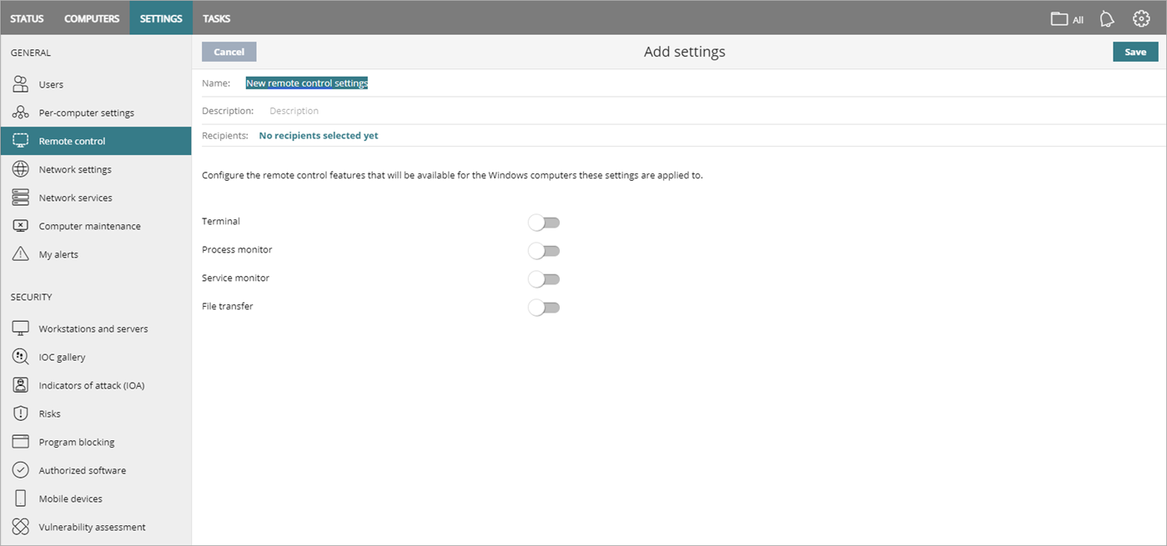
Remote Control (Windows computers)
You can remotely connect to the Windows computers on your network from the Endpoint Security management UI to investigate a potential attack and remediate it
In the Remote Control settings profile, enable the features you want to have access to (Terminal, Process Monitor, Service Monitor, and File Transfer)

Slide 26
Required URLs and Ports
To use the Remote Control tool, the user computer and the network perimeter firewall must allow traffic to and from these URLs and ports:
dir.rc.pandasecurity.com (port 443)
eu01.rc.pandasecurity.com (ports 8080 and 443)
eu02.rc.pandasecurity.com (ports 8080 and 443)
eu03.rc.pandasecurity.com (ports 8080 and 443)
eu04.rc.pandasecurity.com (ports 8080 and 443)
eu05.rc.pandasecurity.com (ports 8080 and 443)
eu06.rc.pandasecurity.com (ports 8080 and 443)
ams01.rc.pandasecurity.com (ports 8080 and 443)
ams02.rc.pandasecurity.com (ports 8080 and 443)

Slide 27
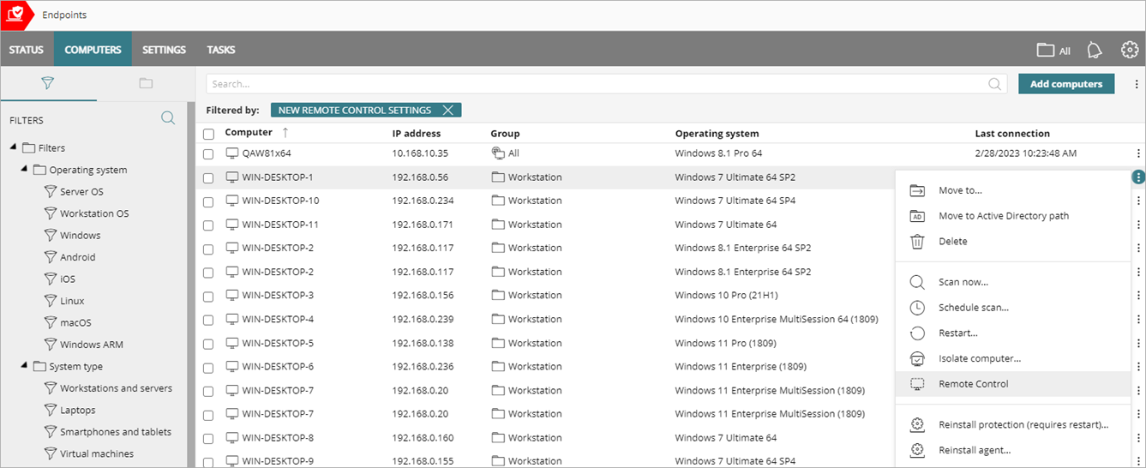
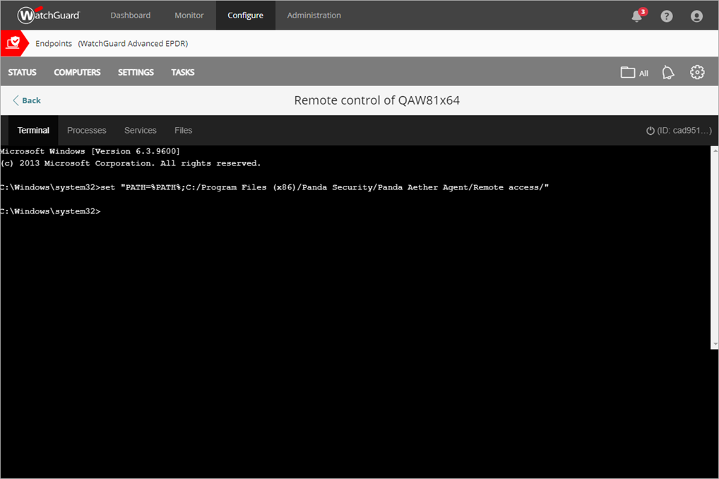
Open the Remote Control Tool
From the Computers page, open the Remote Control tool for a Windows computer with remote control enabled

Slide 28
Remote Control Tool
The Remote Control tool can include up to four functional areas:
Terminal — Runs commands compatible with the command line tool on the remote computer
You can launch programs that generate text output
Processes — Shows information about each process in the computer memory, including the RAM and CPU used
Services — Shows all services configured on the computer and enables you to find specific services and change their status
Files — Shows information about each file on the computer
You can transfer files to and from the remote computer
You can also navigate the file system on the remote computer and delete files

Slide 29
Remote Command Line Tools
Commands are accessible from the Terminal area of the Remote Control tool
Use these commands to collect information to enhance investigations, recover data for forensic analysis, and remediate security breaches:
delete — Deletes files from the target computer hard disk
dump — Dumps the memory assigned to processes to disk
netinfo — Shows information about network interfaces
pcap — Captures network packets and dumps them to the computer hard disk
ports — Shows processes with open ports on the computer
process — Shows the processes loaded in memory and their modules
url — Shows a history of all the URLs accessed from the computer browser

Slide 30
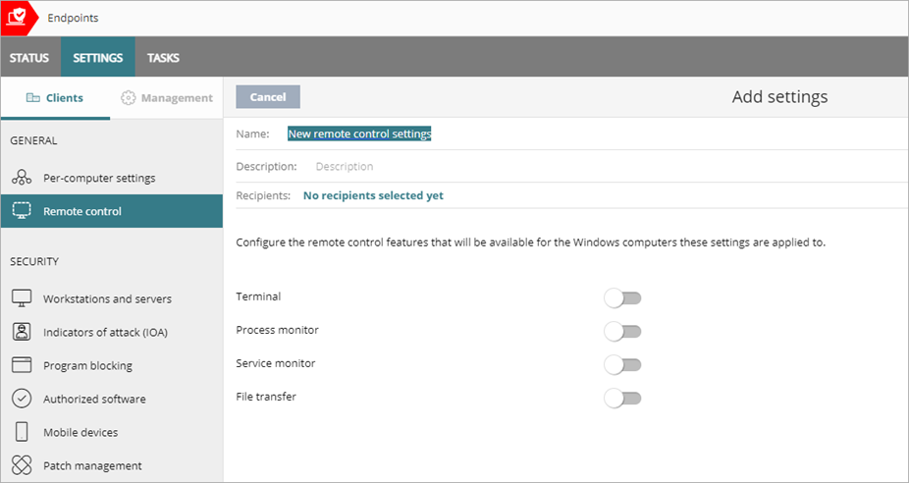
Remote Control – Service Provider View
Service Provider accounts can enable Remote Control on tenant accounts with Advanced EPDR
Terminal
Process monitor
Service monitor
File transfer

Slide 31
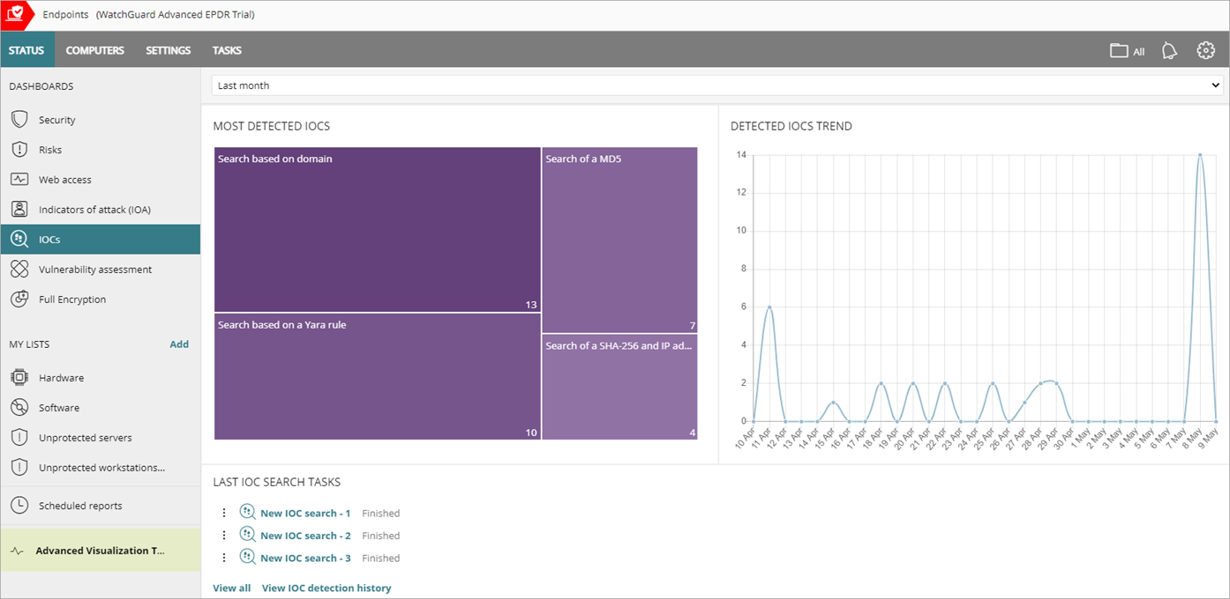
Indicators of Compromise (IOCs)
Indicators of Compromise (IOCs) are an industry standard to describe conditions on IT systems which, if met, could compromise the security of an organization
Administrators can use IOCs to increase the detection capabilities of Advanced EPDR

Slide 32
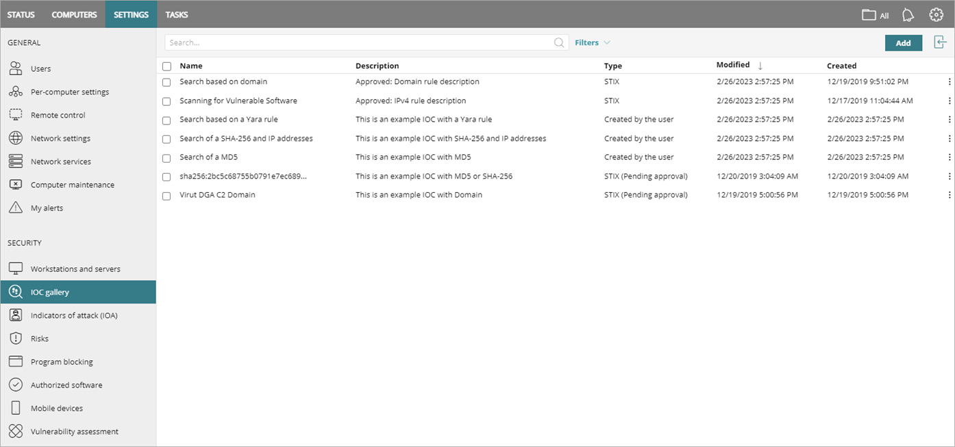
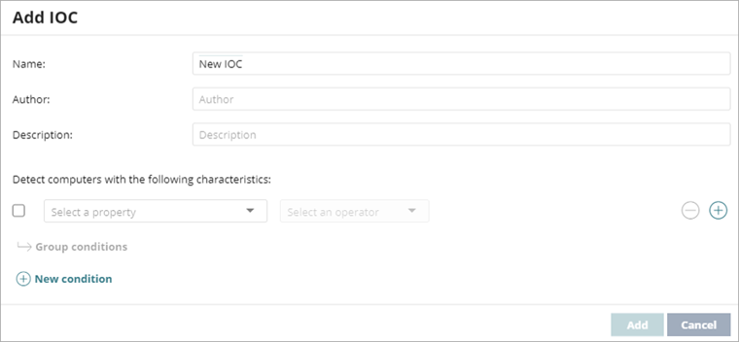
IOC Gallery Settings
On the Settings > IOC Gallery page, the table shows information on all imported and created IOCs, including Name, Description, Type, Modified date, and Created date

Slide 33
STIX File
Structured Threat Information Expression (STIX) is a language and serialization format used to exchange cyber threat intelligence
When an IOC is imported from an external source, it must be approved for use by IOC searches in Advanced EPDR (Advanced EPDR is compatible with the STIX 2.x standard)
Imported IOCs show in the Type column as STIX or STIX (Pending Approval)
If the STIX file is Pending Approval, you can approve it in the IOC Gallery:
In WatchGuard Cloud, select Configure > Endpoints
Select Settings > IOC Gallery
Select the IOC you want to approve
Click Approve Search Statement and Save

Slide 34
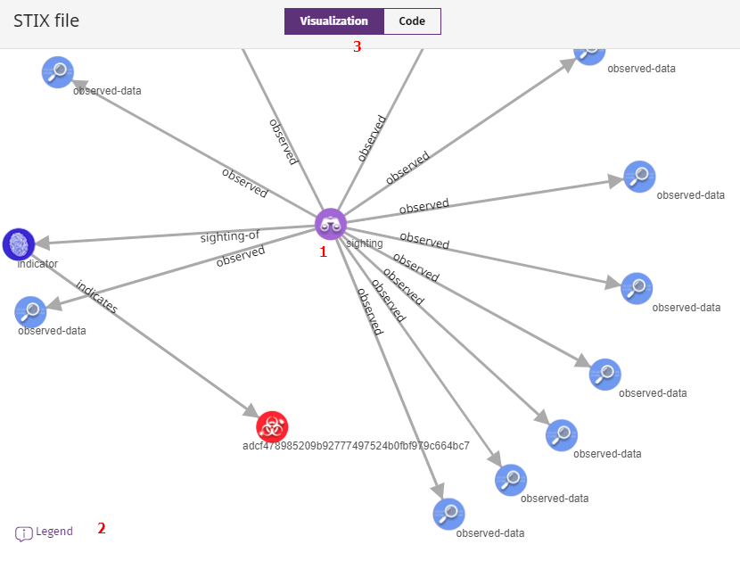
Review the STIX File
To open the original STIX file for an IOC, in the row for an IOC, click and select View Original STIX File
The STIX File page shows a graphical representation of the activity and the code of the IOC

Slide 35
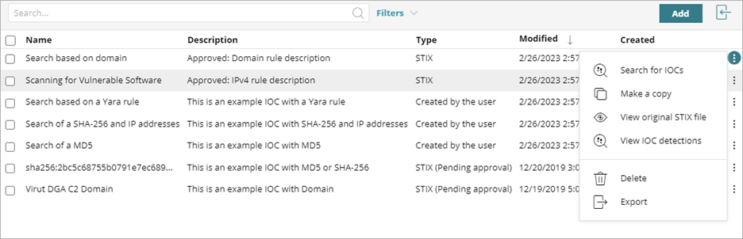
IOC Search Task
You can create a task to search the computers and devices on your network for approved IOCs
From the Settings > IOC Gallery, in the row for an IOC, click and select Search for IOCs

Slide 36
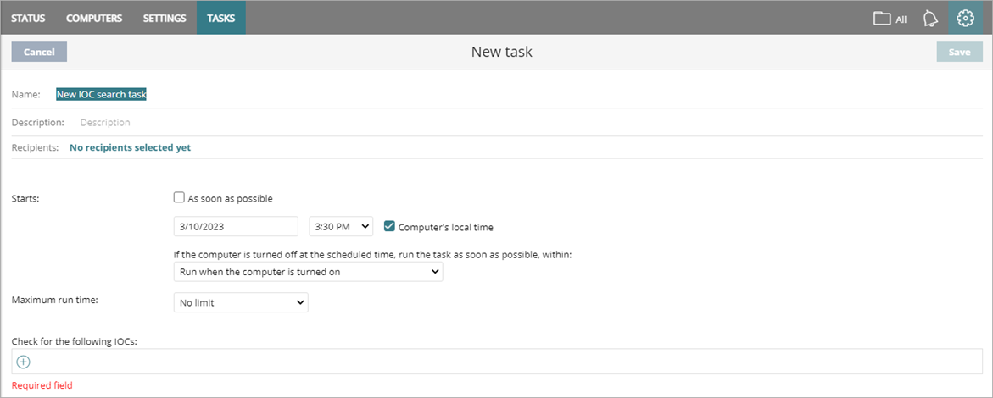
IOC Search Task
You create a search task and assign the task to recipients
After you publish the task and it runs, you can review the search results in the IOC Detected list and on the IOC dashboard
To help prevent network overload when an infection has reached many files on computers in the network, Advanced EPDR restricts the depth and reporting of searches

Slide 37
Multi-Tenant Endpoint Security Management

Slide 38
Multi-Tenant Endpoint Security Management
Service Providers can centrally manage the endpoint security of tenant Subscriber and Service Provider accounts and account groups in WatchGuard Cloud
In this release, these features are only available in the Advanced EPDR multi-tenant endpoint security management UI:
Advanced Security Policies
Advanced IOAs settings
Remote Control

