Slide 1
What’s New
WatchGuard Endpoint Security

Slide 2
Endpoint security Updates
This presentation describes updates to these products:
  WatchGuard Advanced EPDR
  WatchGuard EPDR
  WatchGuard EDR and EDR Core
  WatchGuard EPP
This presentation does not describe:
  Changes before November 2022
  Panda and Cytomic products
  Some minor bug fixes
For a complete list of enhancements and resolved issues by date, go to the Endpoint Security Release Notes

Slide 3
April 2024

Slide 4
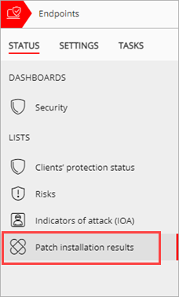
Patch Installation Results List for Service Providers
A new Patch Installation Results list (Status > My Lists) is available for Service Providers to quickly access a list that shows which clients have Patch Management
For clients with Patch Management, Service Providers can see the patch installation results and the number of computers that require a restart to complete patch installation
Release date: 11 April 2024

Slide 5
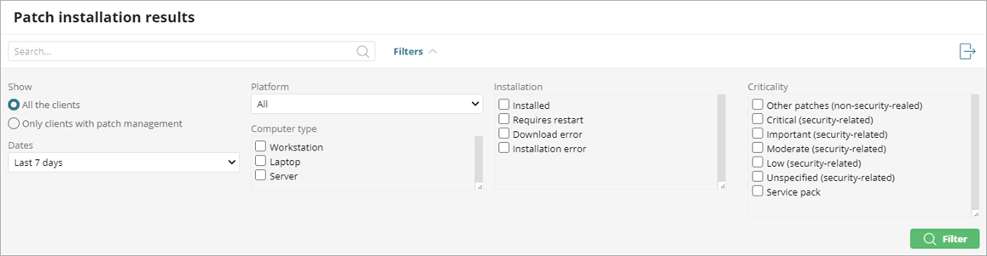
Patch Installation Results List Filter
From the list, Service Providers can filter the installation results by date, platform, computer type, patch installation status, and patch criticality
Release date: 11 April 2024

Slide 6
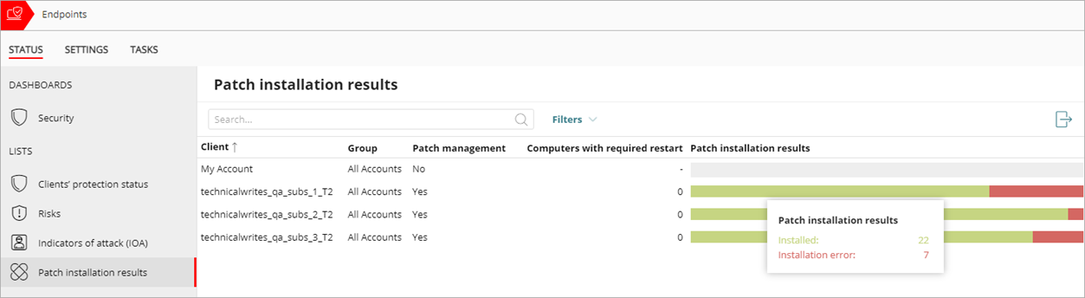
Patch Installation Results List Table
Service Providers can point to the Patch Installation Results bar to show the number of patches for the last installation attempt: Installed, Requires Restart, Download Error, or Installation Error
Release date: 11 April 2024

Slide 7
Additional Settings
These settings are now available for Service Providers in the multi-tenant management UI:
  Anti-tampering features protect Windows computers when they start in Safe Mode. This setting is enabled by default (Per-Computer Settings)
  New content categories for artificial intelligence (Web Access Control settings)
    Generative AI - Conversation
    Generative AI - Multimedia
    Generative AI - Text & Code
    Other AI ML Applications
Release date: 11 April 2024

Slide 8
March 2024

Slide 9
21 March 2024 – Update
This update includes improvements for Patch Management settings and installation history:
  You can now designate computers as test computers for patch installation
  You can specify computers and groups where you do not want to apply patches
  Installation status in the Installation History list updates from Requires Restart to Installed when the endpoint restarts and installs the patch
  You can filter the Installation History list to show the last patch installation attempt or all attempts in the results
For Service Providers, there is a new Patch Installation Results list

Slide 10
21 March 2024 - Update
This release includes changes to the Endpoint Risk Assessment:
  For EDR and EDR Core, when you start an Endpoint Risk Assessment, decoy files and anti-exploit settings for the All group are automatically disabled
  When an Endpoint Risk Assessment is in progress, the Risk Assessment report is selected by default in Scheduled Reports
  Subscriber accounts with EDR Core allocated to their endpoints, but not deployed, can start a trial of WatchGuard EPDR or Advanced EPDR and activate an Endpoint Risk Assessment
Web Access Control supports new AI categories
  This is also available in the Service Provider view

Slide 11
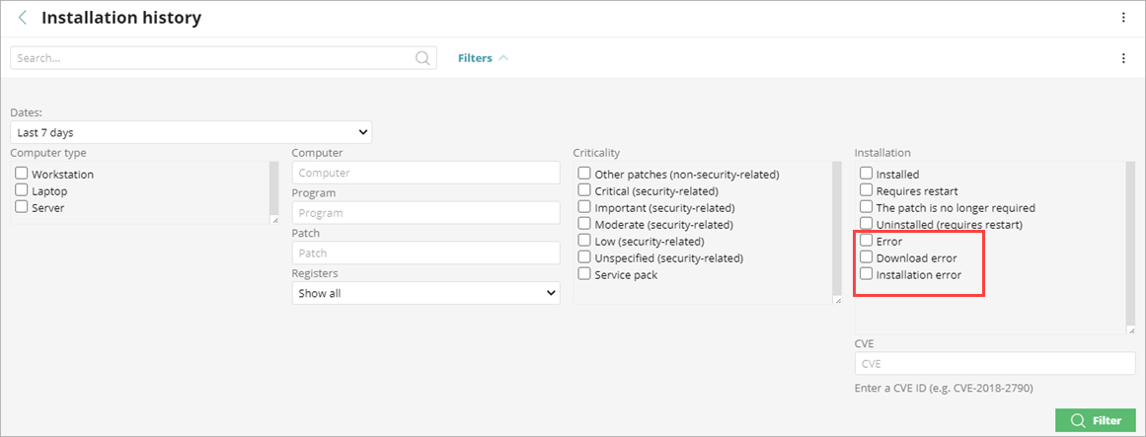
Patch Installation Status
In the Installation History list for Patch Management, you can now filter the list for additional installation statuses — Error, Download Error, and Installation Error
In the list, if the status was Requires Restart and the patch successfully installs on the computer after it restarts, the status dynamically updates to Installed
Release date: 21 March 2024

Slide 12
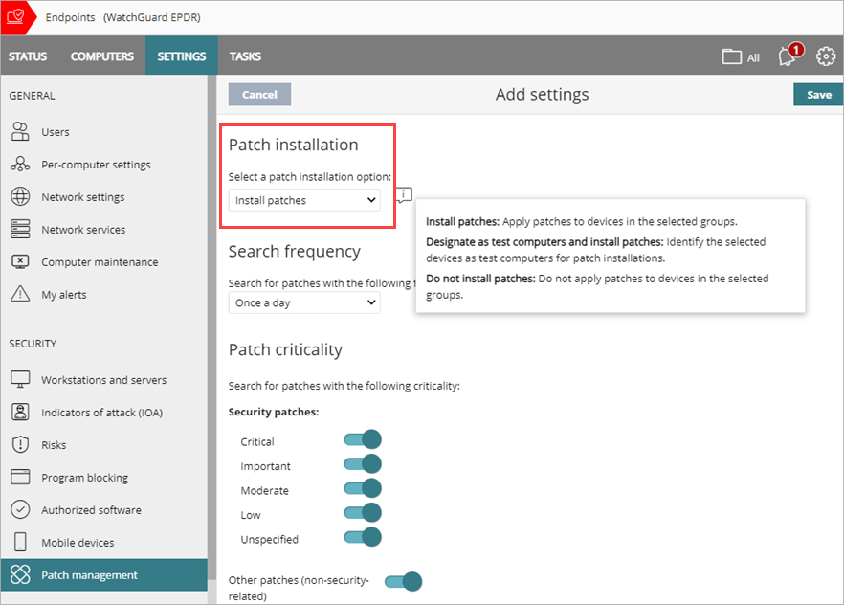
Patch Management Settings – Installation Option
In the Patch Management settings profile, you can specify whether patches install on a device
  Install patches — Automatically apply patches to devices in the assigned groups
  Do not install patches — Do not apply patches to devices in the assigned groups
You can also designate computers as test computers for patch installation
Release date: 21 March 2024

Slide 13
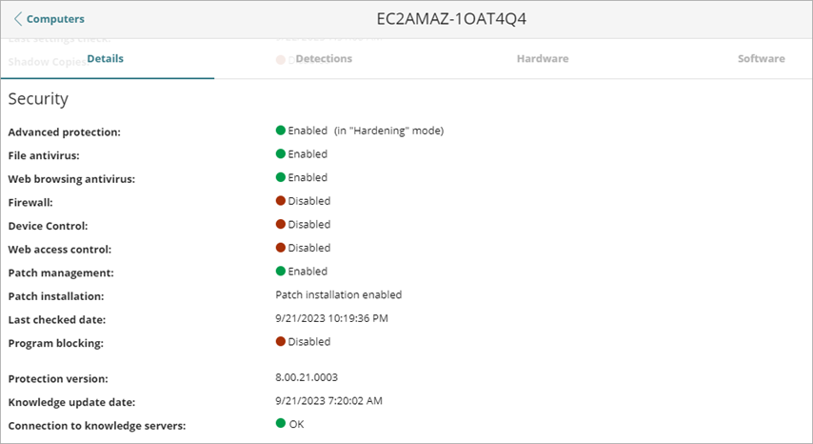
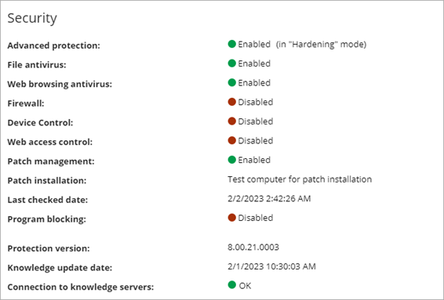
Computer Details – Patch Installation Option
The computer details page for a device shows the patch installation option — Patch installation enabled, Patch installation disabled, or Test computer for patch installation
Release date: 21 March 2024

Slide 14
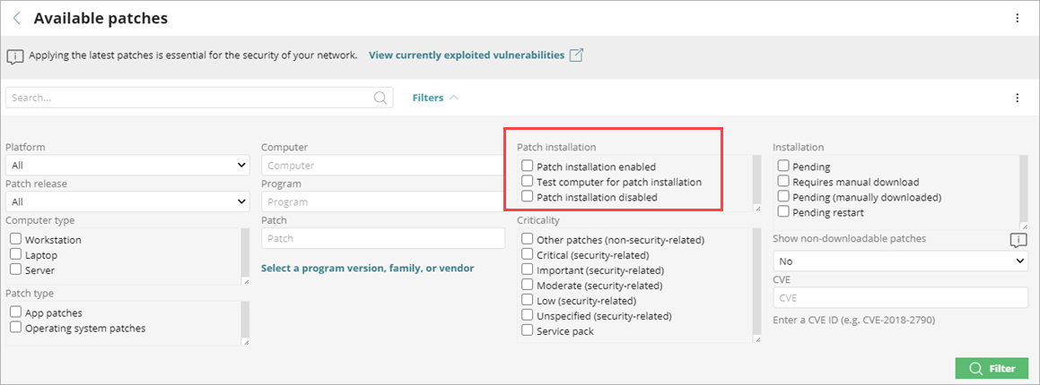
Available Patches List – Installation Options
In the Available Patches list, you can filter the list by the patch installation option — Patch installation enabled, Patch installation disabled, or Test computer for patch installation
Release date: 21 March 2024

Slide 15
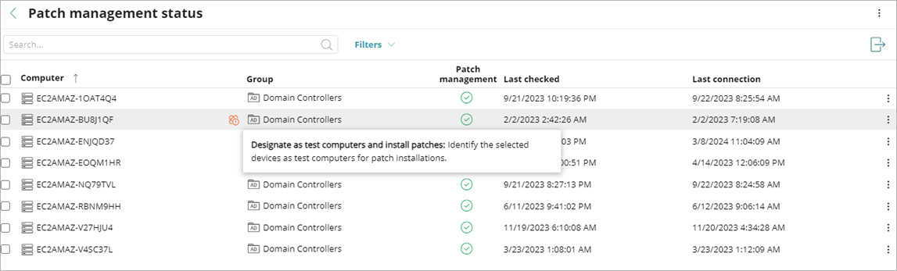
Patch Management Status – New Icon for Installation Option
In the Patch Management Status list, a new icon shows next to a computer that is designated as a test computer for patch installation
Release date: 21 March 2024

Slide 16
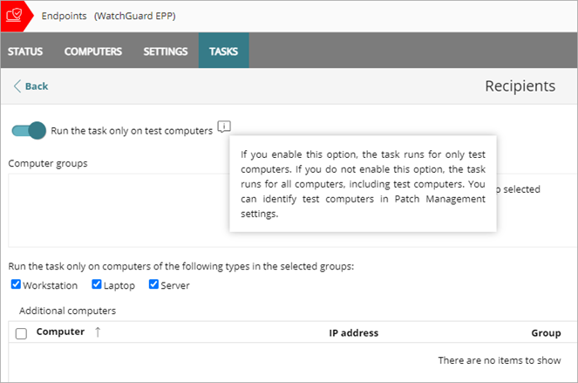
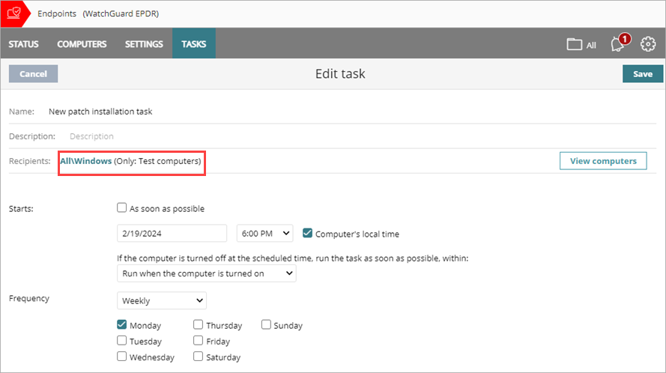
Patch Installation Task – Test Computers
In a patch installation task, you can specify that the task runs only on computers that are designated as test computers
Release date: 21 March 2024

Slide 17
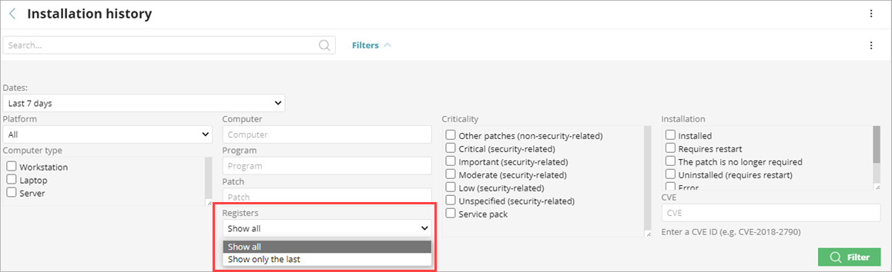
Patch Installation History – Registers
In the Installation History list for Patch Management, you can now filter the list to show all patch installation attempts or the last installation attempt for a patch
Release date: 21 March 2024

Slide 18
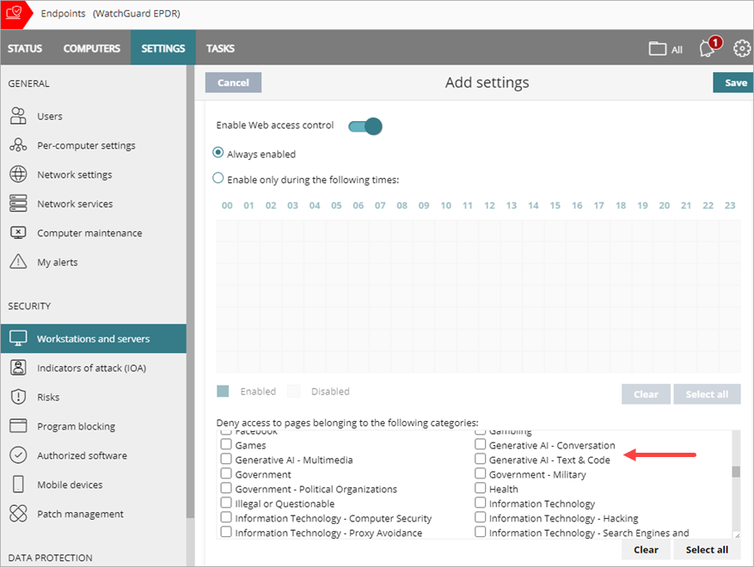
Web Access Control Categories for AI
In Web Access Control settings, you can now block these new categories for artificial intelligence:
  Generative AI - Conversation
  Generative AI - Multimedia
  Generative AI - Text & Code
  Other AI ML Applications
Release date: 21 March 2024

Slide 19
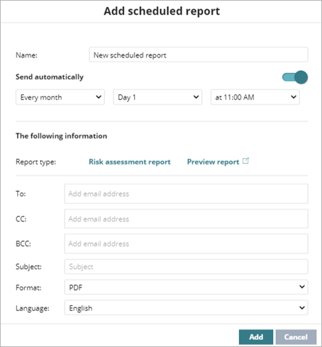
Endpoint Risk Assessment Report
When an Endpoint Risk Assessment has started and the the user wants to schedule a report, the Risk Assessment Report is selected by default
Release date: 21 March 2024

Slide 20
Endpoint Risk Assessment with EDR Core
Subscriber accounts with EDR Core allocated to their endpoints, but not deployed, can now start a trial of WatchGuard EPDR or Advanced EPDR and activate an Endpoint Risk Assessment
Release date: 21 March 2024

Slide 21
EDR Core – Default Workstations and Servers Profile
The default workstations and servers settings profile now has anti-exploit and decoy files disabled
  This profile is applied to the All group by default until you create and assign a new profile
This profile helps to prevent issues with third-party antivirus and EDR solutions when you activate the Endpoint Risk Assessment
  This change does not affect Endpoint Risk Assessments in progress
Release date: 21 March 2024

Slide 22
December 2023

Slide 23
12 DEcember 2023 - Update
This update is available to all customers with the latest version of WatchGuard Endpoint Security:
  WatchGuard EDR, EDR Core, WatchGuard EPDR, WatchGuard Advanced EPDR v4.30
  WatchGuard EPP v9.30
If you do not have this version, a notification to upgrade is available from the Endpoint Security management UI
You can upgrade at any time to the latest version
  We recommend that you plan a controlled upgrade process to reduce the risk of potential issues
For more information, go to this Knowledge Base article: WatchGuard Endpoint Security Upgrade Process

Slide 24
Full Encryption for Mac Devices
WatchGuard Full Encryption is now available for Mac devices
  Supported on macOS Catalina 10.15 and higher
  No specific hardware requirements
Full Encryption for macOS uses FileVault technology to encrypt hard disks
  External removable drives can be encrypted from a Windows device only
When an encryption policy is applied to a non-encrypted Mac device, the user is prompted for administrator credentials to start encryption
  If the user does not enter the credentials, they receive a prompt every hour to enter the credentials
  On the Computer Details page, the computer status is Encryption Pending User Action
Release date: 12 December 2023

Slide 25
Full Encryption for Mac Devices – Recovery Keys
When the encryption process is complete, a recovery key associated with the computer is generated
Recovery keys are centrally managed in the Endpoint Security management UI
  All volumes on the Mac device are encrypted with the same recovery key
  You can search for the recovery key from the management UI
When a Full Encryption trial or license expires, endpoint devices are not decrypted by default
If a Mac device was previously encrypted by another product, Full Encryption re-establishes the recovery key and prompts the user for administrator credentials
Release date: 12 December 2023

Slide 26
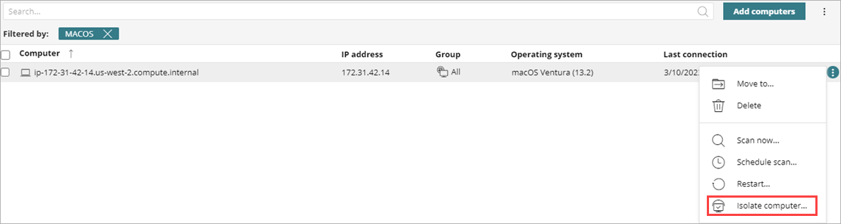
Isolation for Mac Devices
The Isolate Computer action is now available for Mac devices from the management UI
Release date: 12 December 2023

Slide 27
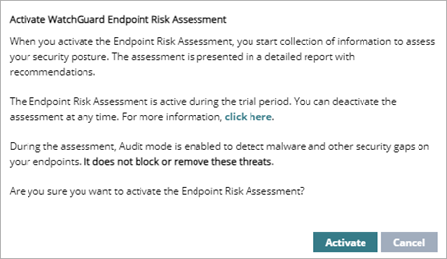
Endpoint Risk Assessment Settings Updates
The Endpoint Risk Assessment is a tool to identify threats, vulnerabilities, and other security risks on managed accounts that use a third-party endpoint security solution
When you activate the Endpoint Risk Assessment, decoy files and anti-exploit technology are now disabled on the endpoints
  This change makes sure that the assessment is non-intrusive
  This change only impacts new assessments
Release date: 12 December 2023

Slide 28
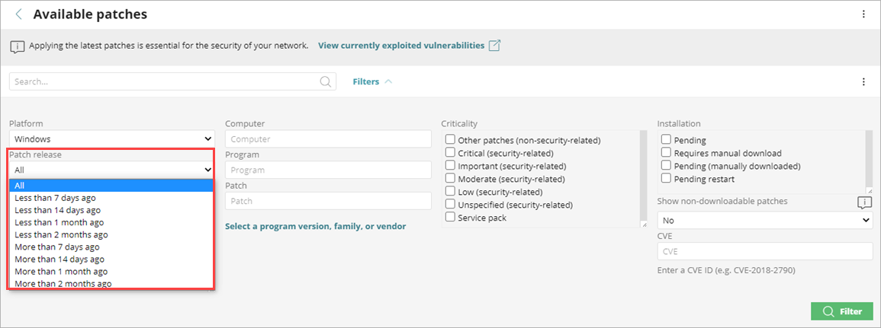
New Filter in Available Patches List
You can now filter the Available Patches list by the patch release date
Use this filter to identify older patches
Release date: 12 December 2023

Slide 29
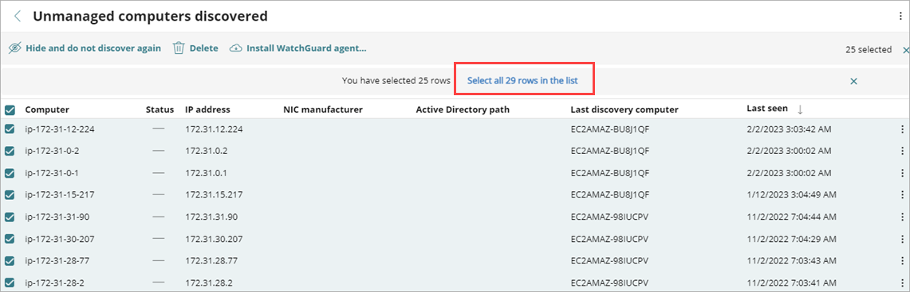
Select All on Unmanaged Computers List
In the Unmanaged Computers list, you can now select all computers across multiple pages
Release date: 12 December 2023

Slide 30
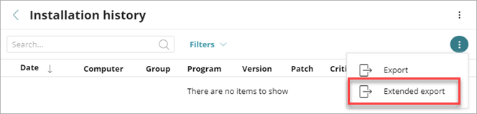
Patch Management Installation History Report
A new Extended Export option is available from the Patch Management Installation History list
The extended CSV file includes these columns in the exported CSV file:
  Task name
  Task launch date
  Task start date
  Task end date
Release date: 12 December 2023

Slide 31
Zero-Trust Application Service Enhancement
The Zero-Trust Application Service can now compress and scan Windows files larger than 50 MB
Unknown Windows executable files larger than 50 MB can now be sent to the Collective Intelligence Service
  We can gather more information about these larger files, and the Zero-Trust Application Service can more accurately classify them as trusted or malware
Release date: 12 December 2023

Slide 32
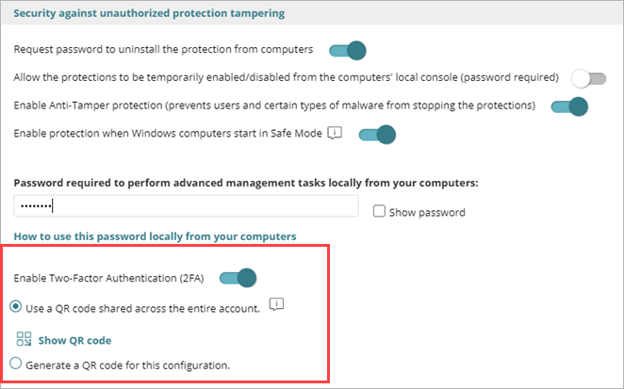
Anti-Tampering Improvements – 2FA*
In the Per-Computer Settings > Security Against Unauthorized Protection Tempering section, you can now enable two-factor authentication (2FA) to help prevent tampering
When you enable 2FA, you generate a QR code that you can scan with any authenticator app, such as AuthPoint, to create a token
When enabled, 2FA is required to authenticate and log in to the local management UI or to uninstall the protection software from a device
*Requires Windows protection version 8.00.22.0023 or higher. Available January 2024.
Release date: 12 December 2023

Slide 33
Enable 2FA
When you enable two-factor authentication, you can choose to:
  Enable it for all settings profiles in the account
  Enable it in the current Per-Computer Settings profile only
Make sure that all administrators with the existing QR code use the new QR code to activate a new token
If you select to enable two-factor authentication in the current configuration only, you can share a QR code key with other administrators to enable them to generate the same QR code
Release date: 12 December 2023

Slide 34
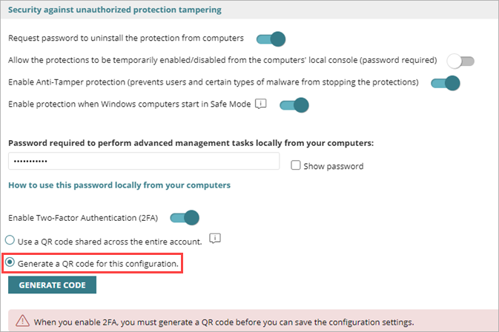
Enable 2FA – Current Configuration
To generate a QR code for the Per-Computer Settings profile only:
  In the Security Against Unauthorized Protection Tampering section, enter a password to perform advanced management tasks locally from your computers
  Select Enable Two-Factor Authentication (2FA)
  Select Generate a QR Code for this Configuration
  Click Generate Code
Release date: 12 December 2023

Slide 35
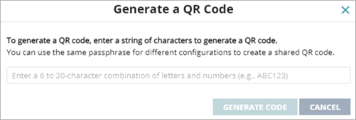
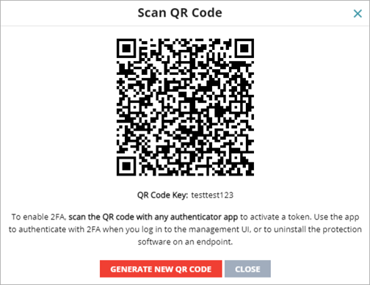
Enable 2FA – Current Configuration
  Enter a 6 to 20-character combination of letters and numbers for the QR code key
  Click Generate Code
  Scan the QR code in the app
  Click Close
  Save the updated configuration settings profile
  Administrators can use the QR code key to generate the same QR code
The QR code key (or passphrase) is used to enable all administrators in the account to generate a shared QR code for different per-computer settings profiles
Release date: 12 December 2023

Slide 36
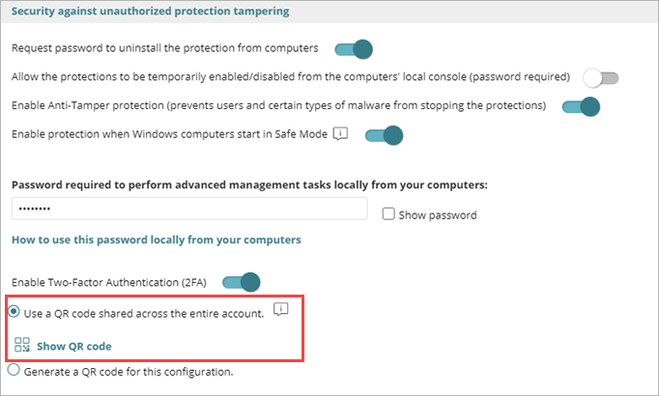
Enable 2FA – Entire Account
To generate a QR code for the entire account:
  In the Security Against Unauthorized Protection Tampering section, enter a password to perform advanced management tasks locally from your computers
  Select Enable Two-Factor Authentication (2FA)
  Select Use a QR Code Shared Across the Entire Account
  All Per-Computer Settings profiles will share the same QR code
Release date: 12 December 2023

Slide 37
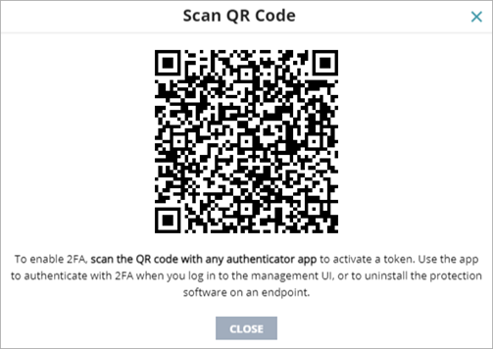
Enable 2FA – Entire Account
  Click Show QR Code
  Scan the QR code in the app
  Click Close
  Save the updated configuration settings profile
The QR code is saved in this settings profile and applies to all configurations assigned to your computers
Release date: 12 December 2023

Slide 38
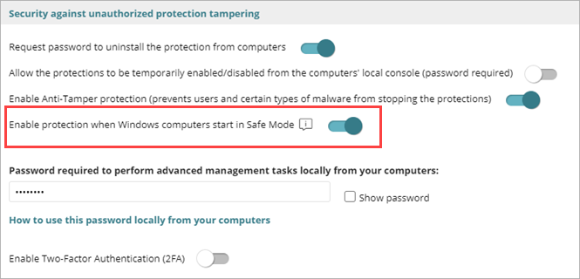
Windows Safe Mode Protection*
In the Security Against Unauthorized Protection Tampering section of the Per-Computer Settings profile, you can enable protection when Windows computers in your network start in Safe Mode
  The toggle is enabled by default in new settings profiles
If you disable the toggle and a computer starts in Safe Mode in the network, the computer and protection could be at risk from tampering
*Requires Windows protection version 8.00.22.0023 or higher. Available January 2024.
Release date: 12 December 2023

Slide 39
November 2023

Slide 40
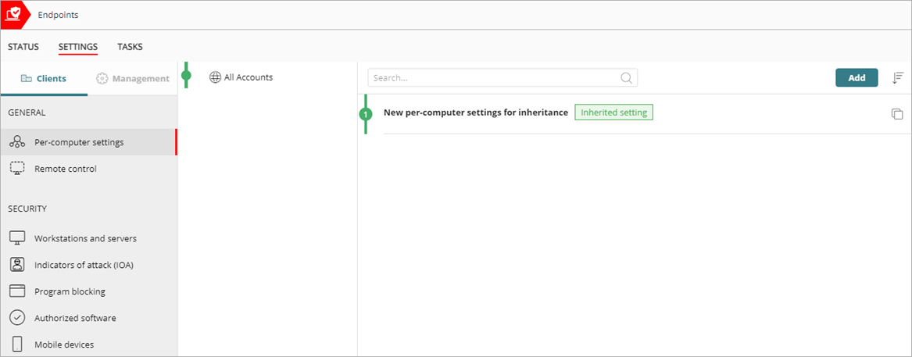
Centralized Settings Inheritance for Service Provider Accounts
In the multi-tenant management UI for endpoint security, tier-1 Service Providers can now create and assign settings profiles to the Service Provider accounts they manage
In the managed Service Provider account, the inherited settings show a green Inherited Setting label
Release date: 30 November 2023

Slide 41
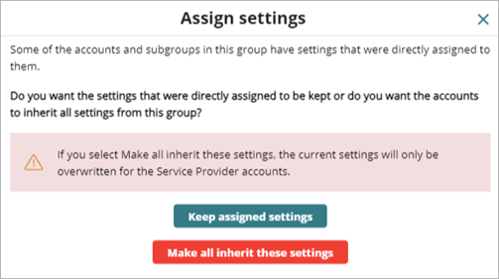
Centralized Settings Inheritance for Service Provider Accounts
When settings are assigned to a Service Provider account or account group that has existing settings, the tier-1 Service Provider account can either force the managed account to inherit all settings, or allow the account to retain the existing settings:
  Keep assigned settings — New settings apply
  only to groups and accounts that do not
  have directly assigned settings. Existing
  settings are retained and the application of
  new inherited settings stops at the first
  group or account with directly configured
  settings.
  Make all inherit these settings — All groups and accounts inherit the new settings. WatchGuard Endpoint Security overwrites all settings and removes all directly assigned settings under the group.
Release date: 30 November 2023

Slide 42
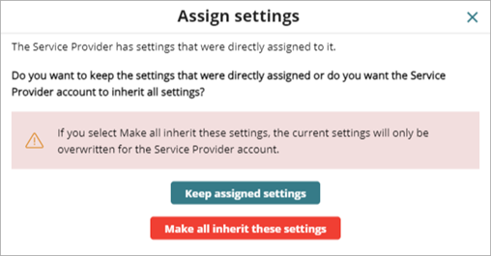
Centralized Settings Inheritance for Service Provider Accounts
If you drag the settings profile to a managed Service Provider account that already has settings assigned, a confirmation dialog box opens with these options:
  Keep assigned settings — The managed Service
  Provider account keeps their existing settings.
  Existing settings are retained and the
  application of new inherited settings stops at
  the first account with directly configured
  settings.
  Make all inherit these settings — WatchGuard Endpoint Security overwrites the All Accounts settings assigned to the managed Service Provider account. Groups and accounts within the managed Service Provider account receive the new settings if they do not have directly assigned settings. Settings that were directly assigned by the managed Service Provider account are retained.
Release date: 30 November 2023

Slide 43
OCTOBer 2023

Slide 44
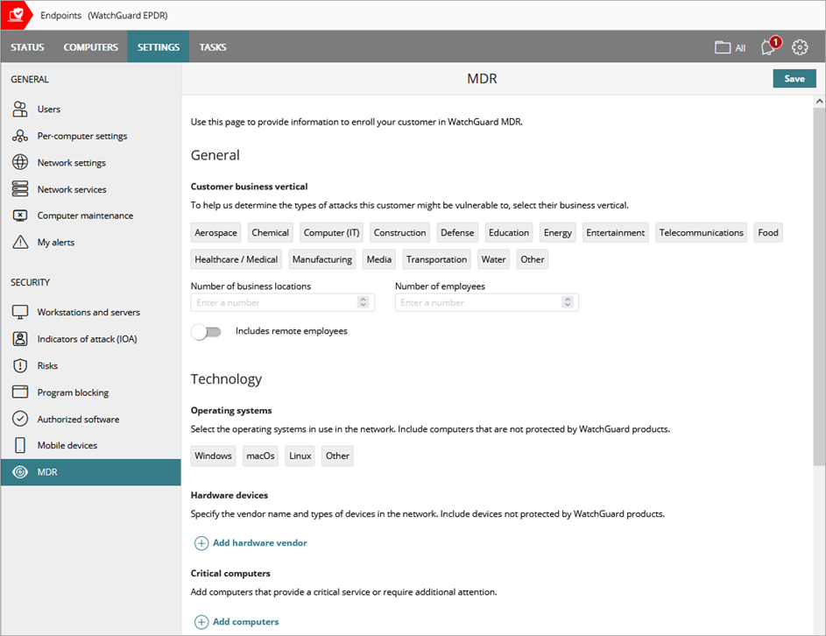
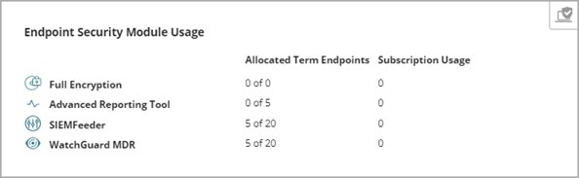
Enroll Customers in WatchGuard MDR
Approved partners with an activated MDR license can enroll their customers in WatchGuard MDR
For more information, go to About WatchGuard MDR and Configure WatchGuard MDR in Help Center
Release date: 12 October 2023

Slide 45
WatchGuard Endpoint Risk Assessment
The WatchGuard Endpoint Risk Assessment is now available for partners and customers with a trial of WatchGuard EPDR or WatchGuard Advanced EPDR
  It is not available for partners or customers with an existing Endpoint Security product or EDR Core license
Partners can use the WatchGuard Endpoint Risk Assessment to evaluate the cybersecurity posture of managed accounts that use a third-party endpoint security solution
  The assessment enables partners and customers to identify threats, vulnerabilities, and other security risks
After the assessment period, you can review a detailed report that provides insights into the account risk profile, recommendations on how to reduce the attack surface, as well as overall security posture improvements
Release date: 12 October 2023

Slide 46
September 2023

Slide 47
Endpoint Security Integration for NinjaOne
The WatchGuard Endpoint Security integration with NinjaOne enables Managed Service Providers to remotely deploy Endpoint Security on customer devices
The integration includes an onboarding application and scripts to deploy Endpoint Security on Windows, Mac, and Linux devices
Import installation scripts to NinjaOne and create automated tasks to search for and install Endpoint Security on customer devices without Endpoint Security already installed
For more information, go to About the WatchGuard Endpoint Security Integration for NinjaOne in Help Center
Release date: 28 September 2023

Slide 48
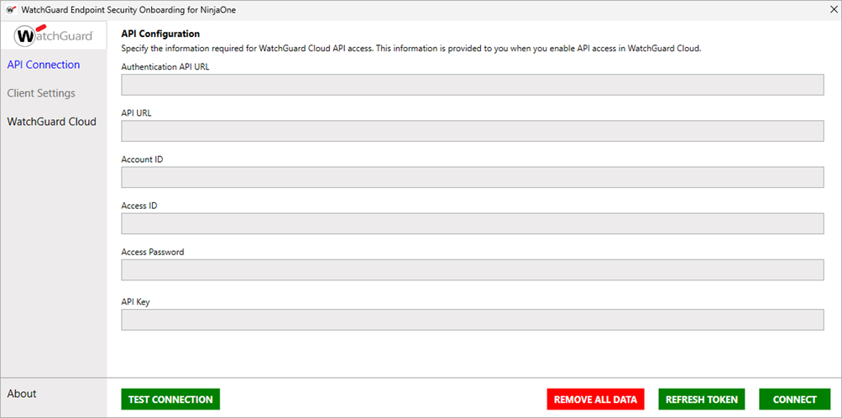
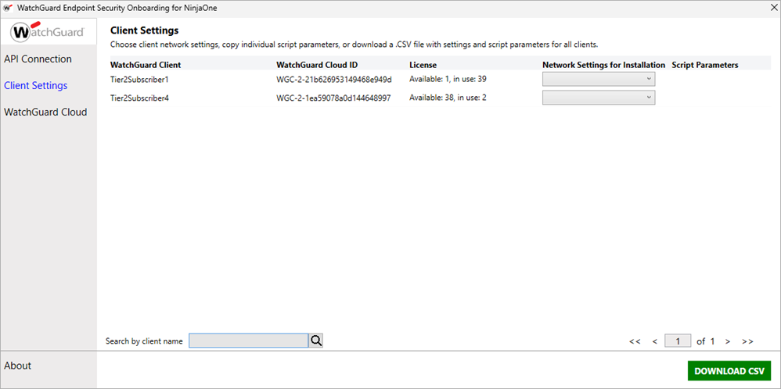
Endpoint Security Integration for NinjaOne
Use the onboarding application to create an API connection to WatchGuard Cloud, then download client settings and parameters to use with installation scripts in NinjaOne
Release date: 28 September 2023

Slide 49
July 2023

Slide 50
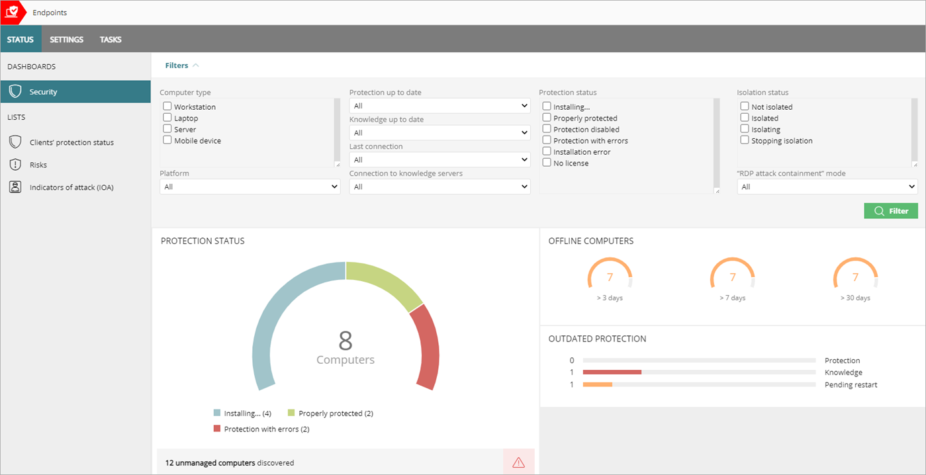
Multi-Tenant Endpoint Management – Security Dashboard
Service Providers can use a new Security dashboard to see an overview of the security status of their managed accounts
The Security dashboard includes information in these tiles:
  Protection status
  Offline computers
  Outdated protection
Release date: 26 July 2023

Slide 51
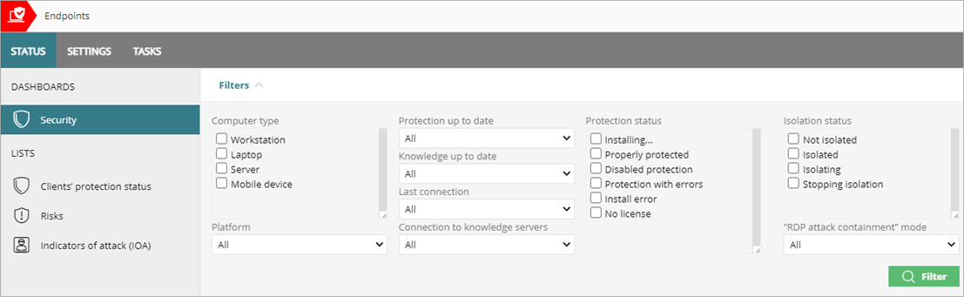
Multi-Tenant Endpoint Management – Security Dashboard
This release also adds new filters that enable you to check the security status of clients more effectively
For more information, go to Multi-Tenant Endpoint Security Management — Security Dashboard in Help Center
Release date: 26 July 2023

Slide 52
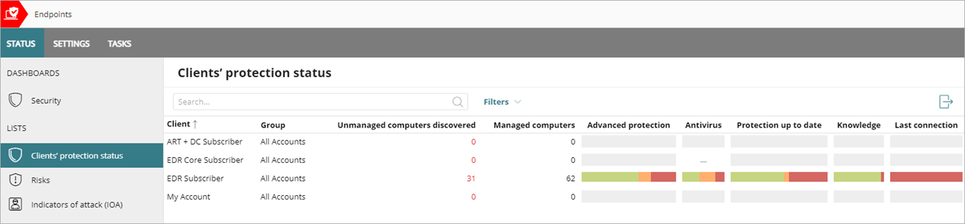
Unmanaged Computers Discovered Column
In the multi-tenant endpoint management UI, the Clients' Protection Status list now includes these changes:
  Data shown in the list corresponds only to the computers that meet the filter criteria you select
  A new column shows the number of unmanaged computers discovered
Release date: 26 July 2023

Slide 53
June 2023

Slide 54
Release Overview
This release of WatchGuard Endpoint Security includes these new features and enhancements:
  Vulnerability Assessment
  Network Attack Protection
  Audit Mode
  Network Access Enforcement
  Patch Management improvements
  Multi-Tenant Endpoint Security Management support
For information on features only available in Advanced EPDR, go to the Introduction to WatchGuard Advanced EPDR presentation

Slide 55
Vulnerability Assessment

Slide 56
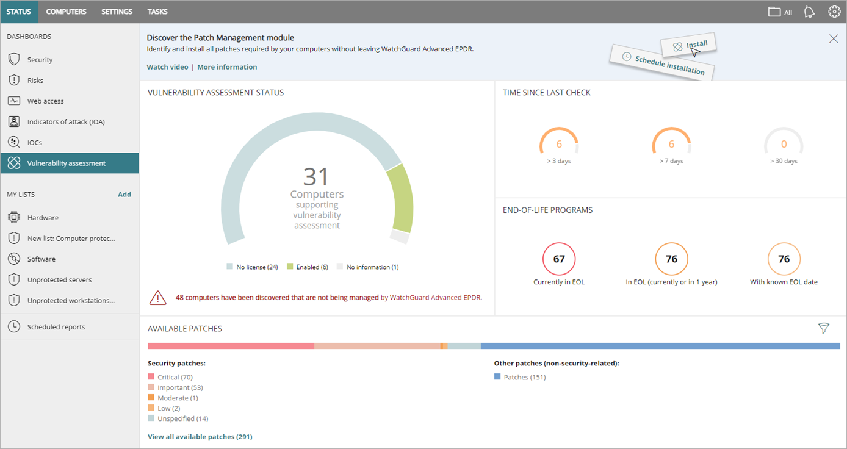
Vulnerability Assessment
Vulnerability Assessment enables you to monitor available patches, software updates, and end-of-life programs on your Windows, Linux, and Mac endpoints
  It is only available in accounts without the Patch Management module
  To see endpoints affected by a vulnerability, upgrade to Patch Management
Release date: 1 June 2023

Slide 57
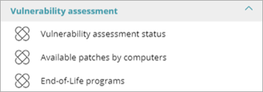
Vulnerability Assessment Dashboard
On the Vulnerability Assessment dashboard, you can review:
Click the Vulnerability Assessment Status tile to show a list of computers and when each was last checked for patch vulnerabilities
These new lists enable you to monitor vulnerabilities:
  Vulnerability Assessment Status
  Available Patches by Computers
  End-of-Life Programs
Vulnerability Assessment Status Time Since Last Check End-of-Life Programs Available Patches | Available Patches Trend Most Available Patches for Computers Programs with Most Available Patches
Release date: 1 June 2023

Slide 58
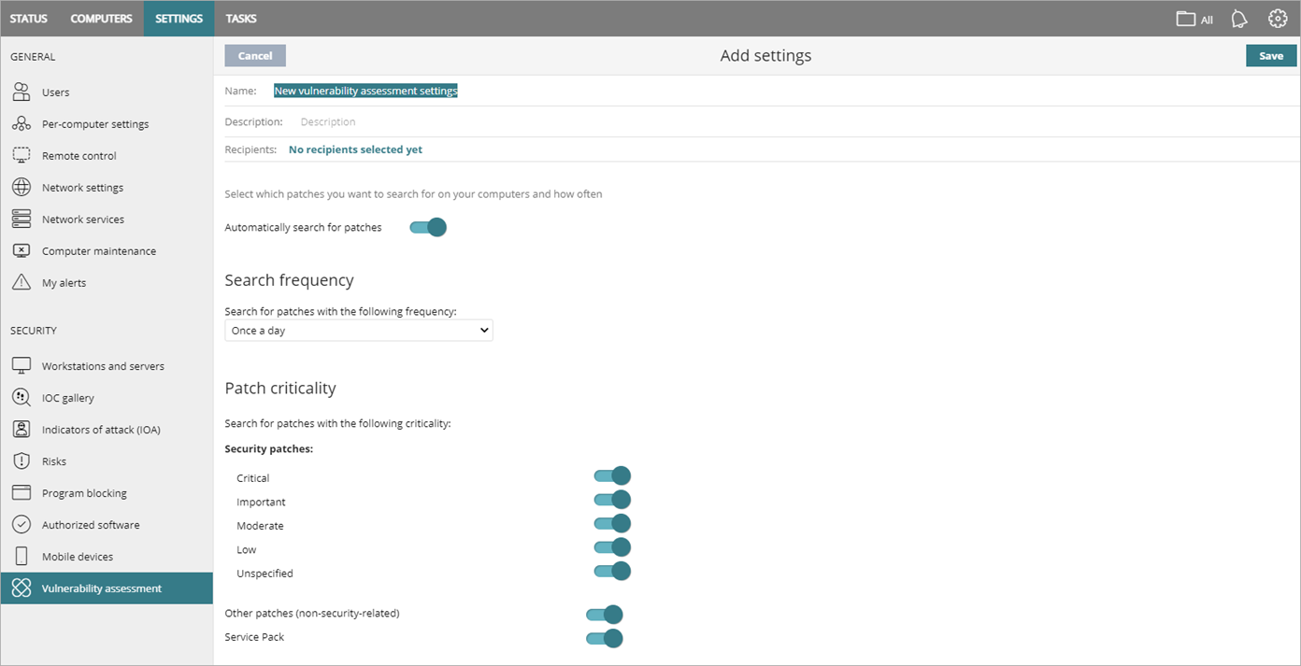
Vulnerability Assessment Settings
In a Vulnerability Assessment settings profile, you specify when to search for new patches and software updates, and the types of patches to search for
Release date: 1 June 2023

Slide 59
Network Attack Protection

Slide 60
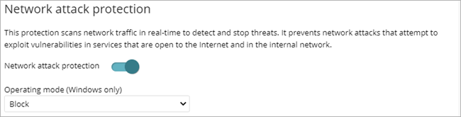
Network Attack Protection (Windows Computers)
In a Workstations and Servers settings profile, you can enable Network Attack Protection to scan network traffic in real-time to detect and stop threats (WatchGuard Advanced EPDR, EPDR, and EDR only)
  Prevents network attacks that try to exploit vulnerabilities in services that are open to the Internet and in the internal network
You can also select an operating mode:
  Audit – Allows the network attack
  Block – Blocks the network attack before it can perform actions
Release date: 1 June 2023

Slide 61
Network Attack Protection – Types of Attacks Detected
Network Attack Protection enables Endpoint Security to detect and prevent these types of attacks in the early stages:
  DCSync
  DCShadow
  EternalBlue (Microsoft CVE-2017-0144 vulnerability)
  BlueKeep (Microsoft CVE-2019-0708 vulnerability)
  ZeroLogon (Microsoft CVE-2020-1472 vulnerability)
Release date: 1 June 2023

Slide 62
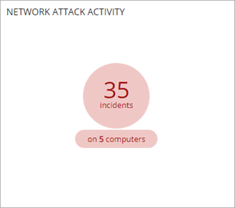
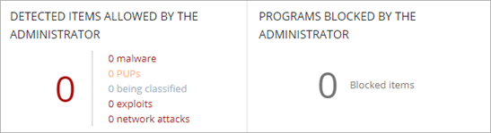
Security Dashboard – Network Attack Activity
On the Security dashboard, the Network Attack
Activity tile shows the number of incidents and
computers with network attack activity
  The Detected Items Allowed by Administrator tile
  (previously Programs Allowed by Administrator) now
  includes network attacks
Release date: 1 June 2023

Slide 63
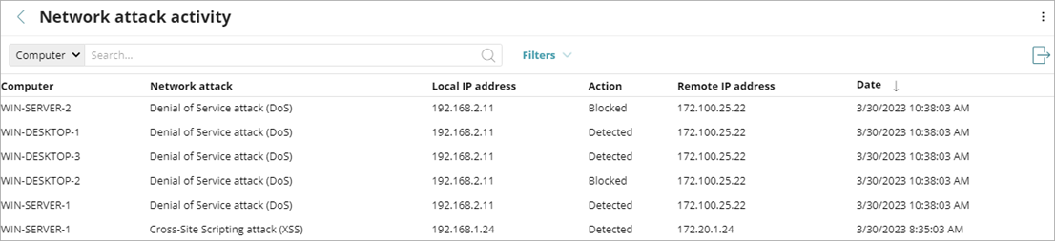
Network Attack Activity List
To open the Network Attack Activity list for all computers affected by a network attack, click the Network Attack Activity tile
Select a computer in the list to review the computer details, including the attack details and actions (events) taken by Endpoint Security
Release date: 1 June 2023

Slide 64
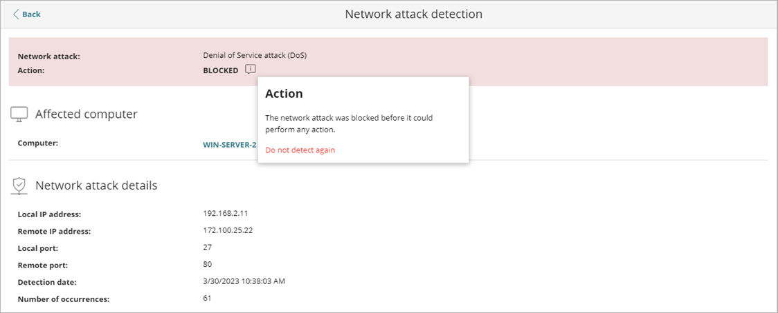
Network Attack Protection – Exclusions
If needed, you can exclude the detection of a specific network attack on all computers in the account
  When you exclude a type of network attack, your computers are still protected from the remaining network attacks in the list
Click Do Not Detect Again and enter the specific IP addresses of the devices you want to exclude from detection
Release date: 1 June 2023

Slide 65
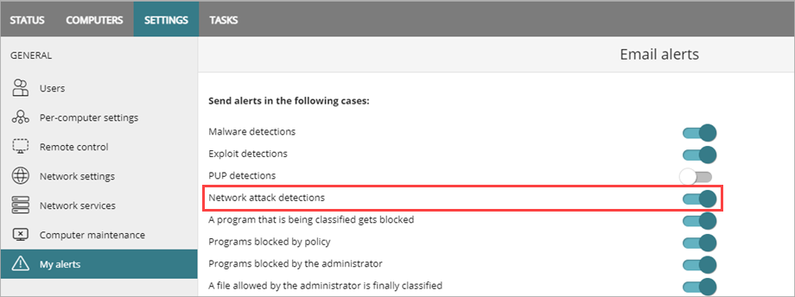
Alerts for Network Attack Detections
You can send email alerts when Network Attack Protection detects an attack
Release date: 1 June 2023

Slide 66
Audit Mode

Slide 67
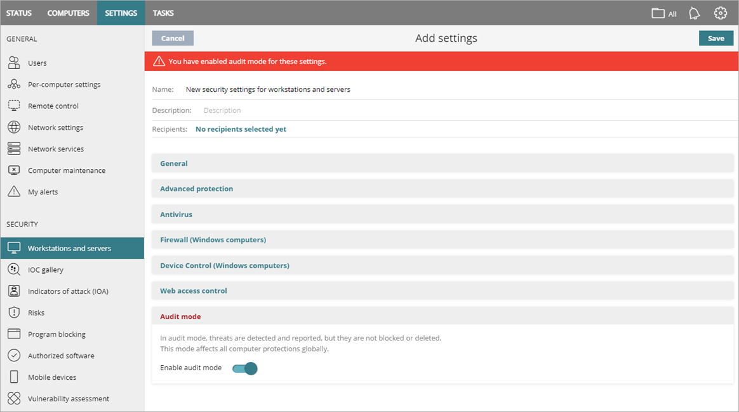
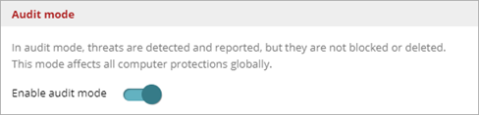
Audit Mode
In a Workstations and Servers settings profile, you can enable Audit mode to detect and report threats on all computers
When enabled, WatchGuard Endpoint Security notifies the endpoint user when a threat is detected
Release date: 1 June 2023

Slide 68
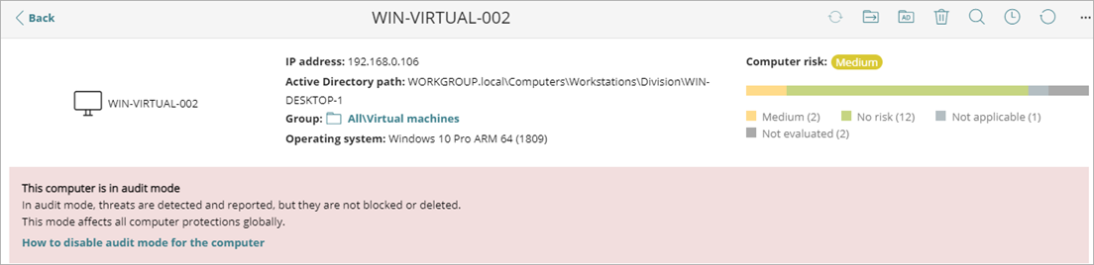
Audit Mode Risk
When a device is in Audit mode, threats are not blocked or deleted
Audit mode appears as a risk in the Detected Risks tile of the Risks dashboard (Audit mode enabled) and on the computer details page
Release date: 1 June 2023

Slide 69
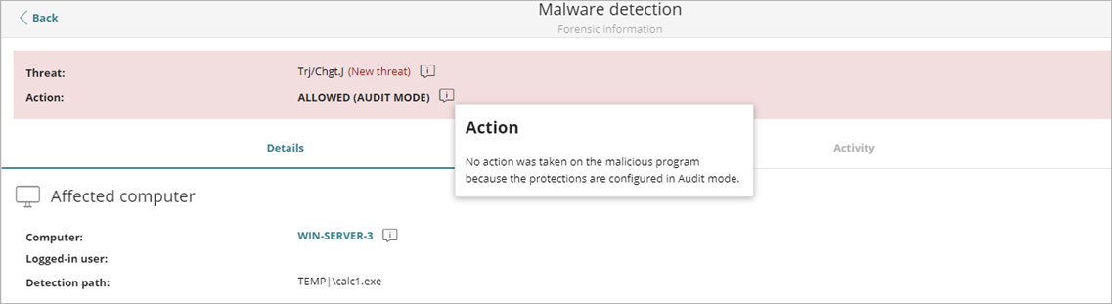
Detection Details – Allowed (Audit Mode)
When Endpoint Security is set to Audit mode, detected threats show Allowed (Audit Mode) on the detection details page for Malware/PUPs, Exploits, and Network Attacks
Release date: 1 June 2023

Slide 70
Network Access Enforcement

Slide 71
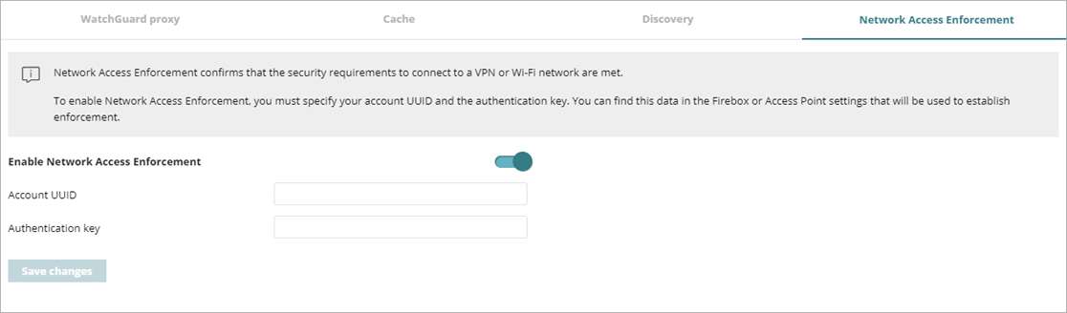
Network Access Enforcement
The Network Services > Secure VPN tab is now called Network Access Enforcement
This change reflects support for VPN and Wi-Fi connections
  In a future release of WatchGuard access point firmware, access points can check that client devices have the WatchGuard Endpoint Agent when they try to join the Wi-Fi network
Release date: 1 June 2023

Slide 72
Patch Management Improvements
Release date: 1 June 2023

Slide 73

Patch Management – Improvements
A new Programs with Most Available Patches tile lists software programs with available patches, as well as the number of available patches for each program, in descending order from left to right
  Click a square to open the Available Patches list filtered to the program
  Filter the tile to show patches by Criticality, Computer Type, and Patch Type
A new Available Patches by Computer list is also available
Release date: 1 June 2023

Slide 74

Patch Management Support (Mac and Linux)
Vulnerability Assessment and Patch Management now support Mac and Linux computers
  Patch Management cannot uninstall Linux and macOS patches
  Operating system patches for macOS with ARM-based processors (M1 and M2) require a password and force a restart
Mac and Linux computers can install patches from a cache server
Release date: 1 June 2023

Slide 75


Patch Management Support (macOS and Linux)
In the Available Patches list, you can now filter the list by operating system
(Patch Management only) In tasks, you can install patches based on the operating system
macOS and Linux patches are not included in existing recurring or new recurring Patch Management tasks
Release date: 1 June 2023

Slide 76
Other Enhancements

Slide 77

IOA – MITRE ID in Filter
In the filter settings, IOA are now listed with the MITRE ID first and then the technique (for example, T1012 - Query Registry)
Release date: 1 June 2023

Slide 78
Multi-Tenant Endpoint Security Management

Slide 79
New Features for Service Providers
In this release, these features are now available for Service Providers:
  Network Attack Protection settings
  Support for Linux and macOS patch install tasks
  Remote control (Advanced EPDR only)
  Changes to inherited configurations (scan exclusions and authorized programs)
Release date: 1 June 2023

Slide 80

Network Attack Protection – Service Provider View
Service Provider accounts can enable Network Attack Protection to analyze network traffic in real-time to detect and stop fileless threats
Release date: 1 June 2023

Slide 81

Patch Management Tasks – Service Provider View
Service Provider accounts can now create patch installation tasks for tenant accounts with Windows, Linux, and macOS computers
From the Delay Restart drop-down list, you can select the amount of time before Patch Management forces a restart (5 minutes to 7 days)
Release date: 1 June 2023

Slide 82

Inherited Configurations – Add Authorized Software
When the Service Provider assigns settings, they appear in the tenant account Endpoint Security management UI with a green Service Provider label
Service Providers can now assign a settings profile that allows the recipient account to add authorized software to the list
  In the tenant account, the settings profile shows the Service Provider label and Editable Settings
Release date: 1 June 2023

Slide 83

Allow Tenant Accounts to Authorize Software
To allow tenant accounts to authorize software programs in an inherited configuration:
  On the Settings > Authorized Software page, select the settings profile you want tenant accounts to be able to edit
  Enable the Settings Editable by Clients toggle
  Save the profile and assign recipients, if required
Release date: 1 June 2023

Slide 84

Subscriber View – Editable Settings
A blue banner shows the Subscriber account that they can edit the settings profile, even though the settings profile was assigned by their Service Provider
Release date: 1 June 2023

Slide 85

Inherited Configurations – Add Scan Exclusions
When the Service Provider assigns settings, they appear in the tenant account Endpoint Security management UI with a green Service Provider label
Service Providers can now assign a settings profile that allows the recipient account to add scan exclusions to specific files and paths
  In the tenant account, the settings profile shows the Service Provider label and Editable Exclusions
Release date: 1 June 2023

Slide 86

Allow Tenant Accounts to Add Scan Exclusions
To allow the tenant account to add scan exclusions:
  On the Settings > Workstations and Servers page, select the settings profile you want tenant accounts to be able to edit
  Enable the Exclusions Editable by Clients toggle
  Save the profile
  Select the profile and assign recipients, if required
Release date: 1 June 2023

Slide 87

Subscriber View – Editable Exclusions
A blue banner shows the tenant account that they can edit the settings profile, even though the profile was assigned by their Service Provider
Release date: 1 June 2023

Slide 88
May 2023

Slide 89
WatchGuard Advanced EPDR Trials (Beta)
You can now start a trial of WatchGuard Advanced EPDR in WatchGuard Cloud
  Advanced EPDR extends WatchGuard EPDR functionality with additional capabilities designed for security operations teams to discover undetected threats on their customer endpoints
  Includes advanced detection and response features such as Advanced Indicators of Attack (IOAs) and events, centralized management of Indicators of Compromise (IOCs) compatible with STIX and Yara rules, Advanced Security Policies, and remote access to detect, contain, and remediate incidents
For more information, go to the Introduction to WatchGuard Advanced EPDR presentation
To report an issue with the beta, go to the WatchGuard Endpoint Security beta test community
Release date: 10 May 2023

Slide 90
February 2023

Slide 91
New Windows Protection v8.0.0.21.0004
The updated version of Windows protection includes:
  Performance improvements for Windows servers with multiple users working at the same time, such as RDS environments.
  Performance improvements to the Decoy Files feature for servers with many concurrent users.
  Correction of an issue where there was a protection service outage with file paths that exceed the maximum length permitted by the operating system.
  Correction of an issue with the mv.sig signature file that caused slowdowns on certain servers.
Release date: 9 February 2023

Slide 92
New Windows Protection, continued
This version also includes:
  Fixes for a new vulnerability that affects most anti-virus and EDR vendors
    For more information about the vulnerability, go to https://www.safebreach.com/resources/blog/safebreach-labs-researcher-discovers-multiple-zero-day-vulnerabilities
  Correction of an issue where the Windows protection stopped working on computers with the FSLogix application installed
  Correction of an issue that prevented the creation of firewall rules on servers.
  Correction of an issue with the VMware VMXNET3 adapter, where files copied over the network were modified (SMB)
Release date: 9 February 2023

Slide 93
New URL Filtering Categories
WatchGuard Endpoint Security now includes these categories in the URL filtering feature:
  Collaboration Office – Apps
  Collaboration Office – Documents
  Collaboration Office – Drive
  Collaboration Office – Mail
Release date: 9 February 2023

Slide 94
New Linux Agent v1.11.04.0001
The updated version of the Linux agent includes:
  Optimization of tasks performed by the Linux agent to prevent performance issues on servers with thousands of active sessions
  Correction of an issue where the protection could not be updated
  Correction of an issue where there were continuous errors when the event queue became full
Release date: 9 February 2023

Slide 95
November 2022

Slide 96
Release Summary – 2 November 2022
This release includes these enhancements in these areas:
  Risks
  Computer Maintenance
  Patch Management
  Tasks
  Integration with Active Directory
  UI Integration in WatchGuard Cloud
  Service Provider Endpoint Manager
  Other Enhancements

Slide 97
Risks

Slide 98

Risks Dashboard
A new Risks dashboard shows information about the security risk level assigned to computers on your network
Release date: 2 November 2022

Slide 99
Risk Assessment
The overall risk level for a computer is calculated from the risk level of one or more risks identified on the computer
Types of risks include:
  Status reported by the endpoint
  Settings assigned by the administrator
  IOAs reported for each computer
  Critical patches reported by each computer
When you configure risks, you specify the risks you want to detect on computers, and assign a risk level to each risk (for example, critical, high, or medium)
  By default, WatchGuard recommends a risk level for each type of risk
Release date: 2 November 2022

Slide 100

Configure Risk Settings
On the Risks page, you specify which risks you want to detect on the devices in your account and set the risk level for each risk
  The risks available depend on your WatchGuard Endpoint Security product
More risks will be available in future releases
Release date: 2 November 2022

Slide 101
Configure Risk Settings
To configure risk settings for an account:
  Select Settings > Risks
  Enable the toggles for the risks you want to detect
  Select a risk level for each risk
  If the recommended risk level is different, a warning icon shows the recommended risk level
  Click Save
Release date: 2 November 2022

Slide 102


Critical Patches Pending Installation Risk
When there are patches available for installation, you can enable the toggle to detect this risk, specify the risk level, and specify the number of days after which the risk triggers
Release date: 2 November 2022

Slide 103

Company Risk
The Company Risk tile on the dashboard shows the number of computers in the network with an assigned risk level
The graph shows computers with no risk and computers with different levels of risks
Release date: 2 November 2022

Slide 104

Risk Trend
In the Risk Trend tile, you can see the number of computers with a specific level of risk over a time period
  Select a time period from the drop-down list
Release date: 2 November 2022

Slide 105

Detected Risks
The Detected Risks tile shows the top risks detected and the number of computers where the risk was found
Click the number of computers to see a list of the affected computers
To show all the risks detected, click View All
Release date: 2 November 2022

Slide 106

Computers at Risk
The Top 10 Computers at Risk tile shows the computers with the highest risk levels, in descending order
For each computer, the bar graph indicates the type of risks found and the overall risk status for the computer
Point to a risk type to see the number of risks
Click the computer name to open the Risks list for the computer
Release date: 2 November 2022

Slide 107
Computer Risk on the Computer Details Page
The computer details page now includes risk information for the computer, including the overall risk status
Click the bar graph or type of risk to open the Risks list filtered for the computer
Release date: 2 November 2022

Slide 108

Mobile Device Details Tab
For Android and iOS devices, the Details tab includes risk information for the device, including the overall risk status
Click the bar graph or type of risk to open the Risks list filtered for the device
Release date: 2 November 2022

Slide 109

Risks List
To open the Risks list, click the Computers at Risk tile on the Risks dashboard
The list shows all the risks detected on the endpoint, as well as the severity
Release date: 2 November 2022

Slide 110

Risks by Computer List
To open the Risks by Computer list, click the Risks Trend tile on the Risks dashboard
The list shows all the risk level detected by computer
Release date: 2 November 2022

Slide 111

Add Lists
On the Status page, you can add
shortcuts to the new lists for risks
In My Lists, click Add and select
one of the available lists:
  Risks by Computer
  Risks
Release date: 2 November 2022

Slide 112

Risks in the Executive Report
You can schedule reports to send daily, weekly, or monthly on specific days and at specific times
You can now include a Risks section in the Executive Report
Release date: 2 November 2022

Slide 113
Computer Maintenance

Slide 114

Automatic Deletion of Computers
On the Computer Maintenance page, you can automatically delete endpoints from the management UI based on a filter
To open the Computer Maintenance page, select Settings > Computer Maintenance
Release date: 2 November 2022

Slide 115
Identify Computers with a Filter
Create a filter to identify the computers you want to delete and then select the Enable Automatic Deletion of Computers toggle
  When you define a filter, any endpoint devices that match the criteria appear in the filter group
  All endpoint devices that meet the criteria in the filter are automatically deleted daily between 01:00 AM and 03:00 AM UTC
  Deletions are tracked in system events
Release date: 2 November 2022

Slide 116
Delete Computers from the Management UI
When you delete computers:
  Computers and their information are deleted from the management UI and are no longer protected
  The endpoint security software and endpoint agent are not removed
  Encrypted computers remain encrypted, but you cannot get the recovery keys
We recommend that you turn off a computer when it is deleted
  If you do not turn off the computer, it will appear in the management UI when it reconnects to the WatchGuard Cloud servers
  Information generated by the device is not permanently deleted from the WatchGuard Cloud servers
  If you reassign a license to the device, the information shows in the management UI when the device reconnects
Release date: 2 November 2022

Slide 117
Patch Management Updates

Slide 118

Available Patches Trend
On the Patch Management dashboard, an Available Patches Trend tile shows the number of patches that are available for installation on the computers on the network, grouped by severity, over time
Point to a node on the graph to see a tooltip with the Date, Type, and Number of Patches
Release date: 2 November 2022

Slide 119

Available Patches Trend
You can filter the tile by Computer Type, Operating System Patches, and App Patches
For information on the patches supported by WatchGuard Patch Management, see this Knowledge Base article:
  Vendors and Apps Supported by Patch Management
Release date: 2 November 2022

Slide 120


Delay Restart for Patch Management Tasks
In the Restart Options section of an install patches task, you can now specify the maximum time that the system waits before it forces a restart on the endpoint to complete the installation of the patch
You can restart immediately when the task is
scheduled, or delay the restart up to seven days
This can be useful to force a restart outside of work hours
Release date: 2 November 2022

Slide 121
Tasks

Slide 122

Filter and Export Tasks List
You can filter the list by task status (In Progress, Finished, Cancelled, etc.)
You can now export the tasks list to a CSV file
Release date: 2 November 2022

Slide 123

Copy Task Recipients
When you copy a task, you can copy its settings with or without the recipients
To copy a task with the recipients:
  On the Tasks page, find the task you want to copy
  Select next to the task
  Select Copy with Recipients
  The Copy Task page opens
  Edit the copied task
  Click Save
Release date: 2 November 2022

Slide 124

Tasks Filter by Status
You can now filter the task list by status
Release date: 2 November 2022

Slide 125
Integration with Active Directory

Slide 126

Integration with Active Directory
When WatchGuard Endpoint Security is integrated with Active Directory, you can now search Active Directory with a Discovery computer to find unmanaged computers
Release date: 2 November 2022

Slide 127


Integration with Active Directory
To discover computers in Active Directory:
  Select Network Services > Discovery
  Click Configure
  Enable the Discover Computers in Active Directory toggle
  Click Add Active Directory Server and specify the server details in the
  dialog box
Release date: 2 November 2022

Slide 128


Last Seen in Active Directory
On the computer details page, the time and date when the computer was last discovered in Active Directory now shows on the Details tab
For macOS and Linux endpoints, the Active Directory path now shows on the Details tab
Release date: 2 November 2022

Slide 129

Remote Installation with Active Directory
When a Discovery computer finds a computer through Active Directory, it is not necessarily connected to the computer
To remotely install the security software on the discovered computer, you must select the Discovery computer that found it
In the case of multiple computers, if the selected computers include computers that were discovered with and without Active Directory, then you must select the Discovery computer for each computer discovered through Active Directory
Release date: 2 November 2022

Slide 130
UI Integration in
WatchGuard Cloud

Slide 131

Endpoint Security in WatchGuard Cloud
WatchGuard Endpoint Security now shows inside the WatchGuard Cloud user interface
Release date: 2 November 2022

Slide 132
Endpoint Security in WatchGuard Cloud
When you move from account to account in the Account Manager, the user interface updates to show endpoint security information for the selected account
To open the management UI for your endpoint security product:
  In WatchGuard Cloud, select the account you want to open endpoint security for
  Select Monitor > Endpoints or Configure > Endpoints
Release date: 2 November 2022

Slide 133
Service Provider Endpoint Manager

Slide 134

Service Provider Endpoint Manager
Service Provider Endpoint Manager UI pages are now integrated in WatchGuard Cloud
Multi-tenant endpoint security management for Service Providers is seamless and no longer referred to as Service Provider Endpoint Manager
Release date: 2 November 2022

Slide 135

Endpoint Manager in WatchGuard Cloud
Service Providers can centrally manage and apply security setting profiles and tasks to computers and devices on the network through WatchGuard Cloud accounts and account groups
To centrally manage endpoint security setting profiles and tasks
in WatchGuard Cloud:
  From Account Manager,
  select a Service Provider
  account
  Select Monitor > Endpoints
  or Configure > Endpoints
Release date: 2 November 2022

Slide 136

Risks by Client
On the Risks by Client page, Service Providers can see a list of clients with computers affected by risks and the distribution of risk types (Critical, High, Medium, No Risk)
To see the details for a client, you must open the Endpoint Security management UI for the client
  In Account Manager, select the client account
Release date: 2 November 2022

Slide 137
Other Enhancements

Slide 138

Visualize Infected Devices – Source IP Address
The Malware, Blocked Programs, and PUPs Activity tiles on the Security dashboard now show when a computer visible to you is infected after a file was copied from another computer on the network
The information includes the IP address of the computer where the infection originated, as well as the number of times that IP address was the source of a detection (in parentheses)
Click the IP address link to open the corresponding list
Release date: 2 November 2022

Slide 139


Reduced Export and Reports
You can now export a simplified device list that does not include configuration details
To export a simplified device list, from the Computers page:
  From the options menu, select Reduced Export
You can also schedule a reduced report
Release date: 2 November 2022

Slide 140


Filters Search
On the Computers page, you can now search Groups and Filters
Release date: 2 November 2022

Slide 141
Updated Linux Support
Protection version 3.02.00.000 now supports these operating system releases:
  AlmaLinux 8.3 - 9.0
  CentOS Stream 8 - 9
  Linux Mint 21
  Oracle Linux 8.6
  RHEL 9.0
  Rocky Linux 8.3 - 9.0
  Suse 15SP4
Improved performance on servers with overload
Release date: 2 November 2022

Slide 142
Updated macOS Support
Protection version 3.02.00.000 now supports macOS Ventura 13
Release date: 2 November 2022

Slide 143

Secure VPN for Endpoint Enforcement (macOS)
With Secure VPN, all VPN connections must meet specified security requirements before they connect to VPN networks
Secure VPN is now available for endpoints with macOS
  Secure VPN supports Mac computers that run macOS High Sierra 10.13 or higher
Release date: 2 November 2022

Slide 144
Update to WatchGuard Endpoint API — Available at Release
Risk assessment scores are accessible through the WatchGuard public RESTful API
  For Partners, this enables you to integrate with your customized dashboards, ticketing system, etc.
  For end users, this enables you to implement real-time conditional access enforcement
The computer risk level is a good way to implement Zero-Trust policies that prevent computers with a high or critical risk level from connecting to the corporate network or to corporate applications with critical data
Release date: 2 November 2022

Slide 145
Improvements to Anti-Tampering
Changes were made to strengthen the anti-tampering protection:
  Users cannot remove the protection or make changes to the registry during restart
  Users cannot change permissions on the protection processes
Release date: 2 November 2022

Slide 146
Windows Filtering Platform
In the Windows protection, there is a new firewall, Windows Filtering Platform
  WFP is part of Microsoft Virus Initiative
  Not enabled by default
  Enabled in some specific accounts
WFP includes performance improvements in high-speed network connections (firewall interceptors)
Release date: 2 November 2022

Slide 147

Windows Security Center — Windows 11
New integration with Windows Security Center
  New process is always protected with ELAM regardless of the anti-tampering configuration
  Anti-tampering is not required in Windows 11 22H2
Release date: 2 November 2022

