Slide 1
What’s new in DNSWatch

Slide 2
DNSWatch Updates
This presentation describes updates to:
  DNSWatch
  DNSWatchGO
This presentation does not describe:
  Updates before July 2020
  Some small bug fixes
For a complete list of enhancements
and resolved issues by date, see the DNSWatch Release Notes

Slide 3
JULY 2021

Slide 4
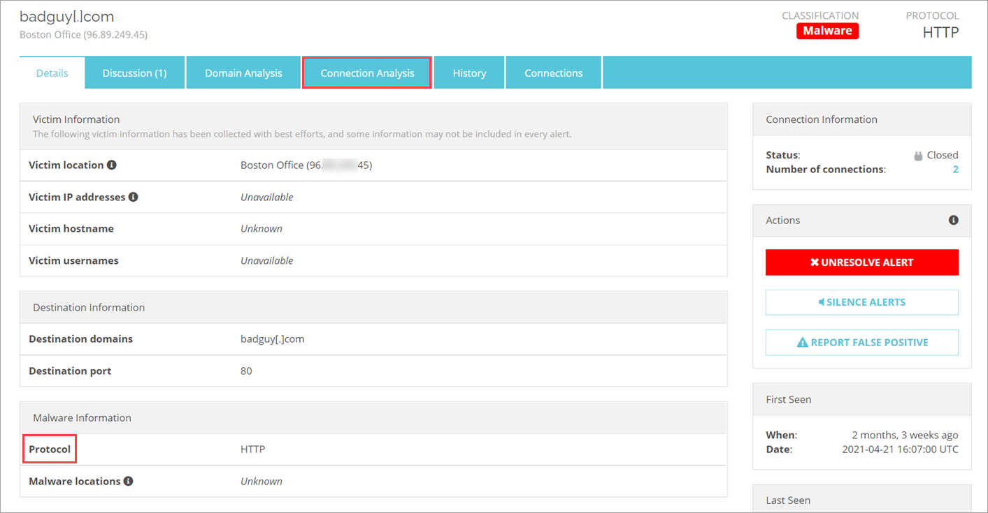
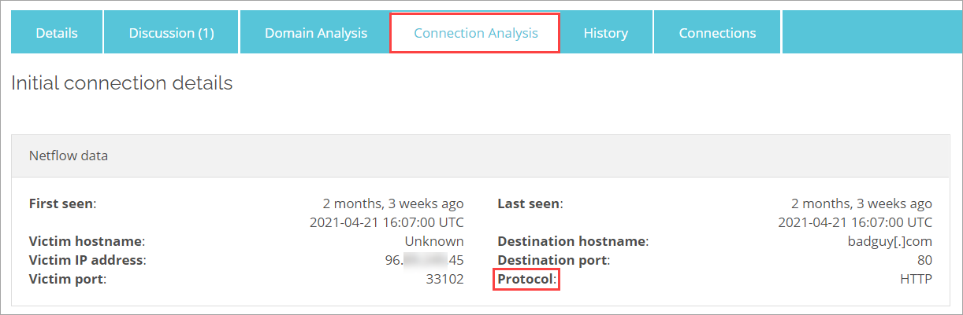
DNSWatch Alert Details Page
On the DNSWatch Alert Details page, the Malware Analysis tab is now the Connection Analysis tab.
On the Details tab and the Connection Analysis tab, Malware family is now named Protocol.
Release date: 15 July 2021

Slide 5
JUNE 2021

Slide 6
DNSWatchGO Chrome OS Support
DNSWatchGO Chrome OS support is now publicly available. The DNSWatchGO Chrome extension provides DNS-level protection for Chrome users. When the Chrome browser opens a site, the DNSWatchGO Chrome extension queries the DNSWatch servers to check if the site is malicious.
Administrators can deploy the extension to Chromebooks in their school, organization, or group.
Release date: 17 June 2021

Slide 7
march 2021

Slide 8
DNSWatchGO Chrome OS Support (Beta)
DNSWatchGO now supports Chrome OS. The DNSWatchGO Chrome extension provides DNS-level protection for Chrome users. When the Chrome browser opens a site, the DNSWatchGO Chrome extension queries the DNSWatch servers to check if the site is malicious.
Administrators can deploy the extension to Chromebooks in their school, organization, or group.
To get started, join the WatchGuard Beta test community.
Release date: 25 March 2021

Slide 9
october 2020

Slide 10
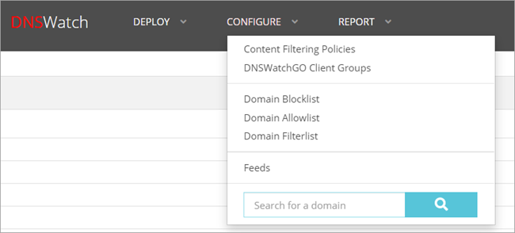
Blacklist is Now Blocklist and Whitelist is Now Allowlist
In the DNSWatch web UI, the terms “Blacklist” and “Whitelist” are now “Blocklist” and “Allowlist”.
  The Blackholed Domains page is now Domain Blocklist.
  The Whitelisted Domains page is now Domain Allowlist.
  The Filtered Domains page is now Domain Filterlist.
Release date: 22 October 2020

Slide 11
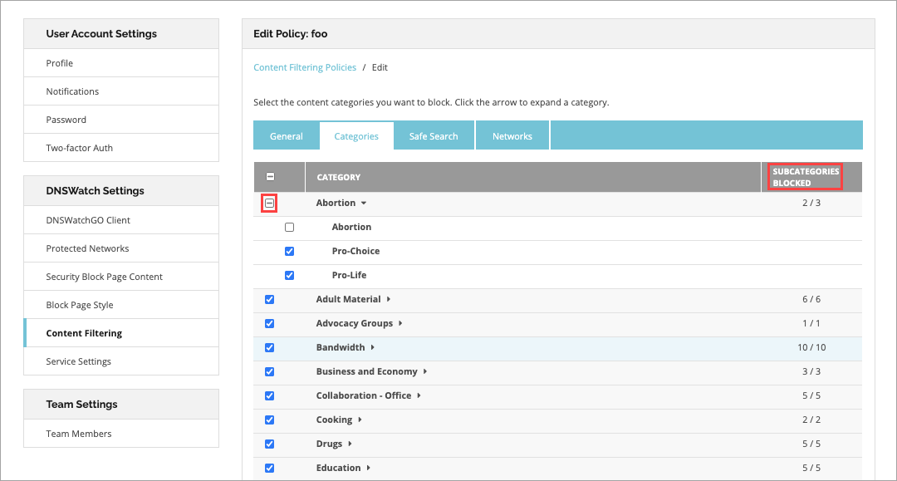
Content Filtering
The Categories tab on the Content Filtering page now displays how many subcategories are blocked without expanding the category. If all subcategories are selected, the check box is selected. If only some categories are selected, a hyphen is displayed.
Release date: 1 October 2020

Slide 12
August 2020

Slide 13
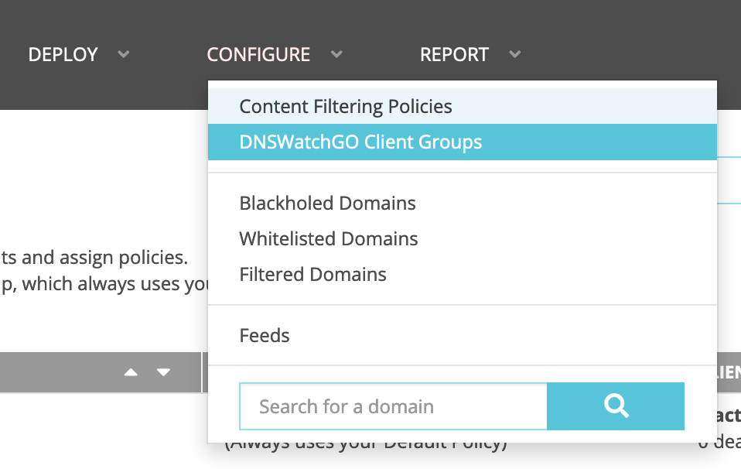
DNSWatchGO Client Groups
You can now create DNSWatchGO Client groups to organize your DNSWatchGO Clients and assign specific content filter policies to each group.
In the DNSWatch web UI, go to Configure > DNSWatchGO Client Groups.
Release date: 20 August 2020

Slide 14
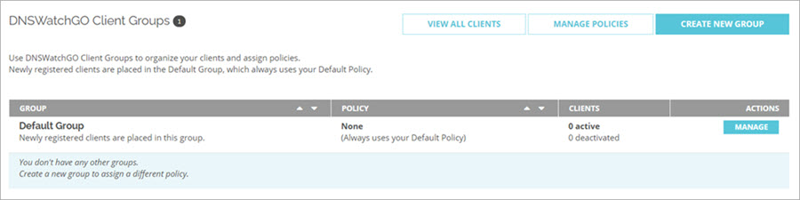
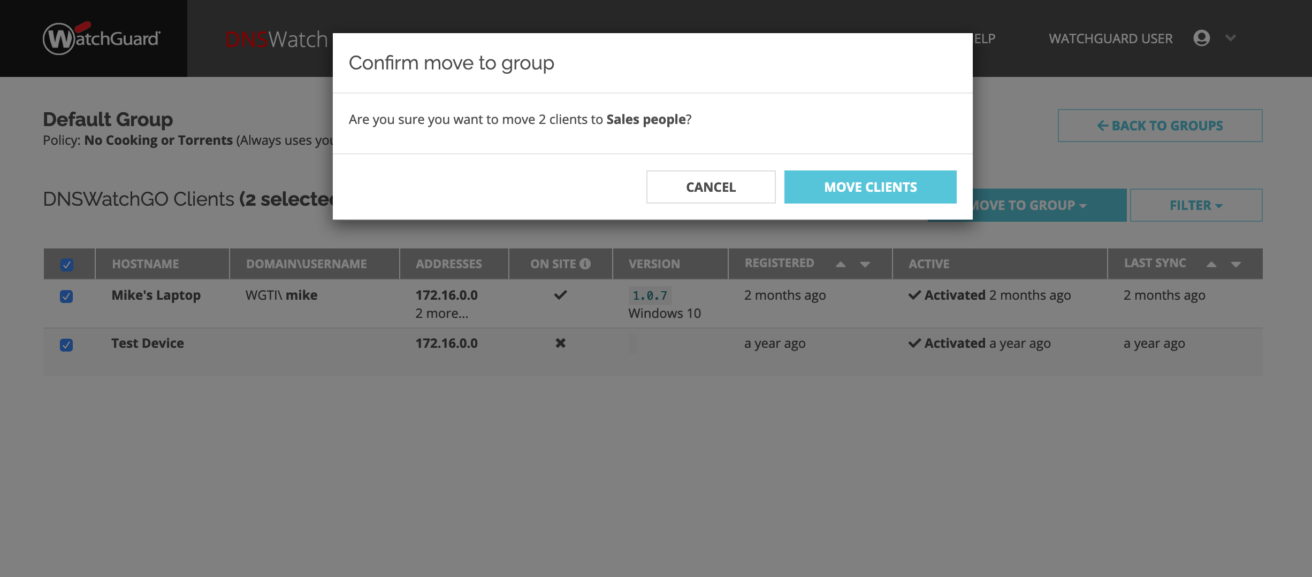
DNSWatchGO Client Groups
You can create, edit, and delete DNSWatchGO Client groups and move individual clients to another group.
Release date: 20 August 2020

Slide 15
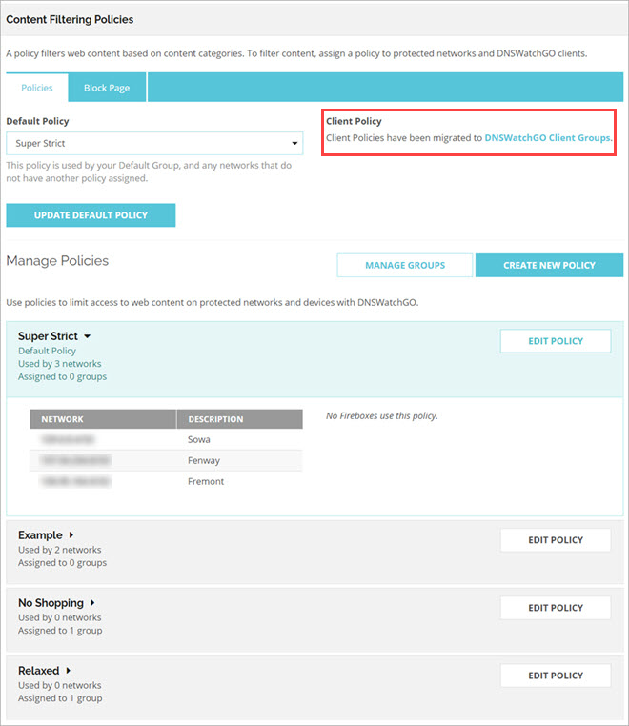
DNSWatchGO Client Groups
Client policies have been migrated to the DNSWatchGO Client Groups page and are now organized at group level.
Release date: 20 August 2020

Slide 16
july 2020

Slide 17
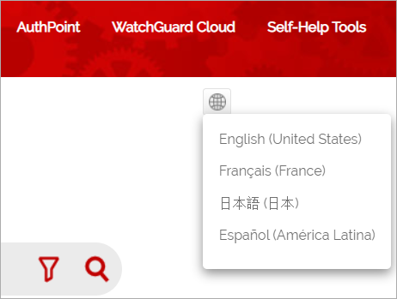
DNSWatch Online Help Localization
DNSWatch Help is now available in French, Japanese, and Spanish.
To switch between languages in Help Center, in the top-right of the page, click the icon and select a language from the drop-down list.
If localized Help is not available for a product, the icon does not appear.
Release date: 30 July 2020

Slide 18
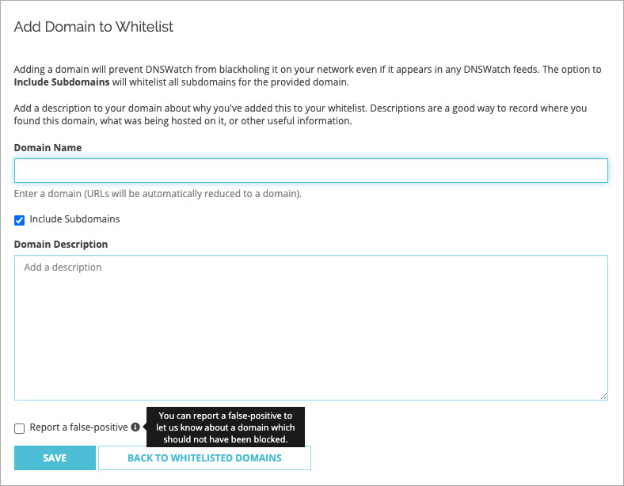
Report False Positives When You Add a Domain to the Whitelist
You can now report a false positive to DNSWatch when you manually add a domain to the Whitelist:
  In the DNSWatch web UI, go to Configure > Whitelisted Domains > WHITELIST A NEW DOMAIN and select the Report a false-positive check box.
Release date: 23 July 2020

Slide 19
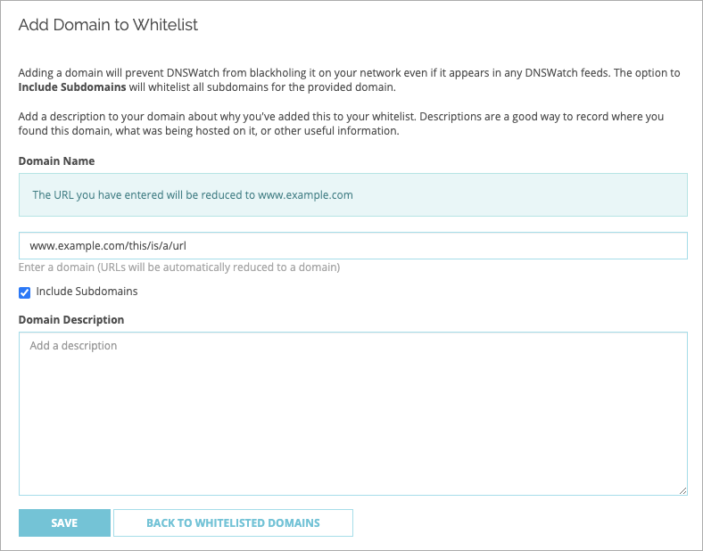
Displayed URLs Reduced to a Domain
On the Add Domain to Whitelist page, displayed URLs are now automatically reduced to a domain.
Release date: 23 July 2020

Slide 20
Thank you

