Slide 1
What’s New in Fireware v12.0

Slide 2
What’s New in Fireware v12.0
Gateway AntiVirus Update
Content Actions for HTTP and HTTPS
IMAP Proxy
OS Compatibility Setting Enhancement
Gateway Wireless Controller Enhancements
Mobile VPN with PPTP Feature Removed
Updated Default VPN Security Settings
Removed Obsolete Security Settings for Mobile VPN with SSL

Slide 3
What’s New in Fireware v12.0
APT Blocker Enhancements
Javascript Scanning of Email Attachments
SMTP and IMAP Zero-Day Protection
WebBlocker Enhancements
Larger IPS Signature Set
WatchGuard Cloud on your Firebox
ConnectWise Integration Enhancements
Multicast Routing

Slide 4
Gateway AntiVirus Update

Slide 5
Gateway AntiVirus Update
Gateway AntiVirus has been updated to use a scan engine and signature set from Bitdefender
In previous releases, the scan engine and signature set was provided by AVG
WatchGuard used virus samples to compare the detection capability of several vendors
Bitdefender had the highest detection rate
Bitdefender offers high performance and frequent signature updates

Slide 6
Gateway AntiVirus Update
Gateway AntiVirus signature set sizes vary by model
Virtual Fireboxes (FireboxV, XTMv, Firebox Cloud) get the Enterprise set if the instance has 2GB or more of memory
Gateway AntiVirus Signature Set | Firebox Models
Standard | T10, T30 XTM 25, 26, 33, 330
Enterprise | T50, T70, M200, M300 M370, M400, M440, M470, M500, M570, M670, M4600, M5600 XTM 515, 525, 535, 545, 810, 820, 830, 870, XTM 1050, 1500, 2050, 2520

Slide 7
Gateway AntiVirus Update
There are no changes to Gateway AntiVirus configuration settings
Signature updates are now faster and are all incremental
Reduces the download time
Reduces the time for FireCluster synchronization of signatures

Slide 8
Gateway AntiVirus Update
For increased effectiveness, Gateway AV no longer supports partial file scanning
Gateway AV now automatically uses a scan limit that is much higher than the previous default values so more files get a complete security scan
5 MB — Firebox T10, T30, XTM 25, 26, 33
If the Gateway AV File Scan limit is set to less than 5 MB, Gateway AV scans files up to 5 MB in size
10MB — All other Firebox models
If the Gateway AV File Scan limit is set to less than 10 MB, Gateway AV scans files up to 10 MB in size

Slide 9
Gateway AntiVirus — Upgrade
When you upgrade to Fireware v12.0, the old AVG files are removed and the Firebox downloads the new Bitdefender engine and signature set
It can take 7–10 minutes to download the files the first time
It takes another 5–7 minutes to synchronize a FireCluster
To minimize downtime, we recommend that you do not schedule the upgrade during business hours

Slide 10
Content Actions and Routing Actions for HTTP and HTTPS Proxy Policies

Slide 11
Content Actions and Routing Actions
A content action is a new type of proxy action for inbound HTTP proxy policies and HTTPS Server proxy actions
Select a content action to use the same public IP address for multiple public web servers that are behind the Firebox
A content action enables the Firebox to route incoming HTTP and HTTPS requests for one public IP address to more than one internal web server
This reduces the number of public IP addresses you need for public web servers on your network
To redirect HTTPS requests based on the domain name without content inspection, you can specify a routing action in a domain name rule in the HTTPS Server proxy action
Notes:
From Networking/Interface page add a custom DHCP Option

Slide 12
Content Actions and Routing Actions
Content actions have two main functions:
Host Header Redirect
Sends inbound HTTP and inspected HTTPS requests to different internal servers based on the path and domain in the HTTP request
TLS/SSL Offloading
Relieves an internal web server of the processing burden for encryption and decryption of TLS and SSL connections
Encrypted (HTTPS) traffic between external clients and the Firebox
Clear-text (HTTP) traffic between the Firebox and the internal server
In an HTTPS Server proxy action, routing actions send inbound HTTPS requests to different servers based on the domain name, without content inspection
Notes:
From Networking/Interface page add a custom DHCP Option

Slide 13
Content Actions and Routing Actions
Content actions
Match the host header/path for each HTTP request
Send an HTTP request to a specific server IP address and port
Content actions do not rewrite data in the request or response
Use cases for content actions:
Redirect HTTP requests based on the domain and host
Redirect HTTPS requests with content inspection
SSL offloading for HTTPS requests with content inspection
Use case for routing actions in the HTTPS Server proxy:
Redirect HTTPS without content inspection

Slide 14
HTTP Requests and Content Actions
When a user browses to a URL, the web browser sends the URL as an HTTP request
The HTTP request includes:
A request method (GET or PUT) that specifies the path
A host header that specifies the domain name
For example, if you browse to the Support section of watchguard.com, the HTTP request includes this information:
GET /wgrd-support/overview HTTP/1.1 Host: www.watchguard.com
Content actions review the combination of the domain name and path in the HTTP request to determine which content rule to apply

Slide 15
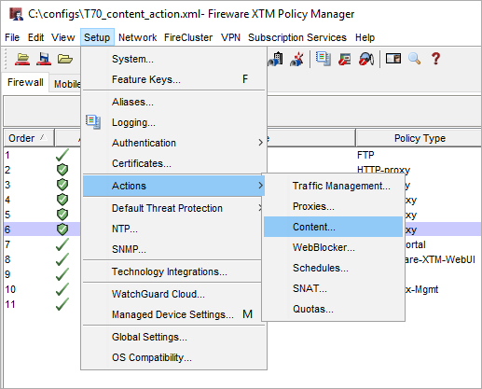
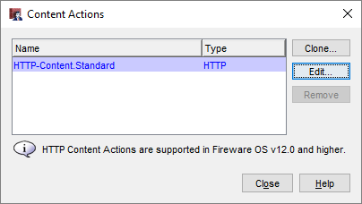
Content Action Configuration
Content actions are separate from other proxy actions
From Policy Manager, select Setup > Actions > Content
To create a new content action, clone or edit the predefined content action

Slide 16
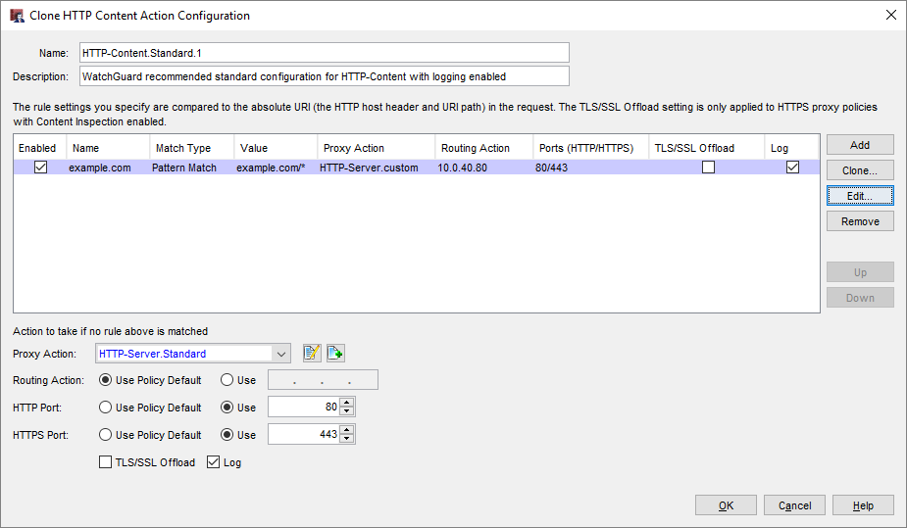
Content Action Configuration
In a content action, you can configure:
Content rules to define the action for each destination, based on whether content in the host header or SNI matches the specified domain and path
The action to take if no content rule is matched

Slide 17
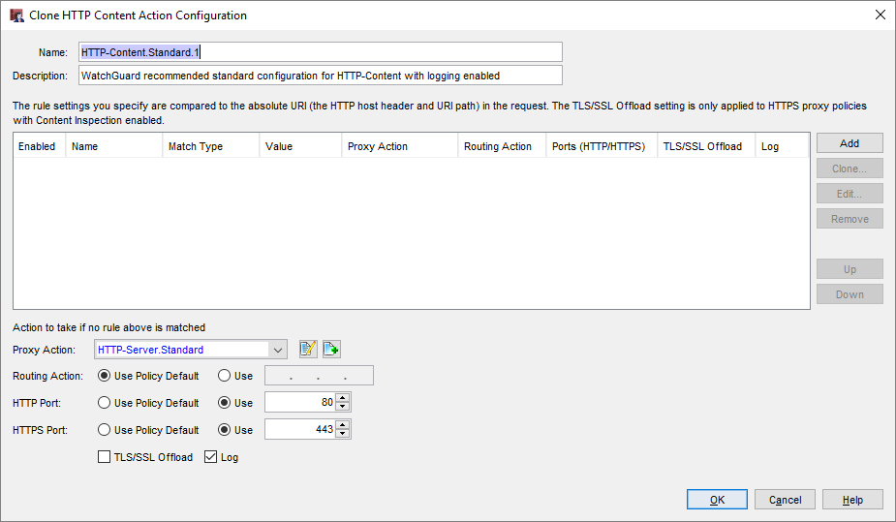
Content Action Configuration
In a content action, click Add to create a new content rule

Slide 18
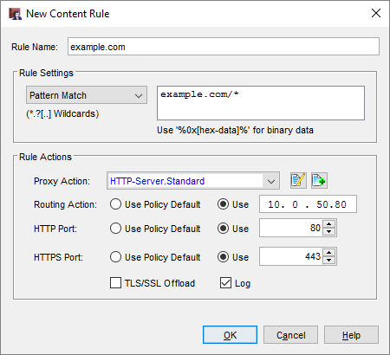
Content Rules
Each content rule specifies:
A pattern to match
HTTP proxy action
Routing action (IP address)
HTTP and HTTPS ports
TLS/SSL Offload setting
Log setting
Pattern match against domain and host:
Domain only wiki.example.net/*
Path */blog/*
Domain and path blog.example.net/resource/*

Slide 19
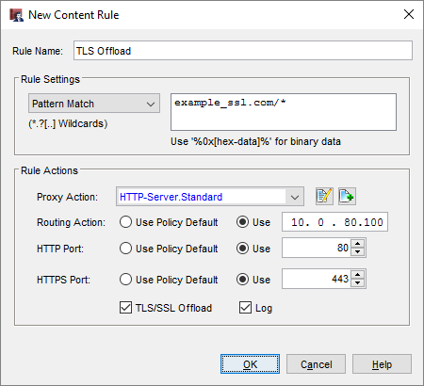
TLS/SSL Offloading
To enable TLS/SSL offloading for HTTPS, in the content rule action, select the TLS/SSL Offload check box
With TLS/SSL offloading:
HTTPS is used between external clients and the Firebox
HTTP is used between the Firebox and the internal server

Slide 20
TLS/SSL Offloading
If you use TLS/SSL offloading, you might need to change configuration settings on your server application
Some server applications must be configured to use HTTPS in links/redirects even if incoming requests use HTTP
$_SERVER[‘HTTPS’]=‘on’; (Wordpress)
Some server applications recognize the Upgrade-Insecure-Requests Header
Upgrade-Insecure-Requests: 1

Slide 21
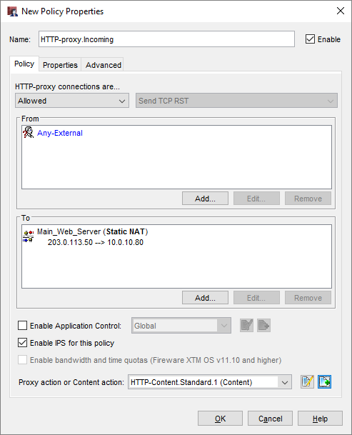
Content Action in an HTTP Proxy
In an HTTP proxy policy, select a content action
The drop-down list includes both proxy actions and content actions
In the policy To list, add a Static NAT rule, or use 1-to-1 NAT
Policy NAT settings are not used unless a routing action in the content action specifies Use Policy Default

Slide 22
Content Action in an HTTPS Server Proxy
To use a content action in a Domain Name rule or in the action to take if no rule is matched:
Select the Inspect action
Select a content action

Slide 23
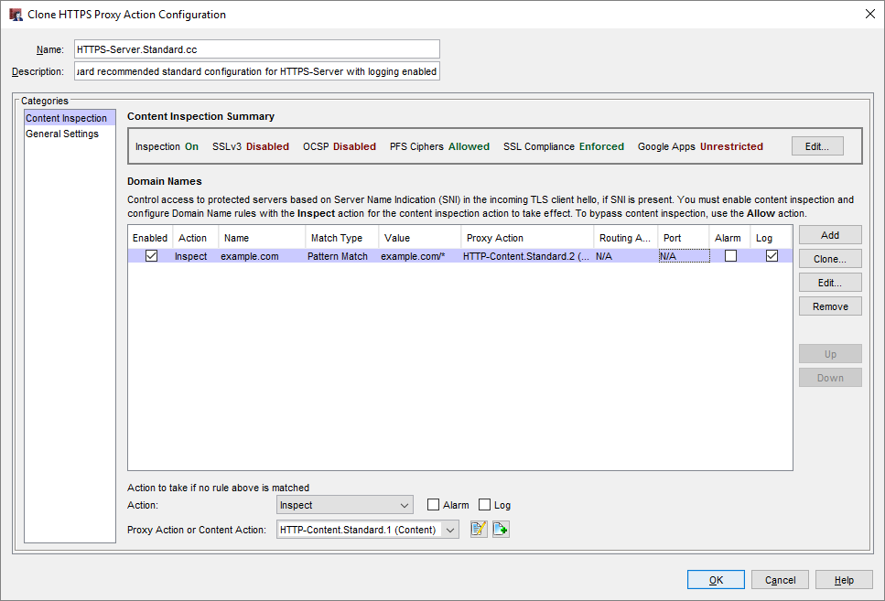
Content Action in an HTTPS Server Proxy

Slide 24
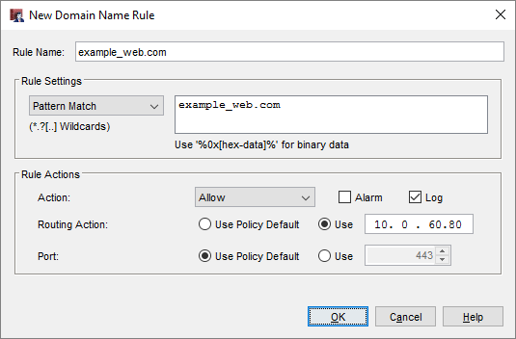
Routing Action in an HTTPS Server Proxy
To route HTTPS requests without content inspection, in a Domain Name Rule or in the action to take if no rule is matched:
Select the Allow action
Configure a Routing Action and Port

Slide 25
Routing Action in an HTTPS Server Proxy
The routing action compares the domain name you specify in a domain name action with the domain name in the TLS Server Name Indication (SNI), or the Common Name of a server in the server certificate
For HTTPS requests, the SNI in the TLS handshake specifies the domain and path of the destination server
SNI is described in RFC 6066 TLS Extensions

Slide 26
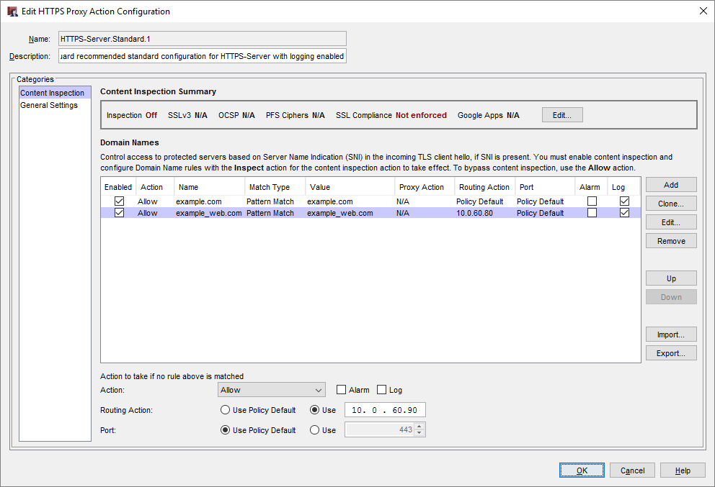
Routing Action in an HTTPS Server Proxy

Slide 27
Proxy Action Changes
Some proxy action settings were removed from the HTTP Server and HTTPS Server proxy actions because they are not applicable to inbound connections to a web server
HTTP Server proxy actions now do not include:
WebBlocker
Reputation Enabled Defense
HTTPS Server proxy actions now do not include:
WebBlocker
OCSP (Online Certificate Status Protocol)
No certificate validation in HTTPS proxy server actions

Slide 28
HTTPS Proxy Action Changes
WebBlocker is removed from the Categories list
Content Inspection and Domain Names settings are now combined in the Content Inspection category
To change content inspection settings, in the Content Inspection Summary section, click Edit

Slide 29
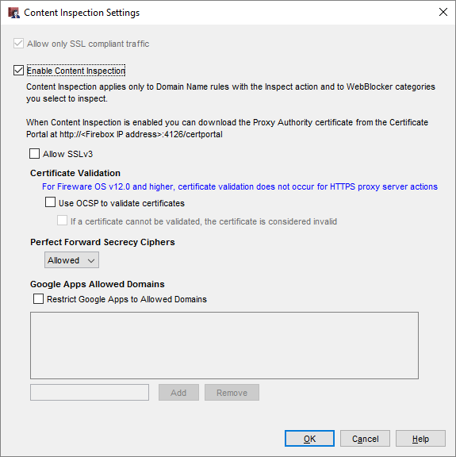
HTTPS Proxy Action Changes
Content inspection settings are the same as in Fireware v11.x, except that you do not select an HTTP Client proxy action
Now you specify an HTTP Client proxy action each time you select the Inspect action
You can use different HTTP proxy actions for each domain name rule and for WebBlocker

Slide 30
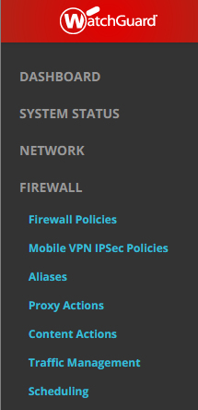
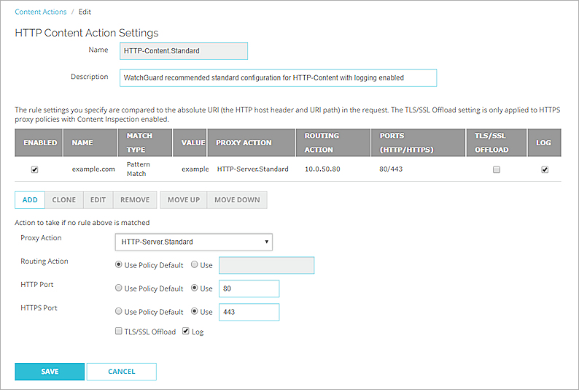
Content Actions in Fireware Web UI
To configure content actions in Fireware Web UI, select Firewall > Content Actions

Slide 31
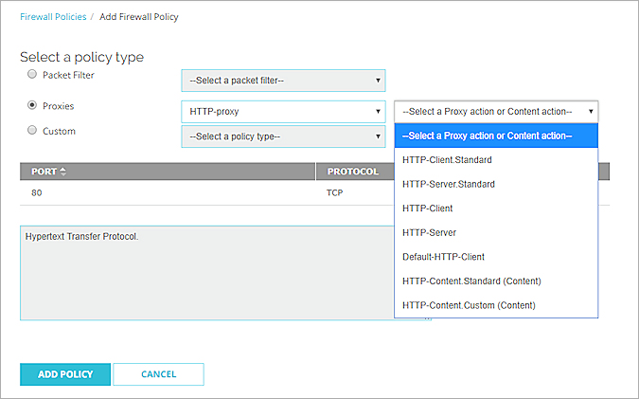
Content Actions in Fireware Web UI
Select a content action when you add an HTTP-proxy policy

Slide 32
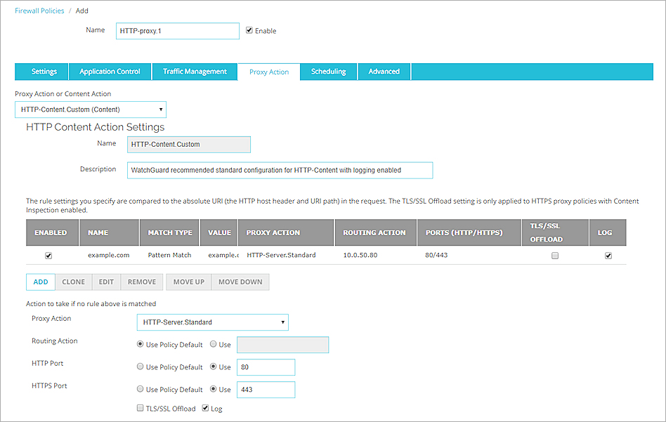
Content Actions in Fireware Web UI
The content action is on the HTTP-proxy Proxy Action tab

Slide 33
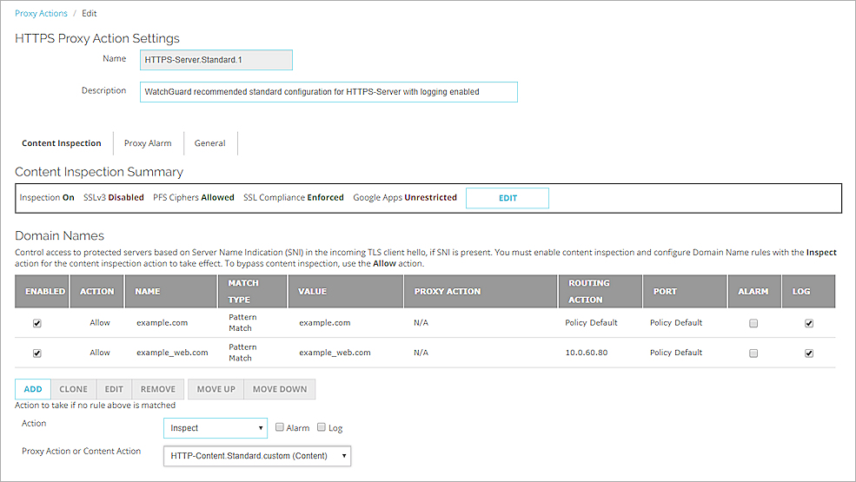
Content Actions in Fireware Web UI
HTTPS proxy action with routing actions and a content action

Slide 34
IMAP Proxy

Slide 35
IMAP Protocol
Fireware now includes an IMAP proxy policy
The IMAP proxy policy supports IMAP v4 on TCP port 143
The IMAP proxy does not support IMAP over SSL/TLS

Slide 36
IMAP Proxy Policy
The IMAP proxy settings are similar to the POP3 proxy
IMAP supports more complex actions than POP3
IMAP clients synchronize changes to the IMAP server
IMAP clients can request many types of information: headers, envelope information, message text, and more
Multiple IMAP clients can connect to the same IMAP server
All clients must stay in sync with the server
The IMAP proxy applies only to clients that connect to the IMAP server through the IMAP proxy

Slide 37
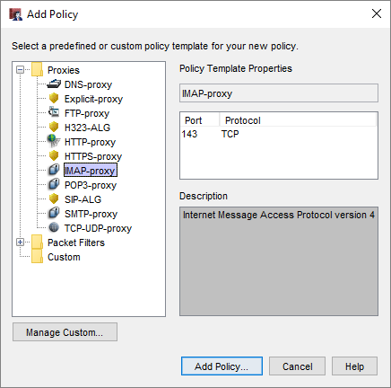
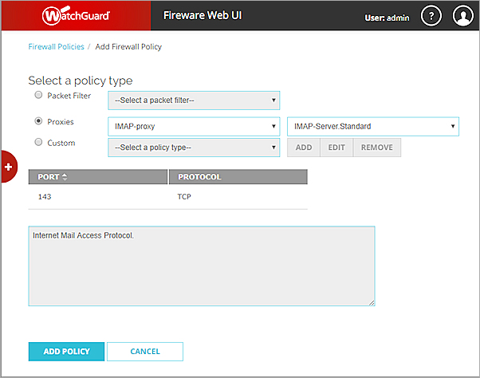
IMAP Proxy Policy
To add an IMAP proxy policy, select the IMAP-proxy policy template

Slide 38
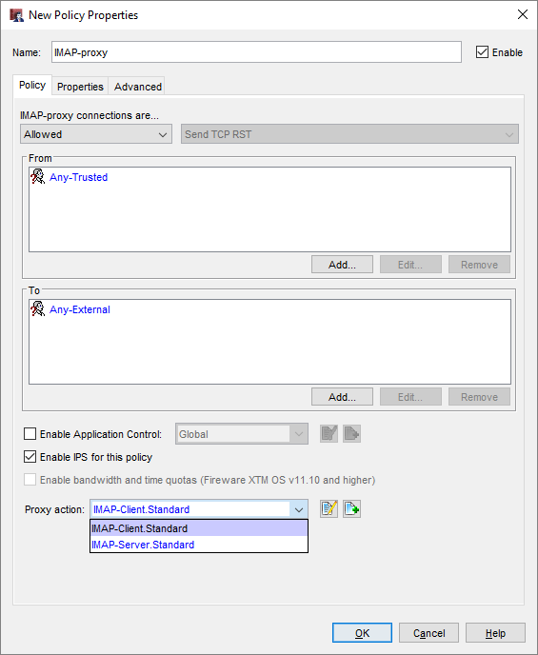
IMAP Proxy
There are two new predefined proxy actions:
IMAP-Client.Standard for outbound IMAP client connections
IMAP-Server.Standard for inbound connections to an IMAP server

Slide 39
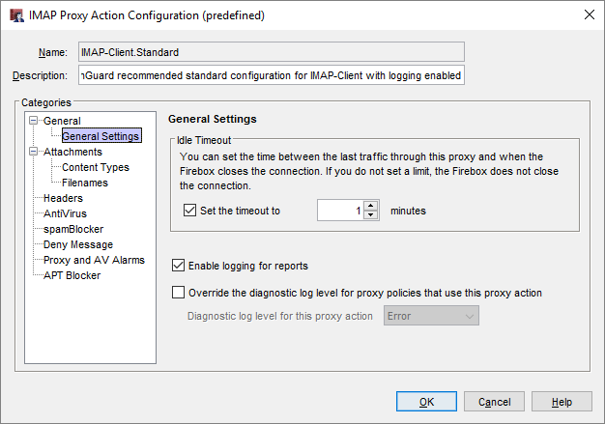
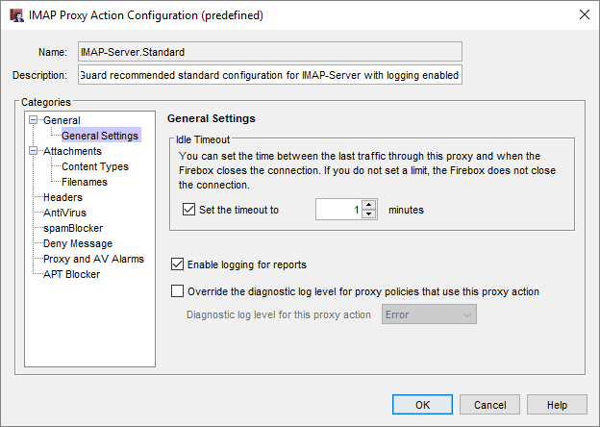
IMAP Proxy Action Settings
Settings in IMAP proxy actions are similar to the settings in POP3 proxy actions

Slide 40
IMAP Proxy — Subscription Services
The IMAP proxy supports these Subscription Services:
Application Control
Intrusion Prevention Service (IPS)
Gateway AntiVirus
spamBlocker
APT Blocker

Slide 41
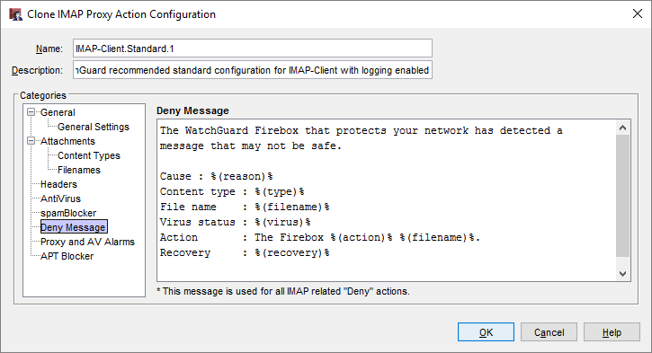
IMAP Proxy — Deny Message
If the IMAP proxy locks or removes an attachment, it adds a text file with the Deny Message as a message attachment
The text file attachment file name starts with: wgrd_deny_msg
The Deny Message text file includes the content you configure in the IMAP proxy action

Slide 42
IMAP Proxy — Message Scan Cache
There can be a brief delay while a message is scanned
To avoid rescanning, the IMAP proxy stores a local cache of email message actions and scan results
The cached information includes:
Message UID and Envelop hash value (to identify the message)
spamBlocker score result and action
Virus Outbreak Detection and action
Final action for the message and the reason:
Filename, Content Type, and Header filtering
Gateway AV and APT Blocker scans

Slide 43
IMAP Proxy — Local Message Scan Cache
If a requested message is in the cache, the IMAP proxy uses the prior message handling/scanning result
If a requested message is not in the cache, the IMAP proxy:
Gets the full email message for scanning
Stores the handling/scanning results to the cache
The cache size varies by Firebox model and is not configurable

Slide 44
New OS Compatibility Setting

Slide 45
Fireware OS Compatiblity Setting
You can use Policy Manager to configure Fireboxes that use different versions of Fireware
Some Fireware features are supported only in specific Fireware versions or have different settings in different Fireware versions
If you use Policy Manager to create a new Firebox configuration, you must select the OS Compatibility setting to one of these options:
11.4 - 11.8.x
11.9 - 11.12.x
12.0 or higher (new)
If you open a configuration from a Firebox, the OS Compatibility is automatically set, based on the installed version of Fireware

Slide 46
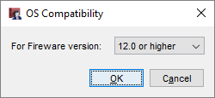
New OS Compatibility Setting
To configure the OS Compatibility setting, in Policy Manager, select Setup > OS Compatibility
To configure features that require Fireware v12.0, the OS Compatibility must be set to 12.0 or higher
The Fireware version is automatically set to v12.0 or higher when you open a configuration from a Firebox that runs Fireware v12.0

Slide 47
Gateway Wireless Controller Enhancements

Slide 48
AP Firmware Updates
Updated AP firmware includes stability and security enhancements
AP100, AP102, AP200 — 1.2.9.13
AP300 — 2.0.0.8
AP120, AP320, AP322, AP420 — 8.3.0
Version 8.3.0 firmware for AP120, AP320, AP322, and AP420 is only supported for Fireboxes that run Fireware v11.12.4 or higher

Slide 49
Improved Discovery and Pairing Times
Much faster initial discovery and pairing times for AP120, AP320, AP322, and AP420 devices with v8.3.0 firmware
It now only takes a few minutes for new AP devices to be discovered and paired to the Gateway Wireless Controller

Slide 50
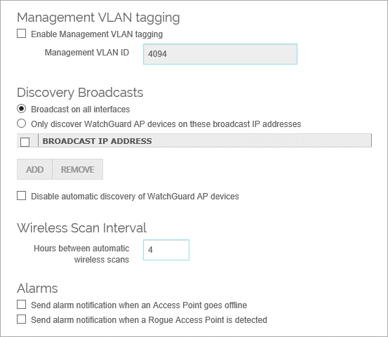
Increased Wireless Maps Scan Interval
The default Wireless Scan Interval in the Gateway Wireless Controller settings is now set to every 4 hours instead of 1 hour, which reduces resource usage
The wireless scan interval is used for AP channel selection, wireless deployment maps, and rogue access point detection

Slide 51
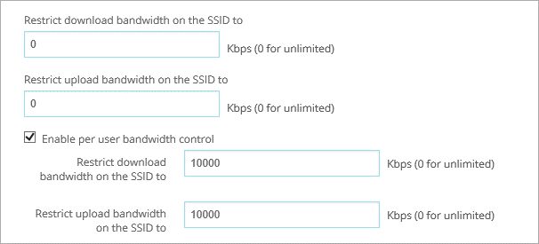
Rate Shaping Enhancements
You can now configure separate upload and download rate limits for each SSID and for each user in an SSID configuration
AP100, AP102, AP200, and AP300 devices only support the download rate limits

Slide 52
Deprecated Wireless Options
Restart Wireless
You can now only complete a reboot action for an AP device
When you reboot an AP device manually or as a scheduled restart, the configuration is reloaded and auto-channel selection occurs
Outdoor only channels — Outdoor models AP102 and AP322 will continue to enforce channel restrictions according to outdoor-only channel availability
Disable DFS channels — You can no longer disable the use of DFS channels on any AP device model
Rate option — The Rate control option for a radio is removed; the default setting is now Auto

Slide 53
Wireless Option Terminology Updates
Improved parity between Wi-Fi Cloud and local Gateway Wireless Controller (GWC) feature terminology
 | Previous Name | New Name
AP device and GWC Settings | Management VLAN | Communication VLAN
Radio Settings | Channel HT Mode | Channel Width
 | TX Power | Transmit Power
 | Country | Country of Operation
 | Band | Frequency Band
SSID Settings | Broadcast SSID and respond to SSID queries | Broadcast SSID
 | Station Isolation | Client Isolation
Monitoring | Foreign BSSIDs | External BSSIDs

Slide 54
Mobile VPN with PPTP Removed

Slide 55
Mobile VPN with PPTP Removed
In Fireware v12.0, Mobile VPN with PPTP is no longer available
PPTP is an older VPN protocol that is not considered secure
If your configuration includes Mobile VPN with PPTP, we recommend that you use a different Mobile VPN solution before you upgrade
To compare mobile VPN solutions, see Select the Type of Mobile VPN to Use in Fireware Help
For minimal changes to your Firebox and mobile clients, we recommend that you select the Mobile VPN with L2TP solution
For more information, see How do I migrate from PPTP to L2TP? in the WatchGuard Knowledge Base

Slide 56
Mobile VPN with PPTP Removed
After you upgrade to Fireware v12.0:
If the built-in PPTP-Users group includes users, or if an alias or policy includes the PPTP-Users group, this group is renamed to PPTP-Users-Legacy
You can view and delete the PPTP-Users-Legacy group
You cannot view the Mobile VPN with PPTP configuration in the WebUI, Policy Manager, or the CLI

Slide 57
Updated Default VPN Security Settings

Slide 58
Updated Default VPN Security Settings
New VPN connections created in Fireware v12.0 have stronger default authentication and encryption settings
The new default settings apply to all VPN products:
Manual BOVPN
BOVPN virtual interfaces
Mobile VPN with IPSec
Mobile VPN with SSL
Mobile VPN with L2TP

Slide 59
Updated Default VPN Security Settings
If you use Policy Manager v12.0 to open an XML configuration file for Fireware v11.12.4 or lower, the new default settings for BOVPN, BOVPN virtual interfaces, Mobile VPN with IPSec, and Mobile VPN with L2TP do not appear for new VPN connections
To convert the configuration file to v12.0, select Setup > OS Compatibility
After the file is converted, the default settings appear for new VPN connections

Slide 60
Updated Default VPN Security Settings
For BOVPN, BOVPN virtual interfaces, and Mobile VPN with IPSec, the new Phase 1 and 2 defaults are:
Authentication — SHA-2 (256)
Encryption — AES (256)
Diffie-Hellman Group — 14
Perfect Forward Secrecy (PFS) — Enabled
For BOVPN and BOVPN virtual interfaces, the new SA Life value is 24 hours
The Traffic option for Force Key Expiration is now disabled for Mobile VPN with IPSec

Slide 61
Updated Default VPN Security Settings
Phase 1 settings for BOVPN and BOVPN virtual interfaces

Slide 62
Updated Default VPN Security Settings
Phase 2 settings for BOVPN and BOVPN virtual interfaces

Slide 63
Updated Default VPN Security Settings
Phase 1 and 2 settings for Mobile VPN with IPSec

Slide 64
Updated Default VPN Security Settings
For Mobile VPN with SSL, the new defaults are:
Authentication — SHA-2 (256)
Encryption — AES (256)

Slide 65
Updated Default VPN Security Settings
For Mobile VPN with L2TP, the new Phase 1 defaults are:
SHA2(256)–AES(256) and Diffie-Hellman 14
SHA1–AES(256) and Diffie-Hellman 20
SHA1–AES(256) and Diffie-Hellman 2
Phase 2 defaults:
ESP–AES(256)–SHA1
ESP–AES(128)–SHA1
ESP – AES(256)–SHA2(256)

Slide 66
Updated Default VPN Security Settings
Phase 1 and 2 settings for Mobile VPN with L2TP

Slide 67
Updated Default VPN Security Settings
The Phase 2 Proposals list now includes the ESP-AES256-SHA256 transform

Slide 68
Updated Default VPN Security Settings
SHA-2 is supported on these Firebox and XTM device models:
All Fireboxes
XTM devices with hardware cryptographic acceleration for SHA-2
SHA-2 is not supported on XTM 505, 510, 520, 530, 515, 525, 535, 545, 810, 820, 830, 1050, and 2050 devices
If your XTM device does not support SHA-2, the available proposals on your device do not include SHA-2

Slide 69
Removed Mobile VPN with SSL Settings

Slide 70
Removed Mobile VPN with SSL Settings
These obsolete security settings were removed from Mobile VPN with SSL:
Encryption — Blowfish and DES
Authentication — MD5
If your configuration includes MD5, this setting changes to SHA-256 after the upgrade
If your configuration includes Blowfish or DES, this setting changes to AES-256 after the upgrade

Slide 71
APT Blocker Enhancements

Slide 72
APT Blocker JavaScript Scanning in Email
APT Blocker now detects and scans JavaScript (.JS) files in email attachments
This can help protect your network from a recent trend in ransomware delivered through JavaScript email attachments

Slide 73
APT Blocker JavaScript Scanning in Email
APT Blocker now scans these file types:
Windows PE (Portable Executable) files, such as: .CPL, .EXE, .DLL, .OCX, .SYS, .SCR, .DRV, and .EFI
Adobe PDF documents
Microsoft Office documents
Rich Text Format (.RTF) documents
Android executable files (.APK)
Apple Mac application files (.APP)
JavaScript files (.JS) — New in v12.0 (email attachments only)

Slide 74
APT Blocker Zero-Day Protection for Email
A zero-day attack is a new attack that has not yet been analyzed and identified
APT Blocker can help protect your network from zero-day attacks that are sent in email attachments
When APT Blocker is enabled, the SMTP or IMAP proxy can delay delivery of the message while it submits the file attachment to the Lastline data center for analysis
APT Blocker analysis can take up to a few minutes for each file
If the Firebox cannot connect to the Lastline data center, APT Blocker releases the message
Zero-day protection is always enabled in the IMAP proxy and is a configurable option in the SMTP proxy

Slide 75
APT Blocker Zero-Day Protection — SMTP
The SMTP proxy has a new APT Blocker configuration option to enable zero-day protection
In previous Fireware versions, the SMTP proxy delivered a message while APT Blocker analysis of all attachments was in progress; this is still the default behavior
The default setting enables immediate message delivery, but does not provide protection against zero-day attacks in email attachments
You can now configure the SMTP proxy to delay delivery of a message until APT Blocker analysis of all attachments is complete
This protects against zero-day attacks, but can introduce a delay in message delivery while APT Blocker analysis is in progress

Slide 76
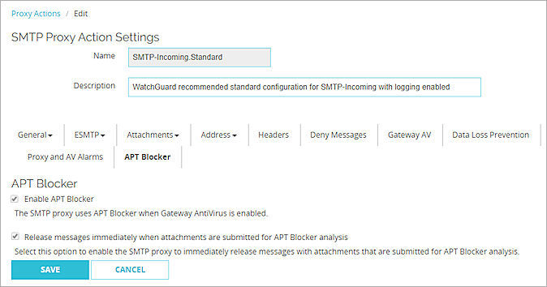
APT Blocker Zero-Day Protection — SMTP
To enable APT Blocker zero-day protection, in the APT Blocker settings clear the Release messages immediately when attachments are submitted for APT Blocker analysis check box

Slide 77
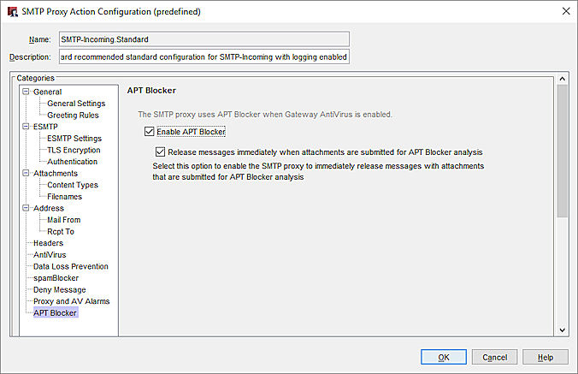
APT Blocker Zero-Day Protection — SMTP
The new APT Blocker zero-day protection option in Policy Manager

Slide 78
APT Blocker Zero-Day Protection — SMTP
When you enable zero-day protection in the SMTP proxy, if the MD5 value of an SMTP file attachment does not match the MD5 value of a previously analyzed file, the SMTP proxy delays delivery of the message while it submits the file attachment to the Lastline data center for analysis
If the SMTP proxy receives the result from Lastline before the sending MTA times out, the proxy takes the configured APT Blocker action based on the result
If the sending MTA times out before the transaction is completed, the message is not delivered
If the sending MTA resends the message, the SMTP proxy takes the configured APT Blocker action based on the APT Blocker analysis result

Slide 79
APT Blocker Zero-Day Protection — IMAP
Zero-day protection is always enabled in the IMAP proxy
If the MD5 value of an IMAP file attachment does not match the MD5 value of a previously analyzed file, the IMAP proxy delays delivery of the message while it submits the file attachment to the Lastline data center for analysis
If the IMAP proxy receives the result from Lastline before the IMAP server times out, the proxy takes the configured APT Blocker action based on the result
If the IMAP server times out before the transaction is completed, the IMAP client cannot retrieve the message
When the IMAP client requests the message again, the IMAP proxy takes the configured APT Blocker action based on the APT Blocker analysis result

Slide 80
APT Blocker Zero-Day Protection in Email
Zero-day protection can cause a delay in message delivery, especially for messages that contain multiple attachments
The IMAP proxy submits all file attachments for APT Blocker analysis at the same time
The SMTP proxy submits file attachments for APT Blocker analysis one at a time
To reduce delivery delays, senders can attach multiple files as a single archive file
The SMTP proxy submits the archive for APT Blocker analysis, all files are analyzed at the same time

Slide 81
WebBlocker Enhancements

Slide 82
WebBlocker Encrypted Lookups
Lookup requests from the Firebox to the Websense cloud are now encrypted with HTTPS
Websense is now Forcepoint
If your Firebox uses a web proxy server for connections to Websense cloud, make sure the proxy server can handle HTTPS connections

Slide 83
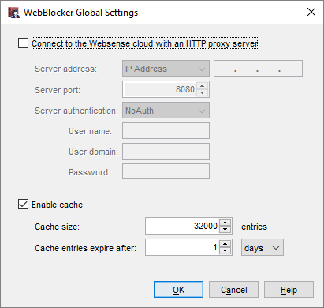
WebBlocker Configurable Cache Settings
To improve performance, WebBlocker stores recent URL lookups in a local cache on the Firebox
You can now set the WebBlocker cache settings in WebBlocker Global Settings
We recommend that you start with the default cache size and expiration settings

Slide 84
WebBlocker Configurable Cache Settings
Two new WebBlocker Global settings:
Cache Size
Controls how many recent URL lookups are stored in the cache
You can change the cache size to balance WebBlocker lookup performance with memory use on the Firebox
The maximum cache size varies by Firebox model
Expiration
Controls how long URL lookups remain in the cache
The default expiration setting is 1 day
Previously, the cache expiration was not configurable

Slide 85
Larger IPS Signature Set

Slide 86
Larger IPS Signature Set
Intrusion Prevention Service (IPS) now includes a larger signature set for some Firebox models
Signature sets include both IPS and Application Control rules; only the quantity of IPS rules changed
Standard signature set with approximately 1800 signatures:
Firebox T10, XTM 2 Series, FireboxV, XTMv, Firebox Cloud with less than 4 GB memory
Enhanced signature set with approximately 6000 signatures:
Firebox T30, T50, T70, M200, M300, XTM 33, 330, 5 Series, 810, 820, 830, 1050, and 2050

Slide 87
Larger IPS Signature Set
Full signature set with approximately 8000 signatures (new in v12.0):
M370, M400, M440, M470, M500, M570, M670 M4600, M5600, XTM 870, 1500, 2520, FireboxV, XTMv, Firebox Cloud with 4 GB or more of memory

Slide 88
WatchGuard Cloud

Slide 89
WatchGuard Cloud
WatchGuard Cloud is WatchGuard’s forthcoming Cloud platform, where you can connect to Dimension Cloud for visibility and management of Fireboxes that run Fireware v12.0 or higher
Fireboxes that run v12.0 or higher now include a menu option for WatchGuard Cloud
Fireware Web UI — Setup > WatchGuard Cloud
Policy Manager — System > WatchGuard Cloud
For the Fireware v12.0 release, you cannot enable WatchGuard Cloud on your Firebox
Notes:
From Networking/Interface page add a custom DHCP Option

Slide 90
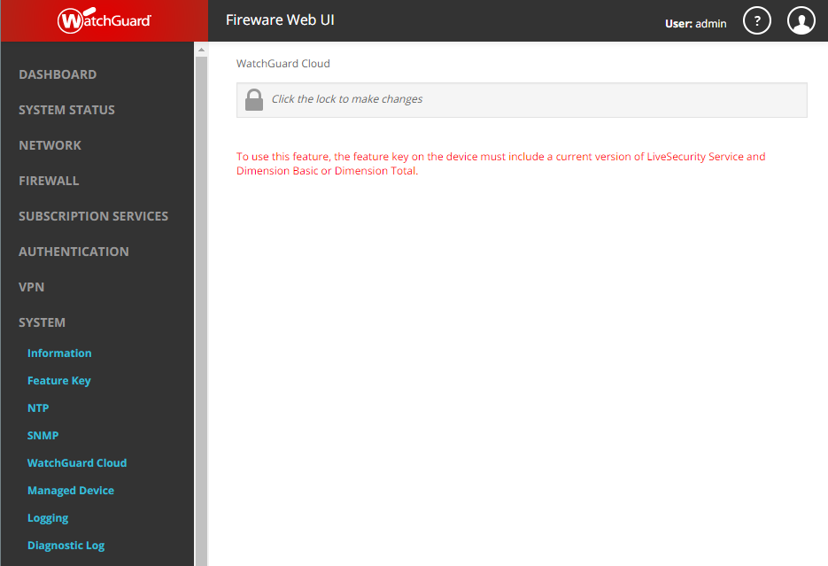
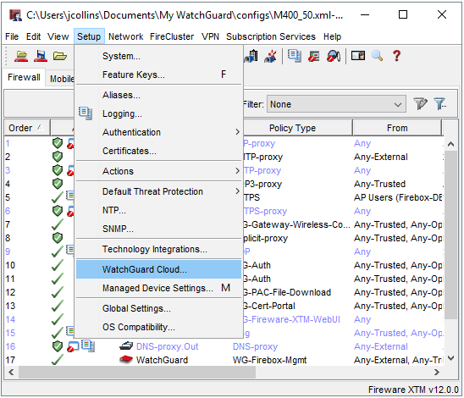
WatchGuard Cloud
Notes:
From Networking/Interface page add a custom DHCP Option

Slide 91
ConnectWise Integration Enhancements

Slide 92
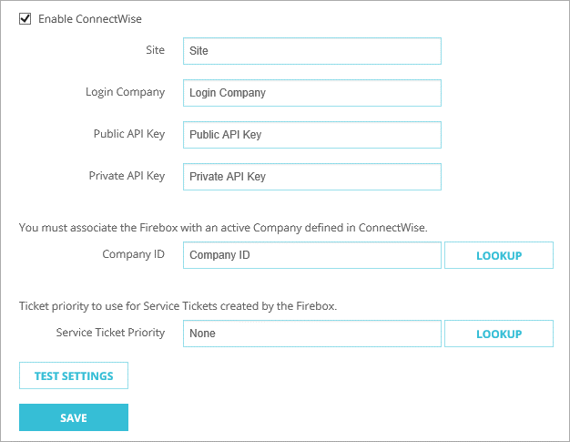
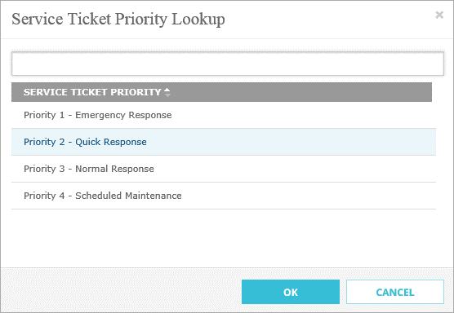
Service Ticket Priority
You can now configure the default ticket priority for service tickets generated by a Firebox
To choose the priority from your ConnectWise configuration, click Lookup
You can customize these priority levels in ConnectWise

Slide 93
Multicast Routing

Slide 94
Multicast Routing
Fireware now includes support for multicast routing, a networking method for efficient distribution of one-to-many traffic
Common uses include VOIP, video on demand (VOD), video conferencing, and IP television (IPTV)
The Firebox acts as a local multicast router to forward multicast traffic from the source to receivers on your network
Receivers are nodes, such as workstations, that join the multicast group
Notes:
From Networking/Interface page add a custom DHCP Option

Slide 95
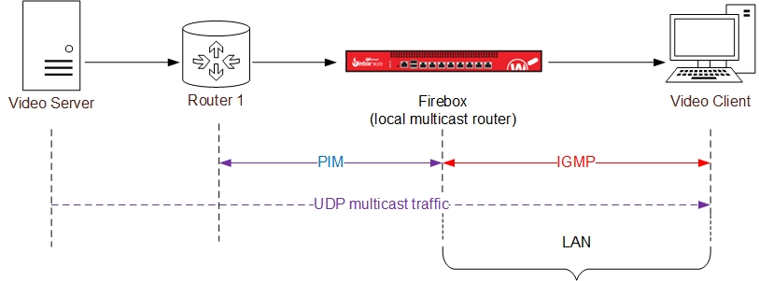
Multicast Routing — Topology
The Firebox is the local multicast router in this diagram

Slide 96
Multicast Routing
Multicast routing on the Firebox has these configurable options:
Enable multicast globally
Select up to 31 interfaces for multicast
Select one or more Rendezvous Points (RPs)
The most common multicast protocols are supported

Slide 97
Multicast Routing — Support Details
Supported Protocols | Unsupported Protocols
PIM Sparse Mode (PIM-SM) | Static multicast routes
Basic IGMP | PIM-DM
IGMPv2 and v3 | IGMP snooping
IPv4 | IGMP proxy
 | IPv6
Supported Firebox Features | Unsupported Firebox Features
Mixed Routing mode | Bridge mode
BOVPN virtual interfaces | Drop-in mode
FireCluster Active/Passive | FireCluster Active/Active
 | Manual BOVPN

Slide 98
Multicast Routing — Support Details
Supported Interfaces | Unsupported Interfaces
Physical | Modem
VLAN | Mobile VPN
Bridge | Loopback
Link aggregation
Wireless
BOVPN virtual interfaces
Supported Zones
External
Trusted
Optional
Custom

Slide 99
Multicast Routing — BOVPN Support Details
The Firebox includes a legacy multicast setting for BOVPN that is supported in Fireware v12.0
Before you can use the new multicast feature, you must disable the legacy BOVPN multicast setting

Slide 100
Multicast Routing — Configuration (Web UI)

Slide 101
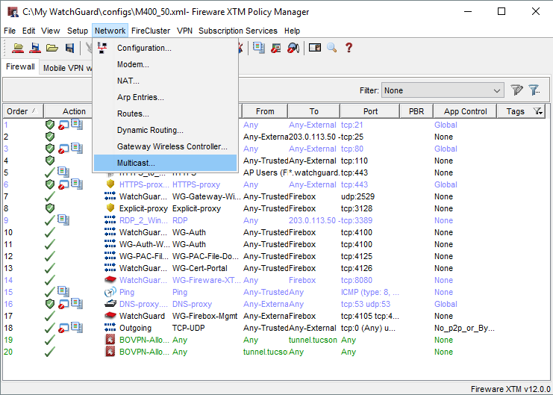
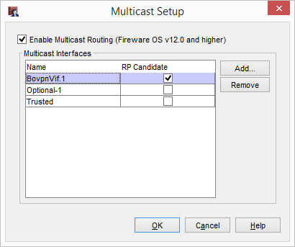
Multicast Routing — Configuration (PM)

Slide 102
Multicast Routing — Policies and Aliases
When you enable multicast routing, new policies for the PIM and IGMP protocols are added to your configuration
The alias Any-Multicast is added to your configuration

Slide 103
Multicast Routing — Policies and Aliases
You can specify only these options in a multicast policy:
Incoming interfaces
Source IP addresses
Destination IP addresses
Protocols and ports

Slide 104
What Else is New

Slide 105
What Else is New
The WatchGuard Mobile VPN app for iOS has been removed from the Apple Store (not related to Fireware v12.0)
If you have this app on your mobile device, we recommend that you use the native iOS VPN client instead

Slide 106
Thank You!

